Slide 1
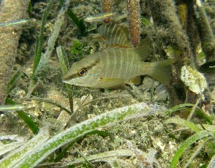
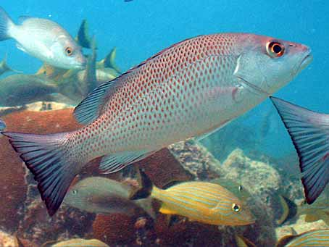
How Climate Change Impacts Florida’s Regulatory and
Research Programs:
Mangrove and Coral Reef Fish Habitats
By Janet Ley, PhD
Florida Fish & Wildlife Research Institute
St. Petersburg, Florida
DEP SLER Training Conference
Orlando, Florida
June 10, 2014
Notes:
Thank you for inviting me speak at this conference.
This is a chance for FWC and DEP to cross boundaries as we consider the impacts of climate change on regulatory and research programs in Florida
My research has primarily been in the area of mangrove fish ecology and fisheries, and my talk focuses on these topics

Slide 2
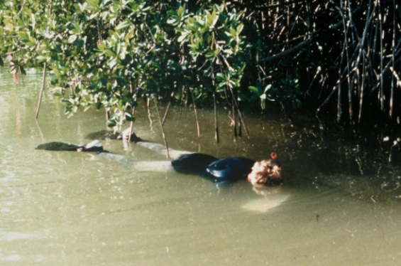
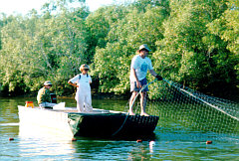
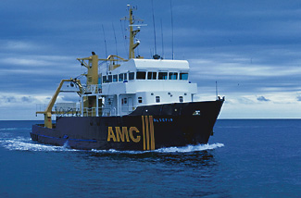
Changes in Latitudes
42⁰ North ….. Michigan
28⁰ North ….. Pinellas Co.
25⁰ North ….. Florida Bay
18⁰ South …. Queensland
42⁰ South …. Tasmania
Notes:
After moving down from Michigan I took a job as a planner for Pinellas County. Somebody told me that mangroves were important because they provide nurseries for fish, and that idea so interested me, that it set the course for the rest of my career.
Then I went to Gainesville, and got my PhD through the Center for Wetlands, studying mangrove fish communities in Florida Bay. I later helped organize research and other projects mainly in the C-111 canal area for the SFWMD.
I went to Queensland in 1995, where I studied mangrove fish associated with the Great Barrier Reef ecosystem
And later I became a Lecturer at the Australian Maritime college in Tasmania, teaching marine fisheries and biology
As you can see, at this point my career was just one long downhill slide!
However, I have since returned to Florida and am now a research scientist at FWRI in St. Pete

Slide 3
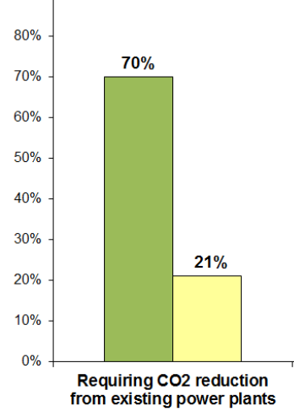
Overview
Sea Change
Global climate change
Impacts on coral reefs, mangroves & associated fisheries
  An explosion of new research since 1990’s
Relevance to Florida’s regulatory programs
  Mangrove-focused
Source: ABC News Poll, June 2, 2014
Notes:
While GCC is hot politically lately, I will only be focusing on the implications for resource management
Let me just say that I am a scientist, not a politician.
My focus today will be on research concerning climate change impacts on 3 of Florida’s most valued natural resources: coral reefs, mangroves and fish.
I will highlight recent discoveries that I hope will be relevant to regulatory matters that you deal with intensively every day.

Slide 4
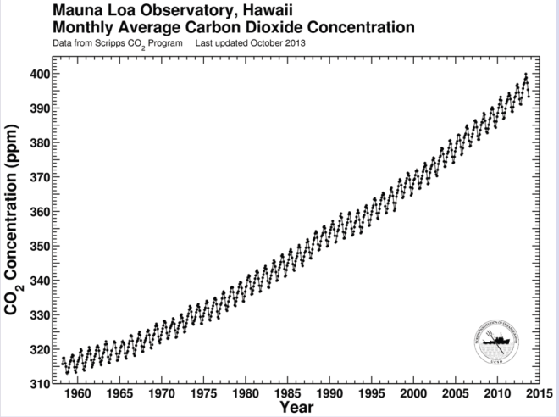
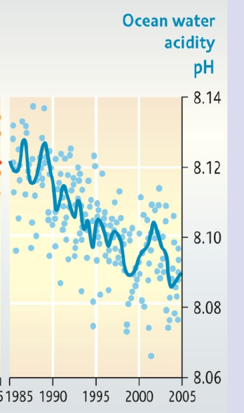
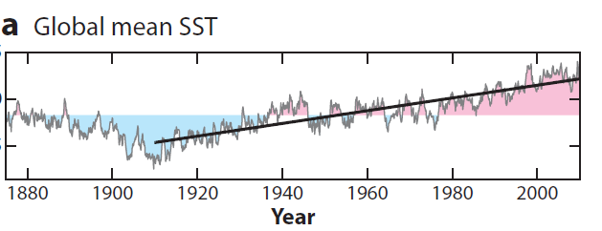
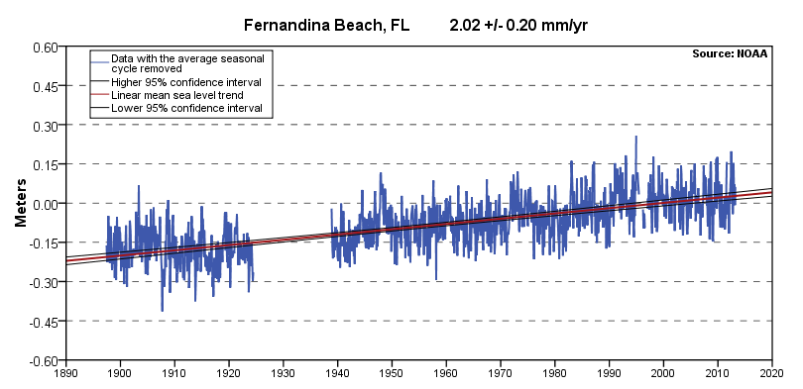
Global Climate Change:
Observed Trends over 50 yrs
CO2
1960-2010 (Mauna Loa)
Ocean pH
1985-2005
Sea Level Rise
1900 – 2013 (1 inch/decade)
Global Sea Surface Temp
1900 – 2009 ( + 1.24 deg F)
68°
67°
Notes:
I recommend the recent report on climate change prepared by Lindsay Cross of the Tampa Bay Estuary Program for a clear and concise summary.
This slide shows how increased CO2 has influenced 3 important features of the world’s oceans, which have in turn influenced the health of coral reefs and mangroves
CO2 has been increasing in the earth’s atmosphere, as measured atop Mauna Loa in Hawaii
CO2 dissolves in the ocean, lowering the pH so that the waters are becoming more acidic
CO2 contributes to the greenhouse effect, and temperatures have also increased
Temperature increases in turn have caused a swelling of the volume of the oceans, leading to rising sea levels.

Slide 5
Sea level rise predictions: ????
Sea Level Rise
Ocean volume
increase
Melting
glaciers
Land
Processes
SLR by 2100:
IPCC: 2 ft
NOAA: 6.6 ft
SE Fla Regional Climate Change Compact, 2011

Slide 6
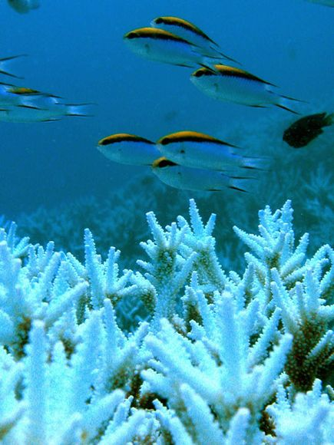
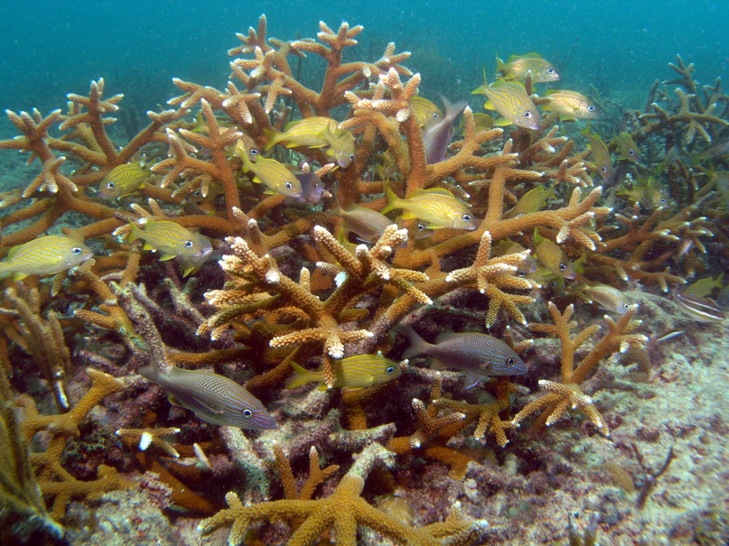
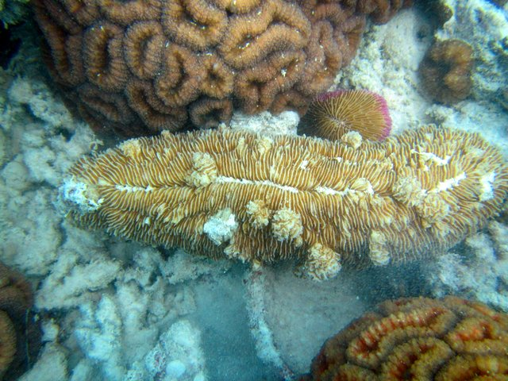
Coral reefs: climate change
Temperature increasing
  Bleaching
  Disease
  Reefs may expand northward
Bleaching
Disease
Acropora cervicornis, Broward Co
D. S. Gilliam, Nova Southeastern University
Notes:
How have higher temperatures impacted coral reefs?
Coral bleaching is the result of Zooxanthellae release, leaving them white skeletons.
Extreme temperatures have stressed corals, making them prone to diseases
On the other hand, warmer waters may also be allowing corals to become more common northward as in Broward County where this photo was recently taken.

Slide 7
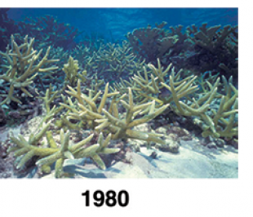
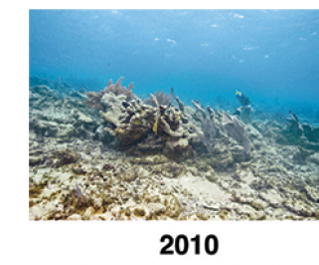
Coral reefs: climate change
Ocean acidification
Branching corals impacted
  Growth impaired
  New growth more porous
  Collapse during storms
Hoegh-Guldberg, 2009.
Notes:
Lower pH levels create ocean acidification
This impact has impaired the growth of corals colonies.
And the new growth that does occur tends to be more porous
Weakened corals can be more readily destroyed by storms as seen here in the Caymans

Slide 8
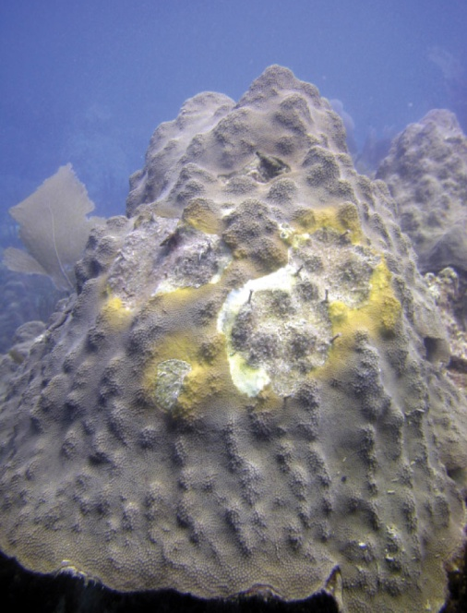
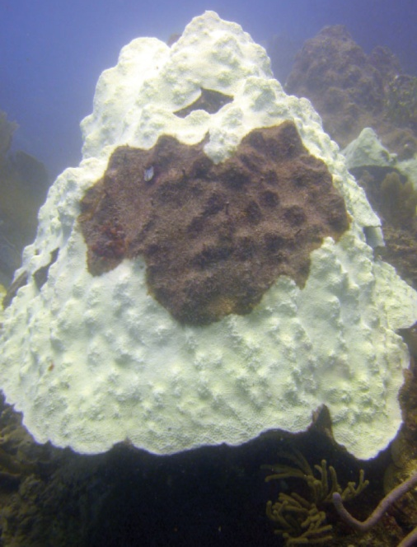
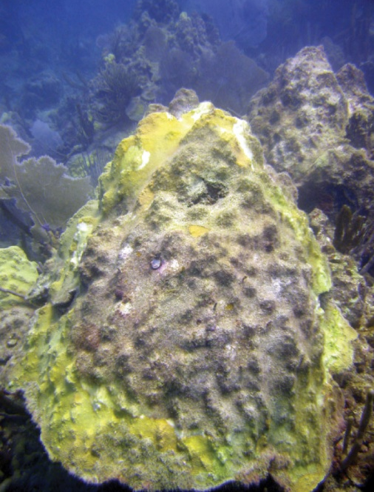
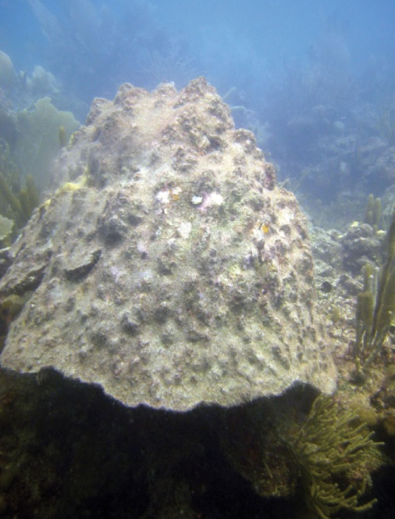

Death of a 500 yr old star coral
Feb 2005
Disease
Turf algae
Bleaching
More disease
After 2 years
Death
Algal invasion
Montastraea faveolata
US National Climate Assessment, May 2014.
Photo credit: Ernesto Weil, Puerto Rico
Notes:
Photographic monitoring provides a record of coral decline as illustrated in this series of pictures of a star coral from Puerto Rico.
First, a patch of the coral has been infected by disease
A few months later, algae has covered the patch and bleaching is seen on the rest of the colony
Then disease infects the newer bleached area
Finally, the entire coral head has died and been overtaken by turf algae

Slide 9
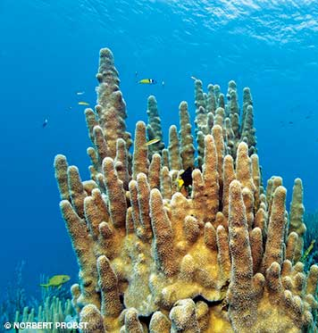
Corals: sentinels of a changing planet
(Billy Causey 1997)
Live coral cover on reefs
  Caribbean
    1977: 55%
    2001: 10%
  Florida Keys
    2009: 7%
Worldwide:
  Destroyed by 2100
Ruzicka 2013, (2) Gardner 2003 (3) Hoegh-Guldburg 2012, (4) Kennedy 2013 (5) FWC 2014
Notes:
As Billy Causey aptly stated, coral reefs are the true marine sentinels of a changing planet.
In the Caribbean, live coral cover has declined from 55% to 10%
A similar decline has occurred for Florida’s reefs
These trends are the same worldwide, leading research scientists to predict that living coral reefs will be destroyed by 2100.
Obviously we need to act now!!

Slide 10
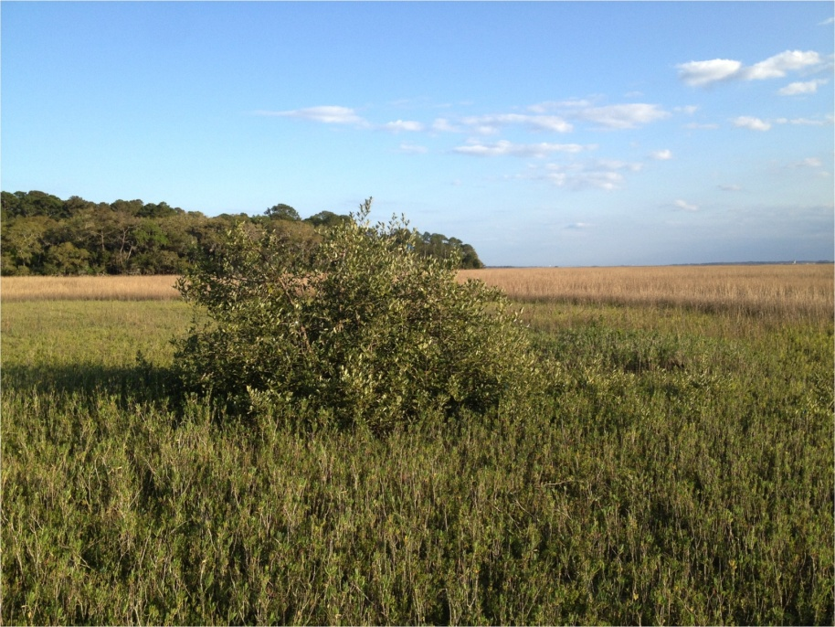
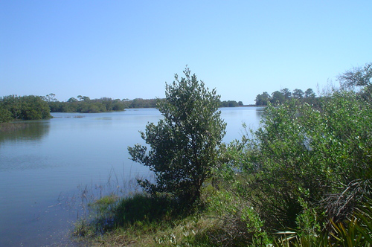
Mangroves: climate change
Temperature increase
Northward expansion: Florida
  East coast
    3,000 acres added 1984 - 2011 (1)
  West coast
    Mangroves at Cedar Key (2)
(1) Cavanaugh K C 2014; (2) Stevens, 2006
Notes:
How have higher temperatures affected mangroves?
Most research indicates that mangroves are more durable than coral reefs.
In Florida, they are becoming more common at more northern latitudes on both the east and west coasts

Slide 11
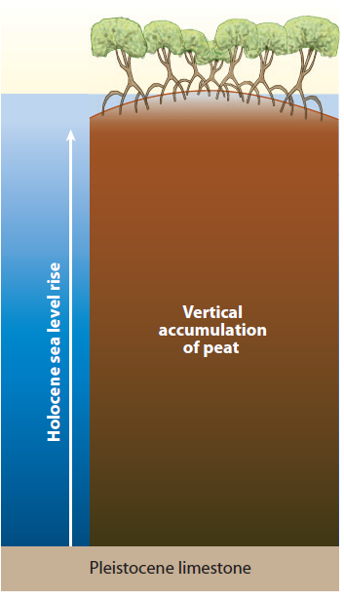
Mangroves: climate change
Sea Level Rise
Without structures (for now)
  Roots anchor substrate
  Substrate builds upward (1, 2, 3)
  Mangrove zone creeps inshore (4)
Feller 2007 (2) McKee 2010, 2012 (3) Krauss 2013
Notes:
However, mangroves will be subject to impacts due to sea level rise
At first here, let’s think about mangroves without shoreline structures in the way
Mangrove root structure anchors the substrate
Leaves, roots, sediments build upward
Mangroves creep upslope and inshore
They are like living engineering structures

Slide 12
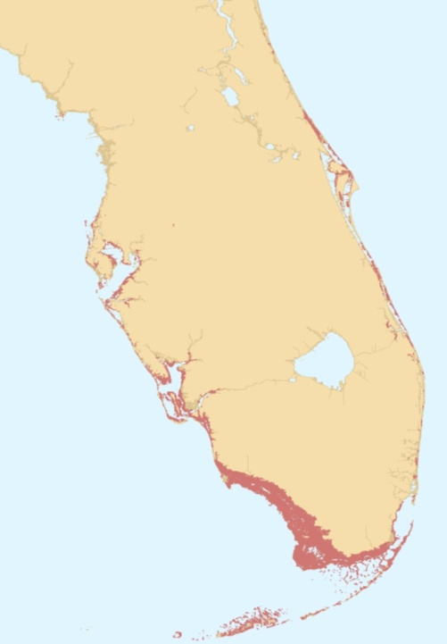
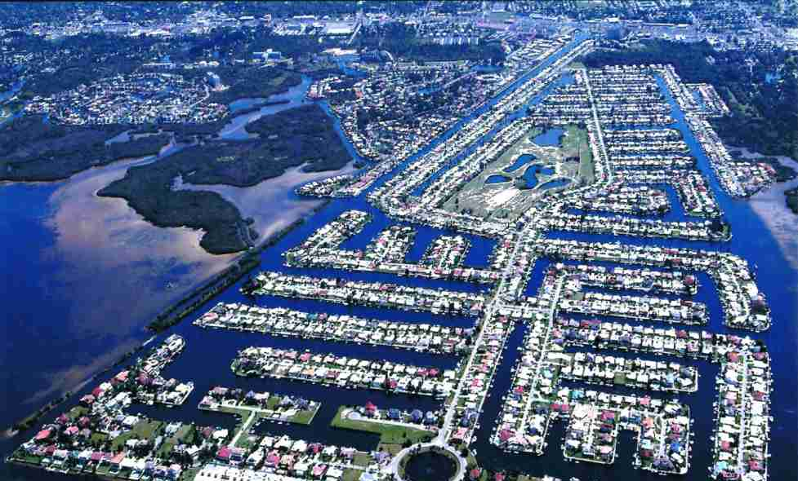
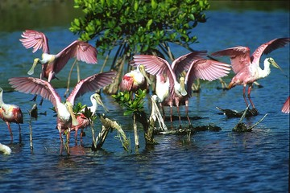
Mangroves: status
St. Augustine
Florida:
  1,000 sq miles (1)
    55% in Monroe County
  Roughly 24% destroyed since 1950’s
    Filled for development
    Tampa and Miami (2)
  Legally protected since 1970s
    DER, Corps (3)
Cedar Key
(1) FWRI 2005 (2) Lewis 1985
(3) FDEP 2002 Homeowner’s Guide to Wetlands
Notes:
Over half of Florida’s mangroves are in Monroe County: the 10,000 islands and Keys have the most
We have lost about 24%
But laws passed in the 1970s curtailed the destruction of mangroves

Slide 13
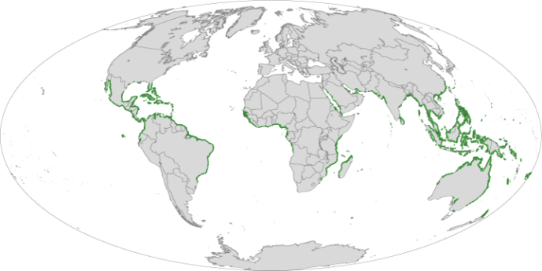
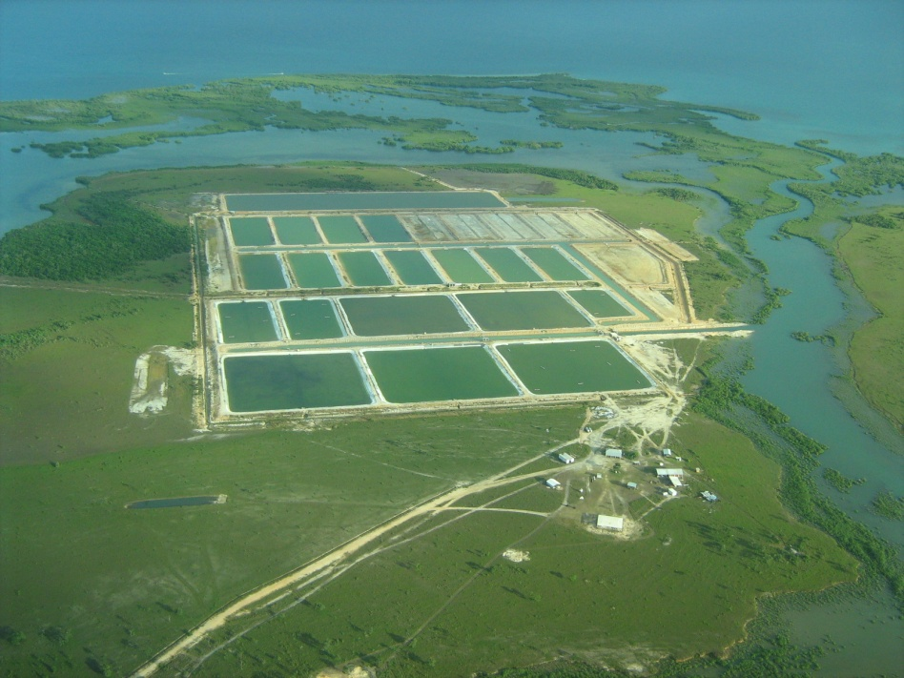
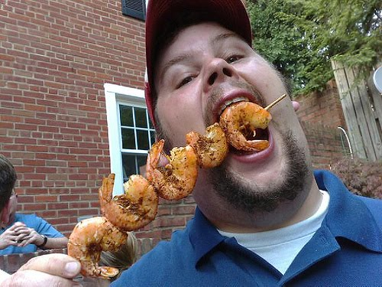
Mangroves: status
Worldwide:
  50,000 sq mi (1)
  About the area of Florida
33% destroyed since 1980’s
  Shrimp ponds
      Thailand, Ecuador, China
      Unusable after a few years
      New mangroves destroyed
    Biggest market = US (2)
(1) Giri 2011 (2) Hamilton 2013 (Photo of shrimp ponds Kirwan 2013)
Notes:
33% of the world’s mangroves have been destroyed since 1980
Much of the destruction has been due to shrimp farming
The US buys these shrimp
Stop eating them

Slide 14
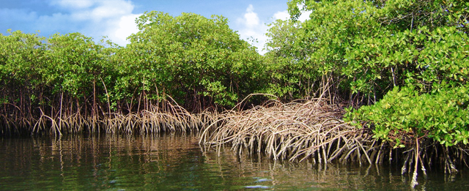
Mangroves: The Future
A durable resource
Survive climate change impacts -- if protected
  Living, well-engineered, persistent structures
Notes:
Mangroves are likely to survive under rising sea levels, if they are protected
They are more durable than coral reefs

Slide 15
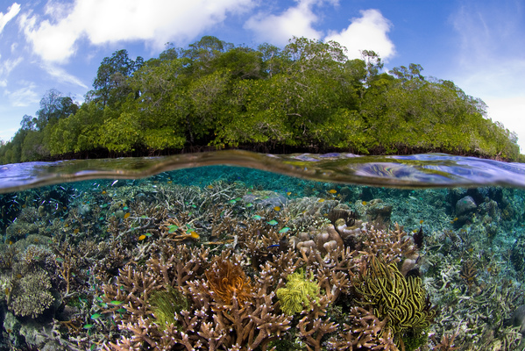
Summary Part 1: Climate change, coral reefs and mangroves
Impacts:
  Increased SST, pH, sea levels
  If not curtailed:
Coral reefs
  Fragile
  Low resilience
  Demise by 2100
Mangroves
  Durable
  High natural resilience
  May survive impacts
The Ecosystem
  Mangroves strengthen coral reef resilience to CC impacts?
Notes:
In summary, the big 3 marine impacts from climate change are warming, acidification and sea level rise
For delicate coral reefs, strong global and local actions are both required; coral reefs are predicted to disappear from the earth by 2100 if trends continue as they are
For the naturally more resilient mangroves, Florida can gain many benefits by continuing to implement regulations and programs that protect them

Slide 16
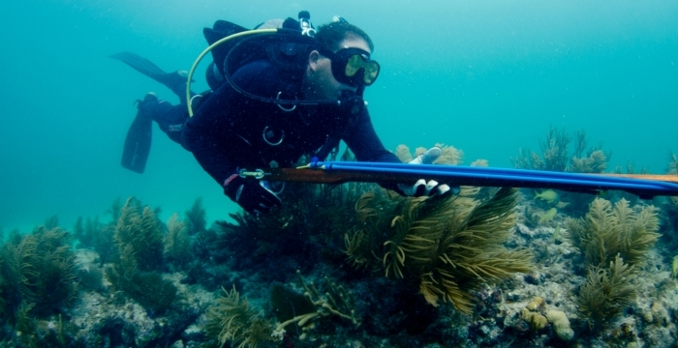
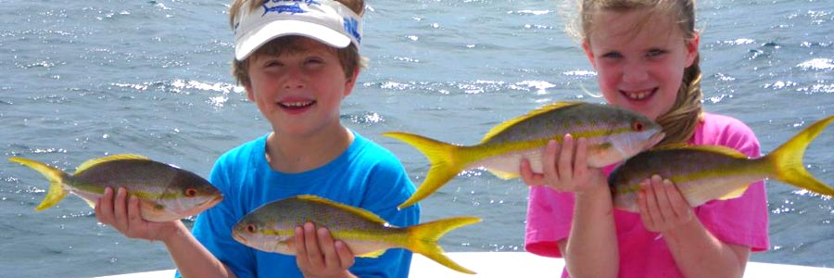
Part 2:
Climate change: fisheries
Do many Floridians know fishing will be impacted?
From Part 1, fisheries associated with coral reefs are most at risk
Can regulatory programs help?

Slide 17
Coral Reef Fishery Species: life cycle
Growth phases:
  Adults aggregate: Spawners
  Larvae: broadcast
  Juveniles: settle, hide, grow
    Bottleneck
    Nursery habitat protection
Larvae
Spawners
Juvenile
Adult
Notes:
But when we think about protecting habitat for coral reef fish, we need to include a variety of habitats used in each phase of their life cycle
Many fish biologists consider the juvenile stage to be the most critical period in the life of a fish
Protecting juvenile habitat begins with identifying Prime Nursery habitat

Slide 18
Coral reef fish: Nursery habitat
Species differ
  Some use living reefs only
  Most use several habitats
    Mangroves & reefs
Priority for protection:
“The habitat that contributes the most juveniles to reef adult populations” (1)
Hot research topic
Nursery
Coral
Mangrove
Coral reef
Adult
(1) Beck 2001, Dahlgren 2006
Notes:
To help focus management efforts, scientists have defined nursery habitats as:
We know that some reef fish use multiple nursery habitats : these are the bet-hedgers
Other species are more specialized

Slide 19
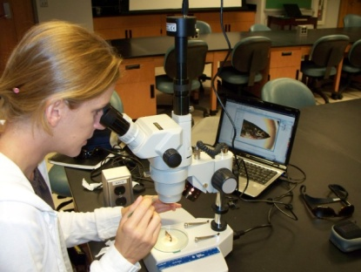
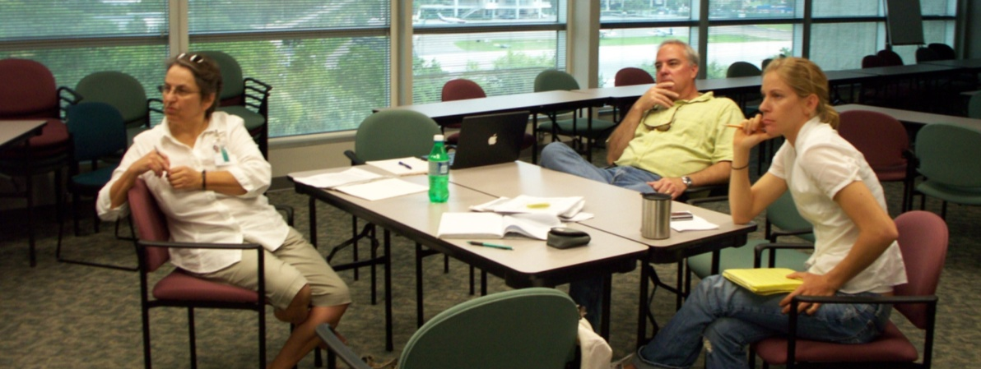
Measuring nursery contribution
High-tech research tools:
  Stable isotopic analysis
  Genetic parentage analysis
  Otolith microchemistry
    The team:
    Carole McIvor USGS
    Ernst Peebles USF,
    Holly Rolls FWC/USF
Notes:
How do we begin to answer the question: What proportion of reef fish adults came from mangrove nurseries?
There are 4 new tools that teams are applying to get a real value based on field and lab studies
Our team in St. Pete is using the 4th: otolith microchemistry

Slide 20
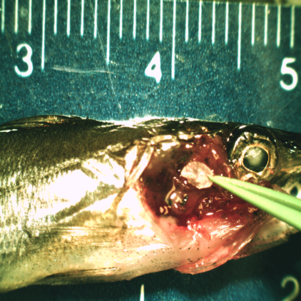
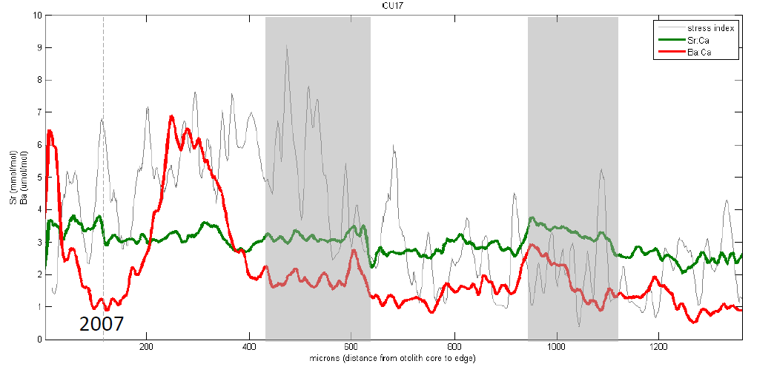
Otolith microchemistry
Otoliths: fish earbones
Grow in layers like an onion
Each layer has elements derived from the habitat
  Laser / mass spectrometry analysis
  Microchemical signature
Reveals habitat transitions
  Mangrove ⇒ Reef
  Reef ⇒ Reef
Notes:
Otoliths are the earbones of fish
They grow in layers like an onion, that when sectioned reveals concentric rings, like a tree trunk
Each ring stores chemical information about the chemicals that were present in the water the fish was living in when it was formed.
The analysis reveals habitat transitions based on the history revealed by the otolith’s “microchemistry”

Slide 21
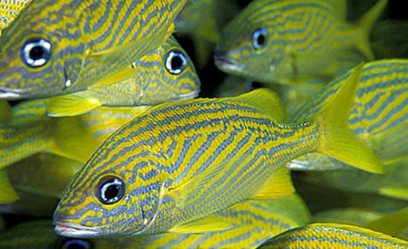
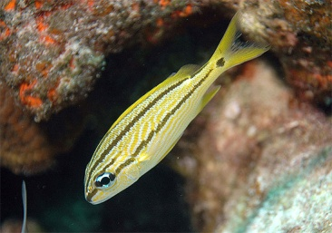
Otolith microchemistry
- example
Puerto Rico and St. Croix
  Adult French grunts on a coral reef
  What nursery habitat did they come from?
    Mangrove: 67%
    Coral reef: 33%
Mateo 2010
Notes:
Here is an example from Puerto Rico
Of adults French grunts collected on a coral reef, 67% had lived in mangroves as juveniles
Of adult schoolmaster snappers, 99% had lived in mangroves as juveniles
While some had used seagrass beds as nurseries as well, none relied on the coral reef as a nursery

Slide 22
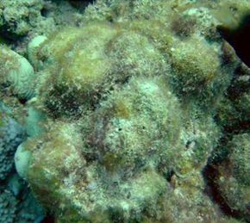
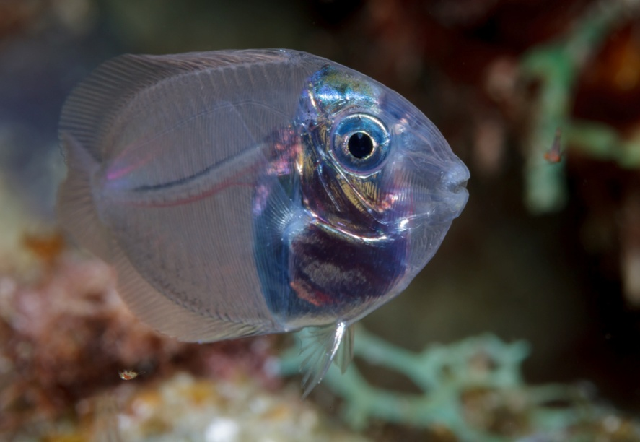
Climate change:
Coral reef nurseries?
Part 1: Coral reefs are dying
  Dead coral skeletons: covered by algae (1)
  Juvenile fish avoid them
    Repelled by chemical signals (2)
Species reliant on living coral are more at risk from climate change impacts
Species that use mangroves may have a fighting chance
(1) Adam 2011 (2) Lecchini 2003
Notes:
As corals die, they become covered with mats of turf and other algae
Very recent studies have shown that young fish avoid these algae covered coral skeletons
Thus, those coral reef fish that depend on live coral as nursery habitat are at great risk from climate change

Slide 23
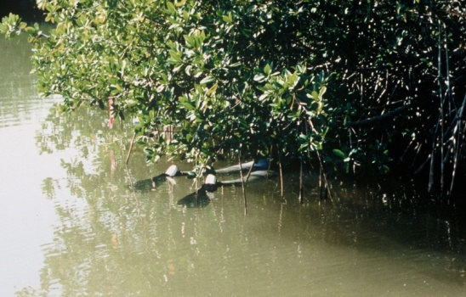
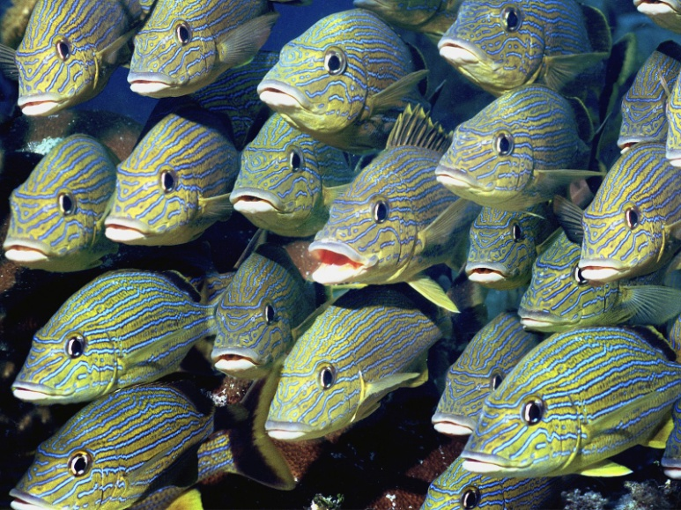
Mangroves as reef fish nurseries
Surveys in mangroves
  My own research
  Florida Bay mangroves
  Juveniles of Keys reef fish were very abundant (1)
    Snappers, Grunts, Barracuda
Globally
  81 species (2)
  Also Groupers, Parrotfish, Surgeonfish
Ley 1992 (2) Ley 2014 (3) Nagelkerken 2000
Notes:
My own research in the late 1980s suggested that mangroves in Florida Bay harbored large numbers of juveniles of species such as gray snappers and blue-striped grunts that are known to live on coral reefs as adults (1)
Since then many studies have confirmed this discovery
I recently wrote a paper summarizing studies from around the world showing that most of the families of coral reef fish have at least a few species that are commonly found as juveniles in mangroves (2)
These fish are called “mangrove nursery fish” (3)

Slide 24
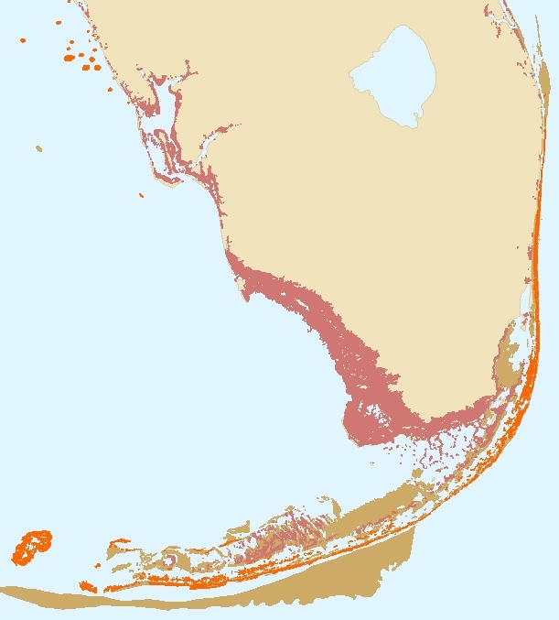
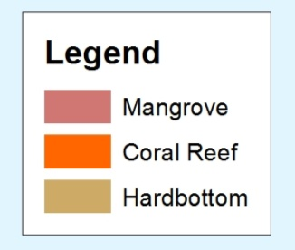
Florida’s coral reef fisheries
  How important are mangrove nurseries?
  All of Florida’s reefs (coral and rocky) are close to mangroves
Mangroves are likely to buffer impacts of climate change on reef fisheries
Mangrove-Reef links: ecosystem resilience?
Notes:
The contribution of mangrove nurseries to coral reef fish populations ranges between 21 to 100% for the cases studied so far
Species include snappers, grunts, groupers and parrotfish
Populations that use mangrove nurseries may be more resilient to climate change

Slide 25
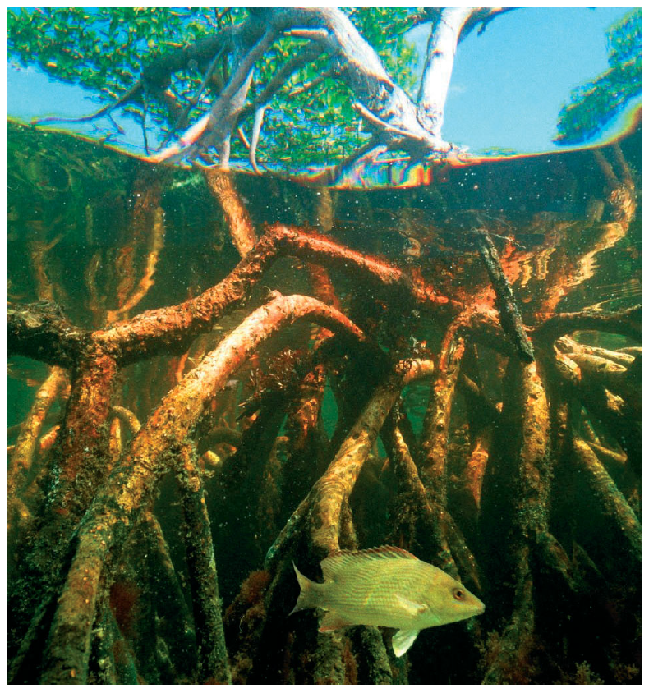
Mangrove nurseries: habitat quality
Research:
  Most juvenile reef fish shelter in mangrove fringe by day
    Move out at night (3)
  Grunts and Snappers prefer:
    Well-developed mangroves (1)
    Greater shade (2)
Tall, mangrove fringe =
    Important nursery habitat
(1) Ley & McIvor 2002 (2) Cocheret de la Moriniere 2004) (3) Ley et al. 2002
Notes:
Research is needed into what features are important to mangrove nursery fish
So far, we know they are more abundant where the canopy is taller
Experiments showed that snapper were drawn to shade
And our work in Australia showed that the fish shelter in the mangroves by day, but make a mass movement out to adjacent habitats at dusk
We can say that these fish are using the mangroves as a shady area to rest by day

Slide 26
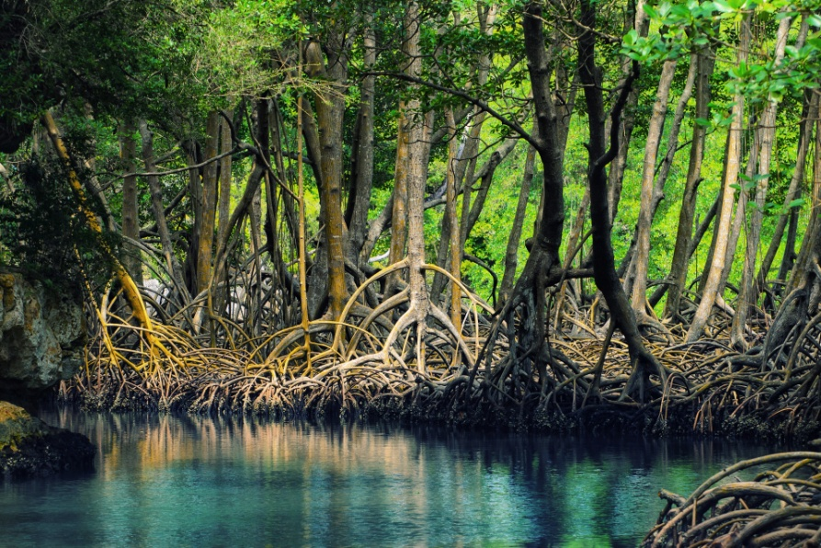
Summary of Part 2: coral reef fisheries
Impacts of climate-related habitat changes on coral reef fisheries?
At great risk: species dependant on live coral habitats
At less risk: species using mangroves as nurseries
Ecosystem resilience: protect tall, full-canopy mangrove fringe

Slide 27
Part 3. Florida regulations & programs
Goal:
  Improve the resilience of reef and other coastal fisheries by protecting ecological functions of well-developed mangrove habitats
Strategy
  Establish and protect buffer zones suitable for mangrove persistence, colonization and development
Notes:
This conference deals with Florida’s regulatory programs and related initiatives
I would like to focus on the mangrove aspect of this talk
Consider a goal whereby we see to maintain reef (and other coastal) fisheries by protecting mangrove habitats
A strategy addressing the goal would be to establish buffer zones

Slide 28
Mangrove Regulations (1)
FDEP +
Water Management Districts +
Delegated Local Governments
Surface Waters
373.403 – 373.468 F. S.
1996 Mangrove Trimming
403.9321-403.9333 F. S.
Projects which only involve the trimming, alteration, or removal of mangroves with no associated construction or earthwork activities
Environmental Resource Permitting Program (ERP)
Earth works or construction that impacts mangroves
(1) As summarized by Ryan St. George, downloaded May 9, 2014
Notes:
Two key programs impact mangroves in Florida
Surface water protection programs regulating construction
Mangrove trimming which regulate non-construction mangrove alteration

Slide 29
Mangrove Regulations
ERP Program
Exemptions
Mangroves may be removed for:
Permits
Mangroves may be removed if…:
Maintenance of swales and ditches
Construction, replacement, and repair of seawalls or riprap in artificial waters and residential canal systems
..the project results in no net loss in wetland or other surface water functions.
…a regulated activity will not adversely impact the value of functions provided to fish ...(2)
Mitigation may be considered
Ryan St. George, downloaded May 9, 2014
Environmental Resource Permit Applicants Handbook, vol 1, Chapter 10
Notes:
The ERP program includes exemptions for certain activities
And issues permits for mangrove removal if “the regulated activity will not adversely impact the value of functions provided to fish…..”

Slide 30
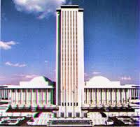

ERP, sea level rise and mangroves
Flat Florida
Coastal slope 2%
Width submerged, if unconstrained
  At 3 ft SLR, 150 ft
  At 6 ft SLR, 300 ft
6 ft
3 ft
150 ft
300 ft
To protect coastal properties & infrastructure: a choice
  Natural buffer zones: unconstrained shoreline
  Hardened shorelines: constrained shoreline

Slide 31
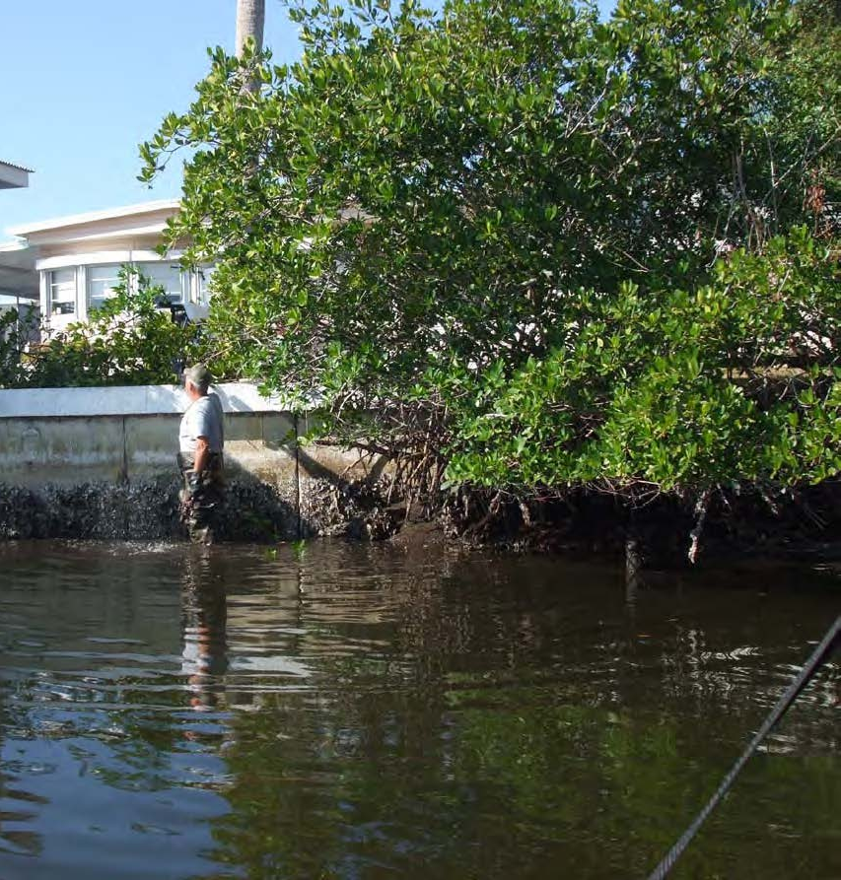
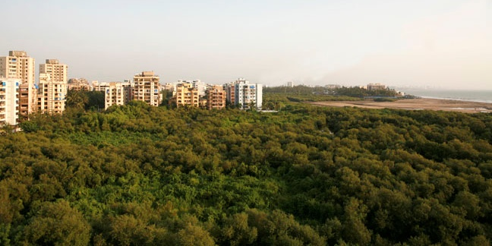
Sea level rise and urban shorelines
Creep vs Squeeze
  Creep: natural buffer zones
    Functions and values retained
  Squeeze: hardened shorelines
    Mangroves, fish habitat lost
http://lsecities.net/media/objects/articles/remaking-mumbai/en-gb/

Slide 32




Sea Levels Affecting Marshes Model (SLAMM): Tampa Bay
Creep
Squeeze
Source: L. Cross, 2014

Slide 33


Sea Levels Affecting Marshes Model (SLAMM): Big Pine Key
Current
2 ft SLR: Creep
Mangroves
Pinelands
Source: Bob Glazer, FWC/FWRI, 2014

Slide 34


Waves, surge buffered by mangroves
Roots: drag near substrate (3)
Leaves and branches: drag higher in the water column
(1) Bouma 2014, (2) McIvor 2012, (3) Quartel 2007, Bao 2011

Slide 35



Assessing mangrove functions under sea level rise: ERP
“Regulated activity will not adversely impact the value of functions”
Functions include:
  Prime nursery: tall, full canopy fringe
  Food web(leaves, twigs, seeds)
  Natural, long-term, durable buffer for property and infrastructure protection

Slide 36

Mangrove Regulations
Minick & Sensi
Wed, 3pm
Trimming
Exemptions
Mangroves may be trimmed if:
Permits
Mangroves may be trimmed if:
General
Fringe width < 500 ft
Professional Mangrove Trimmer (PMT) conducts the trimming
Individual
Activity may not adversely effect public safety, fishing, or marine productivity in the vicinity
Fringe width < 50 ft
Height < 24 ft
Minick, downloaded May 11, 2014

Slide 37



Mangrove trimming
April 2006
May 2014
Well-developed black and red
Low hedge whites and vines

Slide 38



May 2002
May 2014
April 2006
Removing the canopy exposes the network of intertidal rivulets.
Changing function as the mangroves as nursery.

Slide 39

Recommendations
Mangrove habitats face ecological threats from accelerated sea level rise
FWRI/FDEP can partner to:
Evaluate regulations and programs related to fish habitat functions
Test effectiveness of mangrove-friendly shoreline protection alternatives
Review aspects of all programs governing exempted and permitted mangrove alterations

Slide 40

Florida’s fisheries depend upon healthy mangrove forests.
Rick Scott, Governor
Declaration of Florida Mangrove Day,
Oct 11, 2011

