Slide 1
USACE Regulatory Program & SPGP Coordination
Tori White
Deputy, Regulatory Division
Jacksonville District
10 June 2014

Slide 2
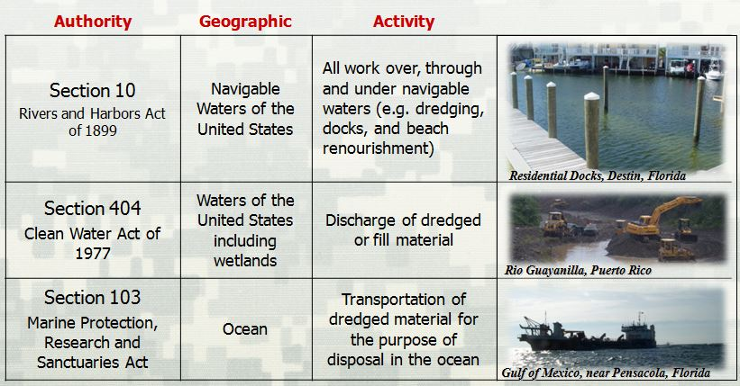
USACE Regulatory Authorities

Slide 3
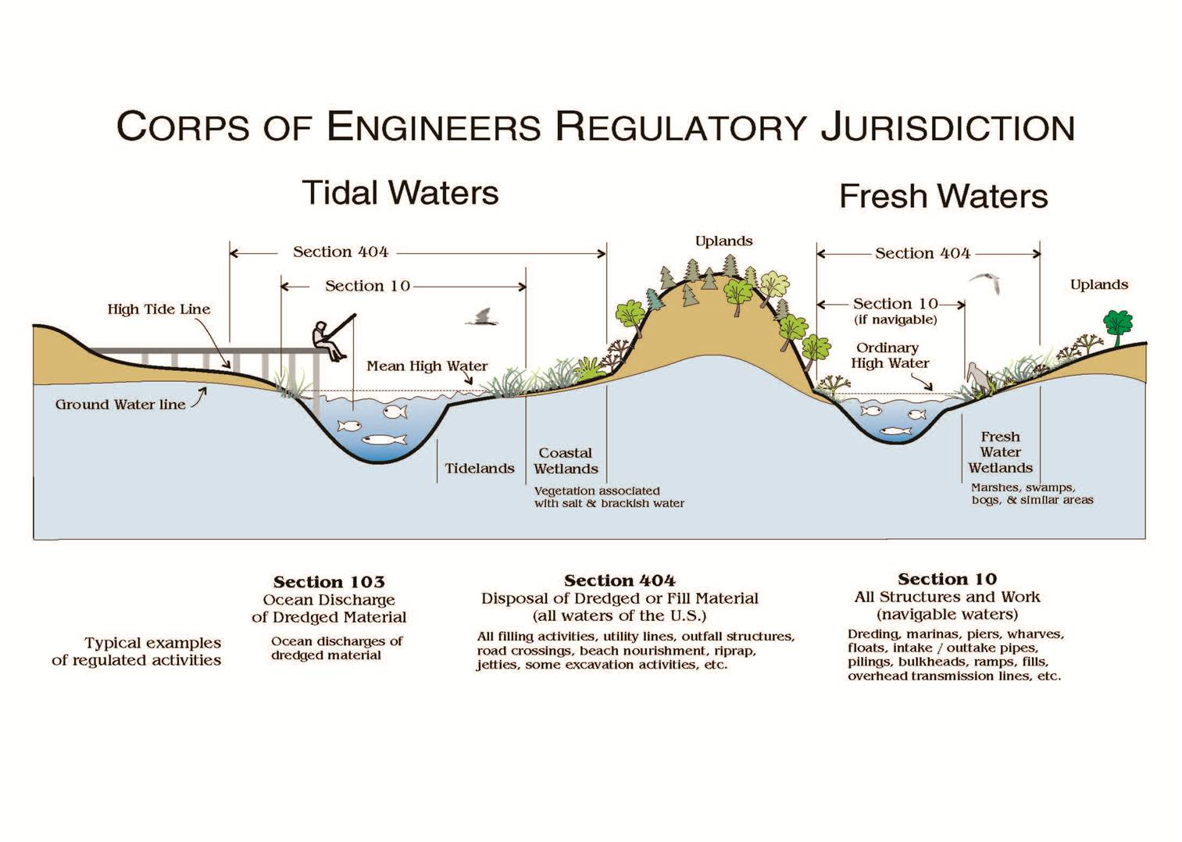

Slide 4
Types of Permits
General Permits (GPs)
  Evaluation and authorization not project-specific
  Similar activities resulting in minimal adverse effects to aquatic environment (with mitigation)
  Developed and issued with same process as IPs
  Must be reissued every five years
Types of General Permits
  Nationwide permits (NWP)-issued by Corps HQ
  Regional permits (RGP)-issued by districts and divisions
  Programmatic permits (PGP)-reduce duplication

Slide 5
Types of Permits
Standard Permits (SP)
  Evaluation and authorization project-specific
  Involved process (public notice, public involvement)
Letters of Permission (LOP)
  Less controversial than SPs
  Minor impacts, coordinate with agencies/neighbors (no public notice)

Slide 6
Permit Evaluation Process
Verify GP/NW
Joint Permit App
Submittal to State
App Received from State
Begin Processing
Public Notice
Corps
Individuals
Special Interests
Other Agencies
Application
Approved
Permit
Issued
Federally Recognized Tribes
Adjacent Property Owners
Decision
Document
Application
Denied
  404(b)(1) Guidelines
  Public Interest Review
  NEPA, ESA, NHPA, EFH
  State & Territorial Certifications
  (CZM, WQC)
Application Reviewed

Slide 7
SPGP Process
Applications submitted to DEP; DEP evaluates and codes as green, yellow or red
Greens are able to be processed by DEP with no input needed from Corps; however, DEP sends to NMFS for 5-day review; if no response from NMFS, DEP issues.
Yellows are sent to Corps and evaluated by Corps, and other Federal agencies as appropriate; within 5 days will be sent back to DEP for processing as green or kept as red.
Reds sent to Corps and are processed by Corps
Main factors in yellow/red decisions are endangered species, essential fish habitat, Federal channels, current enforcement actions, emergency permitting

Slide 8
SPGP History
August 1995 implemented in Clay, Duval, Nassau & St. Johns counties for shoreline stabilization, boat ramps, docks and piers, and maintenance dredging
September 1996 expanded to include all counties within the DEP Northeast District
September 1997 expanded to include all counties except for Monroe and those in Northwest Florida WMD; also expanded activities to include many of Florida’s exemptions and Noticed General Permits
December 1998, SPGP was updated.
July 2006 reissued and because of litigation the scope of activities was reduced to those activities covered in the original SPGP.
In 2006 administration provided to WMDs and any county or municipality delegated authority by the DEP in accordance with the provisions of Sections 373.441 F.S.
August 2008, SPGP was added to the DEP self-certification program for boat docks and boat lifts
August 2012, reissued and expanded to include counties within NWFWMD
August 2013, Hillsborough County began administering SPGP
December 2013, SJRWMD began administering SPGP

Slide 9
SPGP Results
From January 2000 - March 2014, DEP authorized 30,790 actions under the SPGP.
Approximately 78.65% of all SPGPs have been for docking facilities, boat ramps, seawalls and riprap
To date, 6322 authorizations issued under the self-certification program or about 20.53% of all SPGPs.
DEP compliance report Q1 2014 (259 inspections)
  8 non-compliant with SPGP
USACE compliance report Q4 2012 (94 inspections of 546)
  23 not constructed to permit drawings of which 22 would still have met SPGP criteria
  1 incorrectly issued within exclusion area “Red”

