Slide 1

St. Johns River Water Management District
Introduction to Hydric Soils
Travis Richardson, MS
DOT Mitigation Program Manager
SJRWMD

Slide 2
Topics
Why do we need to understand soils
What is soil and how does it form
Components of soil morphology
What is a hydric soil
Common hydric soil indicators
Hydric soil technical standard

Slide 3
Understanding Soils
Hydric Soils
Wetland Delineation
Seasonal High Saturation
Organisms & Chemistry

Slide 4
What Is Soil?
Plant growth
Water quality and quantity
Nutrient and pollutant source/sink
Soil Organisms
Engineering media

Slide 5
Soil Formation
Parent Material
Climate
Landscape Position
Organisms
Time
Notes:
Because soils for in a somewhat consistent manner it allows us to identify oddities – I’m not talking about soil scientists (we are an odd group) but I’m talking about the soil. For example, if you are in a mesic to wet flatwoods landscape and you have yellow sand at the surface and you hit a black layer beneath it warning bells should go off. Or if you have inclusions of clay in an other wise sandy layer you should start question whether fill was placed on the site.

Slide 6
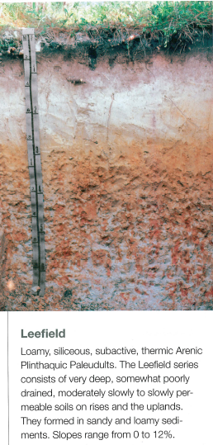
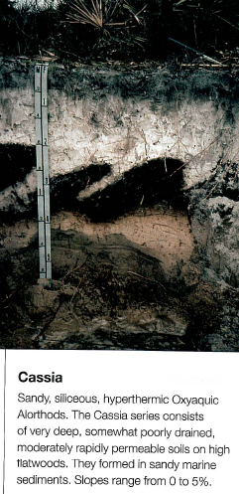
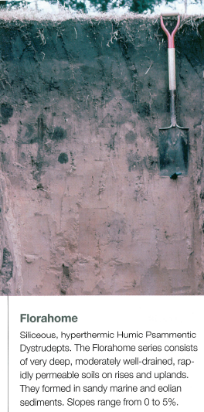
Soil Morphology - layers
Soil series photos from: Watts, F.C. and M.E. Collins. 2008. Soils of Florida. Soil Science Society of America, Inc. Madison, Wisconsin, USA.

Slide 7
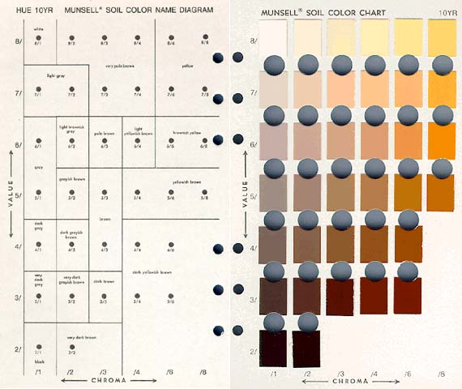
Soil Morphology - Color
yellowish brown (10YR 5/6)
hue
value
chroma

Slide 8
Soil Color - Hue
Red
0 2.5R 5R 7.5R 10R
Yellow-Red
0 2.5YR 5YR 7.5YR 10YR
Yellow
Hues highlighted in yellow are the common soil hues.
0 2.5Y 5Y 7.5Y 10Y

Slide 9
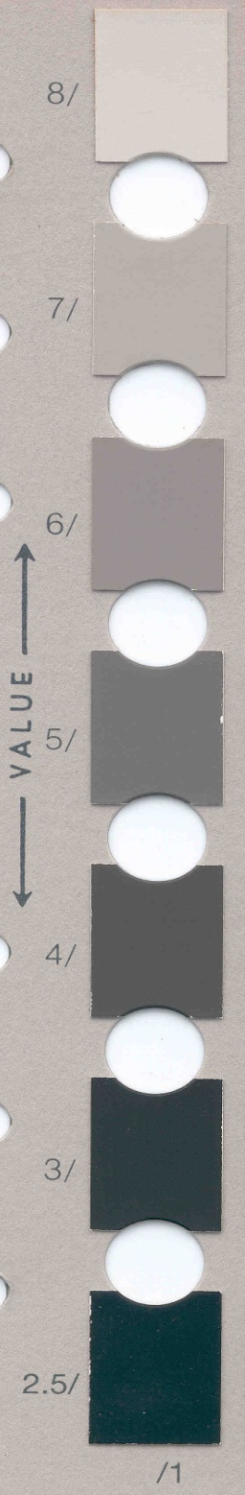
Soil Color - Value
10/0 - Pure White
5/0 - “Gray”
0/0 - Pure Black
The Lightness or Darkness of Spectral Color

Slide 10

Soil Color - Chroma
“Neutral”
Color
“Pure”
Color
/0 /2 /4 /6 /8… /20
Increasing strength of color
Increasing grayness

Slide 11
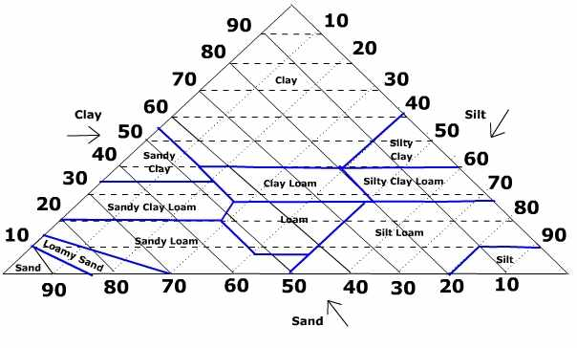
Soil Morphology - Texture

Slide 12
Hydric Soil
A soil that formed under conditions of saturation, flooding, or ponding long enough during the growing season to develop anaerobic conditions in the upper part (Federal Register, July 13, 1994)
Field Indicators of Hydric Soils In the United States
www.nrcs.usda.gov
Notes:
Wetness → anaerobic conditions → OM accumulation & redox chemistry

Slide 13
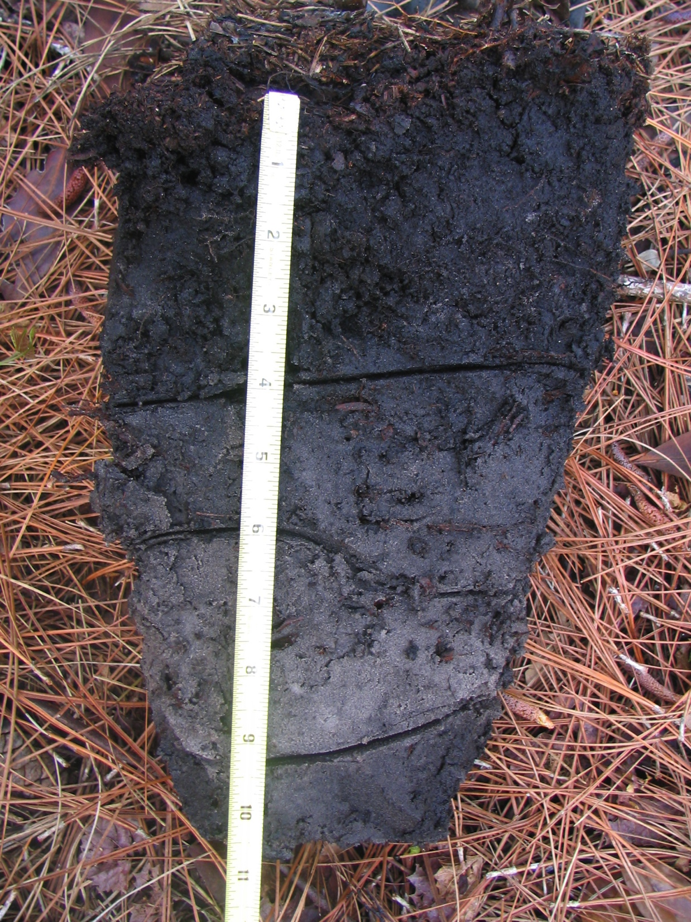
Muck Presence (A8) for use in LRRs Q, U, V, & Z
A layer of muck with value 3 or less and chroma of 1 or less, starting within 15 cm (6 inches) of the soil surface.
All criteria for hydric soils indicators and LRR map from:
USDA, NRCS. 2010. Field Indicators of Hydric Soils in the United States , Version 7.0. L.M. Vasilas, G.W. Hurt, and C.V. Noble (eds.).

Slide 14
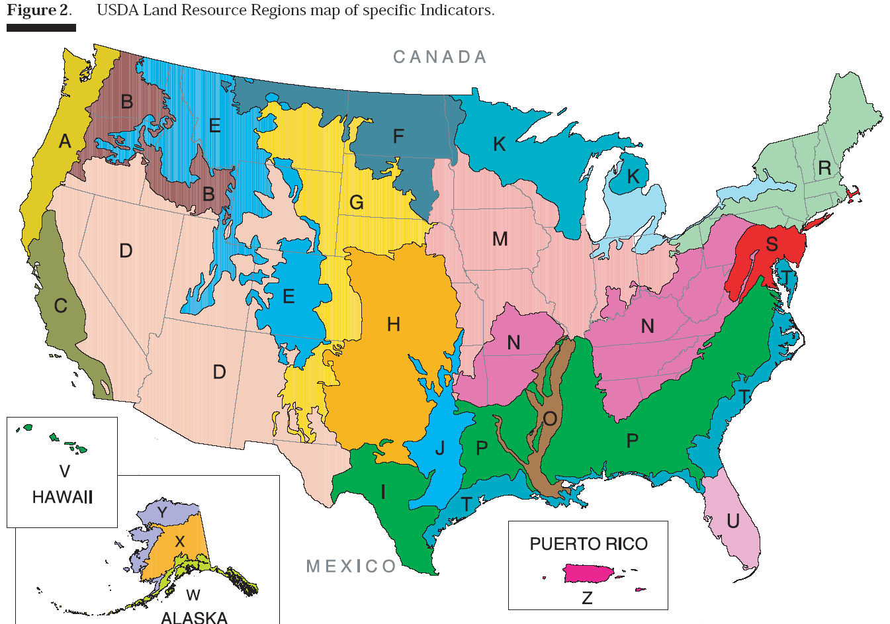
Land Resource Regions

Slide 15
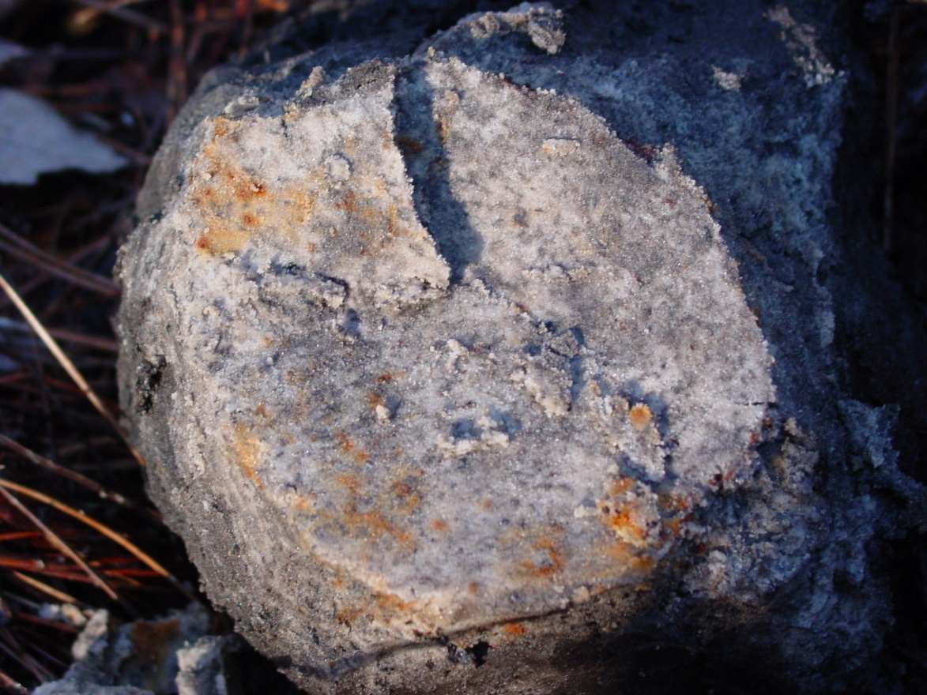
Sandy Redox (S5) for use in all LRRs except Q, V, W, X, & Y
A layer starting within 6 inches of the soil surface that is at least 4 inches thick and has a matrix with 60% chroma of 2 or less and 2% or more distinct or prominent redox concentrations occurring as soft masses and/or pore linings.

Slide 16
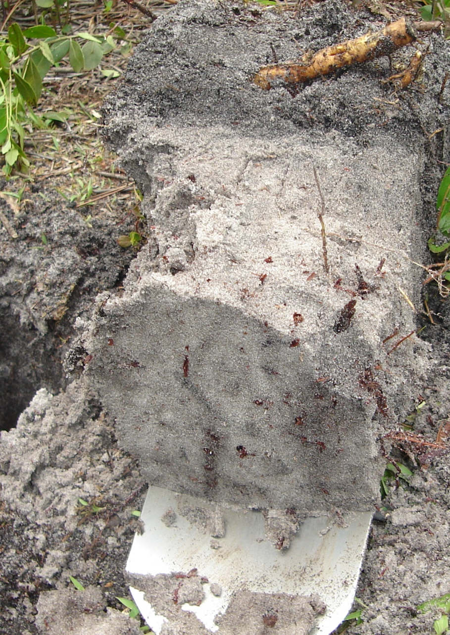
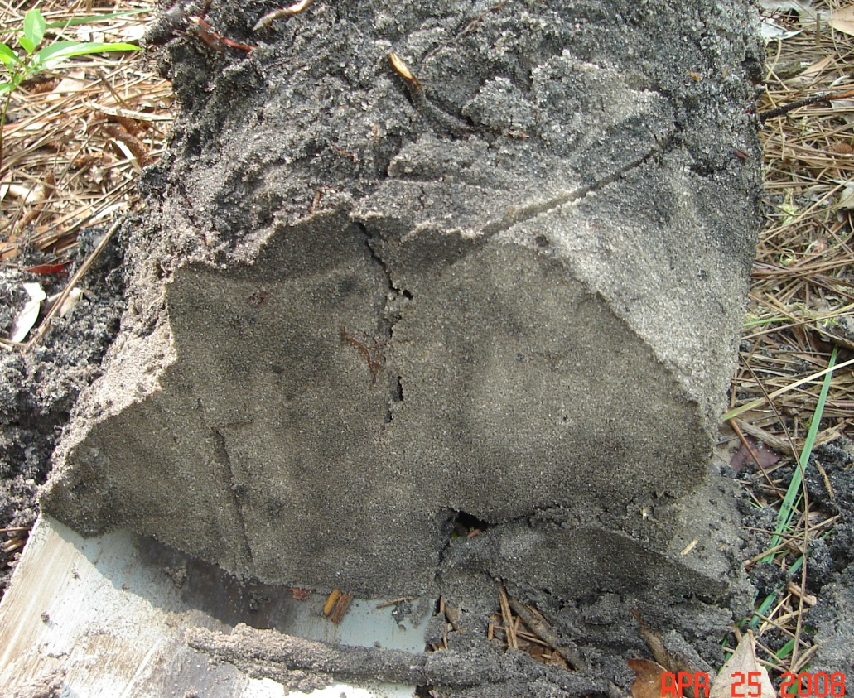
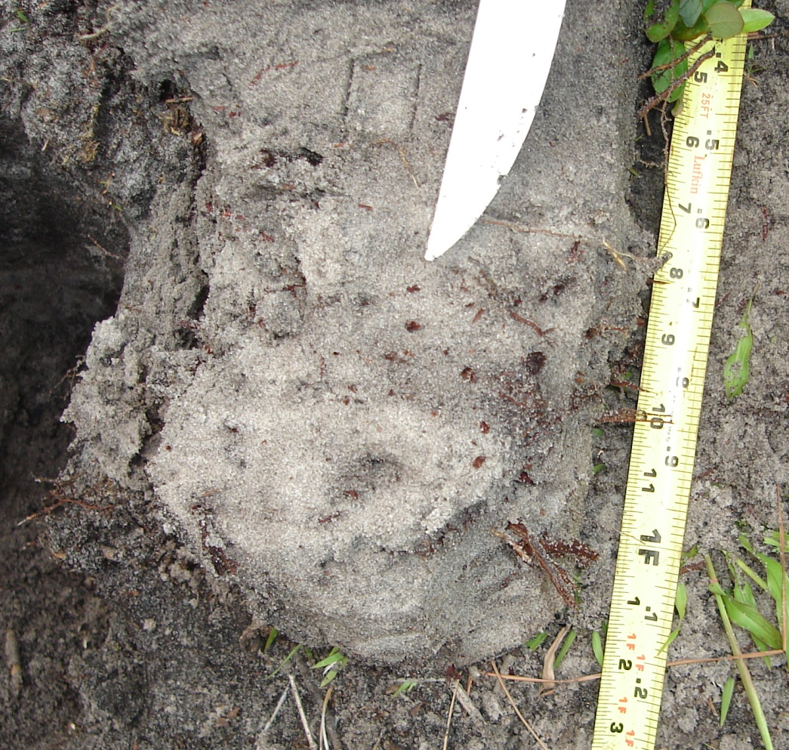
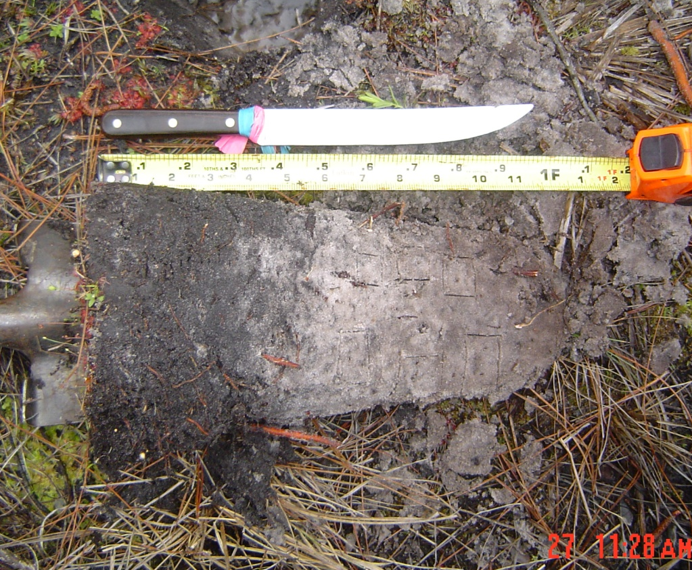
Stripped Matrix (S6) for use in all LRRs except Q, V, W, X, & Y
A layer starting within 6 inches of the soil surface in which iron-manganese oxides and/or organic matter have been stripped from the matrix and the primary base color of the soil material has been exposed. The stripped areas and translocated oxides and/or organic matter form a faintly contrasting pattern of two or more colors with diffuse boundaries. The stripped zones are 10% or more by volume and are rounded.

Slide 17
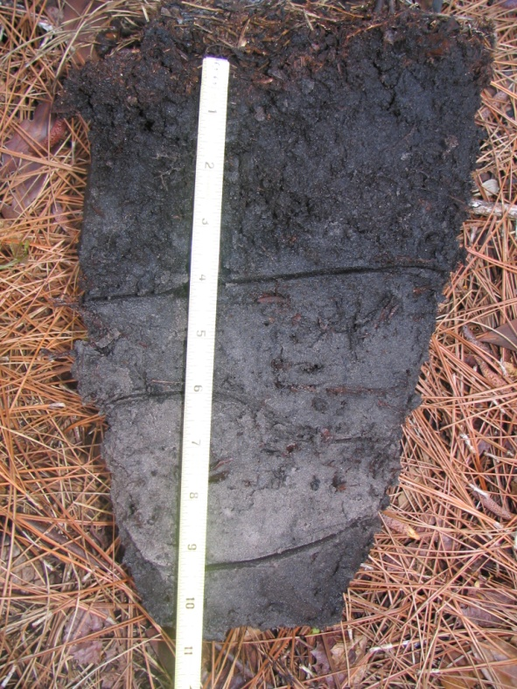
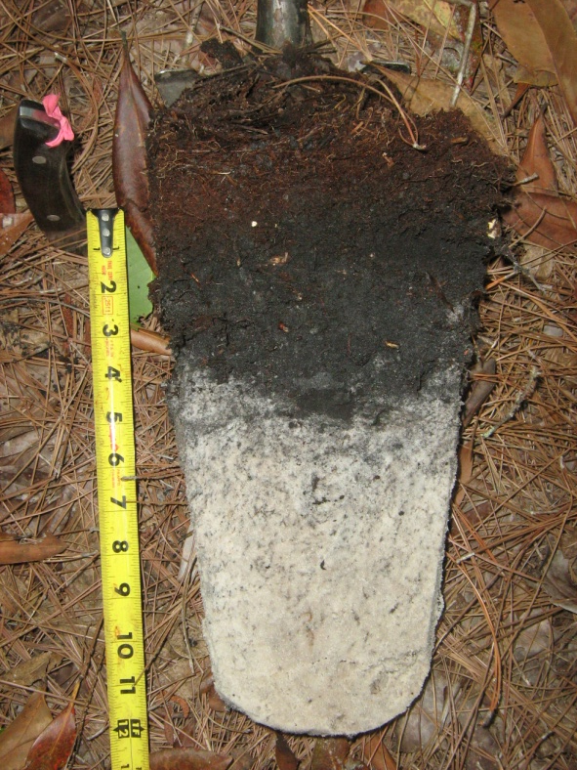

Dark Surface (S7) for use in LRRs K, L, M, N, P, Q, R, S, T, U, V, & Z
A layer 4 inches thick, starting within the upper 6 inches of the soil surface, with a matrix value 3 or less and chroma of 1 or less. At least 70% of the visible soil particles must be masked with organic material, viewed through a 10x or 15x hand lens. Observed without a hand lens, the particles appear to be close to 100% masked. The matrix color of the layer directly the dark layer must have the same colors as above or any color that has chroma 2 or less.

Slide 18
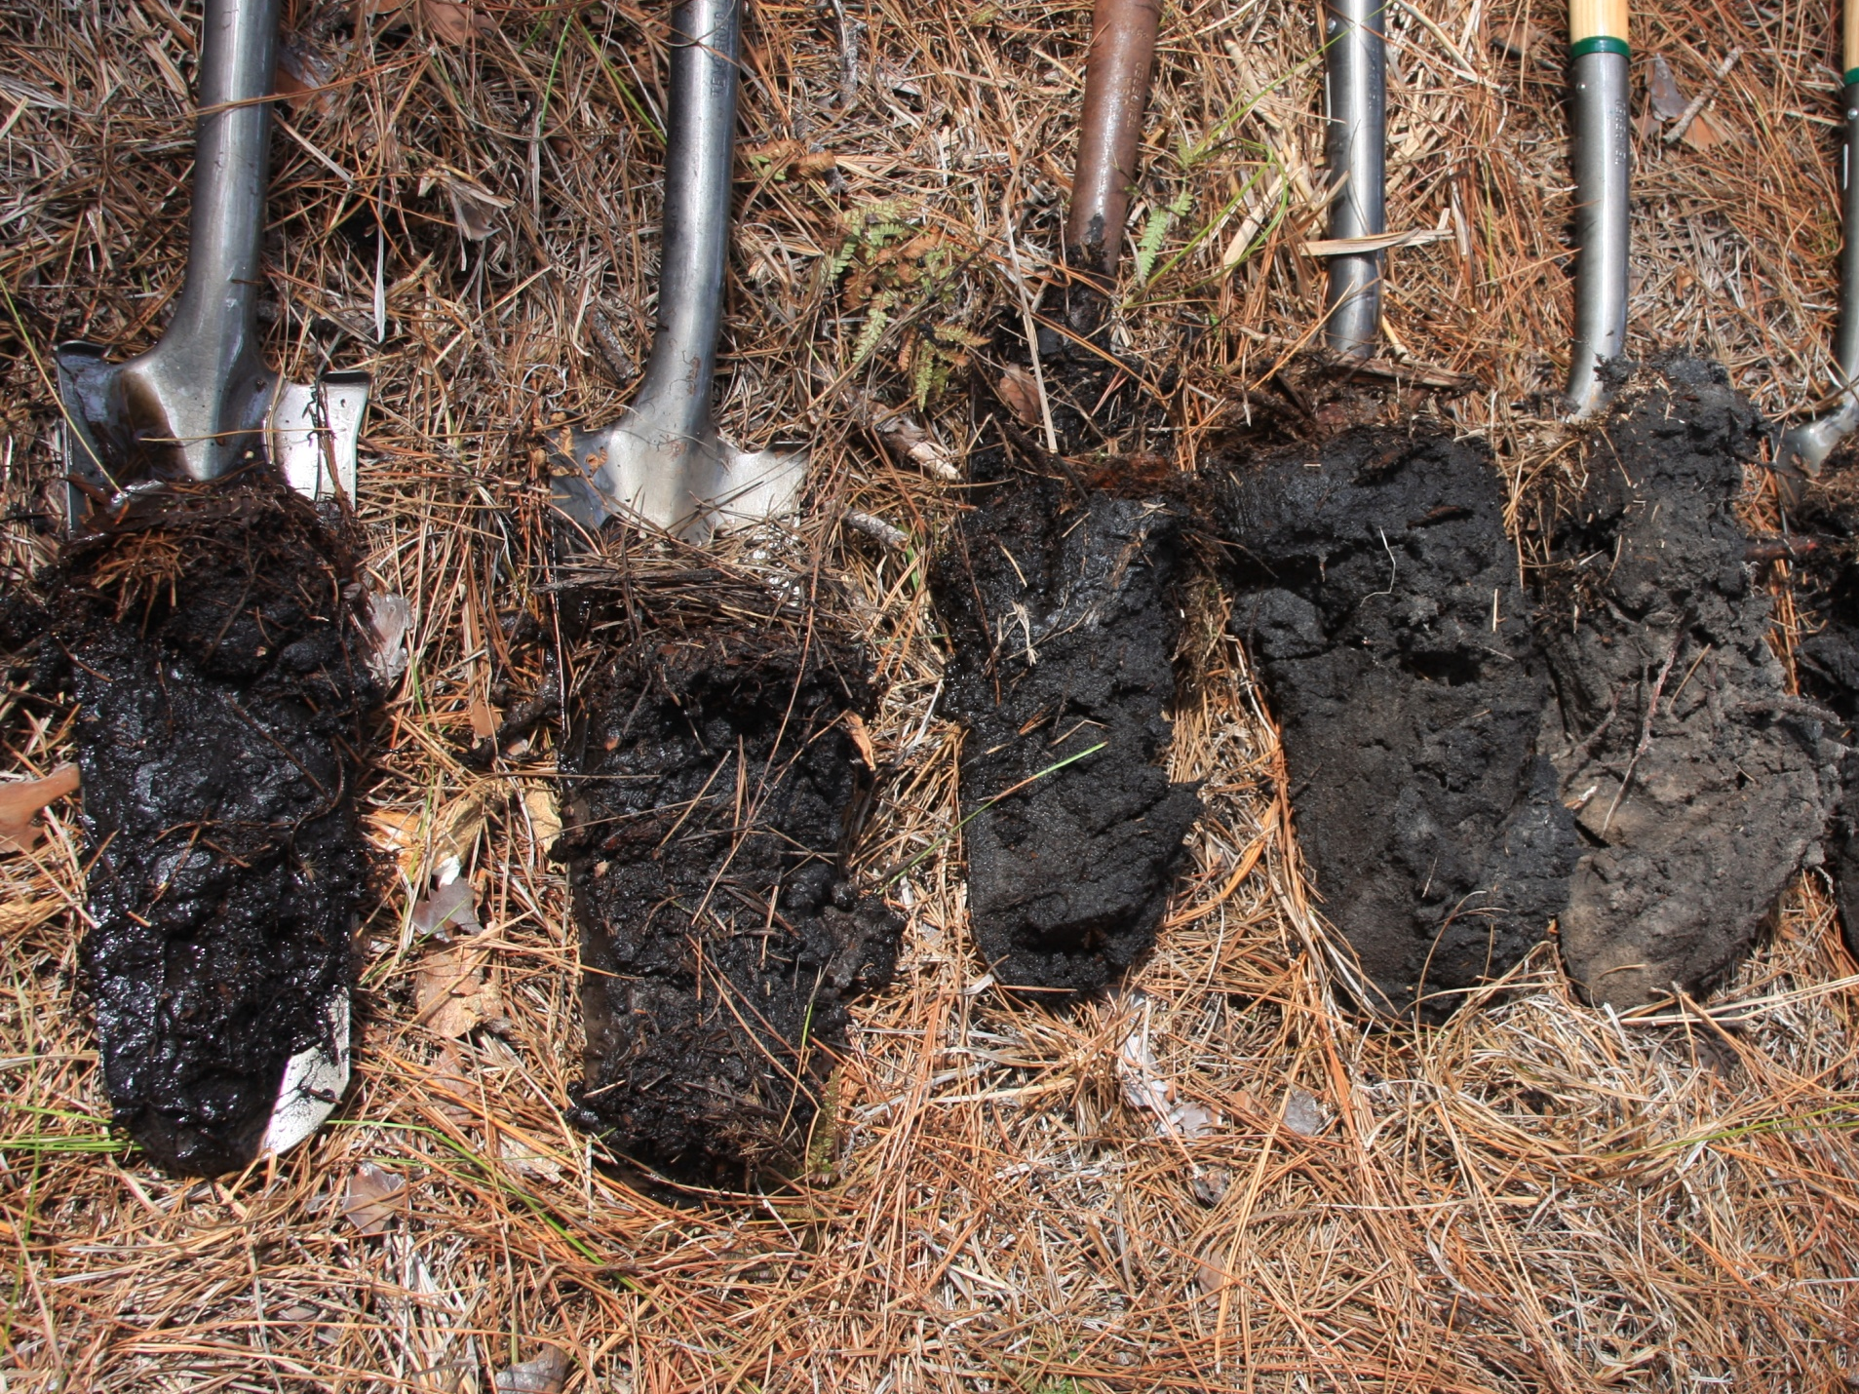
Photo Courtesy of Rex Ellis

Slide 19
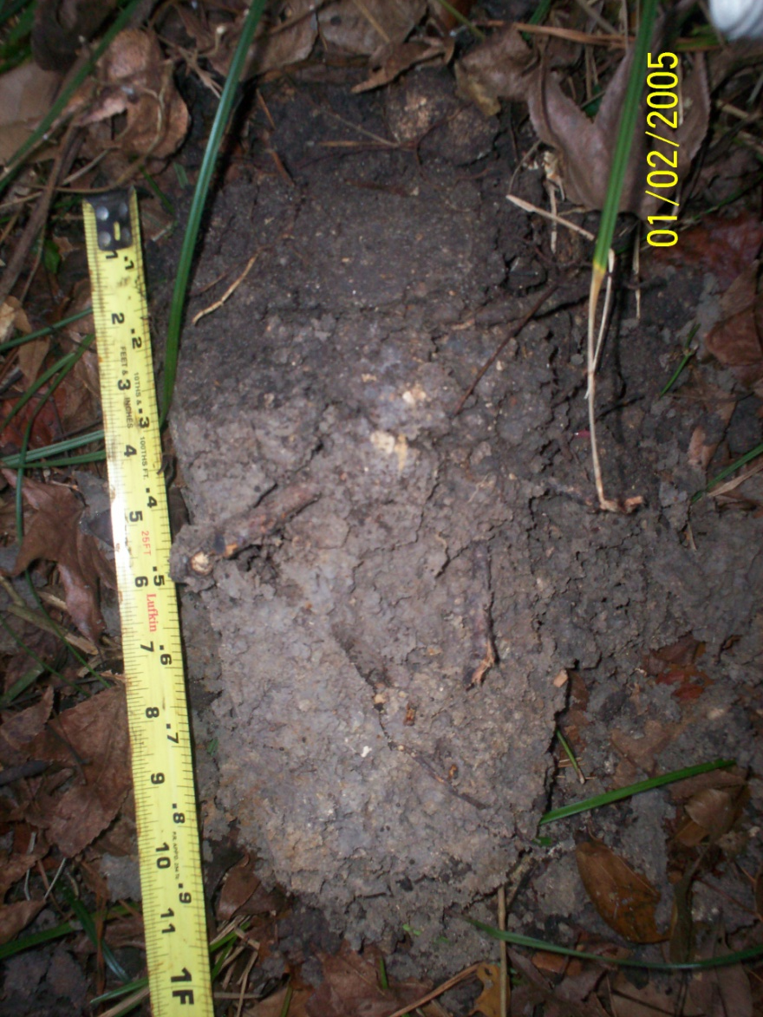
Depleted Matrix (F3) for use in all LRRs, except W, X, & Y
A layer that has a depleted matrix with 60% or more chroma 2 or less and that has a minimum thickness of either:
2 inches if the 2 inches is entirely within the upper 6 inches of the soil, or
6 inches, starting within 10 inches of the soil surface.

Slide 20
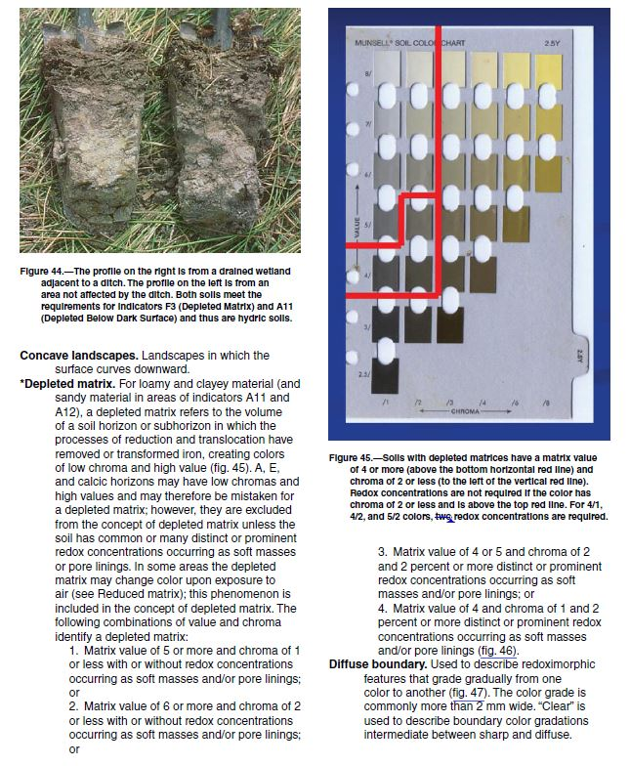
Depleted Matrix (F3)

Slide 21
Depleted Matrix (F3) for use in all LRRs, except W, X, & Y
A layer that has a depleted matrix with 60% or more chroma 2 or less and that has a minimum thickness of either:
2 inches if the 2 inches is entirely within the upper 6 inches of the soil, or
6 inches, starting within 10 inches of the soil surface.

Slide 22
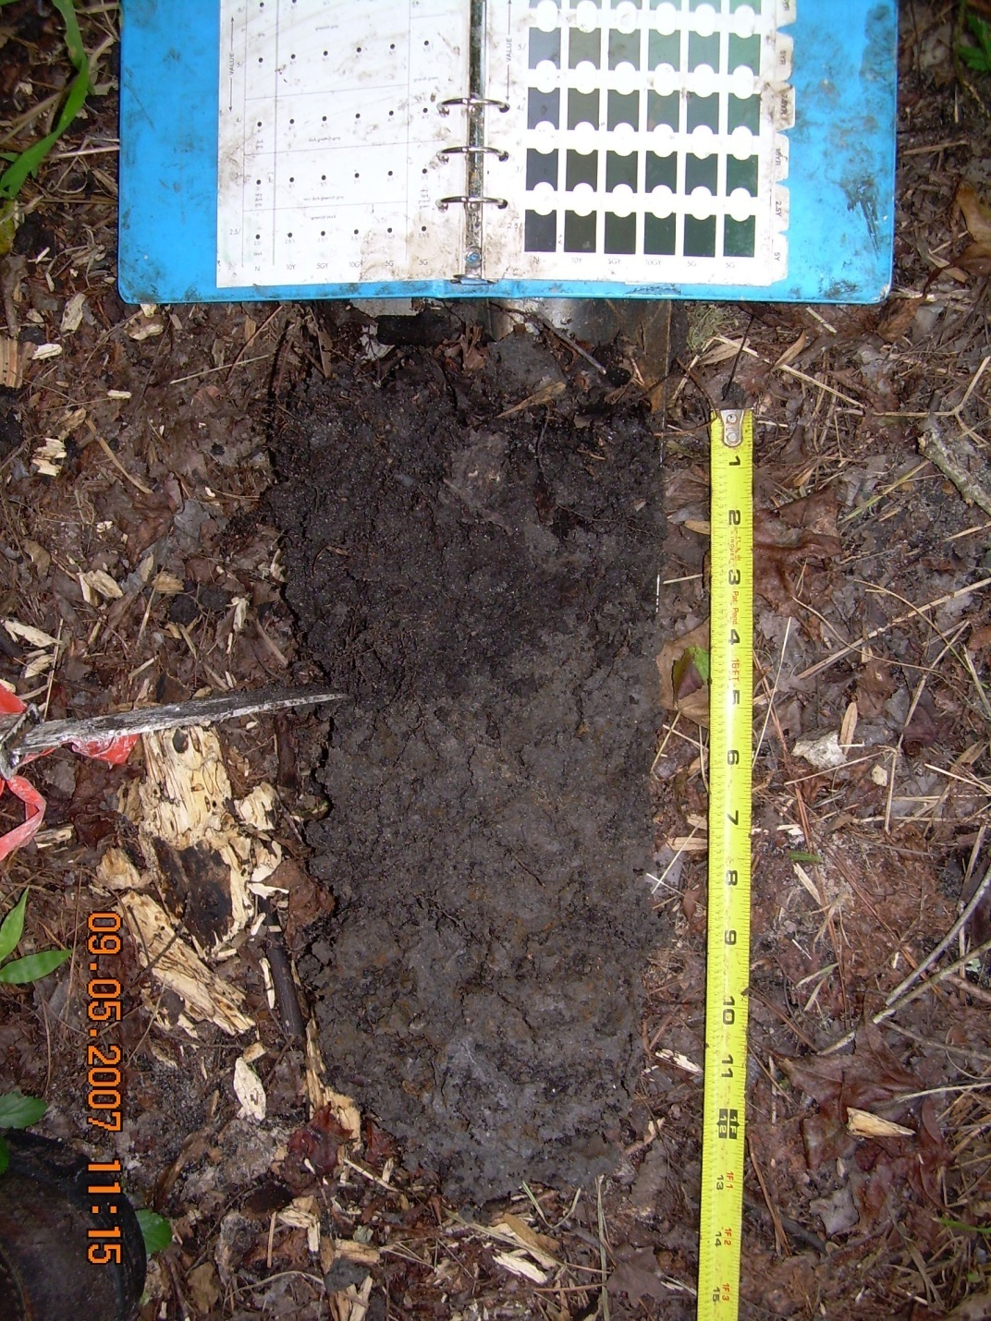
Umbric Surface (F13) for use in LRRs P, T, & U and MLRA 122 of LRR N
In depressions and other concave landforms, a layer 10 inches or more thick, starting within 6 inches of the soils surface, in which the upper 6 inches has value of 3 or less and chroma of 1 or less and in which the lower 4 inches has the same colors as those described above or any other color that has chroma of 2 or less.

Slide 23
Hydric Soils Technical Standard
The hydric soils technical standard documents the methods required to confirm that a soil is hydric (minimum 14 consecutive days of anaerobic and saturated conditions)
*see Technical Note 11: Technical Standards for Hydric Soils (National Technical Committee for Hydric Soils 2007)

Slide 24
Summary
Soil formation is somewhat predictable
Wet conditions favor accumulation of organic matter, anaerobic conditions, and specific chemical reactions that result in soil morphologies that can be touched, seen, or smelled (Hydric Soil Indicators)
Hydric soil indicators document the textural, depth, color, etc. requirements to meet each indicator.
Extensive observations and data collection are required to add new field indicators of hydric soils
www.faess.org – Annual Hydric Soils Workshop

Slide 25
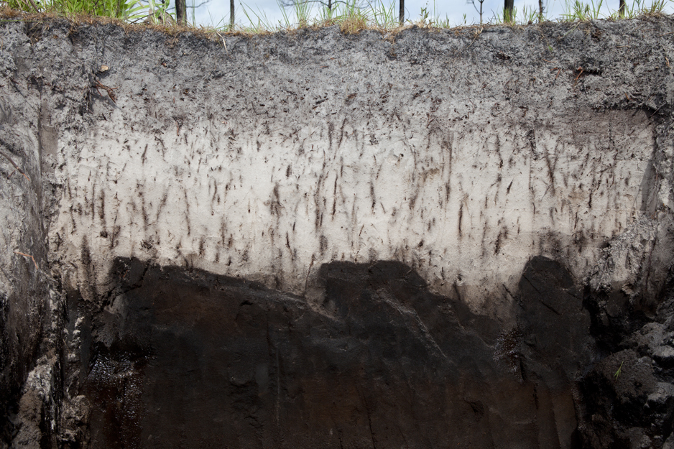
Questions

