Slide 1
Common Trees and Shrubs of Florida Wetlands
(OBL and FACW)
Camille Beasley, ESIII
Camille.Beasley@dep.state.fl.us
FLDEP SLERC Wetland Evaluation and Delineation
June 11, 2014

Slide 2
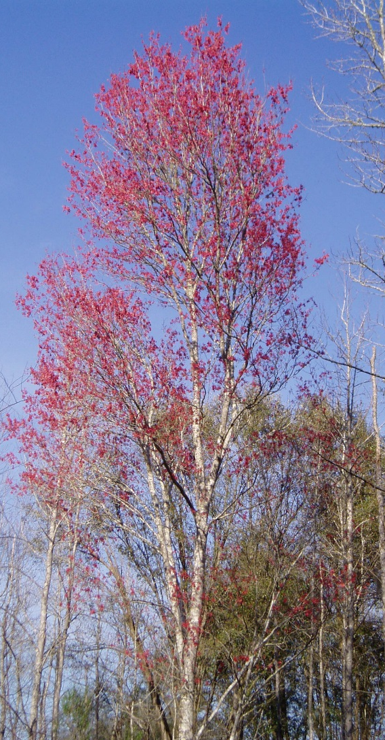
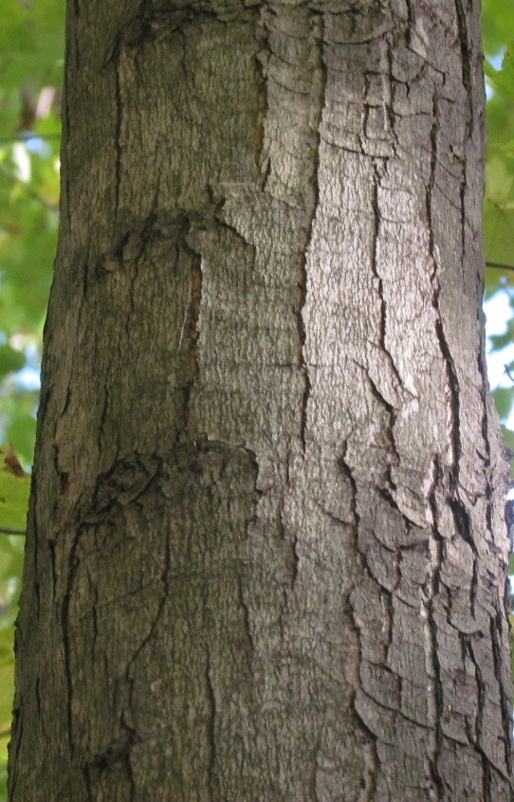
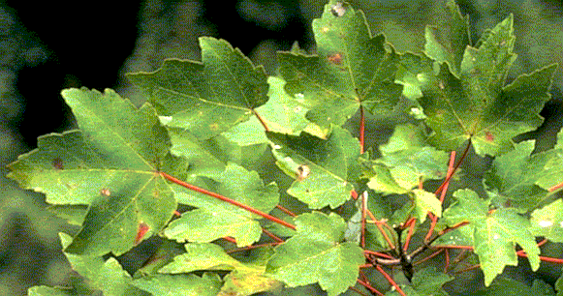
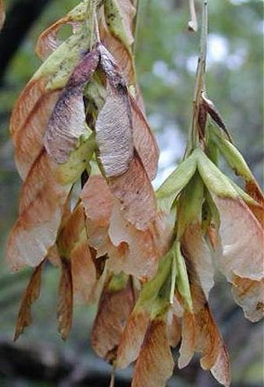
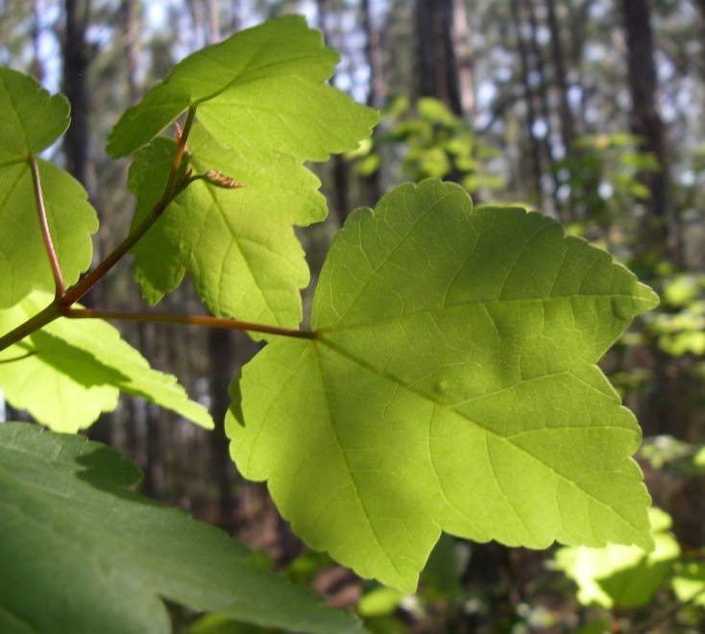
Acer rubrum red maple FACW
Opposite leaves, with 3-5 pointed lobes, margins serrated
Petioles, twigs, and buds reddish
Small red flowers appear early in spring
Paired samaras
Smooth gray bark develops long, scaly plates with age

Slide 3
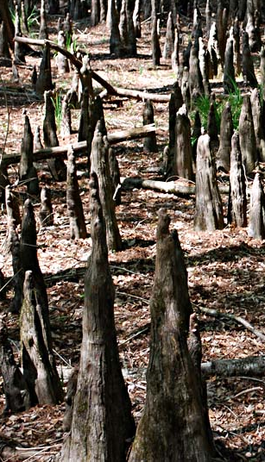
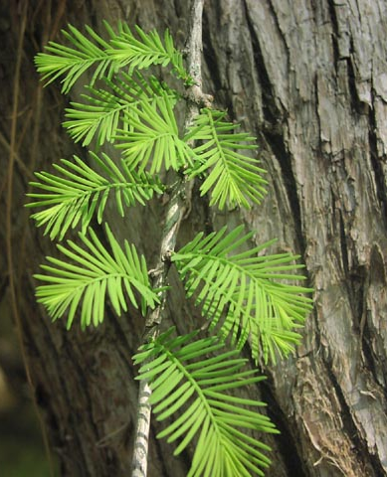
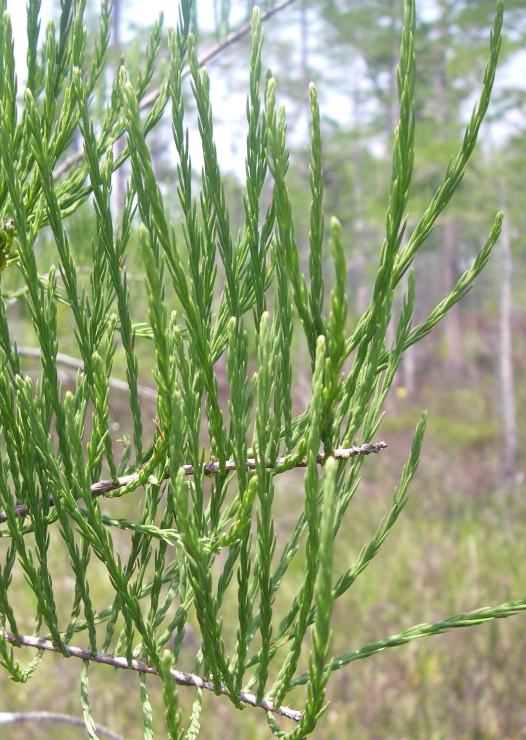
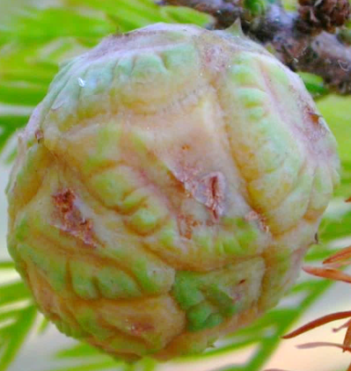
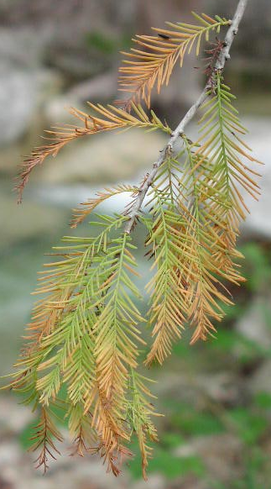
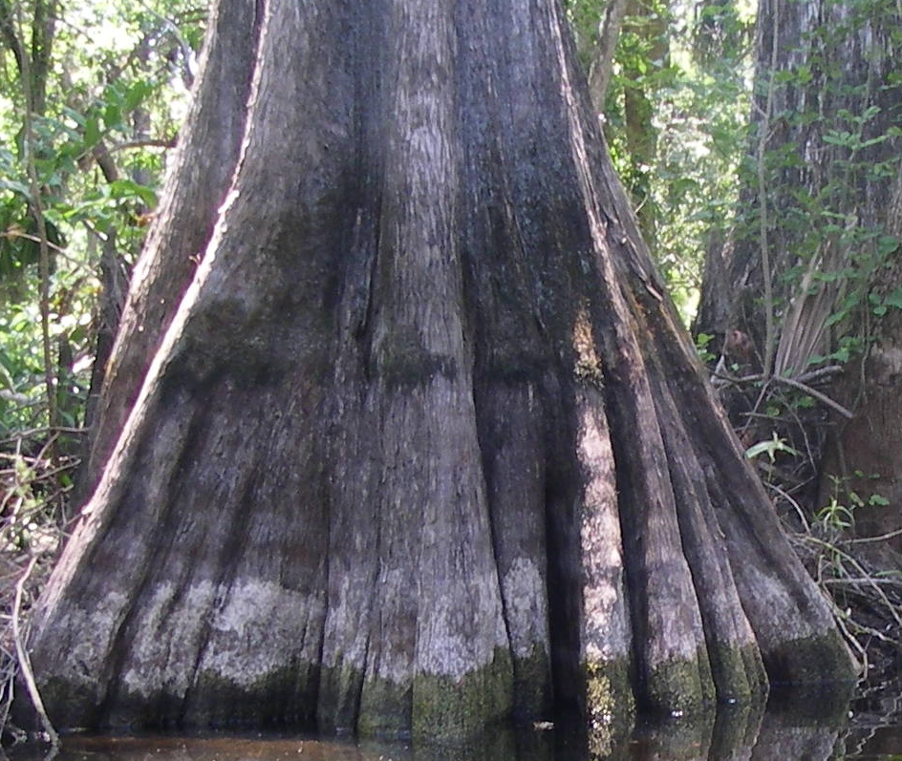
Taxodium distichum bald cypress OBL
Alternate, needle-like leaves on deciduous branchlets
Leaves spread like a feather
Bark in narrow, peeling strips
Base typically fluted, “knees” sticking out of ground around tree
Fruit a round, waxy cone
Taxodium ascendens
pond cypress

Slide 4
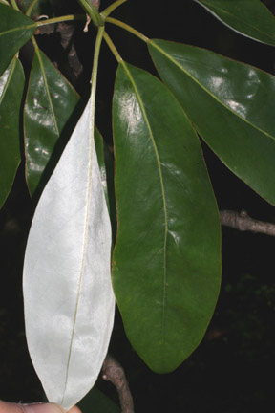
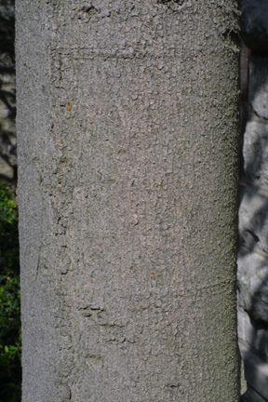
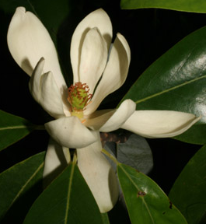
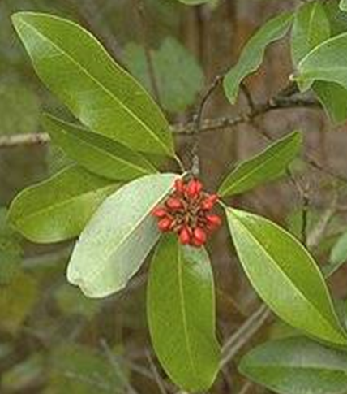
Magnolia virginiana sweetbay magnolia OBL
Alternate, long elliptical leaves, margins entire
Evergreen
Silvery on underside
Leaves aromatic when crushed
Bark smooth and gray
Fragrant, creamy white flowers

Slide 5
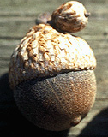
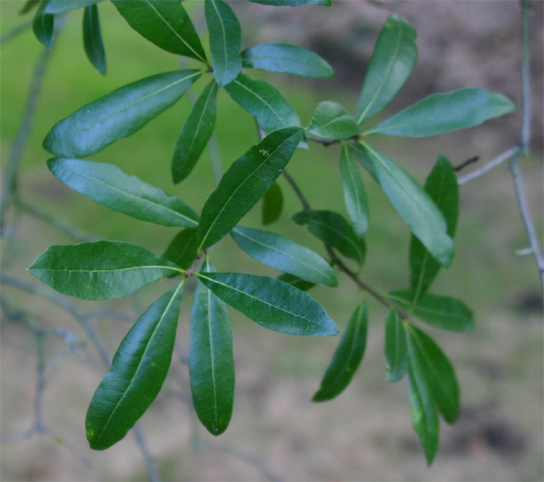
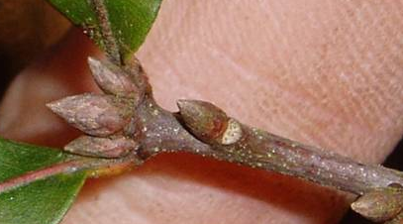
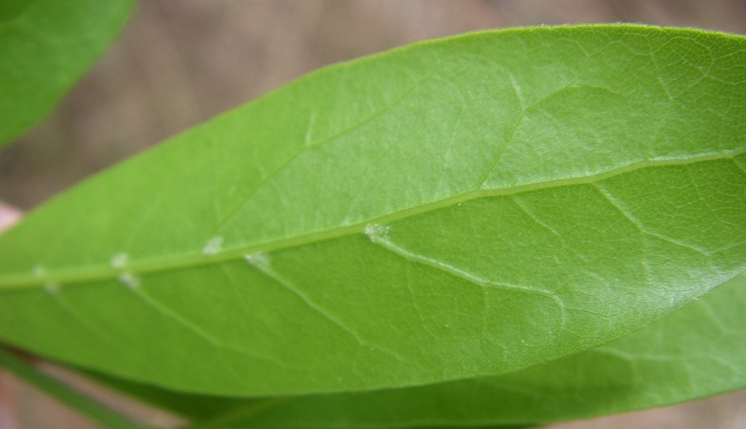
Quercus laurifolia swamp laurel oak FACW
Alternate leaves, variable in size and shape
Apex usually blunt
Tufts of hairs in some vein axils on underside
Acorns smallish
Bark smooth to furrowed into small plates
Buds cluster at branch tips
Young leaves can have small lobes or teeth

Slide 6
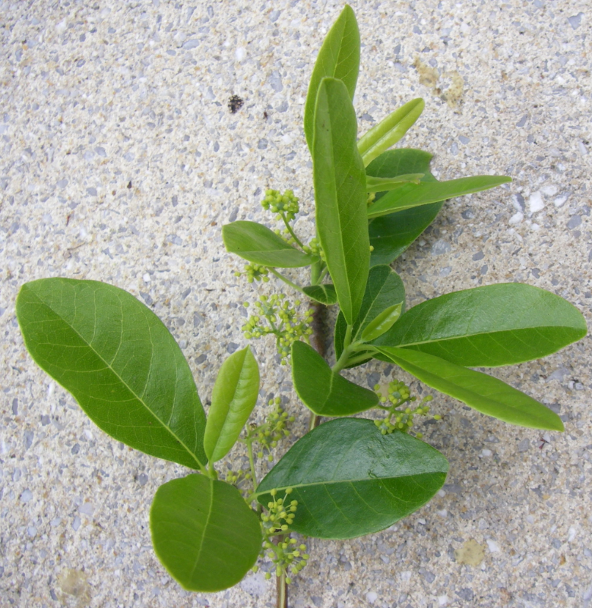
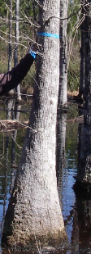
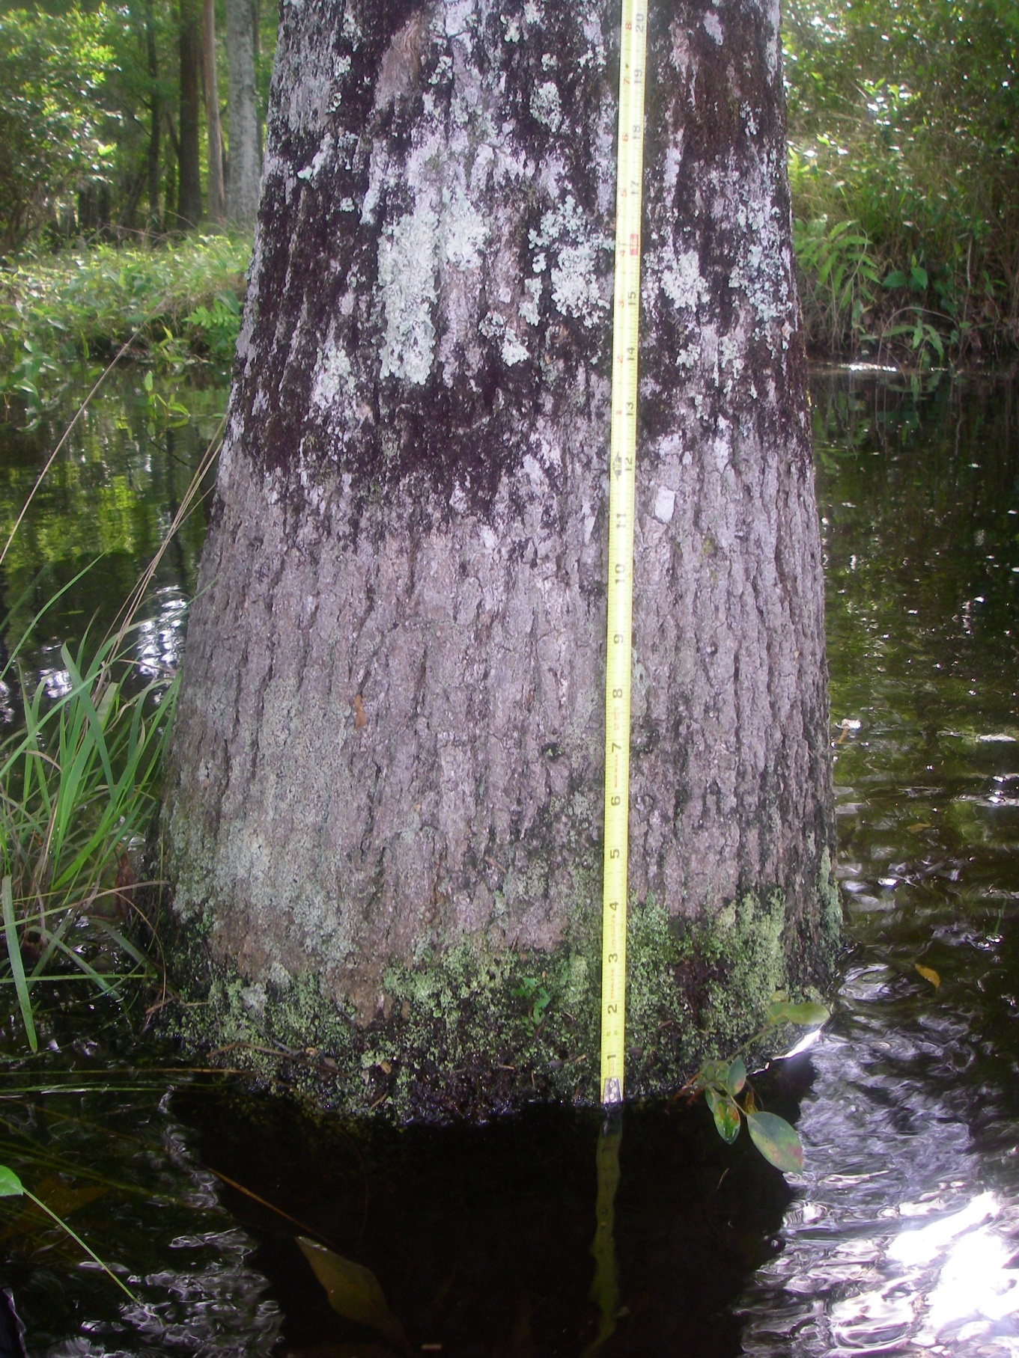
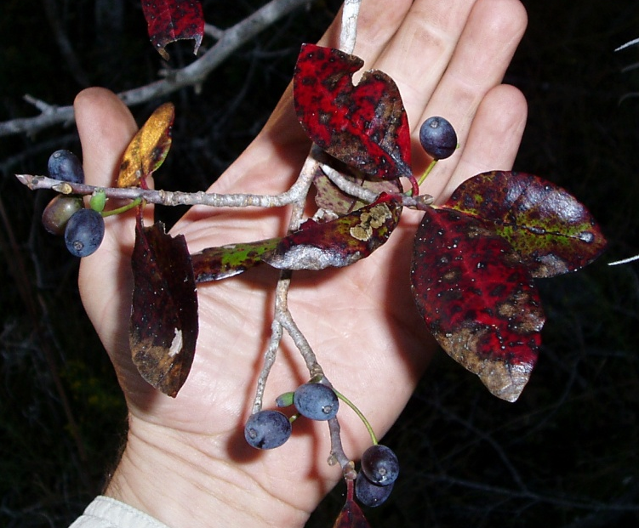
Nyssa sylvatica var. biflora swamp tupelo OBL
Alternate, elliptical leaves
Bark has long, vertical ridges with deep fissures
Often swollen or buttressed at base
Blue-black drupes borne in pairs
Branches typically at 90° angles to trunk
Buds sharp pointed

Slide 7
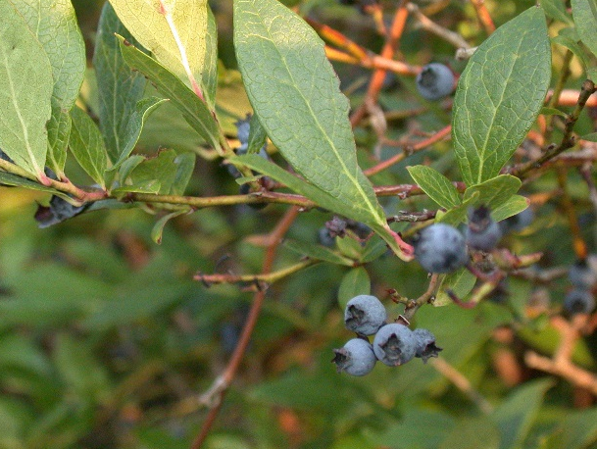
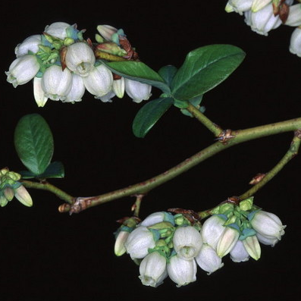
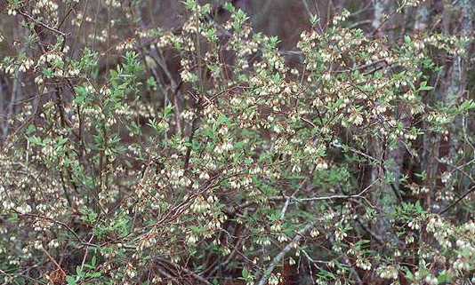
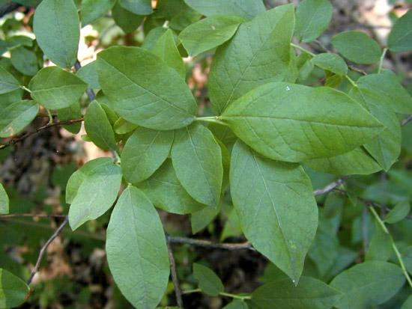
Vaccinium corymbosum highbush blueberry FACW
Shrub
Alternate, elliptical leaves
Many sizes of leaves on same plant
White urn-shaped flowers in clusters
Blue to black berries, typically open at apex
V. elliottii has uniform leaves, greener twigs

Slide 8
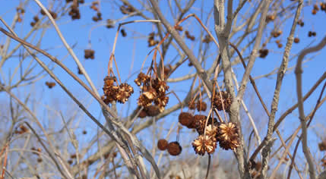
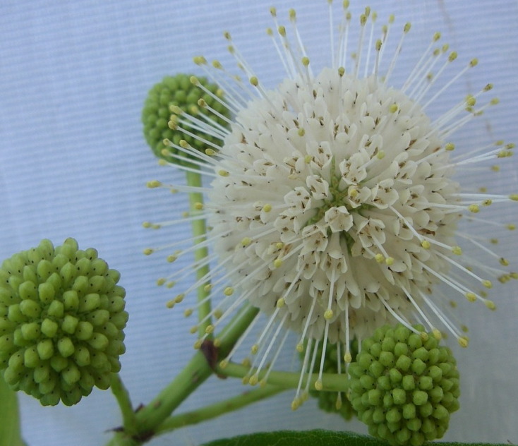
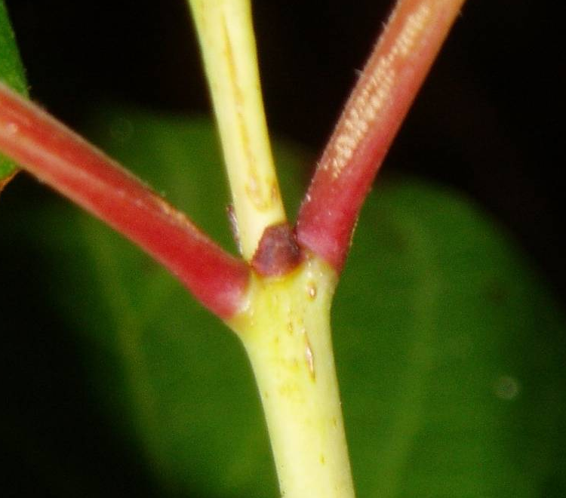
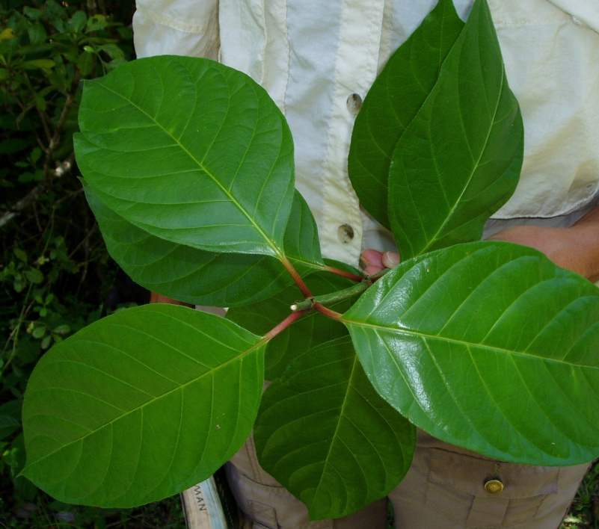
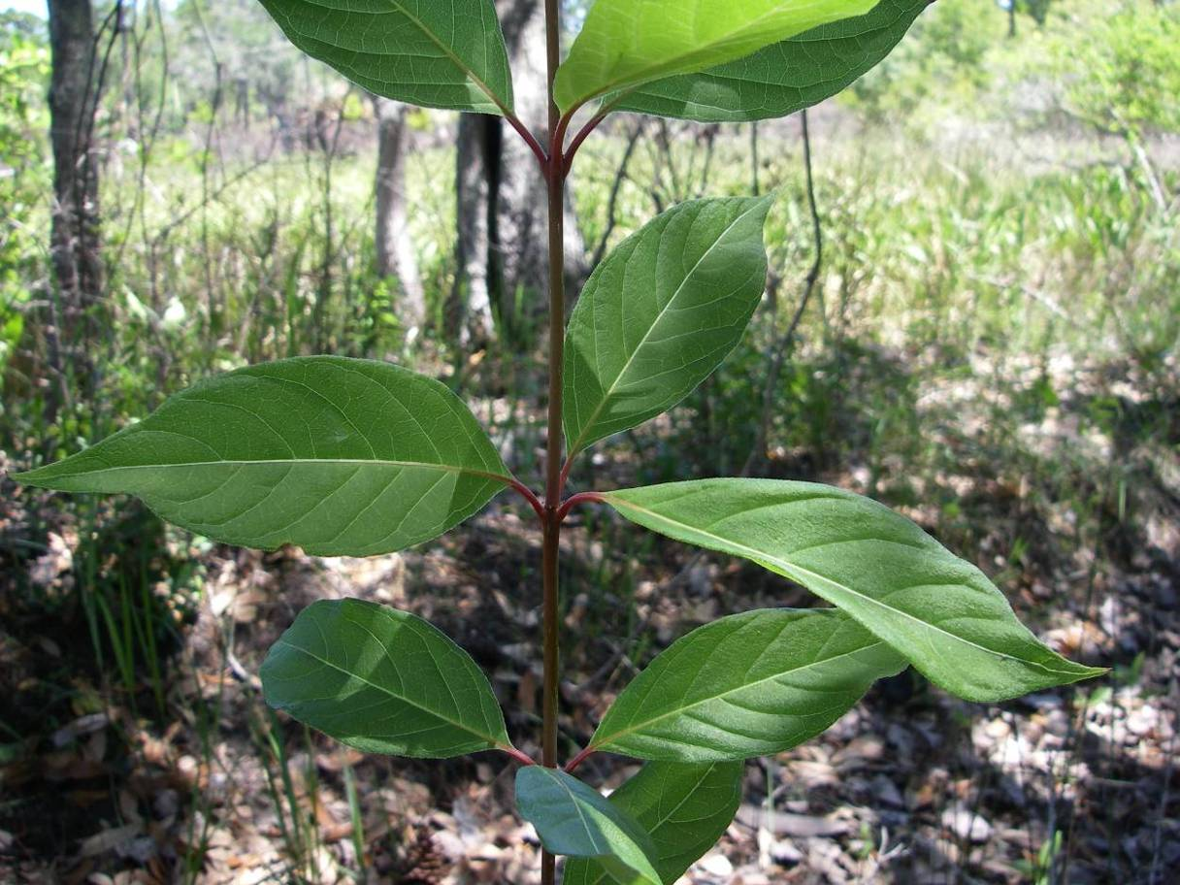
Cephalanthus occidentalis buttonbush OBL
Shrub to small tree, often multi-stemmed
Whorled (3) or opposite leaves, elliptic to ovate
Conspicuous veins
Arching branches with raised, corky lenticels
Bark thin, gets narrow, scaly ridges with age
Flowers and fruits (nutlets) form a ball
Brown, triangular stipule

Slide 9
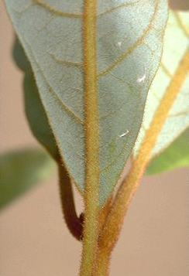
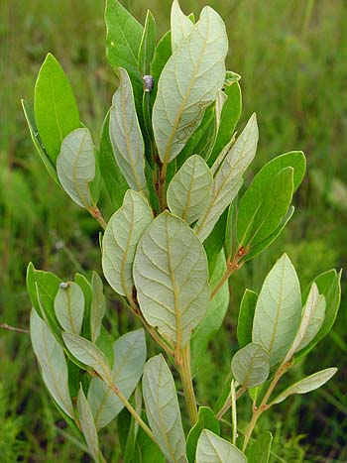
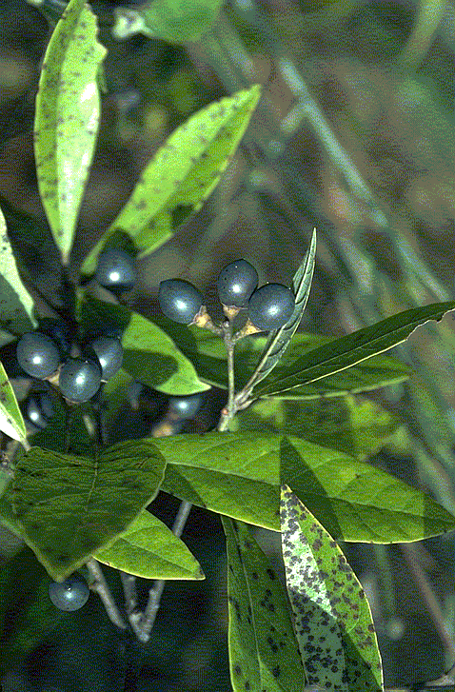
Persea palustris swamp bay OBL
Alternate, evergreen elliptical leaves
Rusty hairs underneath and on twigs
Principle veins rust-colored
Aromatic when crushed
Bark in flat, scaly ridges
Fruit a dark blue drupe
Dying from fungal disease spread by beetles

Slide 10
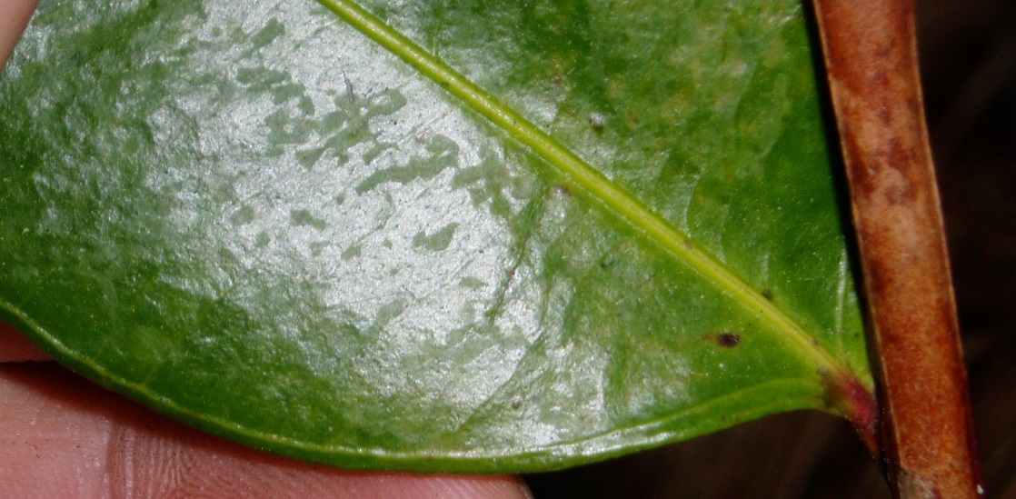
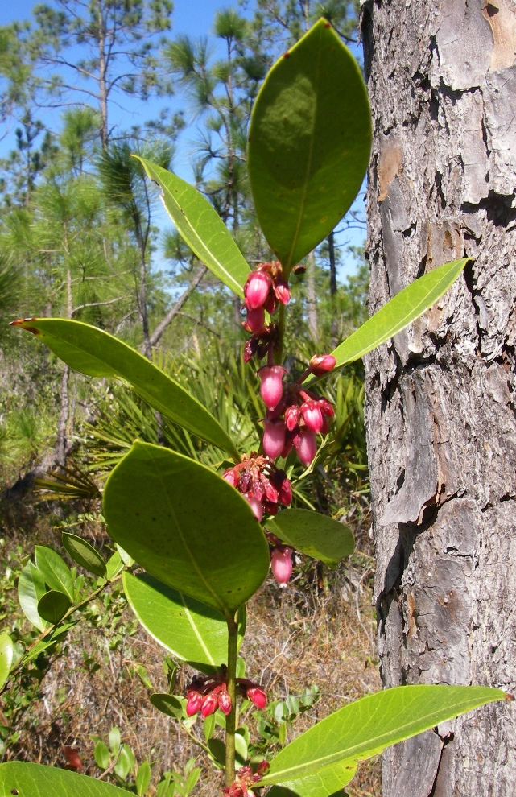
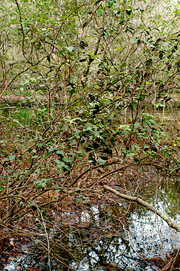
Lyonia lucida fetterbush FACW
Shrub
Alternate, broadly elliptical leaves
Evergreen, leathery
Margins thick with distinctive paralleling vein
Cylindrical pink flowers
Young twigs flattened
Often forms dense thickets

Slide 11
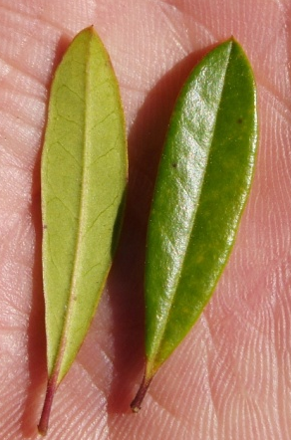
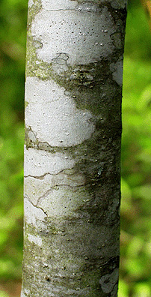
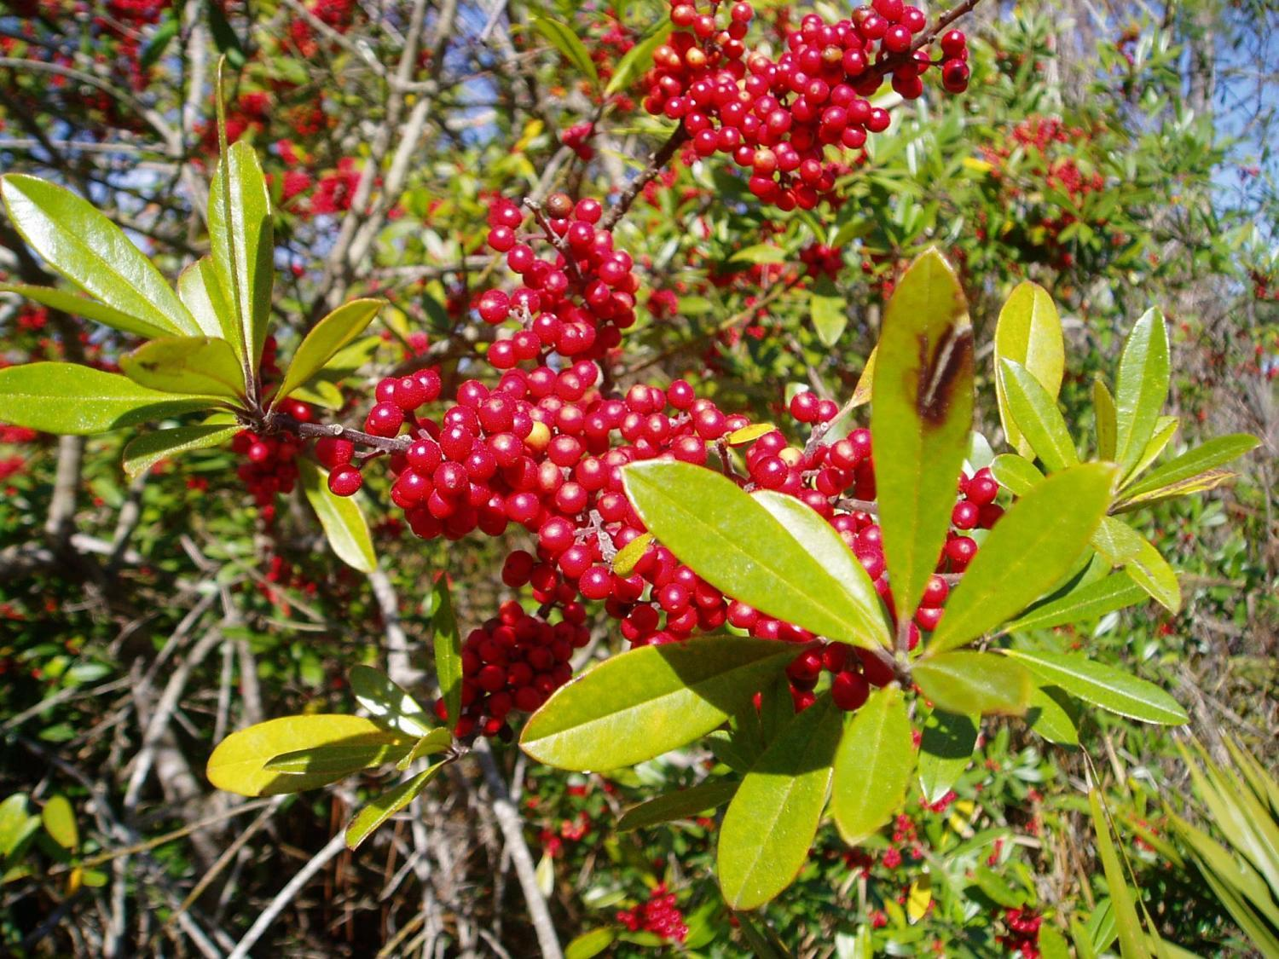
Ilex cassine dahoon holly OBL
Leaves alternate, varying in shape among individuals
Evergreen, leathery
Small spine on apex, often a few on margins
Bark smooth, thin, gray
Fruit is a bright red, round drupe

Slide 12
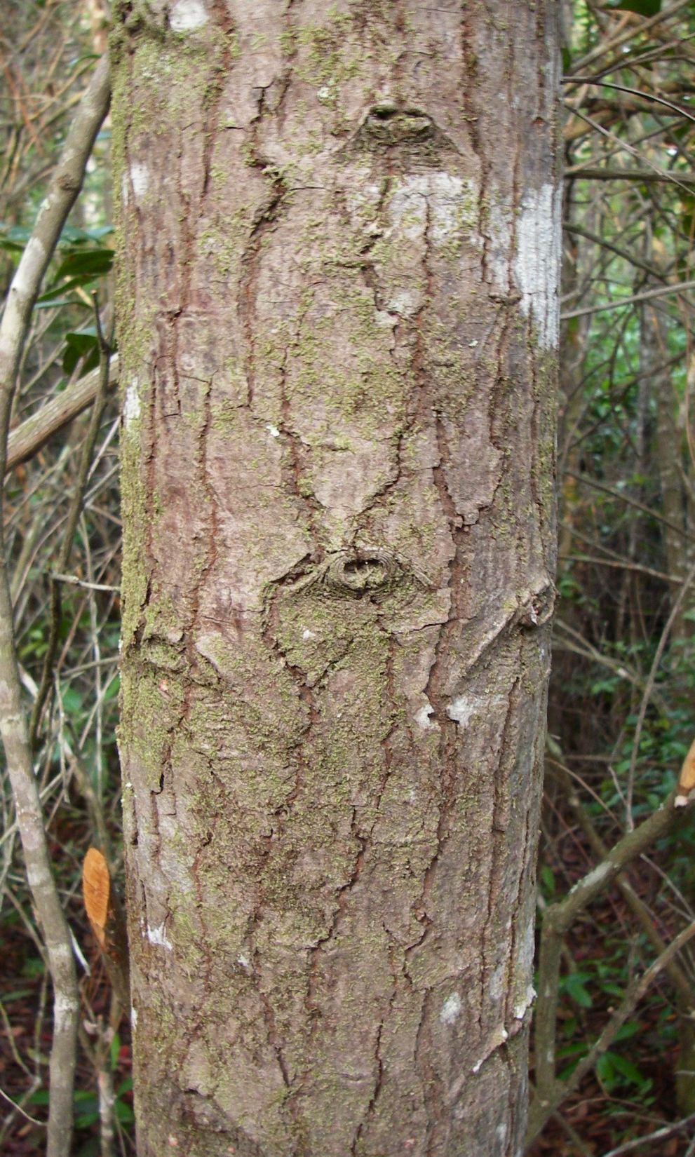
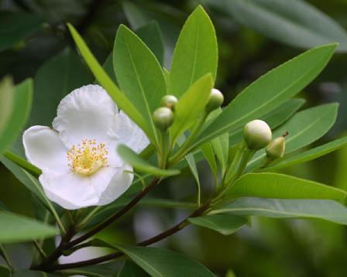
Gordonia lasianthus loblolly bay FACW
Alternate, long elliptical leaves
Evergreen, leathery
Margins shallowly serrate or crenate
Bark has interlacing flattened ridges with shallow fissures
Flower with 5 white petals, yellow stamens
Leaves not aromatic

Slide 13
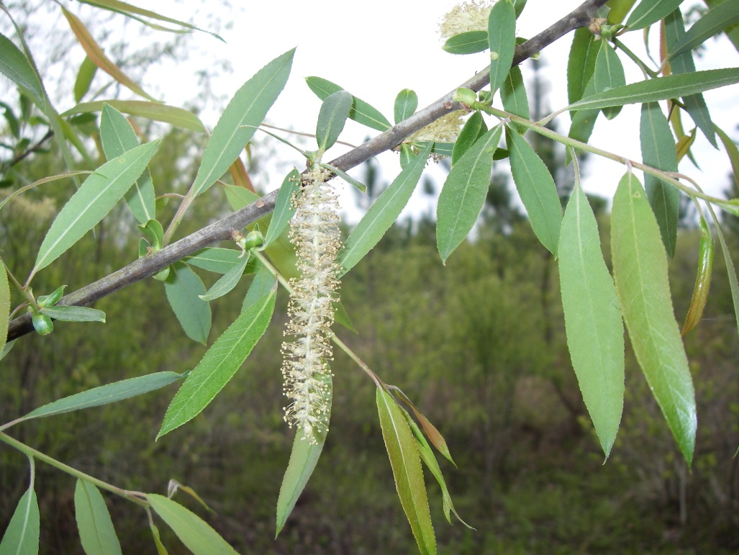
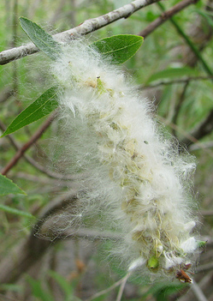
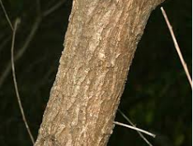
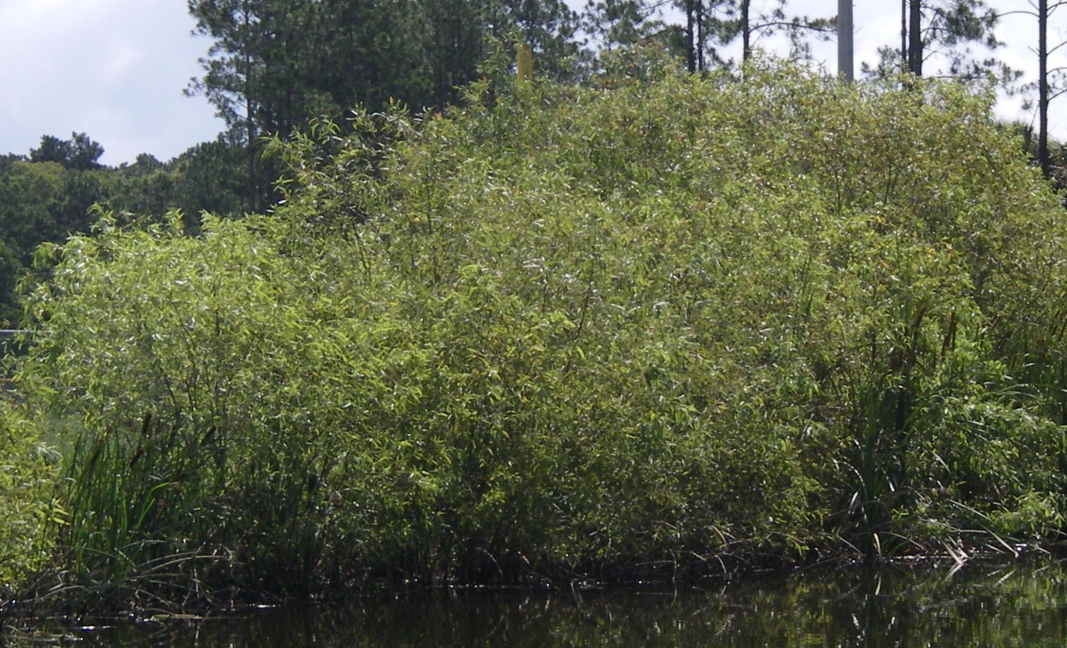
Salix caroliniana
Carolina willow OBL
Small tree
Alternate, long lanceolate leaves
Margins serrate with yellow tips
Yellowish twigs
Bark furrowed into broad, scaly ridges
Flowers on catkins producing many cottony tufted seeds

Slide 14
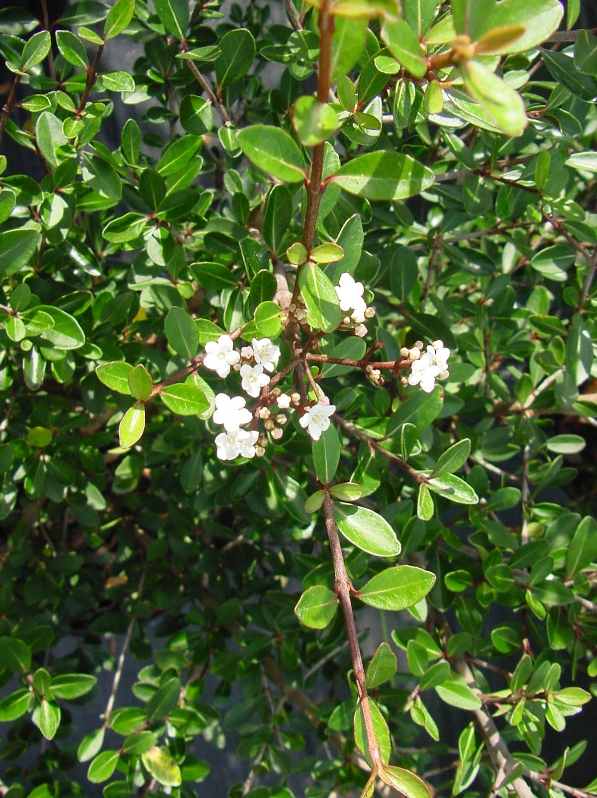
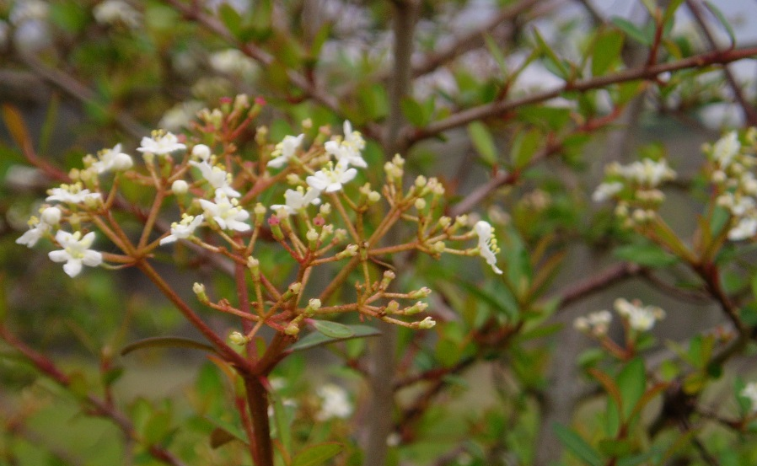
Viburnum obovatum
Walter’s viburnum FACW
Shrub to small tree
Opposite, evergreen, obovate leaves
Margins entire or with dentations near apex
Bark smooth, becoming plated, often fluted
Clusters of white flowers
Blue to black, flattened elliptical drupe
Leaves aromatic when crushed

Slide 15
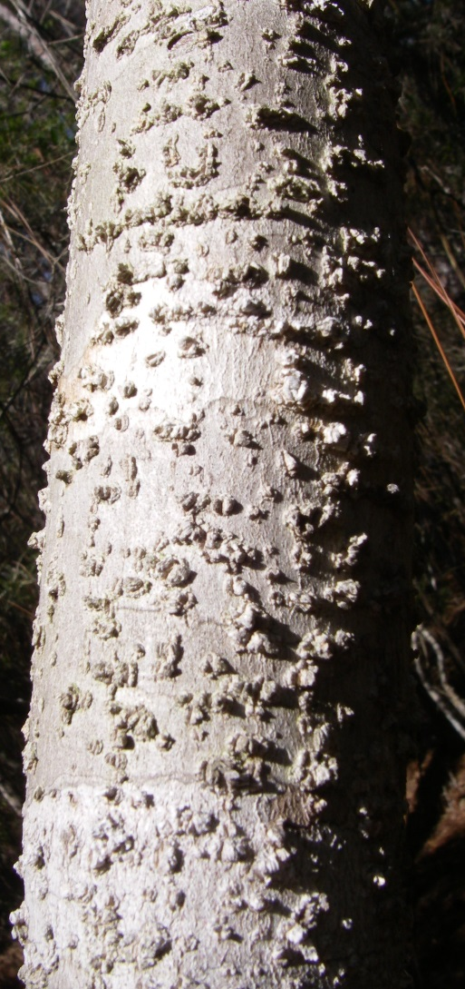



Celtis laevigata sugarberry FACW
Alternate leaves, variable in shape
Bases usually unequal
Long, pointed tip
Bark covered in corky outgrowths, looks warty
Zigzag twigs with raised lenticels
Fruit an orange to brownish red drupe
  Mildly sweet, but not fleshy

Slide 16





Fraxinus caroliniana
Carolina Ash OBL
Leaves opposite, pinnately compound, leaflets variable in shape
Margins entire or irregularly serrate
Multi-trunked, crooked
Bark gray, shallowly fissured, scaly
Samara wing starts at base of seed, widest at middle, but variable
Twigs flattened at nodes

Slide 17






Liquidambar styraciflua sweetgum FACW
Alternate, star-shaped leaves with 5 lobes
Margins serrate
Bark furrowed, forming narrow, scaly ridges
Bark and twigs on young trees with corky protruding wings
Fruit a spiny ball of capsules, woody
Leaves have resinous fragrance when crushed

Slide 18
Questions?
Camille.Beasley@dep.state.fl.us

