Slide 1


Delineation of Surface Waters in Sandhill Landforms
Lance D. Hart
SJRWMD
Technical Program Manager
Formal Wetland Determinations

Slide 2
373.421, Florida Statutes
Florida Department of Environmental Protection (DEP) directed to adopt statewide unified method by Section 373.421(1), Florida Statutes (F.S.)

Slide 3
373.421, Florida Statutes
Section 373.421(1), F.S., directed that a methodology also “…include provisions for the determining of the extent of surface waters other than wetlands.”

Slide 4
62-340, Florida Administrative Code (F.A.C.)
Delineation of the Landward Extent of Wetlands and Surface Waters
Effective July 1, 1994

Slide 5
Definition of Surface Waters is found in 62-340.600, F.A.C.
“For the purposes of section 373.421, F.S., surface waters are waters on the surface of the earth, contained in bounds created naturally or artificially, including the Atlantic Ocean, the Gulf of Mexico, bays, bayous, sounds, estuaries, lagoons, lakes, ponds, impoundments, rivers, streams, springs, creeks, branches, sloughs, tributaries, and other watercourses.”

Slide 6
Subsection 62-340.600 (2), F.A.C. provides the methods for determining the landward extent of surface waters
For surface waters located in sandhill landscapes — paragraphs 62-340.600(2)(a) and 62-340.600(2)(c), F.A.C. are the most relevant.

Slide 7
(2) The landward extent of surface water in the state for the purposes of implementing Section 373.421, F.S., shall be the more landward of the following:
Wetlands as located by section 62-340.300, F.A.C.;
The ordinary high water line for non-tidal water bodies…”

Slide 8
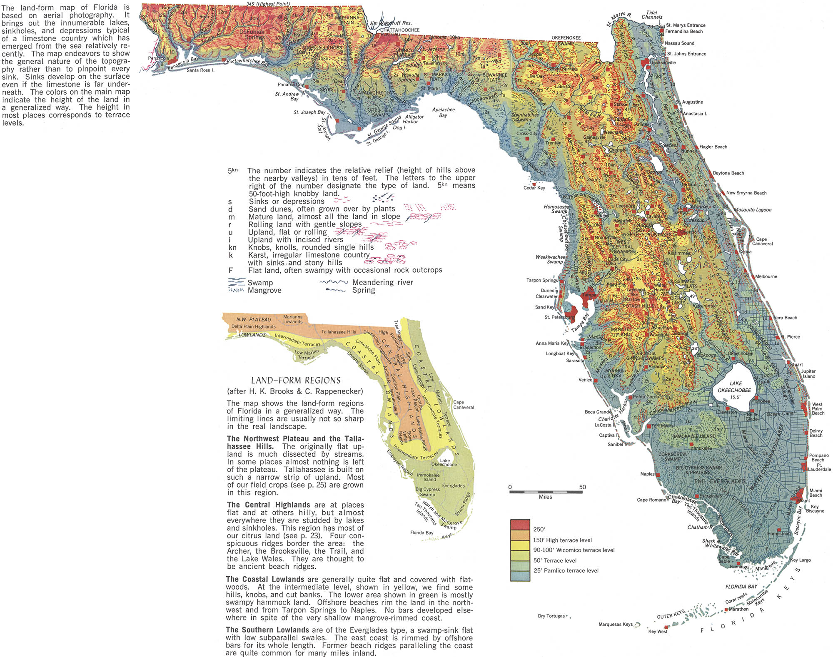
Source: http://www.codex99.com/cartography/images/raisz/fla_landform_lg.jpg

Slide 9
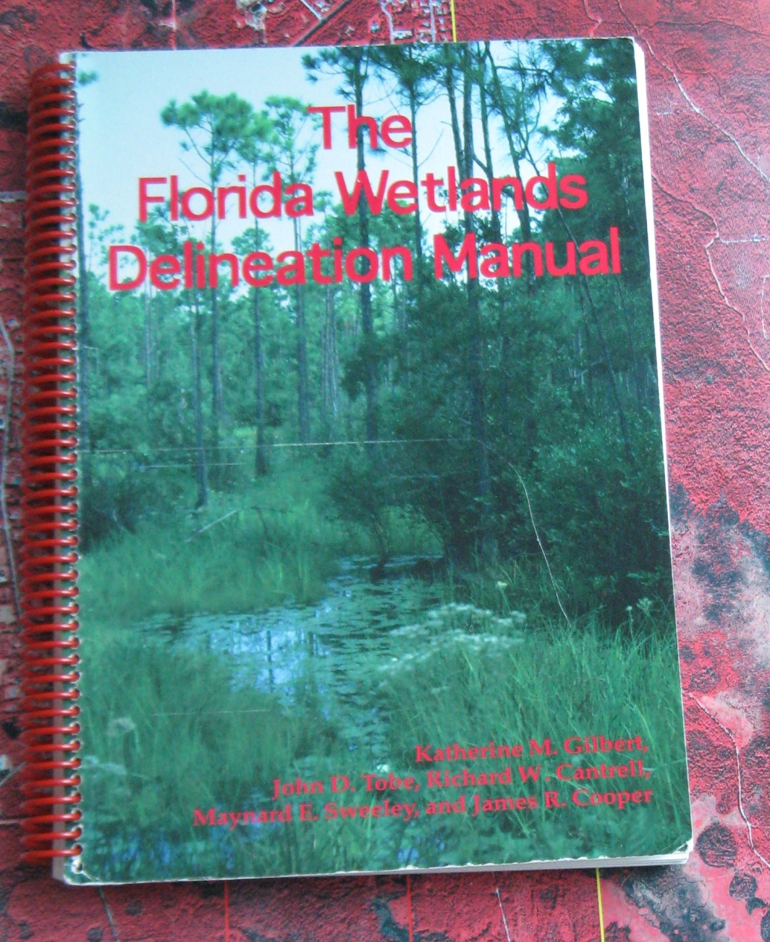
The Florida Wetlands Delineation Manual
Pages 36–38: Guidance is provided for the delineation of surface waters pursuant to 62-340, F.A.C.

Slide 10
Because of topographic, climatic, and geologic factors, there are areas adjacent to most Florida surface water bodies that regularly flood but which do not develop wetland characteristics.

Slide 11
The landward extent of surface waters, when it is other than a wetland, is determined through the location of the ordinary high water line (OHWL) for freshwater surface waters….” (p. 36)

Slide 12
The Florida Wetland Delineation Manual — Ordinary High Water Is
“…the point on the slope or bank where surface water… ceases to exert a dominant influence on the character of the surrounding vegetation and soils.”
(Page 37)

Slide 13
The Florida Wetland Delineation Manual - “…When the OHWL is not a wetland edge….”
Area may look like an upland
Is an area where flooding is common
Is a “harsh” environment for plant life because of the hydrologic “extremes”
May be characterized by a “denuded” band around the perimeter of the surface water body
(Page 37)

Slide 14
The Florida Wetland Delineation Manual — Determining Ordinary High Water Level when not the wetland edge
Sufficient hydrologic water level data available
Vegetative characteristic may be a “more prominent and reliable indicator”

Slide 15
“…Overall, the most productive approach is to locate the least disturbed area along the water body and determine the edge of the mature, upland vegetative community.”
(Page 37)

Slide 16
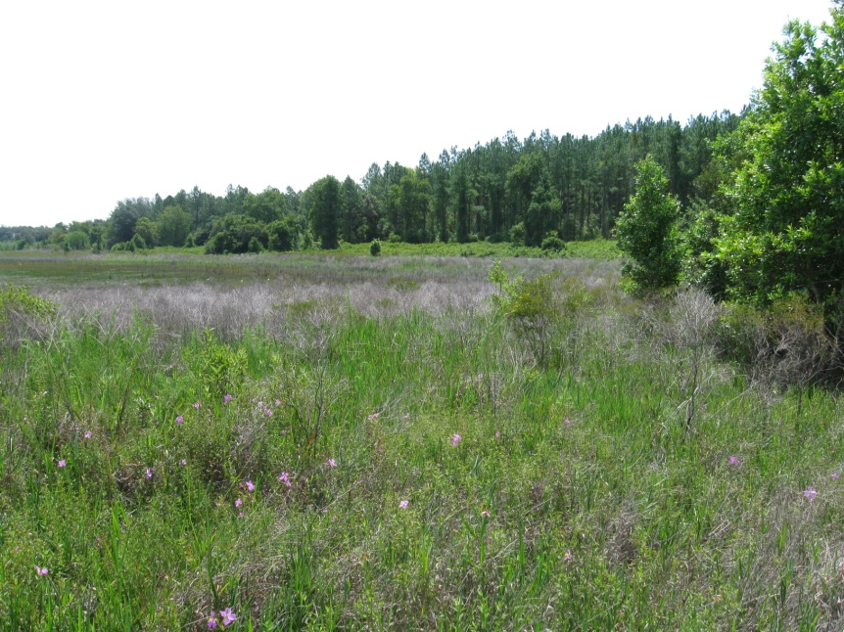
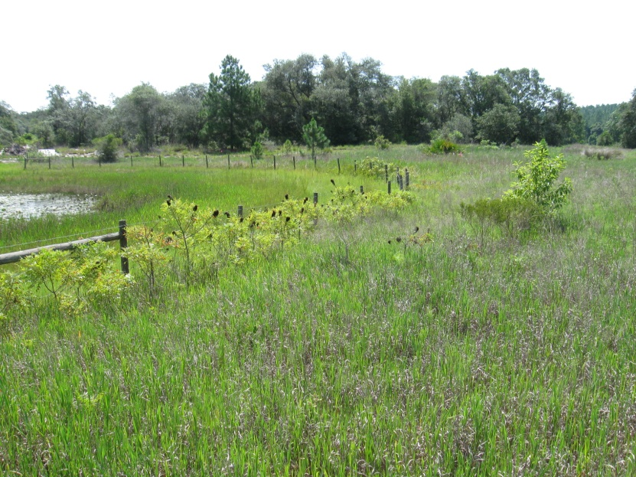
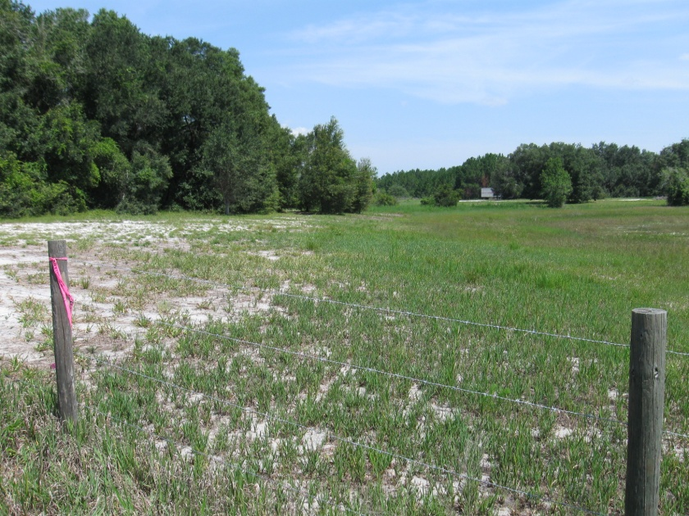
So, What Does That Mean?

Slide 17
Resources and Tools
NRCS (SCS) County Soils Maps
Aerial photographs
Topographic information
LIDAR elevation data
Rainfall data
Hydrologic data (…if reliable and sufficient)
Gazetteer of Florida Lakes
National Wetlands Inventory
All interpretations should be ground truthed and onsite conditions evaluated.

Slide 18
And, always use “…reasonable scientific judgment….”

Slide 19
Examples for Delineation of Surface Waters in a Sandhill Land Form
Tishler Pond, Marion County
Drew Meadow Property, Lake County

Slide 20
Tishler Pond
Located in the Ocala National Forest, Marion County
55 acres in size
Named surface water in the Gazetteer of Florida Lakes

Slide 21
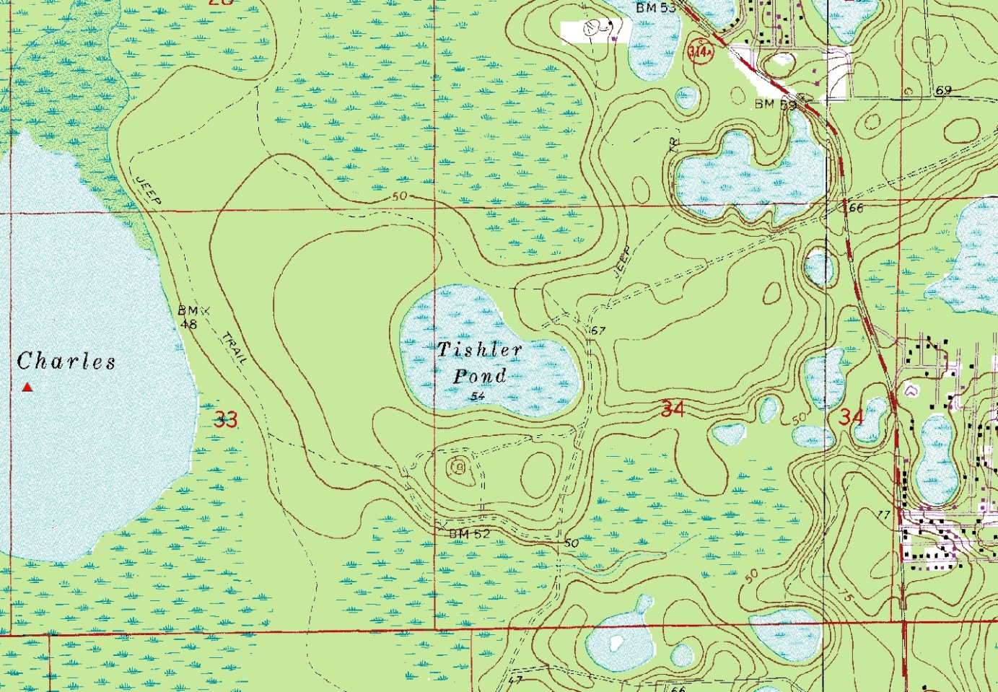
Tishler Pond
United States Geological Survey Topographic Map identifying Tishler Pond, Ocala National Forest

Slide 22
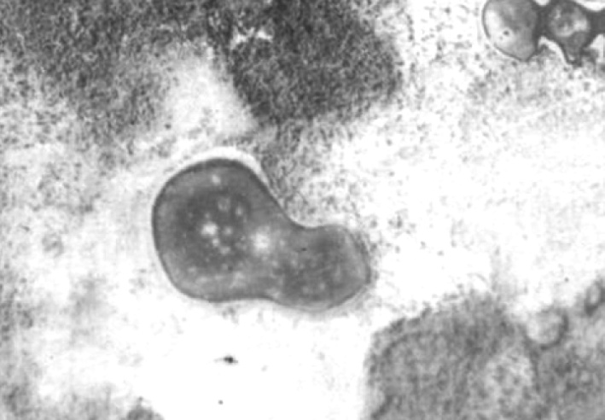
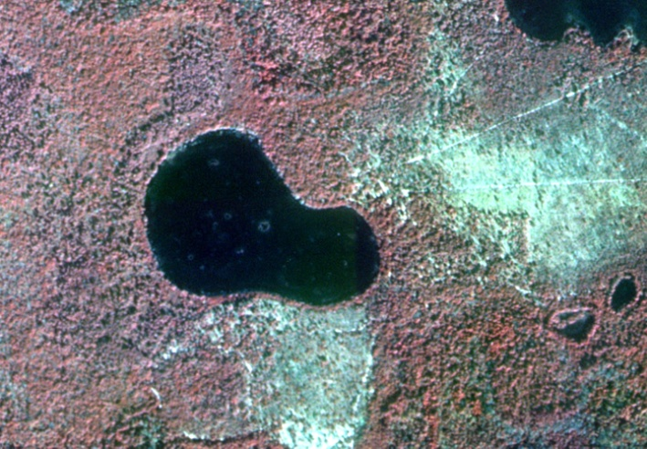
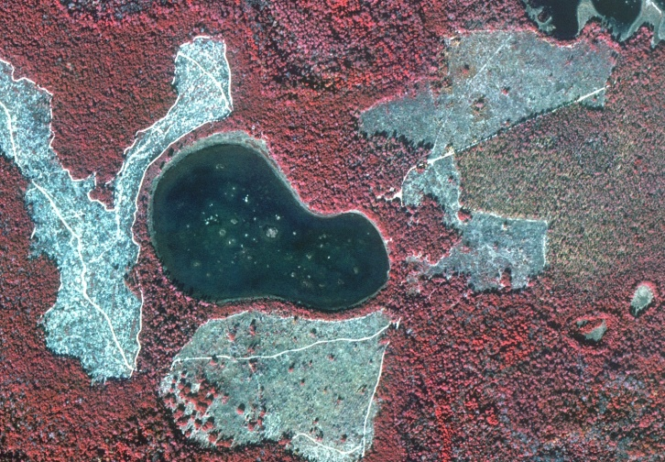
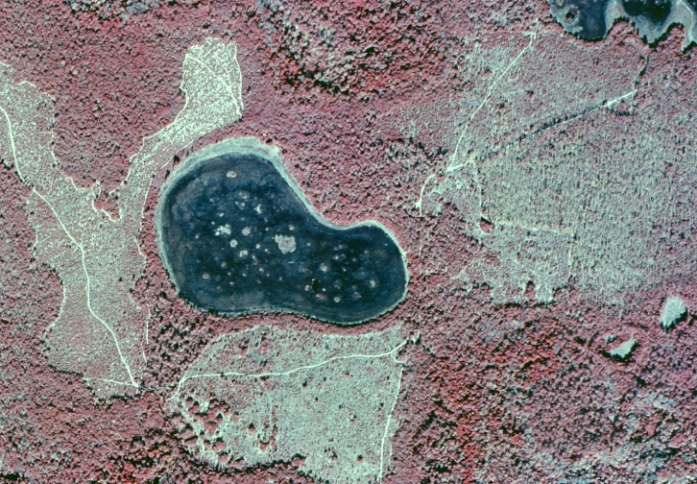
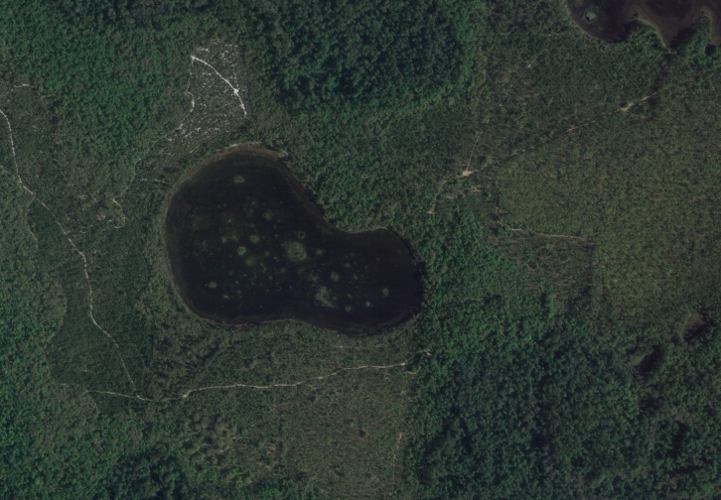
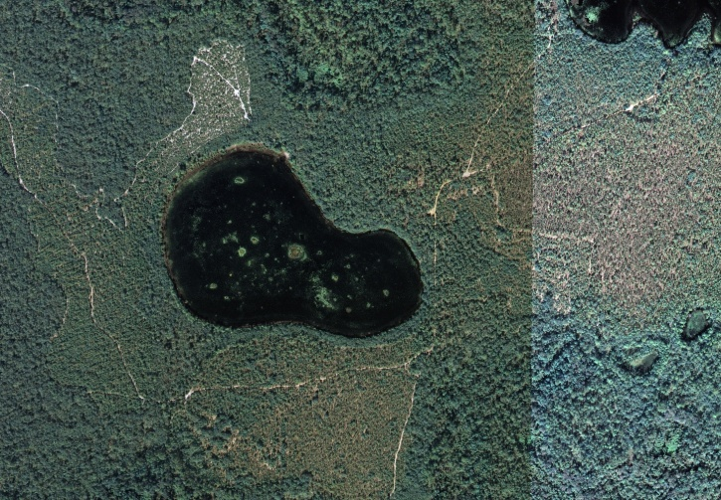
Tishler Pond
Aerial photographs from 1943 to 2005
1943
1984 IR
1994-1995
1999-2000
2004
2005

Slide 23
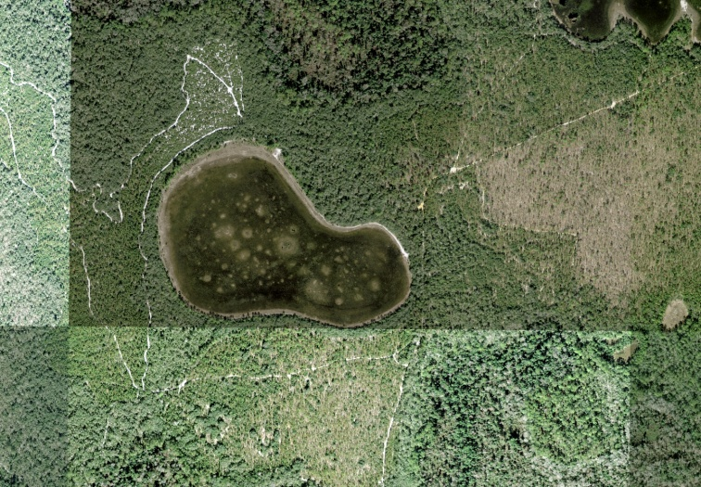
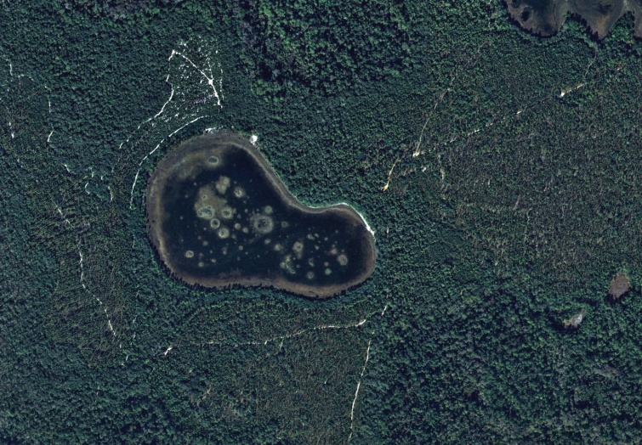
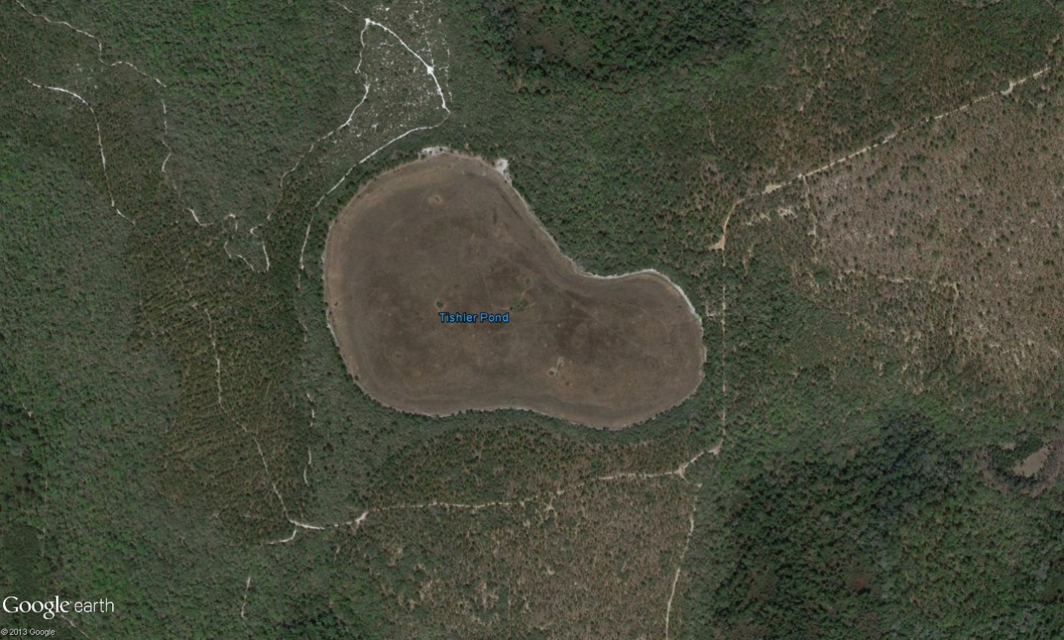
Tishler Pond
Aerial photographs from 2008 to 2013
2008
2011
2013
Google Earth

Slide 24
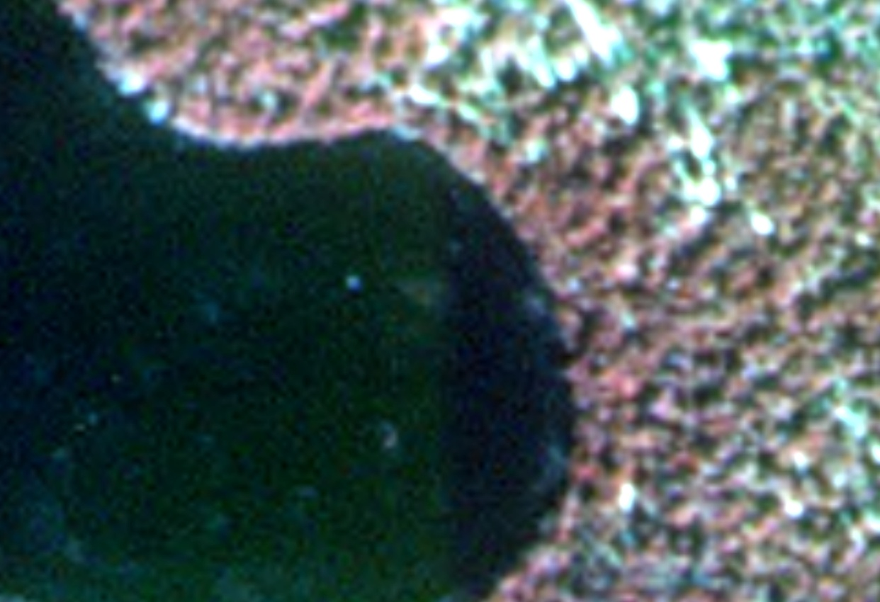
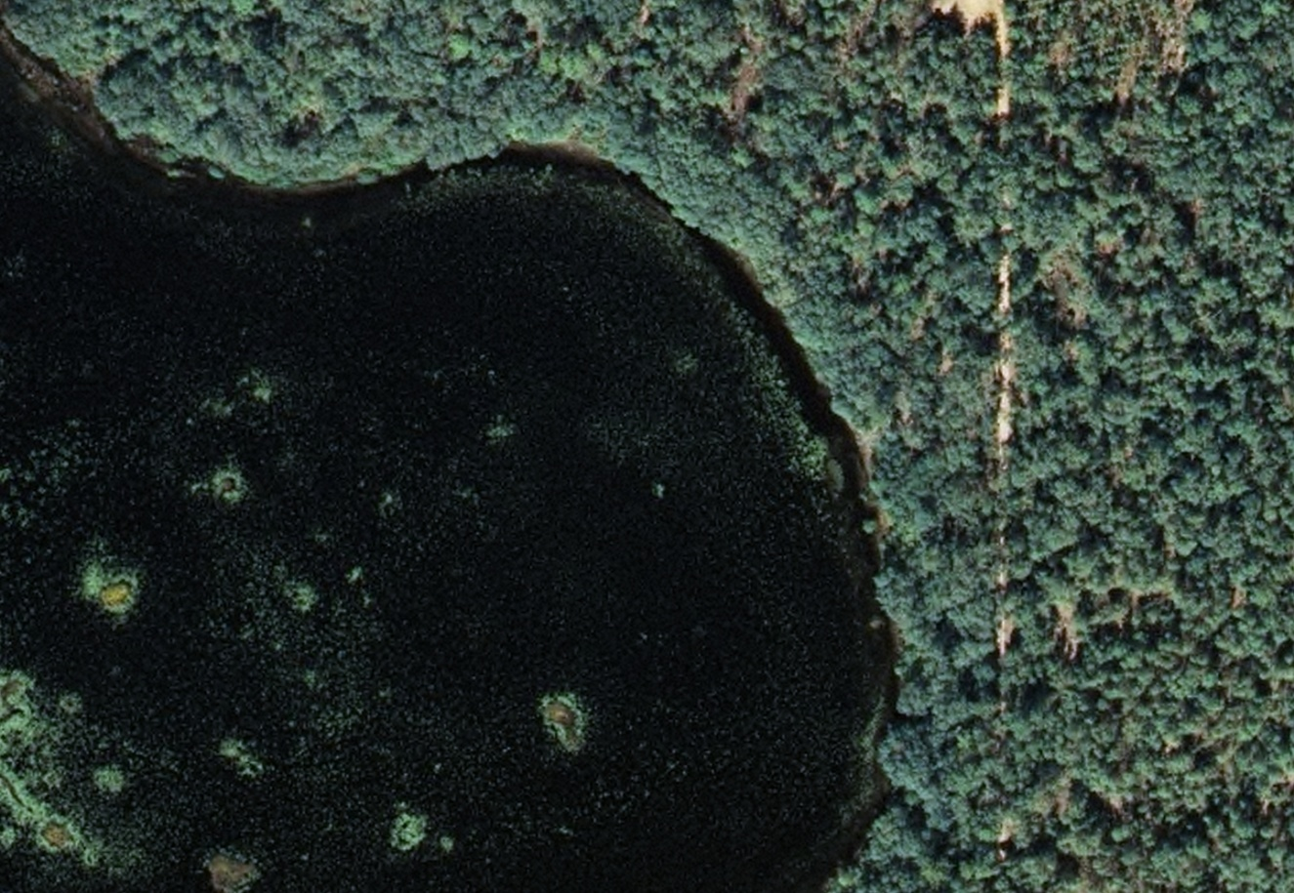
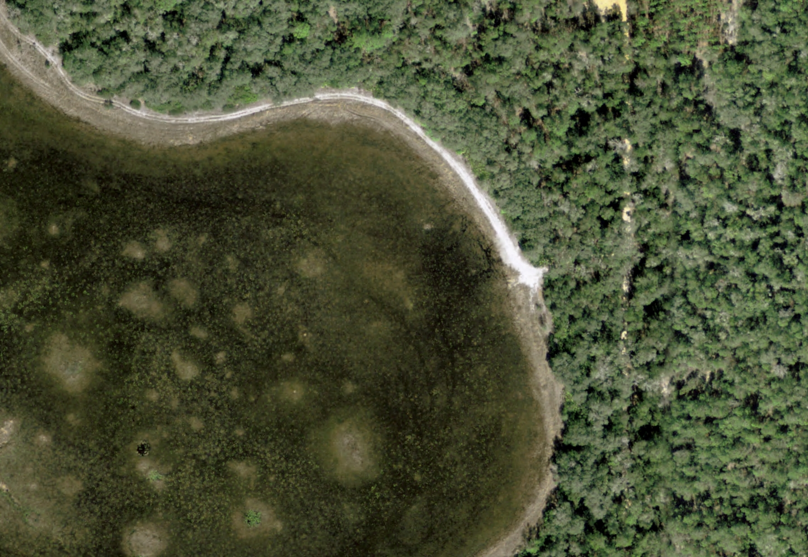
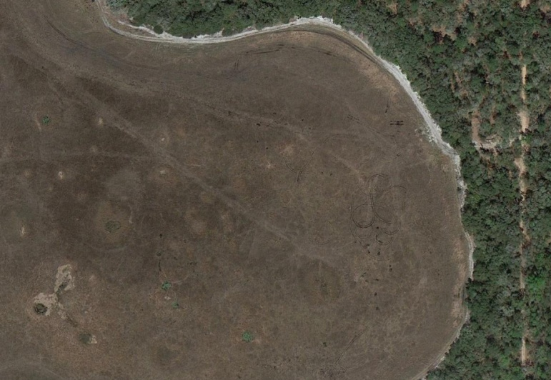
Tishler Pond
Identify area with “least disturbed” mature upland community….
1984
2005
2013
2008

Slide 25
Drew Meadow Property
Located in the Lake County, west of County Road 33 and north of the Florida Turnpike
Property subject of a petition for a Formal Wetland Determination
Property contains numerous surface water bodies
None of the surface water features are identified in the Gazetteer of Florida Lakes

Slide 26
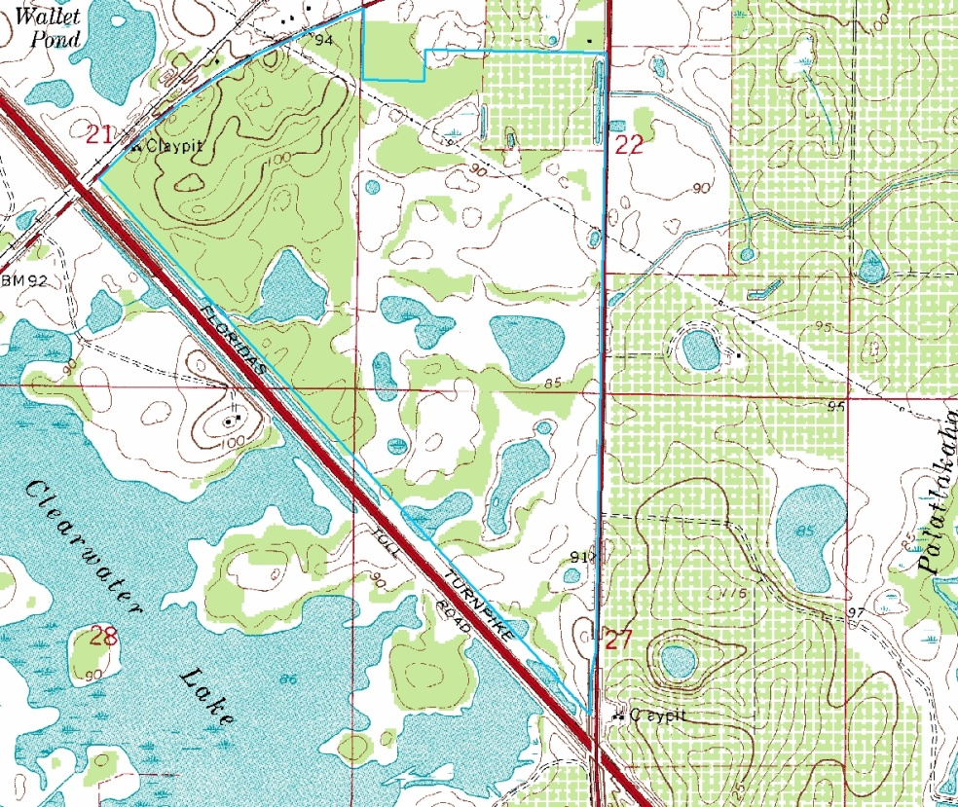
Drew Meadow Property
United States Geological Survey Topographic Map identifying Drew Meadows Property, Lake County
DREW MEADOWS PROPERTY

Slide 27
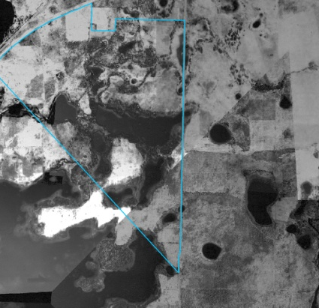
Drew Meadow Property
Aerial photographs from 1941 to 1974
1941
1953
1958
1966
1974
1970

Slide 28
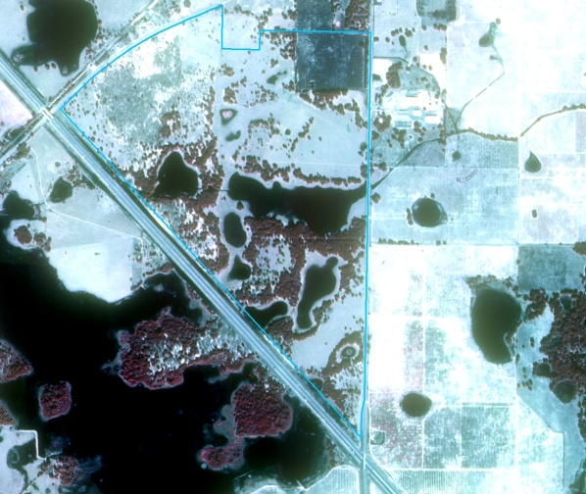
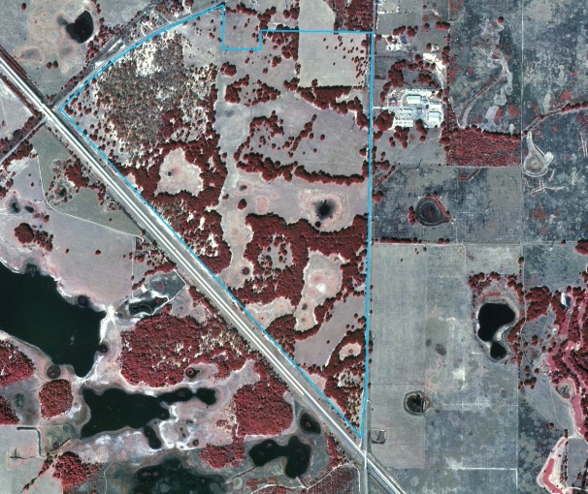
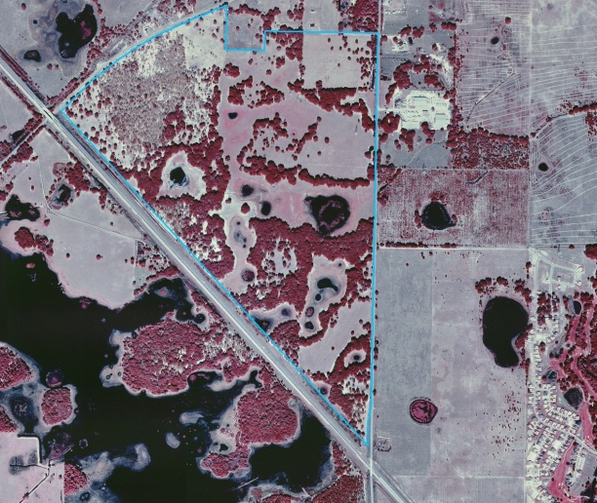
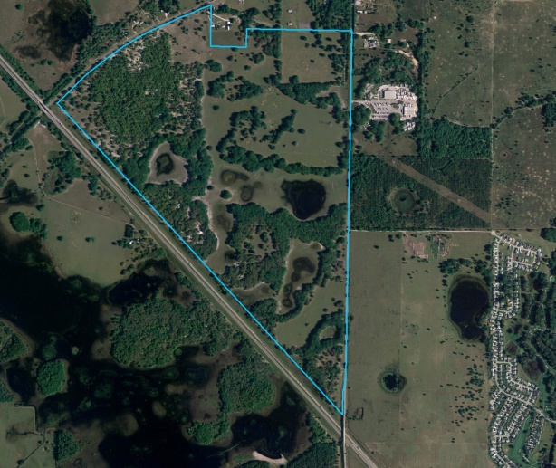
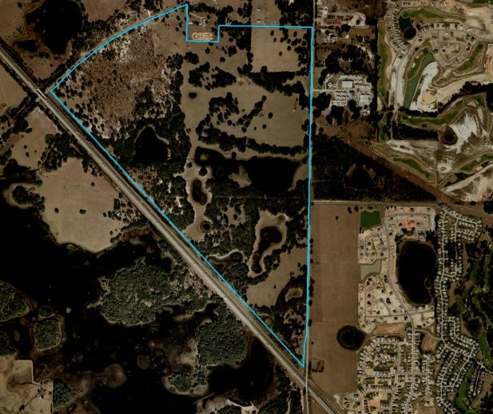
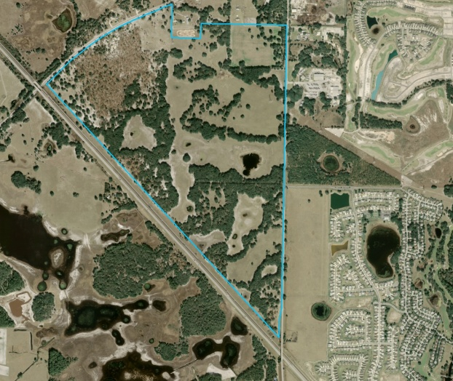
Drew Meadow Property
Aerial photographs from 1984 to 2008
1984
1994-1995
1999-2000
2004
2006
2008

Slide 29
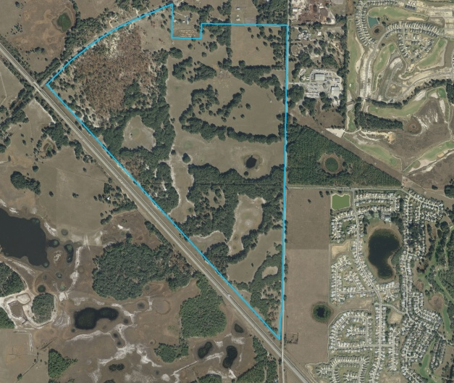
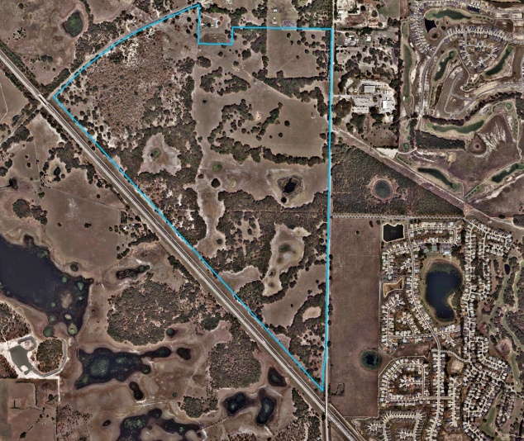
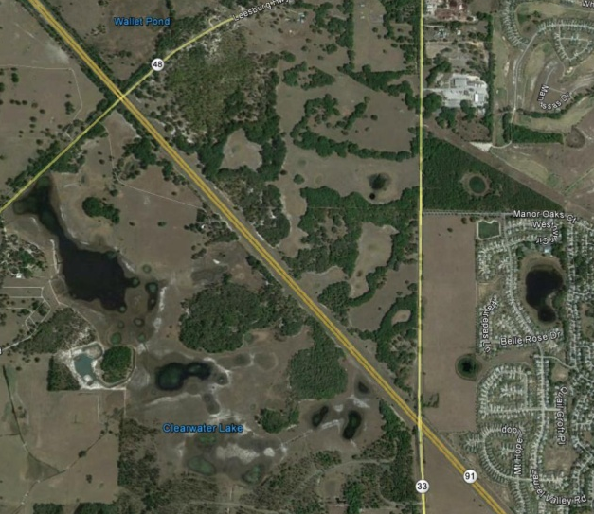
Drew Meadow Property
Aerial photographs from 2009 to 2013
Highest water levels occurred in 1941, 1953, 1970, 1984 and 2006
Lowest water levels appeared to have occurred in 2009 and 2011
2009
2011
2013

Slide 30
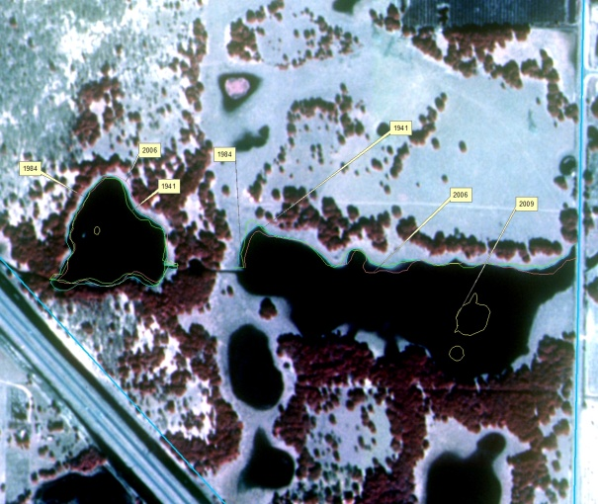
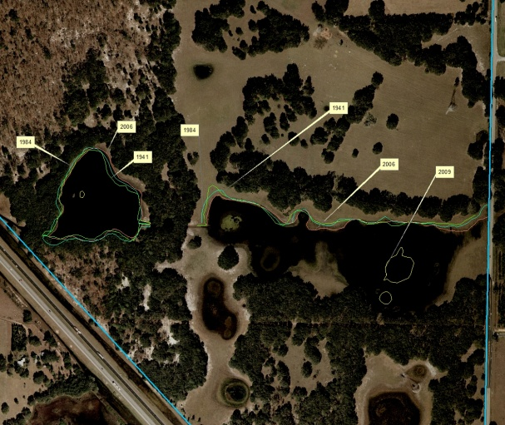
Drew Meadow Property
It appears that the water levels in 1941, 1984 and in 2006 were fairly comparable
1984
2006

Slide 31
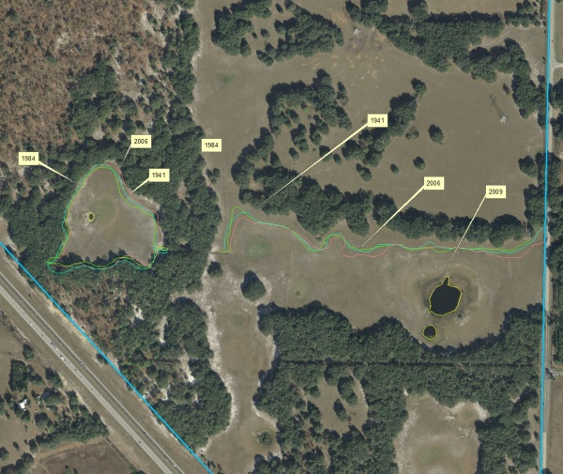
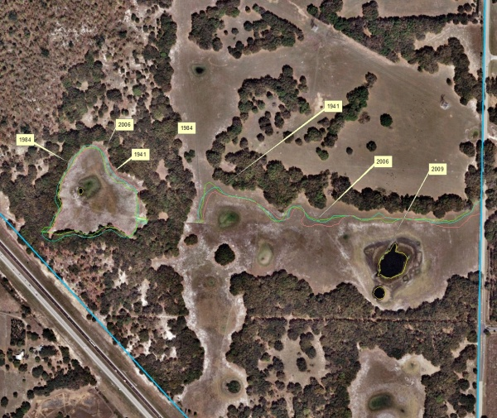
Drew Meadow Property
1984 and 2006 water levels projected on 2009 and 2011 aerial
2009
2011

Slide 32
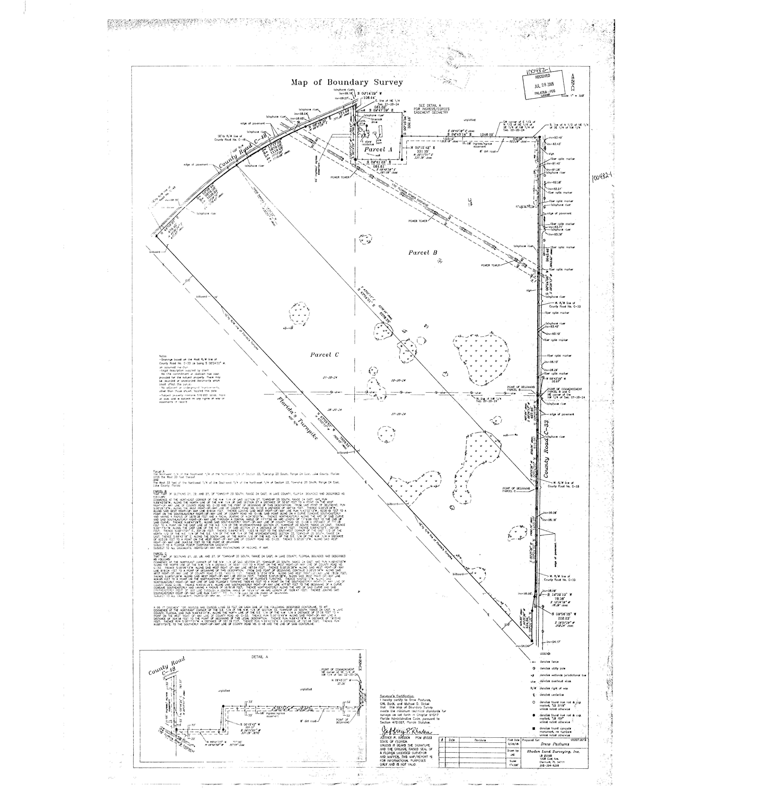
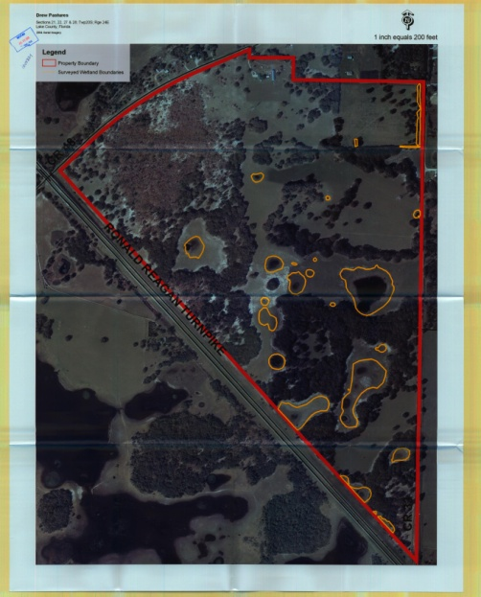
Drew Pasture Property
Limits of wetlands and other surface waters as identified by the petitioner prior to SJRWMD’s site inspection.
Site was flagged in winter of 2004‒2005

Slide 33
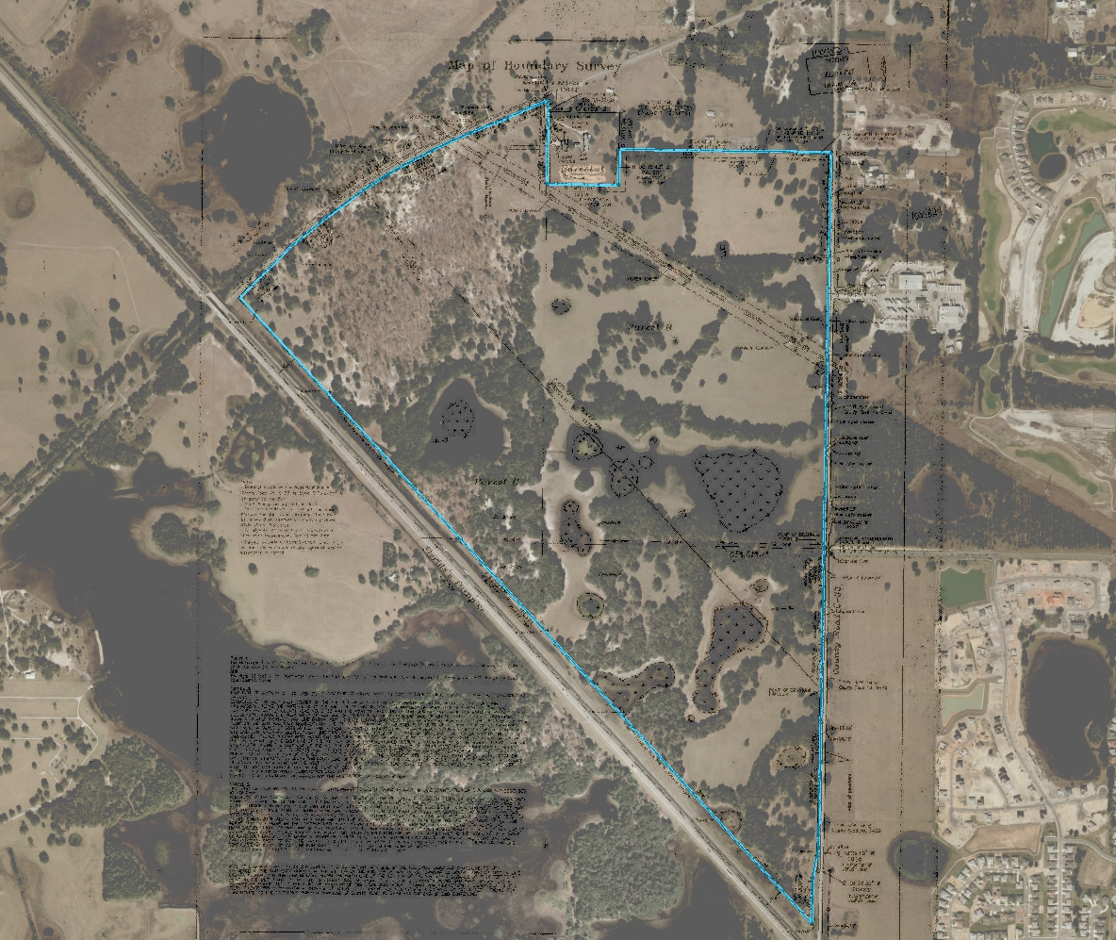
Drew Pasture Property
The initial site visit was conducted by SJRWMD staff in January 2006. Site conditions most resembled those depicted on the 2006 DOQQ.

Slide 34
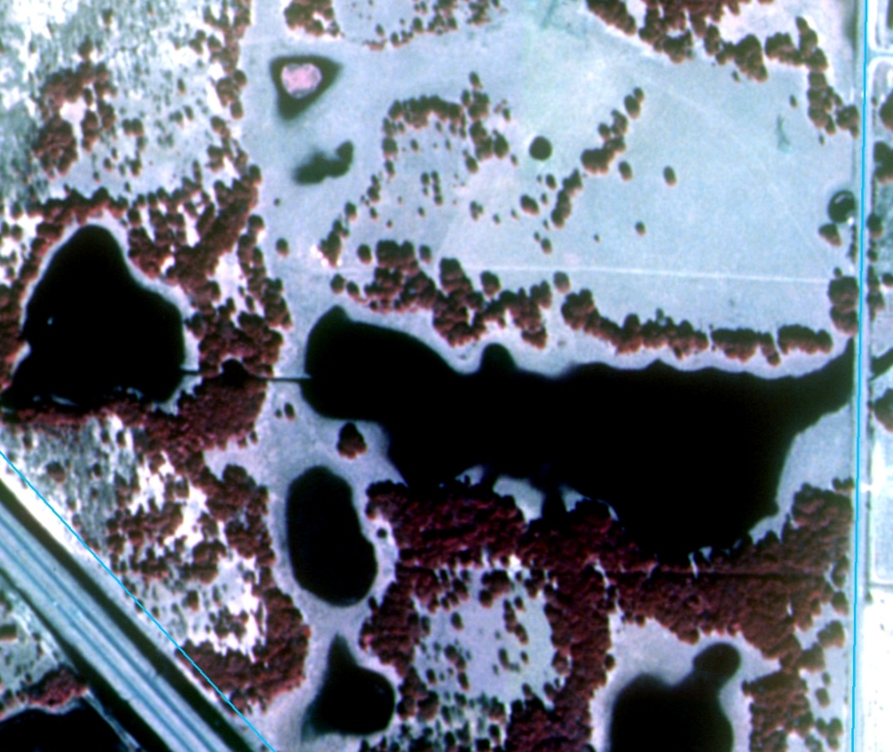
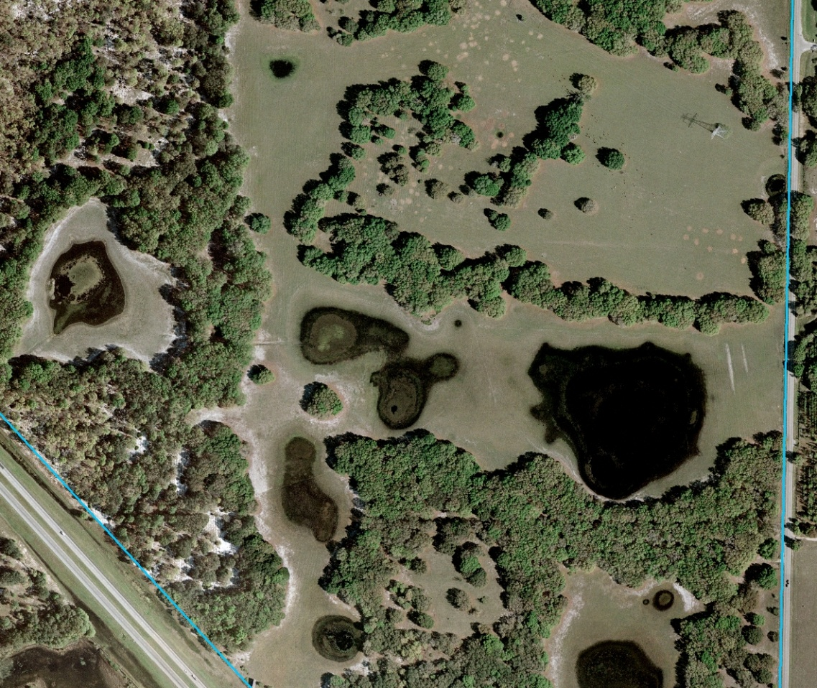
Drew Meadow Property
Because of ongoing land use practices, limited areas of mature upland vegetation
Persistent feature along the shoreline representing an “escarpment” zone
1984
2004

Slide 35
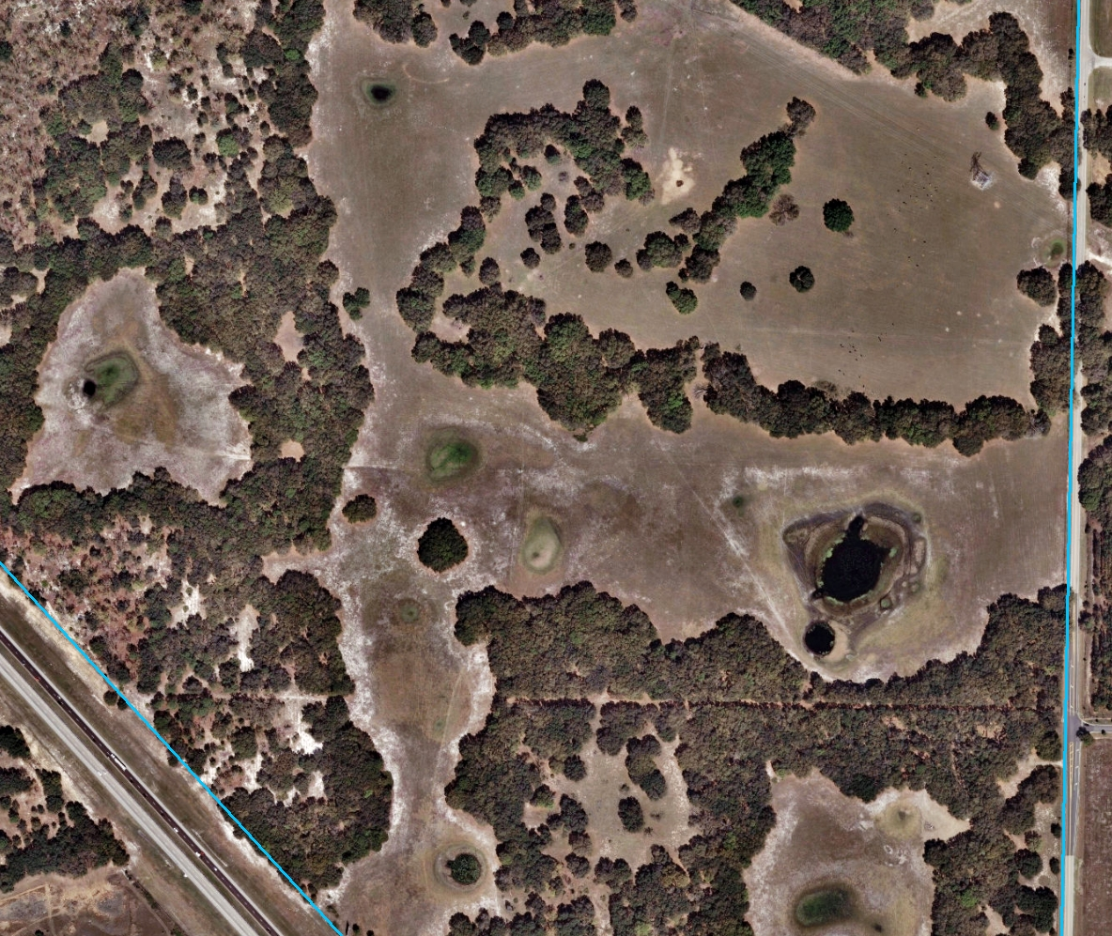
Drew Meadow Property
Escarpment features still apparent in 2011

Slide 36
Drew Meadow Property
Rainfall analysis

Slide 37
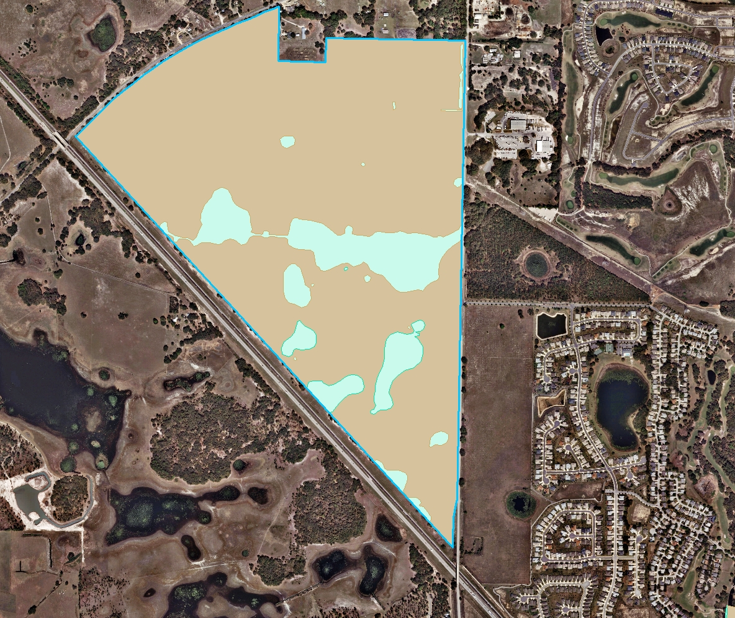
Drew Meadow Property
Limits of surface waters and wetlands as determined by SJRWMD and approved

