Slide 1
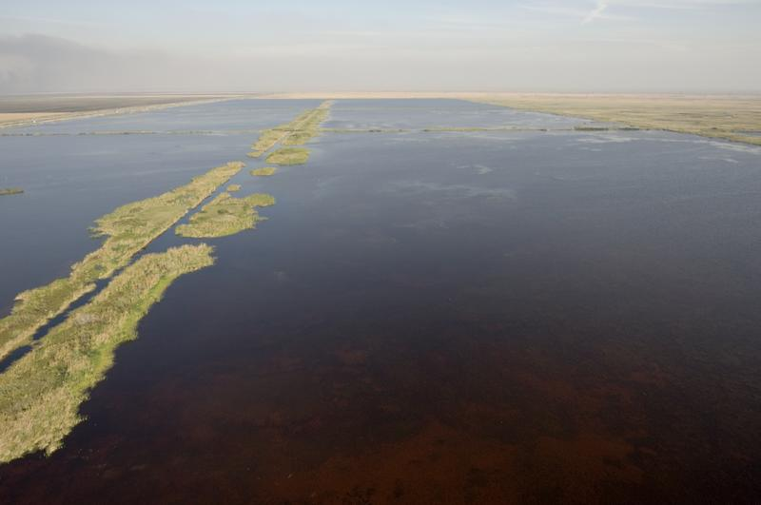


Large-Scale Water Quality Improvement Projects:
An Everglades Perspective
SLER Con
June 11, 2014
Paul Julian II, Environmental Specialist III
Office of Ecosystem Projects
Photo Credit: SFWMD

Slide 2
Office of Ecosystem Projects Permitting Authority
Mandates:
  Lake Okeechobee Protection Act (LOPA)/Northern Everglades and Estuaries Protection Act (NEEPA; Section 373.4595 F.S.).
  Everglades Forever Act (EFA; Section 373.4592 F.S.).
  Comprehensive Everglades Restoration Plan Regulation Act (CERPRA; Section 373.1502 F.S.).
  Environmental Resource Permitting (ERP; 62-344 F.A.C.)

Slide 3
Types of Projects Authorized by Office of Ecosystem Projects
Water Quality
  Stormwater Treatment Areas (i.e. STA-1W, Taylor Creek STA, etc.)
  Hybrid Wetland Treatment Technology (i.e. Lemkin Creek HWTT, Grassy Island HWTT, etc.)
  Other Treatment Systems (i.e. Aqua Knight, etc.)
Water Quantity/Other Projects
  A-1 Flow Equalization Basin
  L-8 Flow Equalization Basin/Reservoir
  C-43 and C-44 Reservoir
  Ten-Mile Creek
  Site-1
  Picayune Strand Restoration Project
Photo Credit: SFWMD

Slide 4
Treatment Wetlands 101
Periphyton
Kadlec, R.H and S.D. Wallace. 2009. Treatment Wetlands. 2nd Edition. CRC Press, Boca Rato, FL.

Slide 5
Treatment Wetlands 101
Kadlec, R.H and S.D. Wallace. 2009. Treatment Wetlands. 2nd Edition. CRC Press, Boca Raton, FL.
Notes:
EAV
Scirpus lacustris (bulrush)
Phragmites australis (common reed)
Typha latifolia (cattail)
FAV
Nymphaea alba (water lily)
Potamogeton gramineus ( variable leaf pond weed)
Hydrocotyle vulgaris (marsh penny wort)
Eichhornia crassipes (water hyacinth)
Lemma minor (duckweed)
SAV
Potamogeton crispus (curly-leaf pond weed)
Littorella uniflora ( American Shoreweed)
Not shown Hydrilla spp., Chara spp., etc.

Slide 6
STA 3/4 Cell 3B – Dominate SAV
STA 1E Cell 6 – Dominate SAV
STA 3/4 Cell 2A – EAV
Taylor Creek STA – EAV
Photo Credit: SFWMD

Slide 7
Treatment Wetlands 101
Surface water total phosphorus concentration ranges for each community type within Everglades STAs†.
Community | Total Phosphorus (µg/L)
 | Min | Max
Emergent Aquatic Vegetation (EAV) | 39 | 283
Submerged Aquatic Vegetation (SAV) | 36 | 153
Periphyton Stormwater Treatment Area (PSTA) | 7 | 56
† Stormwater Treatment Areas 1E, 1W, 2, 3/4, and 5/6.
Goforth, G. 2007. Updated STA Phosphorus Modeling for the 2010 Planning Period. Report to South Florida Water Management District and US Army Corps of Engineers.

Slide 8
Project Example–Everglades STAs
Water Year (WY)
May 1, 1993 – April 30, 2013
Chimney et al. 2014. Chapter 3B: Performance of the Everglades Stormwater Treatment Area. In: 2014 South Florida Environmental Report – Volume I. South Florida Water Management District, West Palm Beach, FL USA.
Notes:
19 years worth of data.

Slide 9
Everglades STA WQBEL
Water Quality Based Effluent Limit (WQBEL)
  Applied to all permitted discharges from the Everglades STAs to the Everglades Protection Area (EPA) to assure discharges do not cause or contribute to exceedance of the total phosphorus (TP) criterion.
  TP Criterion is expressed as a long-term geometric mean of 10 µg/L (62-302.540 FAC).
Julian et al., 2014. Chapter 3A: Status of Water Quality in the Everglades Protection Area. In: 2014 South Florida Environmental Report – Volume I. South Florida Water Management District, West Palm Beach, FL, USA.
South Florida Water Management District. 2012. Technical Support Document for Derivation of the Water Quality Based Effluent Limit for Total Phosphorus in Discharges from Everglades Stormwater Treatment Areas to the Everglades Protection Area. South Florida Water Management District, West Palm Beach, FL USA.

Slide 10
Everglades STA WQBEL
The WQBEL assures compliance with the 10 µg/L long term geometric mean TP criterion for the Everglades.
The WQBEL for STA discharge into the EPA has two parts, both of which must be met. TP concentrations in the discharge from each STA may not exceed either of the following:
  Part 1 (Long Term Flow-weight Mean):
    13 µg/L as an annual Flow-weighted Mean in more than three (3) out of five (5) years.
  Part 2 (Annual Flow-weighted Mean):
    19 µg/L as an annual Flow-weighted Mean.
http://www.dep.state.fl.us/everglades/files/sta/wqbel_sfwmd_tsd.pdf
South Florida Water Management District. 2012. Technical Support Document for Derivation of the Water Quality Based Effluent Limit for Total Phosphorus in Discharges from Everglades Stormwater Treatment Areas to the Everglades Protection Area. South Florida Water Management District, West Palm Beach, FL USA.
Notes:
The WQBEL, through the rescaling methodology, has been derived to be approximately
equivalent to the 10 ppb LTGM TP criterion for the Everglades and it is directly applied to the
discharge from each STA. In the case of multiple discharge structures from a STA, the AFWM
limit (19 ppb) and LTFWM limit (13 ppb) will be applied to the annual FWM TP concentration
across all discharge locations identified in the STA permit, resulting in one annual FWM
reported for the STA. Compliance with the WQBEL is determined on an annual basis.
Additionally, for compliance purposes, the WQBEL and annual results will be rounded to the
nearest integer. (i.e., a calculated AFWM of 10.5 ppb shall be reported as 11 ppb; 10.49 ppb
shall be reported as 10 ppb).

Slide 11
Hybrid Treatment Wetlands 101
Chemical Flocculent:
Alum (AlSO₄)
Iron Chloride (FeCl₃)
Poly Aluminum Chloride (PAC)
Etc.
Wetland Portion:
Floating Aquatic Vegetation
Submerged Aquatic Vegetation
Morgan, T. 2011. Hybrid Wetland Treatment Technology Facilities Contract Amendment. SFWMD Governing Board Meeting, March 10 2011.

Slide 12
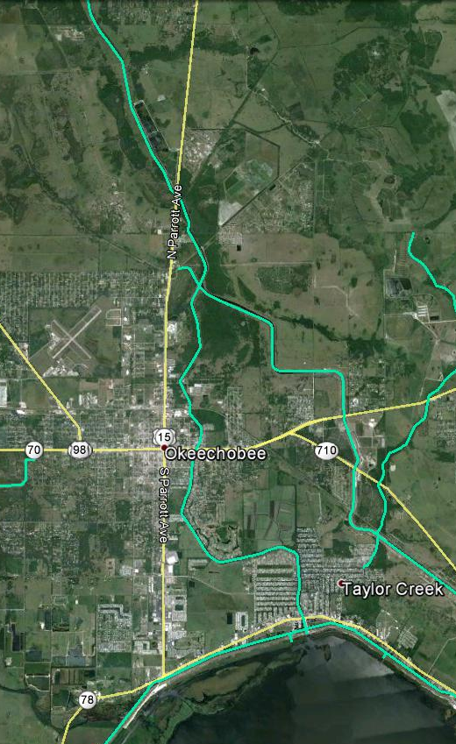
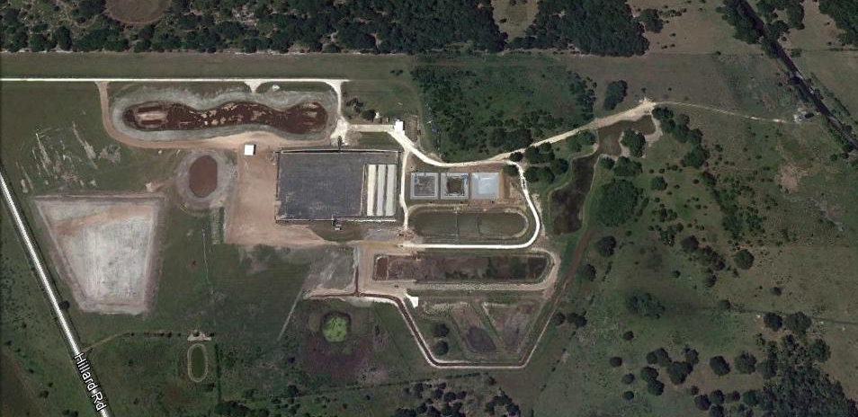
Project Example –
Grassy Island HWTT
Grassy Island HWTT
Taylor Creek STA
Contact Ponds
Settling Pond
Inflow
Lime rock bed
Outflow
SAV
FAV
Lemkin Creek HWTT
Lake Okeechobee

Slide 13
Project Example – Grassy Island HWTT
 | Parameter | Total Phosphorus | Total Nitrogen
 | Period of Record
 | Start Date | 7/14/2011
 | Inflow Water Volume (ac-ft) | 5,963
 | Flow-weighted Mean Inflow (mg/L) | 0.451 | 2.7
 | Inflow Load (kg) | 3,317 | 19,509
 | Amount Retained (kg) | 2,752 | 7,442
 | Percent Retained (%) | 83.0 | 38.1
 | Flow-weighted Mean Outflow (µg/L) | 0.077 | 1.6

Slide 14
Specific Conditions
Pre-Discharge Activates/Net Reduction
  Prior to initiating flow-through activates the permittee shall monitor phosphorus concentrations within the project to demonstrate that the project is achieving a net reduction.
  Net reduction is when the 4-week geometric mean TP concentrations at the outflow is less than the inflow.
  Time limits before Agency Action is needed.
Pre-Discharge STA X¹
¹ STA X is not a real STA nor is the data presented from a real STA.
This data is generated for the sole purpose of this demonstration.
Notes:
If the project has not resulted in a net reduction of phosphorus and nitrogen within two months after beginning pre-discharge activities, the permittee shall submit bi-monthly reports of the 4-week geometric mean difference. If after six months, the system has not met the 4-week start-up test, the permittee shall evaluate vegetative conditions anda identify strategies to achieve the net reduction. When this net reduction demonstration has been made, the permittee shall notify the Department that waters in the STA are acceptable for commencing flow-through (discharge) activities with respect to phosphorus and nitrogen.

Slide 15
Specific Conditions
Other Water Quality Parameters
  For water quality standards other than phosphorus, the quality of water discharged from the facility shall be of equal or better quality than the inflows as stated in Section 373.4595 (7)(d)(2), F.S. Samples shall be collected and shall be used to determine compliance. Compliance with this section shall be evaluated as follows:
    If the average outflow concentration for the project does not exceed applicable criteria, then the facility shall be deemed in compliance;
    If the average outflow concentration for the project causes or contributes to an exceedance of applicable criteria, but does not exceed, or is equal to, the average inflow concentration, then the facility shall be deemed in compliance; or,
    If the average outflow concentration for the project causes or contributes to an exceedance of applicable criteria, and also exceeds the average inflow concentration, then the facility shall be deemed out of compliance with this condition.

Slide 16
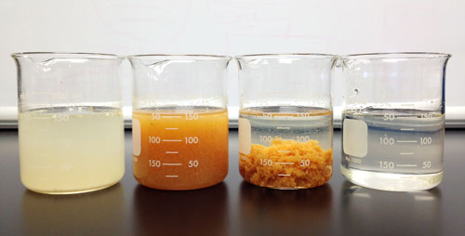
Specific Conditions
Use of Polymer / Flocculants
  Flocculants/Polymer must be approved before use.
    Flocculant/Polymer submitted to an approved toxicology laboratory to perform chronic and acute toxicity.
  Once approved Routine Monitoring is required.
    Monthly Chronic and Acute Toxicity monitoring for the first three months, quarterly thereafter.
  Compliance Actions.
    If any of the tests result in chronic toxicity, the permittee shall investigate the potential cause of this toxicity and retest.
Ecologix Environmental Systems

Slide 17
Other Specific Conditions
Cultural Resources
Maintenance and Management
Threatened and Endangered Species
Photo Credit: SFWMD

Slide 18

Questions?
Photo credit: Paul Julian, FDEP OEP

