Slide 1
Training Presentation
Submitting a delegation of authority (DOA) package to the division of state lands
For Water Management Districts

Slide 2
Introduction
An authorization package, also known as a DOA package, is sent to the Division of State Lands to issue the proprietary authorization for certain activities over sovereign lands.
The four types of proprietary authorizations are: Consent by rule, letter of consent, submerged lands lease, and submerged lands easement.
Activities that qualify for a consent by rule or letter of consent, do not require an authorization package to be sent to DSL.

Slide 3
Where to begin
Guidance and forms are located on the Online Procedures Manual (OPM).
http://depnet/wrm/sler/erp/docs/SLERP_Online/LeadPage.pdf
The Lease checklist can be found under SLER 0803.

Slide 4
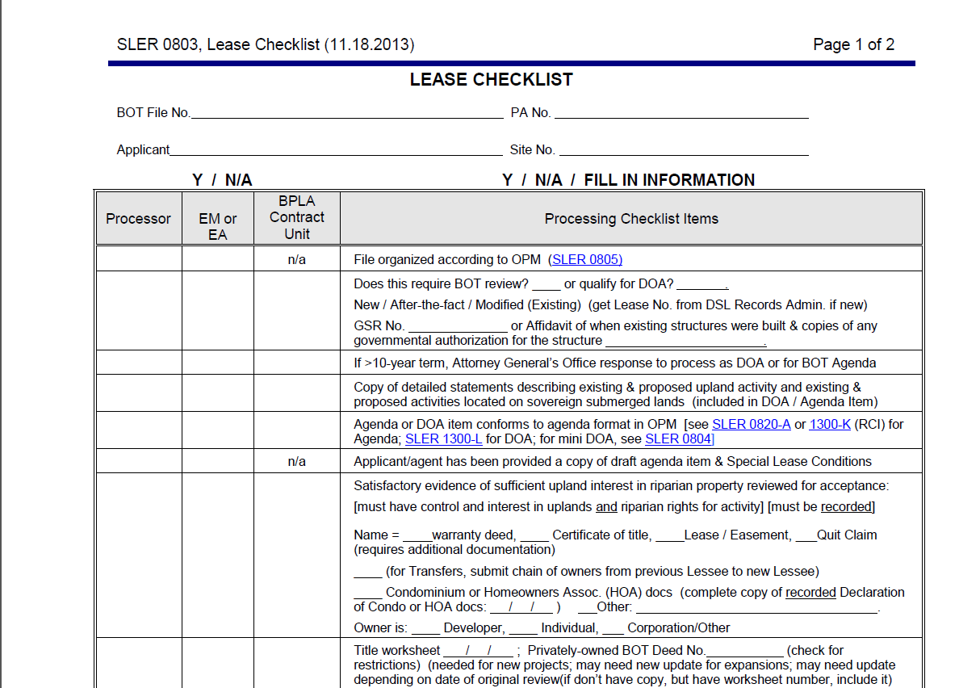
Required
Notes:
Important to fill out the heading. This is a reminder to ensure the applicant and the upland owner are the same.
Request a site number from the DEP district office
“Sites” need to be created in ERPce for leases associated with WMD permits (this is necessary to account for the enhancements that were made to ERPce and ILMS). Since the DEP District offices are conducting the renewal lease inspections they’d eventually be placed in ERPce. DSL will contact the DEP District (that will be responsible for lease inspections and compliance) and request they set up an ERPce site number. We need the site numbers to help track the compliance data. DSL needs this number to add it into ILMS.

Slide 5
Does it meet the delegation under
18-21.0051?
Notes:
Is this of heightened public concern? Is it within the delegation in 18-21.0051.
18-21.0051 Delegation of Authority.
(2) The Secretary of the Department of Environmental Protection and the Governing Boards of the Suwannee River Water Management District, the St. Johns River Water Management District, the Southwest Florida Water Management District, and the South Florida Water Management District are delegated the authority to review and take final agency action on applications to use sovereignty submerged lands when the application involves an activity for which that agency has permitting responsibility, as set forth in the respective operating agreements between the Department and the water management districts identified in subsection 62-113.100(3), F.A.C., unless the final agency action is to approve any of the following proposed activities:
(a) Docking facilities with more than 50 slips, and additions to existing docking facilities where the number of proposed new slips exceeds 10% of the existing slips and the total number of existing and proposed additional slips exceeds 50;
(b) Docking facilities having a preempted area, as defined in Rule 18-21.003, F.A.C., of more than 50,000 square feet, and additions to existing docking facilities where the size of the proposed additional preempted area exceeds 10% of the existing preempted area and the total of existing and proposed additional preempted area exceeds 50,000 square feet;
SLERP Procedures Manual - 01/21/2011 SLER 0860 - Page 8
Q. How do you determine when a modification of a docking facility with more than 50 slips or
greater that 50,000 square feet has to go the Board?
A. If a mod exceeds 10% of existing, then you look to see if the total project (existing plus additional)
is more than 50 slips or more than 50, 000 square feet
If yes, it goes to the Board
If no, it is DOA:
paragraph 18-21.0051(2):
(a) Docking facilities with more than 50 slips, and additions to existing docking facilities where the
number of proposed new slips exceeds 10% of the existing slips and the total number of existing
and proposed additional slips exceeds 50;
(b) Docking facilities having a preempted area, as defined in Rule 18-21.003, F.A.C., of more than
50,000 square feet, and additions to existing docking facilities where the size of the proposed
additional preempted area exceeds 10% of the existing preempted area and
the total of existing
and proposed additional preempted area exceeds 50,000 square feet;
Some examples:
35 existing, adding 36 – that’s more than a 10% increase and 35 + 36 is more than 50 ==
therefore, it goes to BOT
if 35 existing, adding 10 – that’s more than a 10% increase, but 35+10 is NOT more than 50 ==
therefore, is DOA
if 52 existing, adding 4 slips – that is NOT more than a 10% increase, so even though 52
+ 4 is more than 50 slips, it is DOA

Slide 6
Extended Term?
Notes:
This review by the AG’s Office is required for all leases and private easements. The AG’s review applies to new requests, modifications, and renewals.

Slide 7
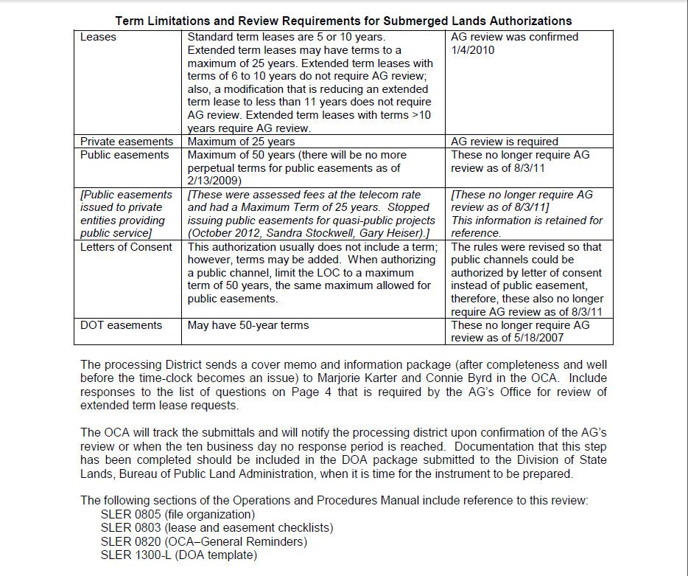

Slide 8
Included in the DOA
Notes:
Extremely important since HB 13 and HB 999 (253.0347 F.S.)
Commercial or Residential?
Redidential: How many upland units? Is an association in control?
Is a Conservation easement required and/or in place?

Slide 9
Creating the DOA
Notes:
Extremely important since HB 13 and HB 999 (253.0347 F.S.)
Commercial or Residential?
Redidential: How many upland units? Is an association in control?
Is a Conservation easement required and/or in place?

Slide 10
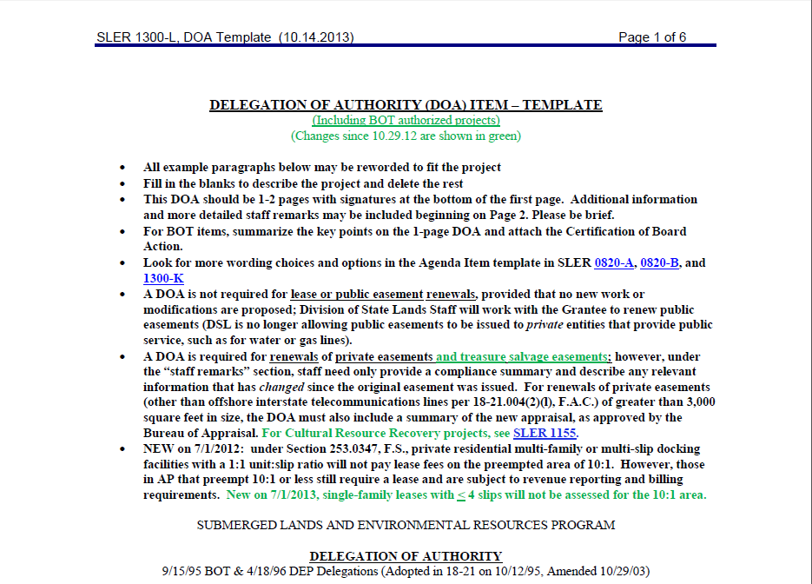

Slide 11
SUI
Notes:
Extremely important since HB 13 and HB 999 (253.0347 F.S.)
Commercial or Residential?
Redidential: How many upland units? Is an association in control?
Is a Conservation easement required and/or in place?
Please remind processors to submit upland interest for easements, utility permit from FDOT, ROW easements/Deeds.

Slide 12
Notes:
Extremely important since HB 13 and HB 999 (253.0347 F.S.)
Commercial or Residential?
Redidential: How many upland units? Is an association in control?
Is a Conservation easement required and/or in place?

Slide 13
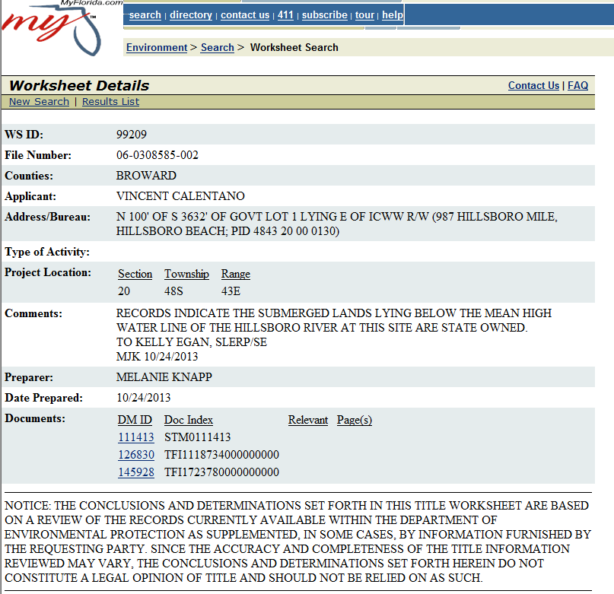
Within 5 years recommended

Slide 14
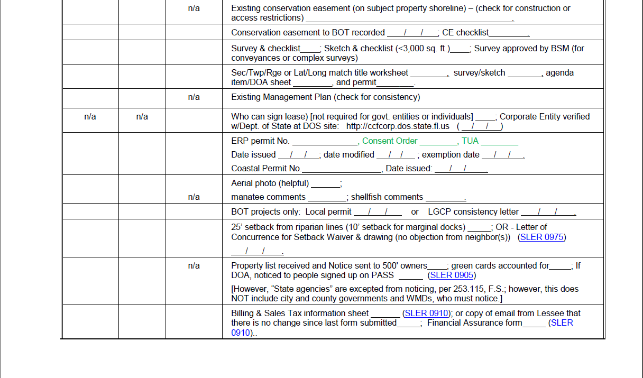
Notes:
Please send original recorded conservation easement

Slide 16
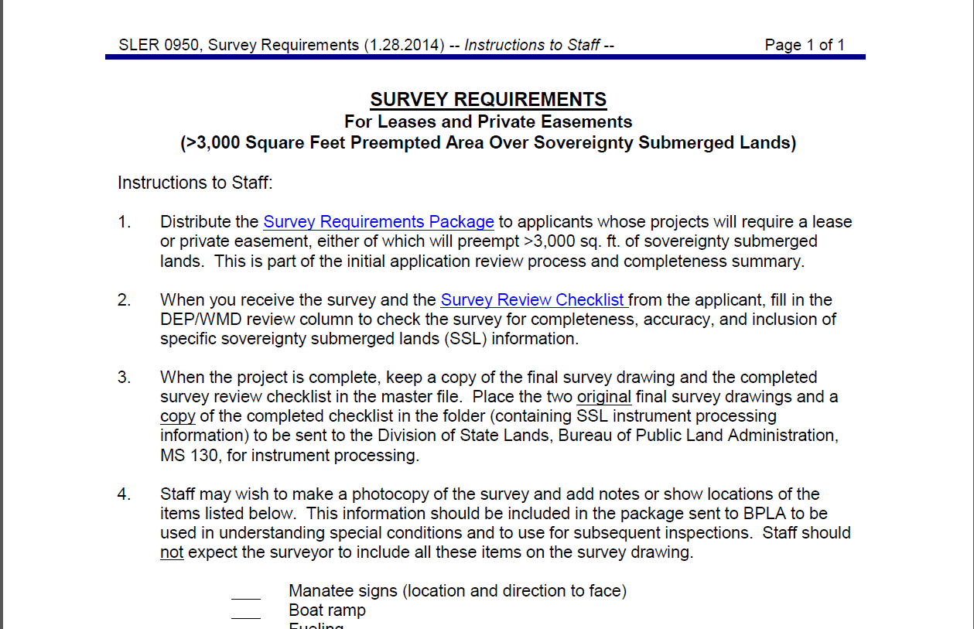

Slide 17
Survey / SUI Review
Surveys – District staff will check the survey using the survey checklist in 0950 or 0960 and, if any questions, will submit the information to the shared mailbox: Lease_ModificationAsbuilt@dep.state.fl.us.
Hard copies of signed/sealed surveys for all leases must be mailed to Jimmy (James E. Wright) for the DSL lease file. Add a post-it or note giving the BOT number.
If surveys are revised after they have been reviewed and approved, then the revised survey needs to be sent back for final review and approval. This should be done before the DOA package is submitted; that way DSL lease processing staff knows that the survey in the DOA package has received specific approval. Once this is done, the DOA package can be sent to the mailbox for further processing. The approval email/memo should be included in this package.

Slide 19

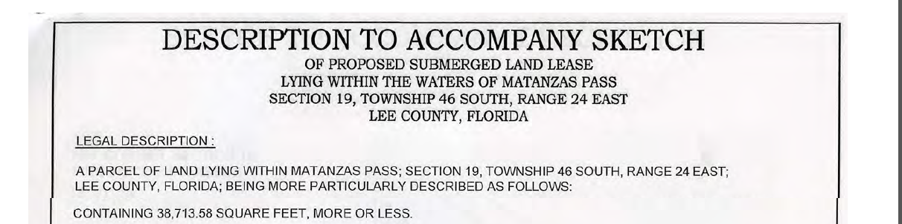
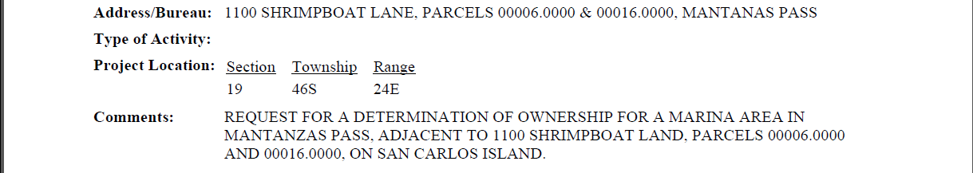
Lease Document
Legal Description
Title Worksheet

Slide 21
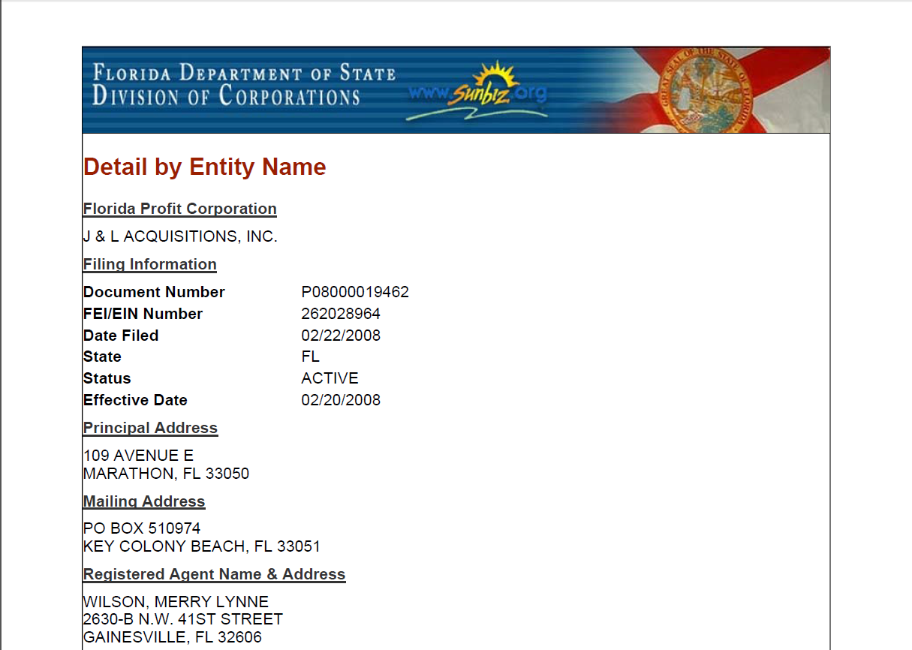

Slide 22
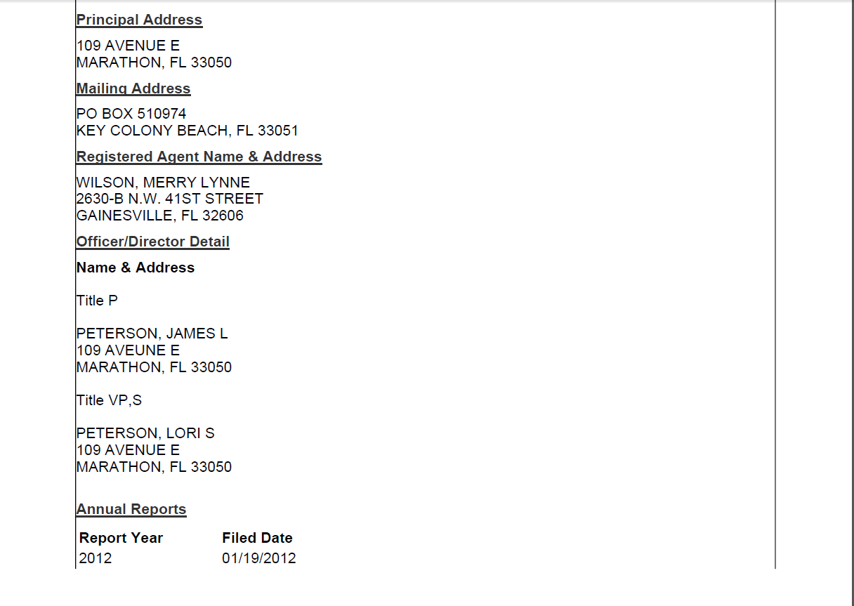
Either the President or the Vice President can sign.

Slide 24
Notes:
SETBACK REQUIREMENT, EXCEPTIONS, WAIVER LETTER
1. Setback requirement: All structures and other activities must be set back a minimum of 25
feet inside of an applicant's riparian rights lines, per sec. 18-21.004(3)(d), F.A.C.
[The citations to Chapter 18-21 are current, but if the rule changes before this procedure, the
current rule applies; see Department of State site for current rule,
https://www.flrules.org/gateway/ChapterHome.asp?Chapter=18-21.]
2. Exceptions to the setback requirements are:
• marginal docks, which must be set back a minimum of 10 feet
• private residential single-family docks or piers associated with a parcel that has a
shoreline frontage of less than 65 feet, where portions of such structures are located
between riparian lines less than 65 feet apart, or where such structure is shared by two
adjacent single-family parcels
• utility lines
• bulkheads, seawalls, riprap or similar shoreline protection structures located along the
shoreline
• structures and activities previously authorized by the Board
• structures and activities built or occurring prior to any requirement for Board
authorization
• when a Letter of Concurrence is obtained from the affected adjacent upland riparian
owner [see Letter of Concurrence for Setback Waiver, which is not adopted by rule,
therefore a letter of similar content may be accepted]. Staff should suggest to the
owner (recipient of the letter) that it may be advisable to record in the public records a
copy of the letter and its attached drawing to deter any future objections by neighbors;
however, recording is not required by rule.
• when the Board determines that locating any portion of the structure or activity within the
setback area is necessary to avoid or minimize adverse impacts to natural resources.

Slide 25
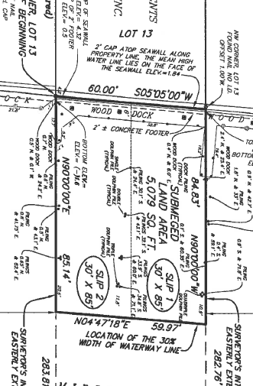
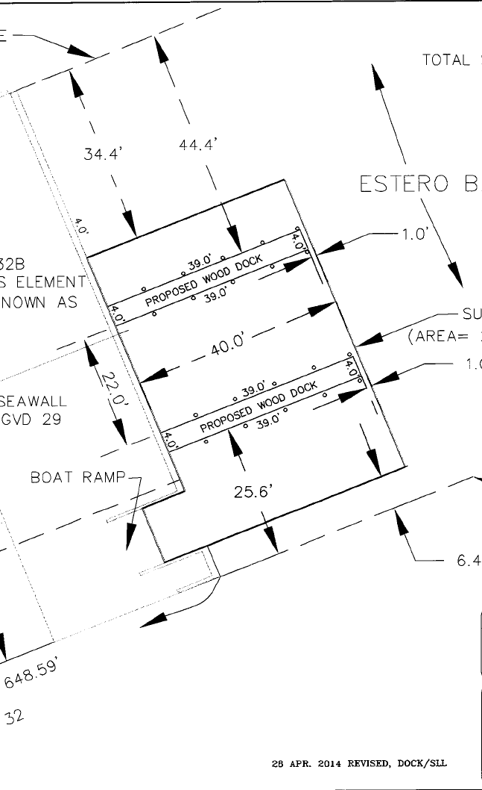
Riparian
44.4’
Riparian
Setback waiver required
25.6’
Riparian
Setback waiver not required
Notes:
Setback requirement: All structures and other activities must be set back a minimum of 25
feet inside of an applicant's riparian rights lines, per sec. 18-21.004(3)(d), F.A.C.
Exceptions to the setback requirements are:
• marginal docks, which must be set back a minimum of 10 feet
• private residential single-family docks or piers associated with a parcel that has a
shoreline frontage of less than 65 feet, where portions of such structures are located
between riparian lines less than 65 feet apart, or where such structure is shared by two
adjacent single-family parcels
• utility lines
• bulkheads, seawalls, riprap or similar shoreline protection structures located along the
shoreline
• structures and activities previously authorized by the Board
• structures and activities built or occurring prior to any requirement for Board
authorization
• when a Letter of Concurrence is obtained from the affected adjacent upland riparian
owner [see Letter of Concurrence for Setback Waiver, which is not adopted by rule,
therefore a letter of similar content may be accepted]. Staff should suggest to the
owner (recipient of the letter) that it may be advisable to record in the public records a
copy of the letter and its attached drawing to deter any future objections by neighbors;
however, recording is not required by rule.
• when the Board determines that locating any portion of the structure or activity within the
setback area is necessary to avoid or minimize adverse impacts to natural resources.

Slide 27
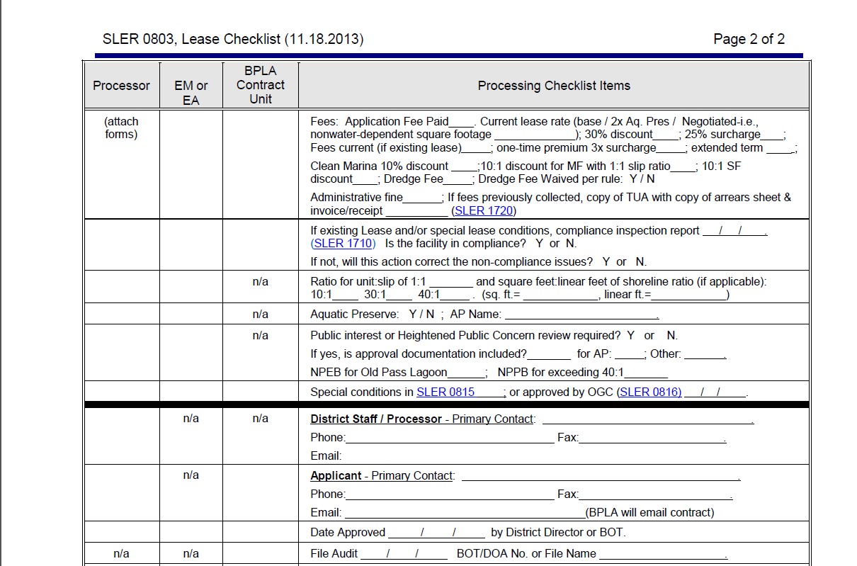
Notes:
Submit calculations for arrears if applicable

Slide 29
Upland Units & Linear shoreline
Notes:
Verify use of slips and is the upland commercial or residential

Slide 31
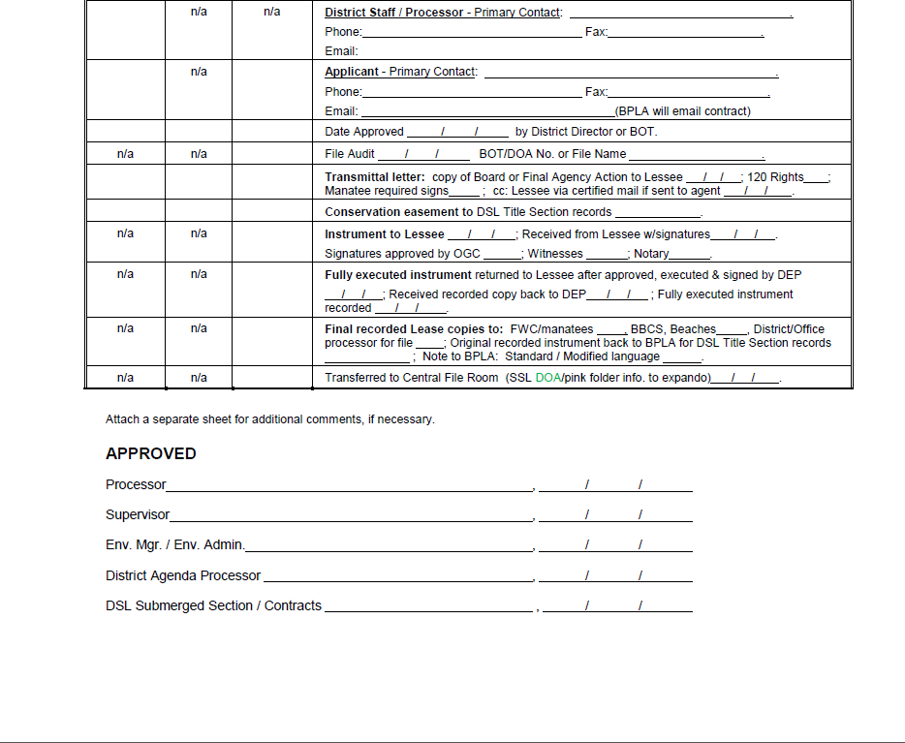
Notes:
Please send contact info for WMD processor and applicant.

Slide 32
Shared Mailbox List
Sufficient upland interest reviews and questions should be sent to: Steve Kellogg
via shared mailbox: mailto:SUI_TitleDetermination@dep.state.fl.us
send oculus link and/or document in an e-mail
Required documents: Survey legal description, upland deed or applicants interest in upland parcel, title determination.
• Electronic DOA packages for new multi-family, multi-slip and commercial leases should be sent to: Amy Horton
via shared mailbox: District.Lease.Submittal@dep.state.fl.us
Send oculus link and/or document in an e-mail
Any questions about those leases should be directed to Amy Horton
• DOA’s for lease modifications should be sent to: Mr. Dana Marcum
via shared mailbox: Lease_ModificationAsbuilt@dep.state.fl.us
Send oculus link and/or document in an e-mail
• All easement packages, whether new or modifications should be sent to: Tiana Brown
via shared mailbox: District.Easement.Submittal@dep.state.fl.us
Send oculus link and/or document in an e-mail
Any questions about these easements should be directed to Tiana Brown

