Slide 1
Determining What Constitutes Sufficient Upland Interest
Nick Campanile – FDEP/DSL OFFICE OF SURVEY & MAPPING
Gary Heiser – FDEP OFFICE OF GENERAL COUNSEL
June 11, 2014

Slide 2
Chapter 253.141(1), F.S. – Riparian Rights
Riparian rights are those incident to land bordering upon navigable waters. They are rights of ingress, egress, boating, bathing, and fishing and such others as may be or have been defined by law. Such rights are not of a proprietary nature. They are rights inuring to the owner of the riparian land but are not owned by him or her. They are appurtenant to and are inseparable from the riparian land. The land to which the owner holds title must extend to the ordinary high watermark of the navigable water in order that riparian rights may attach. Conveyance of title to or lease of the riparian land entitles the grantee to the riparian rights running therewith whether or not mentioned in the deed or lease of the upland.

Slide 3
Chapter 18-21.003(60), F.A.C. – Sufficient Upland Interest
“Satisfactory evidence of sufficient upland interest” shall be demonstrated by documentation, such as a warranty deed; a certificate of title issued by a clerk of the court; a lease; an easement; or condominium, homeowners or similar association documents that clearly demonstrate that the holder has control and interest in the riparian uplands adjacent to the project area and the riparian rights necessary to conduct the proposed activity. Other forms of documentation shall be accepted if they clearly demonstrate that the holder has control and interest in the riparian uplands adjacent to the project area and the riparian rights necessary to conduct the proposed activity.

Slide 4
Examples of What May Provide Sufficient Upland Interest (SUI)
- Deed:
  Warranty
  Quit Claim (with acceptable backup documentation)
  Tax deed
  - Easement – that includes riparian rights and the right to construct/operate/maintain docks
  - Lease
  - Condominium, Homeowners or Similar Association Documents
  - Clerk of Court’s Certificate of Title
  - Court Judgment
  - Board of Trustees’ Instruments
  1975 Fill Certificate
  Butler Act Disclaimer
  Quit Claim Deed (doesn’t require backup documentation)
  Dedications

Slide 5
Examples of What Does Not Provide Sufficient Upland Interest (SUI)
- Mortgage Deed
- License
- Riparian Rights Agreement
- Any typically acceptable document that wasn’t executed properly

Slide 6
Review Checklist
 | Title to Riparian Uplands
 | Y |  | N
 |  |  |  |  | Satisfactory evidence of title to riparian uplands. Evidence consists of:
 |  |  |  |  | Title insurance policy
 |  |  |  |  | Opinion of title by member of Florida Bar
 |  |  |  |  | Deed into applicant - identify with recording information under Comments
 |  |  |  |  | Other (identify):
 |  |  |  |  | Upland legal description has been protracted on current aerial photography and appears to be riparian
 |  |  |  |  | Upland legal description is qualified to sovereign waterbody.
 |  |  |  |  | If lease is held by a condominium association, their SUI is due to:
 |  |  |  |  | Riparian uplands are a common element
 |  |  |  |  | Association has easement with correct rights over riparian uplands
 |  |  |  |  | Owner’s name and address agrees with county property appraiser (print tax card and add to file)
 |  |  |  |  | FDEP Title Determination has been reviewed and there are no discrepancies
 | Comments:
BOT Title Determination Is Very Important

Slide 7
SO……DOES THE DOCUMENT MEET THE RULE DEFINITION OF SUI AND IS THE UPLAND PARCEL WATERFRONT?
Let’s run through some examples…

Slide 8
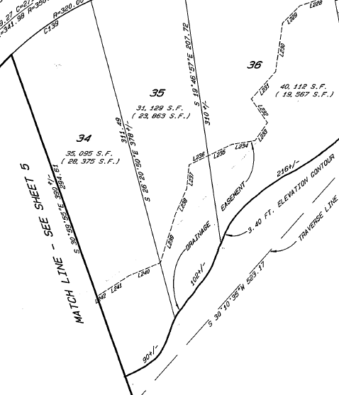
Parcel with SUI
Subject Lot 34
Platted Subdivision Lot Up To An Elevation Contour of 3.40 feet.
Is It Waterfront/Riparian?

Slide 9
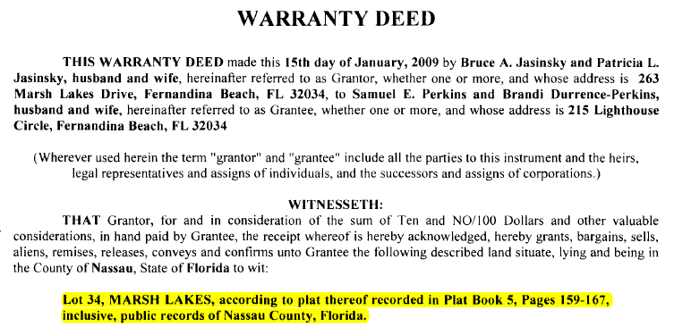
Warranty Deed Into Owner

Slide 10
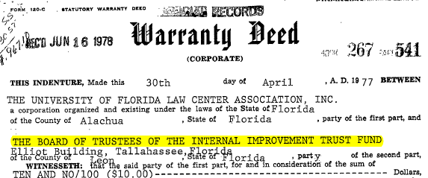
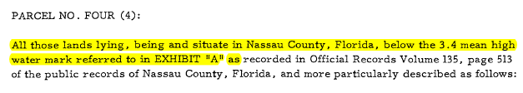
Further Search Yielded Deed into BOT For Any Lands Waterward Of The 3.40 Foot Contour

Slide 11
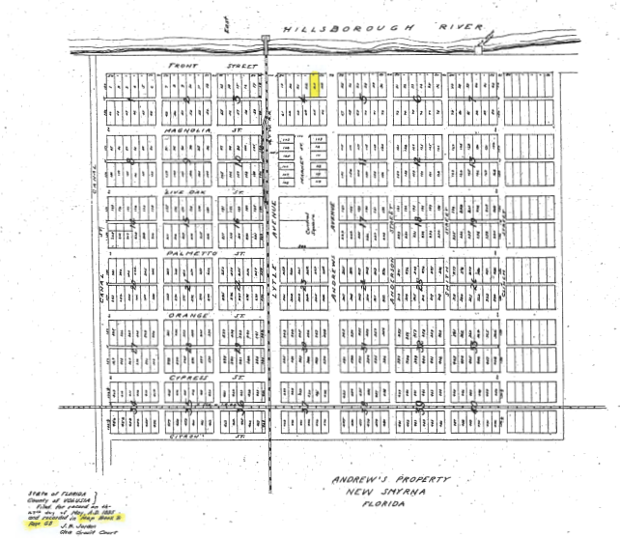
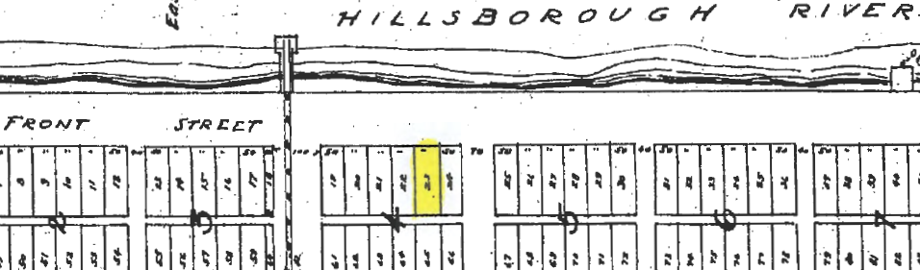
Parcel Without SUI
Subject Lot 23, Block 4
Platted Subdivision Lot Not Fronting On Water Body
Public Road R/W Creates Separation

Slide 12
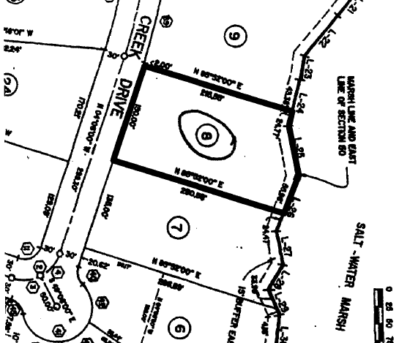
Parcel Without SUI Yet Gained Interest Via Easement From BOT
Subject Lot 8 of a Platted Subdivision
Platted Subdivision Lot Not Fronting On Water Body

Slide 13
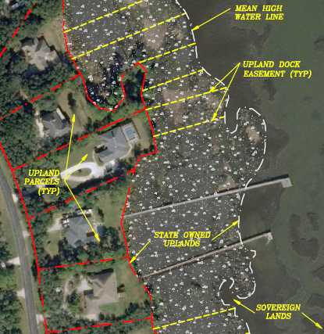
Parcel Without SUI Yet Gained Interest Via Easement From BOT
State-owned Marsh Lands Above MHW Separates Parcel from Water Body
BOT Decision Was To Grant Easement To Lot Owner To Reach Water Body

Slide 14
Parcel Without SUI Yet Gained Interest Via Easement From BOT
Subject Lot 8 of a Platted Subdivision
Platted Subdivision Lot Not Fronting On Water Body

Slide 15
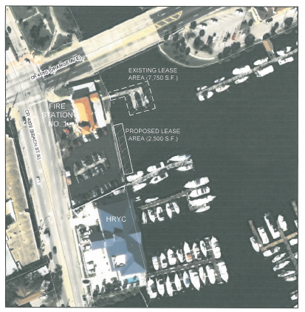
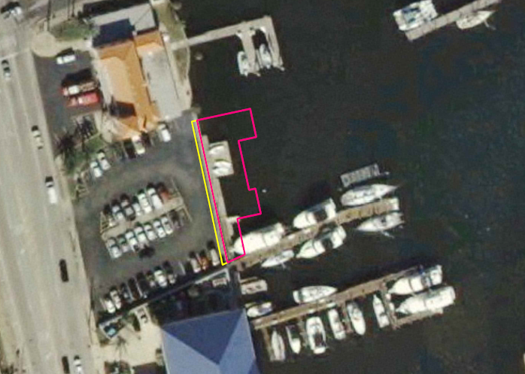
Parcel Without SUI
Yacht Club Parcel Needing Adjacent Proposed Lease Area
Adjacent Fire Station Parcel.
Yellow Area is Proposed “License”. Pink is Proposed Lease

Slide 16
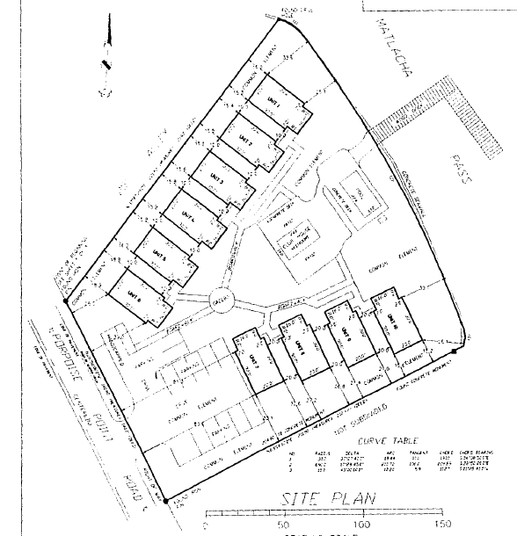
Condominium With SUI
Condominium Documents provide SUI
Survey in the Documents consists of two parcels up to water body, Matlacha Pass. One doesn’t touch Matlacha Pass
Further research provides info on Bulkhead Deed from BOT

Slide 17
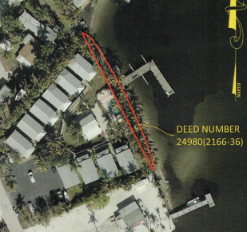
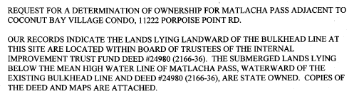
Title Determination Verifies Bulkhead Deed

Slide 18
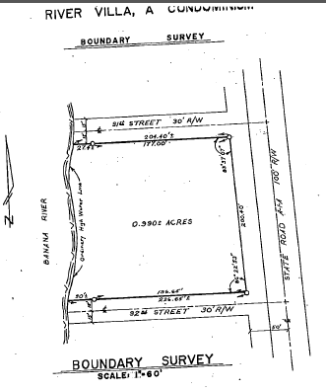
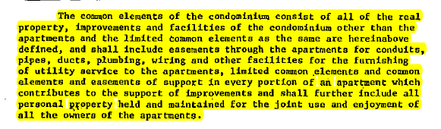
Condominium With SUI
Location Good - Survey in Documents consists of one parcel up to water body, Banana River.
Condominium Documents provide Sufficient Upland interest to the Condominium Association

Slide 19
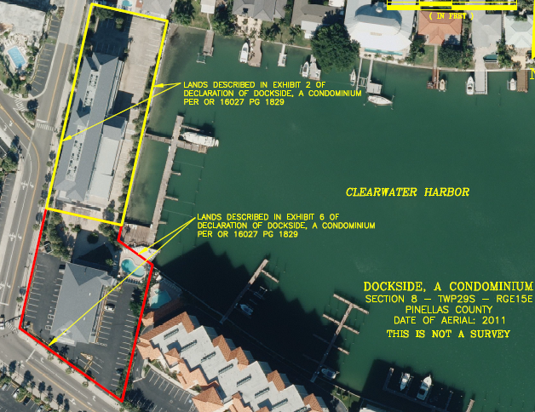
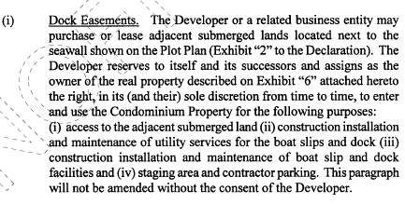
Condominium Without SUI
Location Good – ABUTS CLEARWATER HARBOR
Condominium Documents Do Not provide SuI to the Condominium Association

Slide 20
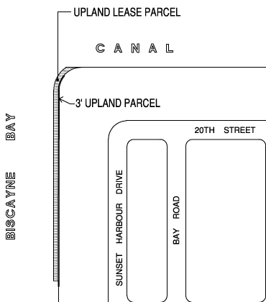
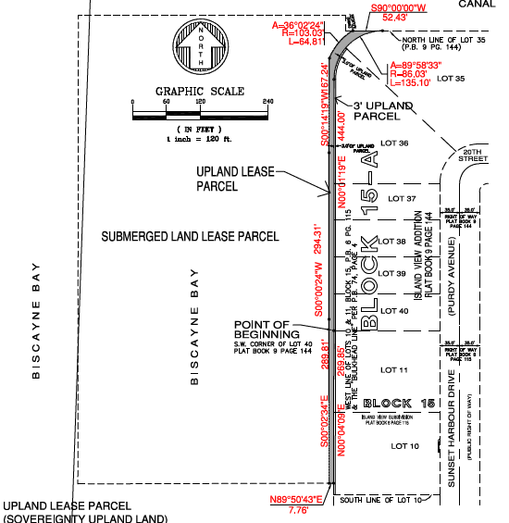
Yacht Club/ Condominium With SUI via 1975 Fill Rule
A Yacht Club (Applicant) Submitted For A Upland Easement And A Submerged Land Lease.
Applicant, Part Of A Condominium, Owns Among Other Lands, A 3 Foot Strip Along The Perimeter Of Platted (Subdivided) Lots.
They Requested An Upland Easement Over Lands Westerly Of the Platted Lots To Join Their Ownership With The Proposed Submerged Land They Wished To Lease.

Slide 21
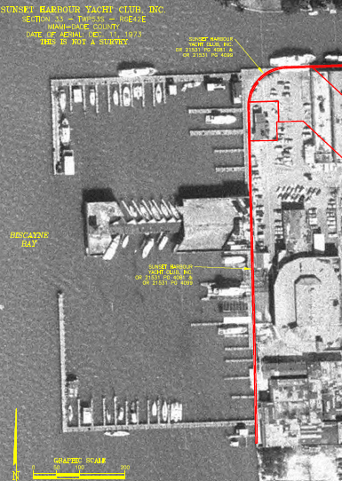
Yacht Club/ Condominium With SUI via 1975 Fill Rule
A Search Into Historic Aerial Photography (12/11/73) Yielded Information That Showed Title To The Area Subject To Their Requested Upland Easement Had Already Passed By Statute (Chapter 253.12, F.S.), Commonly Referred To As 1975 Fill Rule.
The Applicant Was Notified That Title Had Already Passed By Law And That No Upland Easement Was Needed, Nor Could It Be Provided By BOT. They Would Only Need The Submerged Land Easement.
They Still Requested An Upland Easement…..For Good Measure. We Are Not Able To Do That As The Title To The Lands Had Already Passed To Others. They Can Request A Certificate If They Wish.

Slide 22
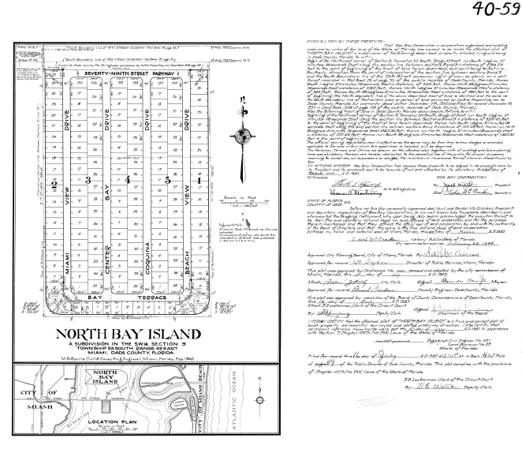
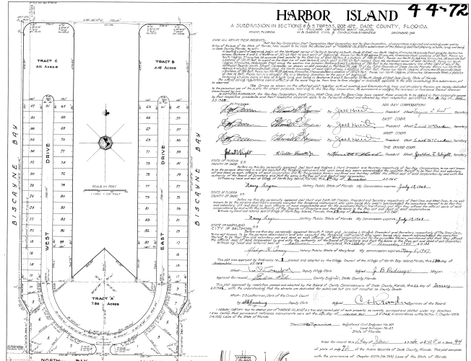
A Quick Run Thru on Some Interesting Issues
Adjacent Record Plats contained within BOT Submerged Land Deeds

Slide 23
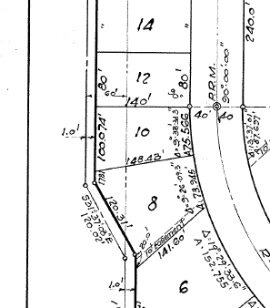
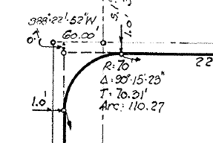
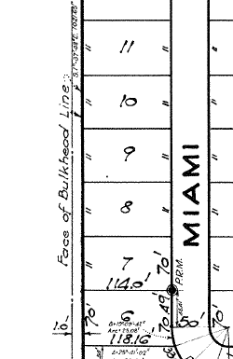
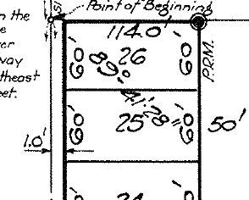
A Quick Run Thru on Some Interesting Issues
The Exterior Limits Of Both Plats were set back to 1 foot inside the limit of the Submerged Land Deed. Platted limits fall 1 foot short of SSL.

Slide 24
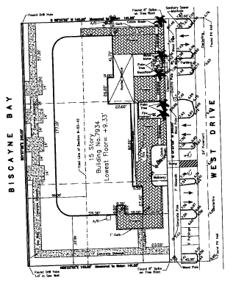
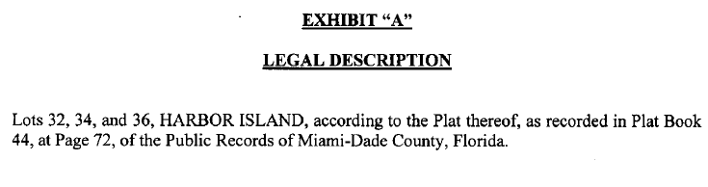
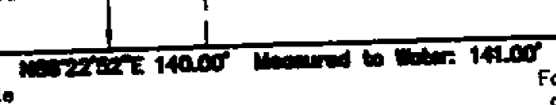
A Quick Run Thru on Some Interesting Issues
For One Of the Record Plats, None Of the External Lot Legal Descriptions Include Any Part Of The Adjacent 1 Foot Strip. Platted Lot Depths Are 140 Feet. Here We Have A Legal Description From A Deed And A Survey Of Same. Neither Acknowledged the 1 Foot Strip. The Survey Depth Is 141 Feet Yet Notes The Platted Distance of 140 Feet. Does The Parcel Abut SSL? There Are Existing SL Leases Along this Plat W/O reference To The 1 Foot Strip.

Slide 25
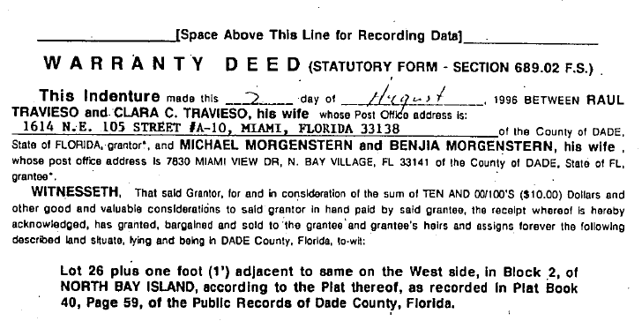
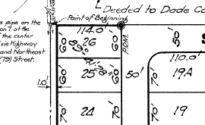
A Quick Run Thru on Some Interesting Issues
For the Other Record Plat, All Of the External Lot Legal Descriptions Include The Adjacent 1 Foot Strip. Does The Parcel Abut SSL? Since The 1 Foot Strip Is In The Deed, Then It Must Be Valid, Right? FYI, There Are No Existing Leases Along this Plat.

Slide 26
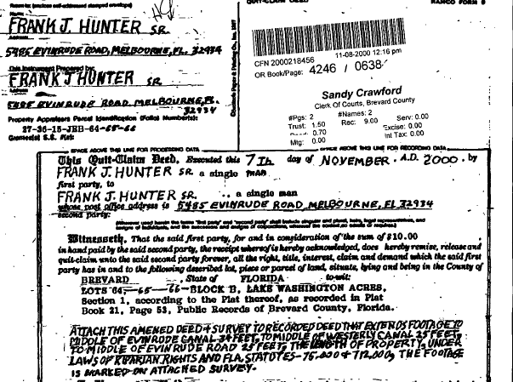

Deeds
The prior slide included a description for a lot and an adjacent 1 foot strip. The strip was probably held by the developer when platted in the 1940’s. Taken at face value, the deed appeared OK. “Sufficient”?. A search thru the chain of title may show it to be valid…or…?
How About the example deed to the right, and on the next slide? The owner deeded additional lands to himself to expand his boundaries.

Slide 27
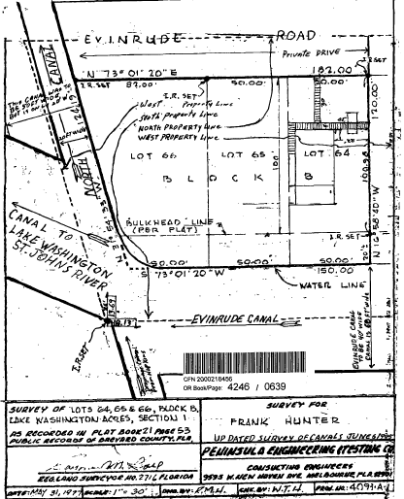
Deeds
The owner deeded additional lands to himself to expand his boundaries and marked the new boundaries on a copy of his prior survey, calling it an updated survey, and recorded all in the Public Records.
THE END

