Slide 1
Revised Dissolved Oxygen Criteria: New Science for the 21st Century
Russ Frydenborg
Frydenborg EcoLogic, L.L.C.
Garry Payne, FDEP

Slide 2
Dissolved Oxygen
Former criteria based on 1970s (outdated) science
Extensive DO and biological study conducted
Revisions based on:
  DO vs. Stream Condition Index relationship (applied to streams and lakes) and reference site evaluation
  DO vs. laboratory toxicity tests for marine waters (EPA Virginian Province approach)

Slide 3
Previous Criteria Resulted in High Type I Error
DO Study Reference Systems (Natural Surrounding Landscape) | Percent in Nonattainment of Previous Criteria
82 Lakes | 52.4%
81 Streams | 70.4%

Slide 4
Use of SCI vs. DO Relationship to Determine Freshwater Criteria (Panhandle West)
Regression line = 62 % Saturation to pass SCI (score of 40)
Lower Confidence Limit = 67 % Saturation to pass SCI

Slide 5
DO Criteria Derived from Regressions are Supported by Reference Site Data
The proposed criteria based on the SCI-2012 versus DO saturation regression analyses are supported by the reference distribution of DO saturation levels
Thresholds based on lower 90% Confidence limit for SCI-2012 versus daily average DO saturation agree well with the 10th percentile of the reference distribution

Slide 6
DO Concentration - Water Temperature Relationships
DO Concentrations Required to Achieve Proposed Criteria Based on Water Temperature

Slide 7
Summary of Revised Florida
Freshwater DO Criteria
No more than 10 percent of the daily average percent dissolved oxygen (DO) saturation values shall be below the following values:
67 percent in the Panhandle West bioregion,
38 percent in the Peninsula and Everglades bioregions, or
34 percent in the Northeast and Big Bend bioregions

Slide 8
Application of Freshwater DO Criteria: Sampling Depth
Criteria for streams will be assessed using data collected throughout the water column
Criteria for lakes will be assessed using data collected in the upper 2 meters of the water column
  DO levels naturally decline with depth in lakes (stratification, SOD, respiration
  Targets protection of area (littoral zone) inhabited by DO sensitive fauna
  Recommended by DO Peer Review Committee

Slide 9
Application of Freshwater Criteria: Diel Data
Criteria will be preferentially assessed using diel data
If instantaneous DO measurements are used for assessment, daily average criteria will be translated to give time of day specific criteria based on time measurement was made

Slide 10
Time of Day Correction
Typical diel curves developed for lakes and streams in each bioregion (red curve)
Diel curves were shifted so that daily average was equal to the criteria (blue curve)
Polynomial equation was fitted to shifted curve
Equations can be used to predict DO level at any time for a site with a daily average equal to the criteria and a typical diel fluctuation

Slide 11
Time of Day Correction
Equations for time of day interpretation of daily average criteria for lakes and streams in each region
To assess criteria using grab samples, measured DO level compared to equation result using time at which sample was collected
Region | Equations for the Time of Day Interpretation of Criteria *
Streams
Northeast + Big Bend | 1.1844 x 10⁻¹³ • T⁵ – 4.1432 x 10⁻¹⁰ • T⁴ + 4.7729 x 10⁻⁷ • T³ – 1.9692 x 10⁻⁴• T² + 0.02314 • T + 31.24
Peninsula + Everglades | 1.9888 x 10⁻¹³ • T⁵ – 6.8941 x 10⁻¹⁰ • T⁴ + 7.8373 x 10⁻⁷ • T³ – 3.1598 x 10⁻⁴• T² + 0.03551 • T + 33.43
Panhandle West | 9.0851 x 10⁻¹⁴ • T⁵ – 2.9941 x 10⁻¹⁰ • T⁴ + 3.1560 x 10⁻⁷ • T³ – 1.0851 x 10⁻⁴• T² + 0.006285 • T + 65.61
Lakes
Northeast + Big Bend | 1.4578 x 10⁻¹³ • T⁵ – 5.5607 x 10⁻¹⁰ • T⁴ + 7.0683 x 10⁻⁷ • T³ – 3.1879 x 10⁻⁴• T² + 0.02817 • T + 34.19
Peninsula + Everglades | 1.3709 x 10⁻¹³ • T⁵ – 5.0496 x 10⁻¹⁰ • T⁴ + 6.1352 x 10⁻⁷ • T³ - 2.5817 x 10⁻⁴• T² + 0.01960 • T + 37.14
Panhandle West | 7.1190 x 10⁻¹⁴ • T⁵ – 2.6420 x 10⁻¹⁰ • T⁴ + 3.2247 x 10⁻⁷ • T³ – 1.3607 x 10⁻⁴• T² + 0.01071 • T + 66.35
* T in the equations is the time of day in minutes past midnight.

Slide 12
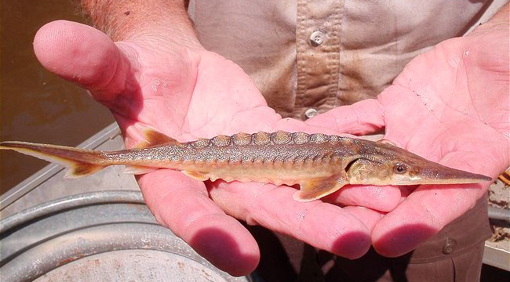
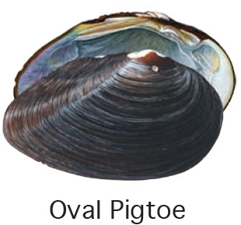
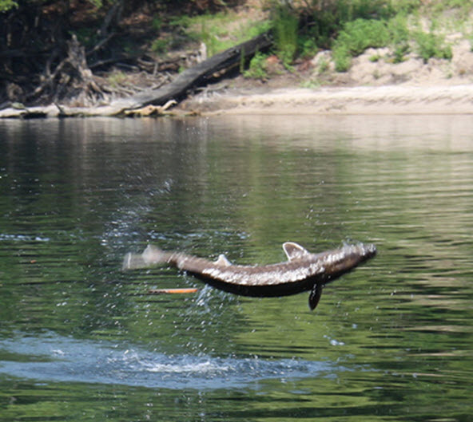
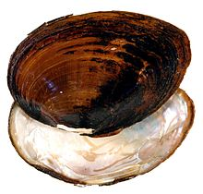
Threatened and Endangered Species Considerations

Slide 13
Protection of Threatened and Endangered Species
Criteria protective of most threatened and endangered species (Panhandle)
Gulf Sturgeon and Oval Pigtoe Mussel found in portions of the Suwannee, Santa Fe, New, and Withlacoochee Rivers and Shortnose and Atlantic sturgeon in the St. Johns River
Criteria include provision to maintaining existing DO levels that are protective of Gulf sturgeon and mussel
In the St. Johns River current criteria of 5.0 mg/L (53% saturation) will be maintained during February and March to protect potential spawning of Shortnose and Atlantic sturgeon

Slide 14
Marine DO Criteria Based on Virginian Province Approach
EPA’s Virginian Province Approach (EPA 2000) uses measured response of sensitive organisms to low DO levels to establish allowable exposure durations

Slide 15
Florida Species Used to Derive Marine DO Criteria CMC
The CMC was calculated based on the acute effects data for 25 genera
Genera mean acute values (LC₅₀) of the test organisms ranged from 6 to 33% Saturation
CMC was calculated as the FAV (95th percentile genus GMAV) multiplied by the mean LC₅ to LC₅₀ ratio (1.35)
Resulting CMC is 42% Saturation

Slide 16
Florida Marine DO Criteria Based on Virginian Province Approach
The daily average DO concentrations shall not be below 42 percent saturation
AND
The 7- and 30-day average DO percent saturations shall not be below 51 and 56 percent, respectively
Criteria applied as a water column average
Assessment will be consistent with Impaired Waters Rule
Protective of threatened and endangered species

Slide 17
Marine DO Concentration vs. Temperature

Slide 18
Addressing Natural Background
Natural Conditions
  Allow for a 0.1 mg/L (1% saturation) deficit from the natural dissolved oxygen value
      Can be granted when implemented through permitting or other Department Action.
  Up to 10 percent deficit will be allowed if it is demonstrated that resident aquatic species shall not be adversely affected
      Plan to use USEPA spreadsheet model to determine acceptable deviation from natural background DO Levels.
      Will be implemented through site specific alternative criteria procedures

Slide 19
Addressing Natural Background
Natural Conditions
If natural ambient DO levels are above the minimum criteria, those higher DO levels shall be maintained
Subject to Rules 62-302.300 and 62-4.242, F.A.C.
Implemented through Seasonal Kendall trend test
Statistically significant decreasing trends in DO percent saturation or an increasing trend in the range of daily DO fluctuations shall not be allowed

Slide 20
New DO Rule Now In Effect
Approved by Environmental regulation Commission in April, 2013
Approved by EPA in October 2013

Slide 21
Implications of New DO Criteria
Reasonable Assurance demonstration (that water quality criteria are achieved) for new projects will change
New criteria are more accurate
Panhandle freshwater criteria are more stringent
Marine monthly average criteria are more stringent at cool temperatures

Slide 22
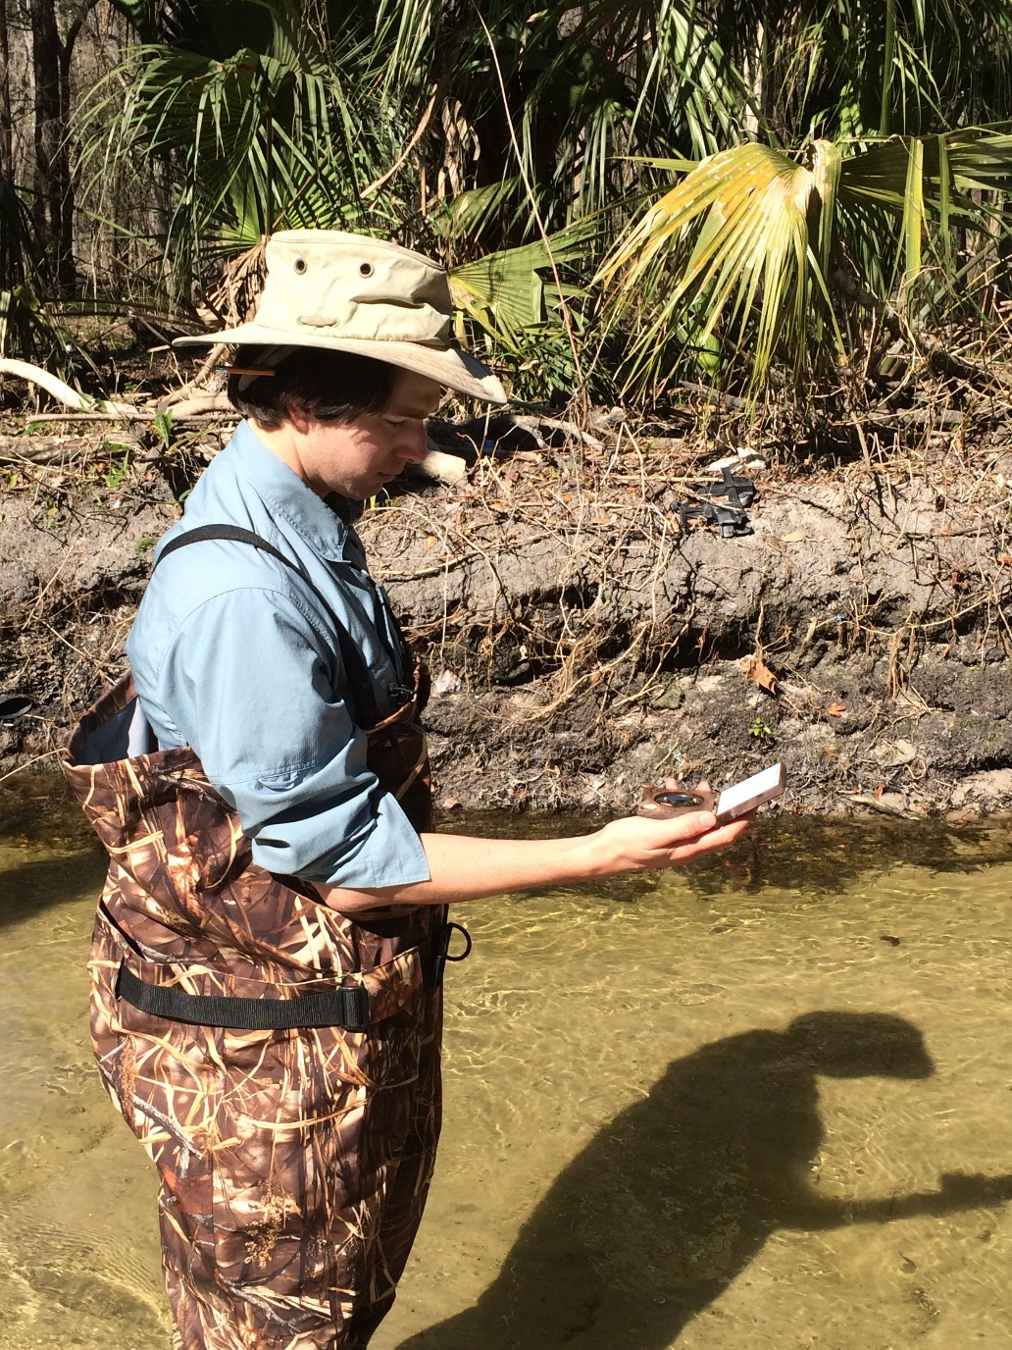
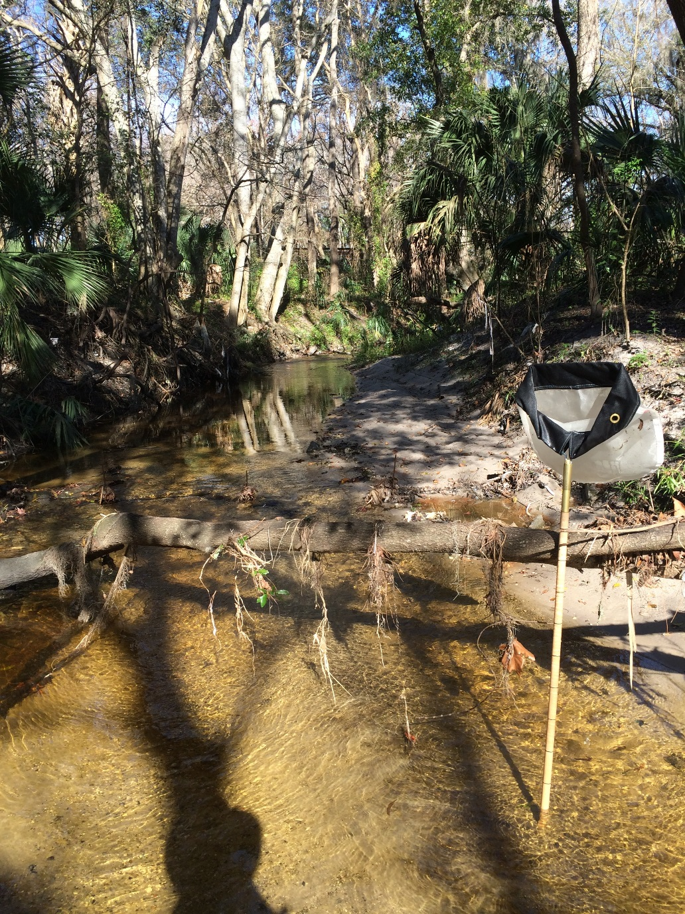
Questions? www.frecologic.com

