Slide 1

Navigating SUPRS
SUPRS = Submerged and Uplands
Public Revenue System
  This system houses all pertinent information regarding the current lease condition that determines the billing; such as activity type, square footage, billing rate, clean marina discount or open to the public discounts.
  This system is where you will find invoices, payments, accounts receivable information and collection activities, such as 12% interest and the Notice to Correct.
  This system includes the Annual Wetslip Revenue Reports (AWRR) and contains the history of all revenue reports received and the calculations of the 6% due on supplemental invoices.

Slide 2
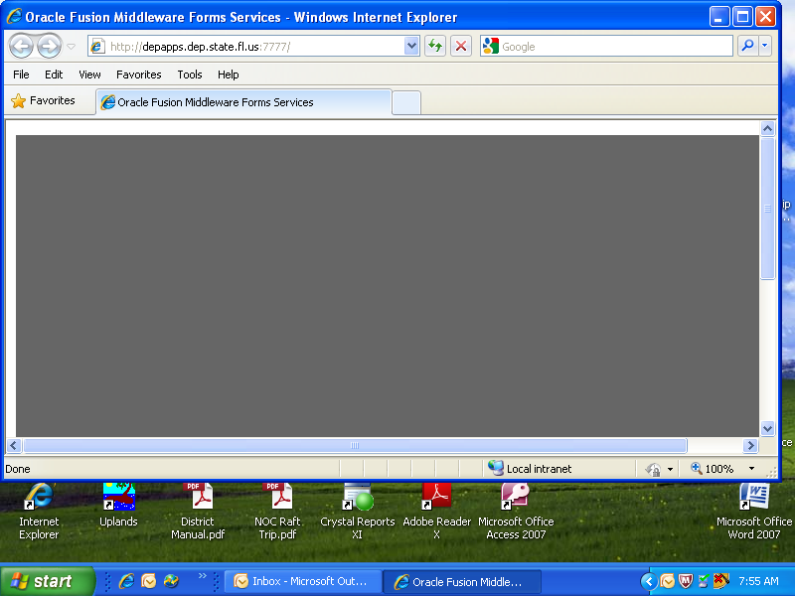
You need to have this site above saved in your favorites to reach the SUPRS sign on screen

Slide 3
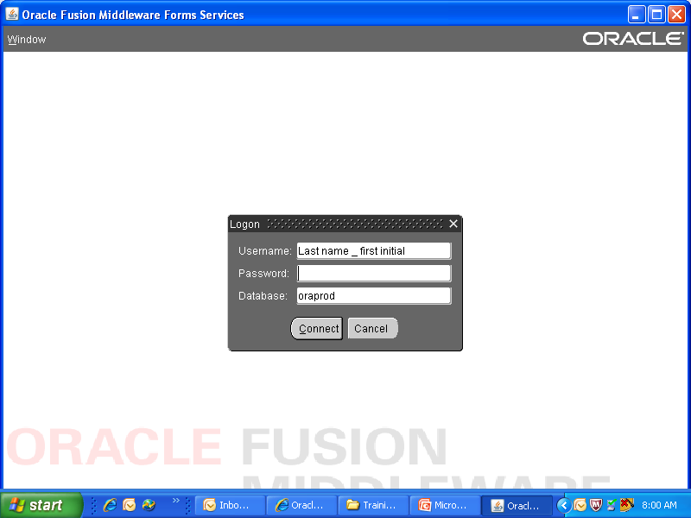
Most of you already have this program because this is what you use to get into Permit Application and ERP Compliance/Enforcement.

Slide 4
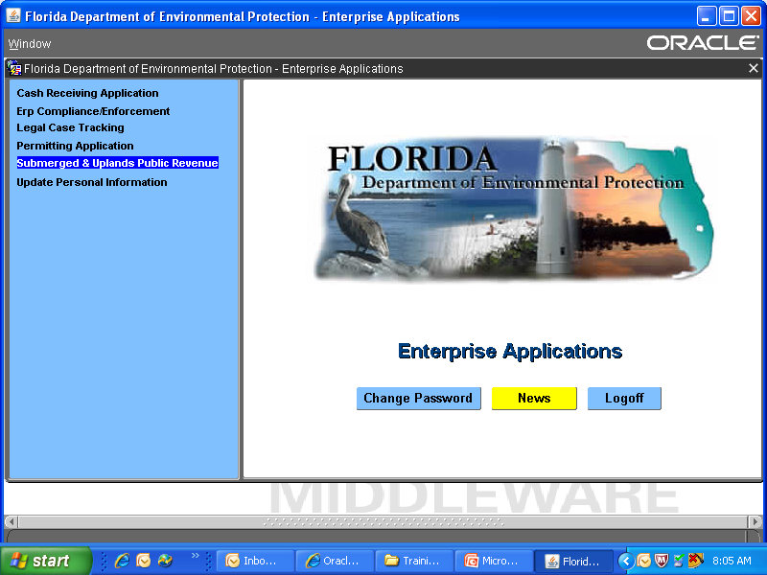
Click on the link above to access SUPRS

Slide 5
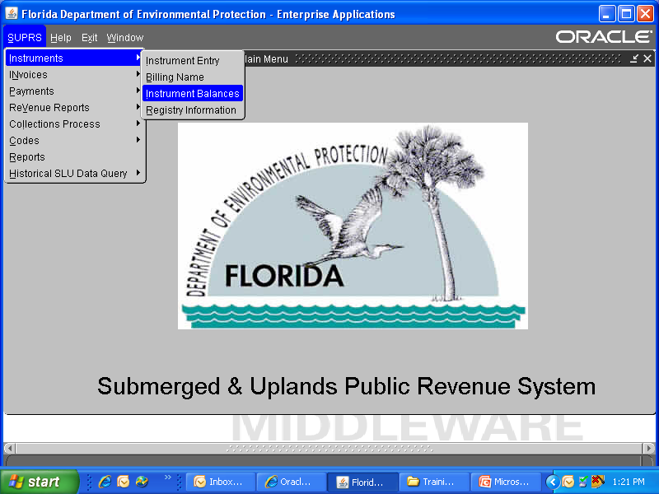
Instrument Balance will show you the Instrument condition and the invoice/payment register
From the Instrument Balance screen you can view all the other drop downs such as Invoices, Payments, and Revenue Reports

Slide 6
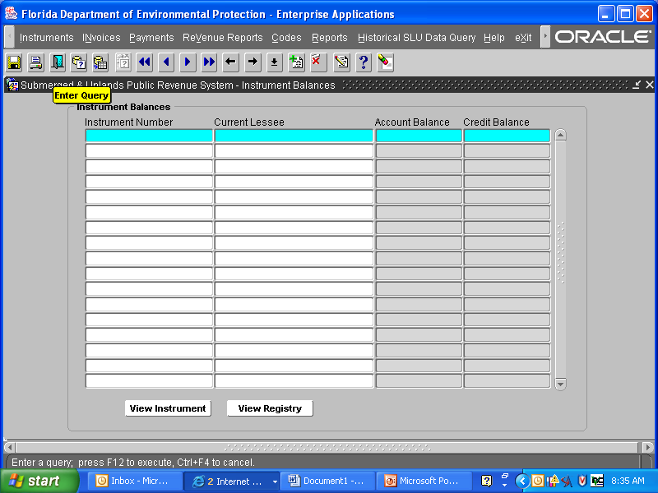
Enter Query Button
It is important to remember to click on the “Enter Query”
Button before placing the Instrument Number in the field, or you can
use the F11 for “enter query”.

Slide 7
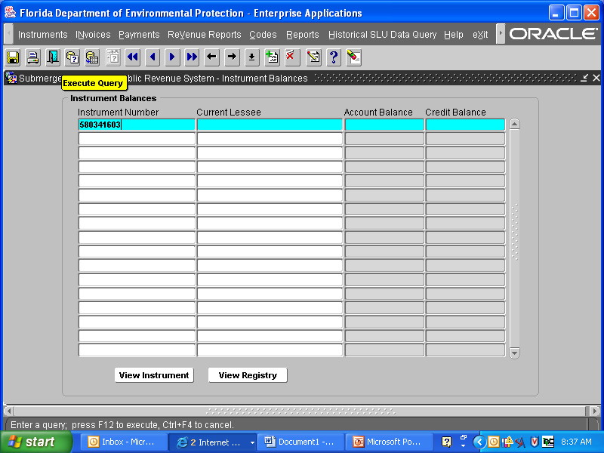
Execute Query Button
You will need to remember to click on the “Execute Query” Button after placing the Instrument Number in the field or you can use the F12 button to execute the query.
You can query by Current Lessee name but this is not as effective as the lease number.

Slide 8
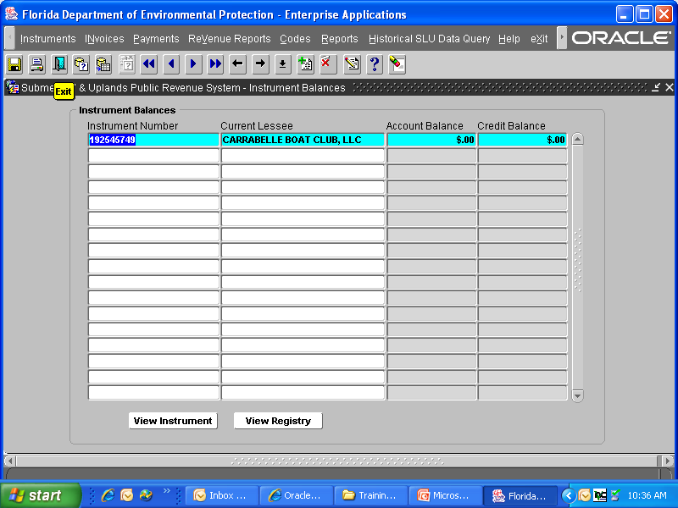
To exit any SURPS screen use the close door button to exit.

Slide 9
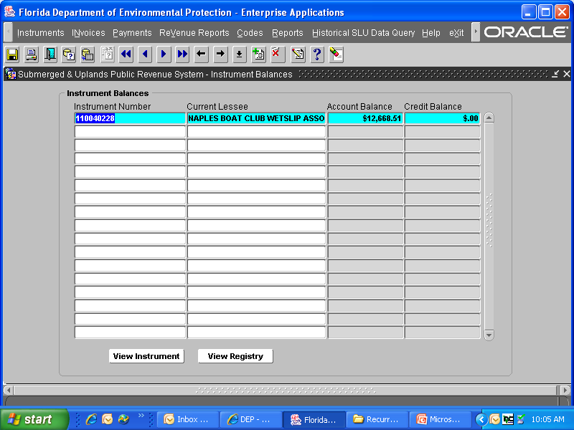
Click View Instrument below to see the lease condition, income reports and notes.

Slide 10
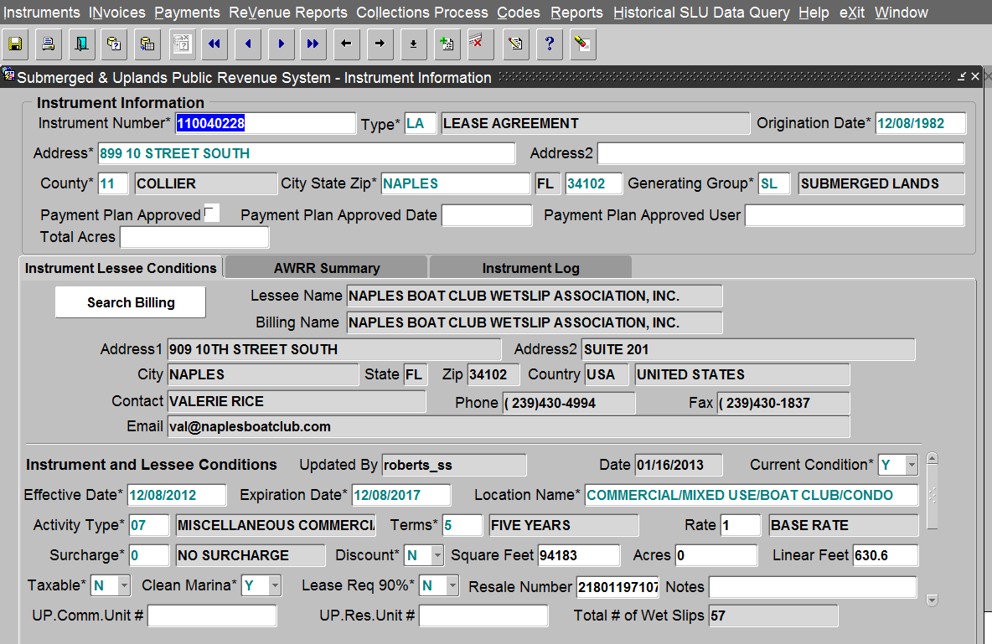
Facility Location Address
This is the View Instrument Screen
Billing Address
The Lessee Condition below tells us what type of facility and how to bill
House Bill Info.

Slide 11
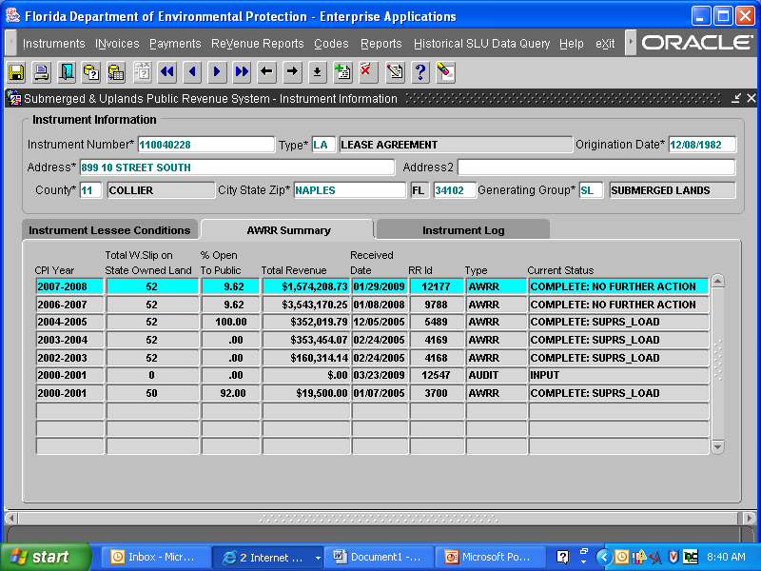
AWRR = Annual Wetslip Revenue Report
Audit in Progress
This revenue information is based on the self-reporting by the lessee
and is the amount that the 6% is based on.

Slide 12
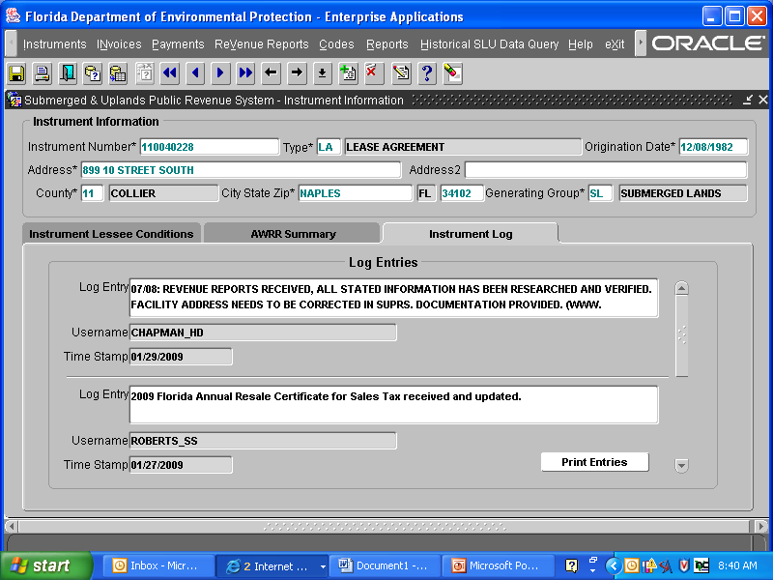
Instrument Log
Click Print button below to view all entries, you can also save as a PDF or print if needed. GO PAPERLESS ☺
These are the same notes that you would place in ILMS for compliance issues.

Slide 13

View Registry is a list of all invoices and payments received. To view the lease registry click on the button below.

Slide 14
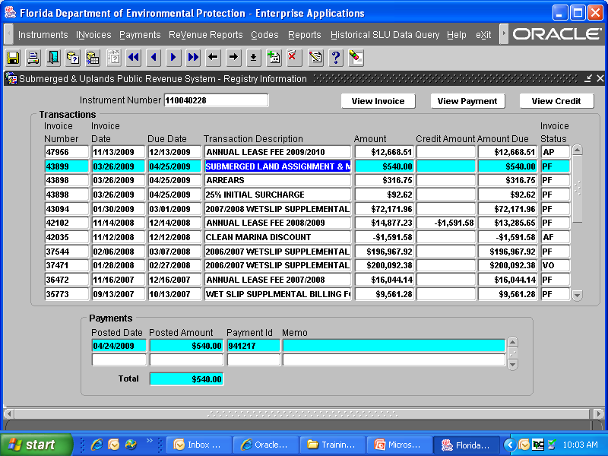
View Invoice/View Payment Above
Click View Invoice button to see this invoice or View Payment button to see the date of payment or the check number.
This is the View Registry Screen
The payment received box is linked to F&A Cash Receiving Application

Slide 15
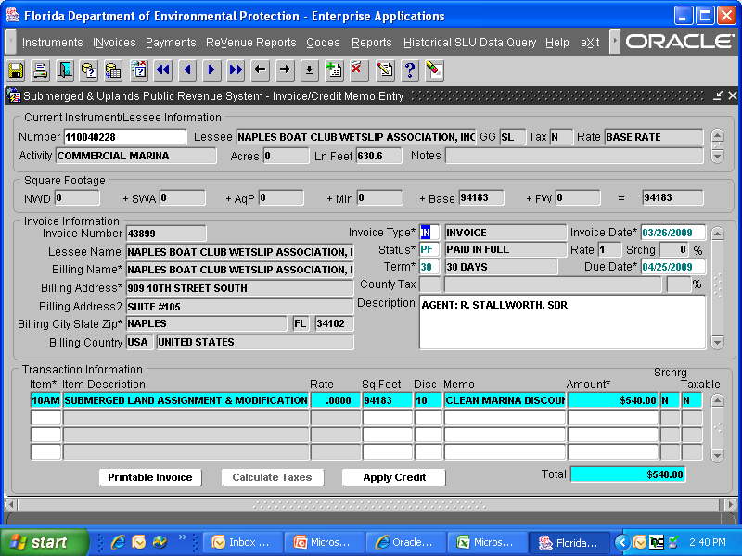
This is the View of Invoice Screen
The Printable Invoice button below will allow you to print, or save the invoice to a file to be attached to an e-mail. GO PAPERLESS ☺

Slide 16
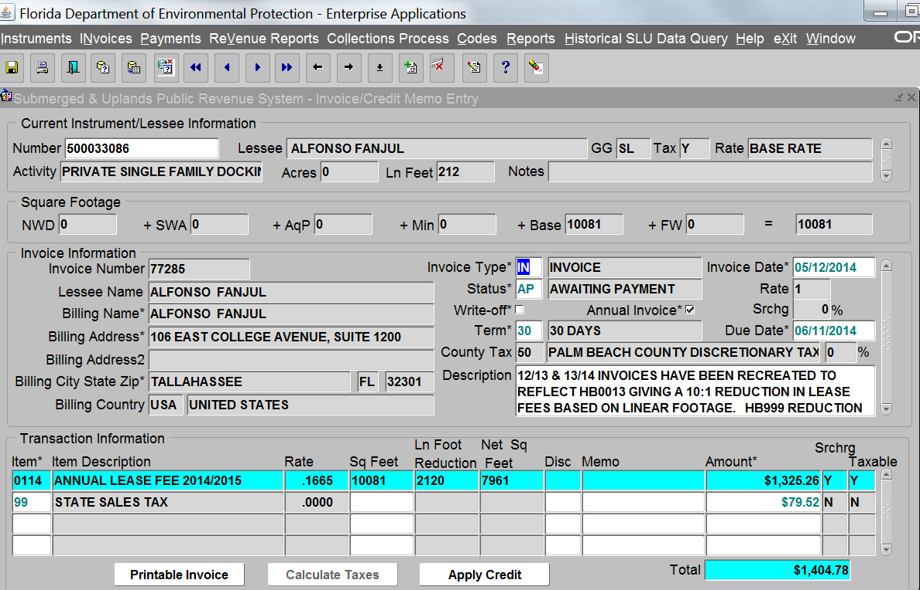
Below the invoice displays the rate, square footage, linear feet and the net area giving the 10:1 reduction.

Slide 17
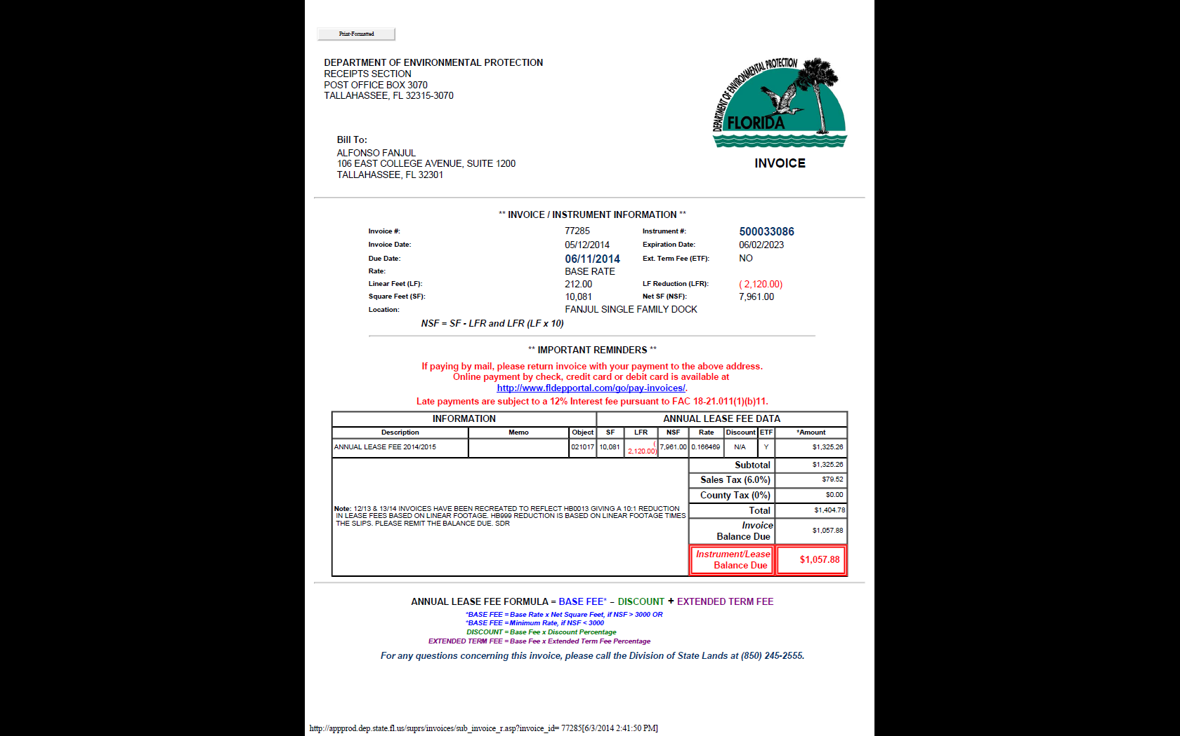
This invoice reflects the 10:1 fee reduction. This is a single family so there is no slip reduction

Slide 18
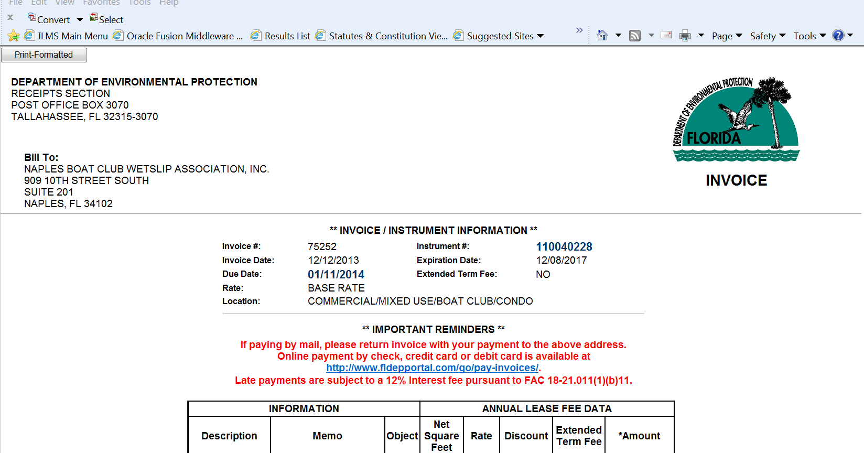
The Convert Button will save this document as a PDF and you can attach it to an e-mail. GO PAPERLESS ☺

Slide 19
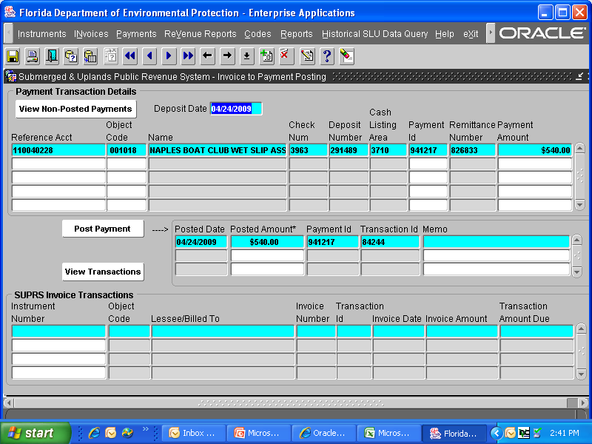
Click View Payment to see this page…..Deposit Date in CRA, Check Number, Amount Received, the payment is linked to the invoice.
This is a View of the Payment Screen

Slide 20
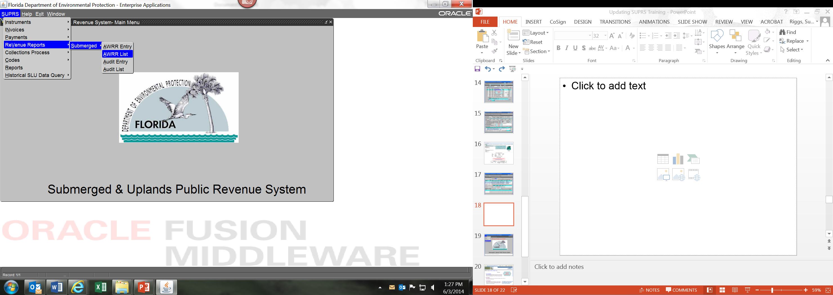
This tab gives you the ability to view the calculation – base fee or 6% of revenue whichever is greater.
You should query by the lease number to view the data entry.

Slide 21
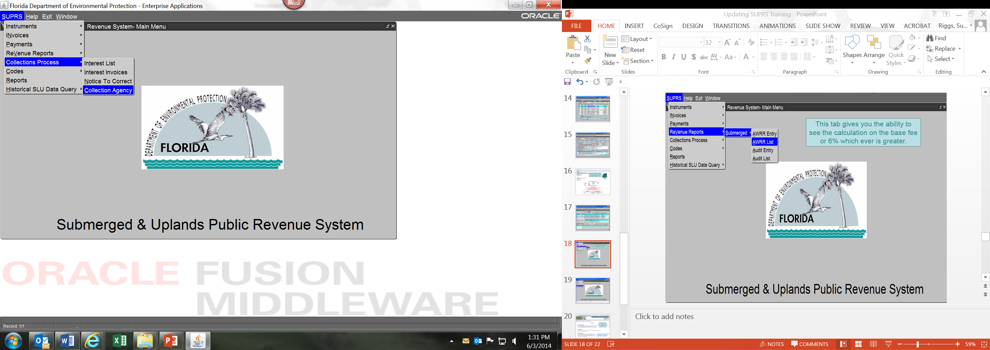
This tab gives you the ability to view the lease accounts that are assigned to the collection agency.
Once there you should query by the lease number to view the Collection Details.

Slide 22
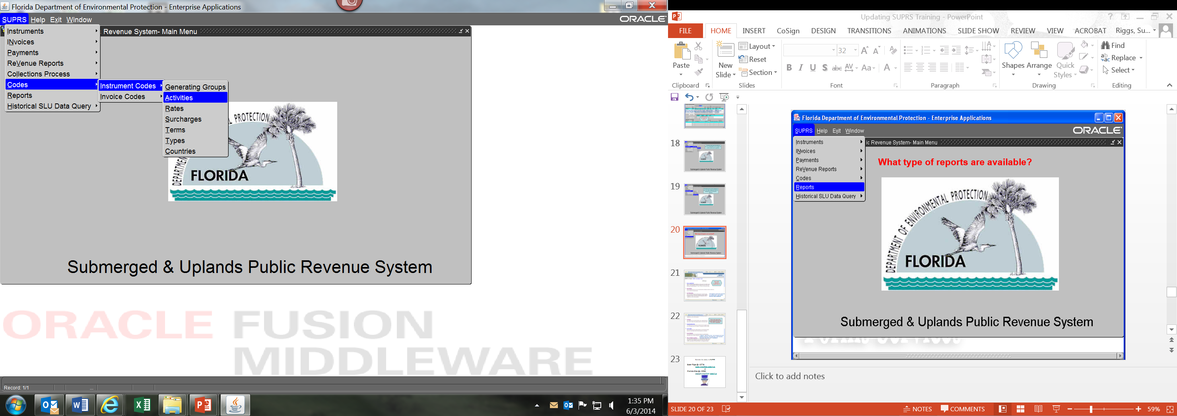
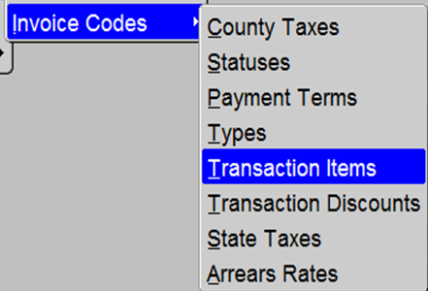
These are the codes for the instrument condition and the codes used when creating the invoice.

Slide 23
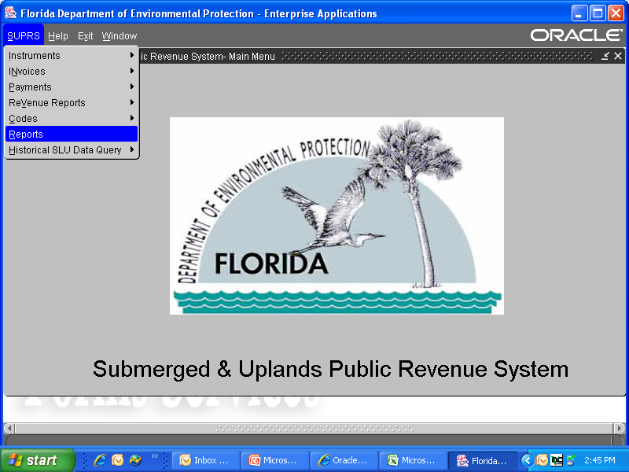
What type of reports are available?

Slide 24
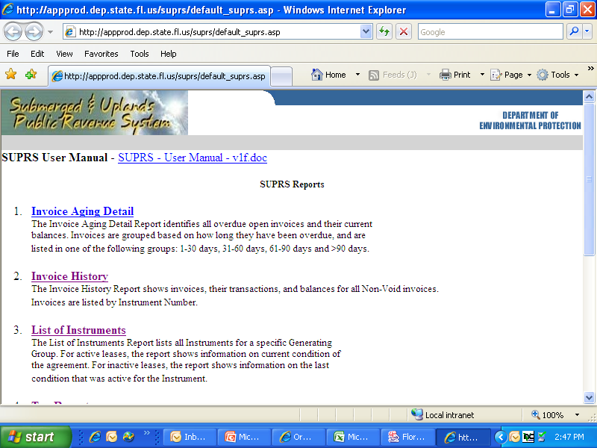
This is the View of Report Screen
This report will give you a List of all the Instruments and their lease conditions. You will need to save as an Excel file then sort by the current condition to remove any duplicates.

Slide 25
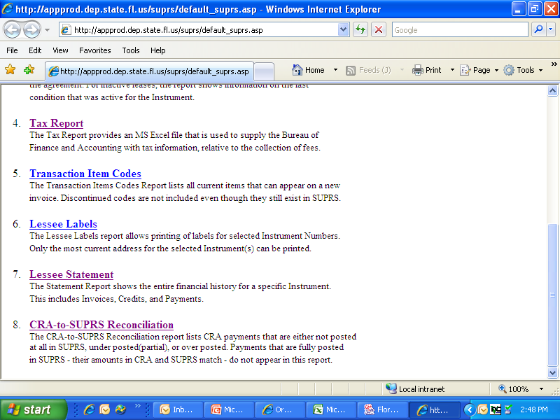
The Tax Report tells you all the dollars received within the time frame requested.
Using the Lessee Statement is the easiest way to view the history of invoices and payments but it will not show you any of the lease conditions. You should click on the invoice to view any attached notes.

Slide 26

Contacts for access to SUPRS
Susan Riggs @ x 52726
susan.riggs@dep.state.fl.us
or
Charlotte Shea @ x 52580
charlotte.shea@dep.state.fl.us

