Slide 1
Training Presentation
ILMS
Integrated Land Management SYSTEM
How to navigate the system

Slide 2
Introduction
The integrated land management system is a working database that collects and stores pertinent information on all active submerged lands leases and easements.
As a comprehensive tool, ILMS contains lease area information including but not limited to location, square footage, contact information of lessee, lease area structural characteristics such as number of wet slips, boat ramps, acreage, linear footage of the applicant’s shoreline, aquatic preserve designation, boatlifts, etc.
ILMS also contains the original effective date for each lease in addition to information on the current term of a lease and the duration of the term.
You’ll also find ILMS maintains a running log of comments associated with each lease/easement in addition to an overview of the account’s financial records.

Slide 3
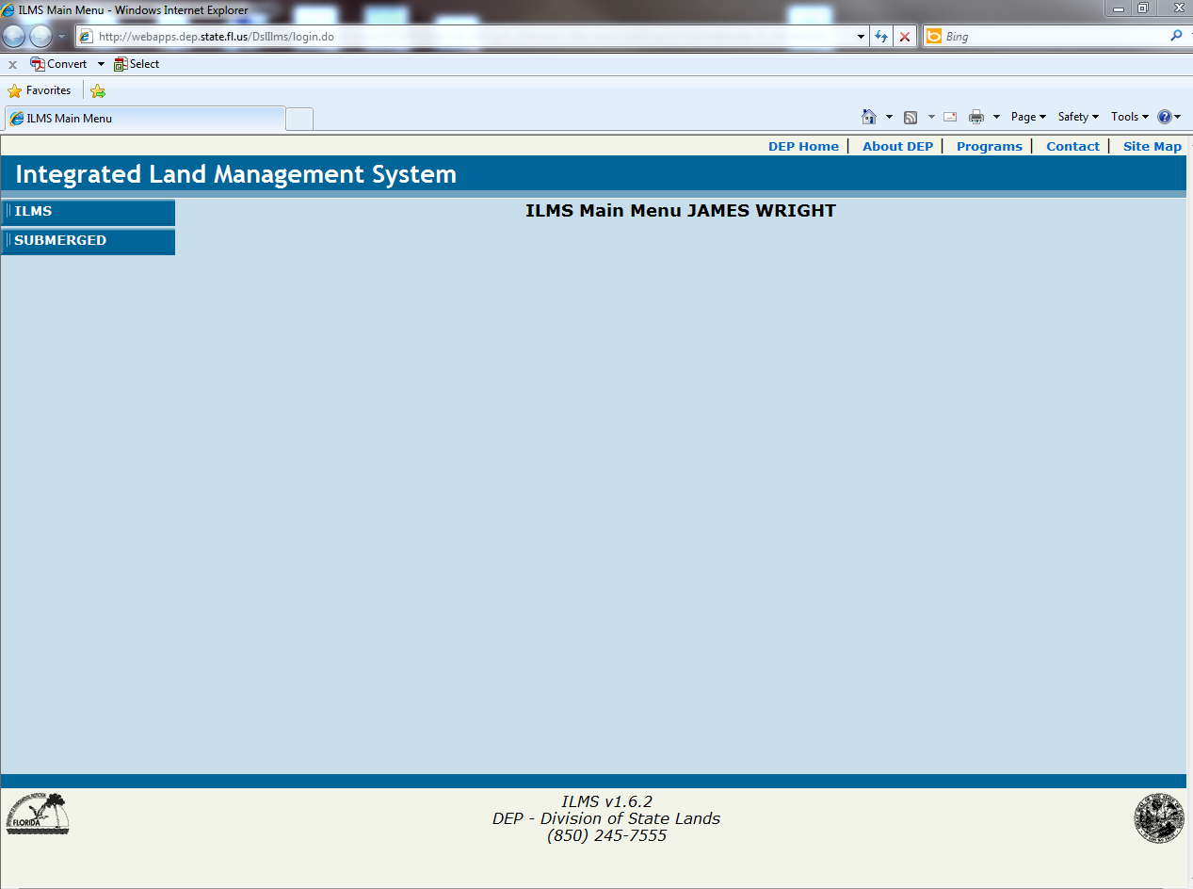
Make the above URL address a favorite for easy access.

Slide 4
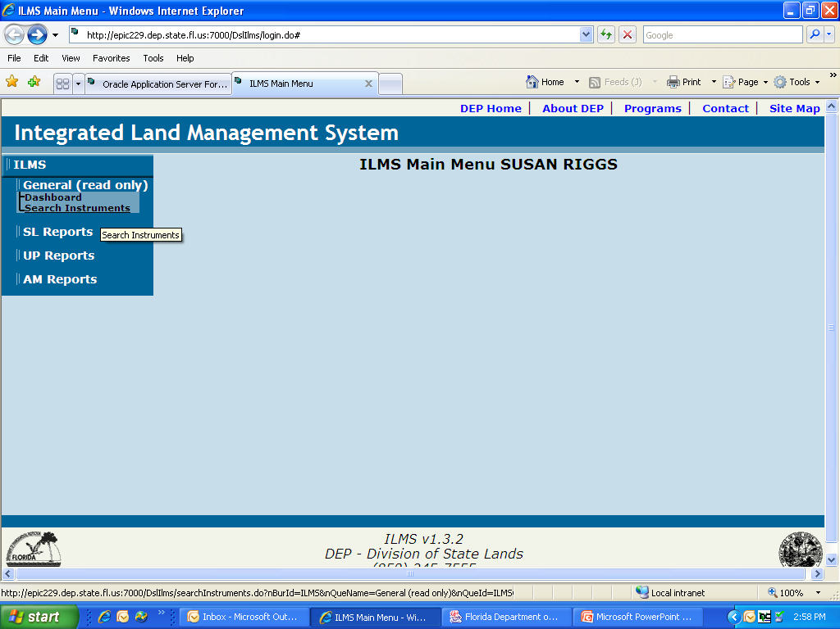
Search instrument tells you where the instrument action is in review and additional information on the facility
SL Reports do not have information that is relevant to district staff. UP Reports and AM Reports are in development and are not available at this time.

Slide 5
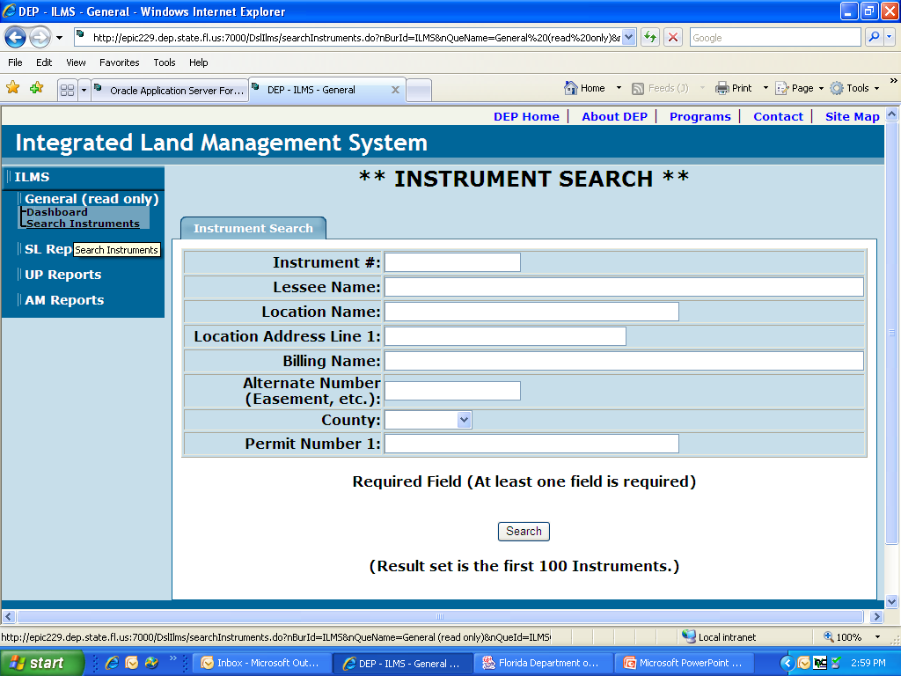
Input the instrument number below to search or the lessee name, you can only search by one criteria.

Slide 6
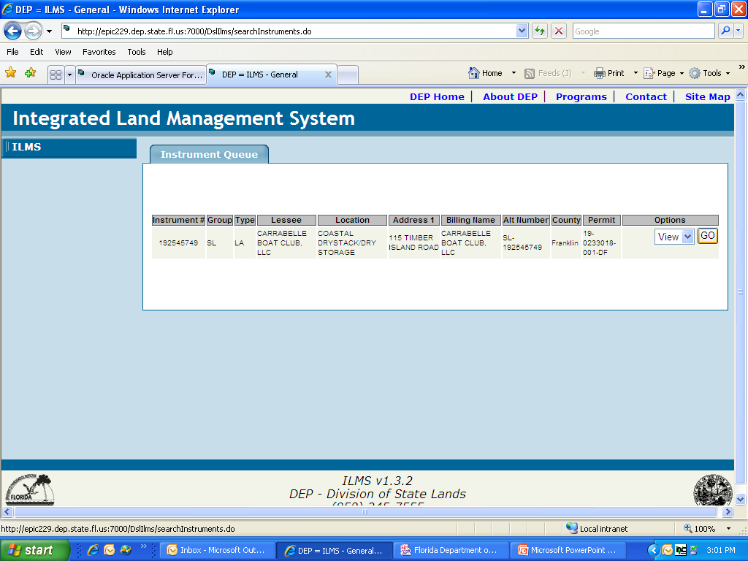
Click on the go button above to view

Slide 7
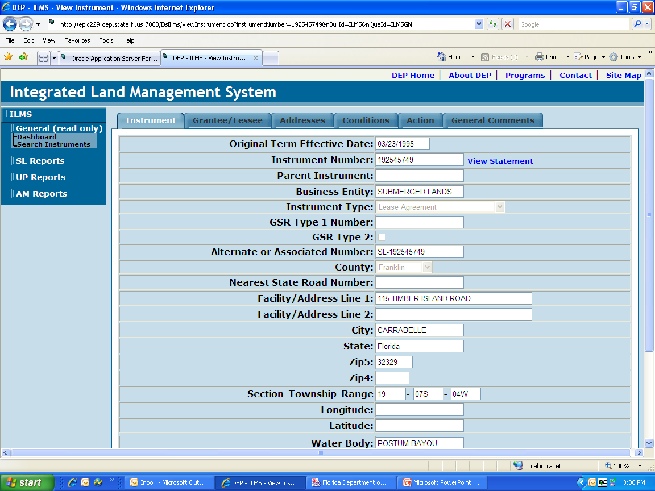
Link to SUPRS Statement
Instrument Information
The instrument information is displayed in a tabular format.

Slide 8
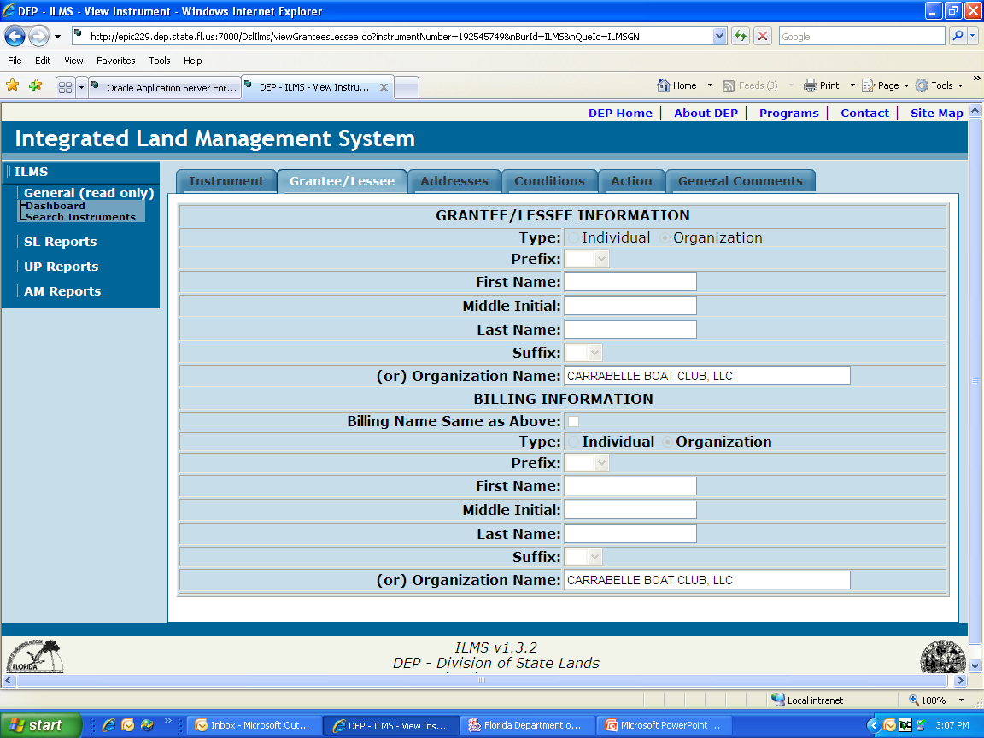
Grantee or Lessee Name
Billing name would be who you wanted the invoice to be sent to such as a management company

Slide 9
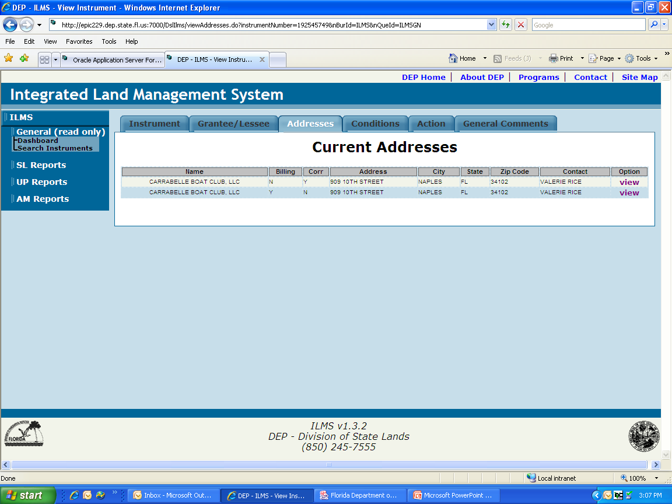
To view the address, click on the view button.
Two addressee, billing and correspondence these can be the same or different, the correspondence should be the address that is in the lease.

Slide 10
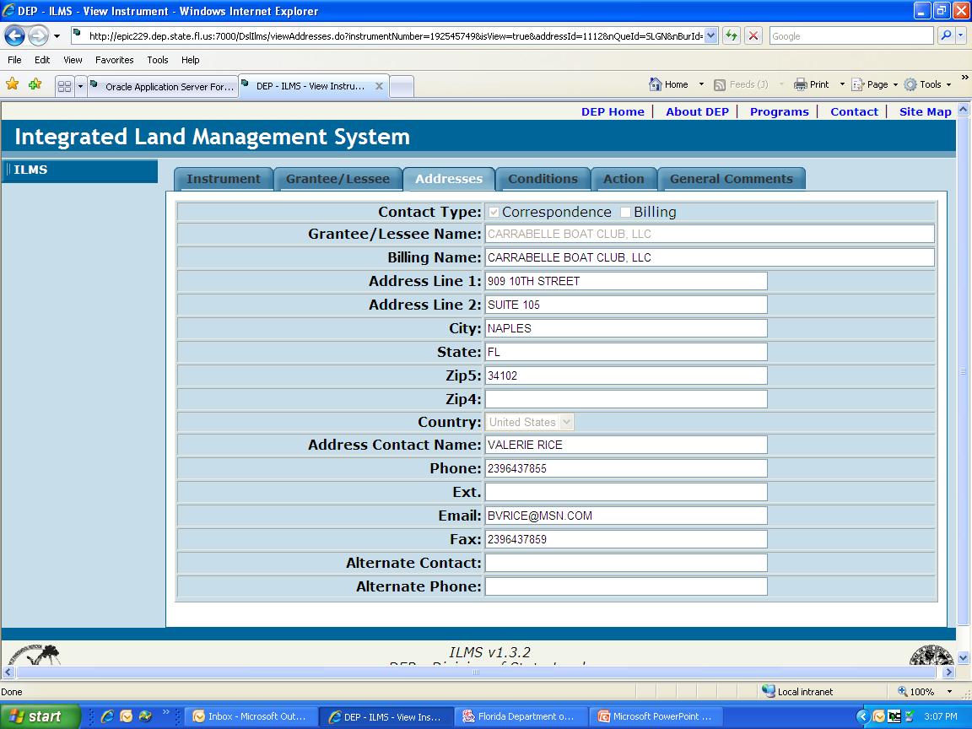
This is what the address looks like when you click on it. This is the correspondence address

Slide 11
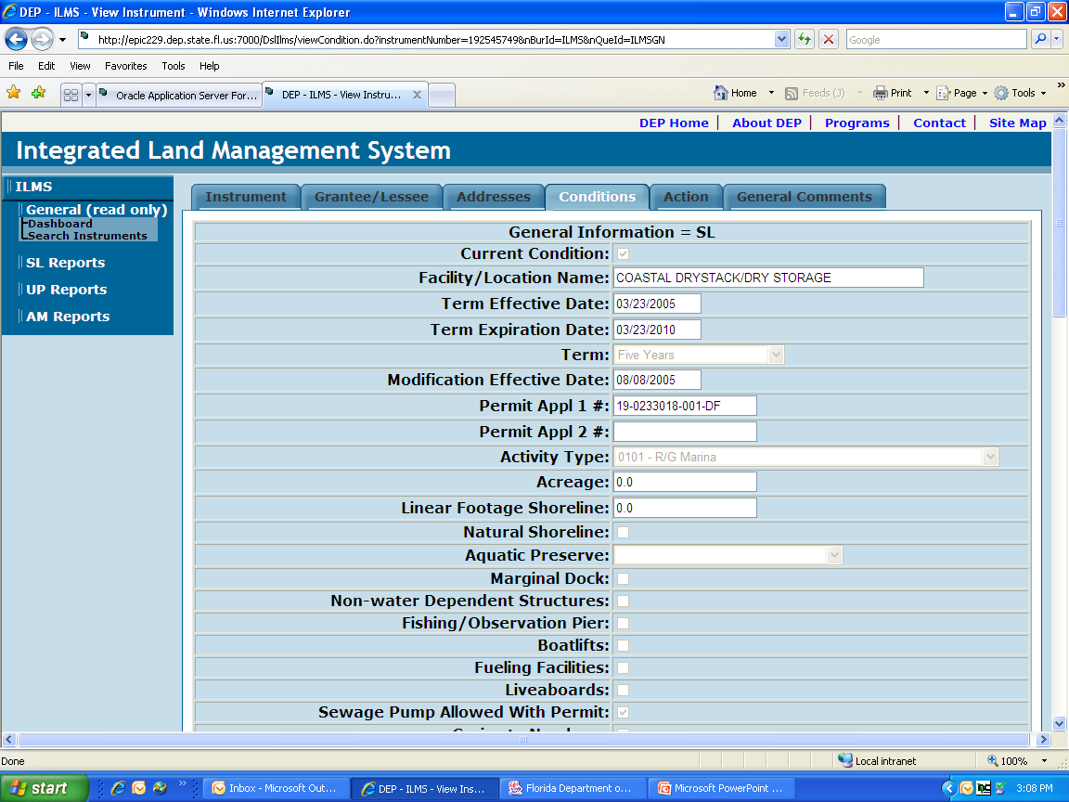
ty
The next three screens are the lease condition, lots of information on this tab, term, discount, permit #, type of slips, rate charged, square footage.

Slide 12
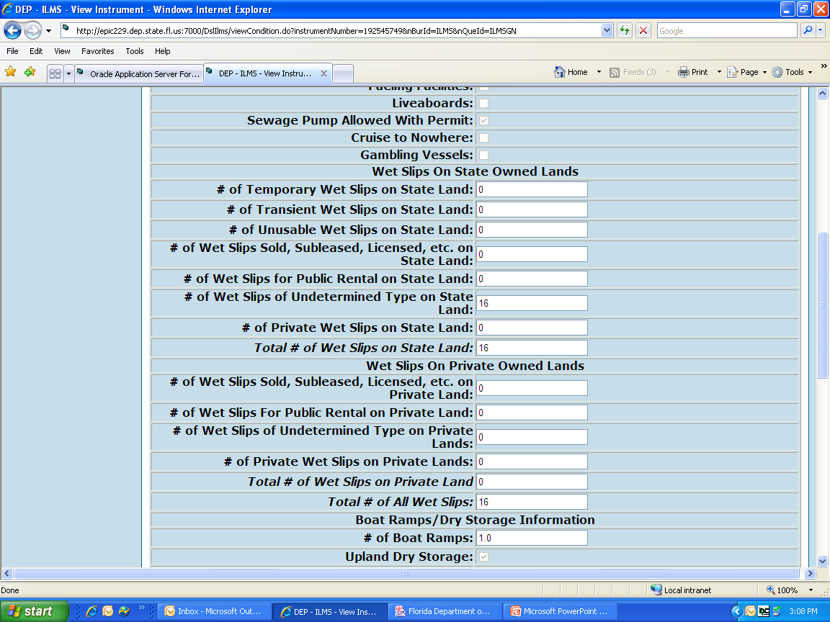
Pg 2 of Lease Condition

Slide 13
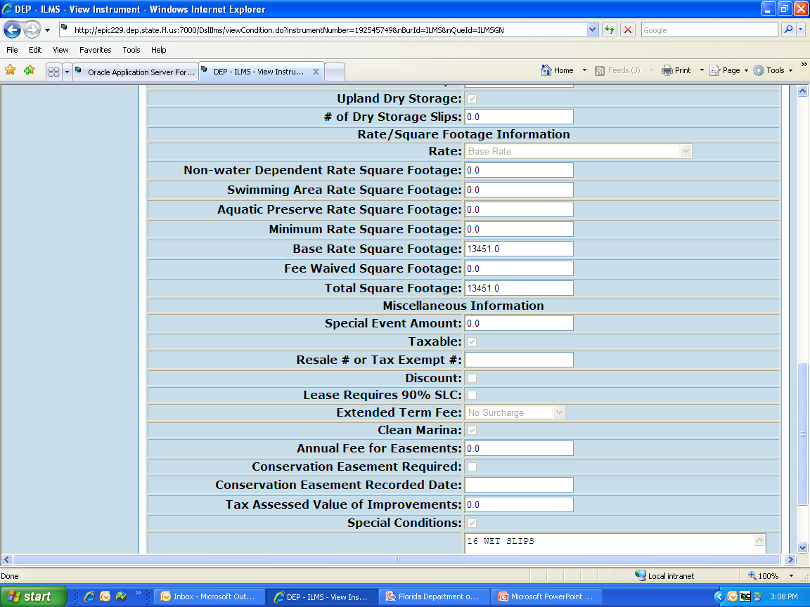
Pg 3 of Lease Condition

Slide 14
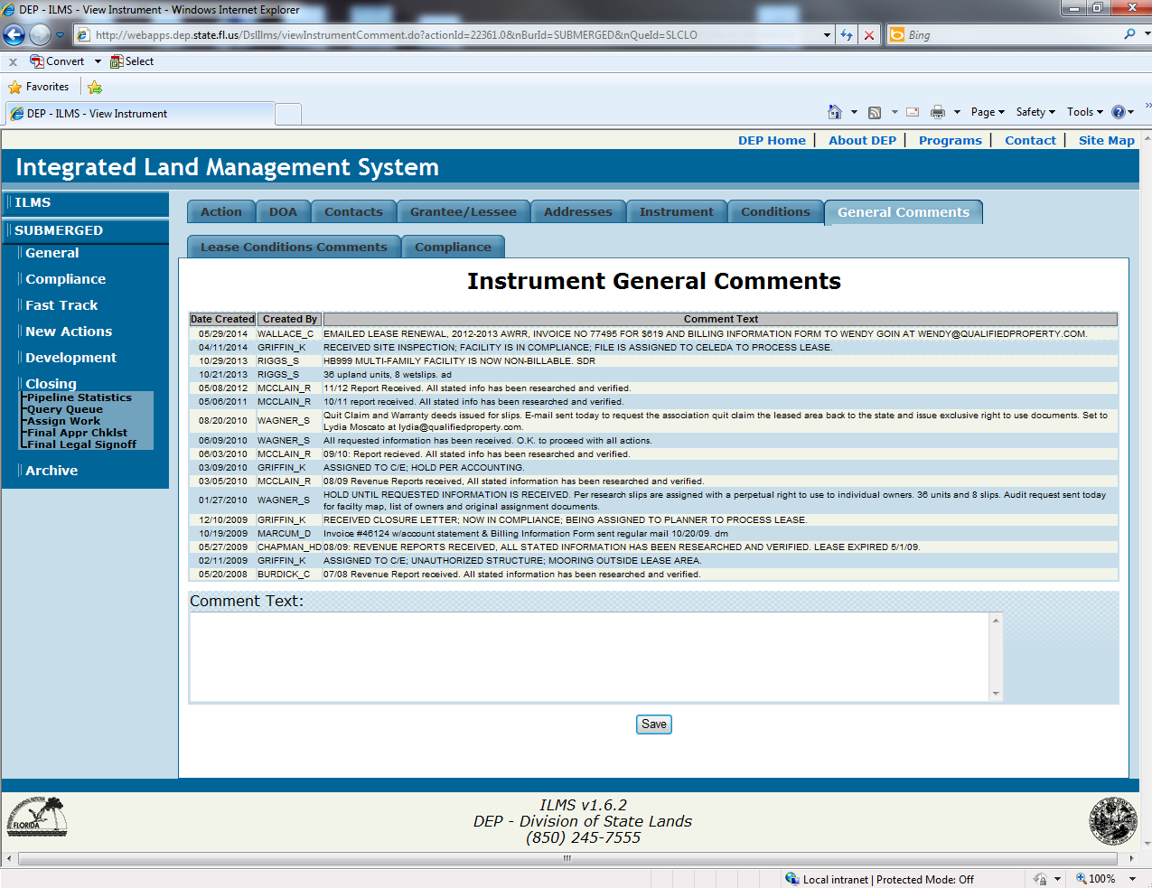
The comment section is a good place to find the status of a file, contact info, and when and where a lease was sent to.

Slide 15
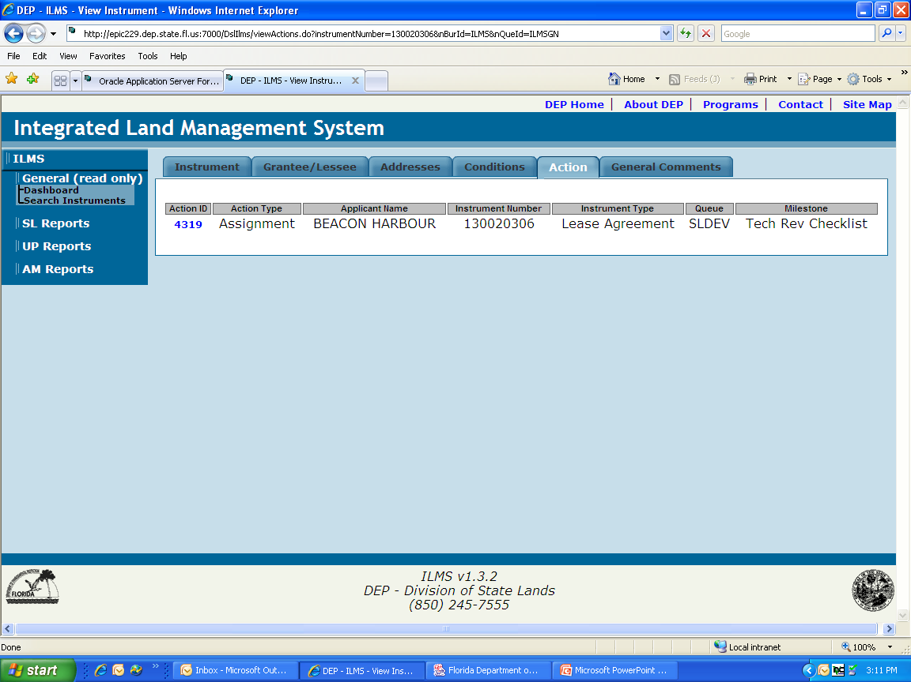
Click on the Action ID to see who has been assigned and what stage the action is in.
Action Tab, this tells you where the lease is and who it has been assigned too.

Slide 16
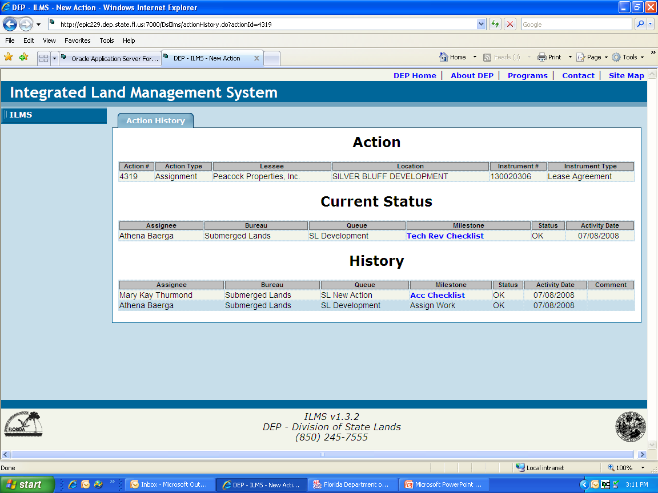
This is the staff person who is working the file.
Where it is located now.
assignee

Slide 17
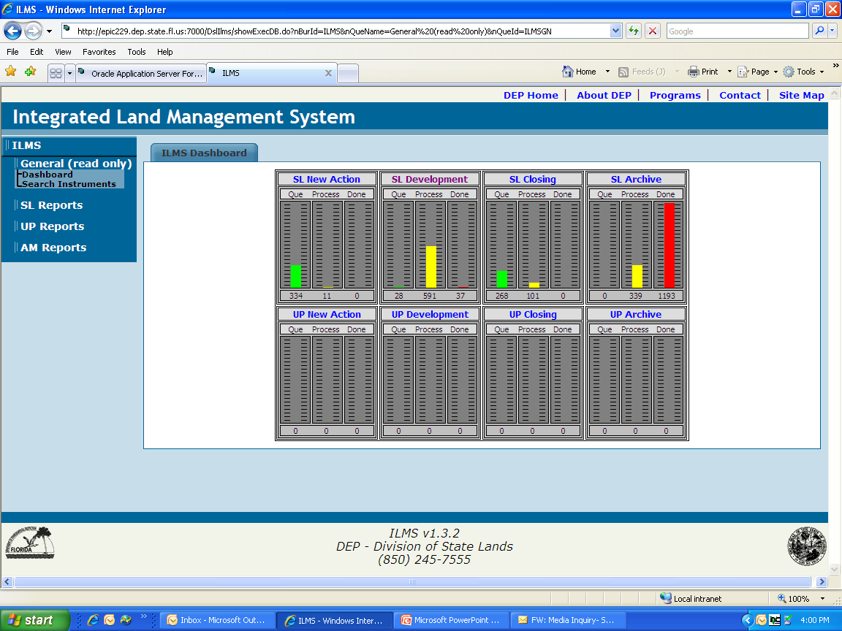
New Actions that have not been assigned
Closing Actions are completed actions
The DASHBOARD tells you where the file is located, it is a graphic representation of active actions that are happening in ILMS now.
Most important actions are in SL Development because they are still PENDING and can be changed or updated.

Slide 18
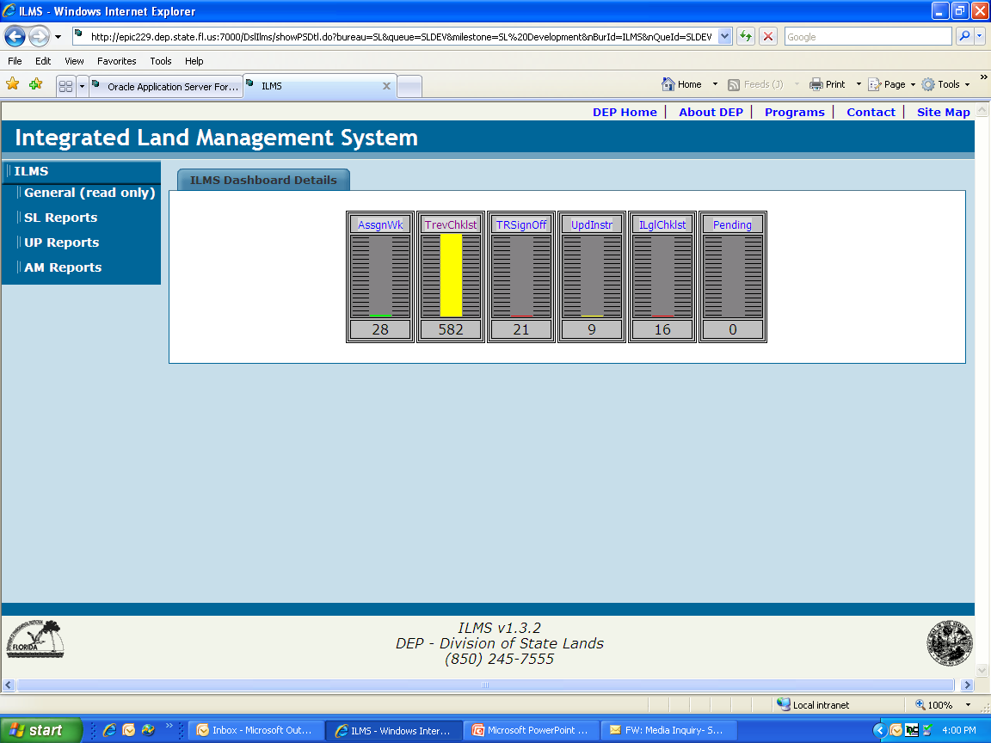
Click SL Development to get to this screen this tells you where the action is in the process of development. This is information that tell you what the Queue and Milestone are .

Slide 19
ILMS Navigation
Queue | Milestone | Description
SL New Actions | ACC Checklist | Initial review of the instrument package.
SL Development | Assign Work | Instrument Package is ready to be assigned to planner.
SL Development | Tech Rev. Checklist | Instrument is in the Planner’s Queue for processing.
SL Development | Tech Rev. Signoff | Instrument has been processed by planner and is pending technical review.
SL Development | Initial Legal Checklist | First legal approval pending prior to mailing instrument to lessee.
SL Development | Update Instrument | Instrument pending review by recurring revenue staff.
SL Development | Mail Out Checklist | Package has been sent to lessee for signature via US mail or electronically.
SL Closing | Assign Work | Awaiting return of lease package.

Slide 20
ILMS Navigation
SL Closing | Assign Work | Package has been seen to lessee for signature.
SL Closing | Final Appr Checklist | Package has been received from lessee.
SL Closing | Final Legal Signoff | Final Departmental signoff on request.
SL Archive | Assign Work | Assign to administrative support staff for filing.
SL Archive | Archive Checklist | Receive notification that instrument package has been recorded in official records office of county where structure is located.
SL Archive | Archive Signoff | Instrument Package approved for return to Archive Storage.

