Slide 1
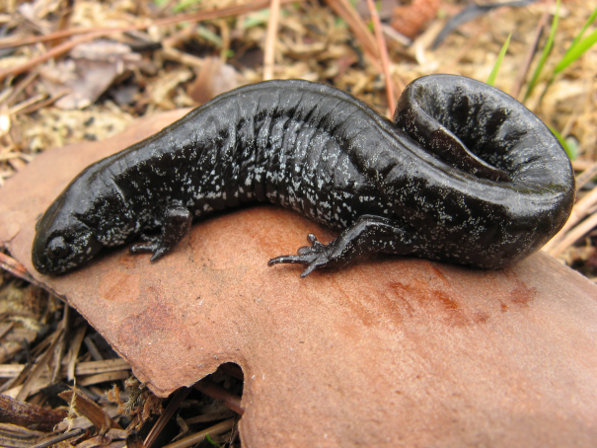
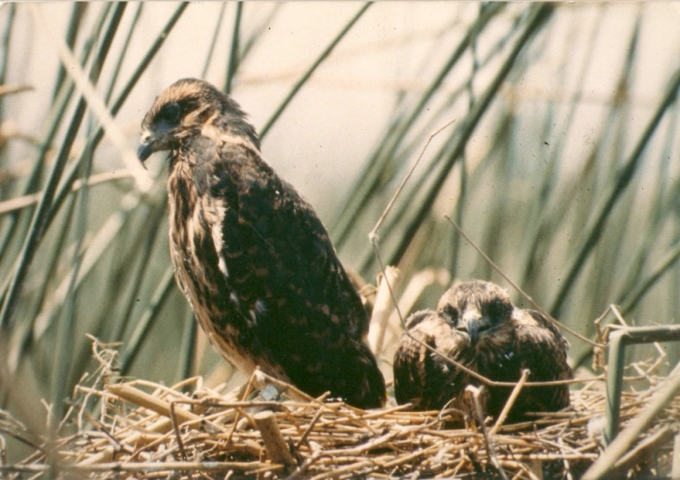
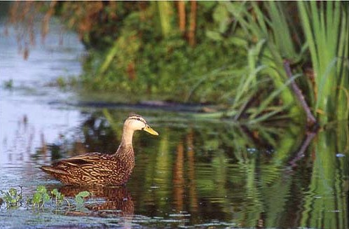
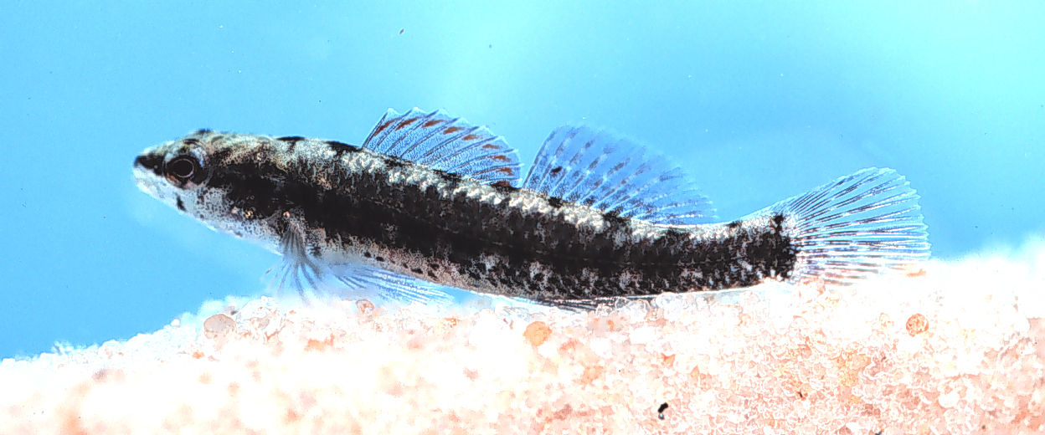
Aquatic Habitat Conservation and Restoration Section
Division of Habitat and Species Conservation

Slide 2
The mission of this section is to manage, enhance and preserve aquatic habitat in Florida for the benefit of wildlife, aquatic life and the people of Florida.

Slide 3
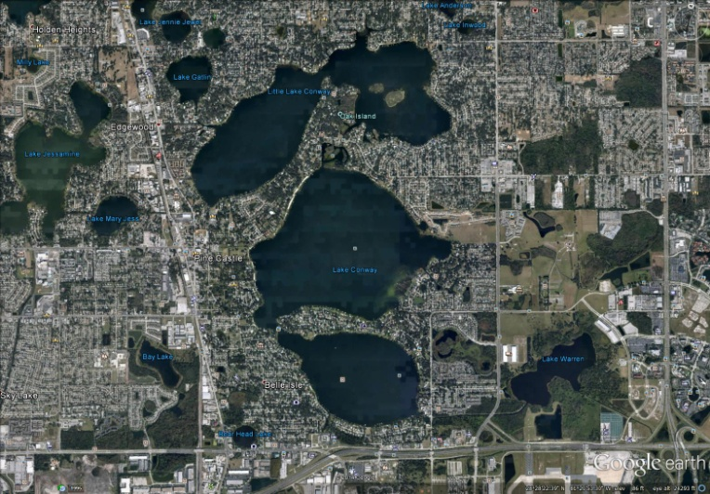
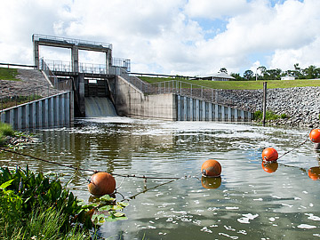
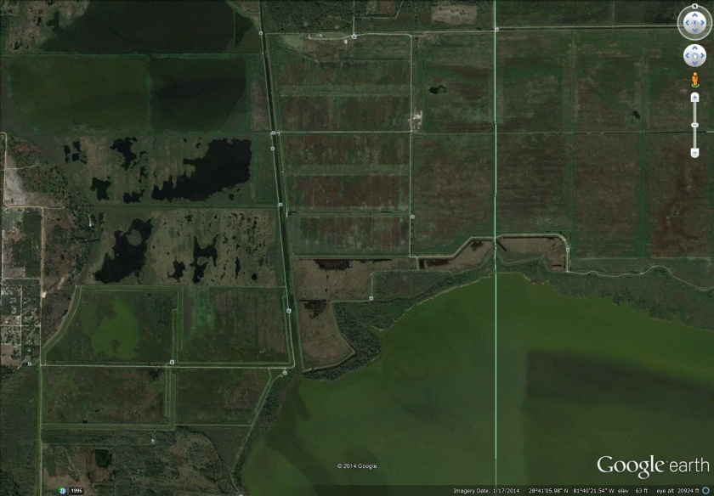
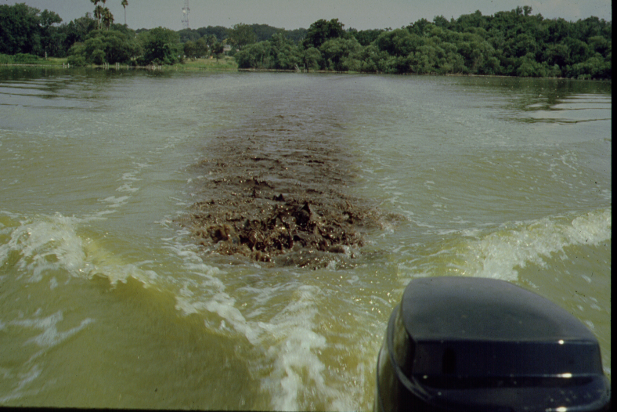
Very Few “Natural” Water Bodies in Florida

Slide 4
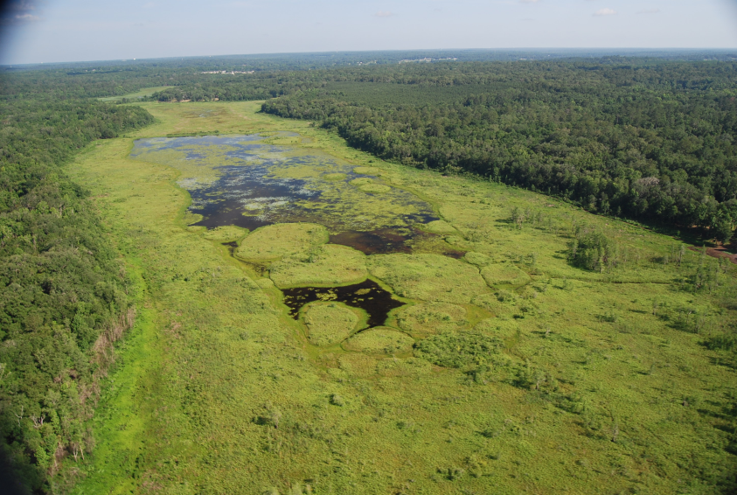
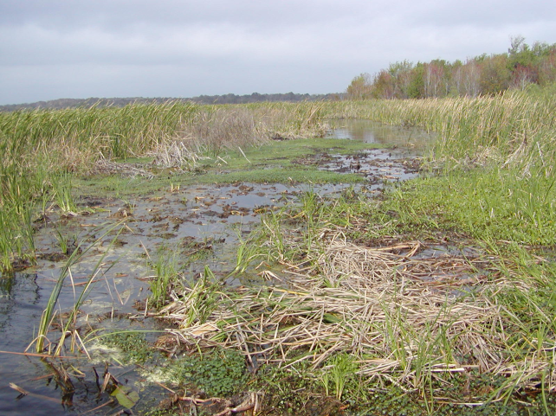
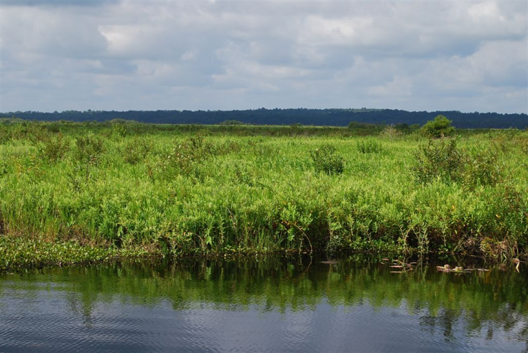
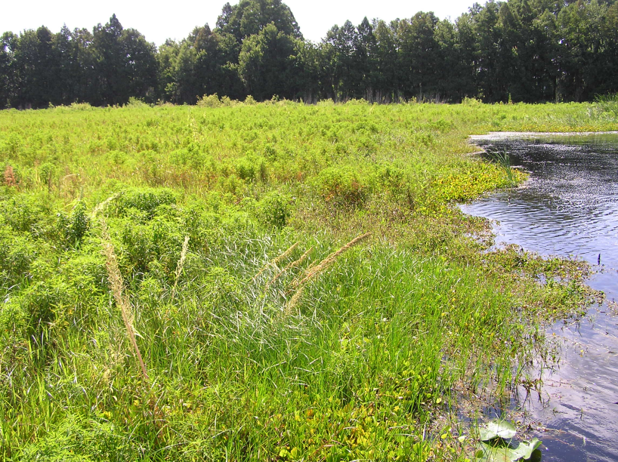
Accelerated Succession

Slide 5
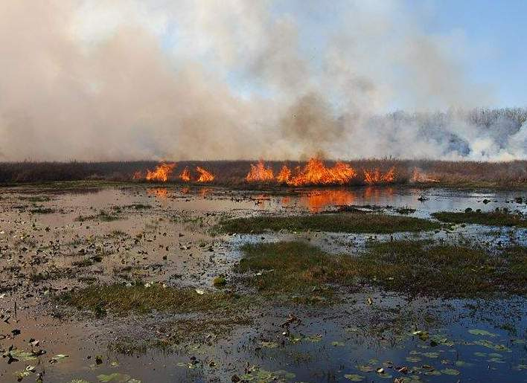
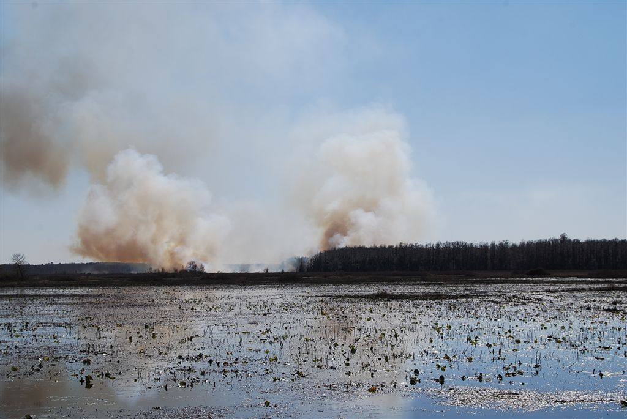
Fire Exclusion

Slide 6
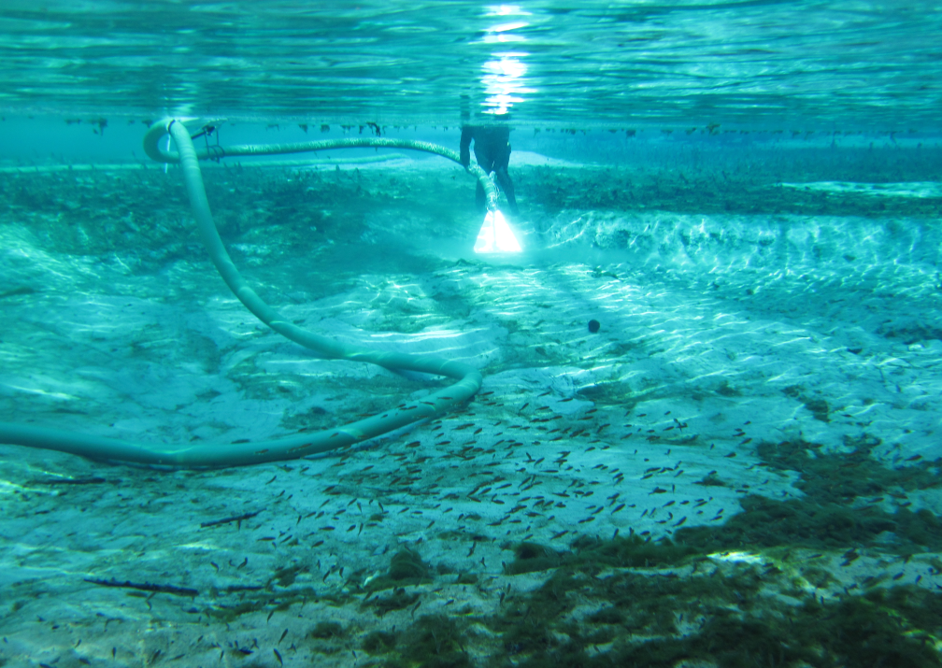
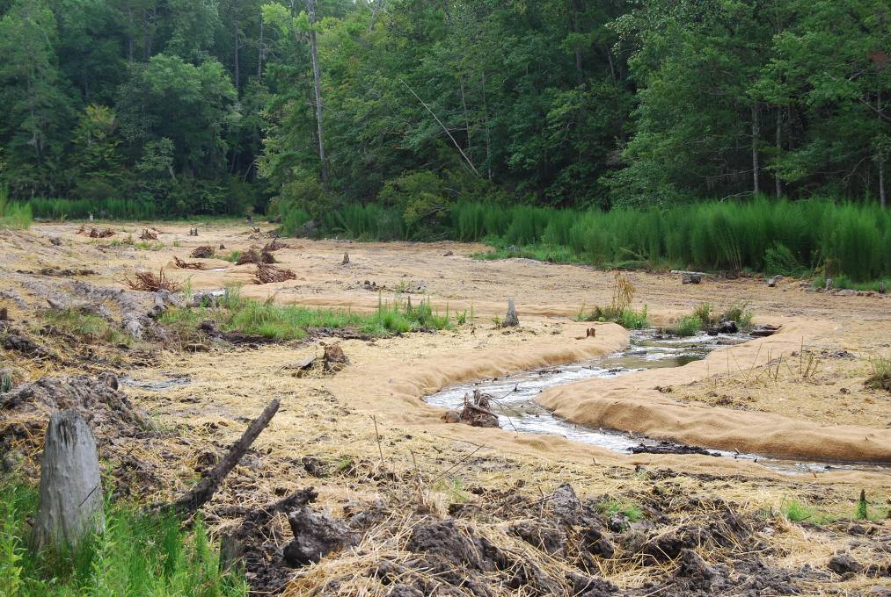
Florida’s Aquatic Habitat Restoration
& Enhancement Program (AHRES)

Slide 7

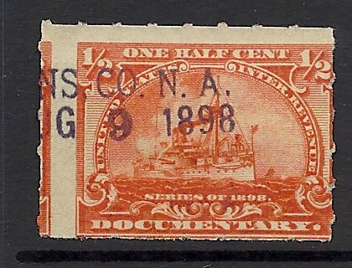

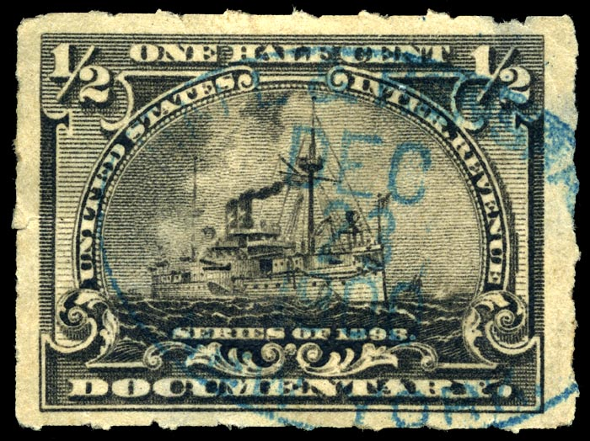
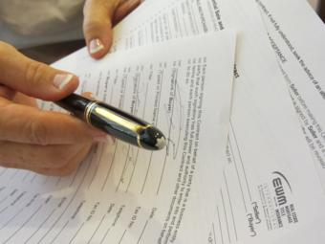
Notes:
Funding for the program is generated from documentary stamps. These are "stamps" which are literally affixed to a deed in any real estate transaction that occurs in the state. Both the buyer and/or the seller pay this tax, which is about 1% of the transaction amount or $1.00 for every $100. The buy and the seller can negotiate who and how much each will pay. Never-the-less, the AHRES program receives ¼ of 1% of documentary stamps levied on real estate transactions.
Since 2001, funding has averaged about 5 million each year and collectively, these funds have been used to restore and enhance over 300 projects affecting hundreds of thousands of acres of freshwater habitats here in the state.

Slide 8
Guiding Principles
Project Must Occur on Public Lands (Sovereign Waters) or on Lands With Guaranteed Public Access
Project Site Must Be “Wet” and Freshwater or Brackish Interface
Project Must Be For Aquatic Habitat Enhancement and Not Access Directed

Slide 9
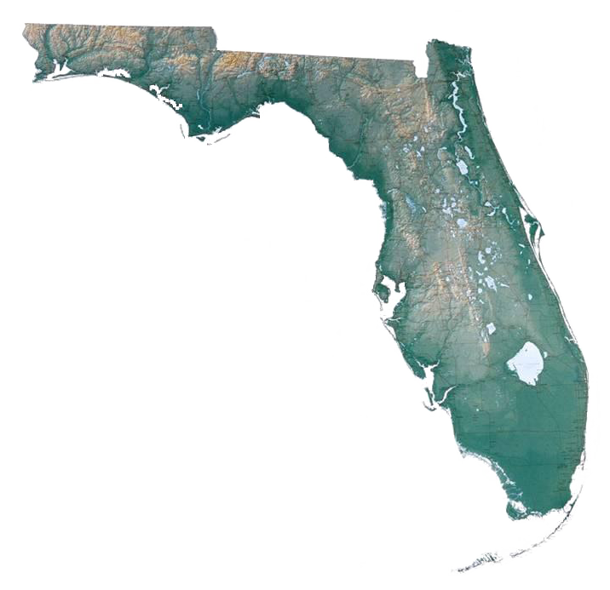
Tallahassee/
Panhandle Region
Upper/Middle St. Johns River basin
Ocklawaha/Orange Creek Basin
Kissimmee
River Basin
West Central Region
Lake Istokpoga
AHRES Staff:
Lake
Okeechobee/South Florida
Notes:
AHRES staff, which are distributed throughout the state, cover a specific geographic territory.
Discuss slide
They are responsible for coordinating with other FWC staff, such as wildlife management area biologists, fisheries biologist, and other agency resource biologists, within their region to identify restoration and enhancement projects.

Slide 10
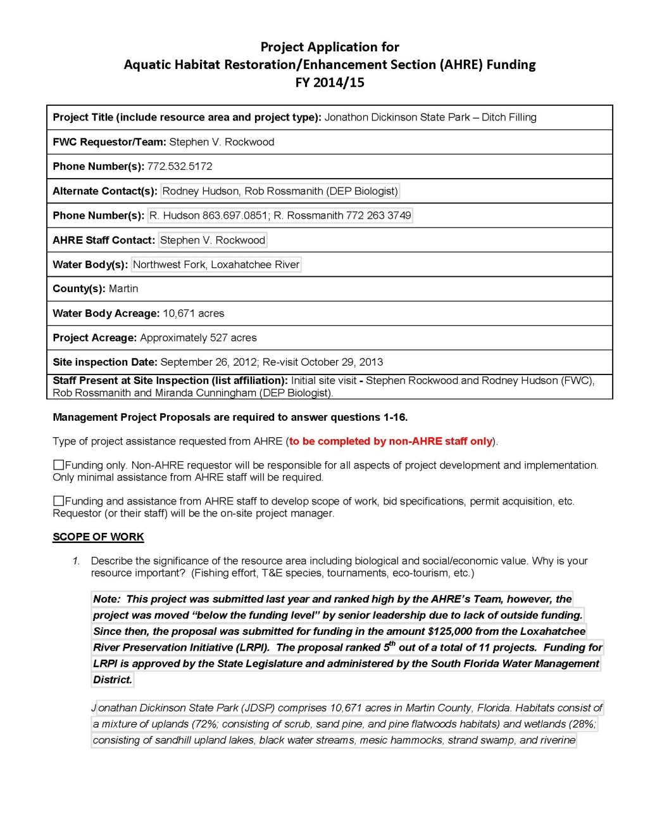
AHRES Funding Application
Required Information
  need for the project
  significance of the resource
  proposed activities
  project objectives
  monitoring and evaluation
  impacts to fish and wildlife
  expected benefits
  project timeline
  budget

Slide 11
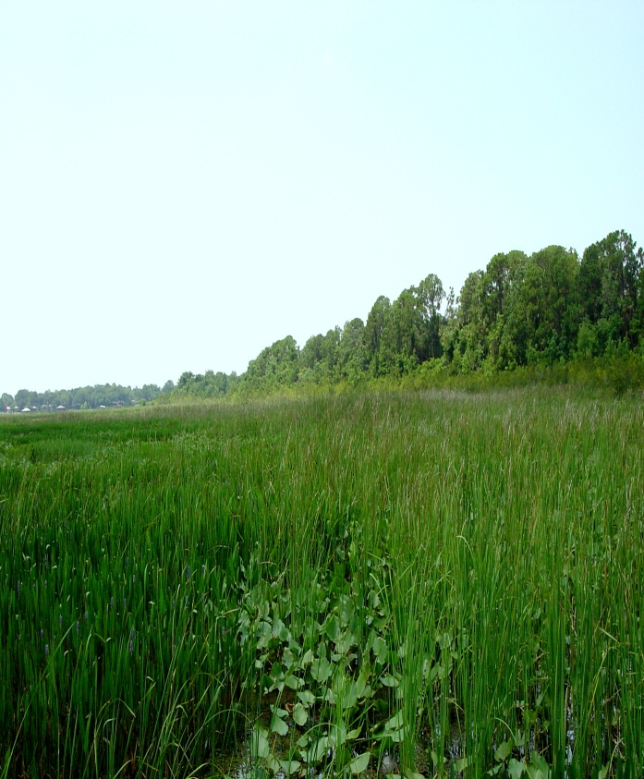
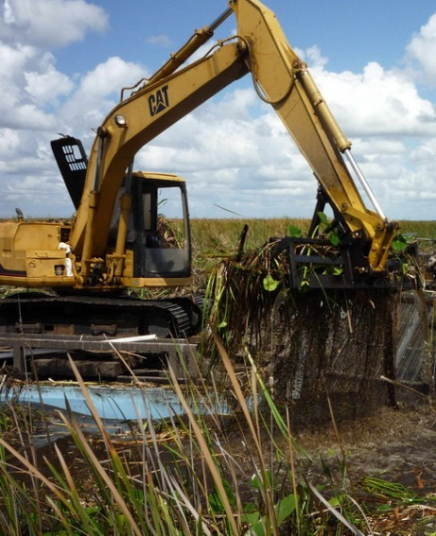
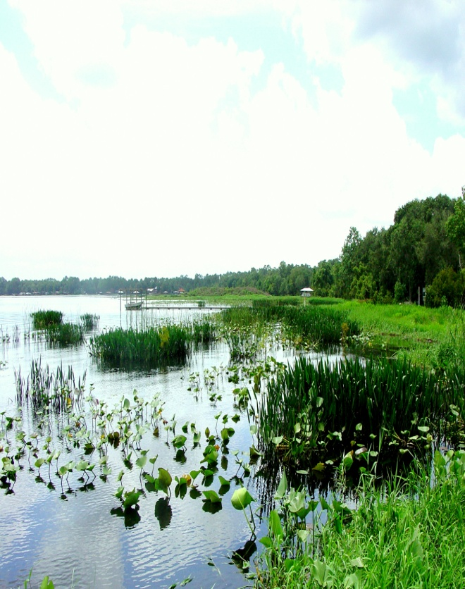
Aquatic Restoration Prioritization and Evaluation Tool (ARPET)
An analytical process for identifying high priority water bodies for FWC aquatic habitat restoration/enhancement projects.
Fish & Wildlife
Socio - Economics
Management Emphasis
LAKE SCORE
Notes:
Since the number of restoration opportunities is overwhelming and funding is limited.
Developing an analytical approach to identifying high priority lakes was considered a critical component for executing a more expedient and cost effective framework for restoration management in Florida.

Slide 12
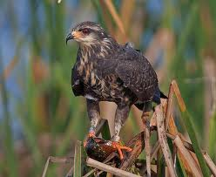
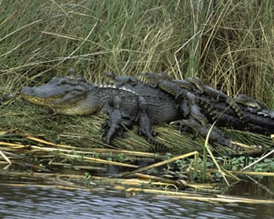
FISH & WILDLIFE POPULATIONS
PARAMETERS
Lake Size
Wetland Connectivity
Freshwater Fisheries Management Priority Lakes
USFWS Avian Focus Areas
Snail Kite Priority Nesting Areas
Alligator Management Units
Threatened & Endangered Species Occurrence
Notes:
Our next category was designed to highlight the benefits of each lake as assessed by fish and wildlife function.
The ecological significance of each lake was determined by its size, its proximity and connectivity to wetlands, the quality of its fishery, the presence of priority wildlife habitat and the utilization by threatened and endangered species.
We hope this type of data can be used to identify and develop projects that will provide ecological benefits to the greatest number of species.
Lake Size -The larger the lake is, the greater the potential for 1) fish and wildlife benefits, 2) diversity and abundance, and 3) habitat availability.
Wetland Connectivity
DFFM Priority Lakes
USFWS Avian Focus Areas - Florida is a part of the Atlantic flyway -AFA’s provide important nesting, foraging, and wintering habitats for numerous waterfowl and waterbird species
Snail Kite Priority Nesting Areas
Alligator Management Units
Threatened & Endangered Occurrence – Our lakes provide habitat for numerous federally and state listed wetland dependent species

Slide 13
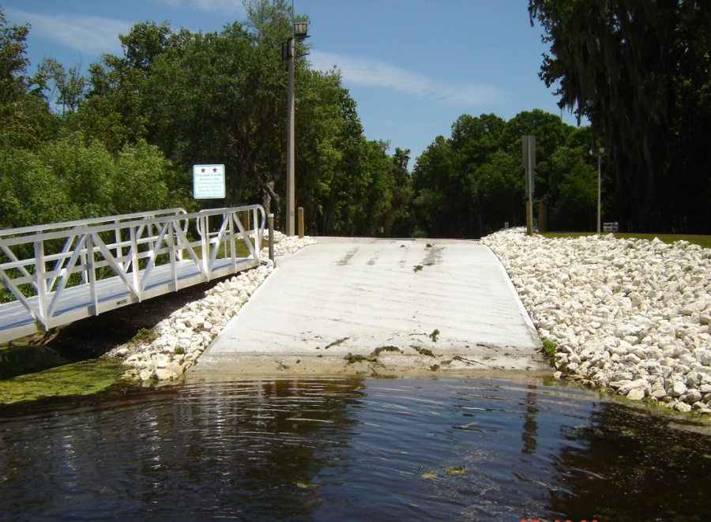
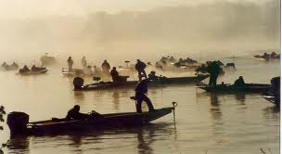
SOCIO-ECONOMIC IMPORTANCE
PARAMETERS
Boat Ramps
Existing Recreational Trails
Great Florida Birding Trails
Fish Management Areas
FWC Permitted Bass Tournaments
Alligator Egg Collection Lakes
Population (50 mile radius)
Notes:
Our first category was designed to evaluate the opportunities for public use and the economic benefits each lake provides.
Identifying restoration projects on lakes with public boat ramps, adjacent to existing trails, or those designated as priority fishing areas increase public awareness and insure recreational use by a variety of users.
The data can utilize this data to identify those lakes where the potential for public use is the highest.
Boat Ramps - Public boat ramps provide access to numerous recreational opportunities and utilization of them contributes to the state’s economy.
Existing Recreational Trails - More people travel to Florida to view wildlife than any other state. Trails provide economic opportunities through nature-based tourism.
Great Florida Birding Trails
Fish Management Areas are important to local anglers and recreationists.
FWC Permitted Bass Tournaments -Bass tournaments are an important recreational attraction. For instance, the Bass Master Classic generated an estimated $25 million during its three-day event on the Kissimmee Chain of Lakes.
Alligator Egg Collection Lakes
Population (50 mile radius)

Slide 14
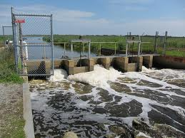
MANAGEMENT EMPHASIS
PARAMETERS
Outstanding Florida Waters
Conservation Lands
Trophic State Index
Water Quality Restoration
Managed Water Control Structures
AHCR Funded Projects
Invasive Plant Management Funded Projects
Notes:
The final category relates to the opportunity and need for aquatic habitat restoration.
Effective lake management depends on understanding the relationship between a lake and its surrounding landscape, current conditions, existing management, and future maintenance requirements. The data layers selected for this category, give emphasis to higher quality lakes that have already received investments, and those that have the greatest potential to benefit from additional restoration efforts.
Outstanding Florida Waters – For instance, Public lakes that were designated as OFW’s afford a higher level of protection were considered a priority and are scored higher than those not designated as such.
Conservation Lands -Lakes that are surrounded by conservation lands have greater potential to be restored, as they are buffered from anthropogenic disturbances.
Trophic State Index
Water Quality Restoration
Managed Water Control Structures -lakes with water control structures have the potential to be more easily manipulated for habitat management activities
AHCR Funded Projects - The data layer included the location of all lake funded projects over the last 10 years, the number of years the lake has received management activities, and the total amount of funding for each year
Invasive Plant Management Funded Projects

Slide 15
AHRE Standing Team
  Team members consist of biologists who serve as subject matter experts representing various fish and wildlife focal taxa groups.
  Advocate development of project proposals on an annual basis and prioritize a list of AHRE project proposals for funding consideration.

Slide 16
Tallahassee Review and Ranking
AHRES Administrators
Habitat and Species Conservation Division Leadership
Wildlife Habitat Management Section Leader
Invasive Plant Management Section Leader
Freshwater Fisheries Research Section Leader
Division of Freshwater Fisheries Management Staff

Slide 17
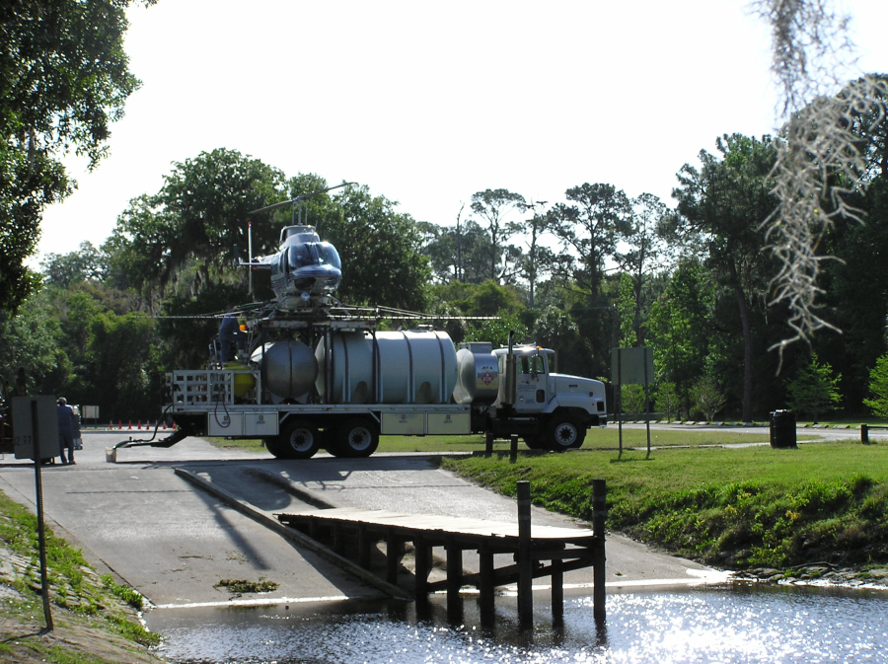
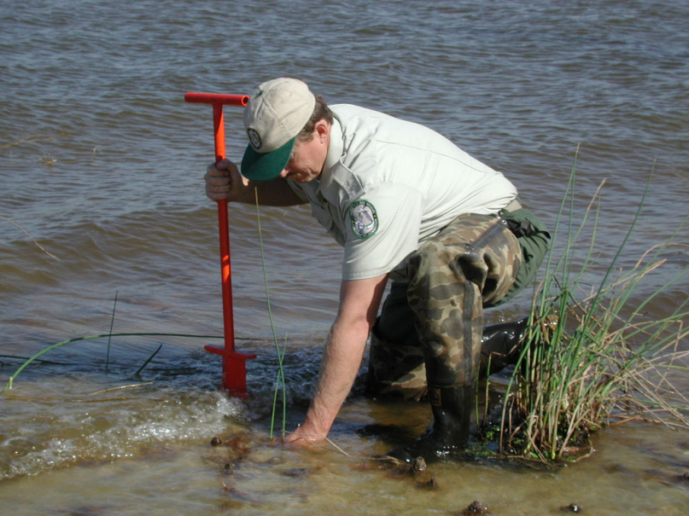
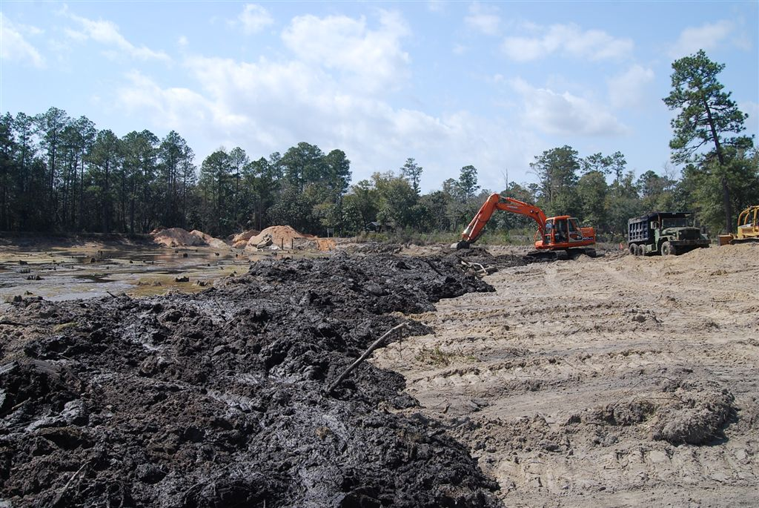
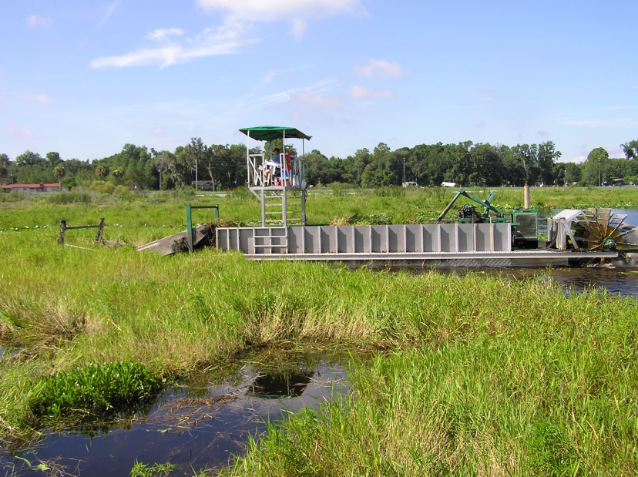
Types of Projects

Slide 18
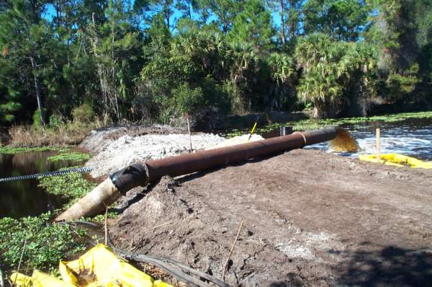
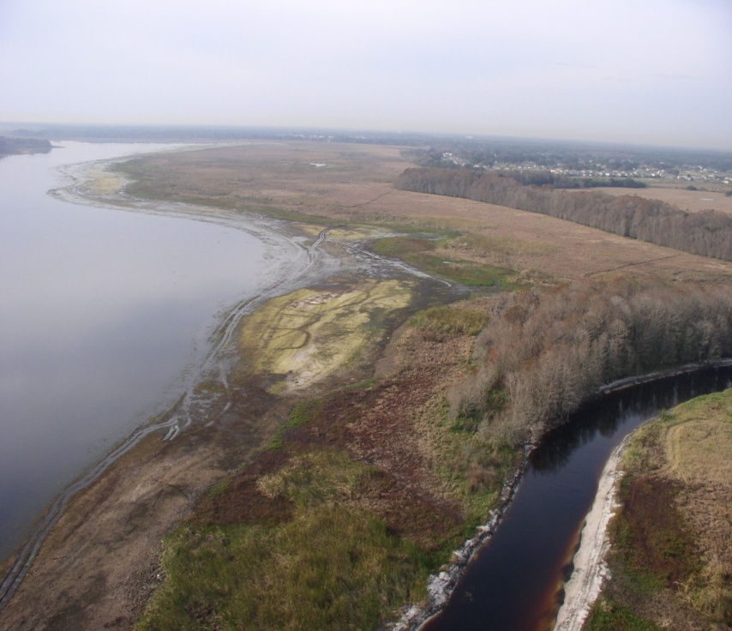
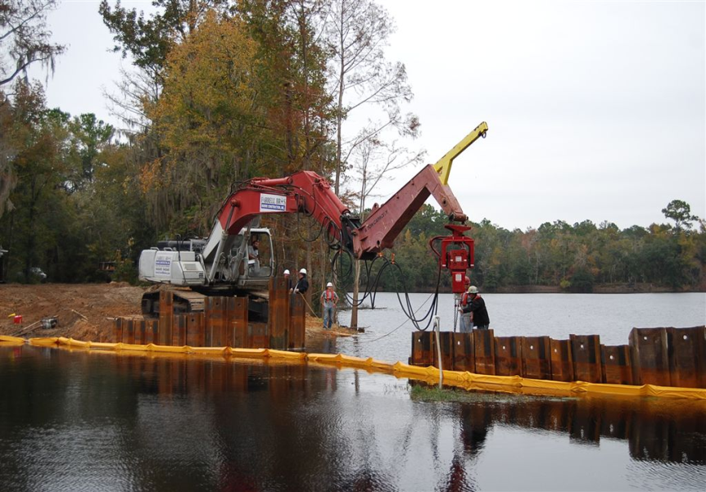
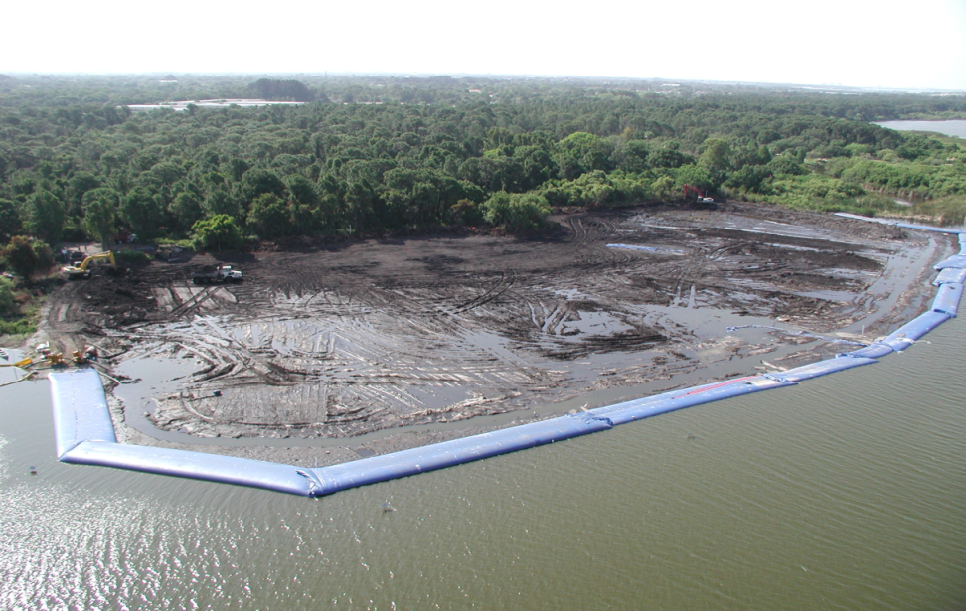
  Pump
  Gravity
  Drawdown

Slide 19
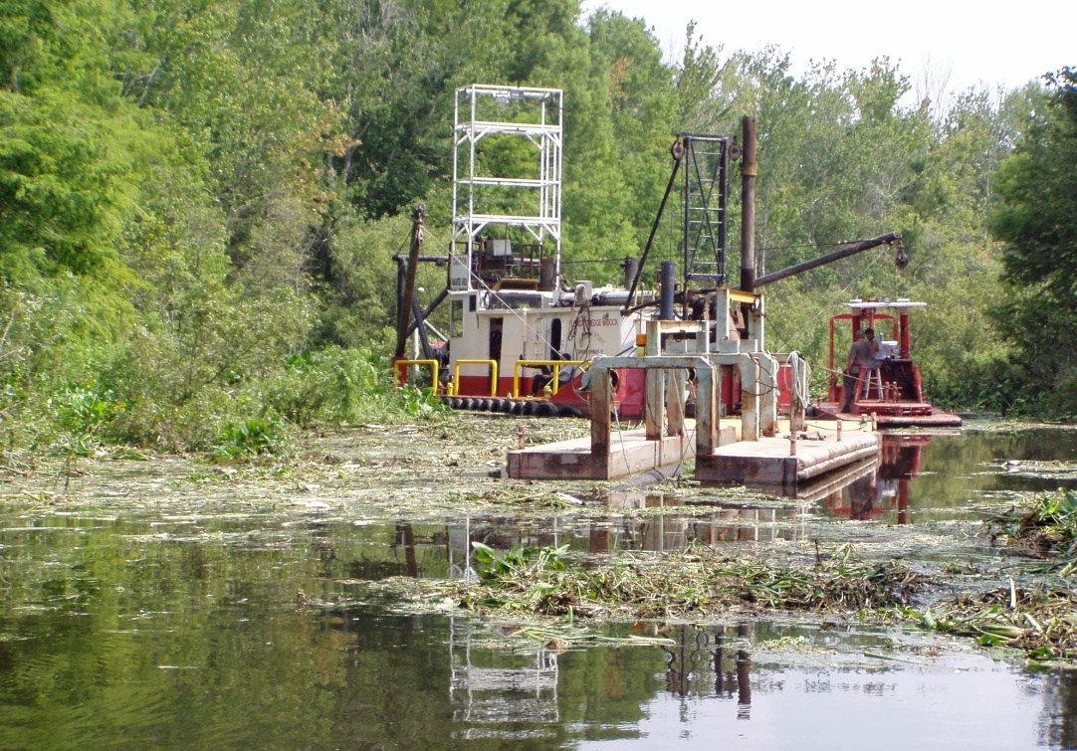
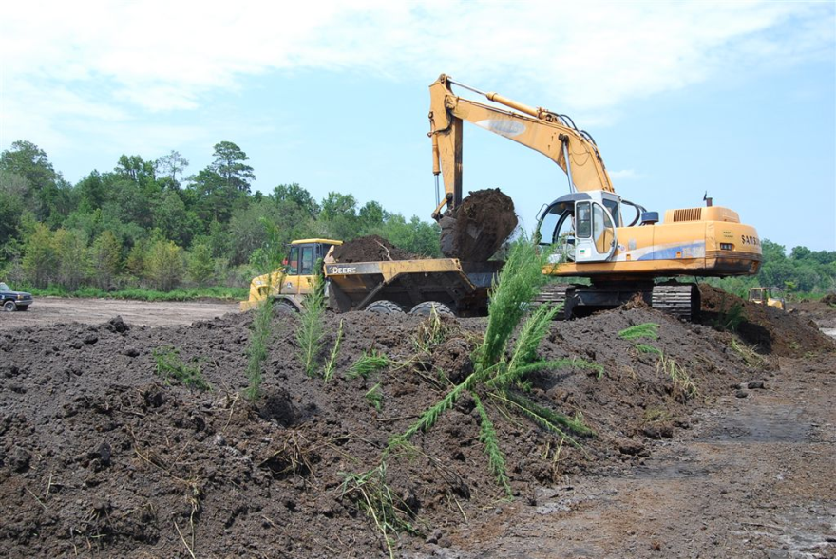
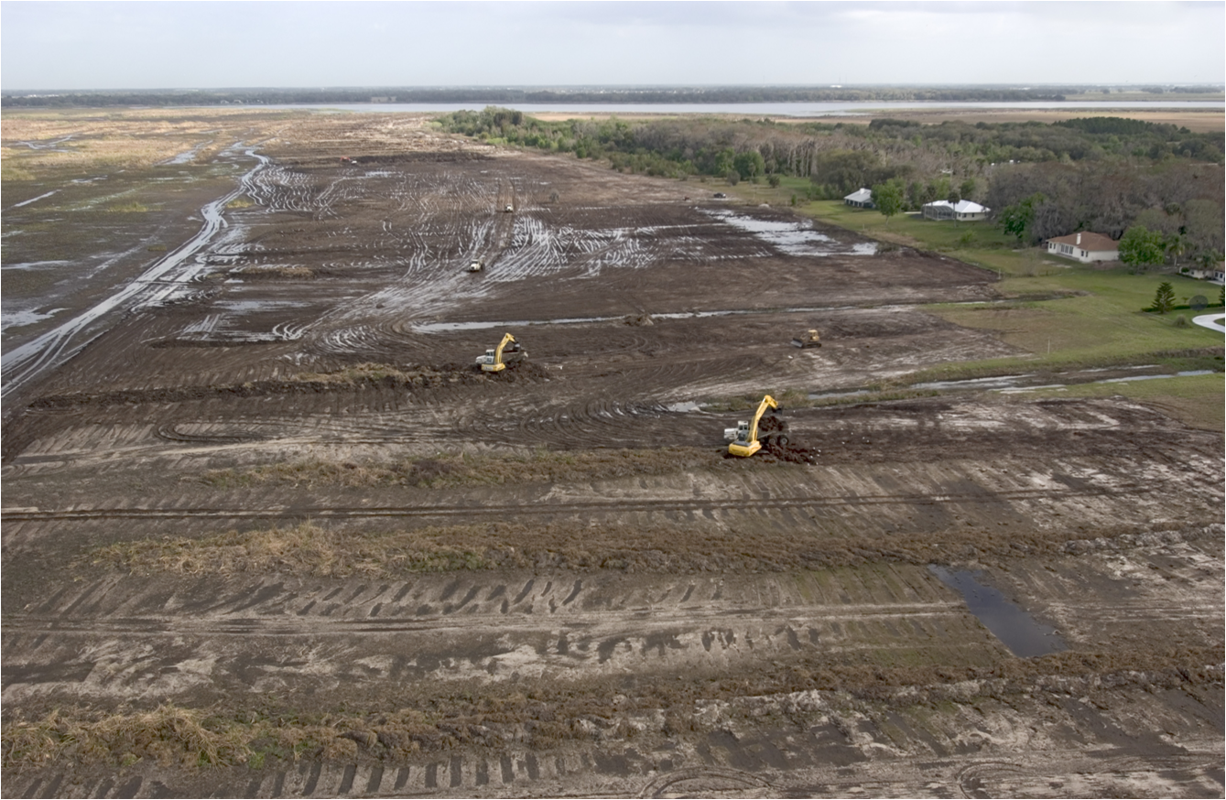
Lake Sediment Removal
Hydraulic Dredging
Conventional Earth-Moving Equipment

Slide 20
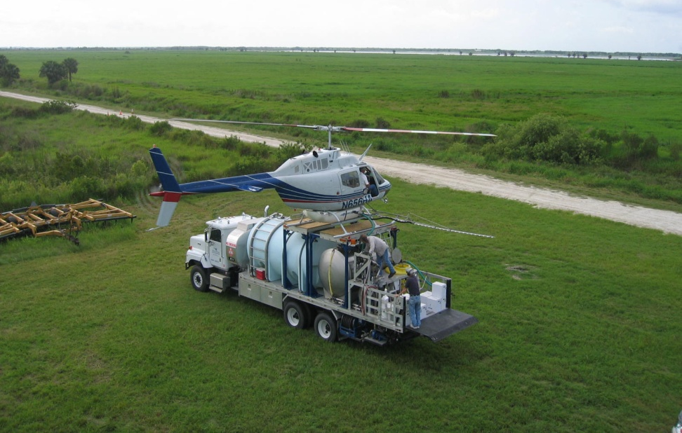
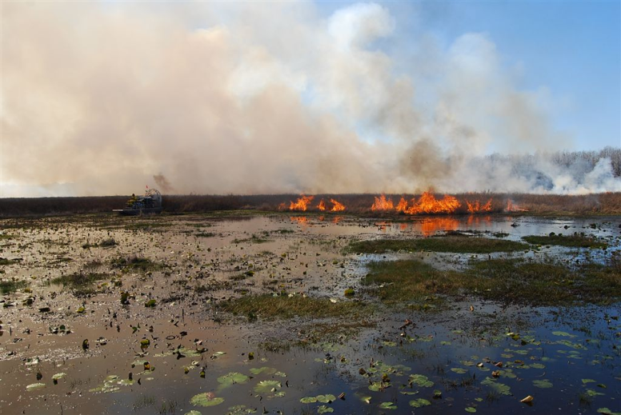
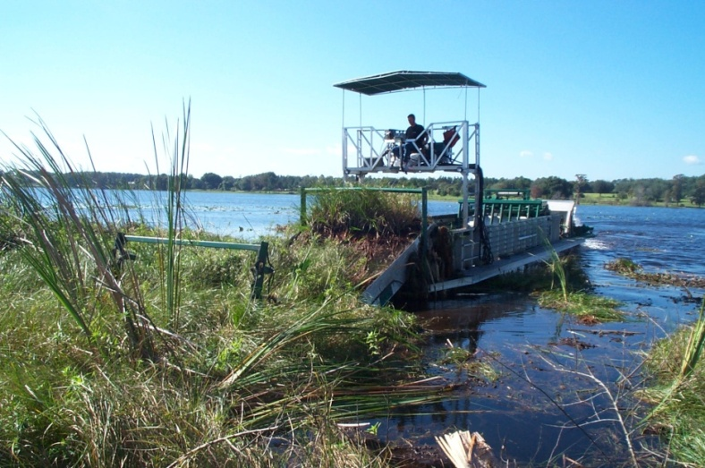
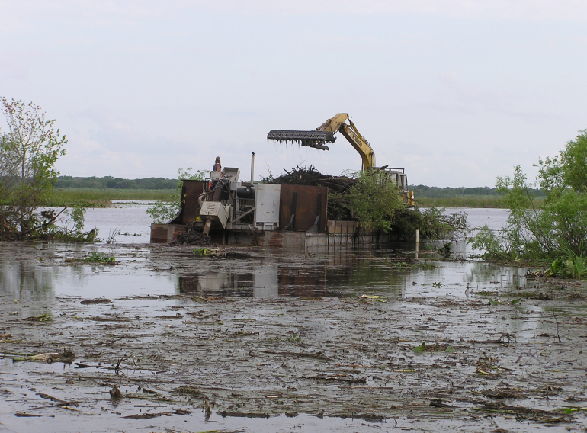
Aquatic Plant Management

Slide 21
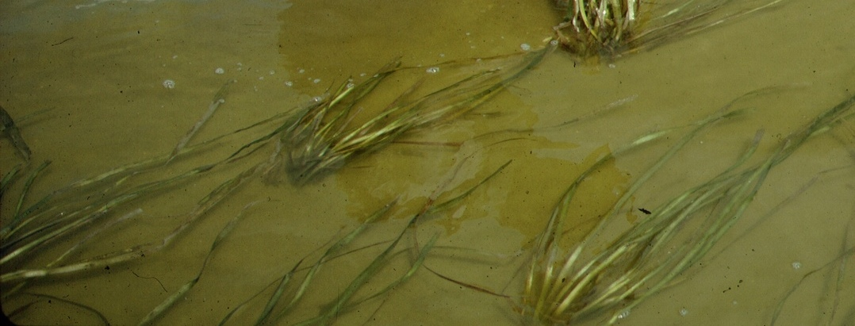
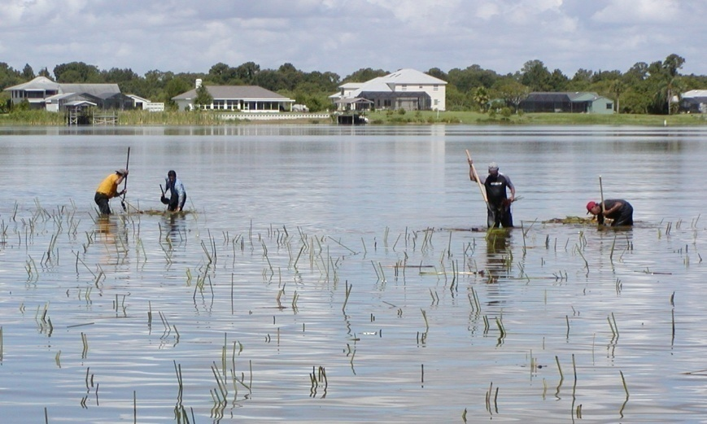
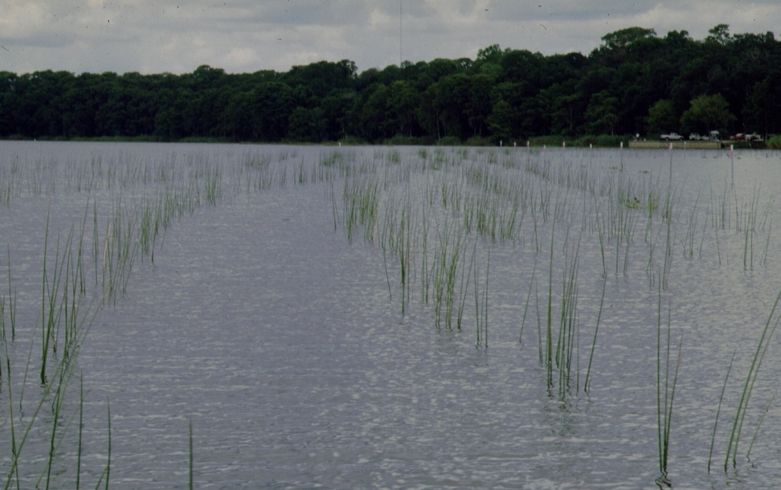
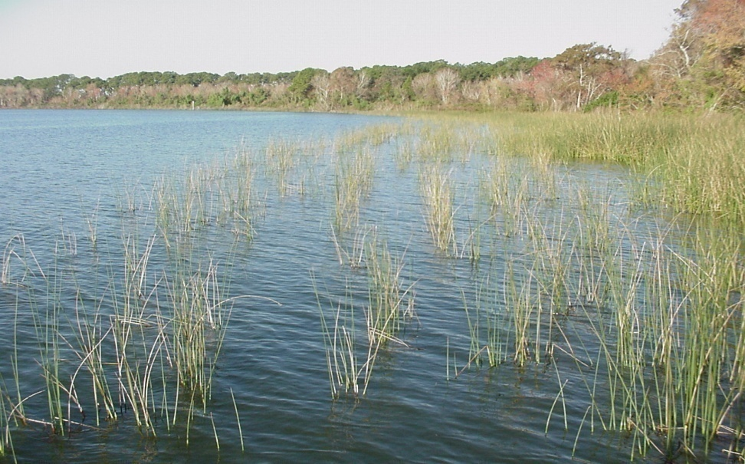
Transplanting Aquatic Plants
Submersed Plant Species
  Emergent Plant Species

Slide 22
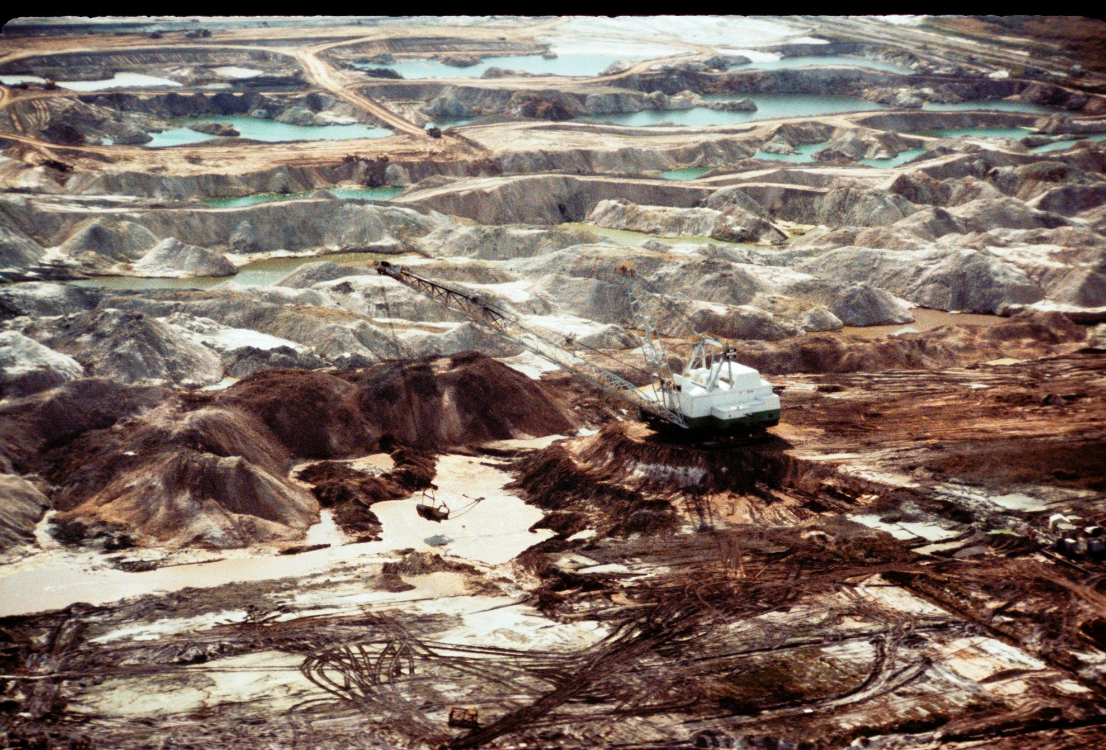
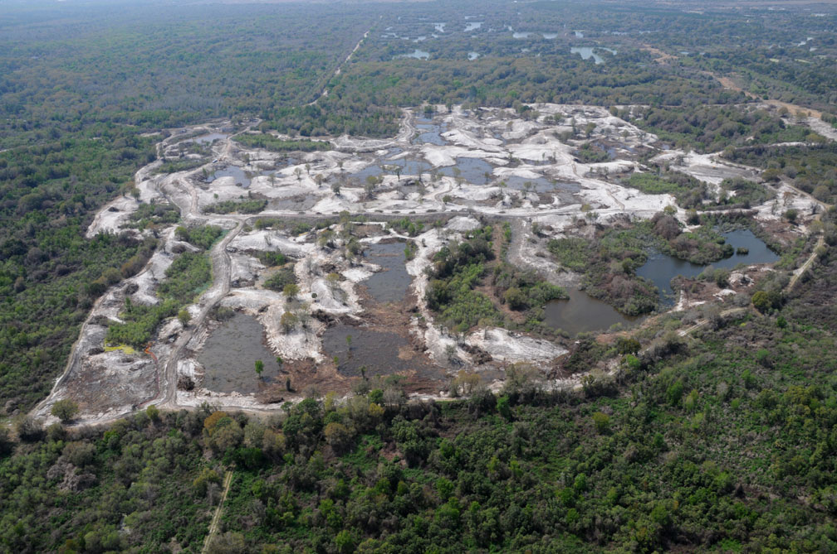
Tenoroc Fish Management Area
Mine Reclamation

Slide 23




Hydrological Restoration

Slide 24


Agricultural Land Restoration
Micro-Topography

Slide 25


Stream Restoration

Slide 26



Springs Restoration

Slide 27



Apalachicola and Osceola NF Borrow/Fire Dipping Pits

Slide 28


Kings Bay Seawall Removal

Slide 29




Restoration of Herbaceous Wetlands

Slide 30



Threatened
and Endangered Species

Slide 31


Commission Managed Impoundments (CMIs)
Bear Lake
Hurricane Lake
Juniper Lake
Karick Lake
Lake Stone
Lake Victor

Slide 32

Other FWC Managed Impoundments
Alligator Lake
Lake Iamonia
Lake Marian
Lake Jackson
Merritt’s Mill Pond
Lake Miccosukee
Piney Z Lake
Webb Lake
Snead’s Smokehouse Lake
Suwannee Lake
Tenoroc Fish Management Area
T.M. Goodwin Waterfowl Management Area
Oceanway Fish Management Area
Hickory Mound Impoundment
Joe Budd Pond Aquatic Education Center
Lake Ponte Vedra/Guana Wildlife Management Area

Slide 33




Water Control Structures
Notes:
Proposals themselves incorporate a variety of wetland management activities, or combinations thereof. Most, but not all, fall into 3 general categories. These include projects involving water control devices for hydrologic restoration. This can include water control structures such as culverts, flash-board riser systems, screw gates and other control devices such as dams, dikes, or levees, hardened low water crossings or emergency spillways

Slide 34


Kelley Branch/Paradise Lake Dam Removal
2004
October 2007

Slide 35



Snead’s Smokehouse Lake Berm Removal

Slide 36


Lake Iamonia Sinkhole Basin Dam
Water Control Structure Removal

Slide 37



Bell Springs Dam Removals

Slide 38


Aquatic Habitat Restoration Assessment Program (AHRAP)

Slide 39
AHRES FY 2012/2013
Funded 50 Aquatic Habitat Enhancement Projects
Funded 9 Management Directed Aquatic Habitat Research Projects
Conducted Projects in 31 Counties
Conducted Projects on 18 Large River or Lake Systems
Partnered With Over 25 Local, State, Federal and Non-Profit Conservation Entities

Slide 40









Notes:
AHRES staff also coordinates project development with many of our stakeholders such as water management district staff, other state federal biologists from the DEP, USFWS and the Forest service, and public and private conservation entities.
The idea here is to identify important wetland restoration projects and forge new partnerships. In many cases, these projects are based on priorities identified in comprehensive fish and wildlife conservation programs, research needs, recommendations from FWC partners, or GIS analysis tools that Jessica will talk about in just a few minutes.

Slide 41
Permitting
Florida Department of Environmental Protection/Water Management District Environmental Resources Permit
U.S. Army Corp of Engineers Permit
FWC Invasive Plant Management Permit
Local Government Permits/Acknowledgement
Department of State Historical Preservation Officer (SHPO) Letter

