Slide 1
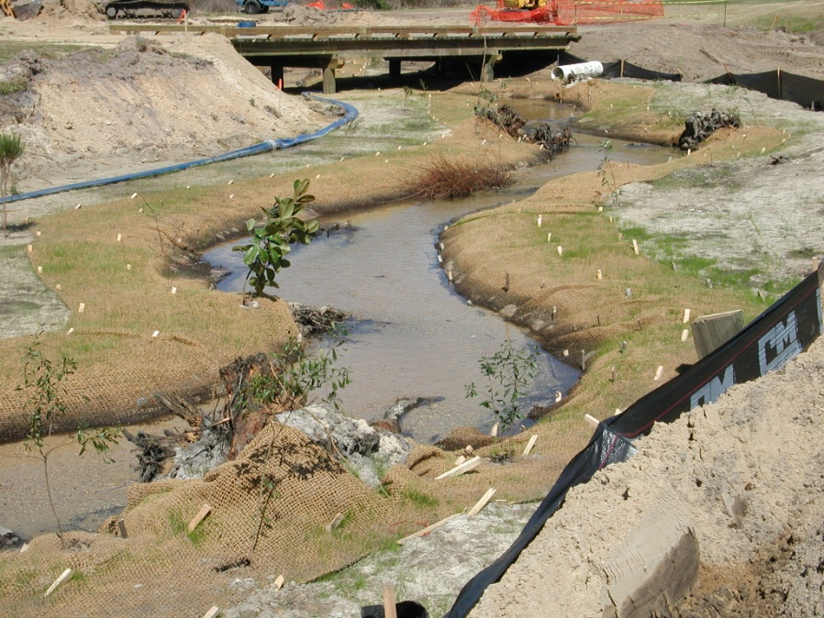
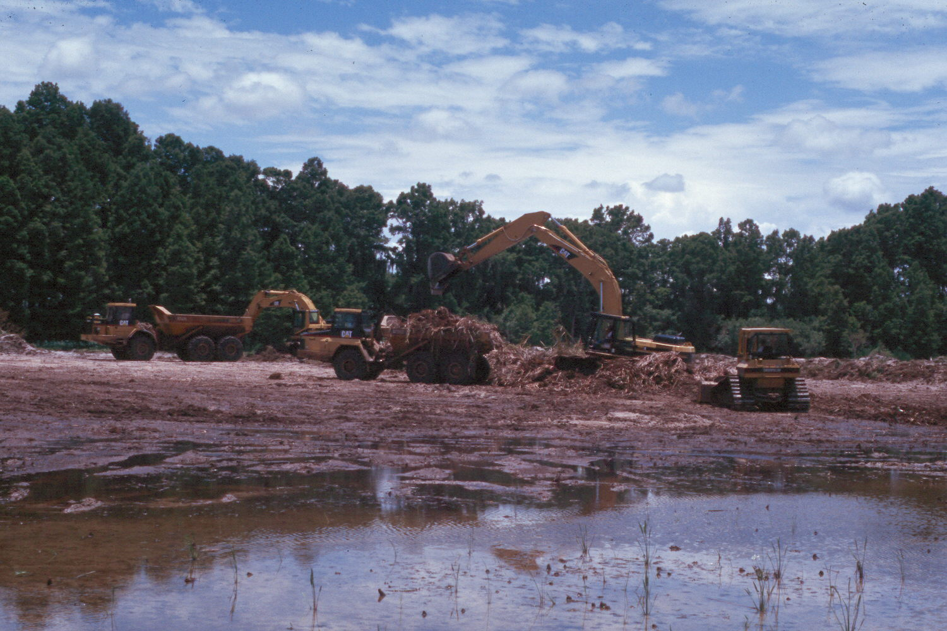
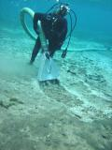
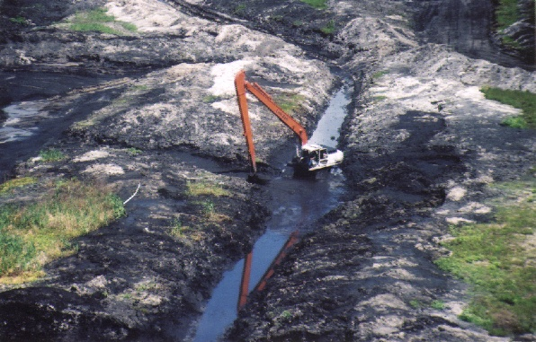
Regulatory Process for
FWC Aquatic Restoration Projects
Notes:
ARPET is a GIS-based analysis that utilizes a specific set of criteria to identify the highest priority public lakes in Florida for restoration.
This morning we’re going to discuss:
the GIS methodology
the Framework for the tool
the Datasets and why we selected them
the Scoring techniques we used
some of the Results and,
the Benefits for using a prioritization tool.

Slide 2
- Prior to October 2013, at least five different versions of the ERP rules were in place statewide.
On April 14, 2012, Governor Scott signed legislation granting DEP the authority to create one statewide rule for the environmental resource permit program (the “SWERP”; 373.3141, F.S.)
As part of this process, DEP agreed to work with FWC to develop a General Permit (GP) that simplifies the ERP process for environmental restoration / enhancement activities similar to the reciprocal GP provided to the WMDs (62-330.485, F.A.C.)
A condition of GP development was compilation of Best Management Practices (BMPs) for aquatic restoration activities; however, many of these activities did not have a consistent and approved set of construction and operation procedures associated with them.
Notes:
Since the number of restoration opportunities is overwhelming and funding is limited.
Developing an analytical approach to identifying high priority lakes was considered a critical component for executing a more expedient and cost effective framework for restoration management in Florida.

Slide 3
WMD/DEP GP for Restoration/Enhancement
(62-330.485, F.A.C)
- Implementation of Department or District environmental restoration or
enhancement projects.
To qualify, the project must comply with any one of the following procedures:
(a) part of a Surface Water Improvement and Management Plan (373.456, F.S.);
(b) approved by WMD Governing Board or Secretary of DEP after conducting
at least one public meeting; or
(c) wholly or partially funded by DEP through the Ecosystem Management and
Restoration Trust Fund (403.1651, F.S.) or the Water Resource Restoration
and Preservation Act (403.0165, F.S.)
- Subject to the following specific conditions:
(a) shall not significantly impede navigation; and
(b) prevent violations of state water quality standards.
Notes:
Since the number of restoration opportunities is overwhelming and funding is limited.
Developing an analytical approach to identifying high priority lakes was considered a critical component for executing a more expedient and cost effective framework for restoration management in Florida.

Slide 4
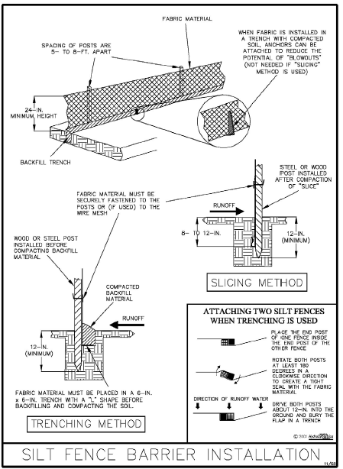
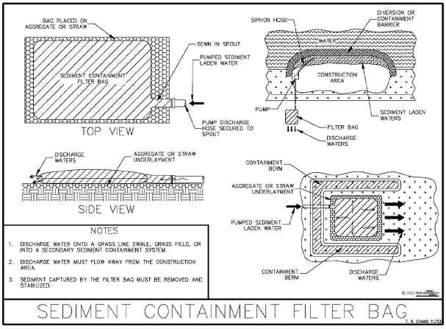
Why do we need BMPs?
Prevent violations to State Water Quality Standards pursuant to Chapter 62-302, Florida Administrative Code (F.A.C.), beyond any authorized mixing zone established in accordance with Rule 62-4.244, F.A.C.
Prevent introduction of soils or sediments into surrounding surface waters or wetlands during aquatic restoration activities

Slide 5
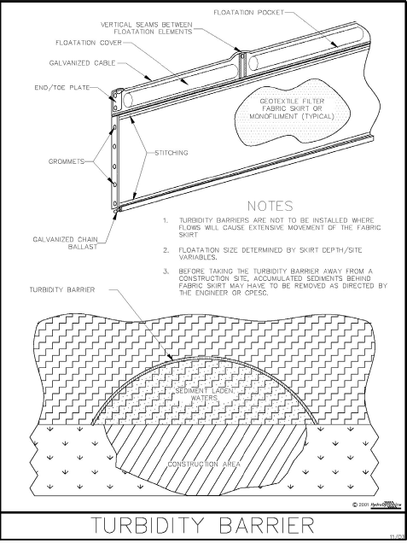
Five primary aquatic restoration activities
  dewatering (usually in conjunction with another restoration activity)
  sediment removal and manipulation
  wetland restoration
  stream / river / creek restoration
  shore stabilization and erosion control
  Manual divided into chapters covering each activity with each chapter intended to be used as a “stand-alone” tool
  Provide reasonable assurance of SWQS compliance to the permitting agencies during the permit application and project implementation processes
  Provide to contractors to ensure DEP-approved BMPs are implemented
Notes:
Since the number of restoration opportunities is overwhelming and funding is limited.
Developing an analytical approach to identifying high priority lakes was considered a critical component for executing a more expedient and cost effective framework for restoration management in Florida.

Slide 6
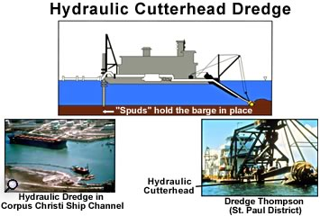
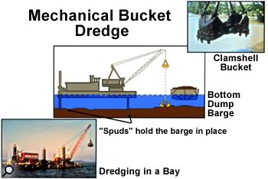
In addition to serving as the platform for development of the Aquatic Restoration GP (62-330.633, F.A.C), the manual may also serve as basis for aquatic restoration activities authorized under the ERP Individual Permit process and in development of GPs for other federal, state and local agencies.
Does not include more advanced BMPs, such as the use of chemical treatment or polymers to reduce turbidity or effects to other water quality parameters, for aquatic restoration activities which will require an Individual Permit.
Notes:
Since the number of restoration opportunities is overwhelming and funding is limited.
Developing an analytical approach to identifying high priority lakes was considered a critical component for executing a more expedient and cost effective framework for restoration management in Florida.

Slide 7
Surface Water Quality Criteria for
Aquatic Restoration
(62-302.530 F.A.C.)
Class III (Predominantly Freshwaters)
  Occasionally Class II
DEP-Recommended SWQS Criteria for Monitoring
  Biochemical Oxygen Demand
  Dissolved Oxygen
  Nutrients
  pH
  Turbidity
Notes:
Since the number of restoration opportunities is overwhelming and funding is limited.
Developing an analytical approach to identifying high priority lakes was considered a critical component for executing a more expedient and cost effective framework for restoration management in Florida.

Slide 8
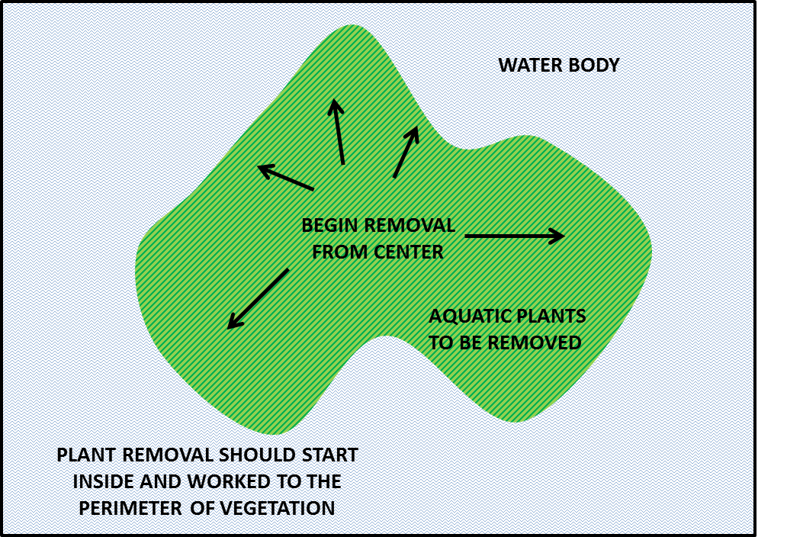
General BMPs
Project Location
  Natural (e.g., vegetative) barriers
  Water movement
  Water Quality / Sediment Contaminants
Project Timing
  Dry Season vs. Wet Season
  Equipment Selection and Use
    Speed of use
    Equipment type
Notes:
Since the number of restoration opportunities is overwhelming and funding is limited.
Developing an analytical approach to identifying high priority lakes was considered a critical component for executing a more expedient and cost effective framework for restoration management in Florida.

Slide 9
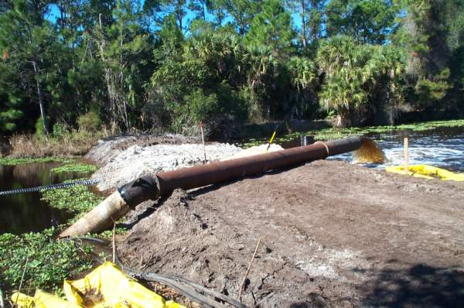
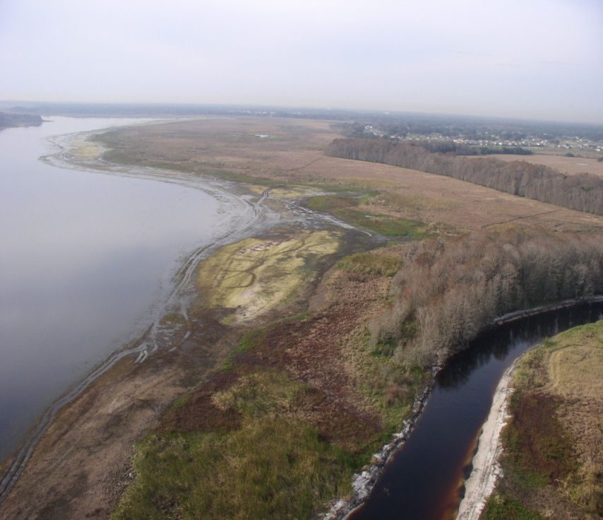
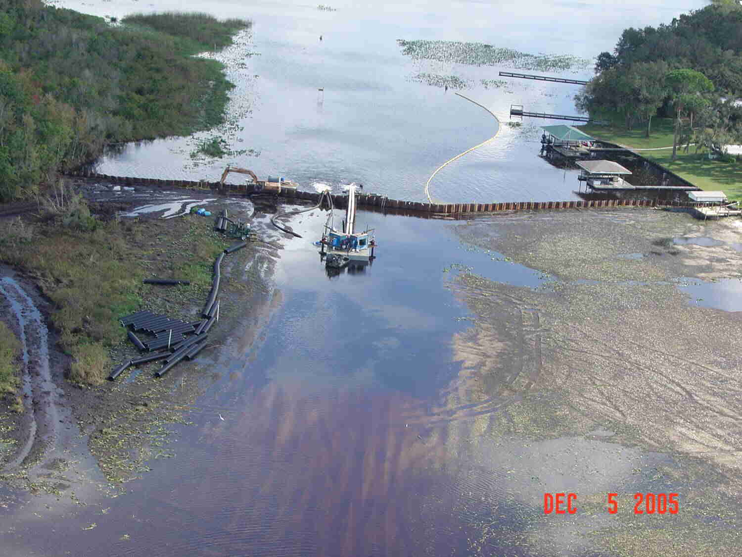
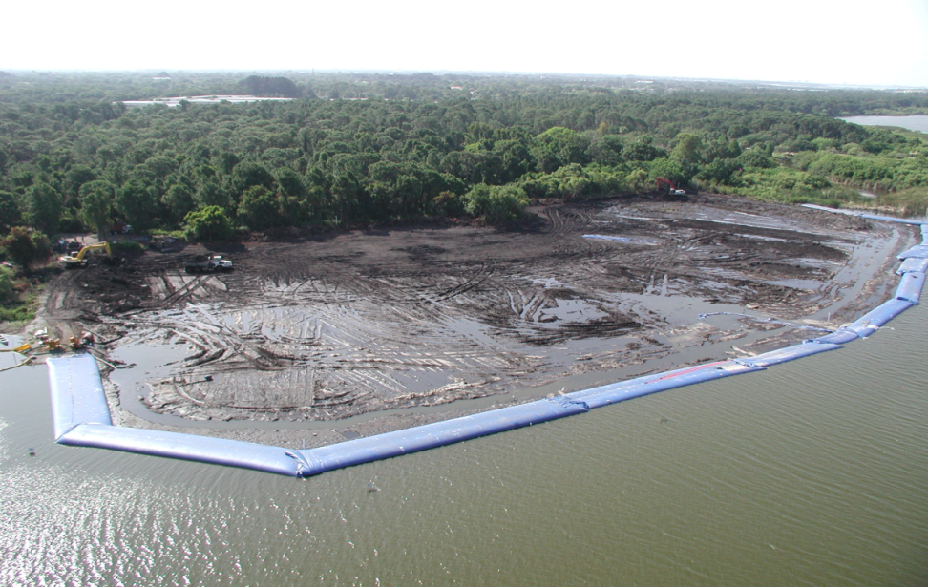
  Pump
  Gravity
Dewatering

Slide 10
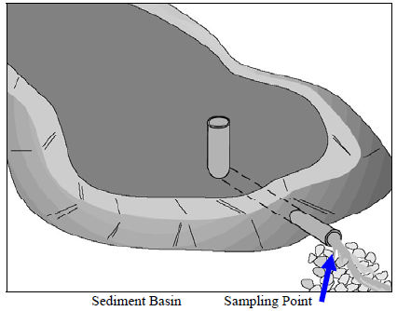
Dewatering BMPs
Waterbody to Waterbody
  Floating Turbidity Screens
  Natural (Vegetative) Barriers
Waterbody to Upland Dewatering Site
  Silt Screens
  Sediment Traps
  Sediment Basins
  Dewatering/Gravity Filter Bag
  Rolled Erosion Controlled Products
  Water-filled Barrier / Cofferdam
Notes:
Since the number of restoration opportunities is overwhelming and funding is limited.
Developing an analytical approach to identifying high priority lakes was considered a critical component for executing a more expedient and cost effective framework for restoration management in Florida.

Slide 11
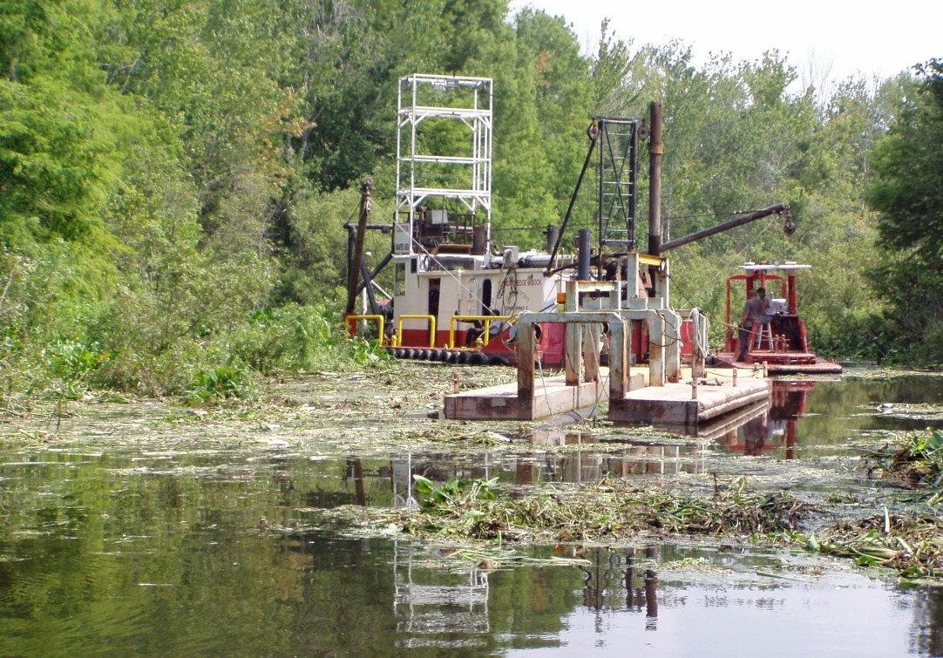
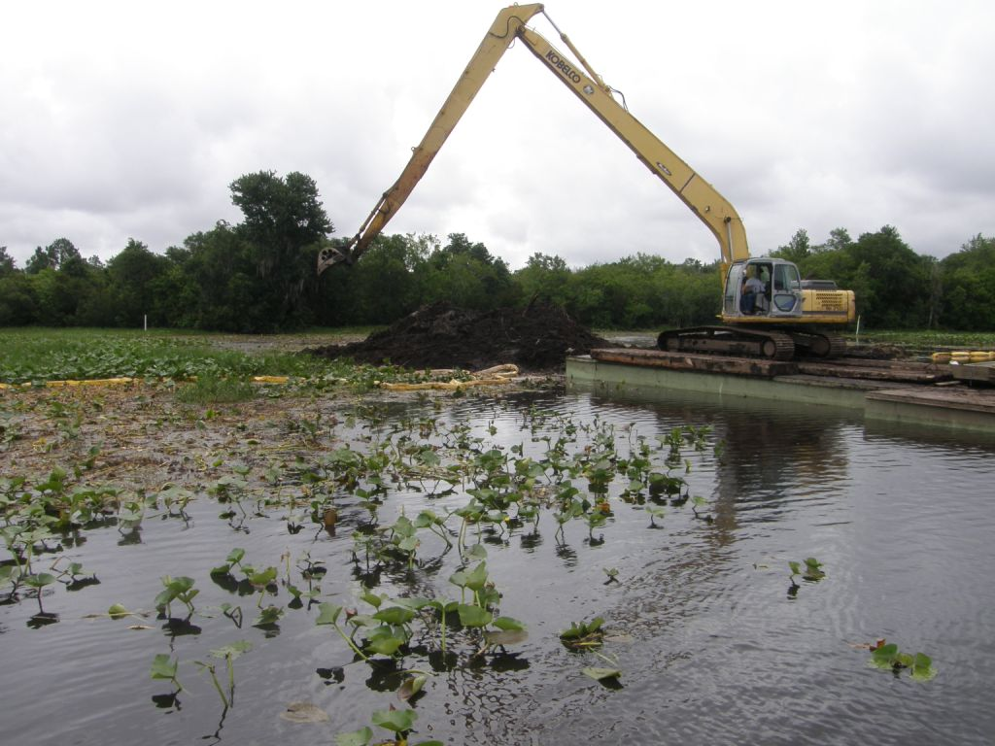
Sediment Removal
Hydraulic dredging
Conventional earth-moving equipment

Slide 12
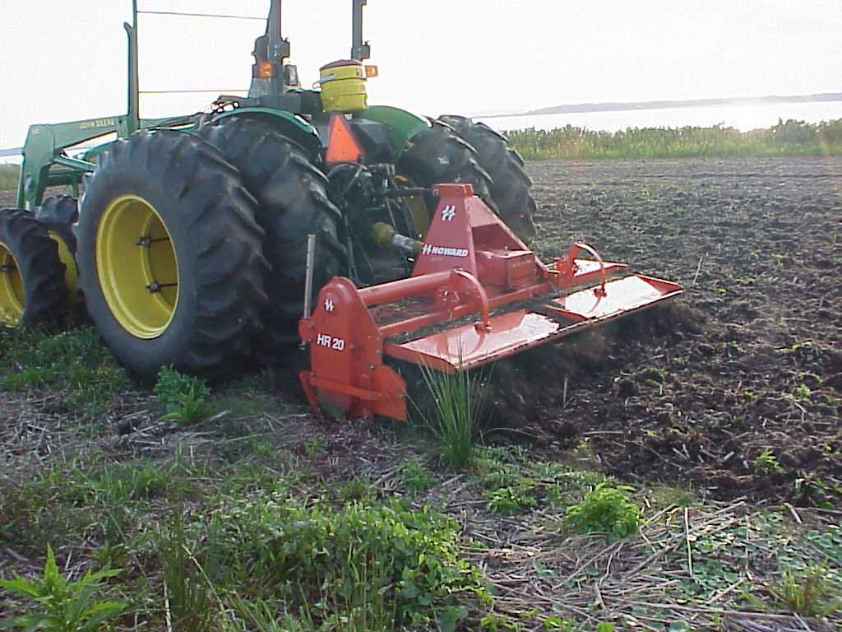
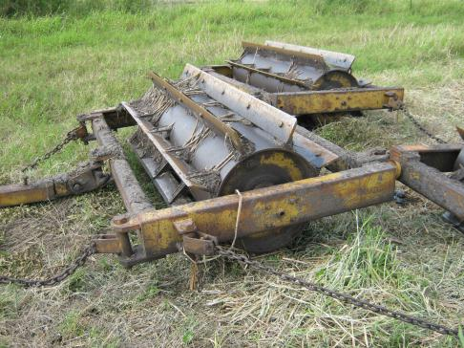
Sediment Manipulation and Associated Aquatic Plant Renovation

Slide 13
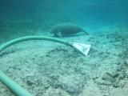
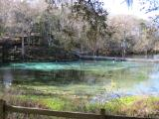
Spring Restoration

Slide 14
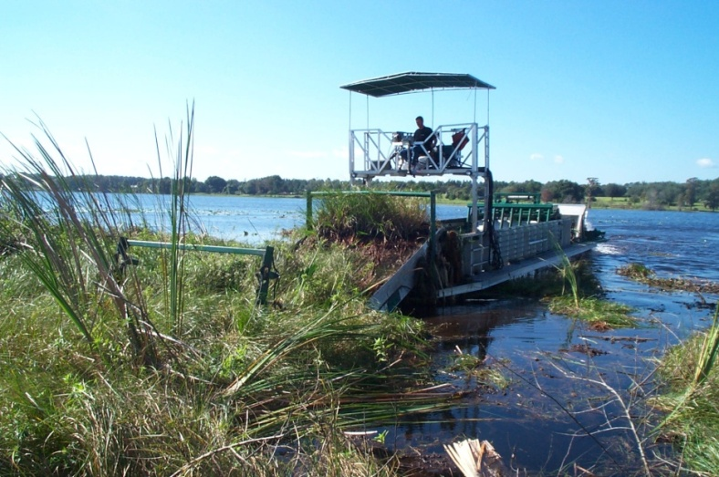
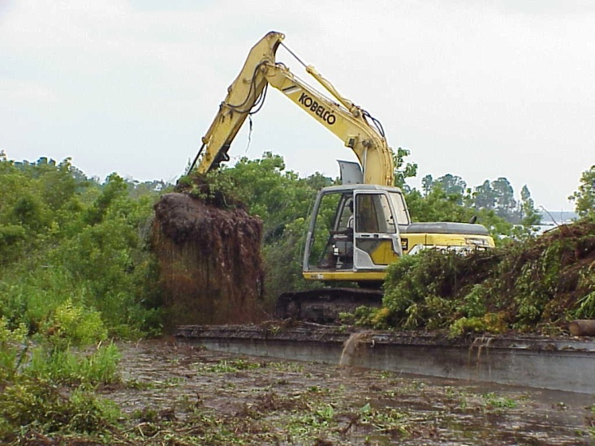
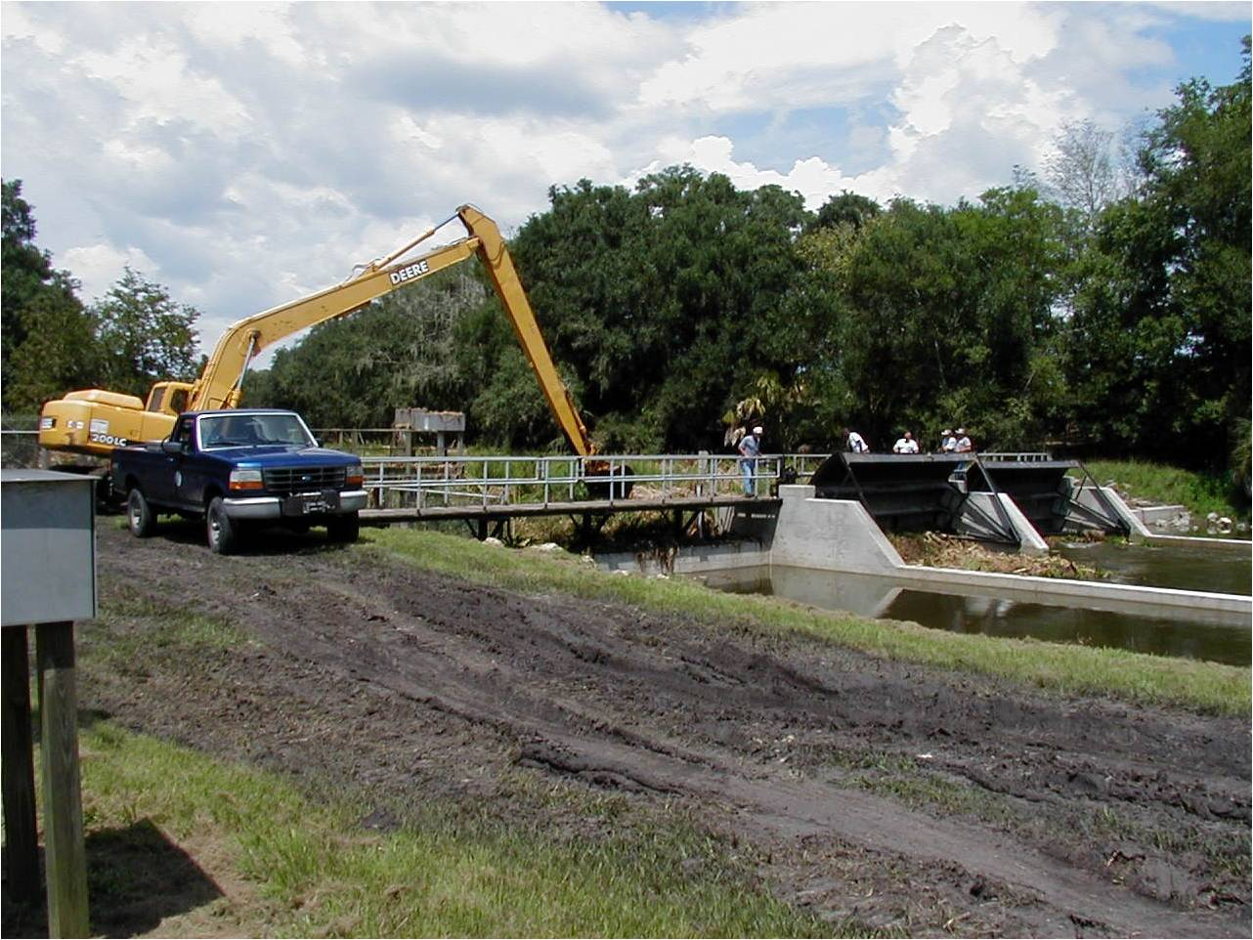
Aquatic Plant and Sediment Removal (ERP-exempted Projects; 403.813, F.S.)

Slide 15
Sediment Removal / Manipulation BMPs
Inundated Conditions
  Floating Turbidity Screens
  Natural (Vegetative) Barriers
Dewatered Conditions
  Silt Screens
  Sediment Traps
  Sediment Basins
  Dewatering/Gravity Filter Bag
  Water-filled Barrier / Cofferdam
Notes:
Since the number of restoration opportunities is overwhelming and funding is limited.
Developing an analytical approach to identifying high priority lakes was considered a critical component for executing a more expedient and cost effective framework for restoration management in Florida.

Slide 16
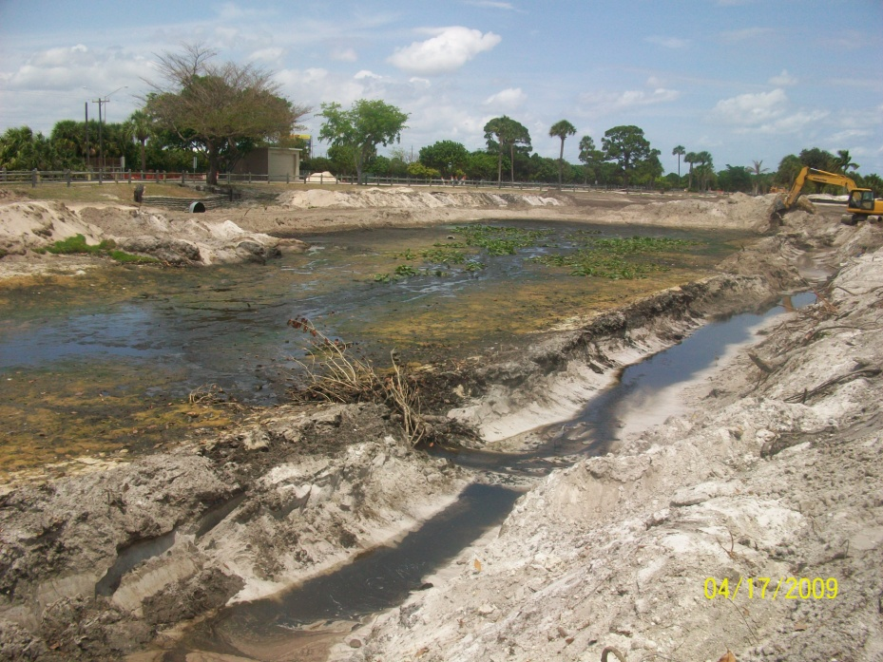
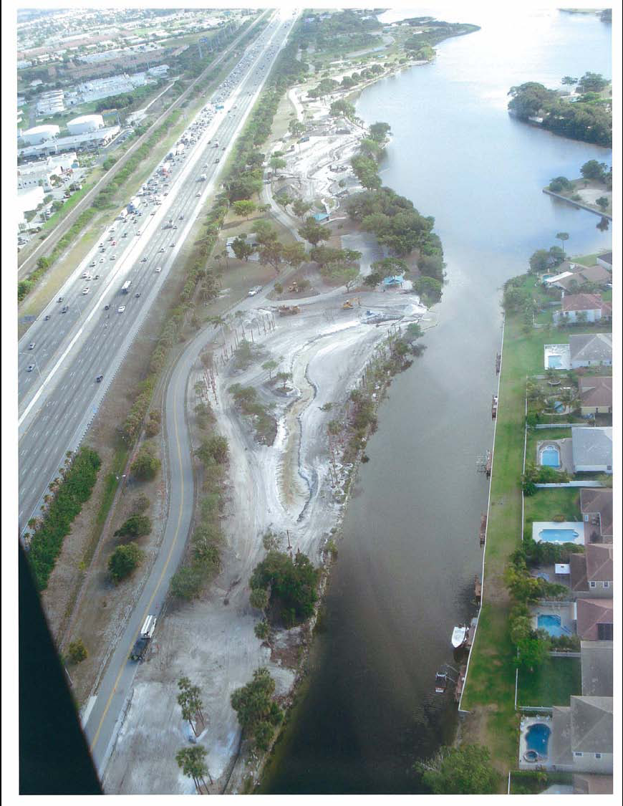
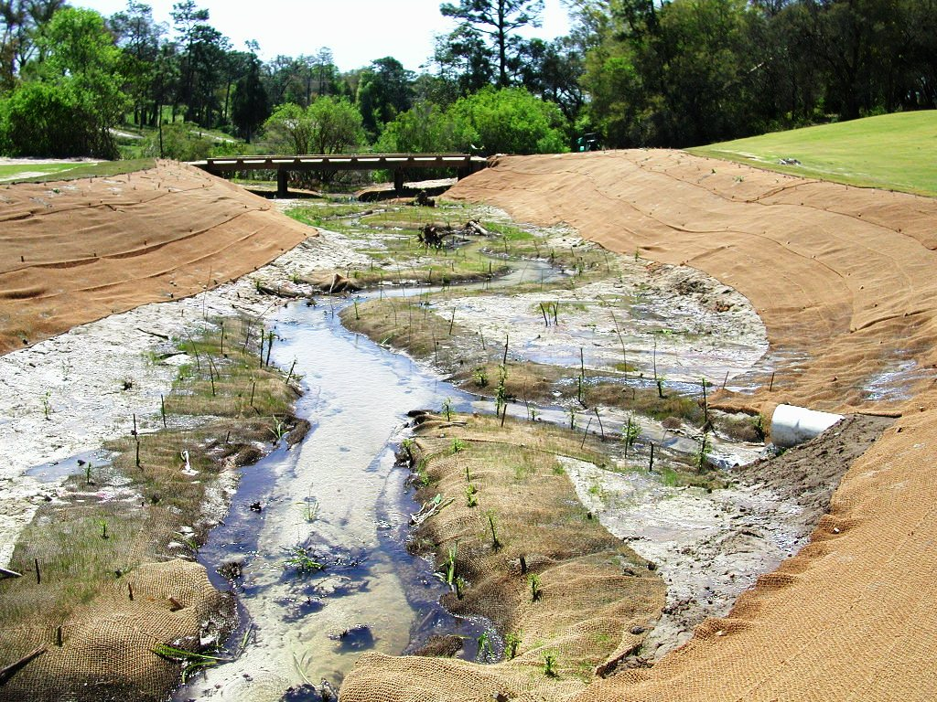
Pond Restoration
Stream Restoration
Wetland Construction

Slide 17
Stream and Wetland Restoration BMPs
Inundated Conditions
  Floating Turbidity Screens
  Natural (Vegetative) Barriers
Dewatered Conditions
  Silt Screens
  Sediment Traps
  Sediment Basins
  Dewatering/Gravity Filter Bag
  Rolled Erosion Controlled Products
  Water-filled Barrier / Cofferdam
Notes:
Since the number of restoration opportunities is overwhelming and funding is limited.
Developing an analytical approach to identifying high priority lakes was considered a critical component for executing a more expedient and cost effective framework for restoration management in Florida.

Slide 18
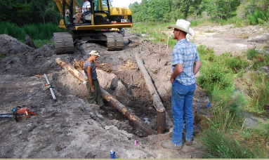
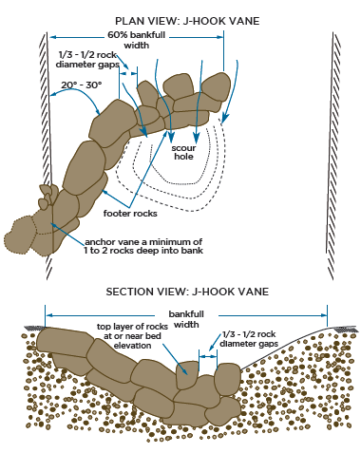
Stream and Wetland Restoration BMPs
Design BMPs for Wetland Restoration
- Ditch Plug / Ditch Backfill Design
- Log Vanes / Cross Vanes
Design BMPs for River / Stream / Creek Restoration
- Channel Sinuosity/Meandering
- Step Pool Features
- Log Vanes / Cross Vanes
- J-Hooks
- Wing Dikes
- Rip Rap
- Rock Check Dam
Notes:
Since the number of restoration opportunities is overwhelming and funding is limited.
Developing an analytical approach to identifying high priority lakes was considered a critical component for executing a more expedient and cost effective framework for restoration management in Florida.

Slide 19
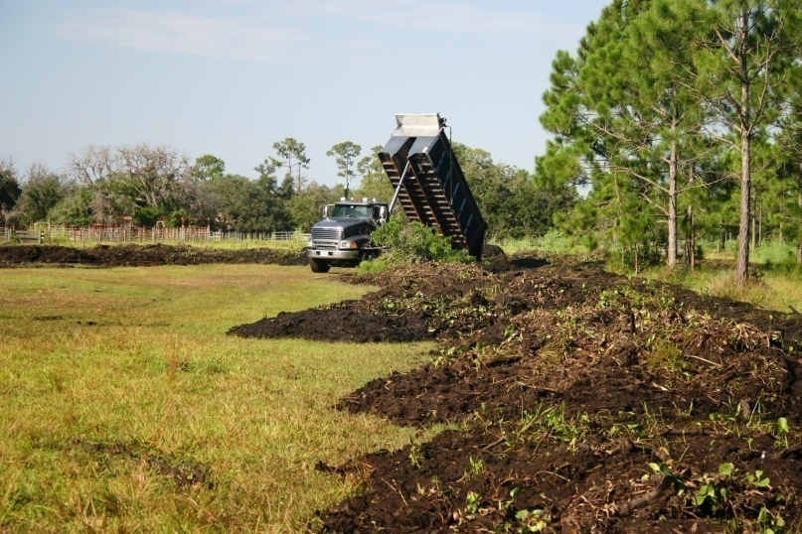
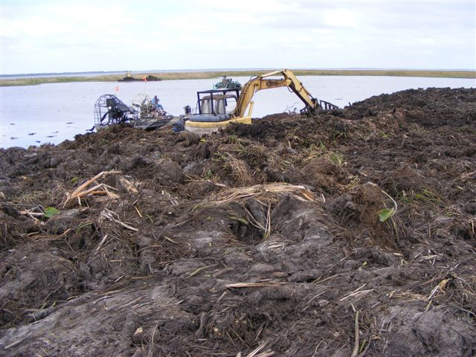
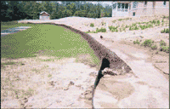
Disposal / Erosion Control

Slide 20
Disposal BMPs
Inundated Conditions
  Floating Turbidity Screens
  Natural (Vegetative) Barriers
  Water-filled Barriers
Dewatered Conditions
  Silt Screens
  Filter Berm Barriers
  Sediment Basins
Notes:
Since the number of restoration opportunities is overwhelming and funding is limited.
Developing an analytical approach to identifying high priority lakes was considered a critical component for executing a more expedient and cost effective framework for restoration management in Florida.

Slide 21
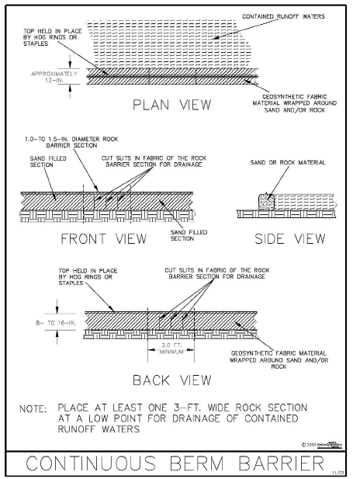
Sediment Stabilization/Erosion BMPs
Seeding
Mulching
- Dry Mulch
- Hydraulic Mulch
Silt Fence Barriers
Filter Berm Barriers
Rolled Erosion Control Products
Sod
Notes:
Since the number of restoration opportunities is overwhelming and funding is limited.
Developing an analytical approach to identifying high priority lakes was considered a critical component for executing a more expedient and cost effective framework for restoration management in Florida.

Slide 22
FWC GP for Restoration/Enhancement
(62-330.633, F.A.C)
DRAFT
- Implementation of FWC environmental restoration or enhancement projects.
To qualify, the project must comply with any one of the following procedures:
(a) approved by FWC Commission after conducting at least one public meeting; or
(b) wholly or partially funded by FWC through Lake Restoration Projects funds (201.15[7], F.S.)
- Subject to the following specific conditions:
(a) shall not significantly impede navigation; and
(b) prevent violations of state water quality standards.
Notes:
Since the number of restoration opportunities is overwhelming and funding is limited.
Developing an analytical approach to identifying high priority lakes was considered a critical component for executing a more expedient and cost effective framework for restoration management in Florida.

Slide 23

Special Recogition for the authors of the
BMP manual at the University of Central Florida
Jamie Jones
Dr. Ni-Bin Chang
Dr. Marty Wanielista
Dr. Patrick Bohlen
Sanaz Imen
Notes:
Since the number of restoration opportunities is overwhelming and funding is limited.
Developing an analytical approach to identifying high priority lakes was considered a critical component for executing a more expedient and cost effective framework for restoration management in Florida.

Slide 24



Special Thanks to those who reviewed, commented, and provided guidance on the BMP manual
Mahmoud Madkour Bill Caton
Bill Coleman Jessica Griffith
Ed Hayes Ron Mezich
Joe Prenger
Richard Musgrove Tim Rach
Andy May Tom Jacobs
Andrew Joslyn
Tony Waterhouse
Notes:
Since the number of restoration opportunities is overwhelming and funding is limited.
Developing an analytical approach to identifying high priority lakes was considered a critical component for executing a more expedient and cost effective framework for restoration management in Florida.

