Slide 1
Florida Coastal Office
Coastal Management,
Federal Consistency Review,
and
ERP permitting
June 2014

Slide 2
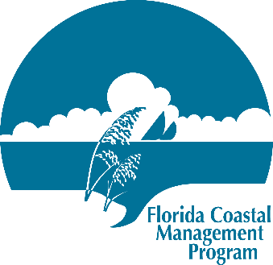

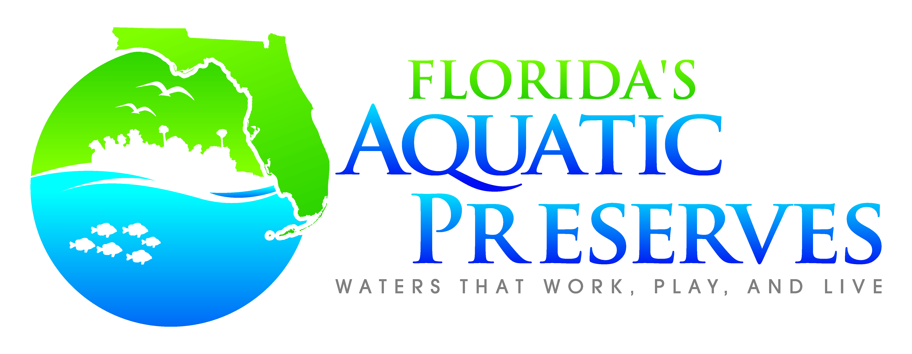
Florida Coastal Office
Florida Coastal Management
Program
Aquatic Preserves
National Estuarine Research Reserves
Coral Reef Conservation Program
Keys Marine Sanctuary
Offshore Projects Section
Deepwater Horizon Response

Slide 3
Coastal Zone Management Act
The Coastal Zone Management Act of 1972 (16 U.S.C. § 1451, et seq.) made coastal states eligible to develop management programs
Addressed national issues by incentivizing state coastal management by providing funding and federal consistency review, a limited waiver of federal authority
The Florida Coastal Management Act (Part II of Chapter 380, Fla. Stat.) put into effect in 1978; federally approved in 1981 after completion of EIS

Slide 4
Actions Subject to
Federal Consistency Review
Actions subject to review: all direct and indirect federal activities affecting land, water, or natural resources of the coastal zone
  Direct activities
  License or permit activities
  Assistance activities

Slide 5
Actions Subject to
Federal Consistency Review
Federal activities that affect Florida’s land, water, natural resources, historic resources or transportation system:
Activities conducted by the federal government - USACE public works projects, Air Force base construction
Federal licenses or permits - USACE Dredge and Fill permits, FERC power plant licenses
Federally funded activities - HUD CDBG projects and apartment complexes, FDOT roads and railroads, EPA water mains or USDA rural development projects
Outer Continental Shelf activities - federal permits for exploration and extraction of oil, gas and minerals offshore in federal waters
Notes:
Direct = new COE dredging project or USAF construction on Eglin AFB
Funding = HUD, EPA, or USDA grants and loans for construction projects
Permits = no analogous state permit (ERP): USCG Marine Events, COE offshore (artificial reefs), or FERC gas pipeline authorizations.
OCS = oil and gas exploration or gas pipeline installation in federal waters.

Slide 6
Florida Coastal Management Program – Network of Agencies
Department of Environmental Protection
Department of Agriculture and Consumer Services
Department of Economic Opportunity
Division of Emergency Management
Fish and Wildlife Conservation Commission
Department of Health
Department of State, Division of Historical Resources
Department of Transportation
Florida Building Commission, (Department of Business and Professional Regulation)
Northwest Florida Water Management District
St. Johns River Water Management District
South Florida Water Management District
Southwest Florida Water Management District
Suwannee River Water Management District

Slide 7
Florida Coastal Management Program –
Network of 24 Florida Statutes*
Chapter 161 Beach and Shore Preservation
Chapter 163, Part II Growth Policy; County and Municipal Planning; Land Development Regulation
Chapter 186 State and Regional Planning
Chapter 252 Emergency Management
Chapter 253 State Lands
Chapter 258 State Parks and Preserves
Chapter 259 Land Acquisitions for Conservation or Recreation
Chapter 260 Florida Greenways and Trails Act
Chapter 267 Historical Resources
Chapter 288 Commercial Development and Capital Improvements
Chapter 334 Transportation Administration
Chapter 339 Transportation Finance and Planning
Chapter 373 Water Resources
Chapter 375 Outdoor Recreation and Conservation Lands
Chapter 376 Pollutant Discharge Prevention and Removal
Chapter 377 Energy Resources
Chapter 379 Fish and Wildlife Conservation
Chapter 380 Land and Water Management
Chapter 381 Public Health: General Provisions
Chapter 388 Mosquito Control
Chapter 403 Environmental Control
Chapter 553 Building and Construction Standards
Chapter 582 Soil and Water Conservation
Chapter 597 Aquaculture
*Only portions of these chapters constitute enforceable policies for the purposes of federal consistency review. Check http://www.dep.state.fl.us/cmp/federal/24_statutes.htm for most current information,

Slide 8
Actions Subject to
Federal Consistency Review
Actions subject to review: all direct and indirect federal activities affecting land, water, or natural resources of the coastal zone
  Direct activities
  License or permit activities
  Assistance activities

Slide 9
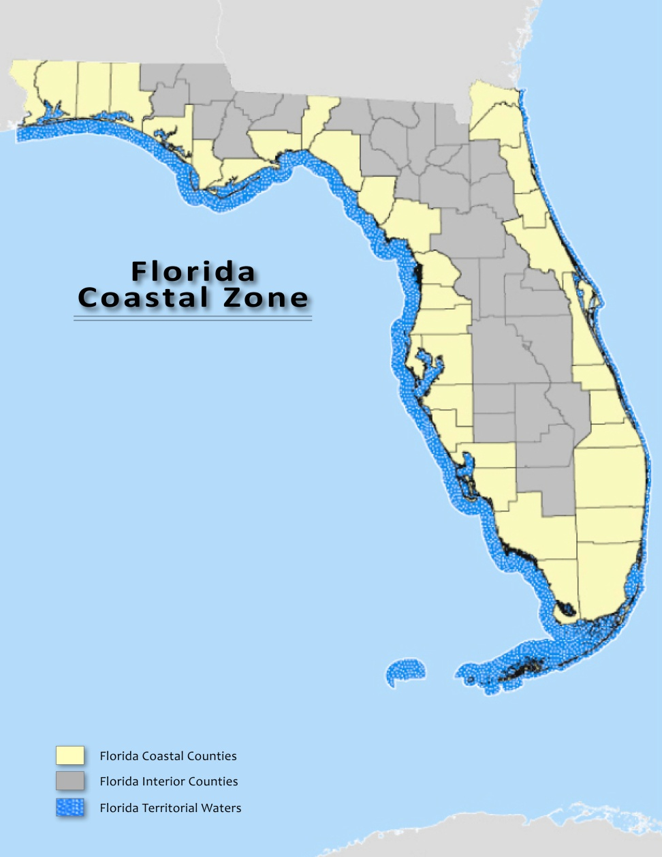
Coastal Zone

Slide 10


Operating Agreement
2012 Operation Agreement
(in place since 1998 [2010 NWFWMD])
Permit-consistency reviews were addressed simplistically in the 2012 DEP-WMD-COE Operating Agreement:
In short, the agreement states:
Issuance = Consistent (including exemptions)
Denial = Inconsistent
Consistency review time frame starts when an application is complete
Refers to the 180-day timeclock requirements in federal regulations
10

Slide 11
SLER 928
OPM contains Procedure SLER 0928
Developed in 1999 and updated in periodically, it is the best guidance to follow.
SLER 928 identifies the relevant statutes and the permits for projects (located in coastal counties) to be reviewed for consistency, and provides general guidelines for soliciting comments from appropriate agencies or DEP programs.
Processors are responsible for providing applications to any affected state agencies or DEP programs so they have an opportunity to make a consistency decision.
Reviewing agencies may also request data and information necessary for their review.
Processors should forward information requests to the applicant to handle, but keep apprised of the outcome.
11

Slide 12
Agency Comments
Most are advisory and offer general recommendations
If a processor receives a letter of objection based on a finding of inconsistency:
1. Call FCMP for assistance : FCMP will help determine if the objection is legitimate & timely
2. Forward to the applicant using the cover letter template in SLER 928
The applicant and the objecting agency will be responsible for resolving the inconsistency issue.
The permit processor must be informed about the progress of the matter, especially if it results in a changed project design or plan of procedure.
If the consistency objection is not resolved, DEP is obligated to deny, provided the objection is timely, legally proper, and supported by the agency head.
12

Slide 13
Technical Support
SLER 928 includes example letters and language for Notice of Denial.
Use of the ‘RAI Final Letter’ (SLER 901) and 90-day Waiver form
(http://www.dep.state.fl.us/water/wetlands/erp/forms.htm) will synchronize ERP and consistency procedures.
FCMP will evaluate objections for legal authority, timeliness, track timeclocks and deadlines, assist with interagency consultation, and assist with writing denial notices.
The objecting agency is responsible for defending the objection in any subsequent administrative hearings or other legal proceedings.
13

Slide 14
Actions Subject to
Federal Consistency Review
Actions subject to review: all direct and indirect federal activities affecting land, water, or natural resources of the coastal zone
  Direct activities
  License or permit activities
  Assistance activities

Slide 15
Florida State Clearinghouse
State Single Point of Contact for receipt of federal funding applications and direct federal development projects (Presidential Executive Order 12372)
Coordinates state intergovernmental review of federal agency activities and federal funding
Coastal Zone Management Act (CZMA) and
National Environmental Policy Act (NEPA)
Coordinates review of oil and gas exploration plans
Outer Continental Shelf Lands Act (OCSLA)
Ensures that federal agencies and applicants are provided a coordinated, consolidated and timely state response
Notes:
Section 061 of Chapter 403, F.S., lists the duties of the DEP. This subsection was established when the SCH and FCMP moved from DCA in 2002.

Slide 16
Clearinghouse
For a range of activities where a Federal agency makes a proposal for action initiating an activity or series of activities when coastal effects are reasonably foreseeable (e.g.: proposal to physically alter resources, a plan to direct future agency actions, a proposed rulemaking altering uses of the coastal zone, a general permit not involving case-by-case issuance by the Federal agency), modifications to previously reviewed activities that result in substantially different effects
Must be undertaken in a manner consistent to the maximum extent practicable with enforceable policies of approved coastal management program
“Consistent to the maximum extent practicable” means fully consistent unless prohibited by existing law applicable to Federal agency (does not include a general claim of lack of funding)

Slide 17
Conditional Concurrences
Agencies and/or applicants should cooperate with State to develop conditions during the review period to include in Federal agency final decision or approval that allow the State to concur
If instead the State issues a conditional concurrence, it must state the conditions which must be satisfied to ensure activity is consistent, an explanation of why those conditions are necessary, and identification of relevant specific enforceable policies
Correspondence shall state that in the event the conditions are not met, the conditional concurrence shall be treated as an objection
Federal agency must notify State if conditions are not acceptable

Slide 18

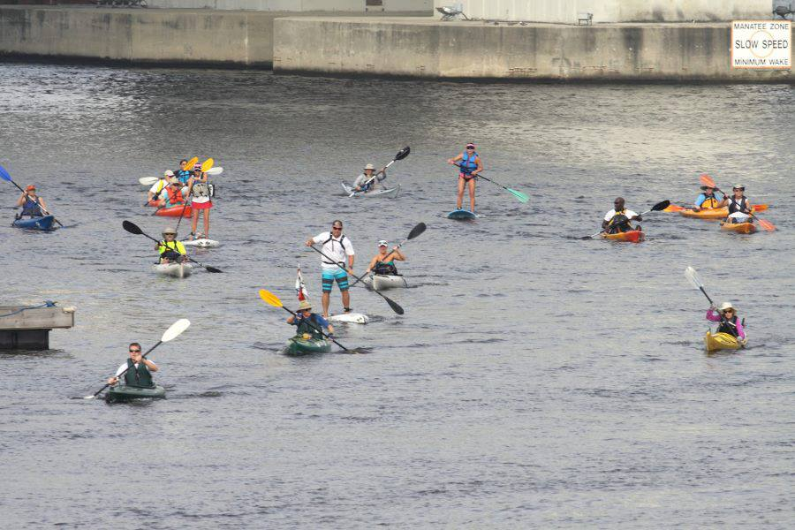
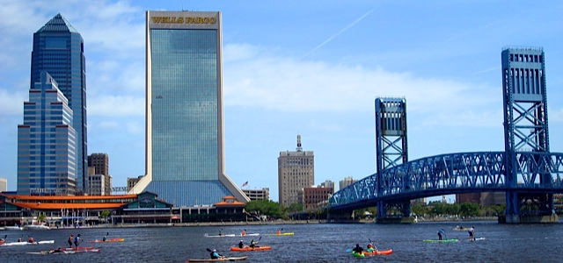
Additional Coastal Management Programs
Greater Jacksonville
Paddling Guide

Slide 19



309 funding and
Project of Special Merit

Slide 20


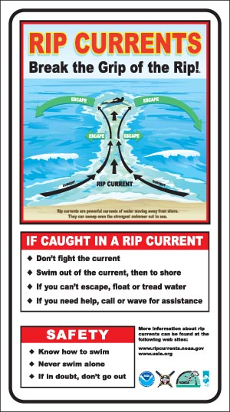
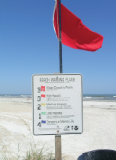
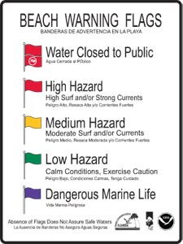
Beach Safety

Slide 21
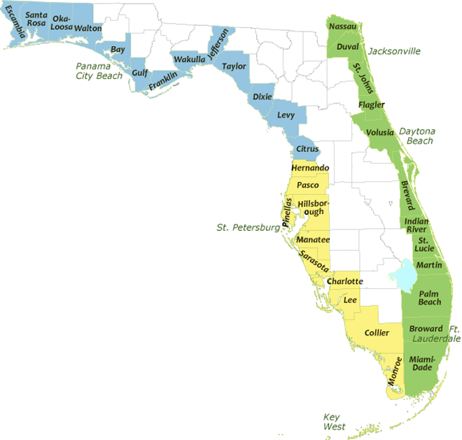

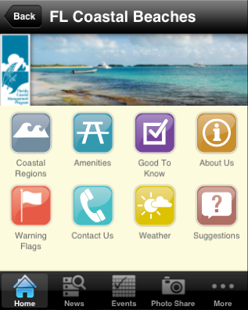

Coastal Access Guide
http://www.dep.state.fl.us/cmp/beachaccess/
2,146 access points

Slide 22
Contacts
Kelly Samek, Program Administrator
850-245-2177
Kelly.Samek@dep.state.fl.us
Ann Lazar: Environmental Administrator
850-245-2168
Ann.Lazar@dep.state.fl.us

