Slide 1
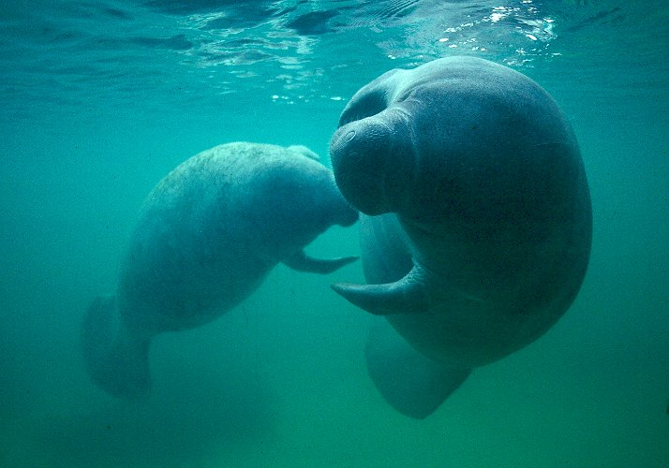
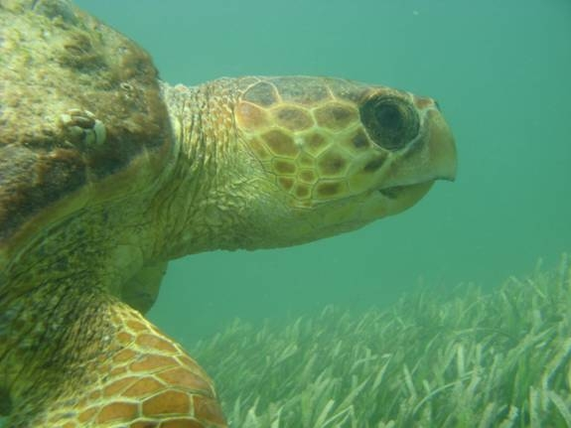
Coordination with FWC on Manatee and Marine Turtle Impacts
Kristen Nelson Sella
June 2014

Slide 2
The Florida Fish and Wildlife
Conservation Commission (FWC)
Agency Mission: Managing fish and wildlife resources for their
long-term well-being and the benefit of people.
Most of the agency commenting is performed by the Division of Habitat and Species Conservation (HSC), although other Divisions also provide comments such as the Division of Marine Fisheries and the Division of Law Enforcement
Most of the HSC comments are performed by either the Imperiled Species Management Section (ISM) or the Office of Conservation Planning Services (CPS)
Notes:
Seven Commissioners
Executive Director is Nick Wiley
Provides comments to regulatory and planning agencies to reduce adverse impacts to fish and wildlife and their habitats

Slide 3
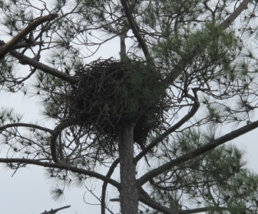
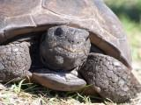
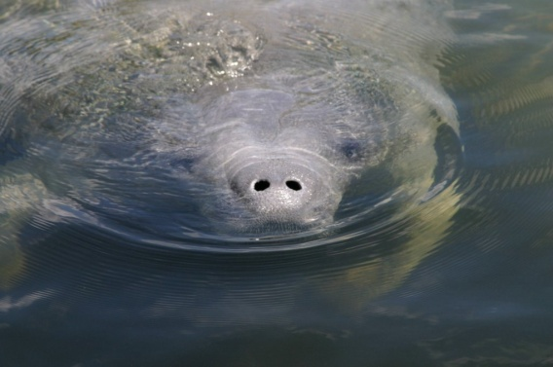
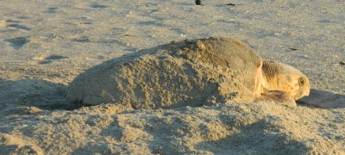
Differences between ISM and CPS
Imperiled Species Management (ISM)
Conservation Planning Services (CPS)
Frequently acts as agency lead to coordinate commenting on manatee and marine turtle impacts. Also coordinates commenting on bears and panthers (including large projects with multiple species.)
Frequently acts as agency lead to coordinate commenting on upland land use projects and large projects with multiple species.
Both ISM and CPS will coordinate with other agency subject matter experts.

Slide 4
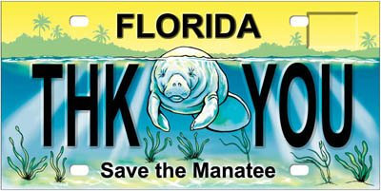
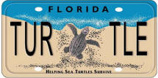
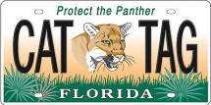
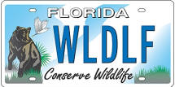
Imperiled Species Management Section (ISM)
Carol Knox
Section Leader
Ron Mezich
Manatee Admin.
Robbin Trindell
Marine Turtle Admin.
Darrell Land
Florida Panther Admin.
David Telesco
Black Bear Admin.

Slide 5
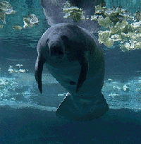
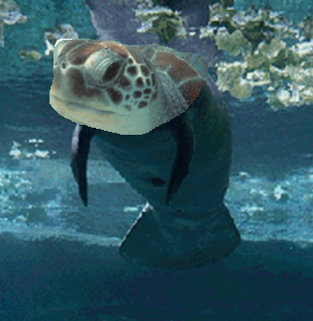
ISM Commenting Staff
The manatee and marine turtle programs are currently cross-training staff to maximize efficiency in permit review.
Mary Duncan – ISM Commenting Supervisor
Kristen Nelson Sella
Kellie Youmans
Luke Davis
Mike Sommers

Slide 6
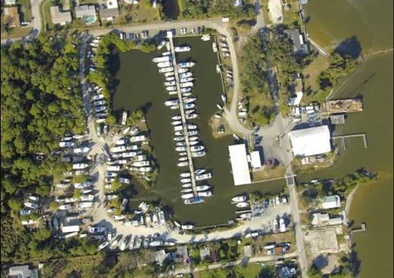
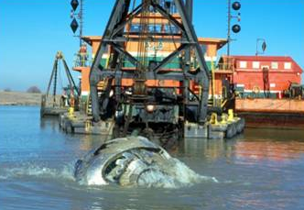
When to consult with ISM for manatees
Activity includes but is not limited to:
New or expanding boat facilities
Dredging
Blasting
Activities that affect foraging habitat or warm water refuge impacts
Culverts and pipes
Structures that act as barriers
Creation of new shoreline or navigational access to landlocked waterways
The Army Corps of Engineer’s Manatee Consultation Key is also a good guide to use.

Slide 7
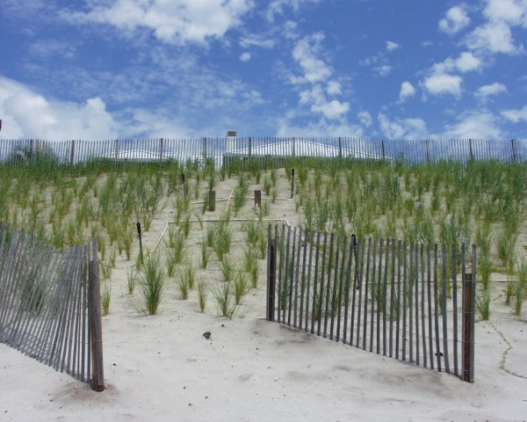
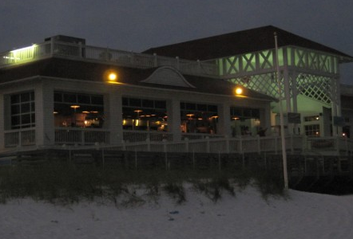
When to consult with ISM for marine turtles
Activity includes but is not limited to:
Beach Nourishment
Dune construction
Armoring and seawalls
Activities seaward of the frontal dune
Activities that produce temporary or permanent lighting visible from a nesting beach
Dredging
Blasting
Groins and other structures

Slide 8
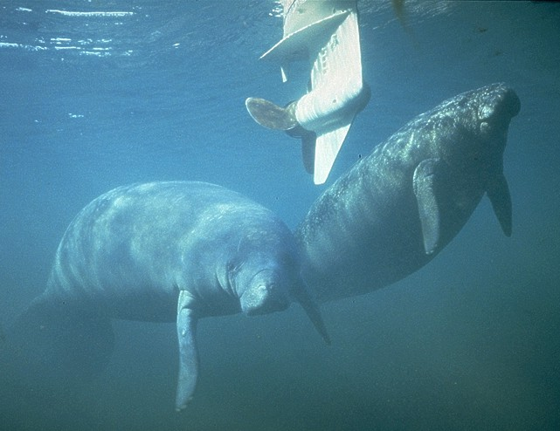
Typical questions from ISM concerning manatees
Includes, but is not limited to:
Potential impacts to SAV
Bathymetry
Culverts proposed?
Existing and proposed facilities and their type of use, change of use?
Located on sovereign submerged lands?
If mooring, is it for temporary use or intensive use (frequent)?
Length of shoreline owned, sometimes including whether it is legal, or newly created

Slide 9
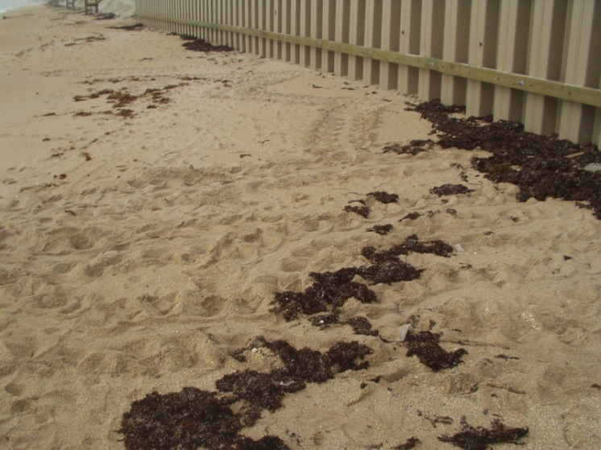
Typical questions from ISM concerning marine turtles
Includes, but is not limited to:
Timing of construction
Location of the proposed construction or beach sand placement
Template profile of proposed sand placement
Location of armoring in relation to the nesting beach
Location, timing, and methods of dredging
Exterior lighting (fixture type, bulb type, location and number of lights)

Slide 10
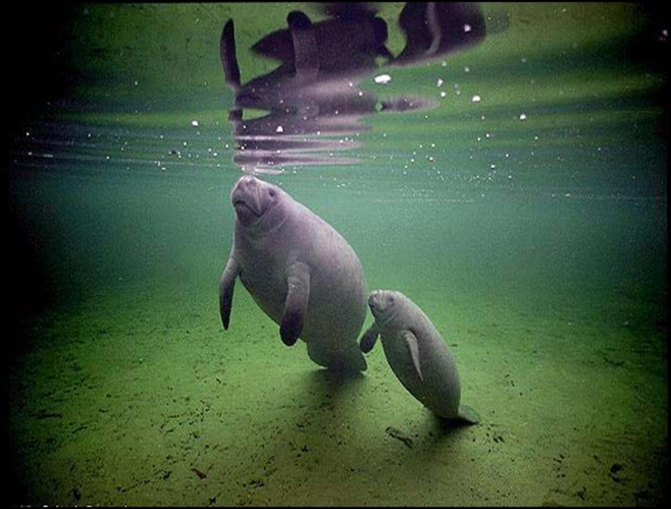
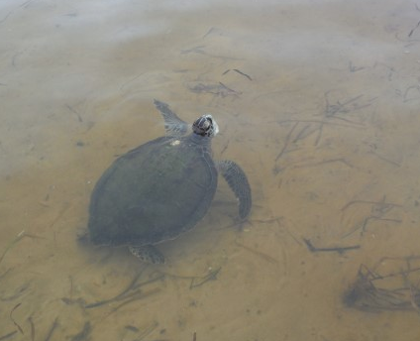
Sending applications to FWC
All new ERP, SSL and CERP type applications and requests
for comments should be sent to:
fcmpmail@myfwc.com and
fwcconservationplanningservices@myfwc.com.
CCCL and JCP applications should be sent to: marineturtle@myfwc.com.

Slide 11
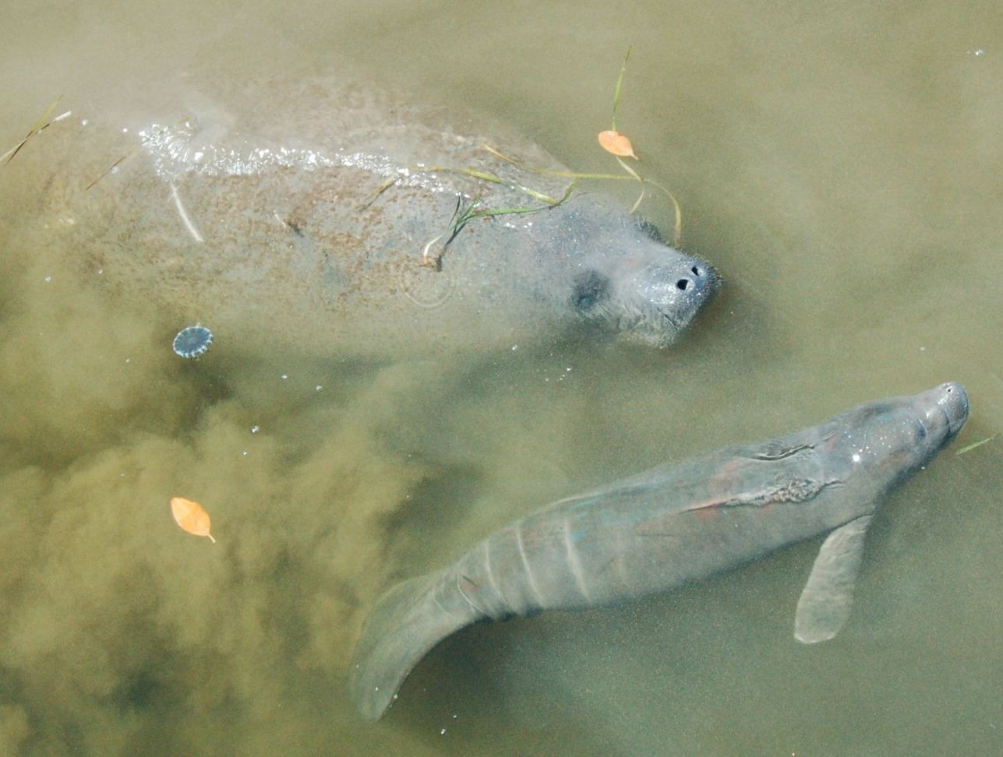
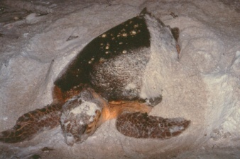
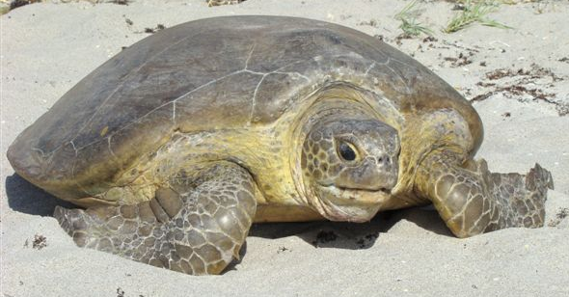
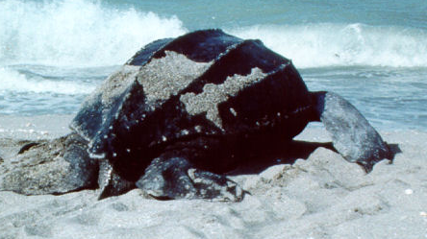
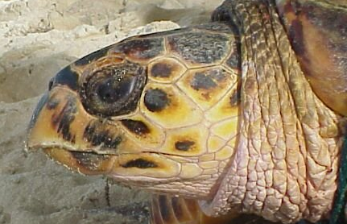
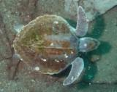
Listing status of manatees and marine turtles
Marine turtles:
Loggerhead (Caretta caretta)
Green (Chelonia mydas)
Leatherback (Dermochelys coriacea)
Hawksbill (Eretmochelys imbricata)
Kemp’s Ridley (Lepidochelys kempii)
Florida manatee (Trichechus manatus) is still federally endangered, although is still being considered for downlisting.

Slide 12
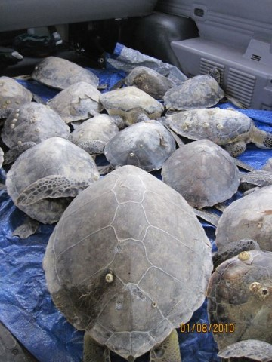
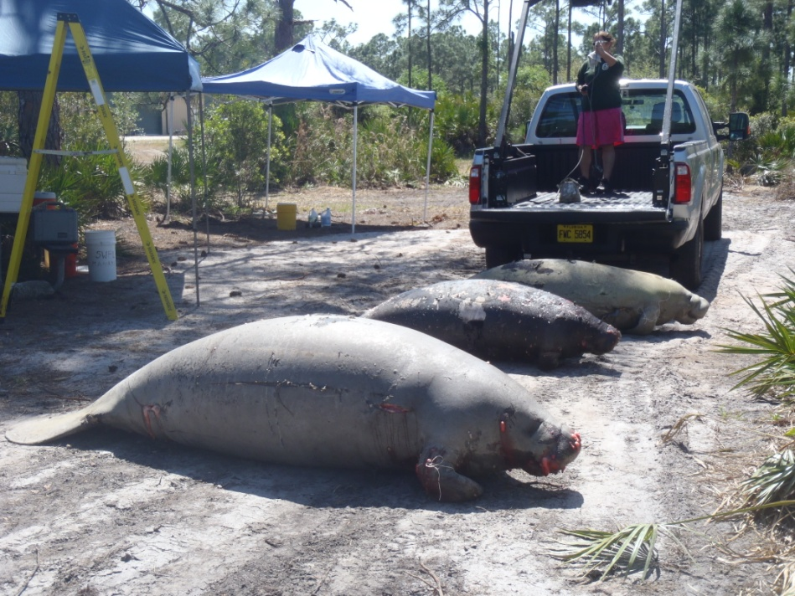
Recent impacts to manatee and turtle populations
2010 Deepwater Horizon Oil Spill
  Relocation of Florida panhandle nests to east coast
2010 Cold Events
2013 Unusual Mortality Events
  Red Tide events
  Brevard County

Slide 13
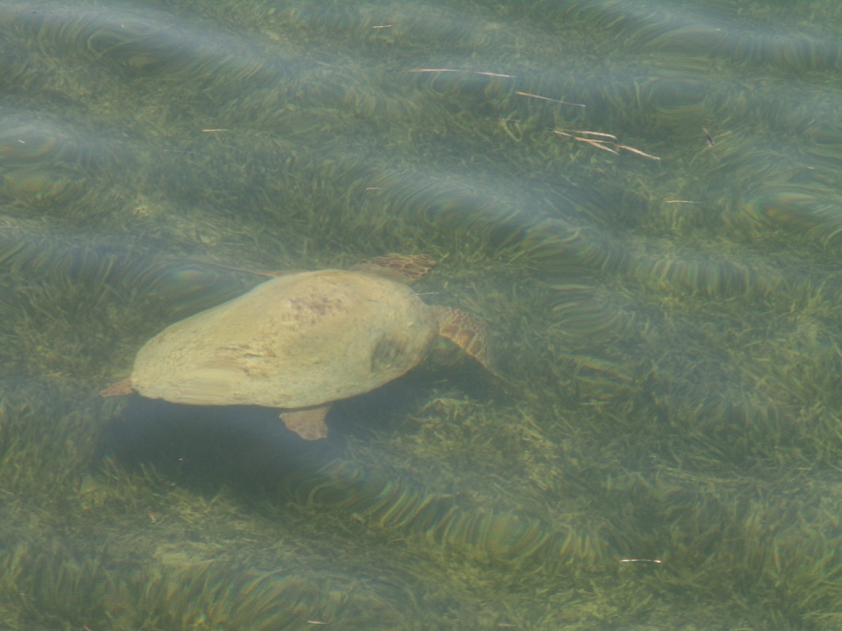
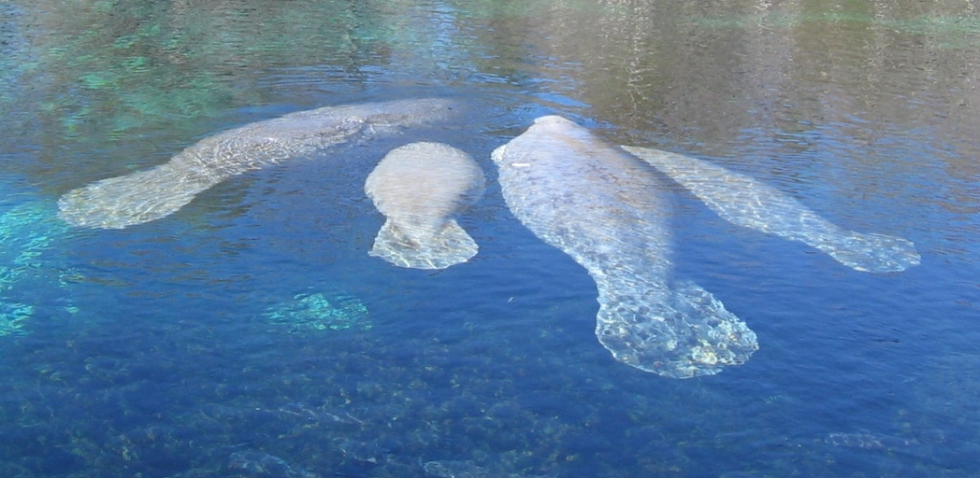
Questions?
http://www.myfwc.com/manatee
http://www.myfwc.com/wildlifehabitats/managed/sea-turtles/
Kristen.Sella@myfwc.com

