Slide 1
Tallahassee
National Pollutant Discharge Elimination System (NPDES) Stormwater
June 11, 2014

Slide 2


NPDES Stormwater Program e
Required by the Clean Water Act the Program regulates stormwater discharges into surface waters from certain:
  Construction Activities (CGP)
  Industrial Activities (MSGP)
  Municipal Separate Storm Sewer Systems (MS4)

Slide 3
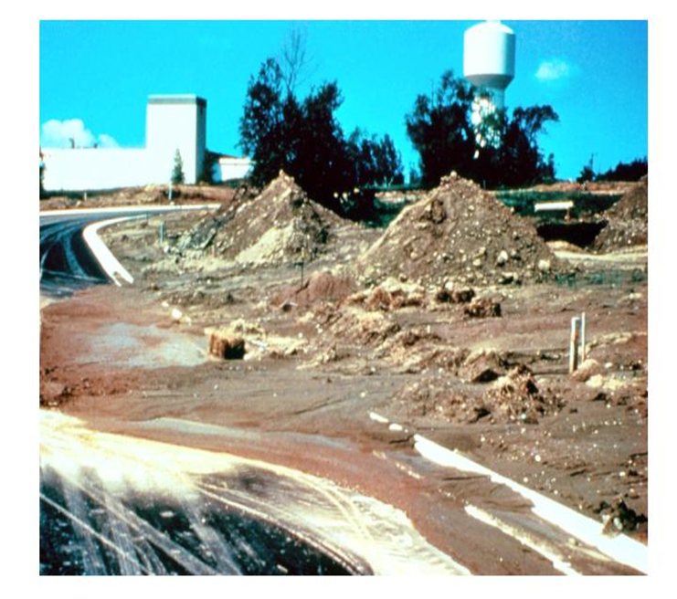
Construction Generic Permit
Who needs this (CGP) permit?
Anyone who disturbs 1 or more acres of land, or is part of a larger common plan of development or sale; and
Discharges stormwater to surface waters of the state or to a Municipal Separate Storm Sewer System (MS4)

Slide 4













CGP & ERP Timelines
Develop & Implement SWPPP (BMPs)
CGP Notice of Intent
CGP Inspections weekly/0.5”
CGP Notice of Termination
CGP
ERP
Construction Begins
Construction Ends
Perpetual ERP Operation & Maintenance
Submittal of ERP application
Issuance of ERP permit
Submittal of ERP application
ERP As-Built Certification; Conversion to Operation Phase
Completeness & RAI review
ERP Notice of Commencement
ERP Construction Conditions

Slide 5
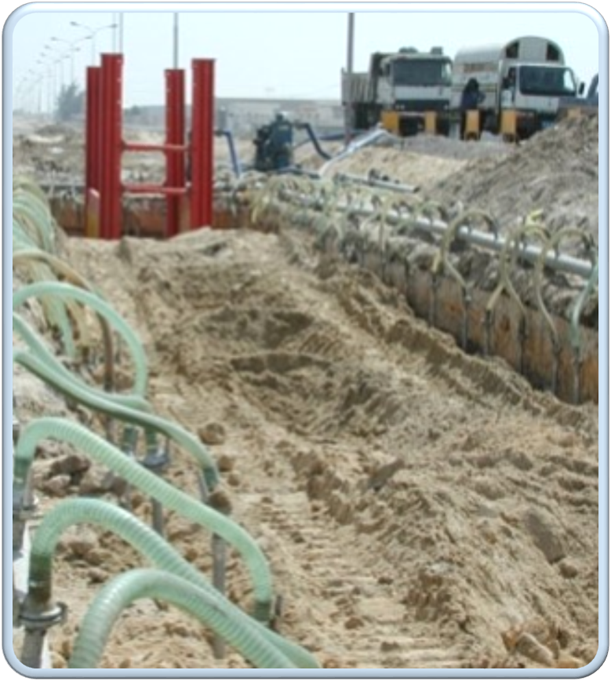
Dewatering Operations
“NEW”
Dewatering Operations”
“Optional” you may apply for dewatering coverage from an uncontaminated site under the 2014 CGP.
What must I do?
Identify that there is no contamination within 500ft of your dewatering operations
Implement appropriate dewatering BMPs
Document information in your dewatering section of your SWPPP

Slide 6
Multi-Sector Generic Permit
Who needs the (MSGP) permit?
If you conduct one or more regulated “industrial activities” as defined in 40 CFR 122.26(b)(14); and
Discharge stormwater associated with those regulated “industrial activities” to surface waters of the State, or to a Municipal Separate Storm Sewer System (MS4).

Slide 7
30 Regulated Industrial Activities by Industrial Sector
Sector A: Timber Products
Sector B: Paper Products Manufacturing
Sector C: Chemical Manufacturing
Sector D: Asphalt Paving
Sector E: Glass, Clay, Cement, Man.
Sector F: Primary Metals
Sector G: Metal Mining
Sector H: Coal Mines
Sector I: Oil and Gas Extraction
Sector J: Mineral Mining & Dressing
Sector K: Hazardous Waste Facilities
Sector L: Landfills
Sector M: Auto Salvage Yards
Sector N: Recycling Facilities
Sector O: Power Plants (Steam)
Sector P: Land Transportation
Sector Q: Water Transportation
Sector R: Ship & Boat Building
Sector S: Air Transportation
Sector T: Treatment Works
Sector U: Food & Kindred Products
Sector V: Textile Mills
Sector W: Furniture & Fixtures
Sector X: Printing & Publishing
Sector Y: Plastics Manufacturing
Sector Z: Leather Tanning & Finishing
Sector AA: Fabricated Metal Products
Sector AB: Transportation Equip.
Sector AC: Electronic Goods
Sector AD: Additional Activities…..

Slide 8
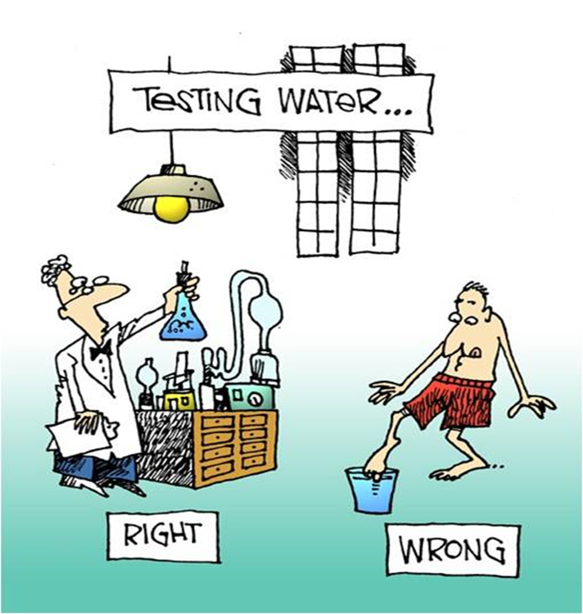
Discharge Monitoring Requirements
Determined by Sector/SIC code
Three types of monitoring:
Visual Assessment (required quarterly for all sectors)
Analytical = Benchmarks (in the 2nd & 4th year of the permit cycle).
Compliance = Effluent Limitations (one sample per year of the permit cycle).

Slide 9
What must I do to stay in compliance?
Develop a Stormwater Pollution Prevention Plan (SWPPP). Implement Proper Best Management Practices (BMPs).
Submit your Notice of Intent (NOI) and fee on time.
Permit coverage is effective two calendar days following the submittal of a complete NOI and fee.
These permits are effective for five years.
Inspect your site and conduct monitoring.
Must meet water quality standards.
Update SWPPP as necessary.

Slide 10

NPDES Stormwater Program
NPDES Stormwater Overview MS4s
June 2014

Slide 11
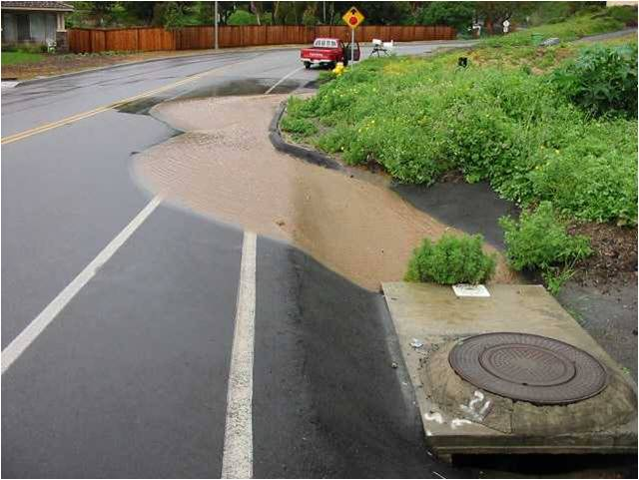
What is a Municipal Separate Storm Sewer System (MS4)?
An MS4 is a system of conveyances (ditches, curbs, catch basins, etc.) that is designed to discharge to surface waters of the State.
It is the “master drainage system.”

Slide 12
CWA Amendments -1987
Congress amended the CWA in 1987
  Required the EPA to develop requirements for stormwater discharges
  Phase I: Large MS4s and industrial activities –November 1990
  Phase II: Small MS4s and construction sites – December 1999

Slide 13
Phase I MS4 Permit Requirements
Inspection, Operation, and Maintenance
New Development / Significant Redevelopment – Local site plan review
Roadways – Litter, street sweeping, prevention
Flood Control Projects – Include WQ Component
Municipal Waste Facilities & BMPs
Pesticide, Herbicide, and Fertilizer Application
Illicit Discharge Inspection/Enforcement Program
Industrial and High Risk Runoff – MSGP coverage, inspection
Construction Site Runoff – Site plan review, inspection
Monitoring and TMDL Implementation

Slide 14
Regulated Phase II MS4s
Phase II stormwater regulations expanded coverage to “small” MS4s in 1999.
Included “Urbanized areas“ (population >10,000 and a density of >1,000 people per square mile) based on the 2000 Census.
Phase II MS4s are permitted under generic permits in Florida.
Notes:
The Phase I “regulations” also applied to construction activities > 5 acres and certain industrial activities (MSGP)

Slide 15
Phase II MS4 Generic Permit Requirements
Public Education
Public Involvement
Illicit Discharge Detection & Elimination Program
Construction review & inspection program
Post-construction Stormwater Management in New Development***
Pollution Prevention / Good Housekeeping at Municipal facilities
*** ERP Satisfies this Element in Florida

Slide 16
Questions?
Please contact us with additional questions.
Program Contacts:
Borja Crane-Amores – Industrial and Construction Permits
(850) 245-7520
Borja.CraneAmores@dep.state.fl.us
Michelle Bull – Phase I MS4 Coordinator
(850) 245-7561
Michelle.Bull@dep.state.fl.us
Ken Kuhl – Phase II MS4 Coordinator
(850) 245-8667
Kenneth.Kuhl@dep.state.fl.us
NPDES Notices Center
(866) 336-6312 (toll-free)
NPDES-stormwater@dep.state.fl.us

