Slide 1
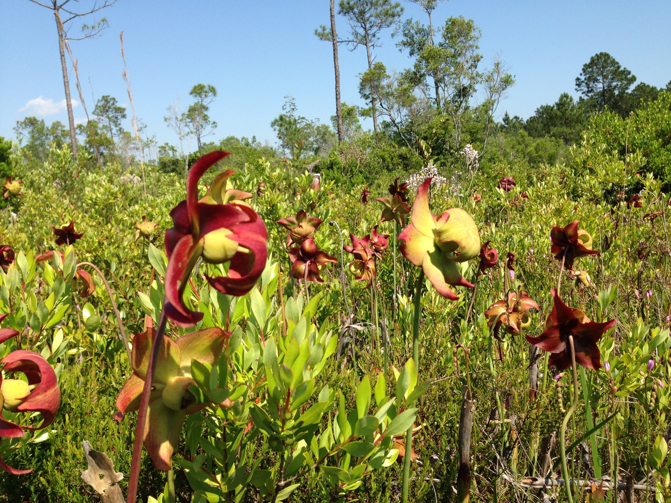



Combined Effluent Wetland Distribution System
Tony Greco, PWS
Nutter & Associates, Inc.
www.NutterInc.com

Slide 2
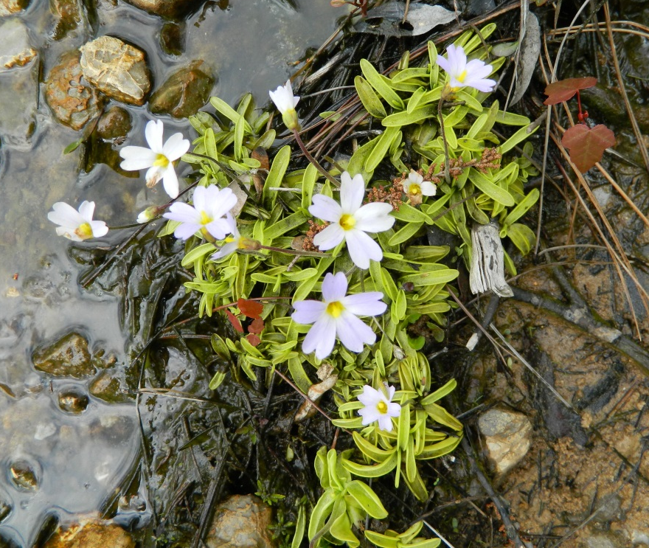
Presentation Overview
Introduction and Project History
Project Design
Permitting
Project Implementation
Results
What we’ve learned

Slide 3
Project History
Pulp mill discharge to Elevenmile Creek since 1950s
Beginning in 2001, International Paper began exploring options for alternative discharge strategies
  Land application
  Deep aquifer injection
  Wetland distribution
Public/Private Partnership – IP and ECUA
Final determination was made to discharge to a natural receiving wetland adjacent to Perdido Bay and lower Elevenmile Creek via a 10-mile pipeline
Infrastructure upgrades:
  Activated sludge component added to the Waste Treatment
  Construction of a 10-mile long pipeline
  Construction of 4 water distribution berms within the receiving wetland
Permit Challenge –“No Significant Adverse Impact” was not demonstrated
  Project reevaluation
  Intensive data collection and assessment of pre- and post-project conditions
100% removal of effluent from Elevenmile Creek was complete by November 2012

Slide 4
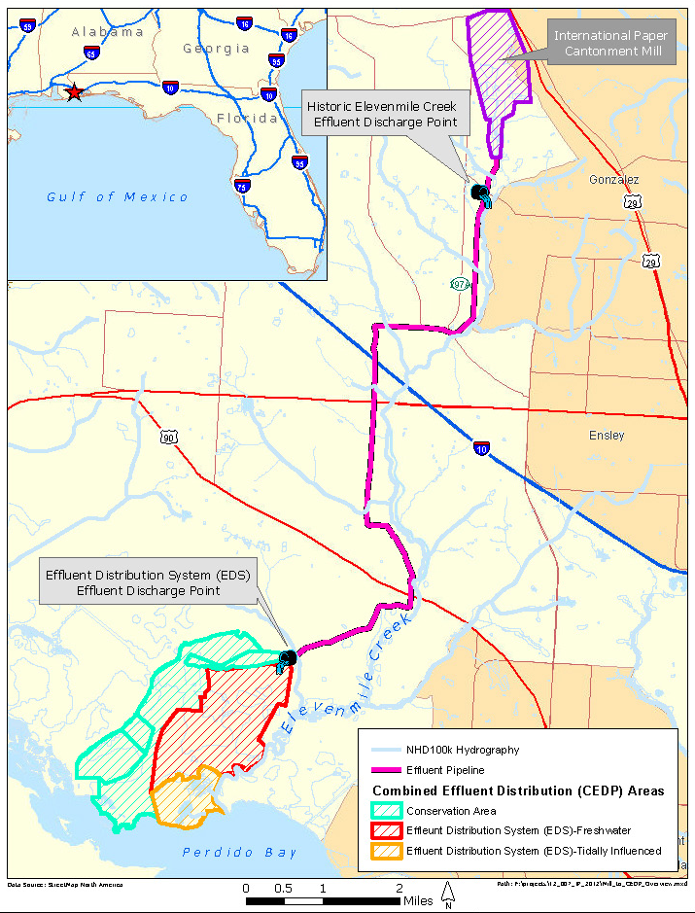
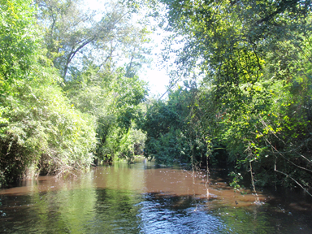
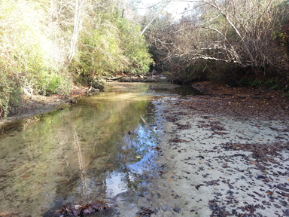
Elevenmile Creek
August 2011
December 2012

Slide 5
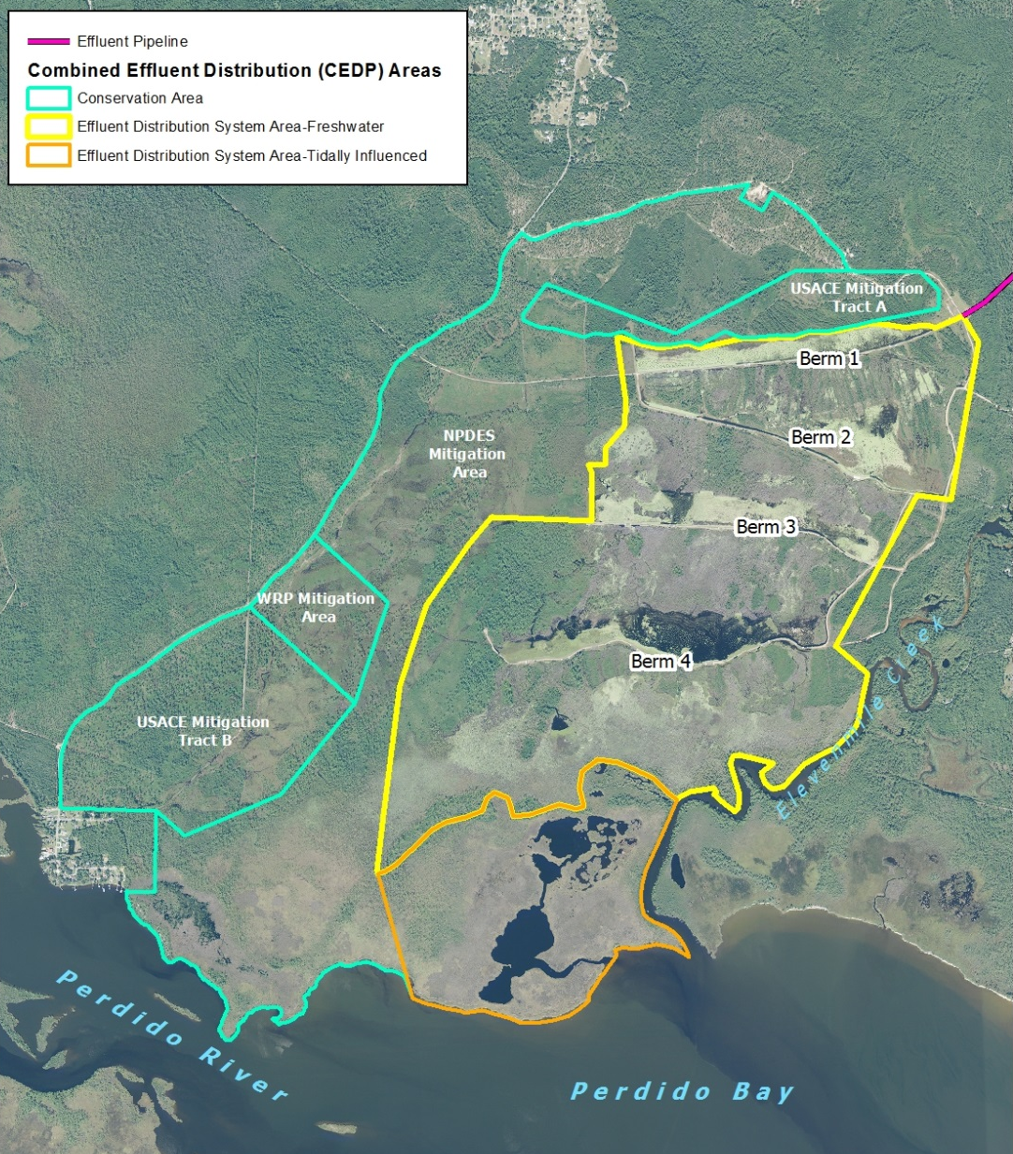
Effluent Distribution Area 1,406 acres
Conservation Areas
1,258 acres

Slide 6
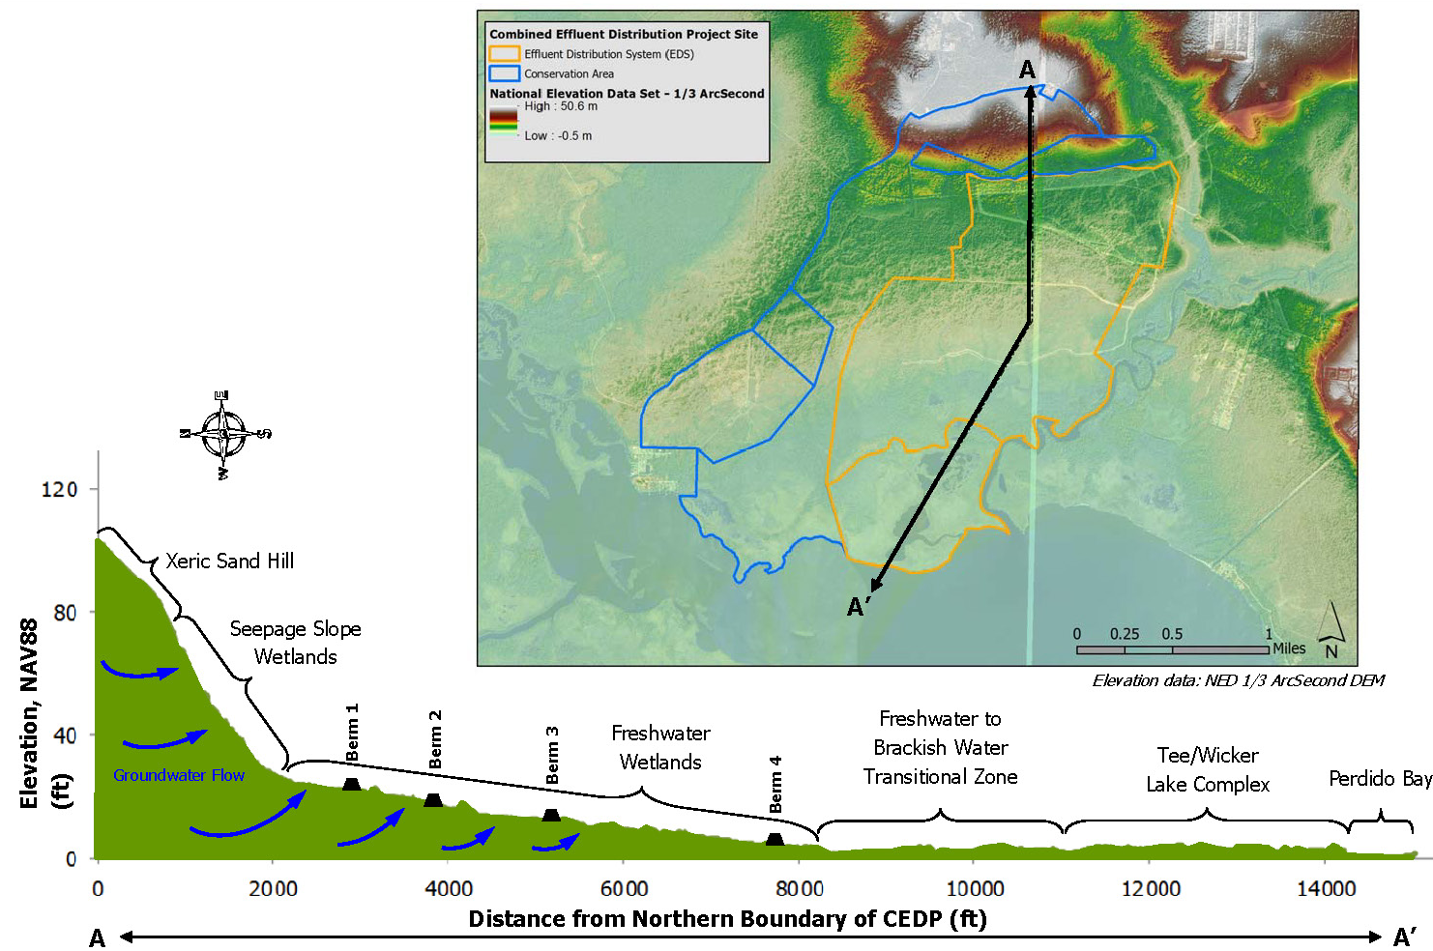

Slide 7
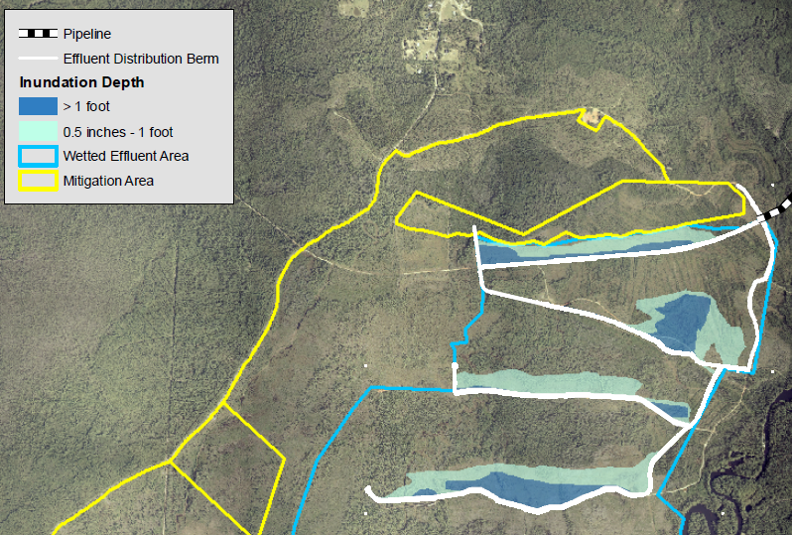
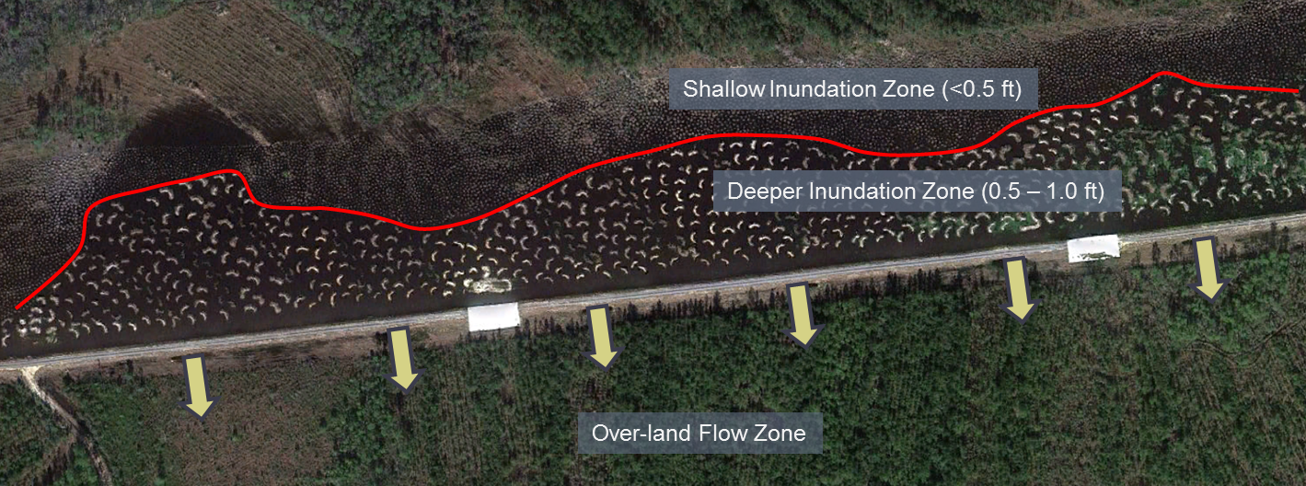
Project Design and Engineering
Complex projects must include a multi-disciplinary review team
Critical needs:
  Resolute elevation data
  Existing site hydrology
  Site knowledge
  Regulatory coordination

Slide 8
Permitting
Baseline site characterization
  Regulated Water Bodies
  Water quality
    Effluent characterization
    Receiving water characterization
  Ecologic characterization
    Vegetation
    Aquatic fauna
    Threatened and Endangered Species and habitats
Project impact evaluation and Permitting
  Construction impacts
  Water management
  Water quality modeling
  Ecologic alterations
  Avoidance and Minimization
  Anticipated post-project conditions
Long-term Monitoring and Management
Site Specific Alternative Criteria

Slide 9
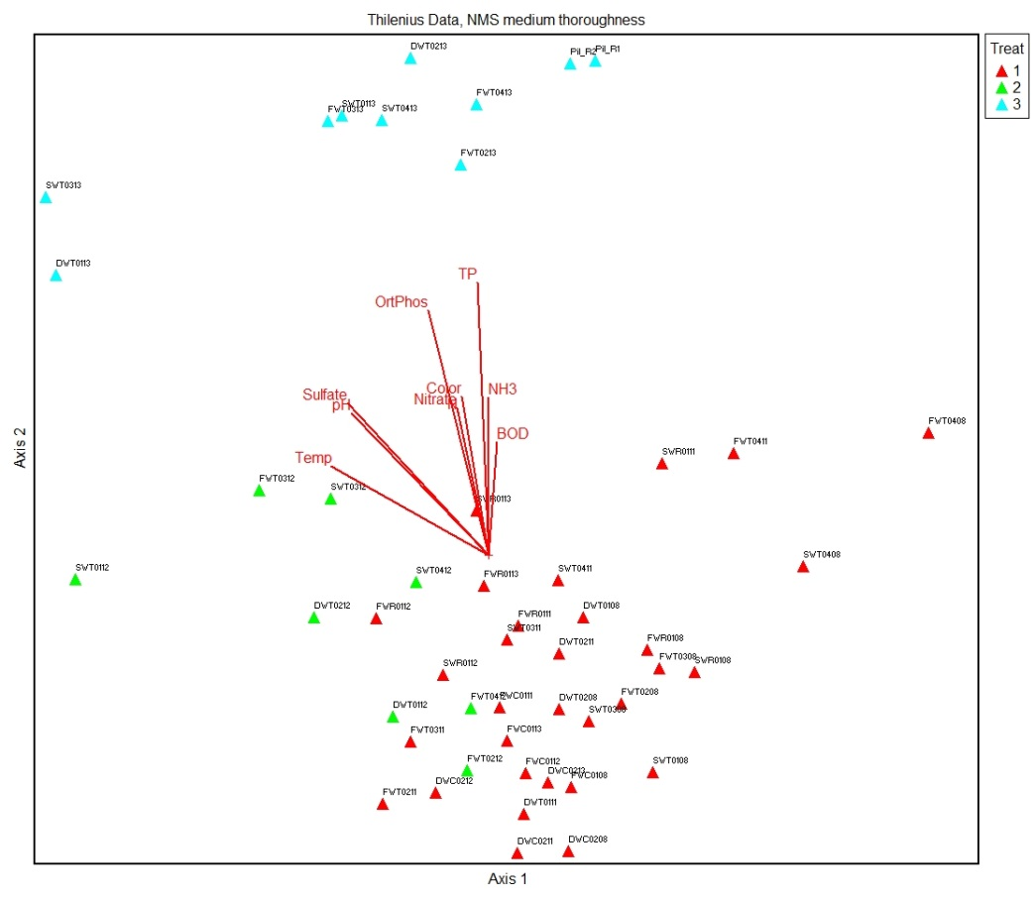
Baseline Monitoring Program Design
Characterization Variables
  Water quality
  Hydrology
  Flora and fauna
  Soils
Statistical Analysis Considerations
  Sample size
  Repeatability
  Stratification
    Wetland type
    Vegetative community
    Management
  Reference and/or control site identification

Slide 10
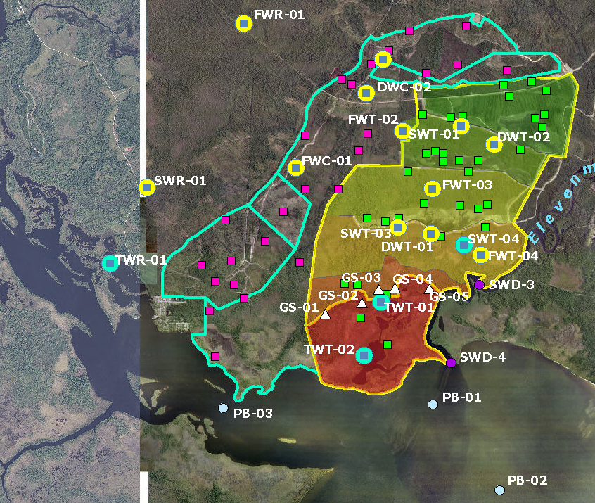
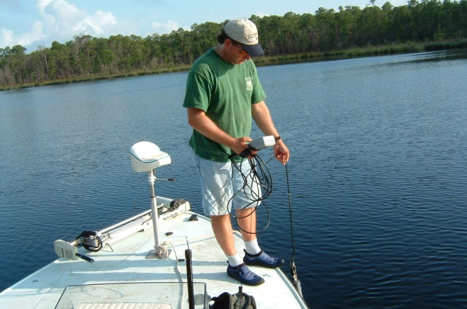
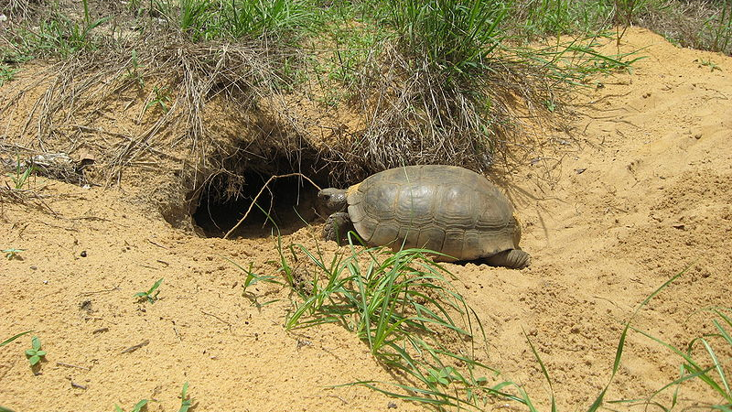
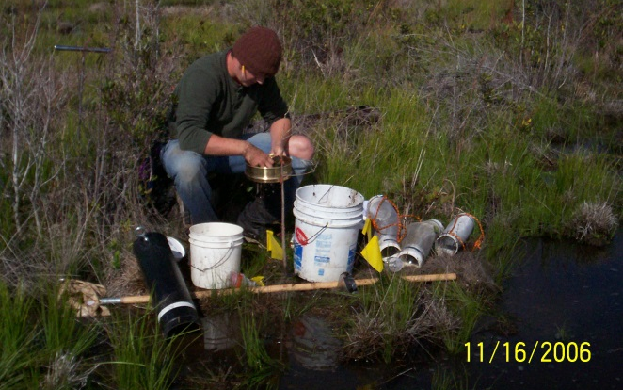
Baseline Monitoring
Water Quality, Vegetation, Aquatic Fauna, Hydrology

Slide 11
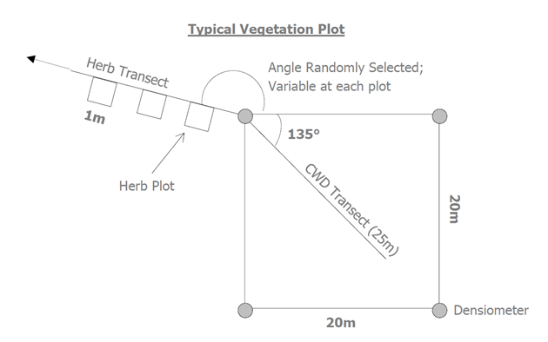
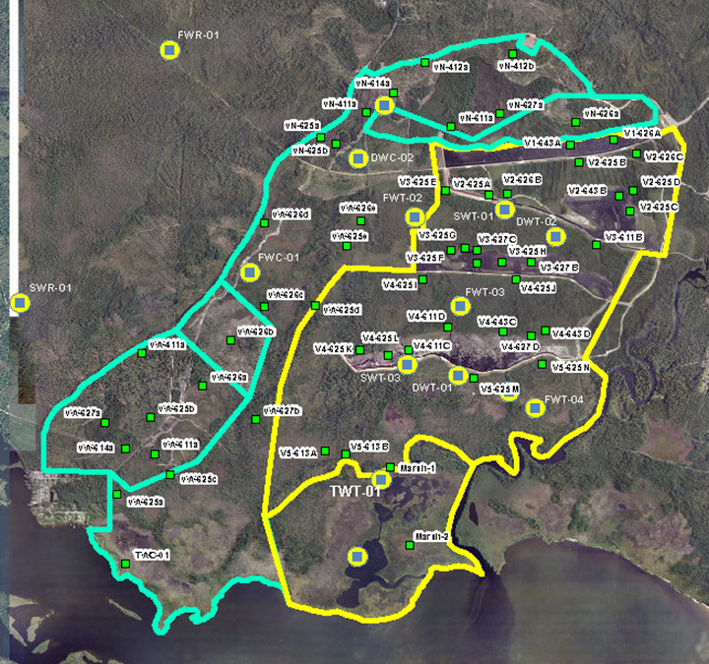
Vegetation Sampling
68 Vegetation Stations
Stratified by FLUCCS community type
EDS stations stratified by Zone:
  Overland flow zones
  Hummock zones
  Downgradient berm zones
Herb transect
  Bearing and start distance randomly selected
  Continued sampling of same 1m x 1m quadrat semi-annually
Canopy Plot
  DBH of all species > 3in DBH within 20m x 20m plot annually
  Canopy coverage at each plot corner annually
CWD Transect
  Line-intercept sampling methodology
  Diameter and length of all CWD > 3in

Slide 12
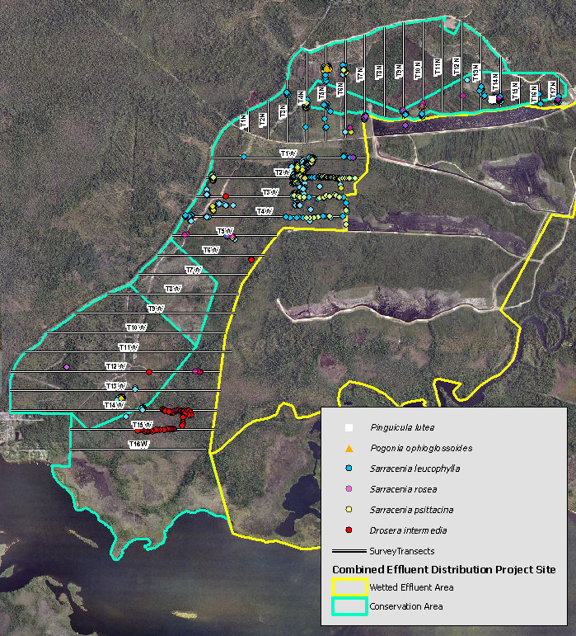
Threatened & Endangered Species
T&E inventories conducted within 10m belt transects
17.6-miles of pedestrian transects located on 150m centers
Surveys conducted at 3 year intervals:
  Pre-management
  Year 1 (2012)
  Year 3 (2015)

Slide 13
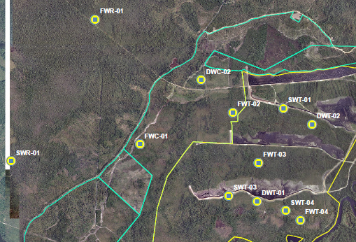
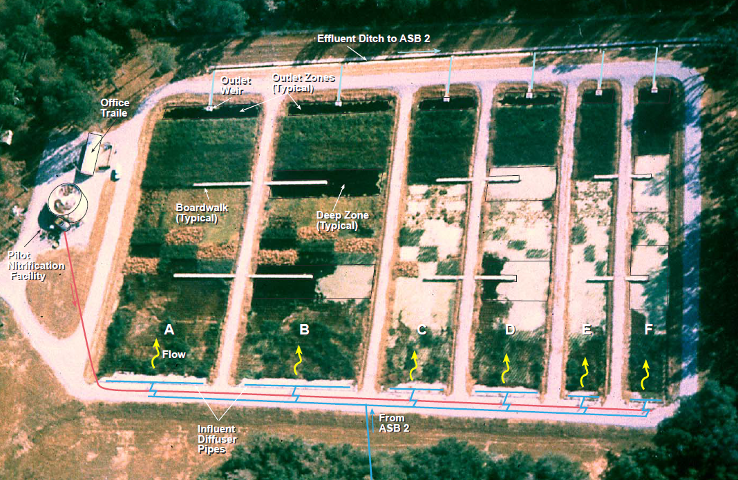
Wetland Macroinvertebrates
Pre-project studies
  FL WCI
  Hester-Dendy
  Core sampling
FL Wetland Condition Index (SOP FS7470)
  Herbaceous wetlands
  Isolated forested wetlands
Post-project projections
  IP Pilot Cell sampling
  Tolerance
  Habitat preference
  Functional feeding guilds

Slide 14
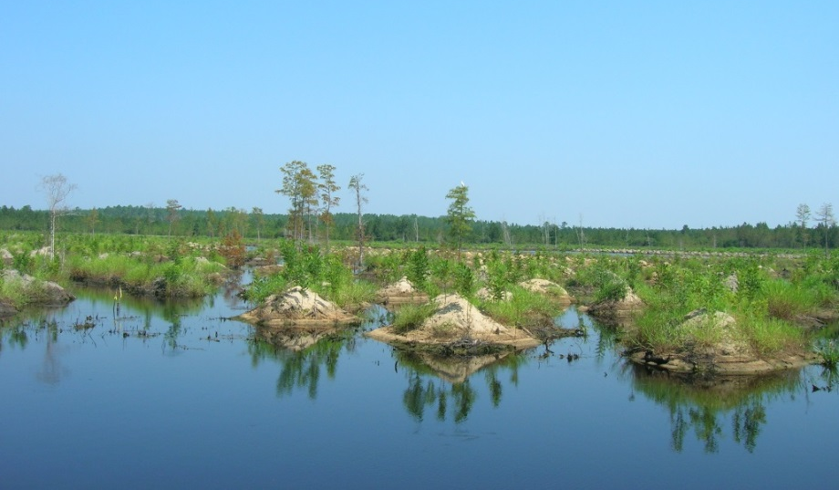
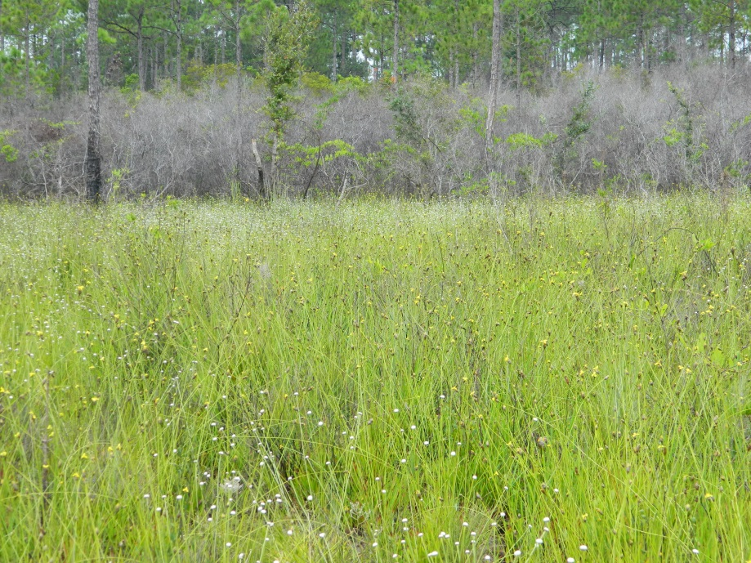
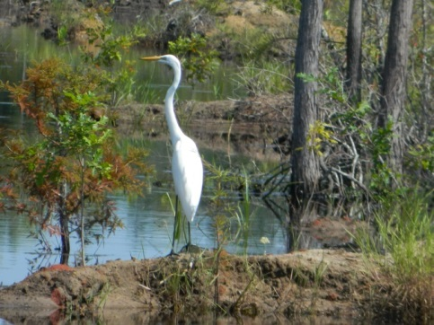
Avoidance and Minimization
Impact Evaluation
  FNAI S2 Habitat identification and avoidance
  Methods to maintain and/or enhance ecological integrity
Mitigation
  Conservation easement established to protect T&E species and their habitats
    Xeric sandhill
    Hydric pine savannah
    Wet prairie
  Land Management to improve habitat quality and quantity

Slide 15
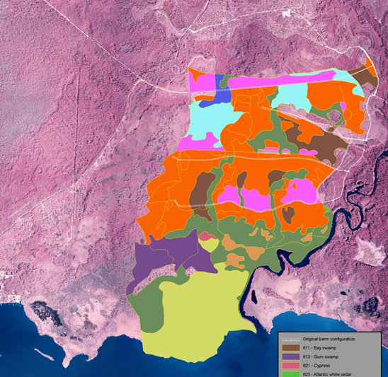
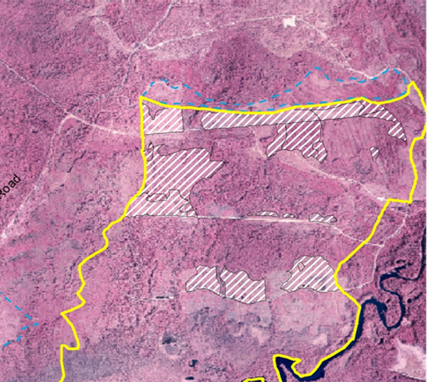
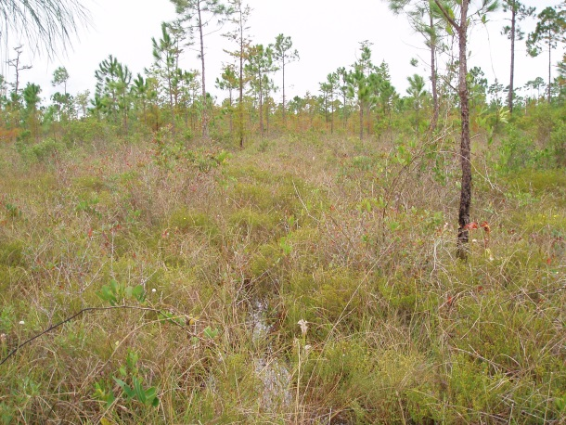
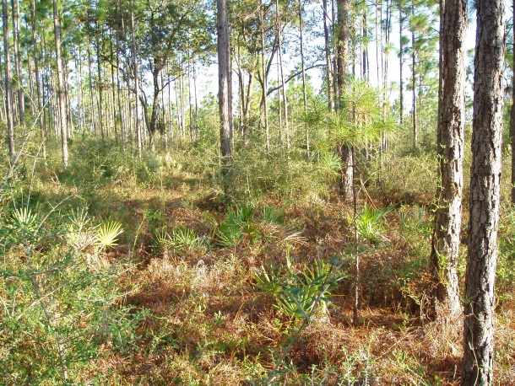
Impact Offsets
Site Characterization
  FLUCCS mapping
  FNAI S2 habitat identification
Minimization of Impacts
  Project modification
  Enhancement and land management plan development
Impact Assessment
  Unified Mitigation Assessment Methodology (UMAM)
  Determination of functional unit loss

Slide 16
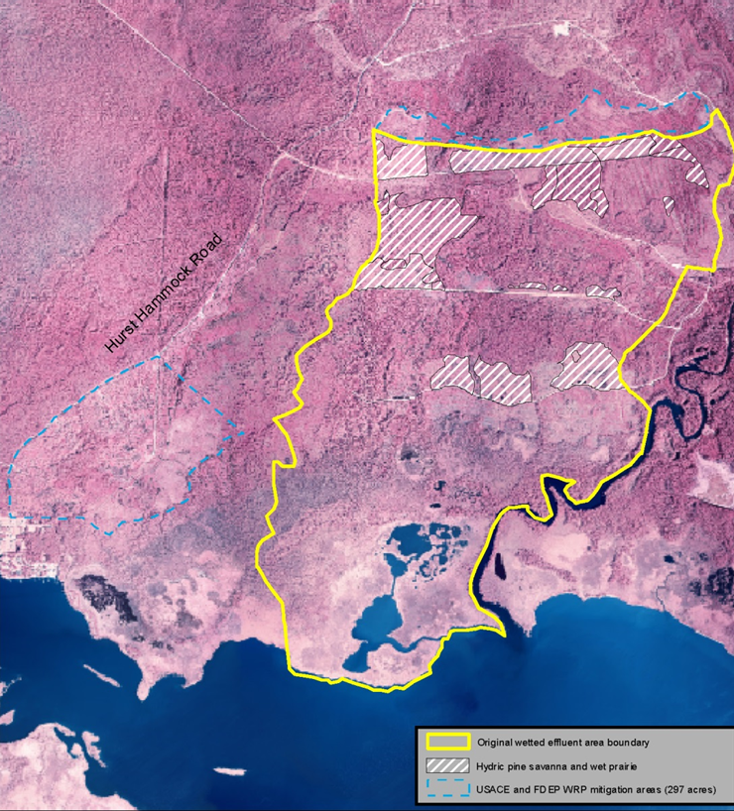
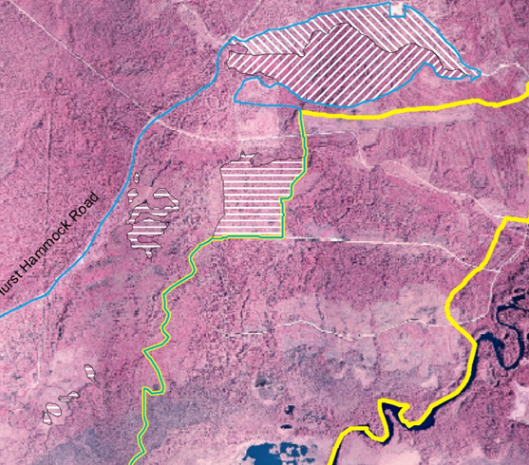
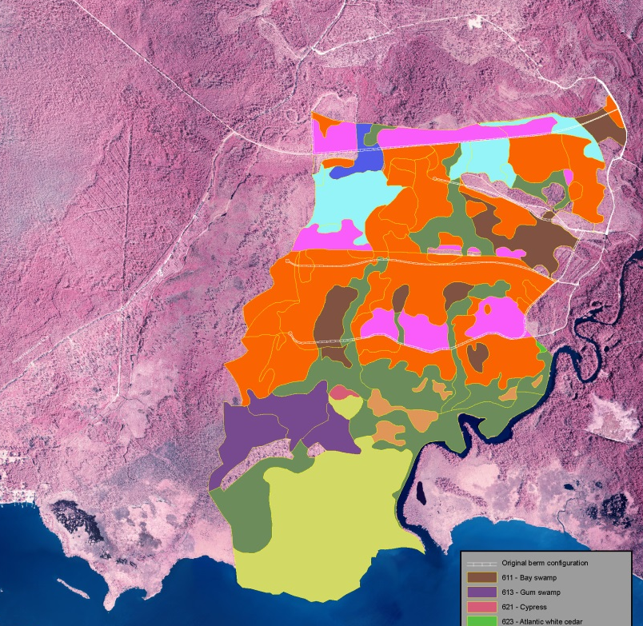
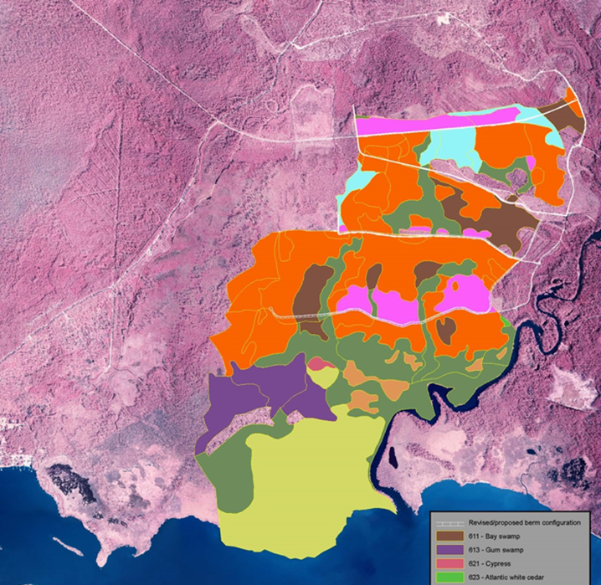

Slide 17
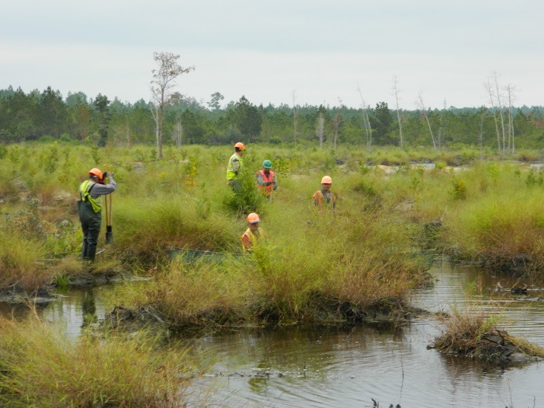
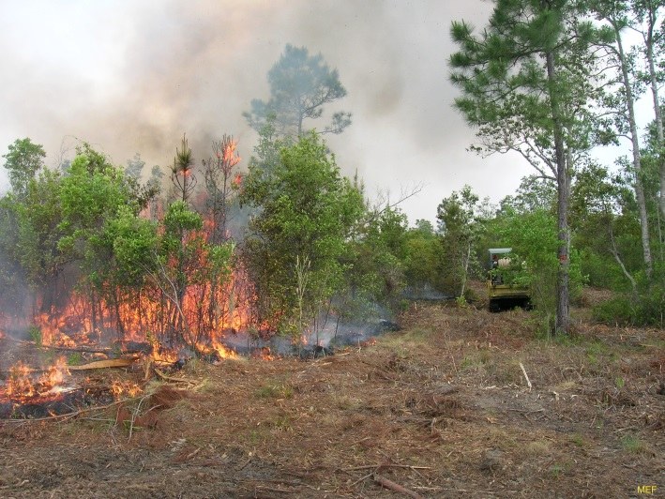
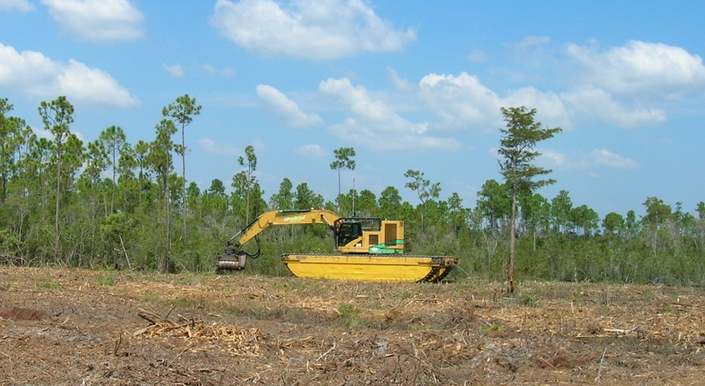
Conservation Area Land Management Plan
Goal: Establish conservation easement to protect and enhance T&E species and their habitats
Methods
  Prescribed burning
  Mechanical shrub reduction
Reestablishment of native vegetative community
Increase ecosystem function
Manage exotic, invasive, and/or undesirable species

Slide 18
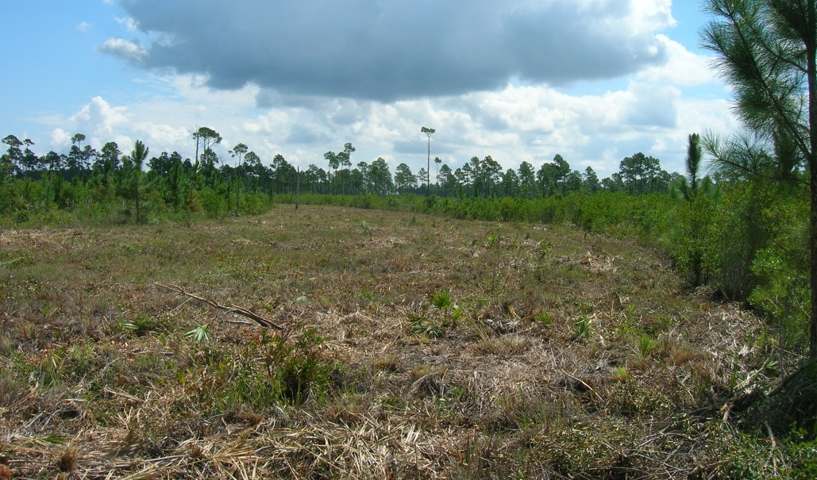
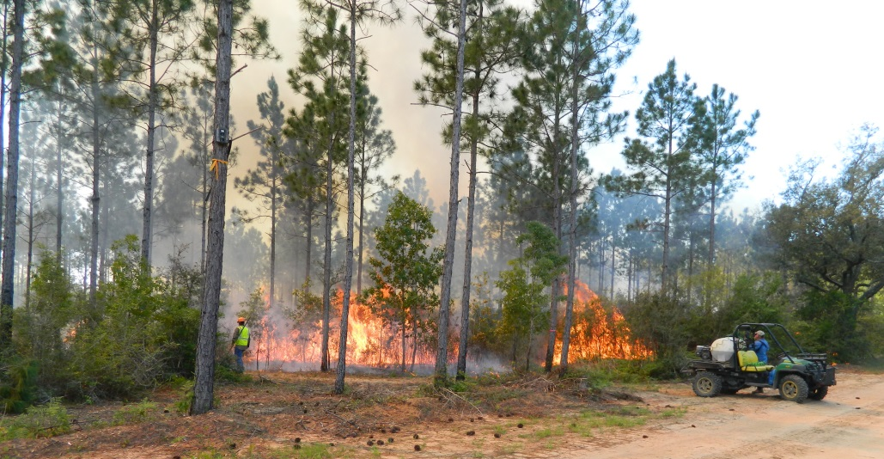
Conservation Area Land Management
Mechanical shrub reduction
  Reduce fuel load
  Stimulate graminoid growth
Prescribed burning
  S2 Wetland Areas
    1 to 3 year rotation
    Initial dormant season burns transitioning to growing season
  Xeric Sandhill Areas
    2 to 5 year rotation
    Initial dormant season burns transitioning to growing season

Slide 19
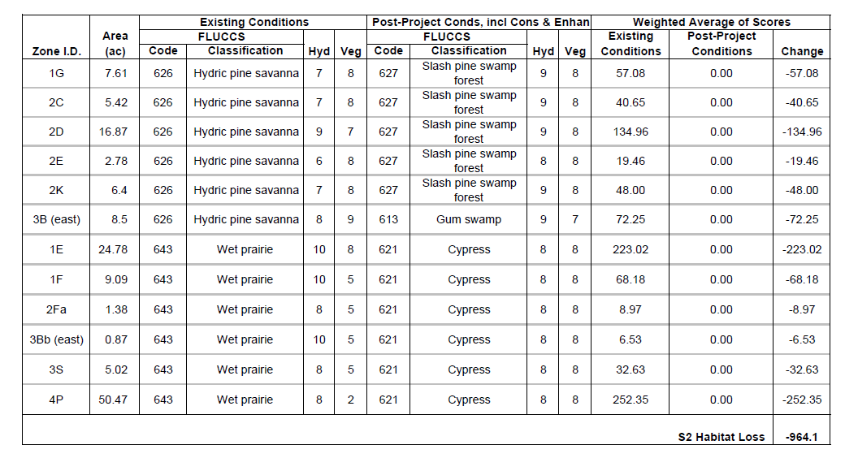
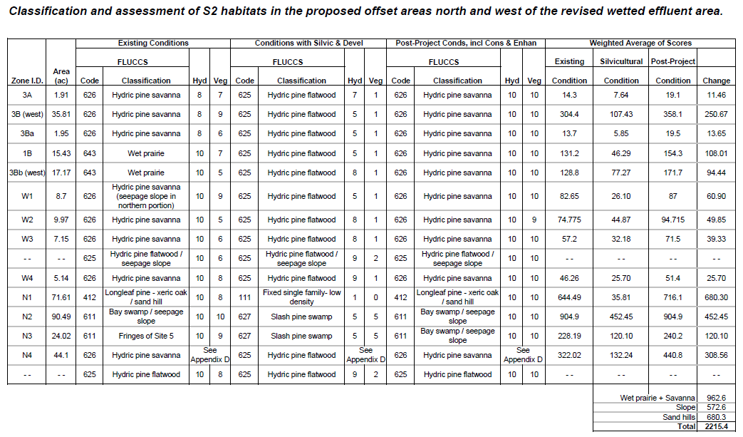
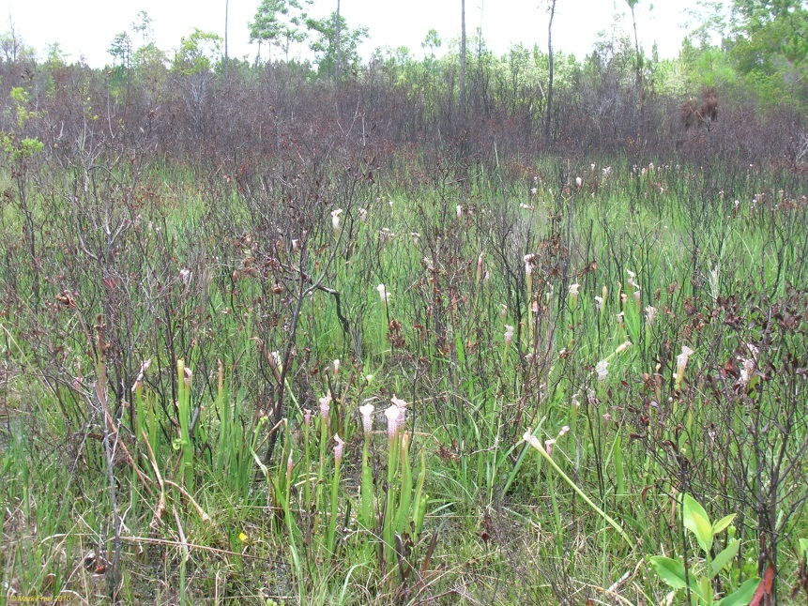
Functional Assessment
Existing condition
  Hydrology
  Vegetation
  Community type
Post-project condition
  Hydrology
  Vegetation
  Community type
S2 Functional Assessment
  Total loss: 964.1 units
  Total gain: 2215.4 units
  Net Gain: 1,251.3 units

Slide 20
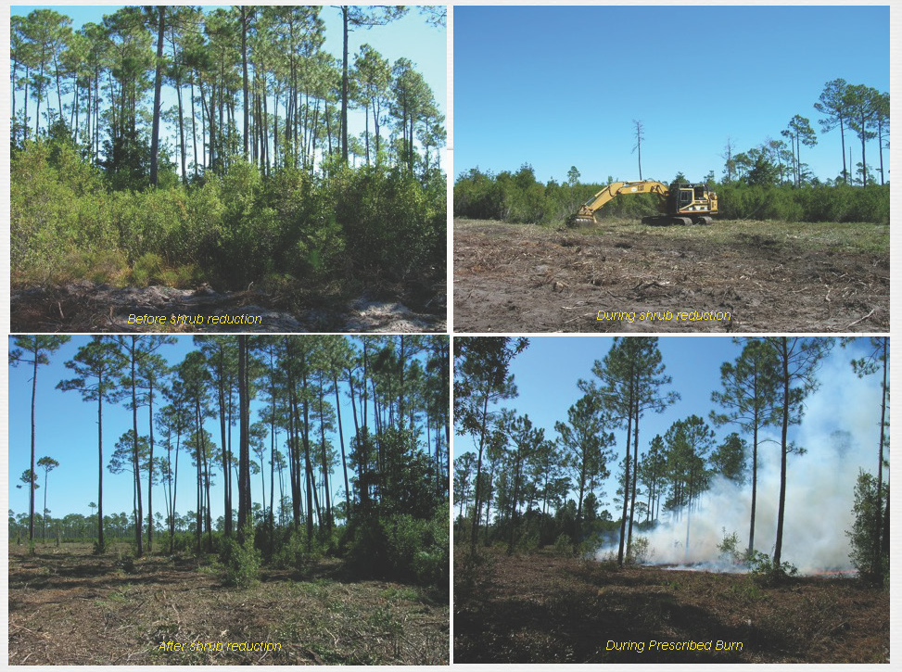

Slide 21
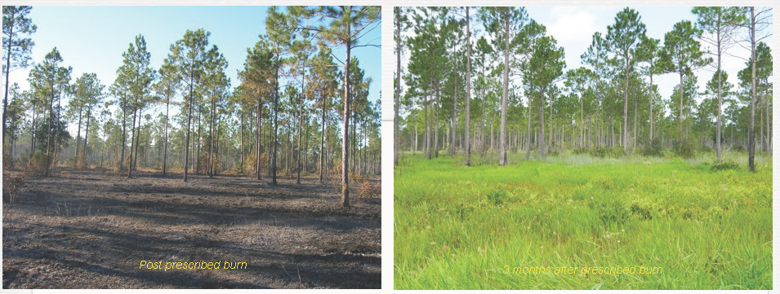

Slide 22
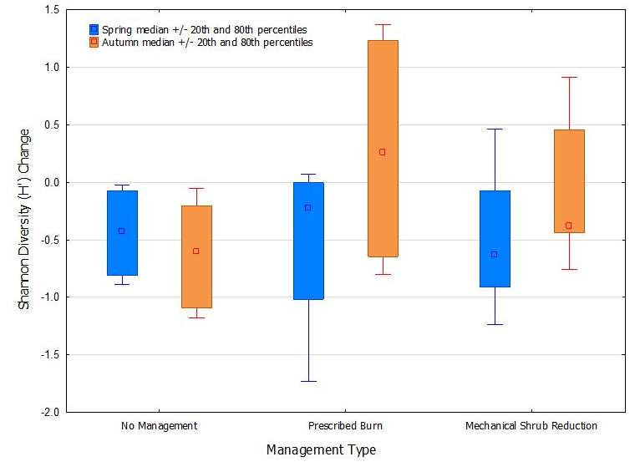
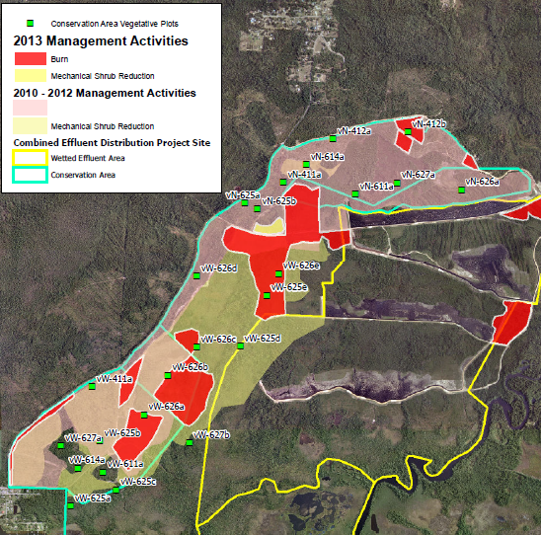
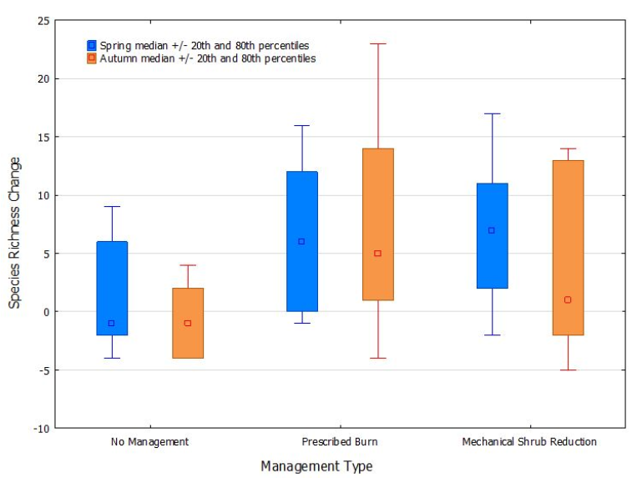
Land Management Results

Slide 23
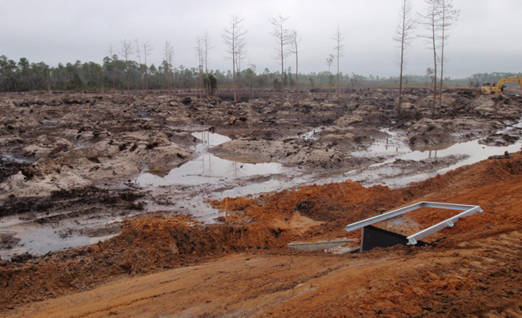
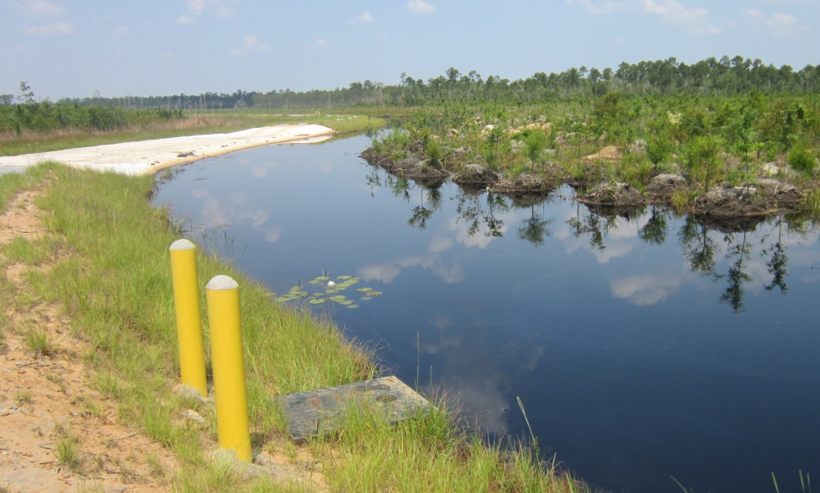
EDS Project Implementation
Construction
Ramp-up Period
Routine Monitoring
Site Specific Alternative Criteria
  Class III: Freshwaters
  Class III: Marine Waters

Slide 24
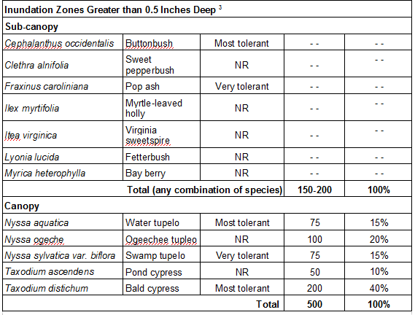

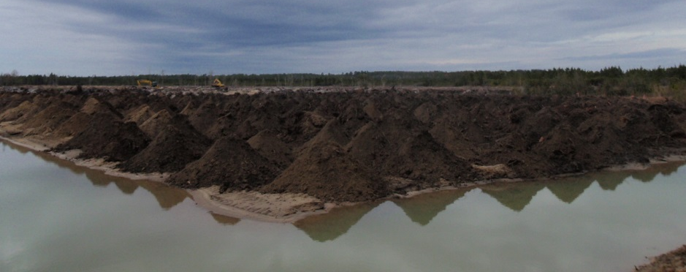
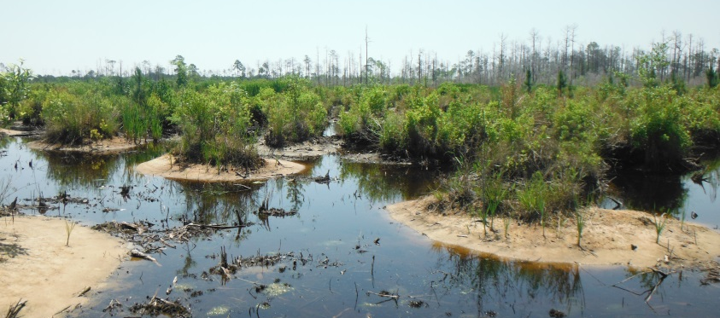
EDS Habitat Enhancement
Construction of raised hummocks within inundation areas
Projected wetland type guided planted species
Success Criteria
  80% survival rate of planted species
  Less than 1% nuisance species
  Mitigation area success

Slide 25
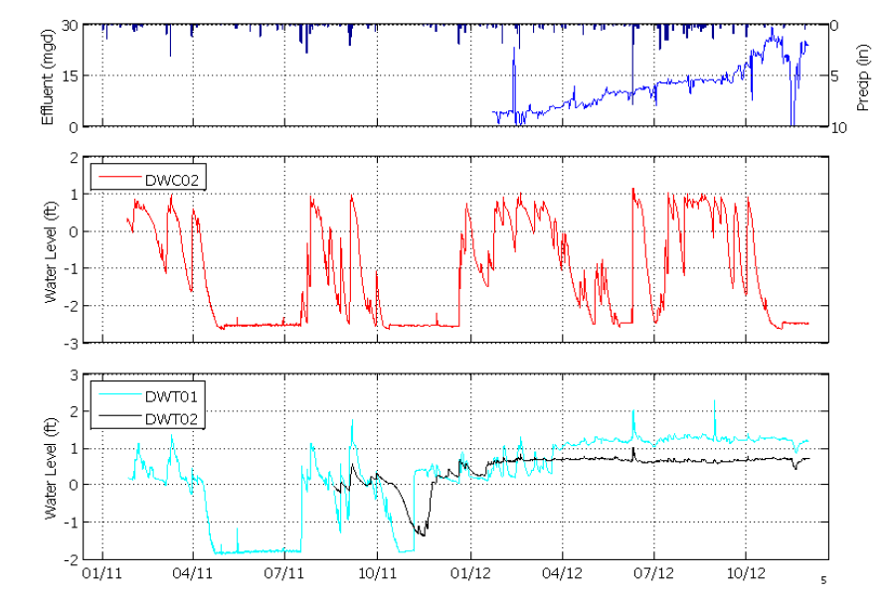
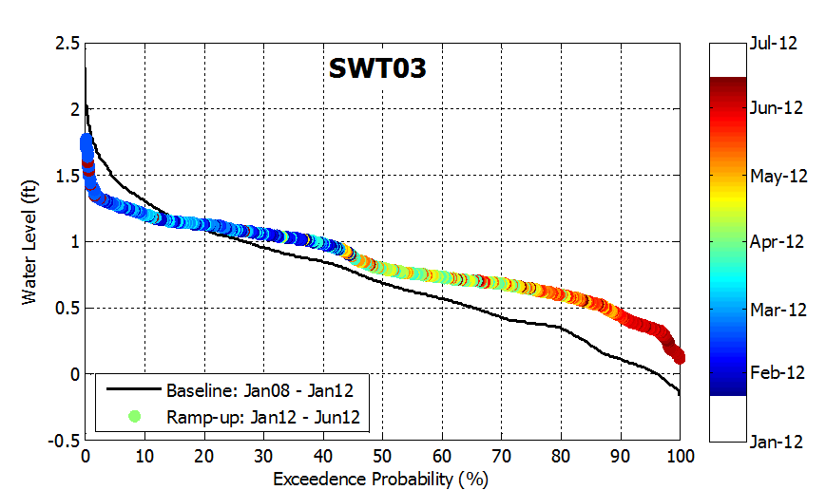

Ramp-up Period
Total flow allocation to wetland system
  IP: 23.5 MGD daily average
  ECUA: 5 MGD max daily
Flow ramped up ~ 25% per quarter in 2012 to moderate hydrologic effects

Slide 26


EDS Monitoring and Trends
Influential Variables
  Specific conductivity
  pH
  Hydroperiod
  Nutrients
Primary Ecologic Shifts
  Structural aquatic habitat shift (variable to permanent hydroperiod)
  Flood-tolerant vegetative community
Maintenance of designated use

Slide 27



EDS Management
Water level
  Introduction of water level management to stimulate vegetative regeneration
  Hummocks have been successful means of maintaining species diversity and habitat availability
  Stormwater and natural hydrologic input planning
Canopy Establishment
  Management of water levels essential for tree establishment and survivorship
  Management of nuisance species

Slide 28



Site Specific Alternative Criteria
Class III Freshwaters
  Specific conductivity
  pH
  Dissolved oxygen
Class III Marine Waters
  Dissolved Oxygen
Maintenance of Designated Use for Type-II SSACs
  Vegetation
  Benthic macroinvertebrates
  Phytoplankton

Slide 29

Questions?
Acknowledgements
International Paper
Mark Free
ECUA

