Slide 1
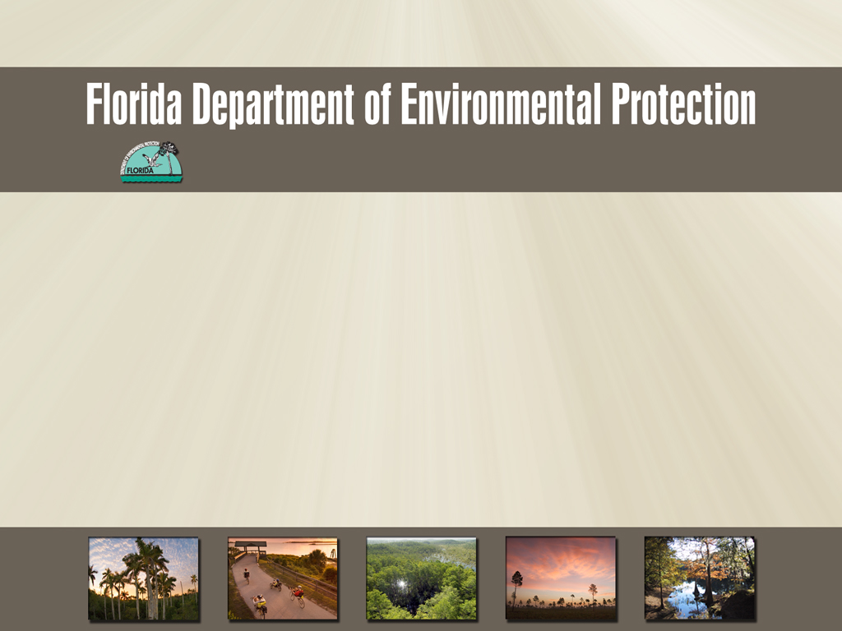
Office of Communications
Bulkheads, Critters, and Local Wetland Ordinances

Slide 2
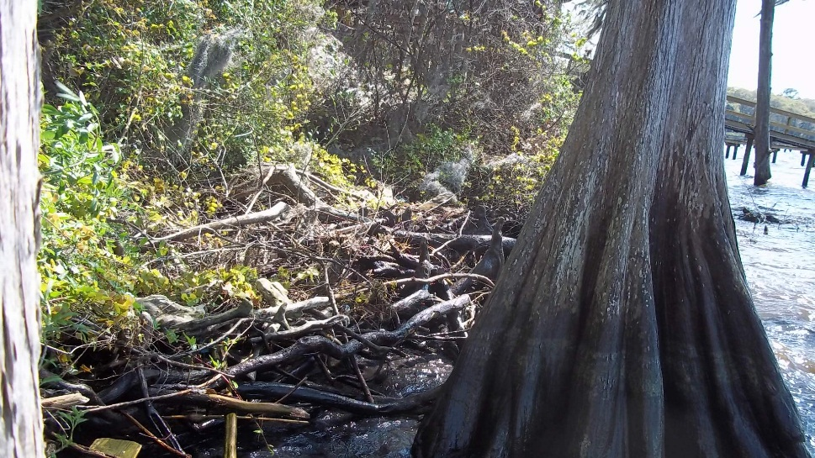
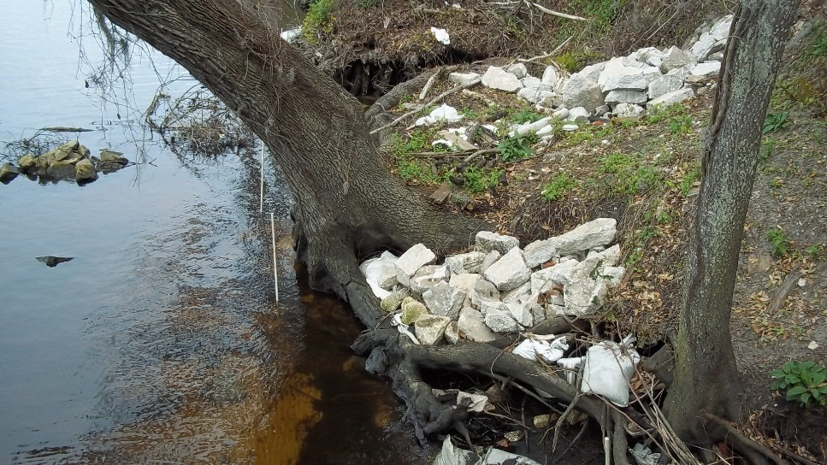
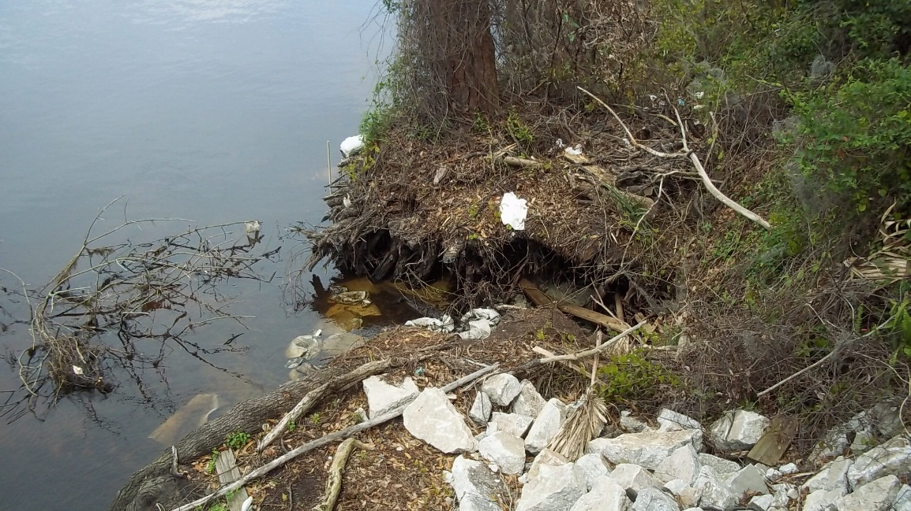
What to do?

Slide 3
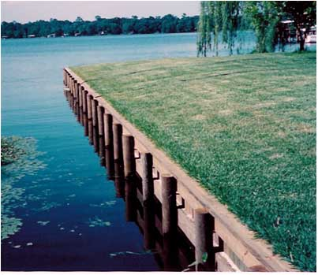
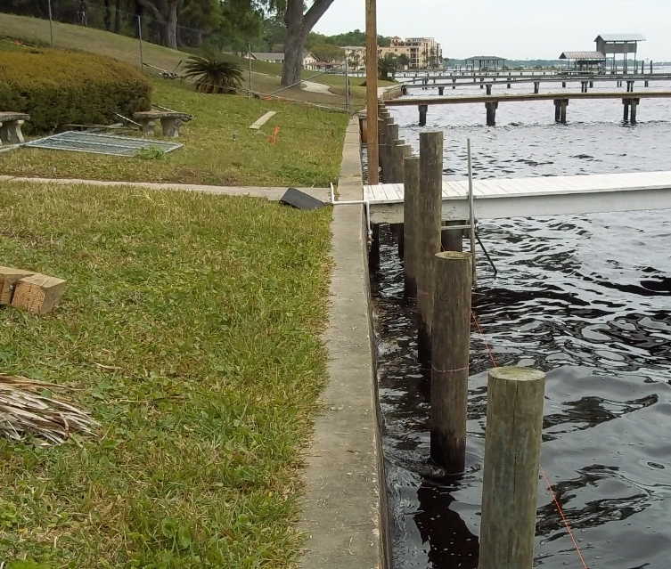
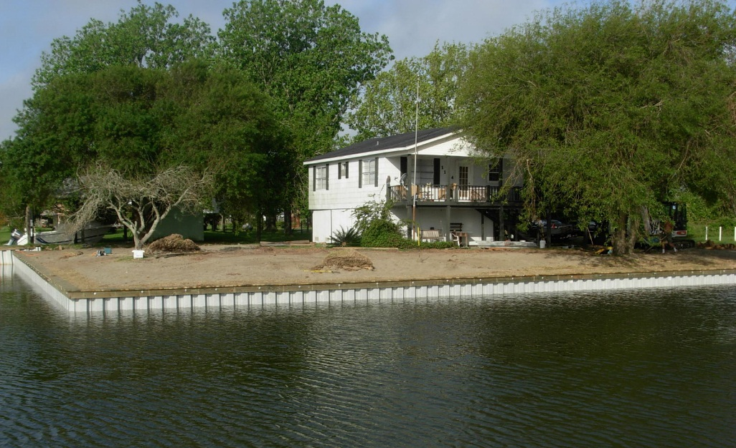
What the neighbors have…

Slide 4
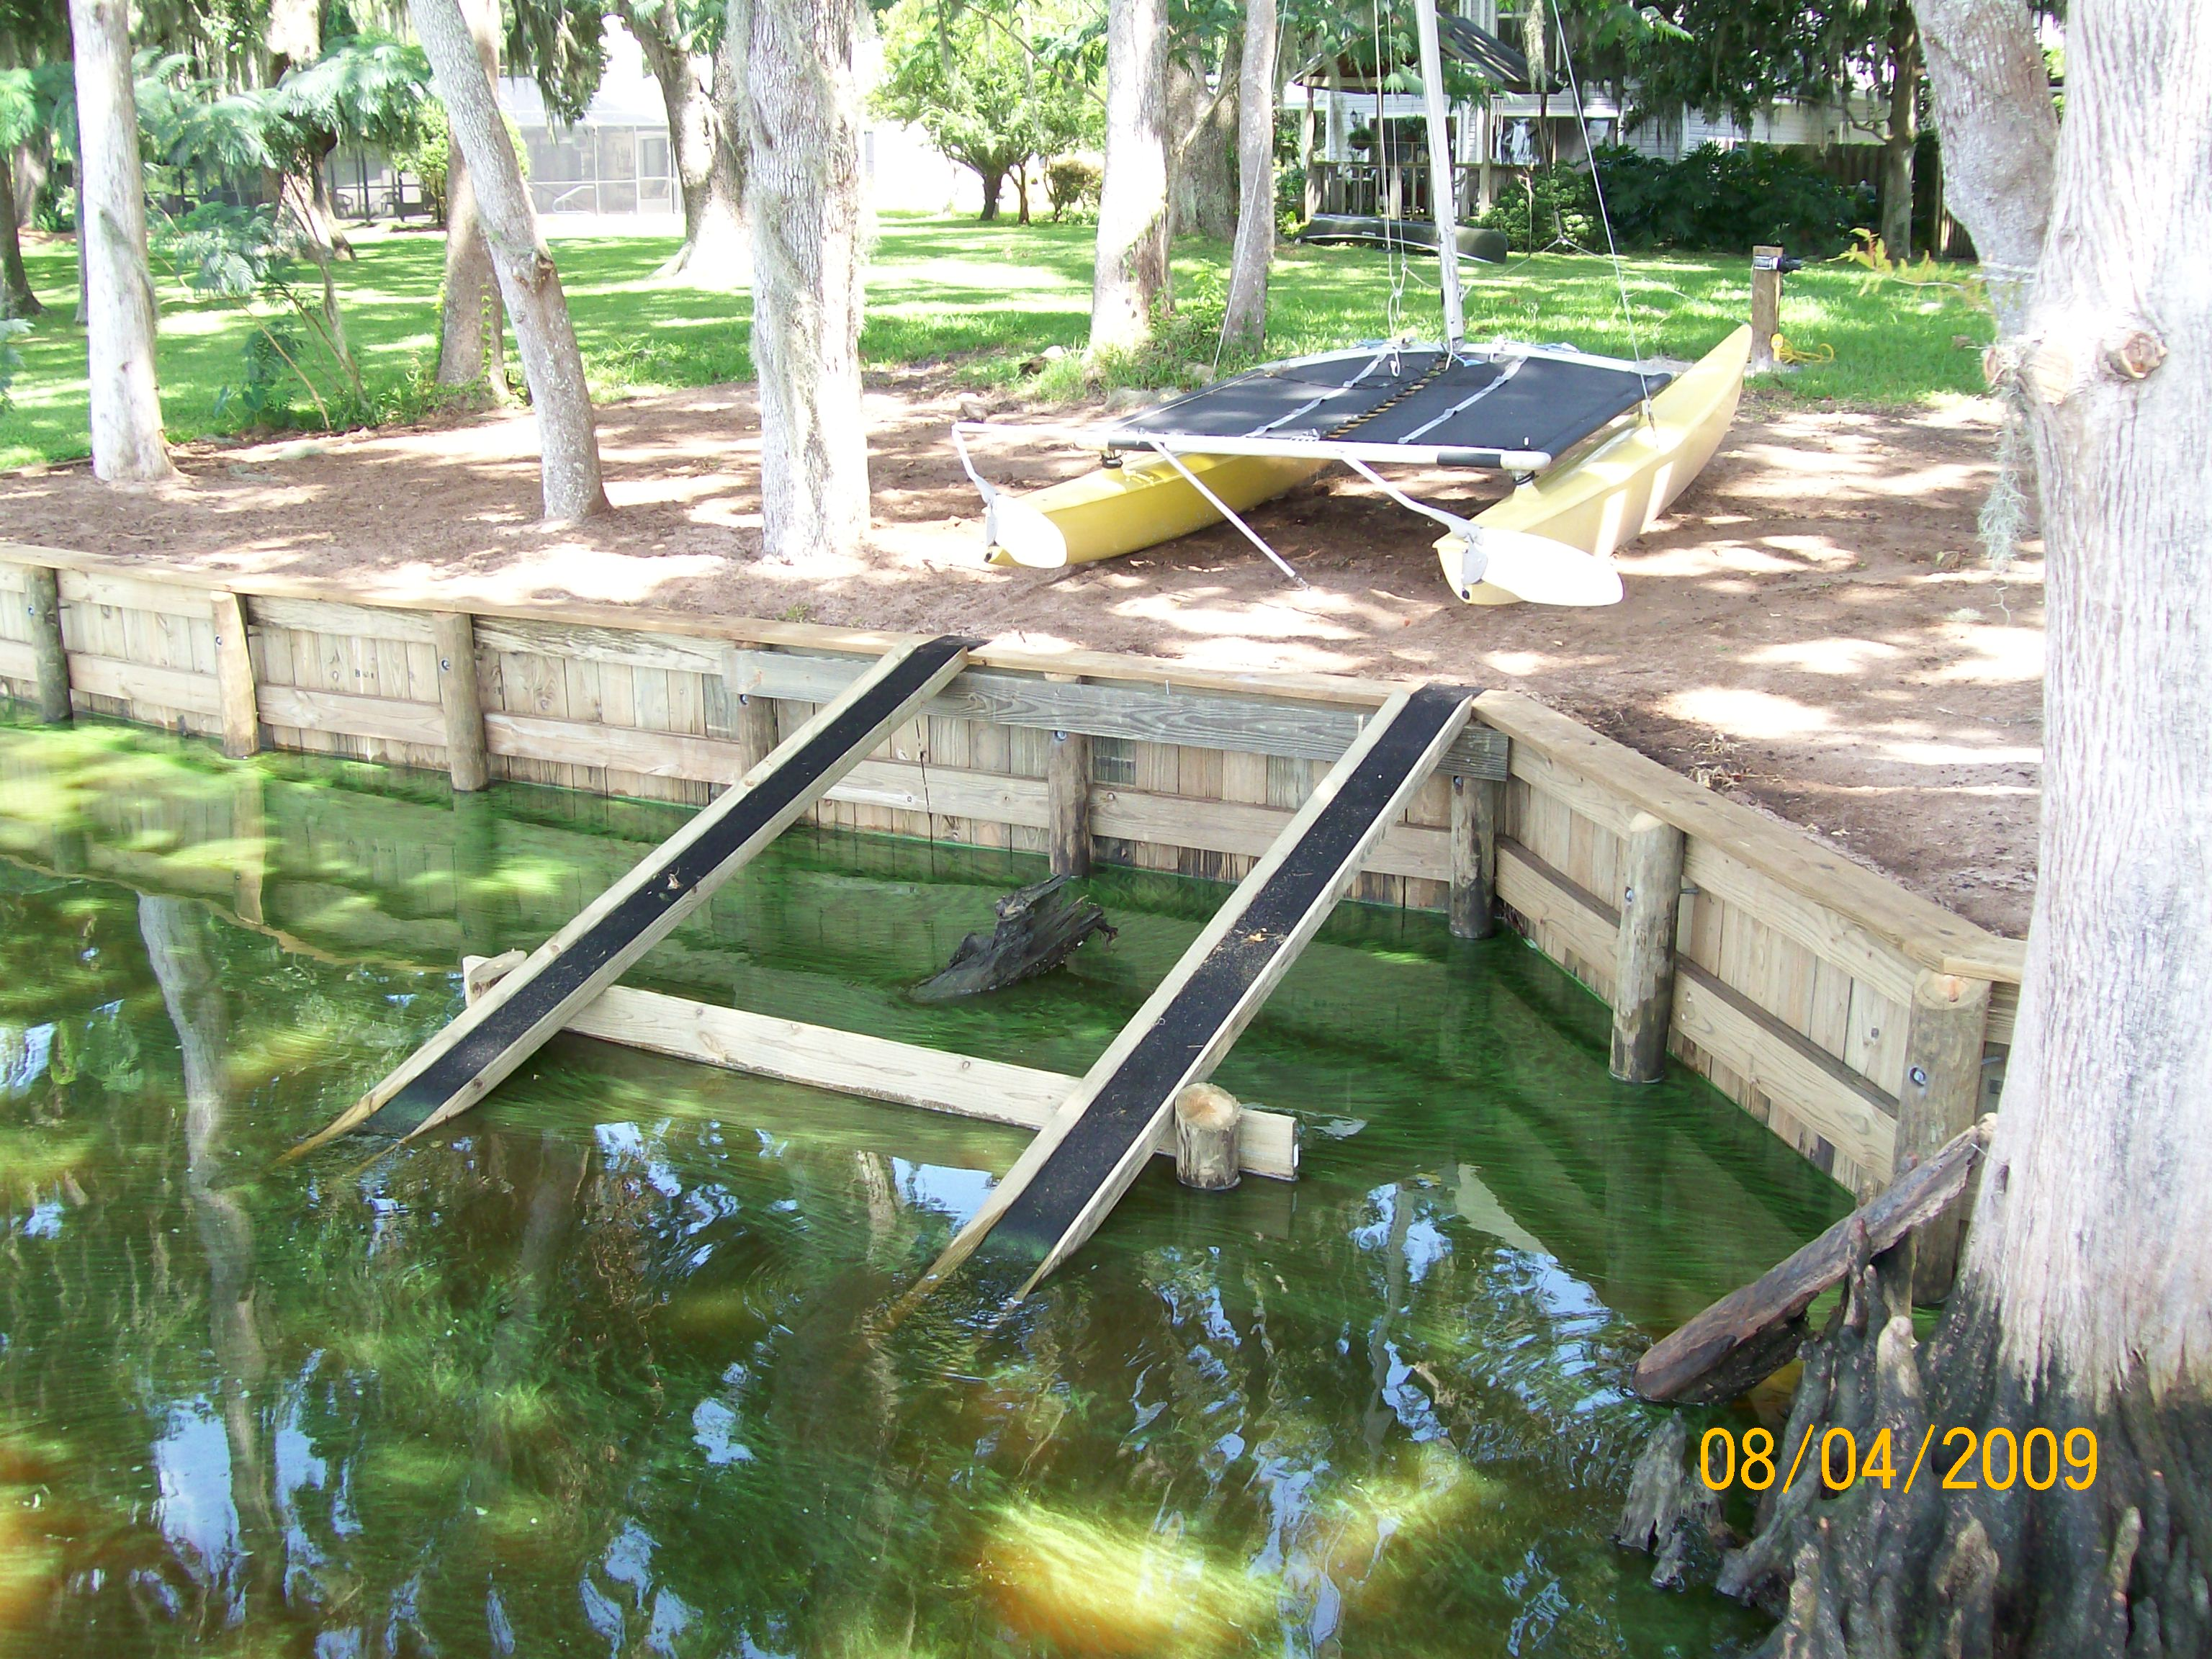
Creative Retrofit?

Slide 5
Pocket Lot #1

Slide 6
Creative Response

Slide 7
Solution ?

Slide 8
Pocket Lot #2

Slide 9
Solution?

Slide 10
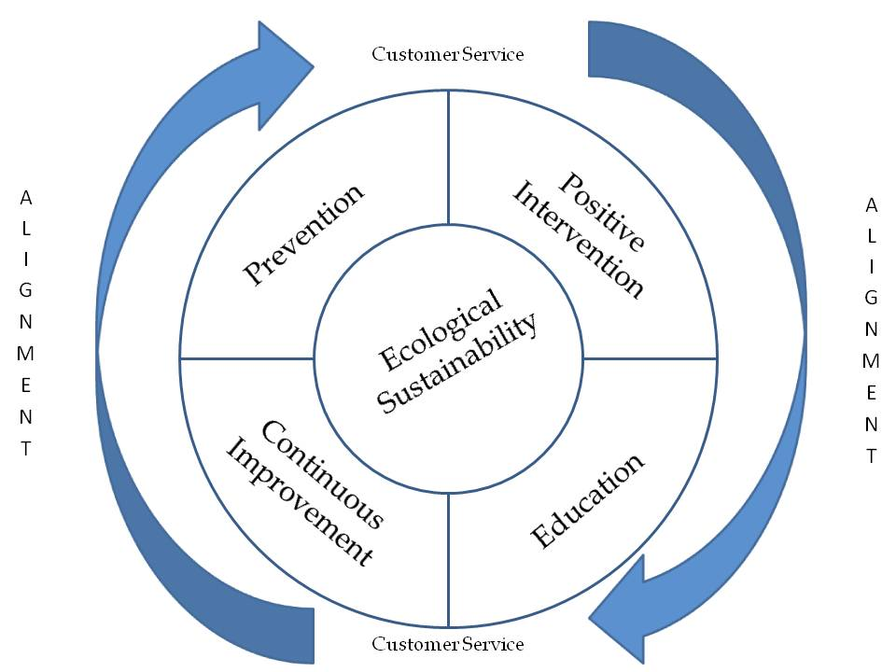
I didn’t know if you wanted me to include this but I saw it in my folder so I put it in.

Slide 11
Credits
Matt Kershner
  matthew.kershner@dep.state.fl.us
Parker Bledsoe, DEP Intern
  plb11b@my.fsu.edu
Byron Peacock, Peacock Consulting, LLC
  peacockconsultinggroup@yahoo.com
Kevin Partel, sole proprietor - construction
  kevinpartel@gmail.com

