Slide 1
We are making an ecological model
what is an ecological model?
An ecological model is an abstract representation of a system or process (Turner et al. 2001).
Ecological models are typically mathematical models using mathematical notation to define relationships describing the system of interest.
Unlike physical models (i.e. building models and car models), abstract models such as ecological models use symbols rather than physical devices to represent the system.

Slide 2
What is the purpose of modeling ecological systems such as Florida wetlands?
Ecological models help to define problems more precisely and concepts more clearly by providing formal organizing framework for ideas or data. Identify the most important landscape processes for further planning
Ecological models provide a framework for comparison across systems, providing the equivalent of experimental design and control that is so elusive in landscape-level field studies. Enhance understanding of complex ecological systems especially that account for spatial processes and spatial dynamics over long temporal scales and large spatial scales
More importantly, ecological models allow us to make predictions about future ecosystem/landscape states. To explore real or hypothetical ‘what if’ scenarios, especially in cases where experiments are not easy to conduct for logistical reasons.
In general, integrate ecological and management issues for planning purposes.

Slide 3
What are the considerations about ecological models?
Landscape ecological models should be regarded as tools or methods to achieve an end and should not be considered as goals unto themselves.
Why?
Because knowledge is incomplete, assumptions are always required within models to fill in the blanks. Consequently, most models are employed to explore the consequences of our hypotheses regarding system structure and dynamics.

Slide 4
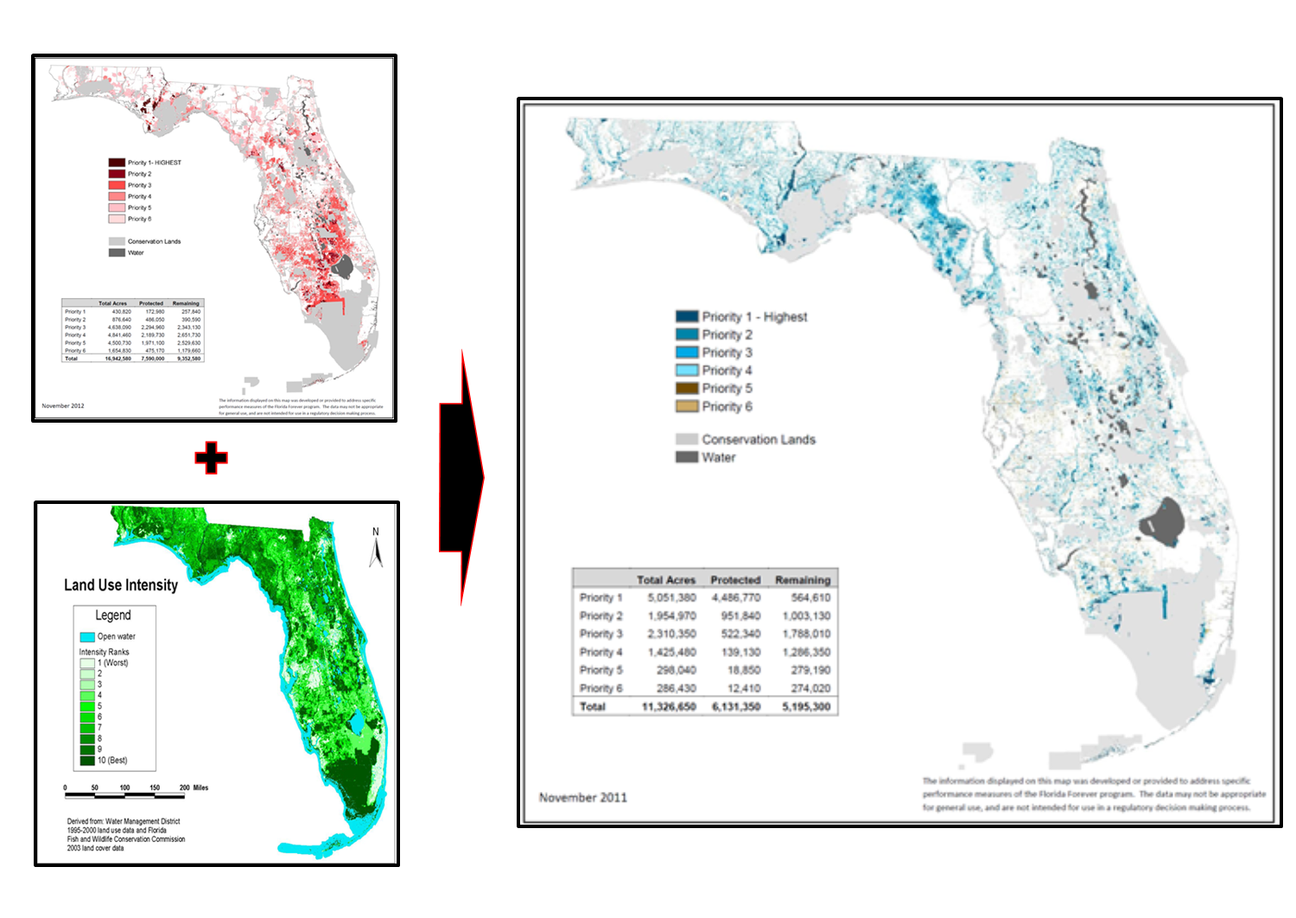
Previous attempts on Florida wetland modeling
Functional Wetlands
FNAI Potential Natural Areas (PNA)
Inventory, F. N. A. (2011). Florida Forever conservation needs assessment. Technical Report, Version 2.1. Florida Natural Areas Inventory, Tallahassee FL.

Slide 5
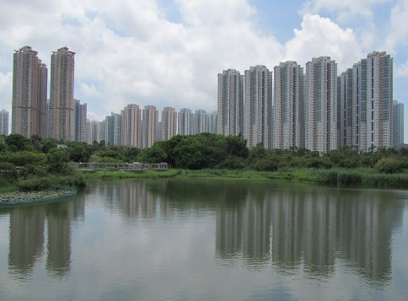
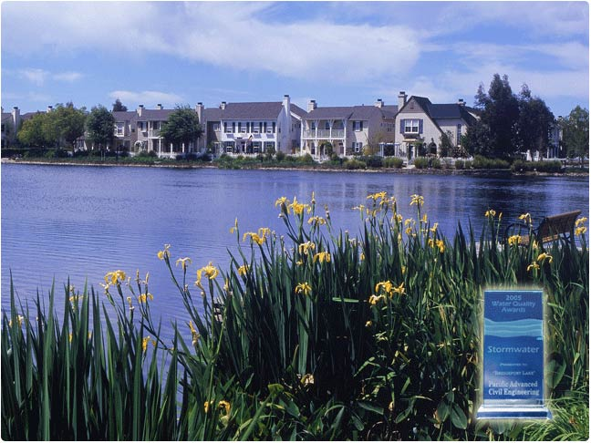
One major disadvantage of previous models is very general and limited land use intensity classification and categories.
For example Florida Forever conservation needs assessment (2011) functional wetland model developed based on only four general land use intensity (LUI) of:
Natural
Semi-natural land use
Intensive agriculture and low intensity development (such as golf courses)
High intensity development
?!!
=

Slide 6
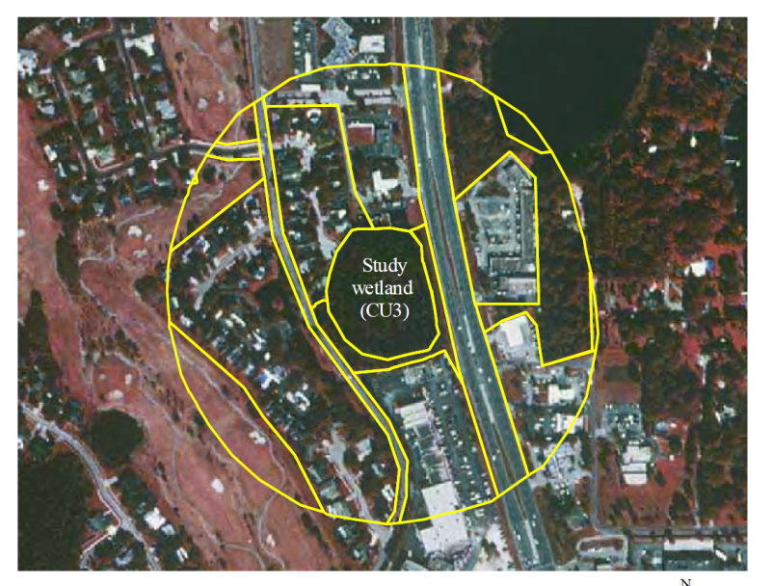
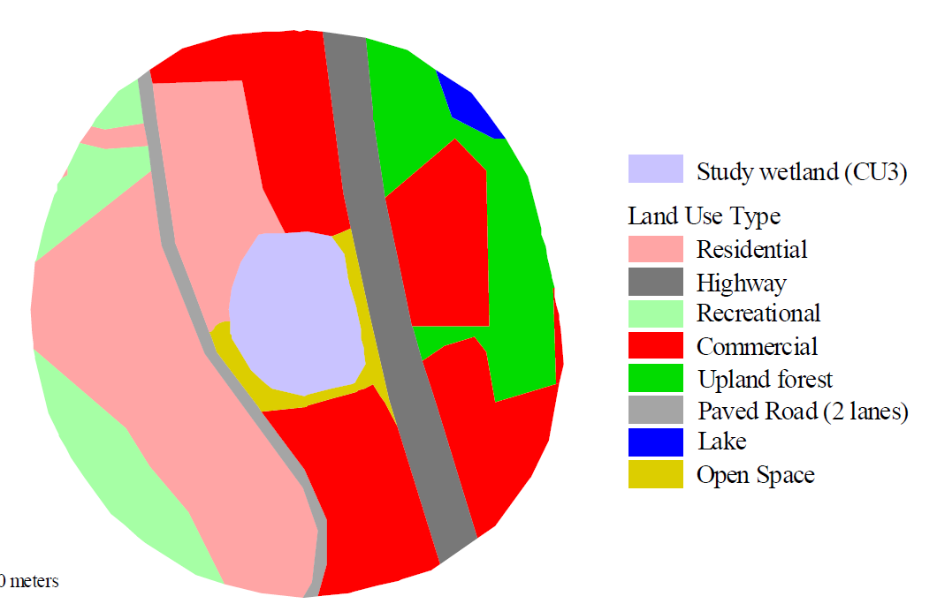
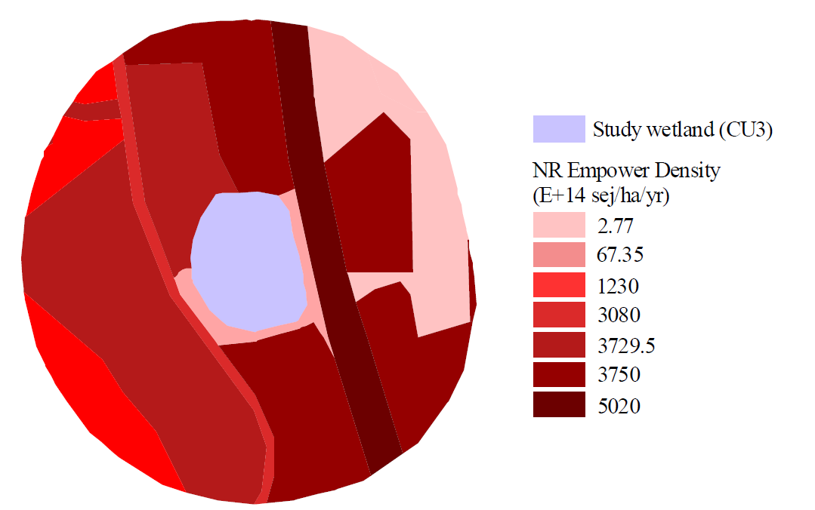
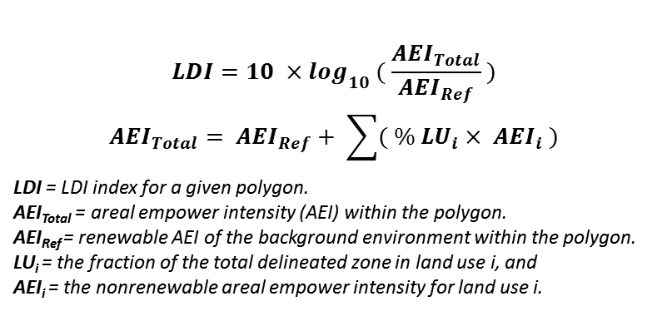
Major land use patches delineated from an aerial photo within a 200 meter buffer
Landscape Development Intensity(LDI) Wetland Assessment Method
$$LDI=10 ×\log_{10} ( \frac{{AEI}_{Total}}{{AEI}_{Ref}} )$$
$${AEI}_{Total}= {AEI}_{Ref}+ \sum{( \% {LU}_{i}× {AEI}_{i} )}$$
LDI = LDI index for a given polygon.
AEI_{Total} = areal empower intensity (AEI) within the polygon.
AEI_{Ref} = renewable AEI of the background environment within the polygon.
LU_{i} = the fraction of the total delineated zone in land use i, and
AEI_{i} = the nonrenewable areal empower intensity for land use i.
Formula after:
Reiss, K. C., Brown, M. T., (2012). Landscape Development Intensity (LDI) Index User’s Manual; Florida Wetlands as a Case Study for Calculating the LDI Index within the National Wetland Condition Assessment (NWCA) 2011 Framework. Gainesvild, FL: H.T. Odum Center for Wetlands, University of Florida.
Images after:
Vivas, M.B. (2007) Development of an index of landscape development intensity for predicting the ecological condition of aquatic and small isolated palustrine wetland systems in Florida. (Unpublished doctoral dissertation). University of Florida, Gainesville, FL.
General land use categories
land use intensity Based on human activities measured as non-renewable empower density

Slide 7
Impact of landscape metrics on traditional wetland modeling methods such as LDI method
Fractal Dimension
Shape Complexity
Diversity Index
Richness
Edge Density
Edge effect
Juxtaposition Index
Adjacency

Slide 8
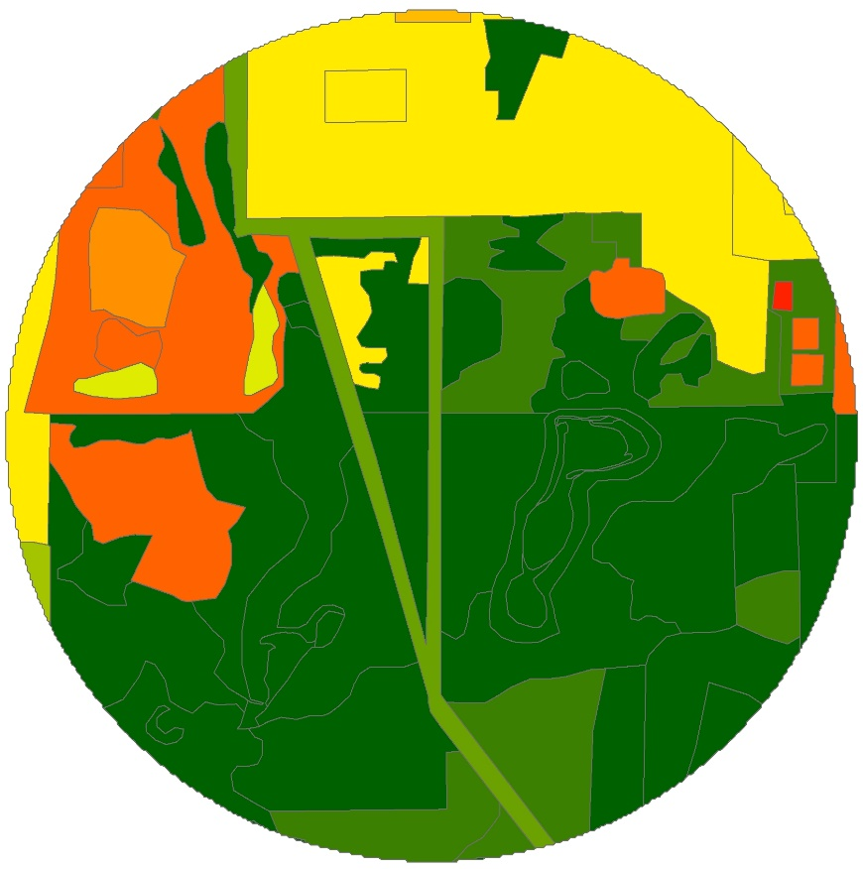
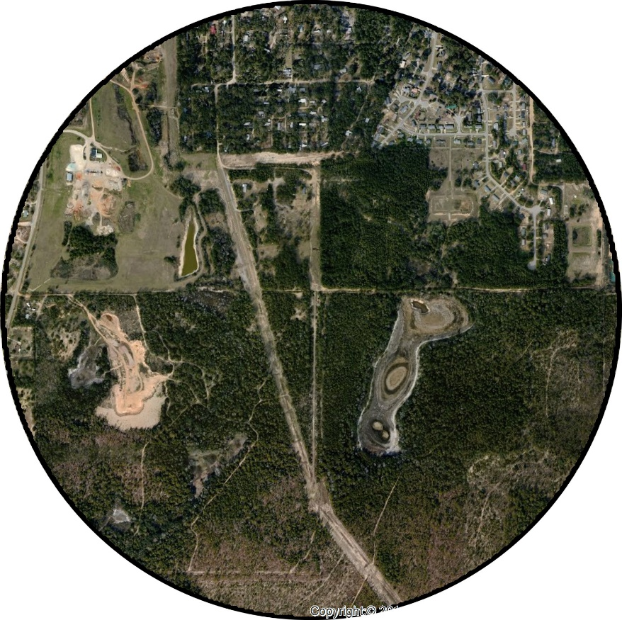
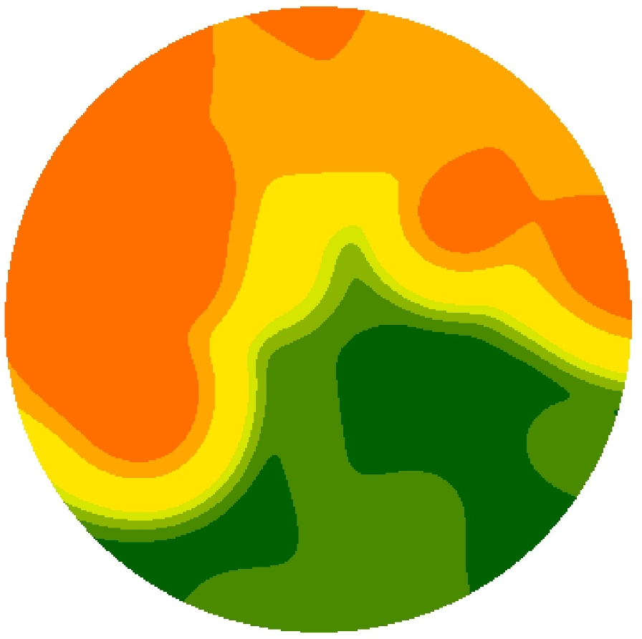
Advanced landscape models Vs Simple landscape models
Simple Landscape Model
Advanced Landscape Model
Landscape
Advanced knowledge of Ecology, GIS, Remote sensing, Spatial geometry, Statistics, Geostatistics
Advance GIS Tools and Methods
Advanced Spatial Analysis Methods
Advanced Statistical Methods
Advanced Geostatistical Methods
General knowledge of Ecology, Geometry, Mathematic and Statistics
Basic GIS Tools and Methods
Basic Geometry Analysis
Basic Statistic
Requirements

Slide 9

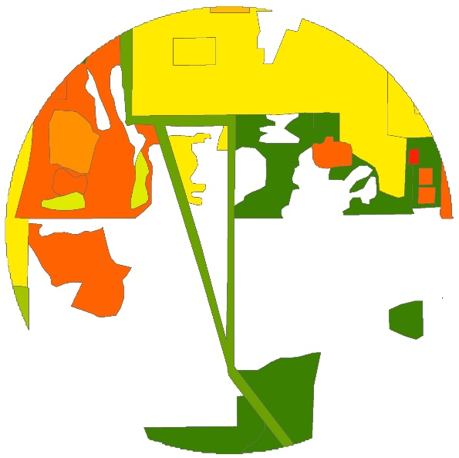




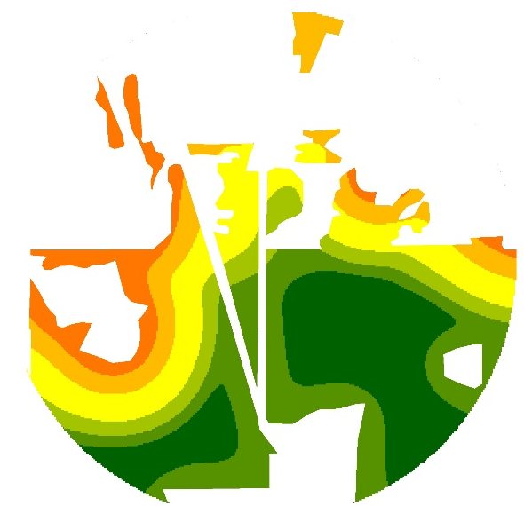
Traditional Wetland Modeling
Workflow Direction
Basic Landscape Model
BASIC
Advanced Wetland Modeling
Workflow Direction
WETLAND MODEINTEGRITY LS
High LUI
Natural Area
Advanced Multivariable and Multidimensional Landscape model
ADVANCED MODEL

