Slide 1
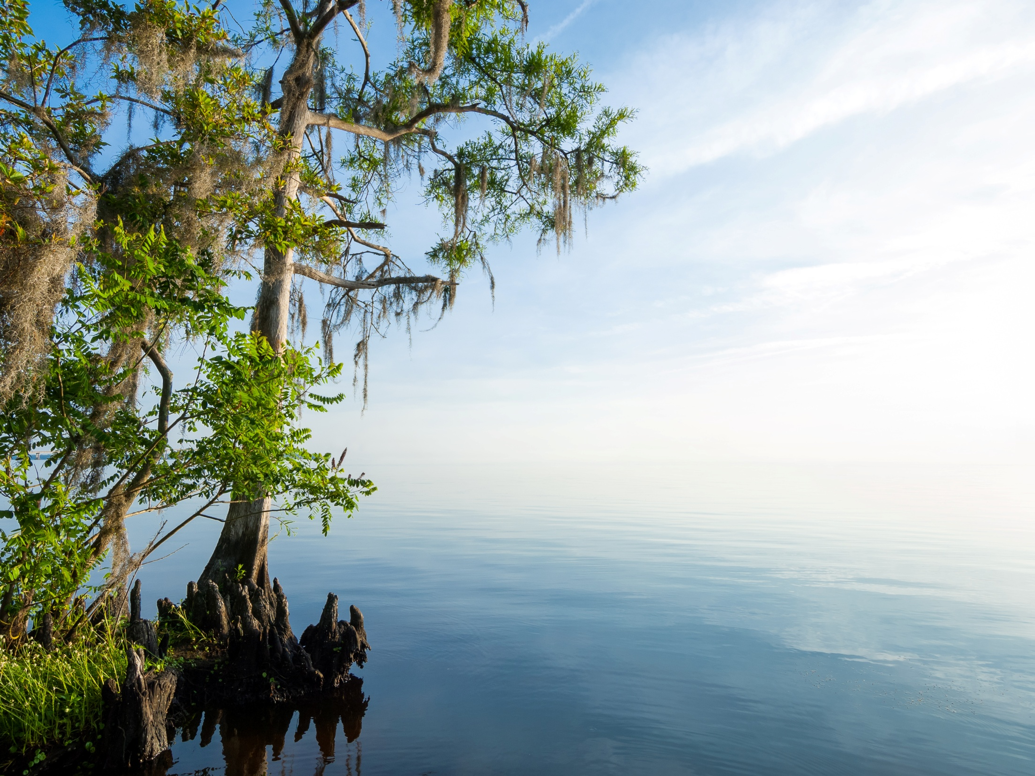
Statewide Programmatic General Permit (SPGP IV-R1)
Michelle Reiber, Bureau Chief
Environmental Resource Regulation
SJRWMD
Barbara Hatchitt, Supervising Regulatory Scientist
Palatka Service Center
SJRWMD

Slide 2
Background
DEP and the Corps, Jacksonville District developed a Statewide Programmatic General Permit (SPGP)
  Consultation with FWS, NMF, EPA, FWC
  Minor works within waters of the United States
  Current SPGP (SPGP IV-R1) expands geographic coverage across the entire state (except areas specifically excluded in the agreement)

Slide 3
Categories of work
Shoreline stabilization
Boat ramps and launch areas and associated structures
Docks, piers, and other minor piling supported structures and associated facilities (excluding municipal or commercial fishing piers)
Maintenance dredging of canals and channels

Slide 4
SPGP Project Review
If the project falls into one of the categories:
  Green projects – meets design criteria and may be issued after notification to NMFS
  Yellow projects – do not meet all of the design criteria and must be discussed with the Corps
  Red projects – have potential to affect T/E species and need to be processed by the Corps; these do not qualify for the SPGP

Slide 5
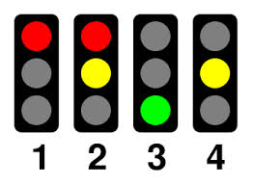
SPGP Project Review
Examples of Red projects:
Potential adversely impact a Federally-listed threatened or endangered species or its designated critical habitat
Located in submerged aquatic vegetation, marsh or mangrove habitats that do not adhere to the Corps Guidelines in Florida for Minor Piling Supported Structures
Projects within 2500 feet of an active wood stork colony
Note: See SPGP for a full list of factors considered in determining project status

Slide 6
SPGP Project Review Steps
If the project
  Falls into one of the four categories and meets Federal design criteria
  Is not excluded by habitat/T&E considerations
The status is Green and Federal authorization issued by SJRWMD, along with State exemption, GP, or ERP.
If the project does not meet the federal design limitations/criteria, the SPGP status is Yellow
  State consultation with ACOE
  Status converted to Green or Red

Slide 7
Benefits of SPGP IV-R1
Eliminate the need to obtain separate approval from the Corps
Continue environmental protection while reducing duplicative permitting
Improve efficiency for regulated community

Slide 8
SPGP since December 7, 2013
27 permit applications reviewed for SPGP
9 Red
4 in review
14 issued
  8 docks
  5 shoreline stabilization
  1 boat ramp

Slide 9
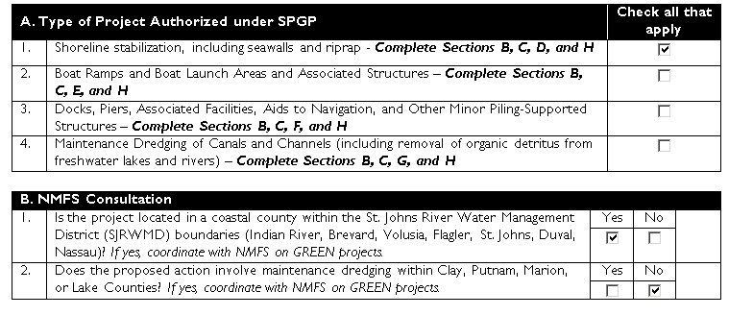
Shoreline stabilization along Intracoastal waterway, Flagler County Review process
Complete check list utilizing GIS Layers, guidelines and field inspection

Slide 10
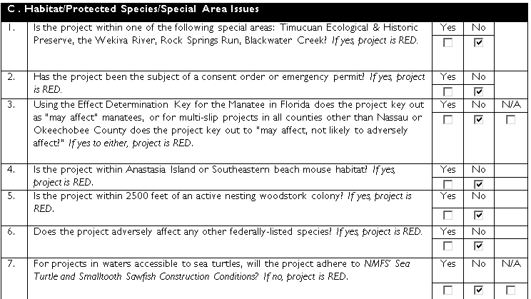
Habitat/protect Species/Special Area Issues

Slide 11
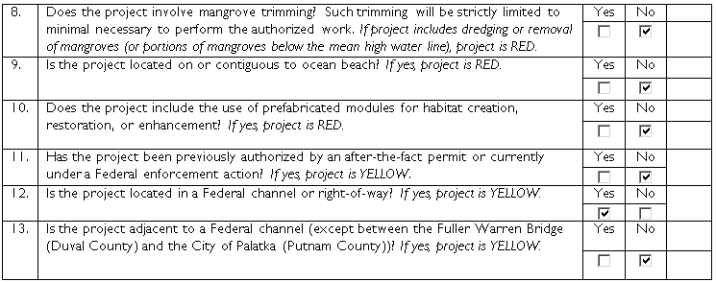
Habitat/protect Species/Special Area Issues

Slide 12
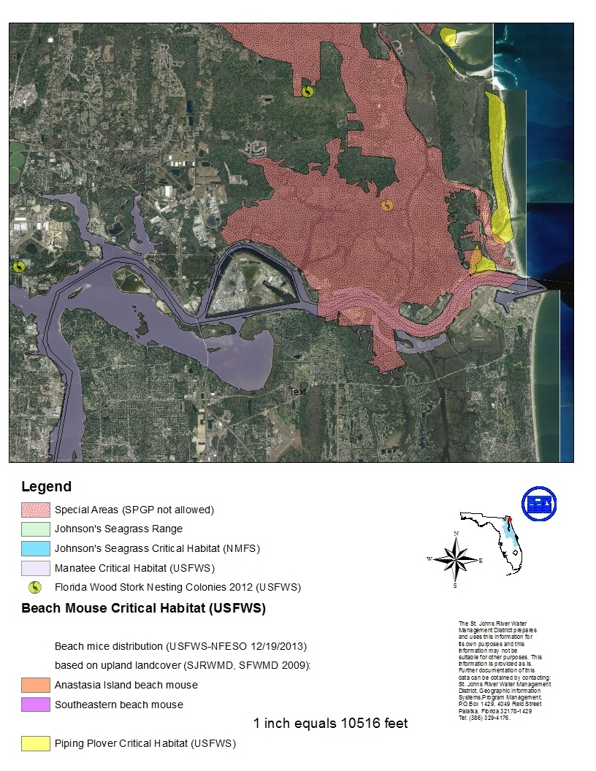
SPGP GIS Layer

Slide 13
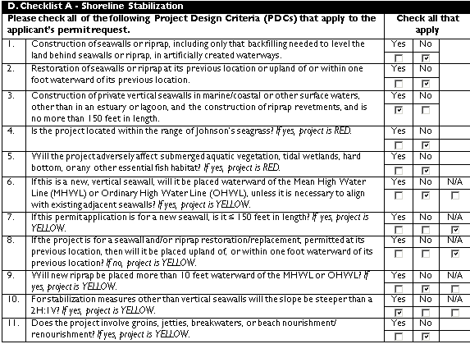
Complete checklist for specific activity

Slide 14
Process
Determine that project is yellow, send project information (transmittal memo and checklist) to the Corps within 5 days.
Corps determined project is green, forward project to National Marine Fisheries Service (NMFS). If no comments from NMFS after 5 days, issue permit.

Slide 15
Process
SJRWMD specific templates for exemption letters, staff reports and permits reduce processing time, estimated to be 30-60 minutes once staff has acclimated to process.

Slide 16
Questions?

Slide 17
Developing Programmatic
General Permits (SAJ-111)
Jeffrey S. Collins
Senior Project Manager
Cocoa Permits Section
Jacksonville District
11 June 2014

Slide 18
USACE General Permits
General Permits (GPs)
  Evaluation and authorization not project-specific
  Similar activities resulting in minimal adverse effects to aquatic environment (with mitigation)
  Developed and issued with same process as IPs
  Must be reissued every five years
Types of General Permits
  Nationwide permits (NWP)-issued by Corps HQ
  Regional permits (RGP)-issued by districts and divisions
  Programmatic permits (PGP)-reduce duplication for similar programs

Slide 19
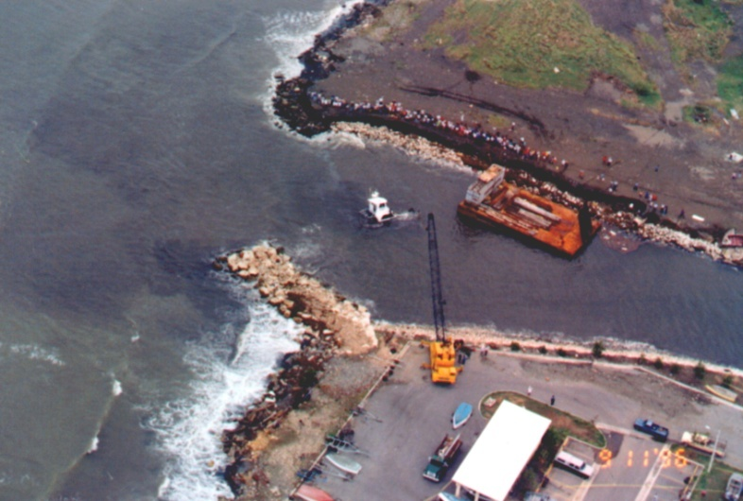
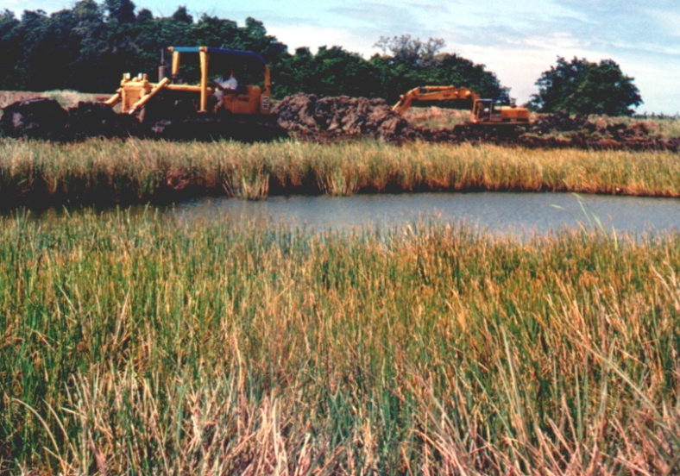
Regulatory Authorities
All structures or work in the
navigable waters of the U.S.
(Section 10, Rivers and Harbors Act of 1899)
Discharge of dredged or fill
material in waters of the U.S.
(Section 404, Clean Water Act
of 1977)
Section 103 of the Marine Protection, Research and Sanctuaries Act - prevents dumping of trash & sewage in waters of the United States
Notes:
Rivers and Harbors Act of 1899 - Sec. 9 Rivers and Harbors Act of 1899 - Sec.10 Clean Water Act - Section 404
Marine Protection Research and Sanctuaries Act of 1972 - Section 103

Slide 20
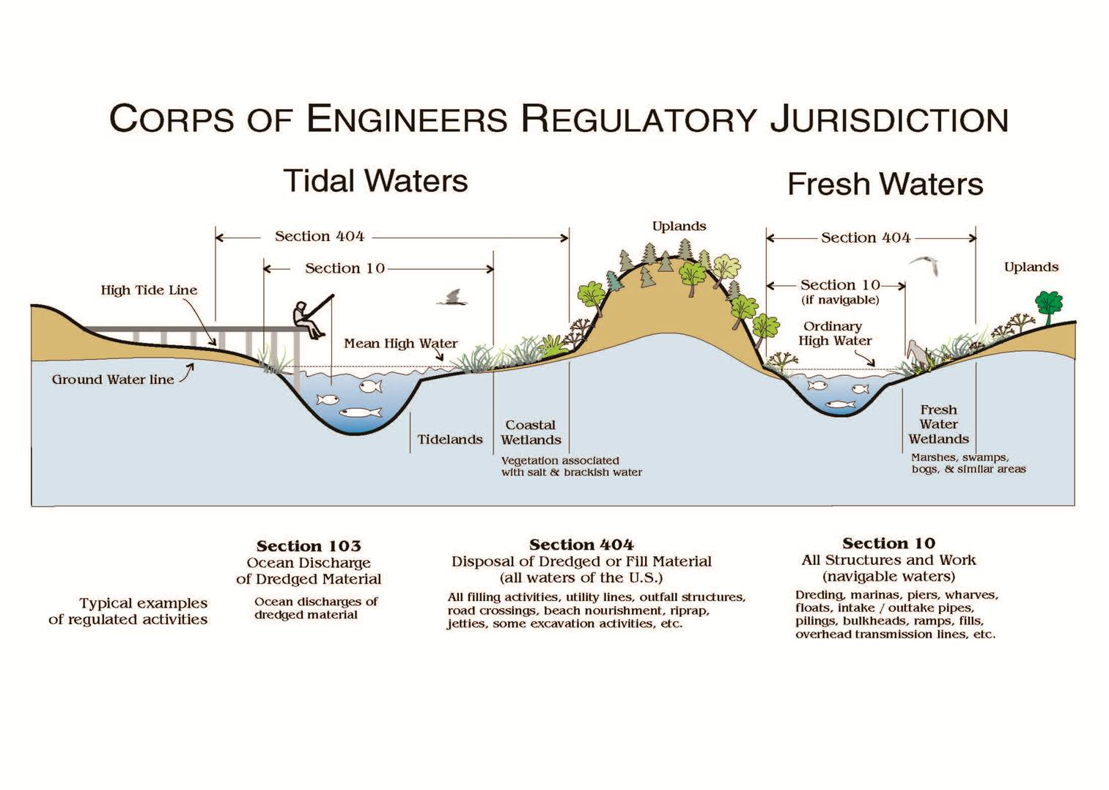
SAJ-111
SPGP
Notes:
Jurisdictional Issues

Slide 21
Other Regulations and Laws
40 CFR Part 230 - Section 404(b)(1) Guidelines
40 CFR Part 22 - Administrative Assessment of Civil Penalties & the Revocation or Suspension of Permits
40 CFR Part 233 - State Program Regulations
40 CFR Part 233G - Tribal Regulations
40 CFR Part 1500 et seq - Council on Environmental Quality
36 CFR Part 800-899 - Advisory Council on Historic Preservation
50 CFR Parts 400-499 - Endangered Species Regulations
Wild & Scenic Rivers Act
50 CFR Part 600 - Essential Fish Habitat Regulations
Marine Protection Research and Sanctuaries Act of 1972 - Section 302
Fish and Wildlife Coordination Act
Native American Graves Protection and Repatriation Act
Clean Water Act - Section 401
Clean Water Act - Section 402
Coastal Zone Management Act of 1972
Endangered Species Act
Marine Mammal Protection Act
National Environmental Policy Act
National Historic
Preservation Act

Slide 22
PGP SAJ-111
Expansive
Has it’s roots in:
  SPGP, August 1995
  SPGP (SPGP IV-R1), Dec 2013
  RGP SAJ-90, 2005
    Review of State vs. Federal Permits
Notes:
Expands into 404 waters/activities
SAJ-90: 3 acres, repetitive actions

Slide 23
PGP SAJ-111
Limitations
Max 3 acres of fill in waters of the U.S.
Limited to:
  Work within 20+ year old bedded pine plantations
  Non-forested wetlands in improved pasture
  Parcels bordered by 75% development
  Wetlands with >80% cover by invasive and/or exotic species
Compensatory mitigation at a federally approved mitigation bank (1:1 ratio)
Federally listed species
Notes:
Non-tidal
SAJ-90: 3 acres, repetitive actions
Mitigation – includes secondary impacts

Slide 24
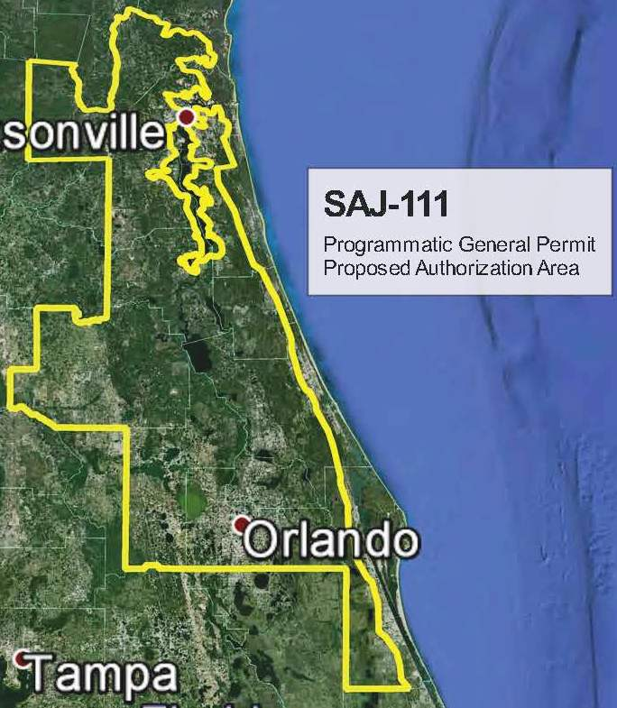
PGP SAJ-111
Categories of Work
  Residential, commercial, or institutional buildings and attendant features
    Non-tidal waters only
    Certain geographic areas excluded from SAJ-111
Notes:
SAJ-90: 3 acres, repetitive actions

Slide 25
PGP SAJ-111
Current Status
Consultation with USFWS
Modification to Authorization Area – NMFS Essential Fish Habitat
Coordination Agreement
Decision Document

Slide 26
Challenges to Creating PGPs
Review Duplicative Actions
Section 404 Clean Water Act
  Jurisdiction
  Federally Listed Species
Section 106 of National Historic Preservation Act
Mitigation Bank Rule
Wetland Functional Assessments
Secondary Wetland Impacts
Notes:
Jurisdiction – tidal and adjacent wetlands. Magnuson-Stevens Act (Essential Fish Habitat - EFH)
Listed species – programmatic consultations
106 vs. SHPO and Appendix C

Slide 27
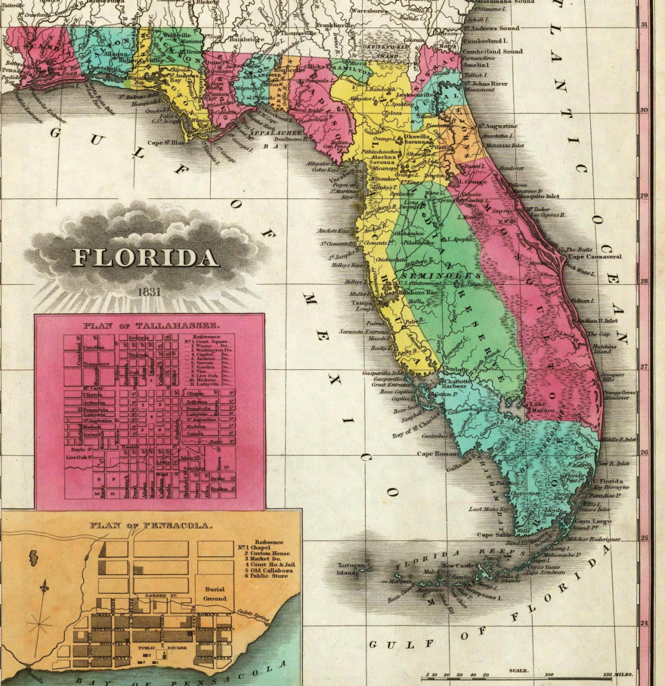
Questions?

