Slide 1

MONEY FOR NOTHING
THAT AIN’T WORKING

Slide 2
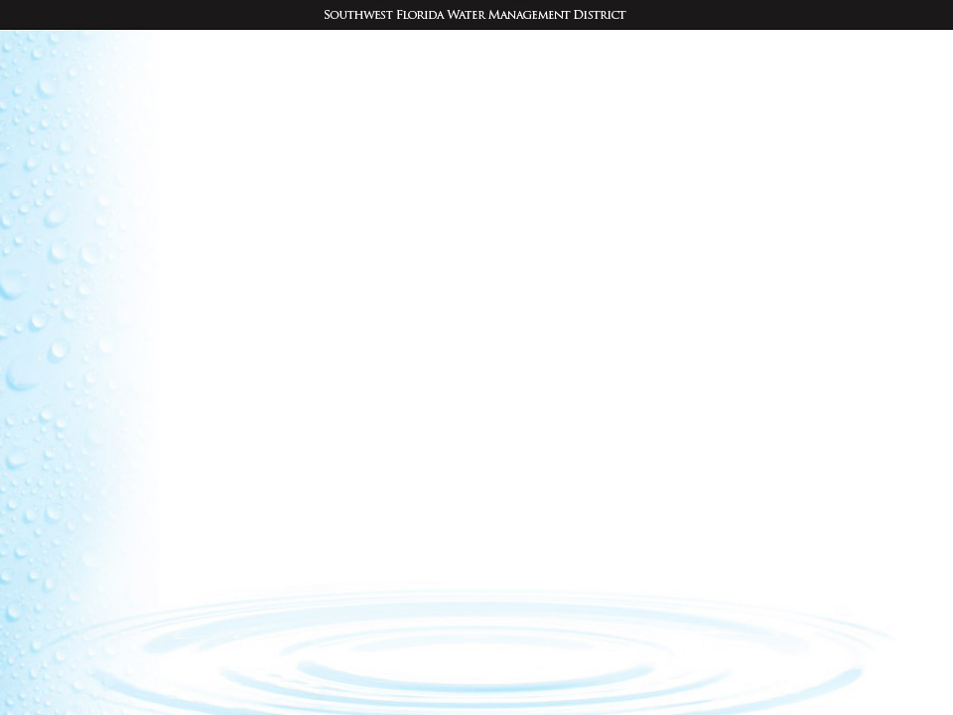

ADDRESSING DIFFICULT PERMITTING SCENARIOS IN A POST-KOONTZ, INSIDE-OUT, UPSIDE-DOWN UNIVERSE
John Emery
and
Marti Moore
Southwest Florida Water
Management District

Slide 3
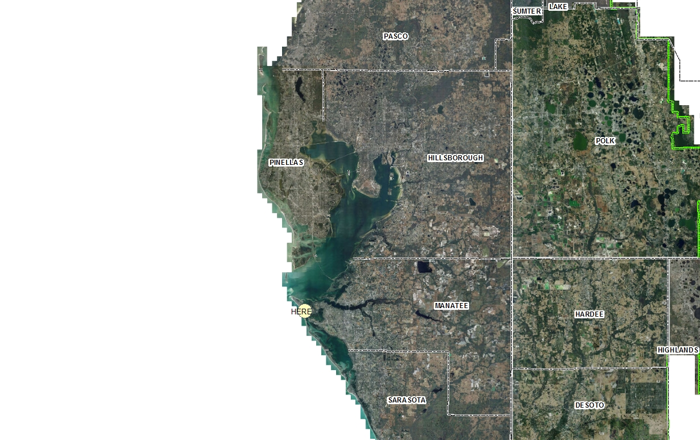
Regional Location Map

Slide 4
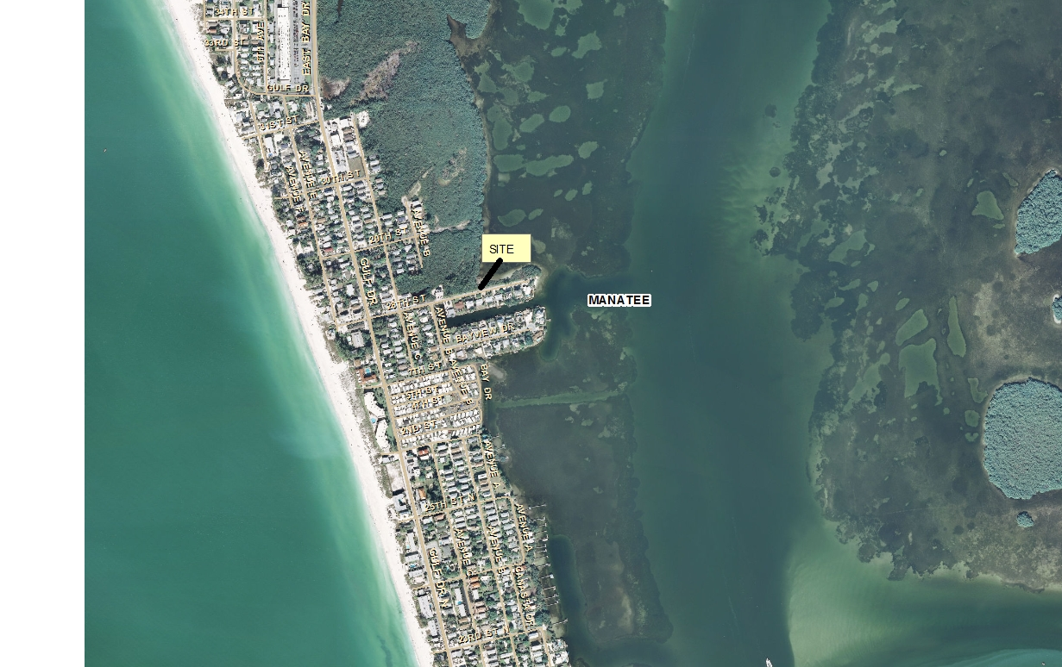
LOCATION

Slide 5
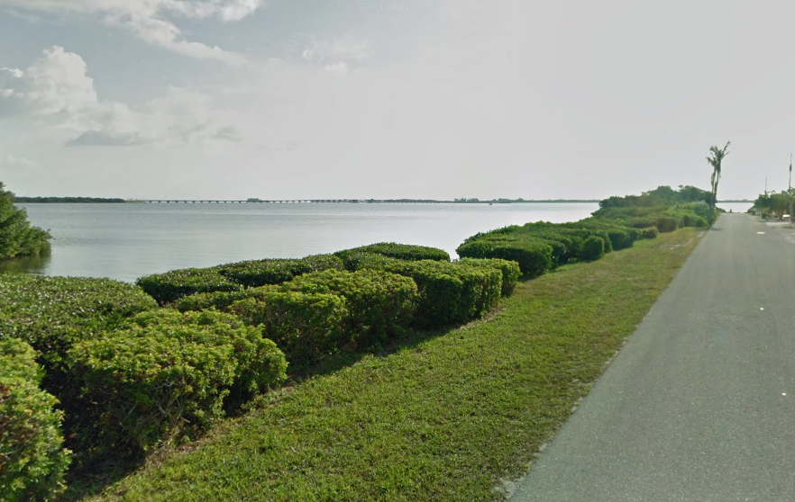
Street View of Lots

Slide 6
ERP Submittal History
ERP Application for 8 separate Single Lot Construction permits submitted to FDEP-Tampa on 8/21/2003
  FDEP staff reviewed and notified applicant that the lots were part of a larger common development plan and would be reviewed by SWFWMD
  8 ERP RAI Letters sent on 9/19/2003
  Applications withdrawn on 11/7/2003

Slide 7
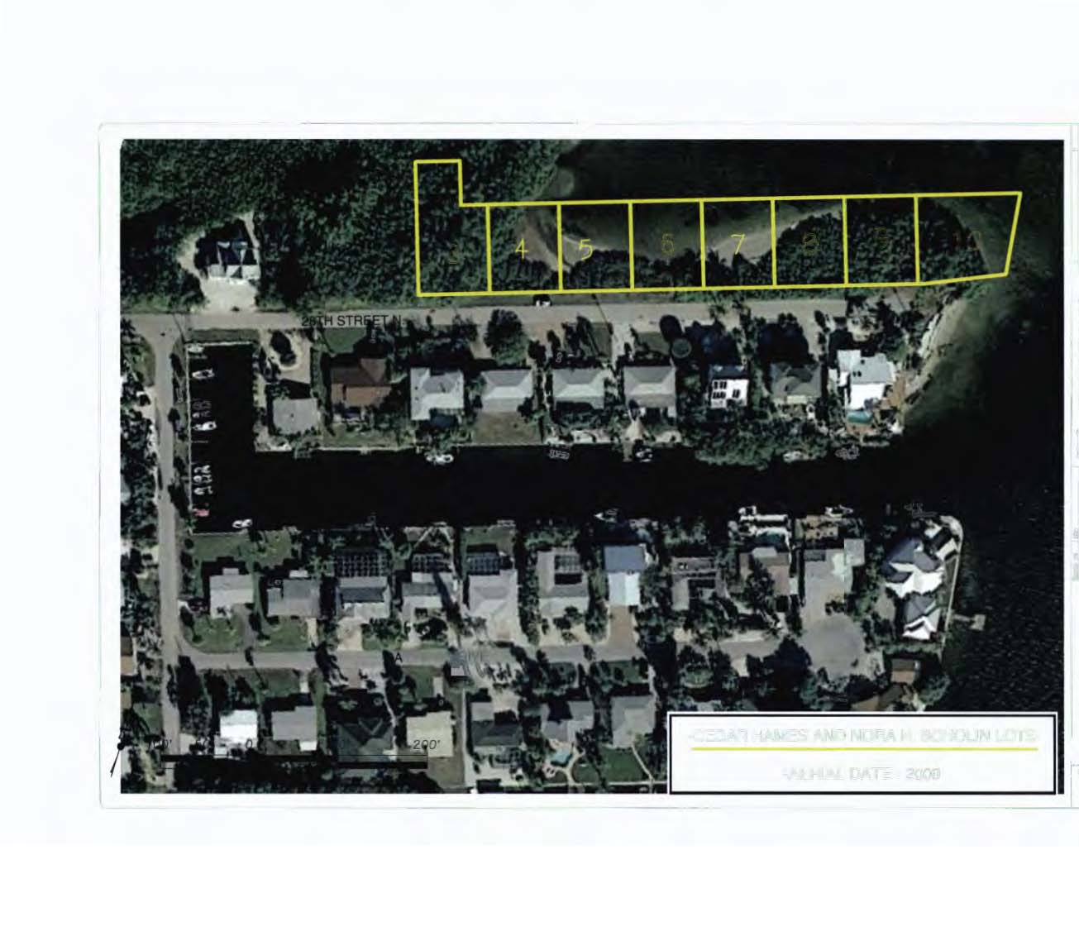
Location of Lots on Project Site

Slide 8
ERP Submittal History
ERP Application for 8 Lot subdivision (1.53 ac.) submitted to SWFWMD-Sarasota on 6/3/2005
  Application showed impacts to all wetlands (approx. 1.3 ac.)
  ‘No mitigation is proposed for the wetland displacement.”
  WHY NO MITIGATION???????????????

Slide 9
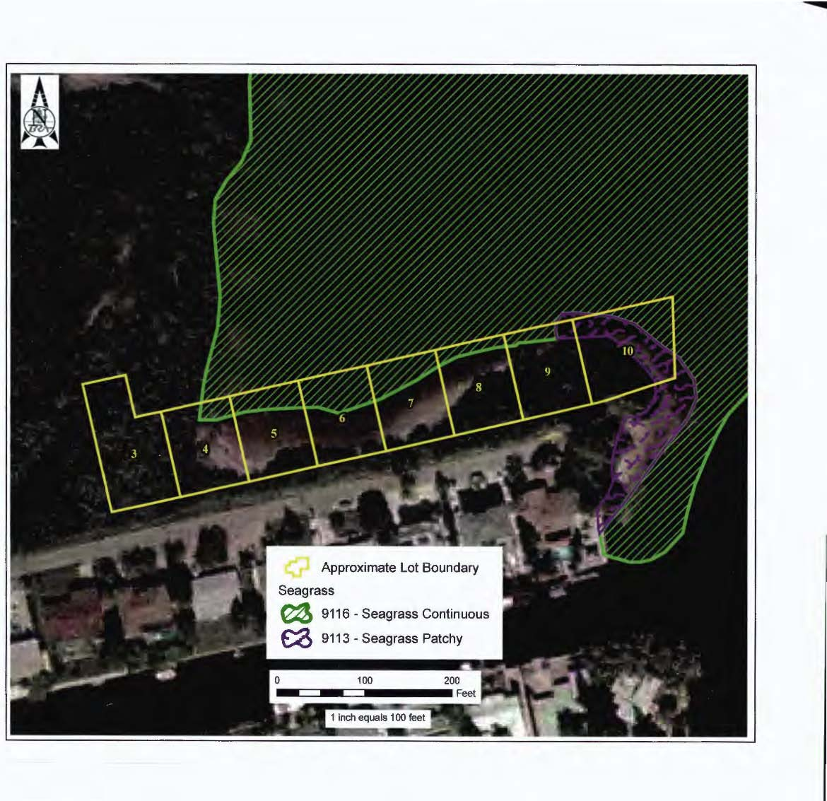
And There Are Seagrasses, too!

Slide 10
ERP Submittal History
Applicant claimed that in 1957, the State of Florida had conveyed state lands to the Applicant’s predecessor in interest.
The sale … by the Trustees carried with it the right to bulkhead and fill submerged lands under Section 253.15, F.S. (without the need to mitigate for impacts)

Slide 11
ERP Submittal History
5 RAI/CLAR Letters issued by SWFWMD
WHAT DO YOU THINK HAPPENED NEXT?

Slide 12


Slide 13
SWFWMD Permit Denial
July 31, 2006
Changes necessary to address denial:
  ● Practicable design alternatives
  ● Provide mitigation proposal
  ● Then demonstrate clearly in public interest- no adverse impacts; enhance fish & wildlife habitat values
  ● Cumulative impacts

Slide 14
Cedar Hames, et al. v. DEP & SWFWMD 12th J.C. – Manatee Co.
Them:
●Inverse condemnation of vested right to bulkhead & fill
● deprivation of all economically beneficial uses
● alternative Penn Central claims
Us:
● Intentional effort to obtain a permit denial
● Failed to explore any alternative designs or mitigation
● Not ripe for judicial review
● Time barred under § 373.617. F.S.

Slide 15
§ 373.617, F.S.
Any person substantially affected by a final agency action with respect to a permit may seek circuit court review within 90 days of such action and request monetary damages and other relief. Such review shall be confined solely to determining whether final agency action is an unreasonable exercise of the state’s police power constituting a taking without compensation. Review of final agency action for determining whether the action is in accordance with existing statutes or rules and based upon competent substantial evidence shall proceed in accordance with Chapter 120.

Slide 16
Case History
March 2007 – Dec 2010
Mar 2007 Complaint filed
May 2007 Unsuccessful attempt to remove to U.S. District Court
Aug 2007 Bifurcated inverse condemnation (bench trial) and damages issues (jury trial)
Oct 2007 District motion for summary judgment - failed to comply with § 373.617: Denied
Plaintiff motion for summary judgment – District liability for taking: Granted

Slide 17
Case History Con’t
Dec 2007 Rehearing? – Denied
July 2008 District Petition for writ of prohibition to 2nd DCA – Denied
2008-2009 Discovery uncovers significant information issues
Sept 2009 District motion to vacate/set aside partial summary judgment for misrepresentation on the court:
● law according right to bulkhead & fill had been repealed earlier
● Only lots 3-7 had deeds from 1957

Slide 18
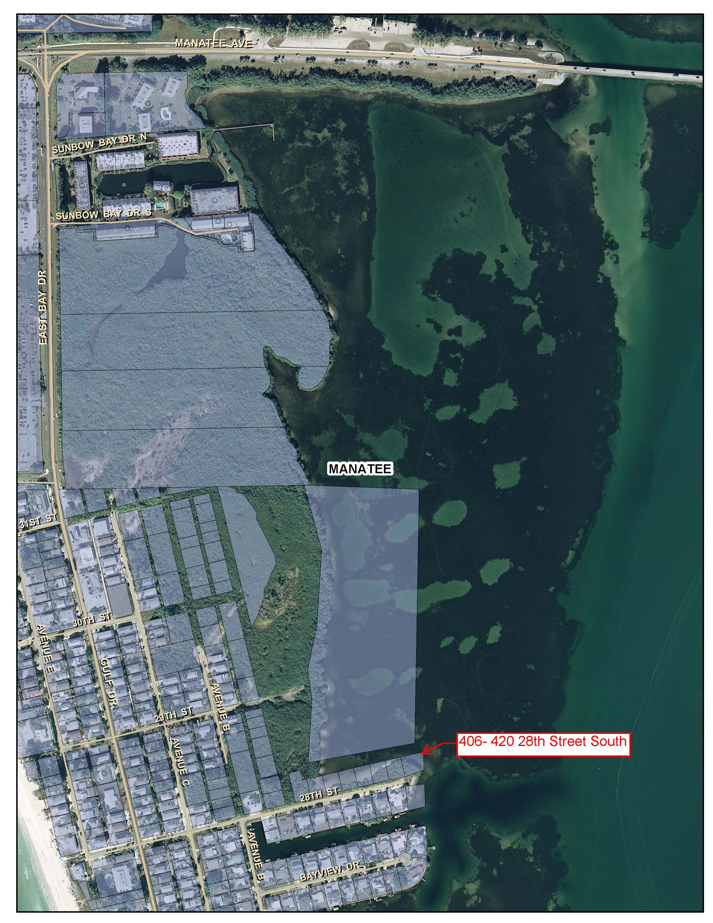

Slide 19
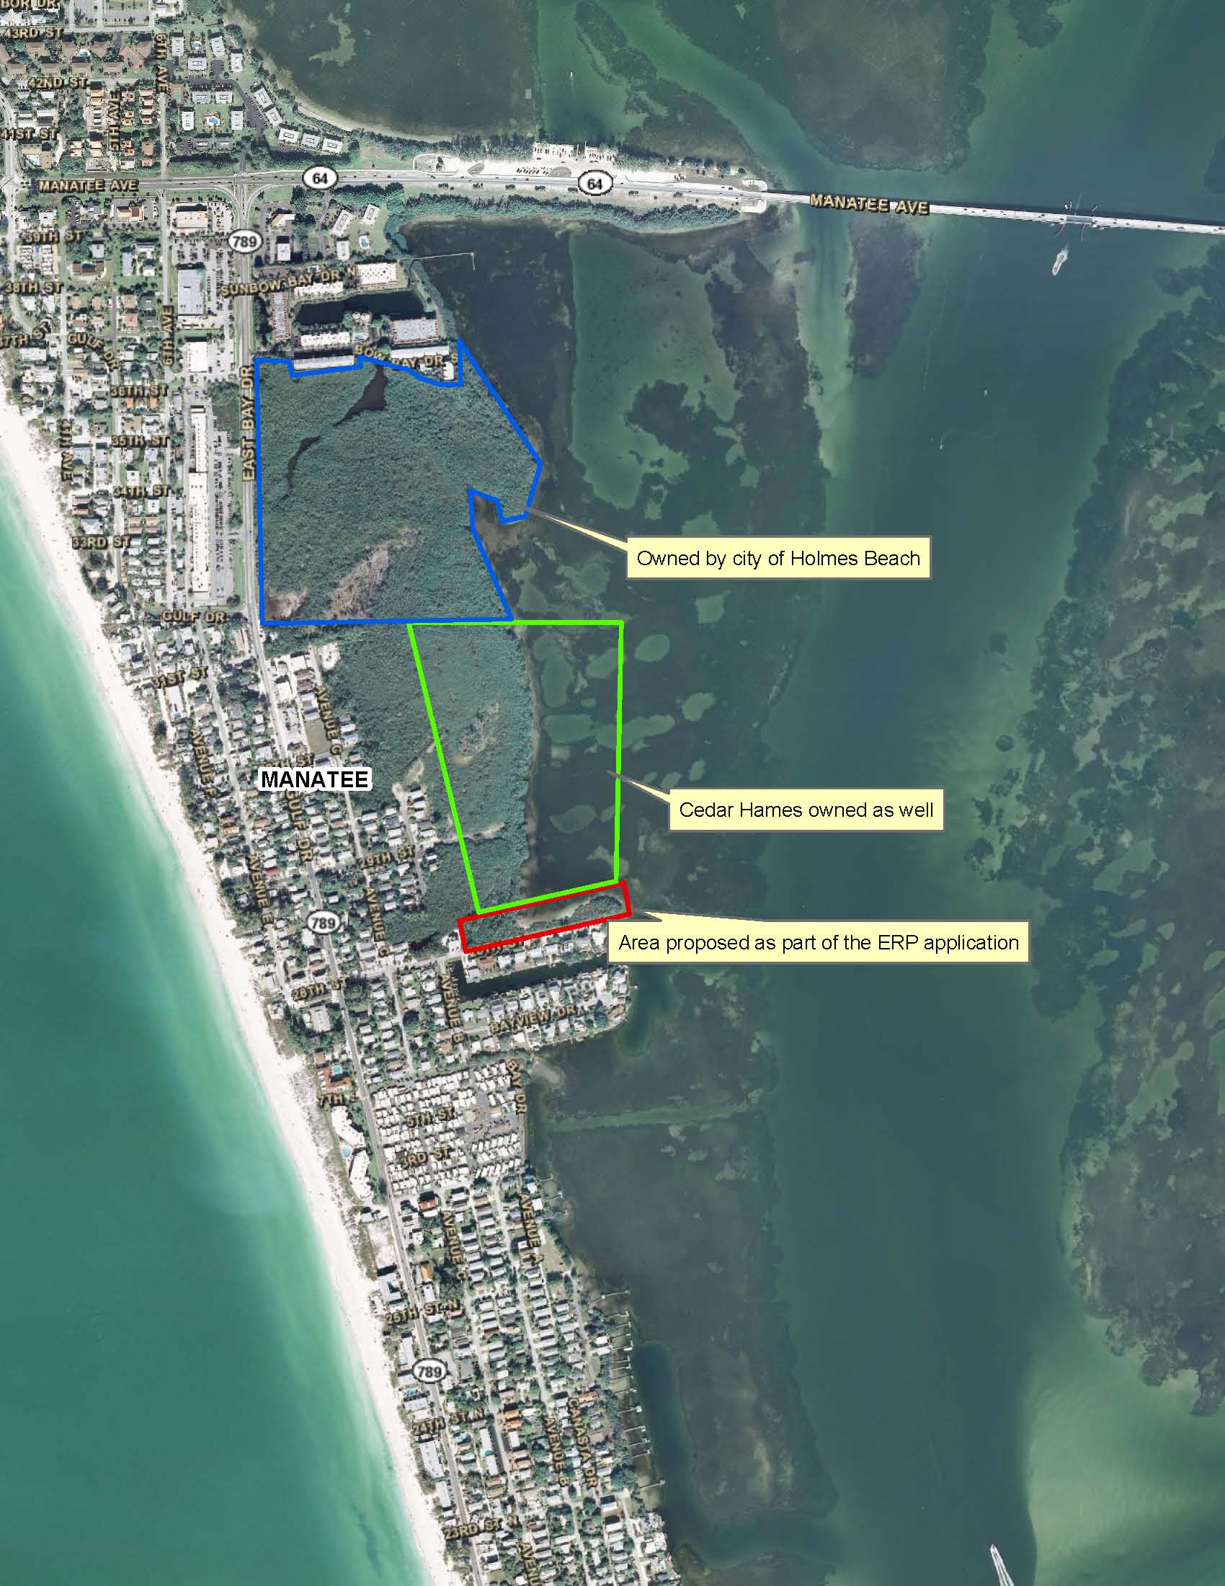

Slide 20
Case History Con’t - the Tide Turns
Oct 2008 Partial Summary Judgment: Vacated
Feb 2009 Petition for writ of cert to 2nd DCA: Denied
Mar 2009 Plaintiff’s motion partial summary judgment on right to bulkhead & fill lots 3 – 7: Denied
June 2009- Series of unsuccessful motions &
Nov 2010 additional pleadings
Dec 2010 Trial on takings issue

Slide 21
Case History Con’t
March 2011 - Trial Court Final Judgment:
● Plaintiffs mistaken about statutory right to bulkhead & fill
● No practicable design alternatives or mitigation ever considered by applicant
● District had no opportunity to make a final decision on extent of development that was permittable
● No taking
● Claim not ripe

Slide 22
Appeal to 2nd DCA – Dec 2011
Cedar Hames Arguments:
● No legal basis for setting aside PSJ – Lots 3-7 had statutory right to bulkhead & fill
● Was ripe for judicial review – exploration of lesser development alternatives not pre-requisite; modifications futile
● Mitigation offer not required to ripen takings claim

Slide 23
2nd DCA Appeal Con’t
District’s Arguments:
● PSJ correctly set aside for misrepresentation in evidence & correct statutory determination
● Inverse condemnation claim not ripe – failed to provide meaningful application preventing a final determination
● Permit denial not a taking under Lucas or Penn Central

Slide 24
Koontz vs. Hames
Koontz
Hames
● Some concessions proposed; claimed to be max possible to retain economic use of property
● Agreed to a conservation easement over majority of parcel
● Applied requirements for avoidance & minimization
● Essential nexus & rough proportionality at issue
● No concessions – right to develop without any environmental regulation
● No mitigation required and none offered
● Not required
● Not raised

Slide 25
Affirmed!
June 2012 - Per curiam, with special concurrence commending lower court’s final judgment:
● Plaintiffs failed to prove any taking
● Claims not ripe for judicial review due to failure to provide meaningful application

Slide 26


Development and Permitting Options – Where Do We Go From Here?
Applicant must propose alternatives and mitigation options
District and applicant must consider proportionality and nexus

Slide 27
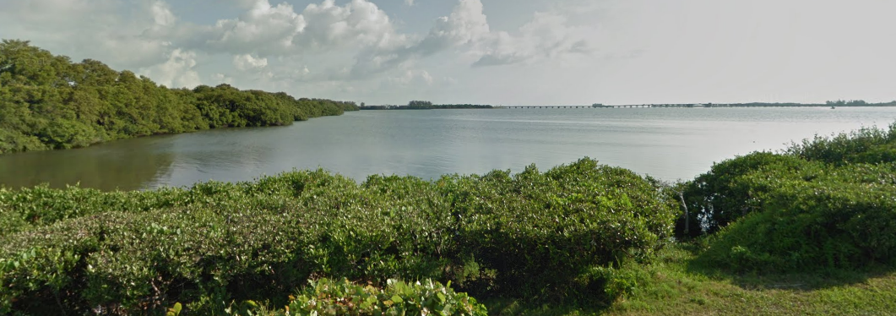
“I WANT MY MTV !”

