Slide 1

Water Quality Standards Program
Florida’s Numeric Nutrient Criteria (NNC):
Of Poison Pills and Imbalance
Division of Environmental Assessment and Restoration

Slide 2
Summary of Presentation
Current Status of State Numeric Nutrient Criteria (NNC)
Basic Concept and Hierarchical Approach
Florida’s Adopted NNC
Waters Excluded from Streams NNC
Downstream Waters Protection

Slide 3
Status of Florida’s NNC
Over last 2 ½ years, DEP has adopted NNC for all lakes, spring vents, and estuaries, and for all streams (“flowing waters”) except in South Florida
  Did not cover tidal creeks, wetlands, or conveyances used for water management purposes
EPA has approved all of our adopted NNC, but only NNC for selected estuaries are in effect due to “poison pill” provision
  Southwest Estuaries from Clearwater to Miami and the Keys
  Panhandle estuaries from Perdido River to Apalachicola Bay

Slide 4
EPA Approval (Rule 62-302.531 (9))
Subsection (9) states that key definitions, NNC for streams/lakes/spring vent, and schedule for estuary criteria development shall be effective only if EPA
  Approves these rules in their entirety,
  Concludes rulemaking that removes federal numeric nutrient criteria in response to the approval, and
  Determines, in accordance with 33 U.S.C. § 1313(c)(3), that these rules sufficiently address EPA’s January 14, 2009 determination

Slide 5
Path Forward
  As part of “Path Forward” agreement between EPA and DEP, State legislation last year addressed the poison pill language
    Repeals “poison pill” language in Rule 62-302.531(9) if EPA withdraws federal NNC and ceases NNC rulemaking
EPA proposed to withdraw federal NNC on April 2, with a 60-day comment period (thru June 2)
  Not clear when EPA will act, but all remaining NNC will go into effect the day after EPA rescinds

Slide 6
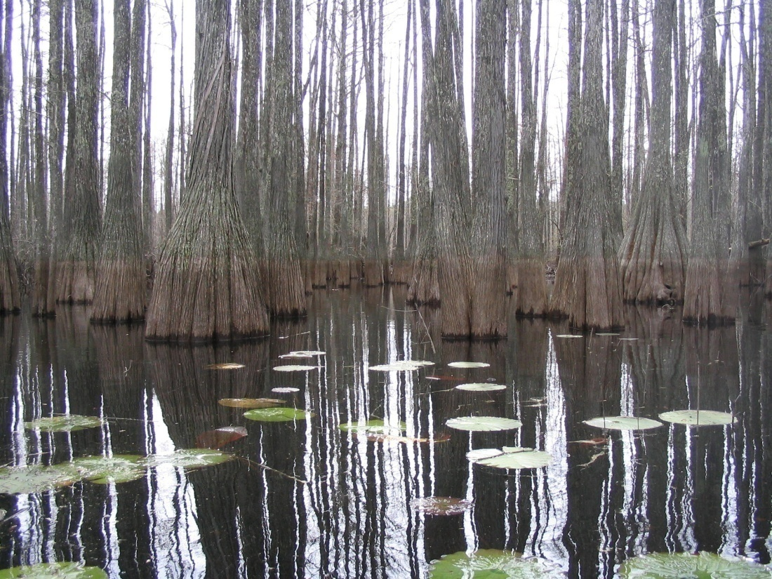
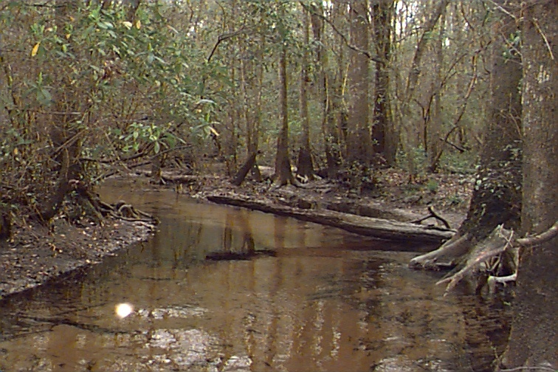
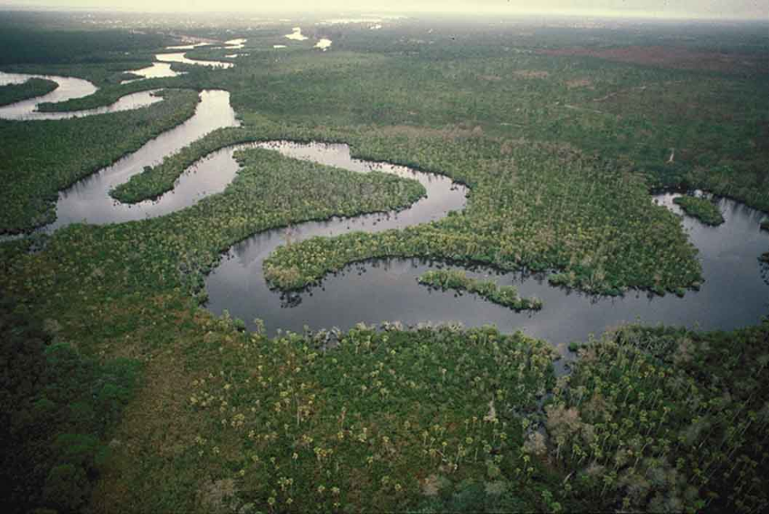
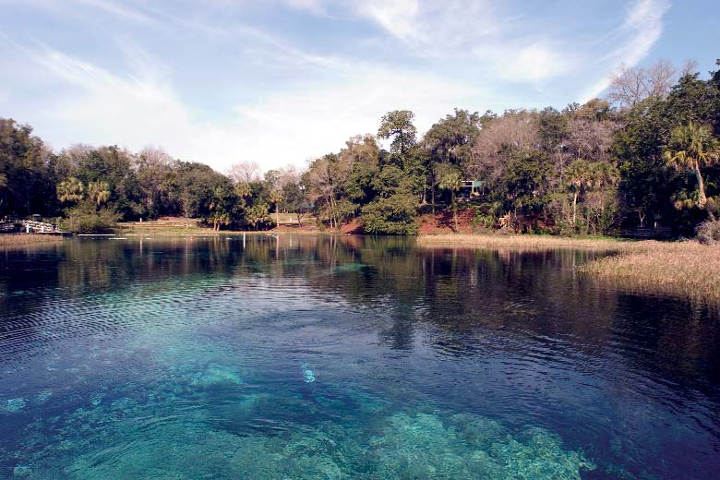

Slide 7
Needed a New Conceptual Model
Nutrients are typically not toxic, and effects are very site specific
  Light penetration, hydraulic residence time, presence of grazers, and habitat considerations
Makes broad-based numeric nutrient criteria development more complicated than for most pollutants (e.g., toxic substances)

Slide 8
Summary of Basic Concept
Maintain the narrative nutrient criterion and numerically interpret it using best available information on a site-specific basis using a systematic, hierarchical approach
  Narrative states that “in no case shall nutrient concentrations of a body of water be altered so as to cause an imbalance in natural populations of aquatic flora or fauna.”

Slide 9
Hierarchical Approach
Nutrient Total Maximum Daily Loads, Site Specific Alternative Criteria , Estuary-specific Criteria, and
Level II Water Quality-Based Effluent Limitations (WQBELs)
Stressor-Response Relationships (lakes & springs)
Reference-based thresholds (streams)
combined with biological data (flora and fauna)
Narrative (wetlands, intermittent streams,
South Florida flowing waters)

Slide 10
Adopted Rules
Rulemaking included revisions to
  Chapter 62-302, F.A.C. (Surface Water Quality Standards), and
  Chapter 62-303, F.A.C. (“Impaired Waters Rule”)
Revisions to Chapter 62-302 included
  A new new provision for “Type 3” Site Specific Alternative Criteria (SSAC) for nutrients
  A document, which was incorporated by reference, titled Implementation of Florida’s Numeric Nutrient Standards

Slide 11
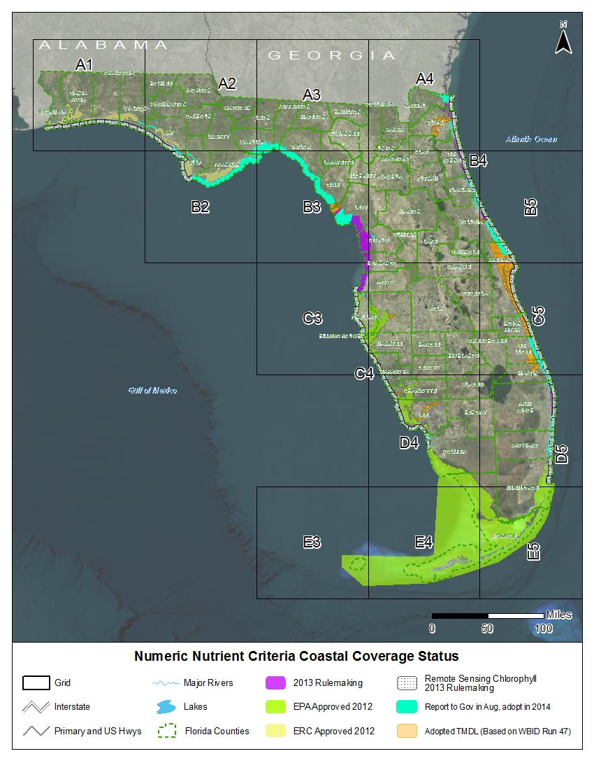
Estuary Numeric Nutrient Criteria: DEP and local scientists developed estuary-specific nutrient standards

Slide 12
Summary of Estuary Criteria
Estuary NNC adopted in 3 separate rulemaking and in Report to Governor and Legislature
  All approved by EPA in October, 2013
Part 1 Estuaries
Clearwater Harbor, Tampa Bay, Sarasota Bay, Charlotte Harbor, Caloosahatchee Estuary, Southwest Coast, Florida Bay, Florida Keys, and Biscayne Bay: THESE ARE IN EFFECT!
Part 2 Estuaries
Perdido Bay, Pensacola Bay, Choctawhatchee Bay, St. Andrews Bay, St. Joseph Bay, and Apalachicola Bay: THESE ARE IN EFFECT!
Part 3 Estuaries
Loxahatchee River, Lake Worth Lagoon, Halifax River, Guana River/Tolomato River/Matanzas River, Nassau River, Suwannee River, Waccasassa River, Withlacoochee River, and Springs Coast
Part 4 Estuaries- Report to Governor
Big Bend from Alligator Harbor to the Suwannee Sound, Cedar Key, St. Mary’s, Southern Indian River Lagoon, several portions of the Intracoastal Waterway (ICWW) connecting estuarine systems, and a variety of small gaps

Slide 13
Estuary | Total Phosphorus | Total Nitrogen | Chlorophyll a
(q) Loxahatchee River Estuary | For estuary segments with criteria expressed as annual geometric means (AGM), the values shall not be exceeded more than once in a three year period. For all other estuary segments, the criteria shall not be exceeded in more than 10 percent of the measurements.
1. Lower Loxahatchee | 0.032 mg/L as AGM | 0.63 mg/L as AGM |  | 1.8 μg/L as AGM
2. Middle Loxahatchee | 0.030 mg/L as AGM | 0.80 mg/L as AGM |  | 4.0 μg/L as AGM
3. Upper Loxahatchee | 0.075 mg/L as AGM | 1.26 mg/L as AGM |  | 5.5 μg/L as AGM
(r) Lake Worth Lagoon | For estuary segments with criteria expressed as annual geometric means (AGM), the values shall not be exceeded more than once in a three year period. For all other estuary segments, the criteria shall not be exceeded in more than 10 percent of the measurements.
1. Northern Lake Worth Lagoon | 0.044 mg/L as AGM | 0.54 mg/L as AGM |  | 2.9 μg/L as AGM
2. Central Lake Worth Lagoon | 0.049 mg/L as AGM | 0.66 mg/L as AGM |  | 10.2 μg/L
3. Southern Lake Worth Lagoon | 0.050 mg/L as AGM | 0.59 mg/L as AGM |  | 5.7 μg/L as AGM
(s) Halifax River Estuary | For estuary segments with criteria expressed as annual geometric means (AGM), the values shall not be exceeded more than once in a three year period.
Lower Halifax River Estuary | 0.142 mg/L as AGM | 0.72 mg/L as AGM |  | 6.2 µg/L as AGM
(t) Guana River/Tolomato River/Matanzas River (GTM) Estuary | Criteria for all estuary segments are expressed as annual geometric mean values not to be exceeded more than once in a three year period.
1. Tolomato | 0.105 mg/L as AGM | 0.65 mg/L as AGM |  | 6.6 μg/L as AGM
2. North Matanzas | 0.110 mg/L as AGM | 0.55 mg/L as AGM |  | 4.0 μg/L as AGM
3. South Matanzas | 0.111 mg/L as AGM | 0.53 mg/L as AGM |  | 5.5 μg/L as AGM

Slide 14
Expression of Estuarine
Interpretations of Narrative
Estuary NNC are expressed as either
  Annual geometric means, not to be exceeded more than once in a three-year period, or
  A single sample value not to be exceeded more than 10% of the time
Criteria apply as average of open water segments
NNC applied independently
Proposed standards do not apply to tidal creeks
  Tidal creeks are important, but distinct, ecological resource that need separate criteria

Slide 15
Numeric Interpretations for Lakes
Established chlorophyll a (chl a), Total Nitrogen (TN), and Total Phosphorus (TP) criteria
  Started with target chl a, and set TN and TP criteria using statistical relationship between nutrients and chl a
  Criteria vary depending on color and alkalinity
    Long-term geometric mean
  Expressed as annual geometric means that cannot be exceeded more than once in a three-year period
NNC are applied as a spatial average in waterbody, consistent with derivation
  True for all of the NNC

Slide 16
Colored Lake Chl-a Response to Total Phosphorus
Range of Uncertainty
Chl-a typically < 20
Chl-a typically > 20
0.05
0.157

Slide 17
Numeric Interpretations for Lakes
Rule allows TN and TP criteria to vary annually depending on chlorophyll a
  If meet chl a value for lake type for a given year, then TN and TP set at annual geometric mean of ambient samples for that year, subject to range shown
  If do not meet chl a or if insufficient chl a data, then criteria set at minimum value

Slide 18

NNC for Lakes
Long Term Geometric Mean Lake Color and Alkalinity | Annual Geometric Mean Chlorophyll a | Minimum calculated numeric interpretation |  | Maximum calculated numeric interpretation
 |  | Annual Geometric Mean Total Phosphorus | Annual Geometric Mean Total Nitrogen | Annual Geometric Mean Total Phosphorus | Annual Geometric Mean Total Nitrogen
> 40 Platinum Cobalt Units | 20 µg/L | 0.05 mg/L | 1.27 mg/L | 0.16 mg/L¹ | 2.23 mg/L
≤ 40 Platinum Cobalt Units and > 20 mg/L CaCO₃ | 20 µg/L | 0.03 mg/L | 1.05 mg/L | 0.09 mg/L | 1.91 mg/L
≤ 40 Platinum Cobalt Units and ≤ 20 mg/L CaCO₃ | 6 µg/L | 0.01 mg/L | 0.51 mg/L | 0.03 mg/L | 0.93 mg/L
¹ For lakes with color > 40 PCU in the West Central Region, the maximum TP limit is 0.49 mg/L

Slide 19
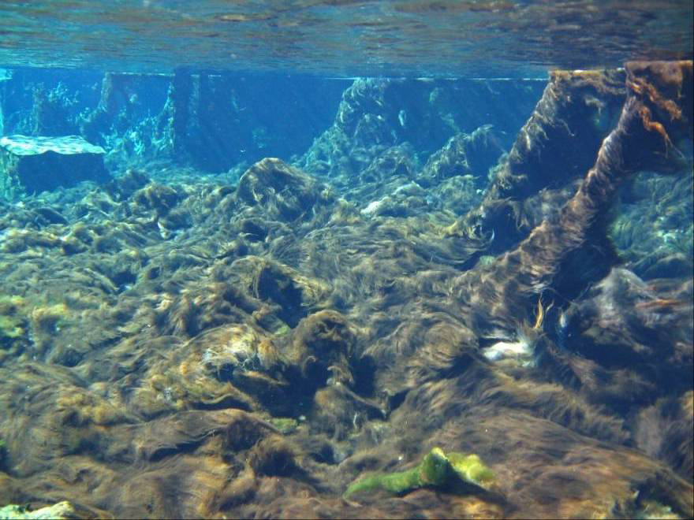
Weeki Wachee, 1950s;
Nitrate < 0.1 mg/L, Eel grass
Weeki Wachee, 2001:
Nitrate ~ 0.7 mg/L, Lyngbya mats
Nuisance Algal Mats in Springs

Slide 20
Nitrate in Spring Vents
Based on a regression between nitrate-nitrite and nuisance algal mats
  Criterion established at a concentration that prevents nuisance mats from occurring
Numeric interpretation of the narrative nutrient criterion is 0.35 mg/L of nitrate-nitrite
  Expressed as an annual geometric mean not to be exceeded more than once in any three consecutive calendar year period
Applies only at spring vent, and stream nutrient standards apply in spring run

Slide 21
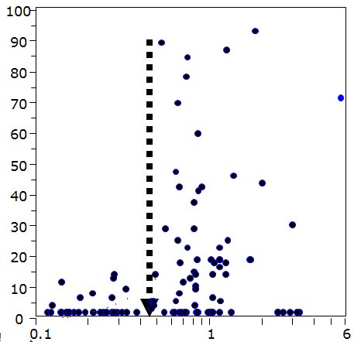
Field Studies: Vaucheria % Cover was Significantly Related to Springs Nitrogen Concentration
Excessive growth and cover of Vaucheria was found at sites with nitrate-nitrite concentrations at or above 0.454 mg/L.
Vaucheria % cover
Total N (mg/L)
Notes:
windows(height=6,width=11.5)
par(mfrow=c(1,2))
par(mar=c(5, 4, 2, 0) + 0.1)
x <- TOTALN
y <- AvgVPCCOVER
plot(x,y, log="x", cex=0.25, typ="n", ylab="Avg Vaucheria % cover", xlab="TN (mg/L)")
points(x, y, xlog=T, cex=1, pch=19, col="black")
lines(lowess(x,y,f=1, iter=3), col="black", lwd=1.5)
par(mar=c(5, 3, 2, 1) + 0.1)
x <- TOTALP
y <- AvgVPCCOVER
plot(x,y, log="x", cex=0.25, typ="n",ylab="", xlab="TP (mg/L)")
points(x, y, xlog=T, cex=1, pch=19, col="black")
lines(lowess(x,y,f=1, iter=3), col="black", lwd=1.5)

Slide 22
NNC for Streams
Looked extensively for cause-effect relationships between nutrients and biological responses, but they were insufficient to develop criteria
Established numeric thresholds based on “reference approach”, but because there is no link to impairment, Florida established broader evaluation of water chemistry and biological data (flora and fauna) to determine if a stream’s nutrient concentrations are protective of balanced flora and fauna
  Often referred to as “biological confirmation”, but not really correct term

Slide 23
NNC for Streams
Nutrient standards for streams attained IF:
  Information on chlorophyll a levels, algal mats or blooms, nuisance macrophyte growth, and changes in algal species composition do not indicate an imbalance in flora or fauna; AND EITHER
  The average score of at least two temporally independent Stream Condition Indices (SCIs) is 40 or higher, with neither of the two most recent SCI scores less than 35, OR
  The Nutrient Thresholds (expressed as annual geometric means) are not exceeded more than once in a three year period

Slide 24
Floral Tools in Streams
DEP will evaluate a variety of floral information
  Linear Vegetation Survey
    Coefficient of Conservatism (> 2.5)
    Invasive Exotics (FLEPPC site average < 25%)
  Rapid Periphyton Survey
    Thickness and extent (< 32% rank 4-6 coverage)
    Autecology (No adverse shifts in dominant taxa)
  Phytoplankton chlorophyll a (< 20 ug/L; 3.5 to 20 µg/L = site specific)

Slide 25
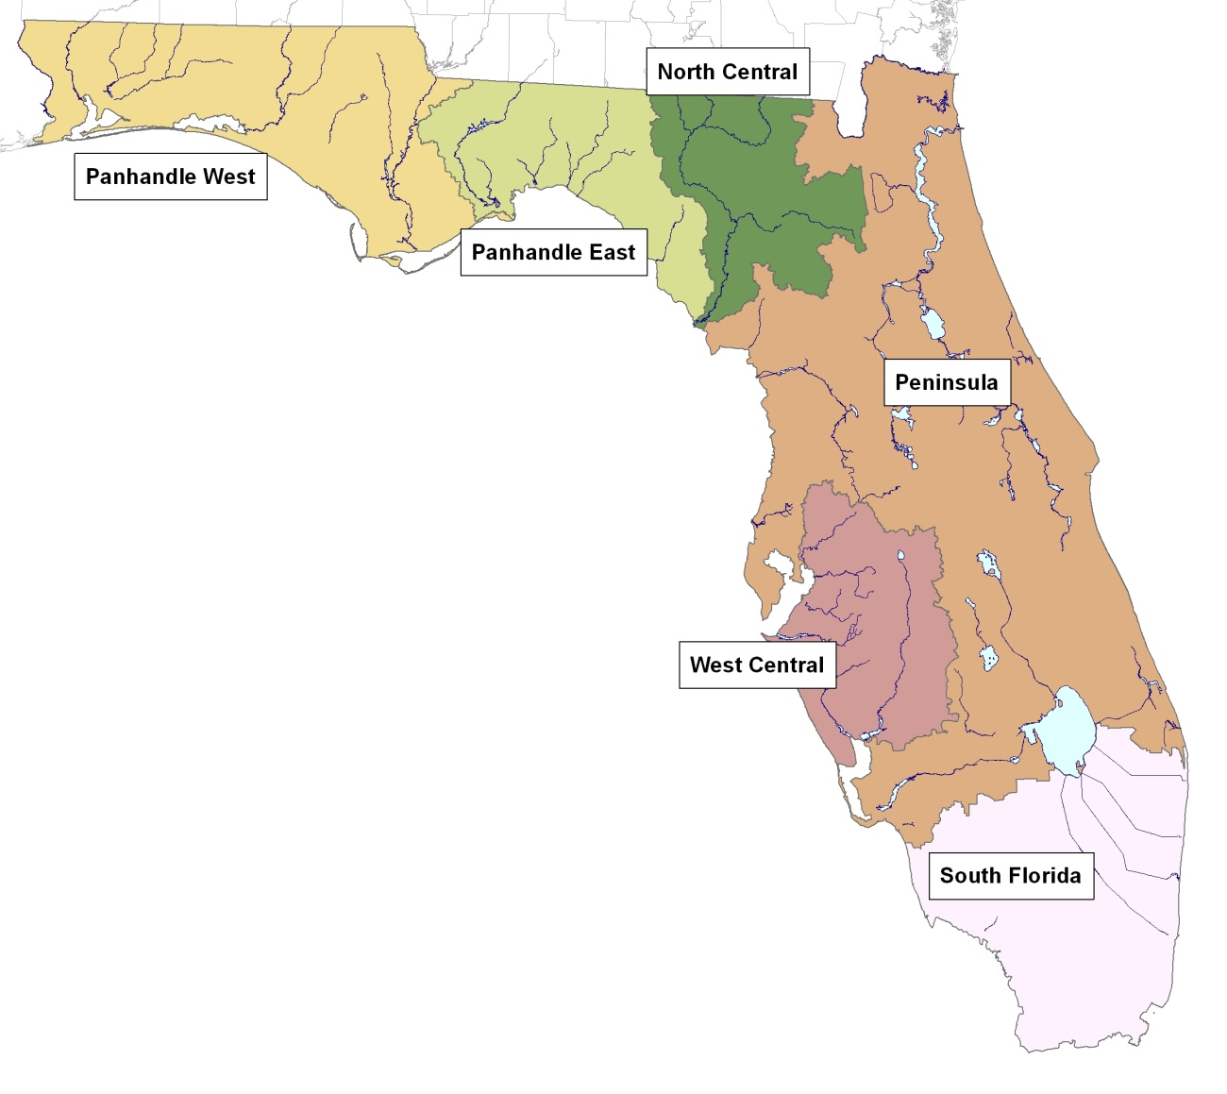
Streams Thresholds and Regions
Nutrient Region | Total Phosphorus Threshold | Total Nitrogen Threshold
Panhandle West | 0.06 mg/L | 0.67 mg/L
Panhandle East | 0.18 mg/L | 1.03 mg/L
North Central | 0.30 mg/L | 1.87 mg/L
Peninsula | 0.12 mg/L | 1.54 mg/L
West Central | 0.49 mg/L | 1.65 mg/L
South Florida | No numeric nutrient threshold. The narrative criterion in paragraph 62-302.530(47)(b), F.A.C., applies.

Slide 26
Exceptions to Streams Definition
Streams definition excludes several waterbody types
  Non-perennial water segments, wetlands, lake-like waters, tidally-influenced segments that fluctuate between fresh and marine, and
  Channelized or physically altered ditches, and canals and other conveyances used primarily for water management purposes (flood protection, stormwater management, irrigation, or water supply) and with limited habitat
Definition does not make any changes that impact whether a waterbody is a “water of the state”

Slide 27
Exceptions to Streams Definition (continued)
Flowing waters are presumed to be streams until documented to meet one of the exclusions in the streams definition
  Stream NNC apply until demonstration
Required demonstration is addressed in NNC Implementation Document (pp 49-50)
  Interested Parties (permit applicants) are responsible for providing information needed
  DEP responsible for providing public notice on determination

Slide 28
Lake-like Portions of Rivers
Some large rivers have portions that are more lake-like due to long residence time, increased width, or preponderance of biological taxa typically found in lakes
  Portions of St. Johns
  Biological taxa (plants and invertebrates) more lake-like than stream-like
  For permitting purposes, applicant would need to provide this information

Slide 29
Exceptions to Streams Definition
(continued)
To document non-perennial or wetland, need data on vascular plants and benthic macroinverterbates to show dominance of taxa more typically found in wetland or terrestrial conditions
To document tidally influenced, need chloride or specific conductance data collected during typical hydrologic conditions, using tide and flow data that are temporally coupled with the water quality sampling events, demonstrating changing salinity conditions

Slide 30
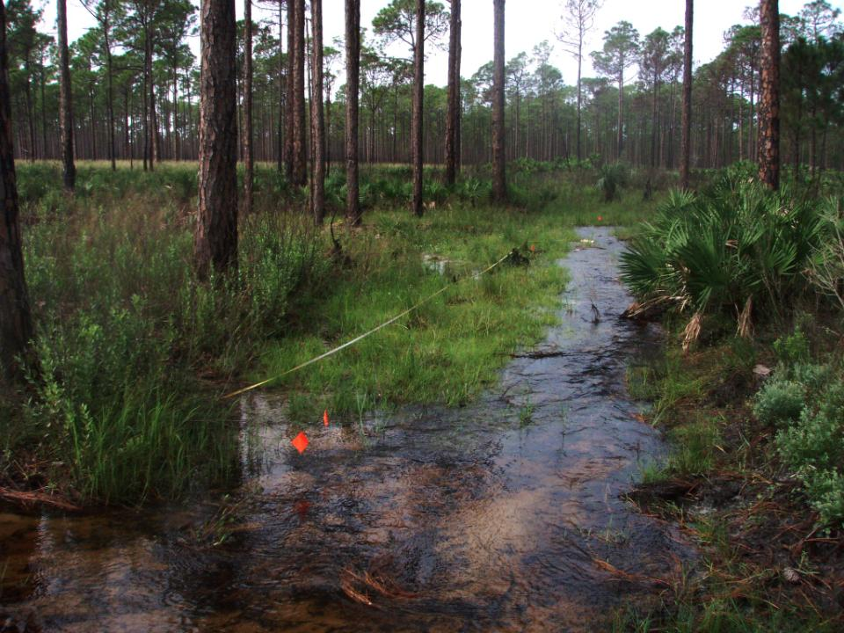
Non-perennial system: channel has non-obligate plants

Slide 31
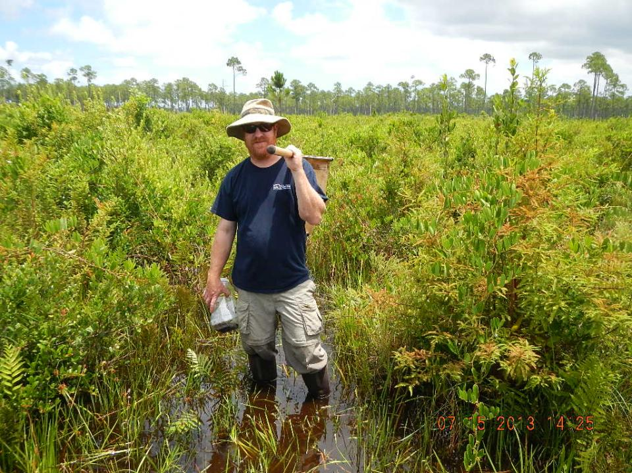
Wetland

Slide 32
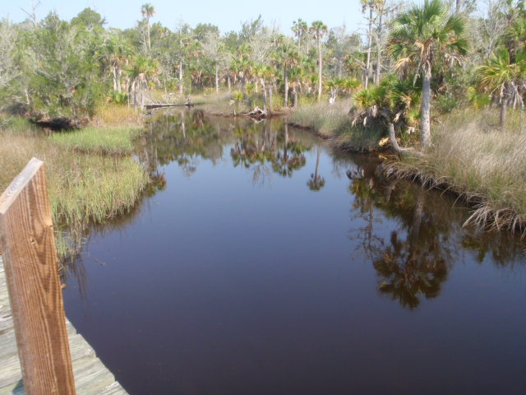
Fluctuating Salinity

Slide 33
Exceptions to Streams Definition
(continued)
For ditches, canals, and other artificial conveyances, need information that the conveyance is primarily used for water management purposes
  See page 55 of Implementation Document
To demonstrate habitat limitation, need a Habitat Assessment (HA) (DEP SOP FT 3000, see http://www.dep.state.fl.us/water/sas/sop/sops.htm)
  Habitat limited if Degree of Artificial Channelization and Substrate Diversity /Availability score in Poor category, and overall score is Poor or Marginal

Slide 34
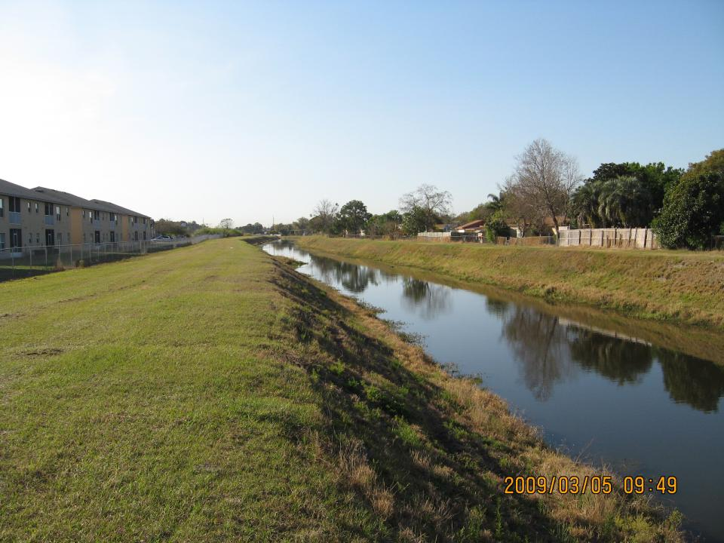
Maintained Conveyance

Slide 35
Implementation Document
To assist EPA’s understanding of Florida’s rules during the EPA review process, DEP wrote a document titled, Implementation of Florida’s Numeric Nutrient Standards
  Describes how the adopted provisions for nutrients in Chapters 62-302, 62-303, and the SCI Primer work in conjunction
  Environmental Community challenged as non-rule policy
Adopted by reference into Chapter 62-302, including floral evidentiary thresholds for stream nutrient standards attainment

Slide 36
Implementation Document
(continued)
Document provides details about implementation in 303(d) assessment process and NPDES permitting
  Notes importance of Water Quality-Based Effluent Limitation (WQBEL) Process and Downstream Protection

Slide 37
Downstream Waters Protection
Nutrient standard includes narrative provision to that downstream waters protected
  Rule 62-302.531(4), F.A.C., states “The loading of nutrients from a waterbody shall be limited as necessary to provide for the attainment and maintenance of water quality standards in downstream waters.”
Implementation Document notes can address by:
  Using models to allocate to upstream watersheds when establishing the TMDL for the downstream waterbody;
  Requiring dischargers to protect downstream waters (if there is reasonable potential that will impact); and
  Identifying trends in nutrient concentrations in all waters, including downstream waters, as part of the IWR assessment cycle

Slide 38
Sources of Information
Can get information about adopted nutrient TMDLs from TMDL Tracker
  http://www.dep.state.fl.us/water/watersheds/assessment/tmdl-tracker.htm
List of Nutrient TMDLs on Water Quality Standards Program website
  http://www.dep.state.fl.us/water/tmdl/final_tmdl.htm
Can get adopted NNC from Chapter 62-302.532
  https://www.flrules.org/gateway/ChapterHome.asp?Chapter=62-302
If estuary not addressed in Chapter 62-302, look at August 1 Report to Governor
  http://www.dep.state.fl.us/water/wqssp/index.htm

Slide 39
Additional Information Sources
TMDL webpage
  http://www.dep.state.fl.us/water/tmdl/final_tmdl.htm
FDEP Biological Data Base
  Biologists (access to S-Bio); Tallahassee (WQAP, AEQA, Biology Section
USGS for flow information
  http://waterdata.usgs.gov/fl/nwis/rt
62-304 for looking up TMDLs
  https://www.flrules.org/gateway/ChapterHome.asp?Chapter=62-304
FDEP Map Direct
  http://www.dep.state.fl.us/gis/
IWR Runs
  http://publicfiles.dep.state.fl.us/dear/IWR/

Slide 40
Additional Information Sources
DEP SOPs for collecting Biology and Water Quality data
  http://www.dep.state.fl.us/water/sas/sop/index.htm
Level II WQBELS for multiple and single discharges
  See TMDL Section
Watershed Assessment Complete List of Verified Waters
  http://www.dep.state.fl.us/water/watersheds/assessment/a-lists.htm#vl
Reasonable Assurance Plans
  http://www.dep.state.fl.us/water/watersheds/rap.htm

Slide 41
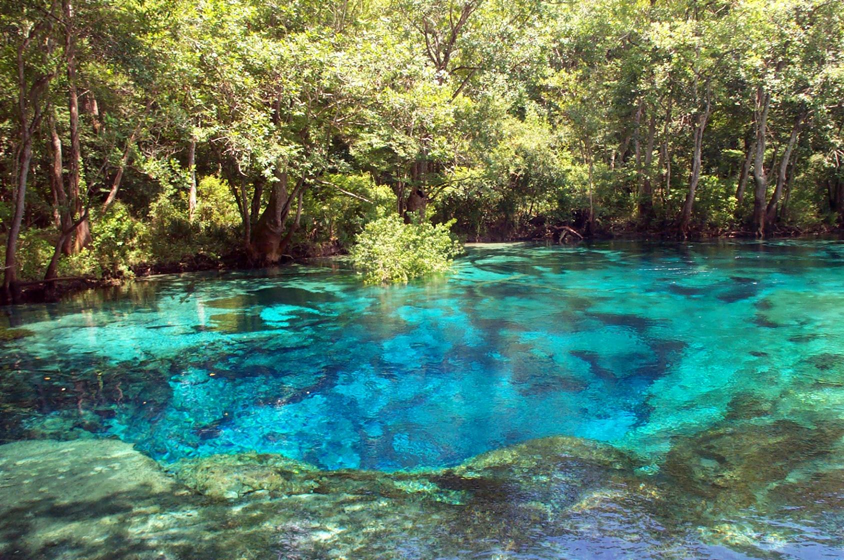
For More Information
http://www.dep.state.fl.us/water/wqssp/nutrients
Notes:
The importance of establishing numeric nutrient criteria: Reiterate that nutrient pollution is currently one of the largest pollution problems in the state. Establishing a numeric standard is the first step to protecting the state’s waterbodies from nutrient pollution.

