Slide 1
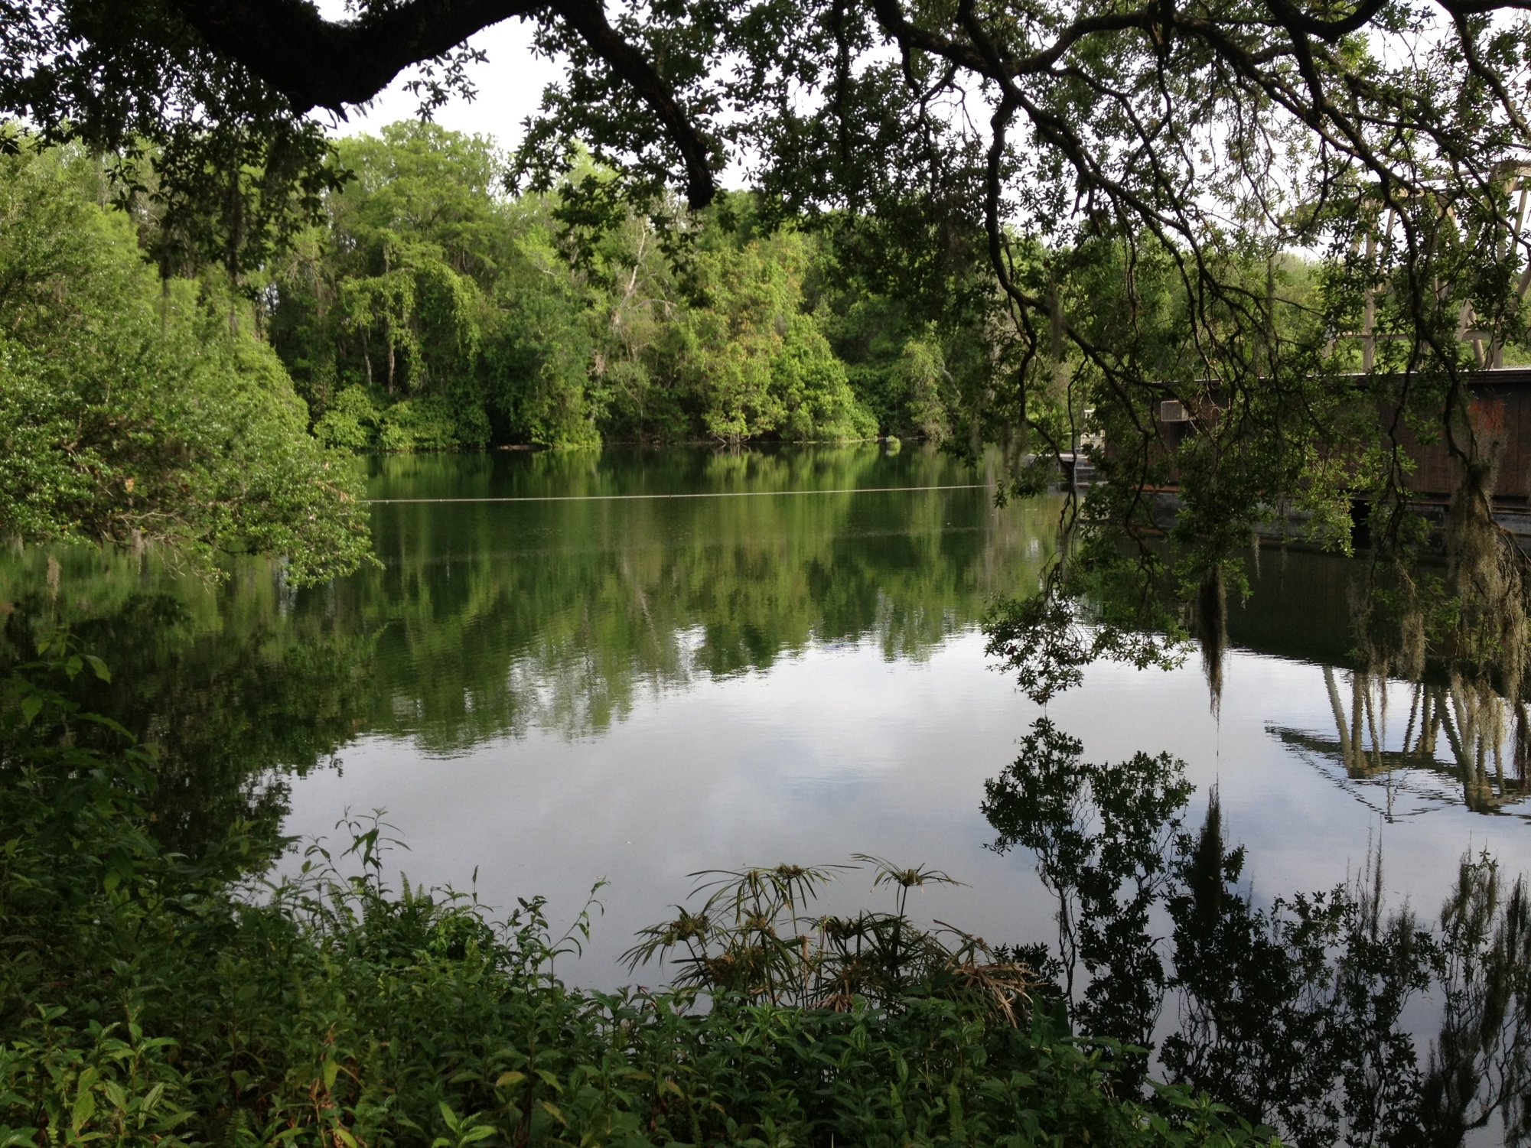
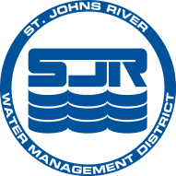
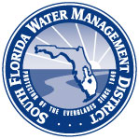
Review and Assessment of Secondary Impacts to Wetlands and Other Surface Waters
Mindy Parrott, MS
Lead Environmental Scientist
Mark E. Brandenburg,
MS, CSE, PWS
Environmental Resource Program Manager

Slide 2
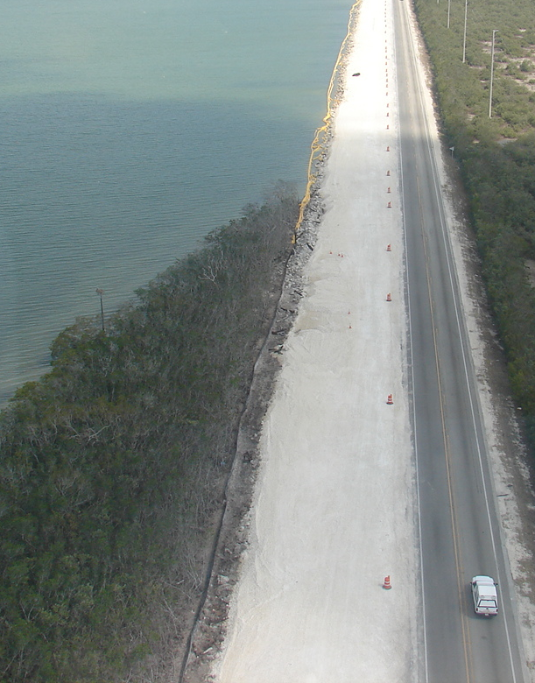
Overview
  Regulatory Basis
  What is a Secondary Impact?
  How to Assess
  Resolving Secondary Impact Issues
  Case Study
  Group Exercise

Slide 3
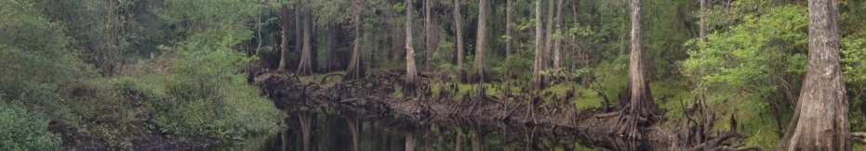
Regulatory Basis
Chapter 62-330.301(1)(f)
  Conditions for Issuance
    (1) To obtain an individual or conceptual approval permit, an applicant must provide reasonable assurance that the construction, alteration, operation, maintenance, removal, or abandonment of the projects regulated under this chapter
      (f) Will not cause adverse secondary impacts to the water resources.

Slide 4
Regulatory Basis (AH Vol 1 10.2.7)
  Includes consideration of impacts to:
    Water quality or functions of wetlands or OSWs
    Ecological value of uplands for bald eagles, and aquatic or wetland dependent listed animal species
    Significant historical and archaeological resources
    Future activities, including additional phases or expansion of the proposed activity for which plans have been submitted to governmental agencies, or on-site and off-site activities are very closely linked and causally related to the proposed activity

Slide 5
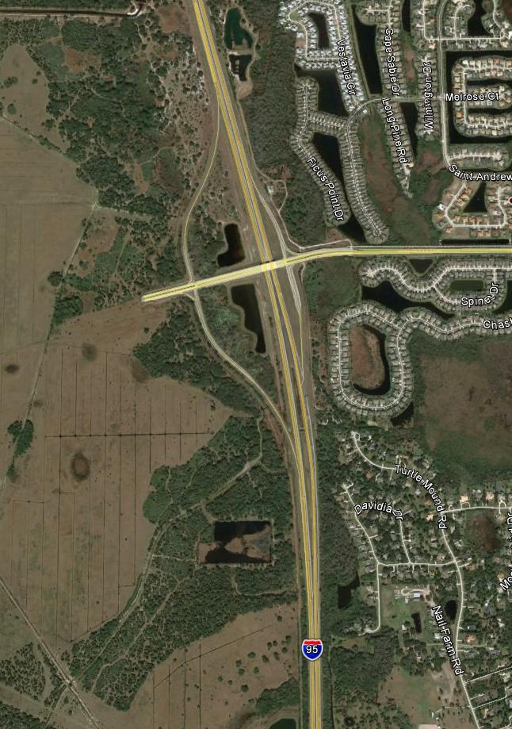
What is a Secondary Impact?
  An effect that is intended or can be reasonably expected to occur due to construction, alteration or use of the proposed project, including future expansions and/or related activities.

Slide 6
How to Assess Secondary Impacts
  Define the extent of and how many assessment areas
  Consider existing development/activities that may already affect the AA
  UMAM or other assessment method if offsetting impacts at mitigation bank assessed using different functional assessment method
  Helpful to categorize secondary impacts into groups matching UMAM – L&L, WE, and CS

Slide 7
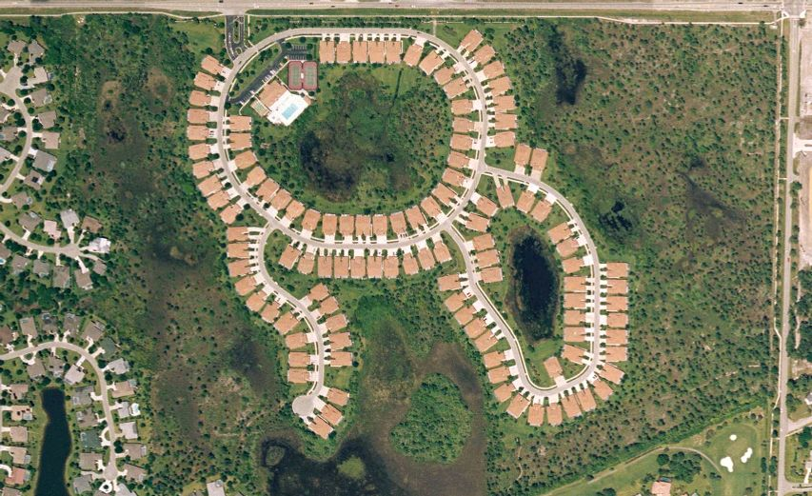
Secondary Impacts – L&L
  Wetland fragmentation
  Lighting and noise
  Create a barrier to wildlife movement
  Reduce the availability of wildlife food sources
  Mortality/reduction of habitat use by wildlife due to pets
  Recreational use of common areas
  Increase in boat traffic related to the use of a proposed docking facility

Slide 8
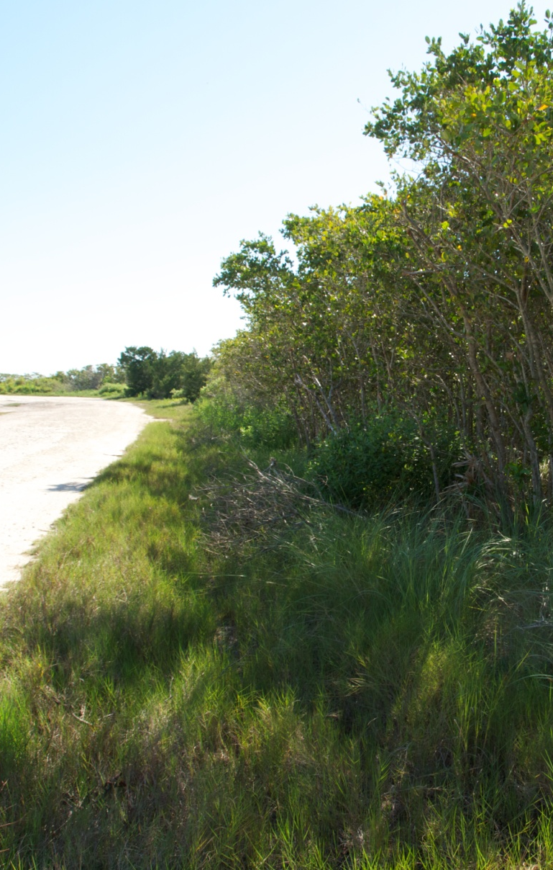
Secondary Impacts –WE
  Alteration of the hydroperiod/hydropattern
  Change drainage characteristics or flow patterns
  Increased input of sediment or toxicants
  Increase the discharge of nutrients
  Alter sediment load or change turbidity
  Reduce detritus development and/or transport

Slide 9
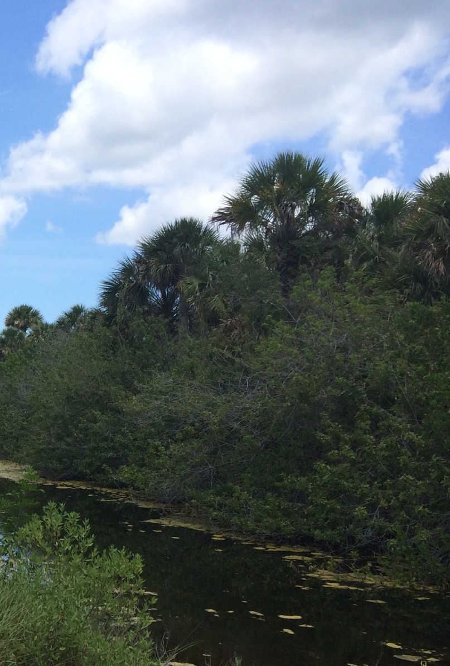
Secondary Impacts -CS
  Reduce/shift in wetland vegetation density or diversity
  Change the dominant wetland class
  Introduction of exotic/nuisance vegetation
  Create a canopy gap that could affect microclimate
  Shading
  Litter/dumping
  Prop dredging

Slide 10
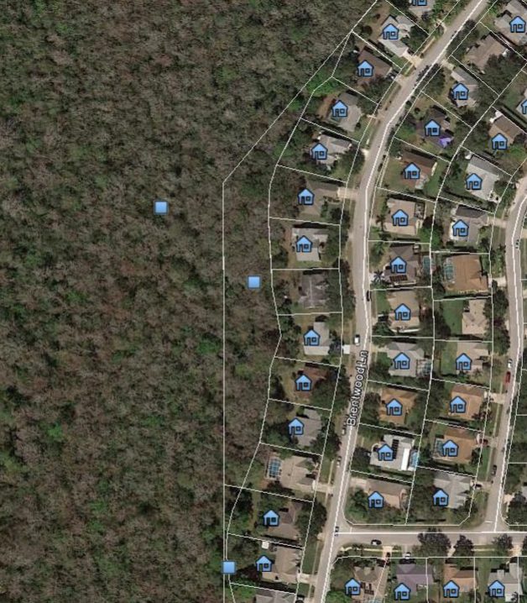
How Far Do You Assess?
  25’?
  200’?
  1’ – 300’?
  Corps Scope of
  Effects tool
300’
200’
100’
25’

Slide 11
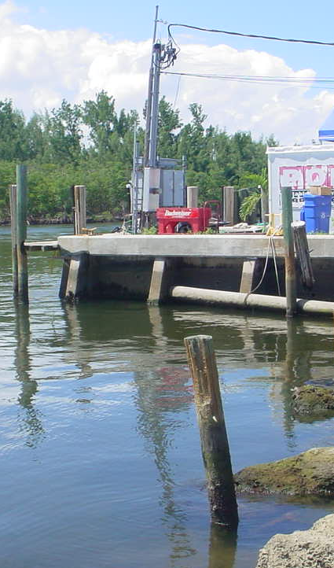
Resolving Secondary Impact Issues
Provide natural and/or planted upland buffers (15’ min, 25’ avg)
Provide appropriate water quality & quantity
Incorporate design elements to reduce impacts
Implement wildlife agencies’ management guidelines for wetland-dependent wildlife
Reduce and eliminate impacts
Provide mitigation for unavoidable secondary impacts

Slide 12
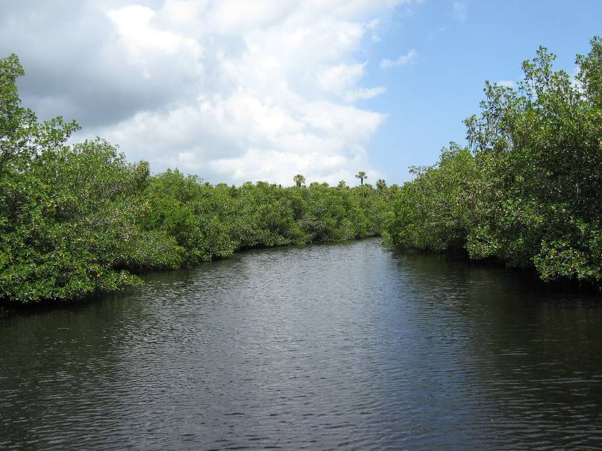
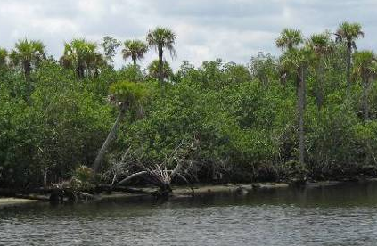
Case Study – Crosstown Parkway
Conceptual Approval
Six Possible Alternatives, final Alternative to be chosen by EIS.
Located within Aquatic Preserve, SSL, OFW, & State Park Lands.
Permit has not been issued.

Slide 13
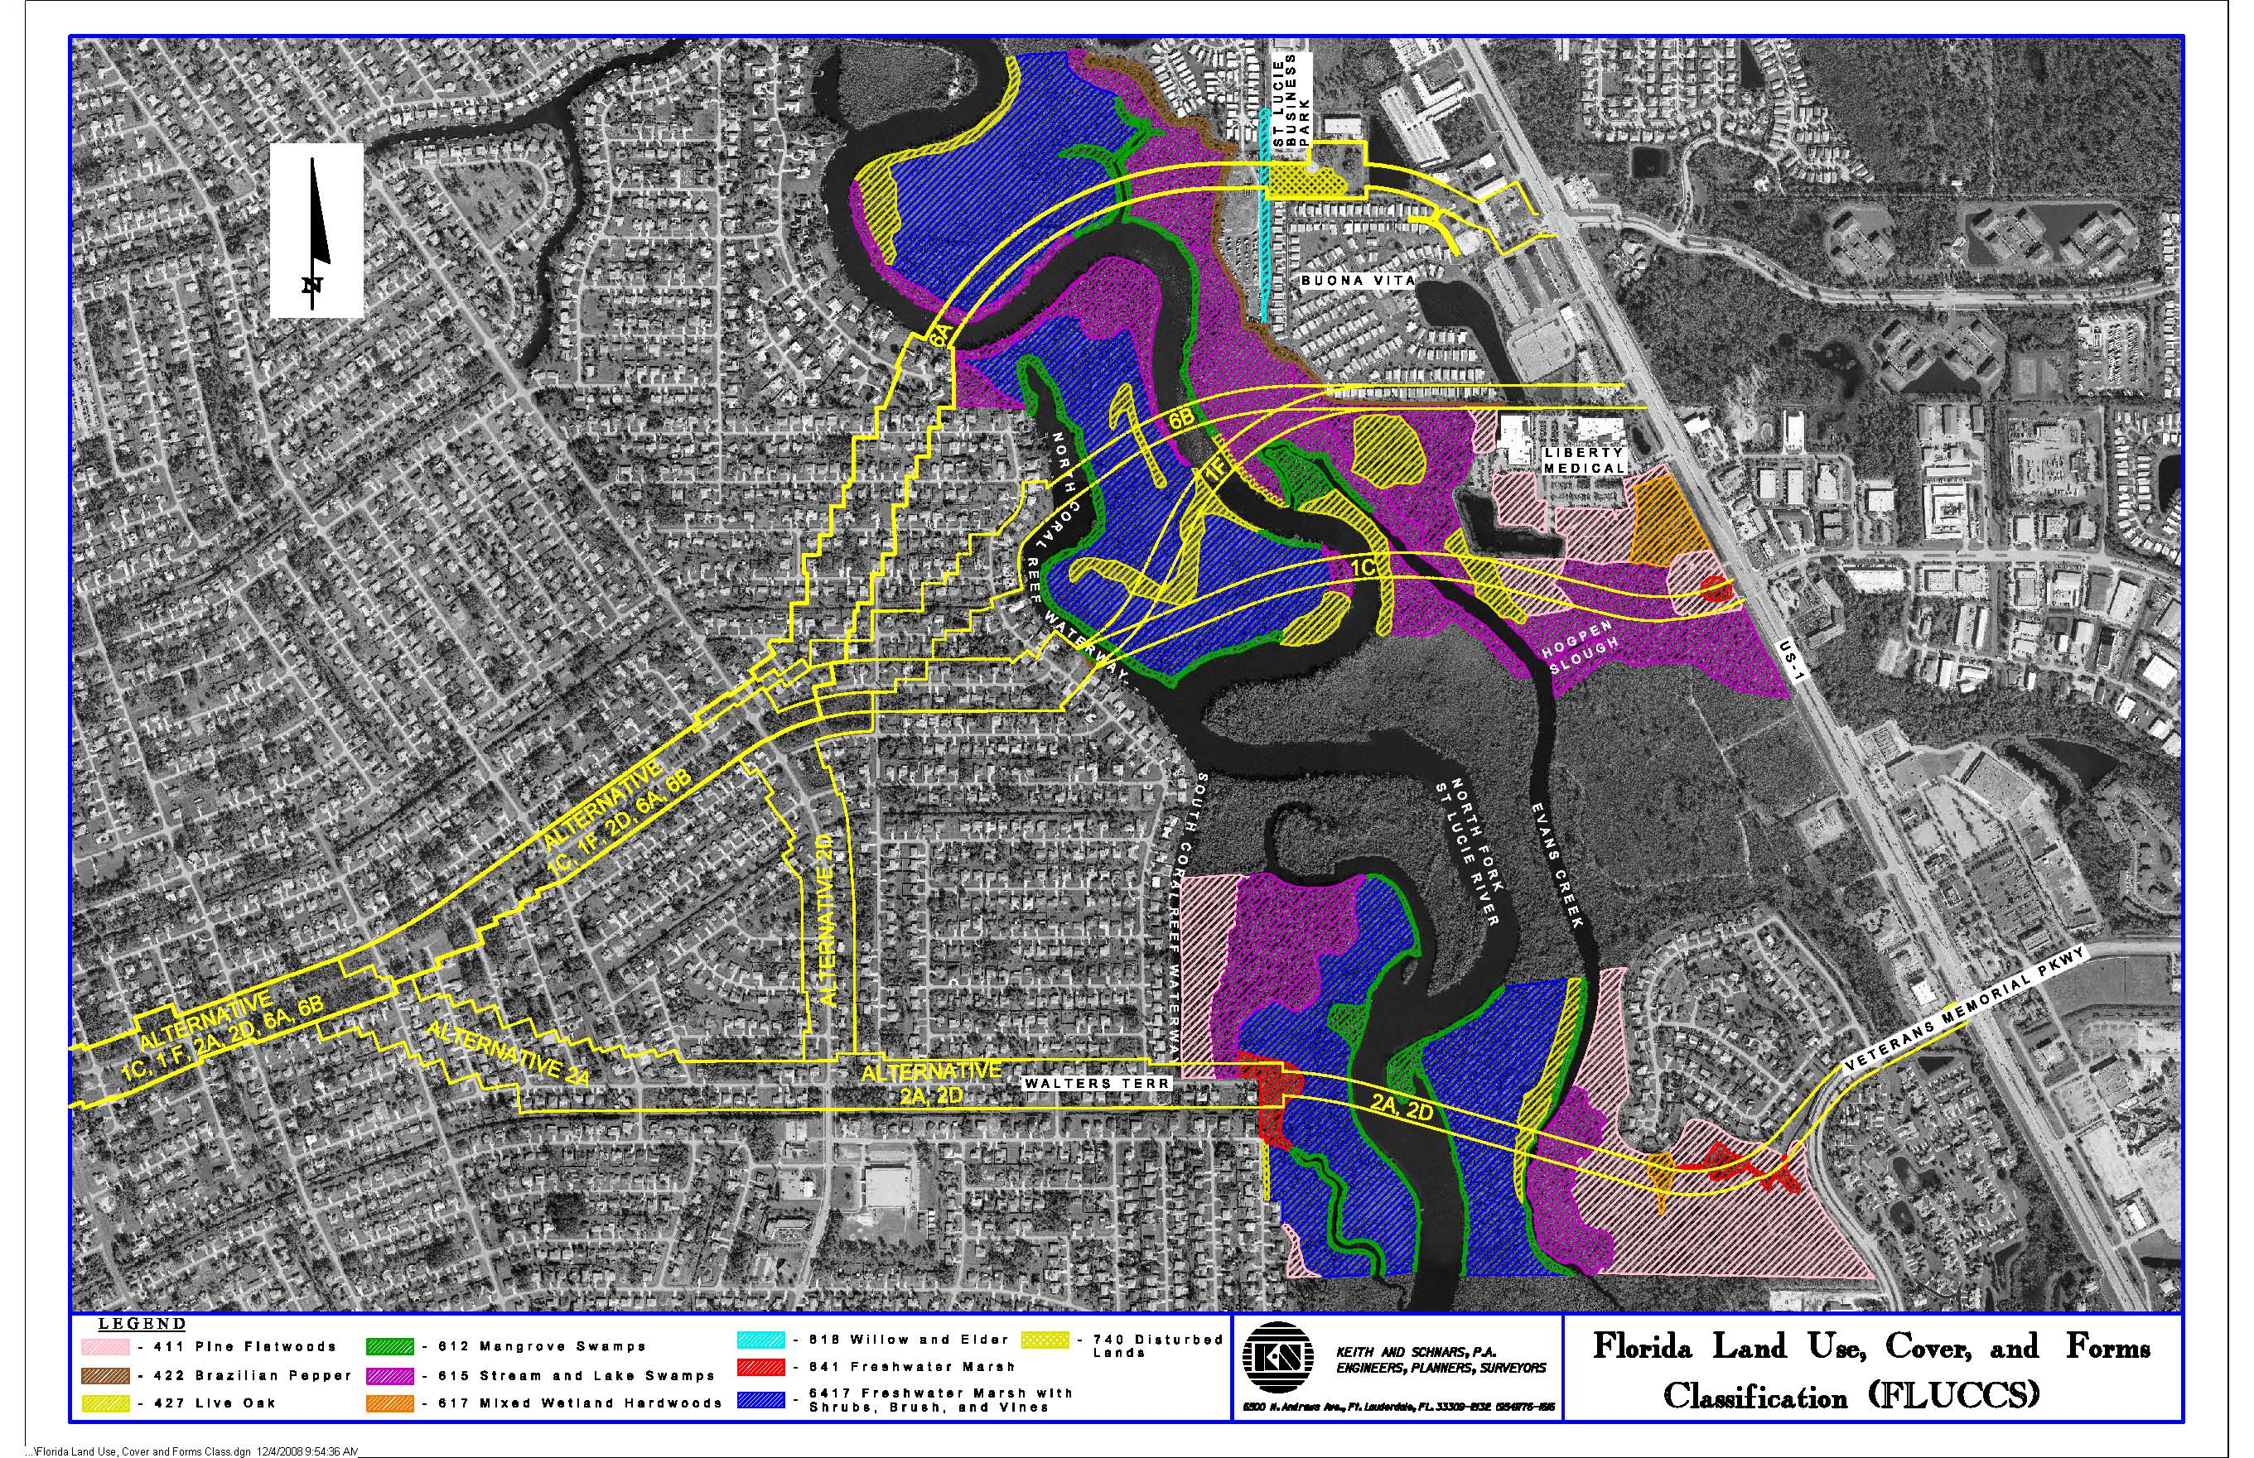
Case Study – Crosstown Parkway

Slide 14
Case Study – Crosstown Parkway
Location and Landscape Support
  Habitat fragmentation
  Noise
  Light
Community Structure
  Shading beyond the bridge footprint
  Edge effect allowing exotic invasion
  Litter, dumping
Water Environment
  Direct discharges from scuppers to water body
  Scour and changes in sedimentation/ water flow from pilings
  Turbidity problems during construction.

Slide 15
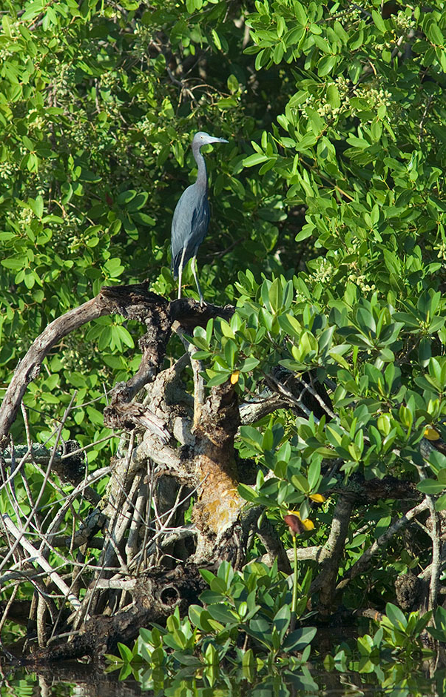
Case Study – Crosstown Parkway
Literature indicates birds and other wildlife are affected by roads & bridges:
  Discourages nesting/roosting
  Birds are flushed by sight/sound of people/vehicles
  Species composition changes- more “suburban” species.
  Encourages some species to forage adjacent to road= road kill.
  Flushing distances varied in studies- 150- 500 feet, with most species needing 100-250 feet.
  Looked at species lists specific to the project

Slide 16
Case Study – Crosstown Parkway
Existing bridges on same river system
  Exotics dominant within 50 feet of the bridge.
  Aerial photography shows shading 40 feet north of the bridge.
  Habitat fragmentation seemed obvious: existing bridges had filled approaches in the river.
Noise
  Literature indicates wading birds may be adversely affected by noise exceeding 56 dB.
  Noise study indicated 56dB contour extending 600 feet from bridge.
  However, it was acknowledged that wildlife can adapt to steady background noise.

Slide 17
Case Study – Crosstown Parkway
During EIS process, commitments were made to reduce secondary impacts:
  Construction methodology will use temporary work platform/ or top-down method, no water jetting
  Manatee, Sea Turtle and Sawfish standard conditions
  Construction staging only within the bridge approach
  No scuppers, all stormwater directed to ponds
  Specialized directional lighting to reduce light trespass
  Bridge supports designed to minimize scour

Slide 18
Case Study – Crosstown Parkway
Result- two secondary impact assessment areas-
  0 to 50 feet from the bridge, and
  51-250 feet from the bridge.
It was agreed that the secondary effects are lessened where forested wetlands exist, in comparison to marshes.
To simplify the analysis, we lumped all of the assessment areas into forested or marsh.

Slide 19
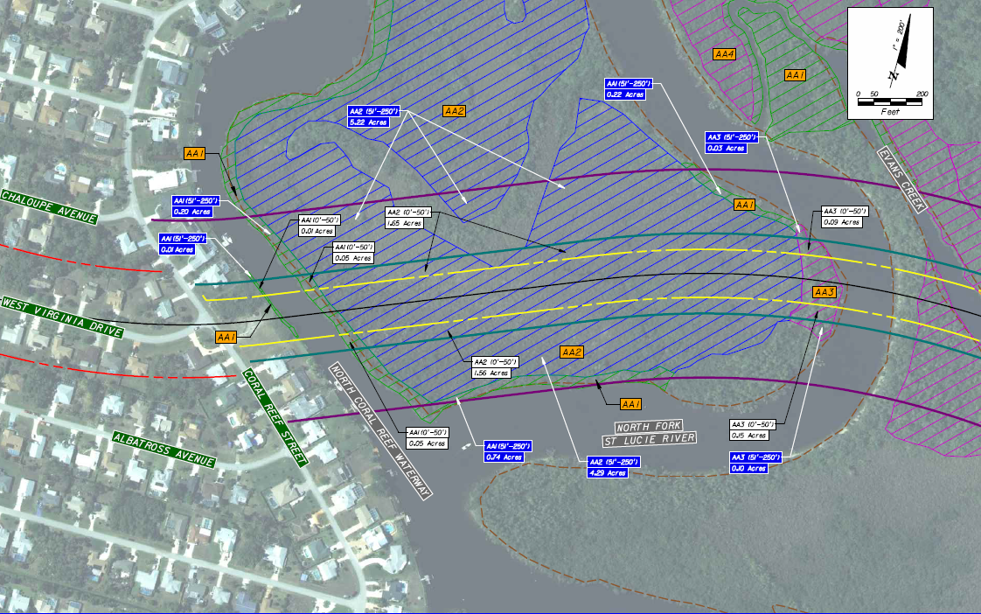
Case Study – Crosstown Parkway

Slide 20
Case Study – Crosstown Parkway
UMAM Scoring Category | Decrease in UMAM Score
 | Marsh |  | Forested
 | 0-50’ | 51-250’ | 0-50’ | 51-250’
Location and Landscape Support | -3 | -2 | -3 | -1
Water Environment | 0 | 0 | 0 | 0
Community Structure | -3 | 0 | -3 | 0

Slide 21
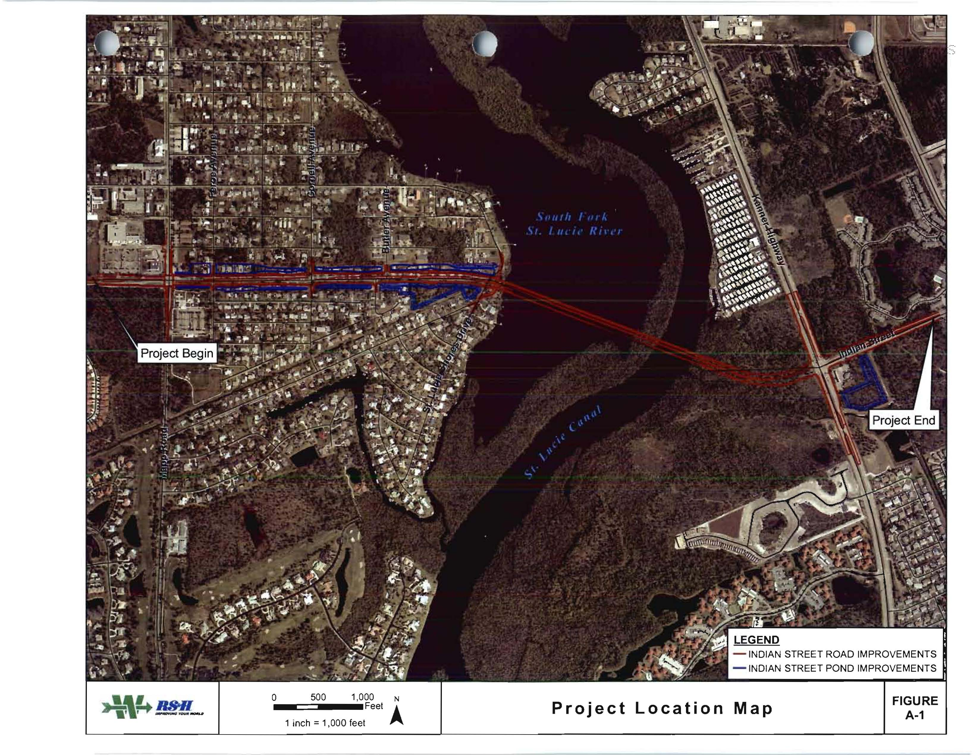
Case Study – Indian Street Bridge

Slide 22
Case Study – Indian Street Bridge
South Fork of the St. Lucie River. Not an AP or OFW. Heightened Public Concern
Stimulus project. Hurry up and issue the permit we haven’t applied for yet!
Because of the multi-agency agreement on the UMAM secondary impact methodology for Crosstown, we were able to use a similar strategy for Indian Street Bridge.

Slide 23
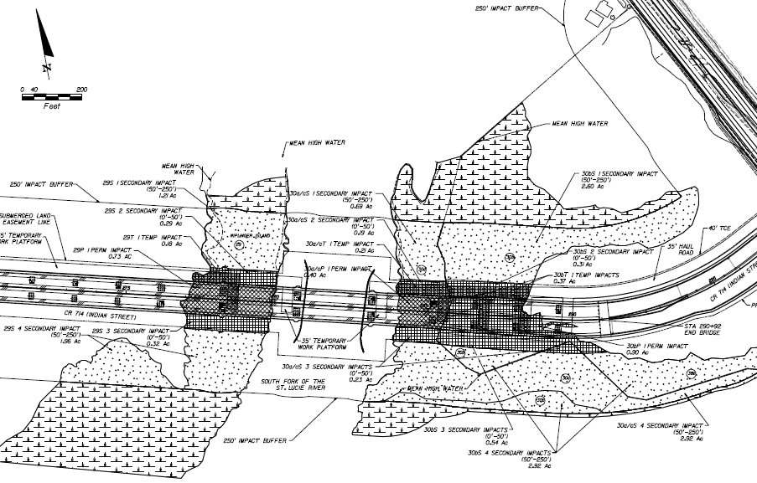
Case Study – Indian Street Bridge

Slide 24
Case Study – Indian Street Bridge
Applicants included the following features in the design of the bridge to reduce secondary impacts:
  Wildlife crossing in uplands under east end of bridge (span begins early).
  Construction via temporary work platform
  Manatee Standard Construction Conditions
  Shoreline stabilization/ mangrove planter at the west end of the bridge
  Directional lighting
  Bridge height allows for some growth under the bridge
  Railings to discourage bird perching

Slide 25
Case Study – Indian Street Bridge
Permit was issued via Final Order in favor of the applicant after an Administrative Hearing.
Testimony included discussion of the methodology used to determine and calculate secondary impacts.
Bridge has been constructed and opened earlier this year.

Slide 26
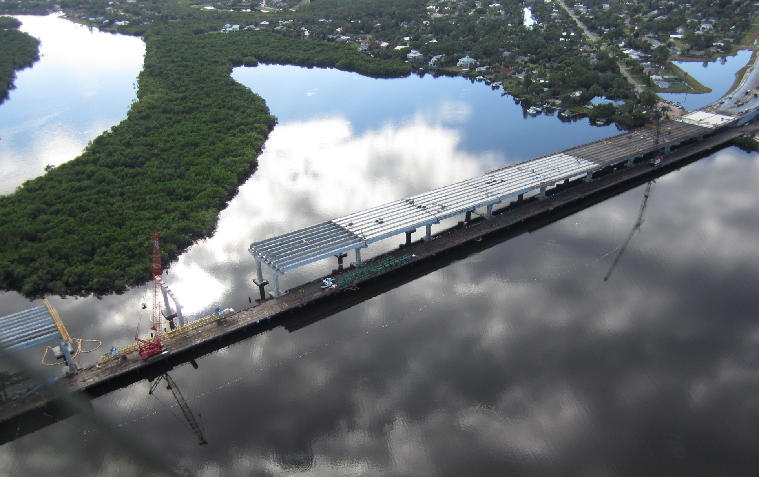
Case Study – Indian Street Bridge

Slide 27
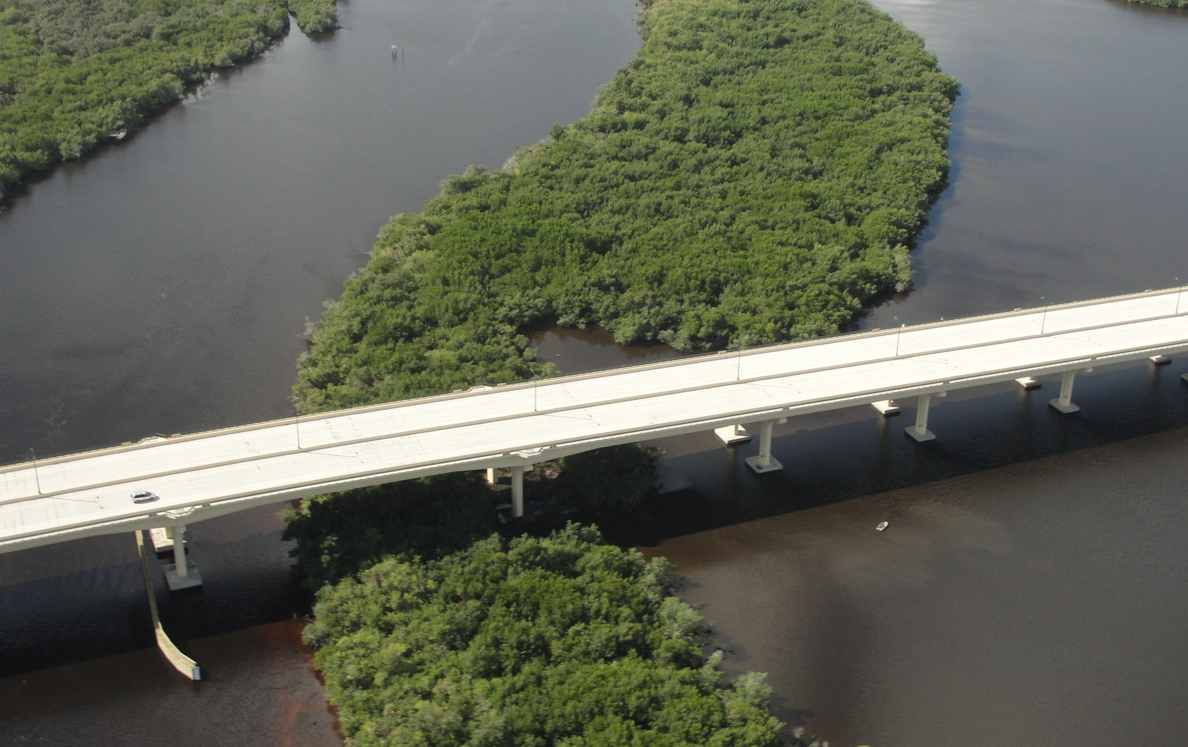
Case Study – Indian Street Bridge

Slide 28
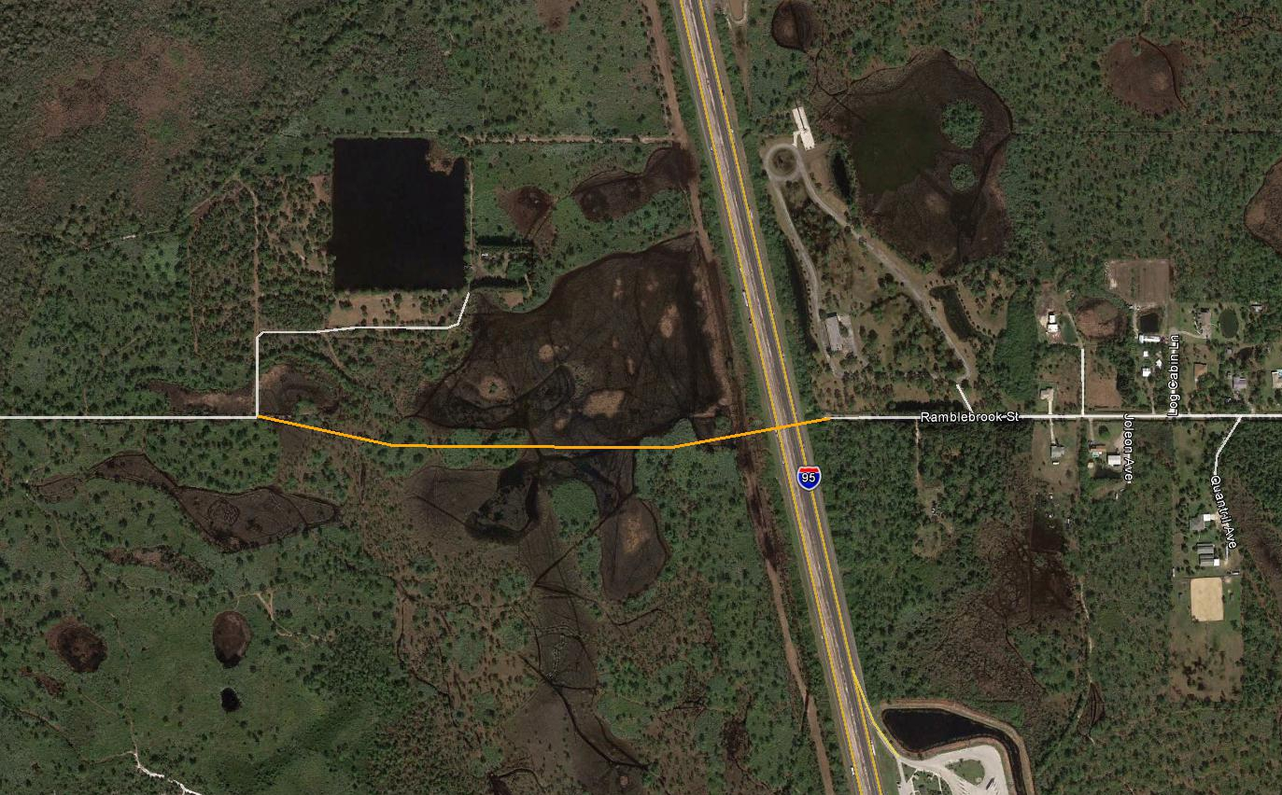
Group Exercise

Slide 29
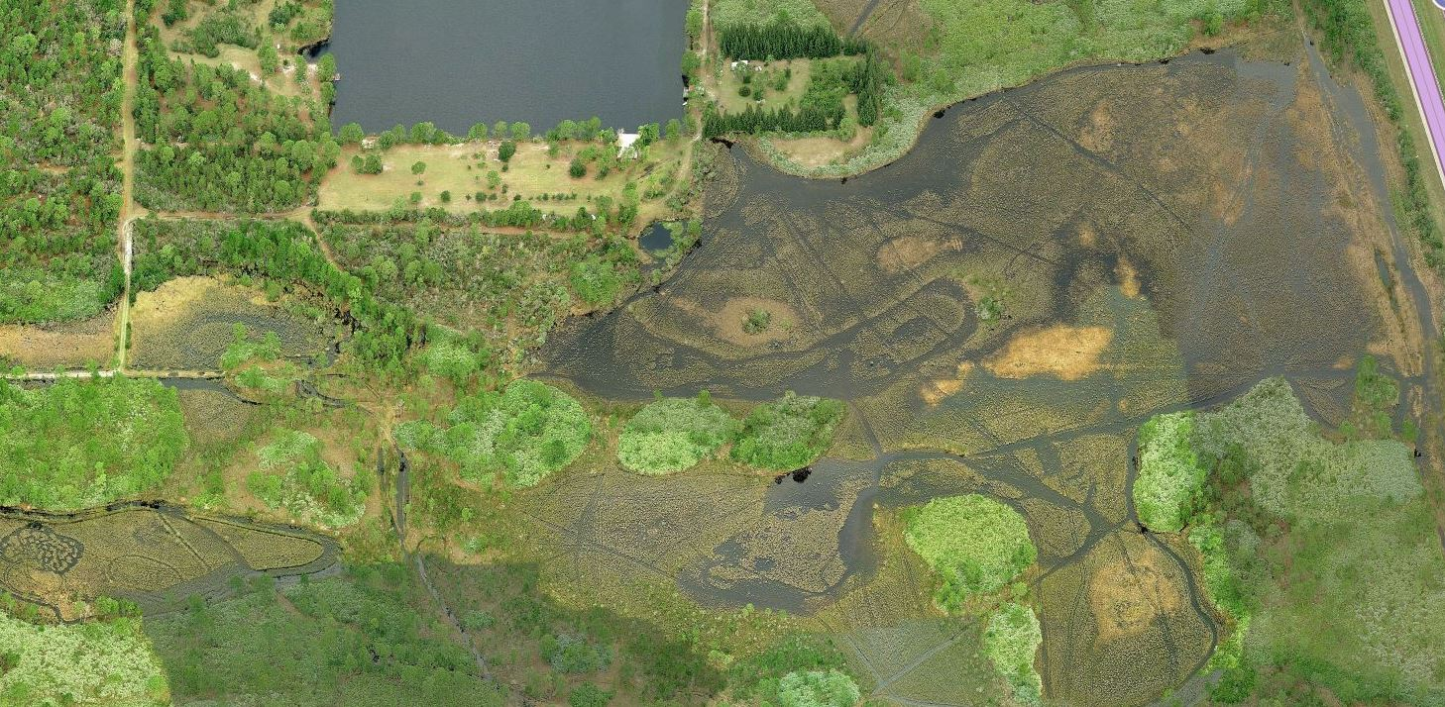
Group Exercise

Slide 30
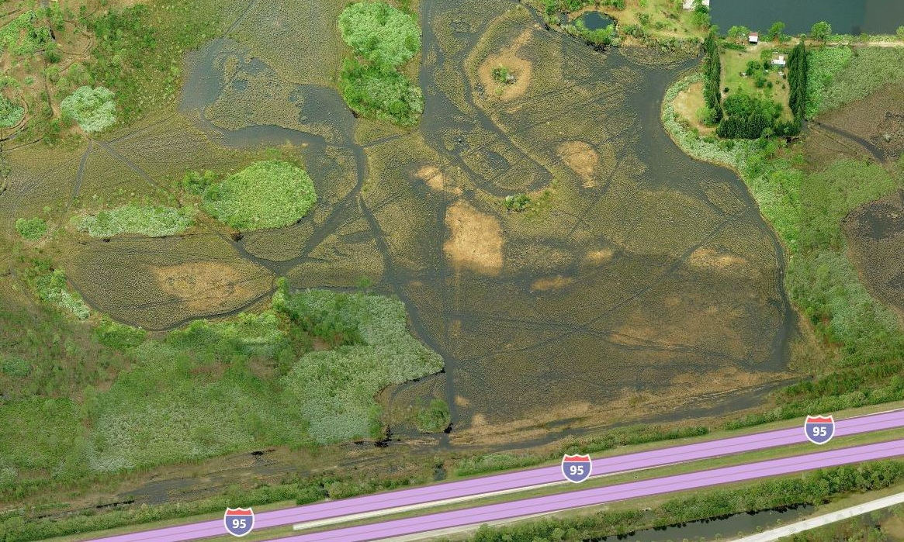
Group Exercise

Slide 31
Questions?
Mindy Parrott, MS
Lead Environmental Scientist
mparrott@sfwmd.gov
Mark E. Brandenburg,
MS, CSE, PWS
Environmental Resource Program Manager
mbrandenburg@sjrwmd.com

Slide 32
Case Study – Crosstown Parkway
What secondary impacts should be considered?
    AHI,10.2.7(a) adverse impacts to the functions of wetlands or other surface waters
    AHI,10.2.2 (a)-(e): Condition, Hydrologic Connection, Uniqueness, Location, and Fish & Wildlife Utilization
What can the applicant do to reduce secondary impacts?
How far beyond the bridge do the effects extend? (Or, what is the assessment area size/shape?)
    No guidance in ERP rule or UMAM rule!

