Slide 1
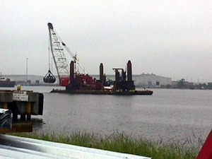
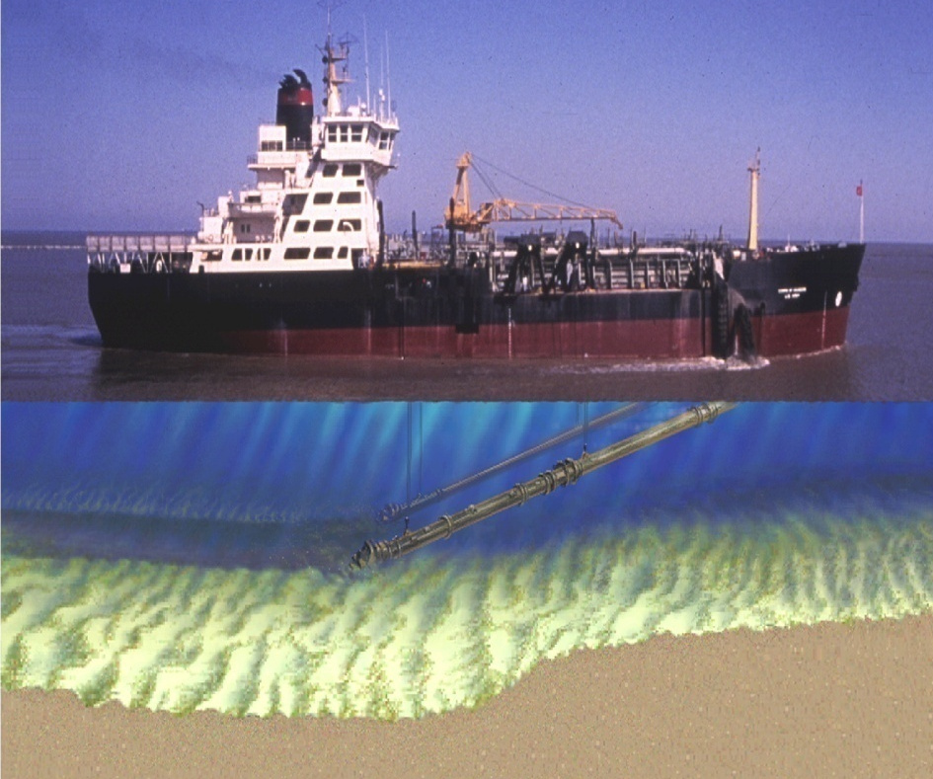
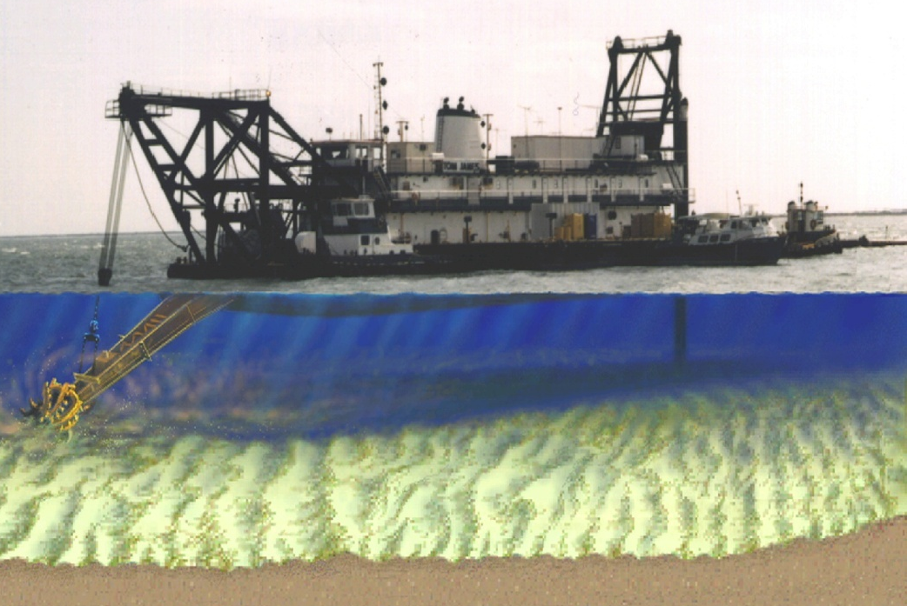

USACE DREDGING 001
For Civil Works Projects
Notes:
We will discuss operating characteristics of the dredge types that typically are working for the Jacksonville District. There are many other types and configurations of dredges, especially when considering small dredges, however, the vast majority of of the Corps work is accomplished by large business contractors with a very limited number of dredges.

Slide 2
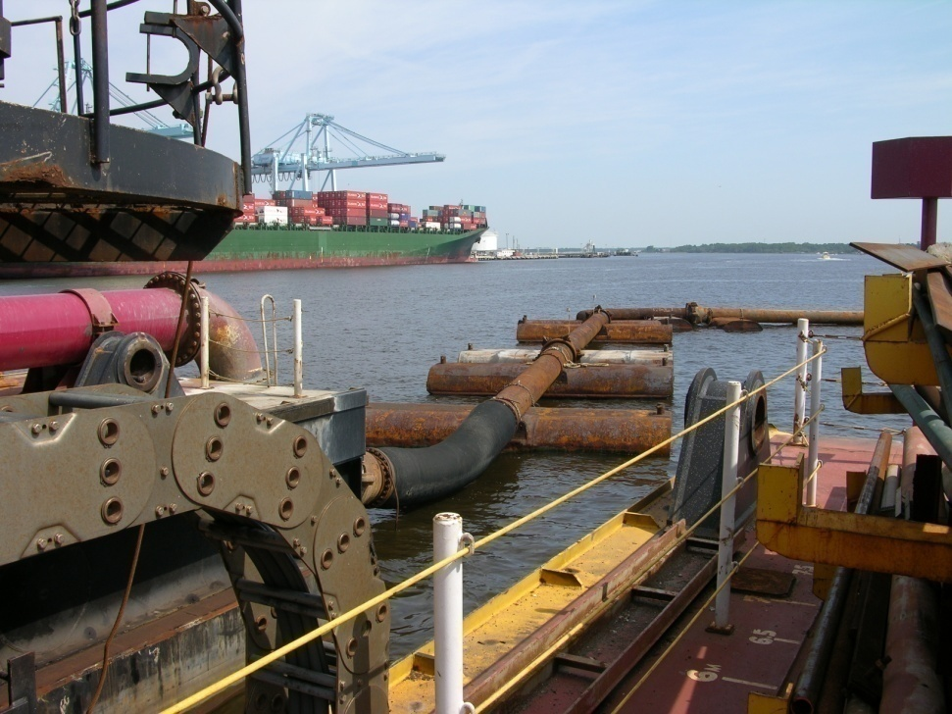
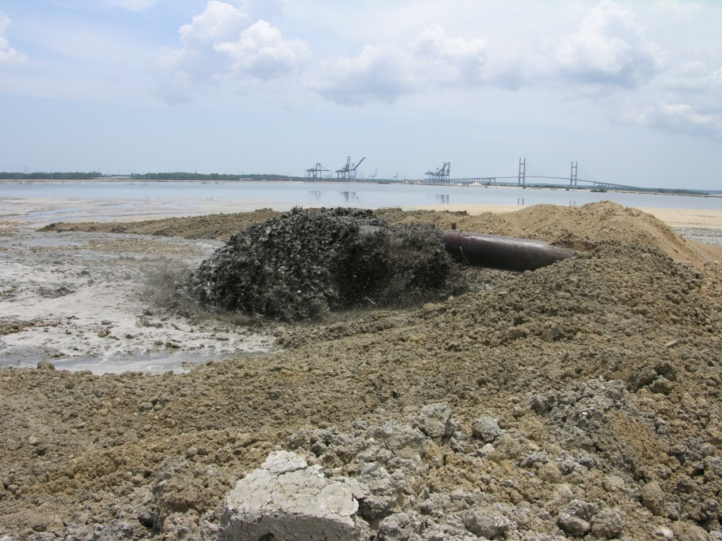
Quiz
Which picture shows
a. Dredge Material
b. Dredged Material

Slide 3
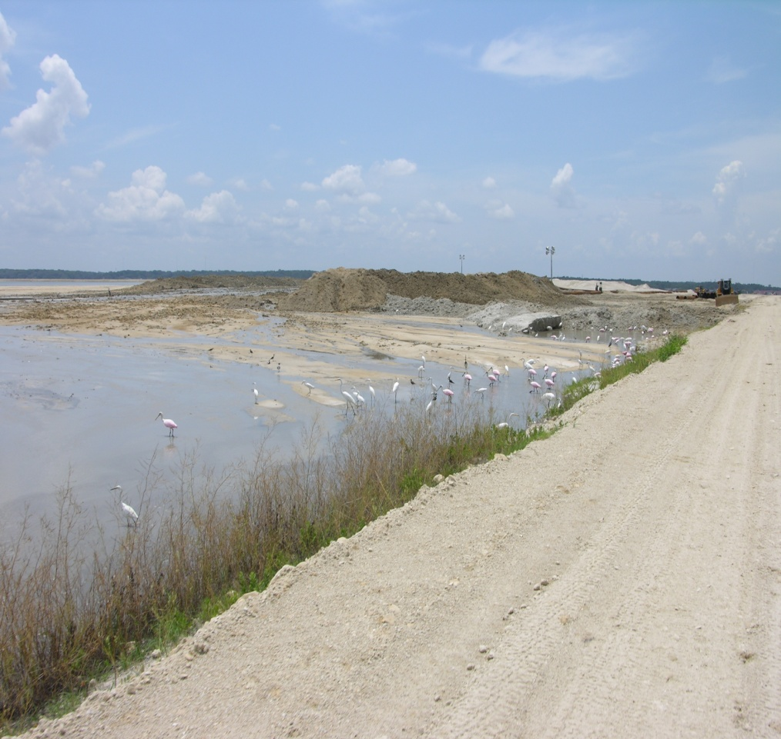
Quiz
Which is it?
a. Spoil Area
b. Dredged Material Management Area

Slide 4
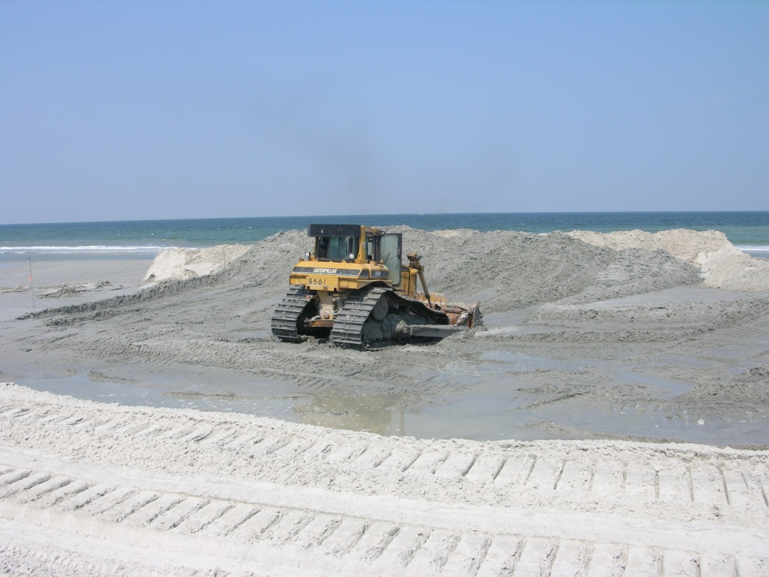
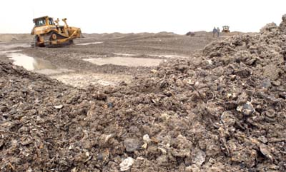
Quiz
3. Which picture shows?
a. Beach Quality Material
b. Non Beach Quality Material
Oyster Shell

Slide 5
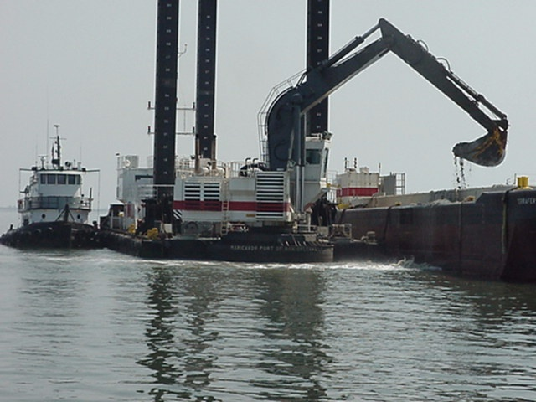
Dredging 001 Two Basic Dredge Types
1. HYDRAULIC
a. Cutterhead
b. Hopper
c. Dustpan
MECHANICAL a. Clamshell
b. Backhoe
Notes:
There are two main categories of dredges –1. Hydraulic and 2. Mechanical - characterized by the method in which they remove sediment and transport it. Hydraulic dredges move material hydraulically, which means suspended and transported by water. Mechanical dredges move material by physically picking up the material and moving it by mechanical methods.
We will discuss 3 types of hydraulic dredges, the cutterhead or pipeline dredge, hopper dredges, and dustpan dredges. Also, 2 types of mechanical dredges, clamshell and backhoe. We will learn about the main features of these dredges and how they operate and under which conditions each type of dredge operates most efficiently.

Slide 6
Dredge Operating Characteristics Comparison
1. Hydraulic
  A. Cutterhead – high production, moderate disposal distance, soft and hard material, moderate wave conditions. Relatively fixed plant.
  B. Hopper– moderate production related to haul distance, good in rough seas, usually soft or maintenance type materials. Rapidly moving plant.
  C. Dustpan-low production, soft material, small cut width, used for small projects or ending clean-up.
2. Mechanical. A. Clamshell, B. Backhoe– Soft to broken up hard material, good for new work jobs, close quarters, heavy shoaled areas, barges needed for long haul disposal. Relatively fixed plant.
Notes:
Quick first overview of Dredging types

Slide 7

A. Cutterhead or Pipeline Hydraulic Dredge
A-Frame
Lever Room
Pump
Spuds
Discharge pipe
Ladder
Cutterhead
Suction Line
Notes:
The first type of Hydraulic Dredge is the Cutterhead – or pipeline dredge. It is efficient for many applications but not self propelled. It moves by use of winches and spuds. The material is pumped via pipeline to the disposal area. Explain main parts. Discuss dredge features. Discuss how dredge moves – winches and spuds

Slide 8
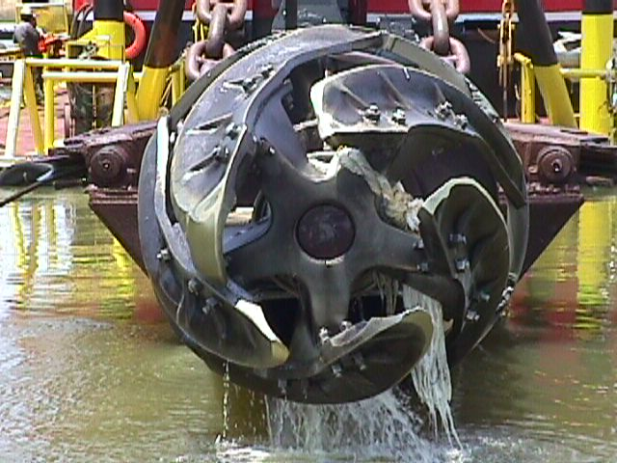
Cutterhead Dredge Features
High Constant Production to 5000 cy/hr
Pump Distances (3 mi per booster)
Digs Soft to Hard Materials
Best in Rivers and Estuaries
Limited Mobility Moves by Spuds or anchor movement.
Need relatively calm seas
Notes:
Potentially the most efficient high production type, a large dredge can produce 3-5Kcy/hr – 60-70Kcy/dayand pump 3-5 miles to the disposal area. With booster pumps. Maybe to 5-10 miles or even longer in soft material. Can’t move on its own, must have tug to move out of the way of passing vessels in rivers. Needs relatively calm water, depending on size of dredge – can work inlets on wires. Can’t readily move out of the channel – rough weather destroys pipelines.

Slide 9
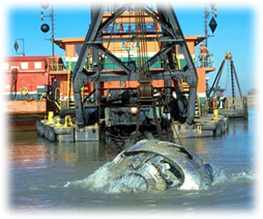
Cutter Suction Front View
Notes:
This is a front view of a cutter suction as the cutter is exposed at the surface.

Slide 10
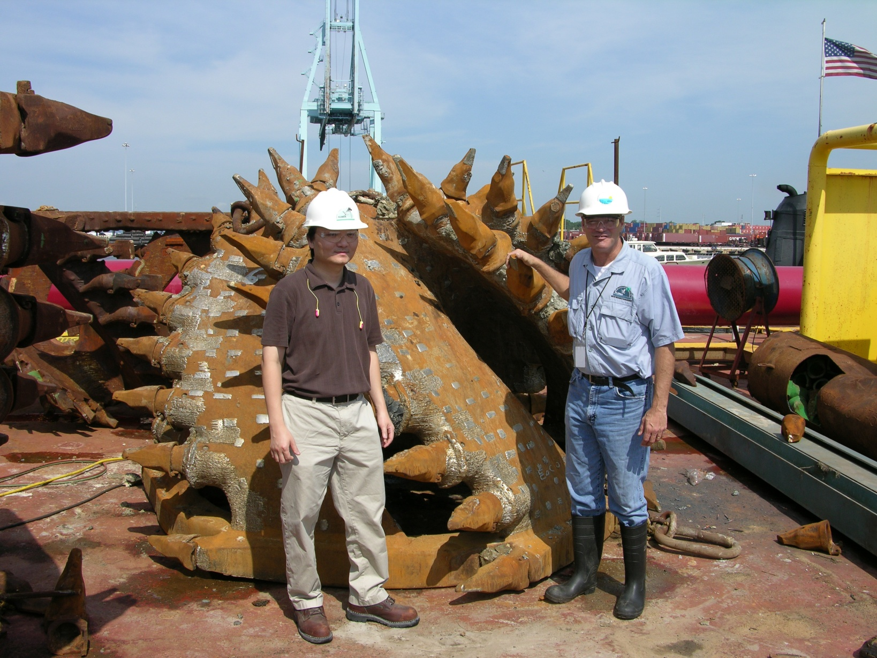
78-inch Cutterhead
Notes:
This is the comparative size of the cutterhead for the GLDD Texas the largest Cutter suction.

Slide 11
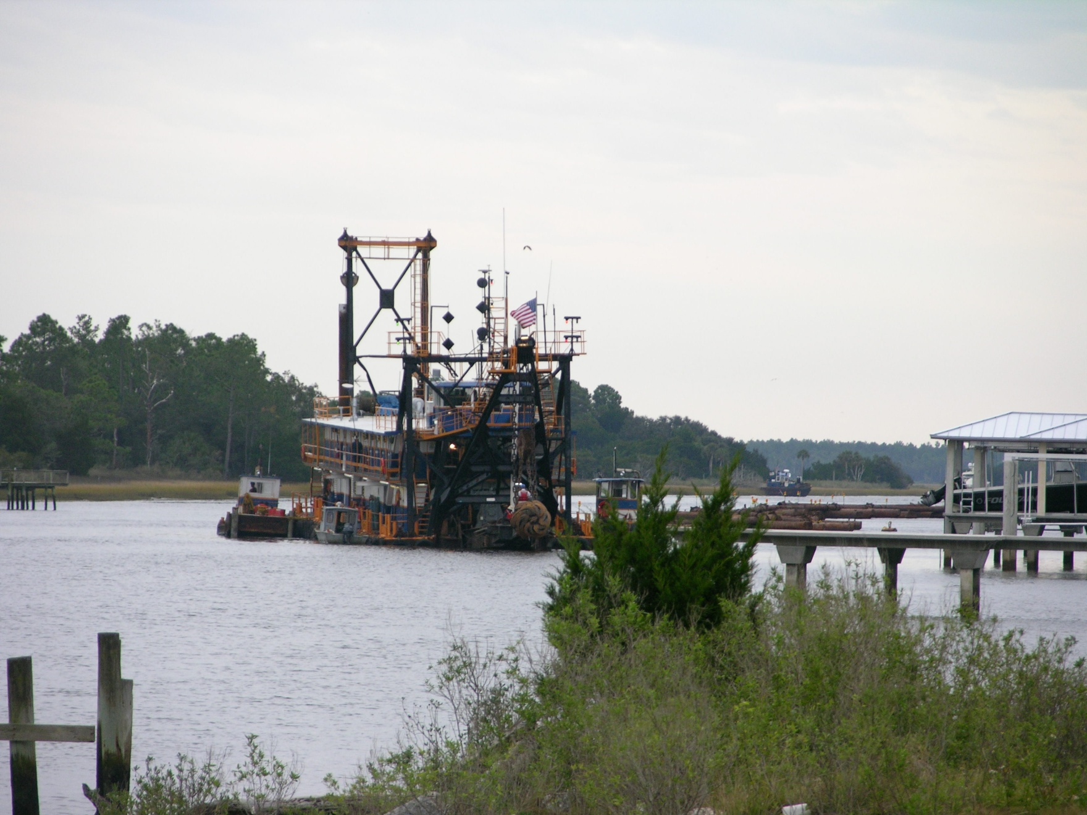
Cutterhead Dredge Palm Valley IWW
Notes:
This is a photo of the dredging recently completed on the IWW near palm valley. It was a 18 inch cutterhead dredge.

Slide 12
24-inch Cutterhead Dredge
Within Bank Disposal
Anchor Booms
Notes:
This is an aerial view of a Typical 24 inch river dredge within bank disposal with no longitudinal dikes.
Note Anchor booms. Talk about types of pipeline, floating on pontoons, or submerged, and the plastic line with low friction.

Slide 13
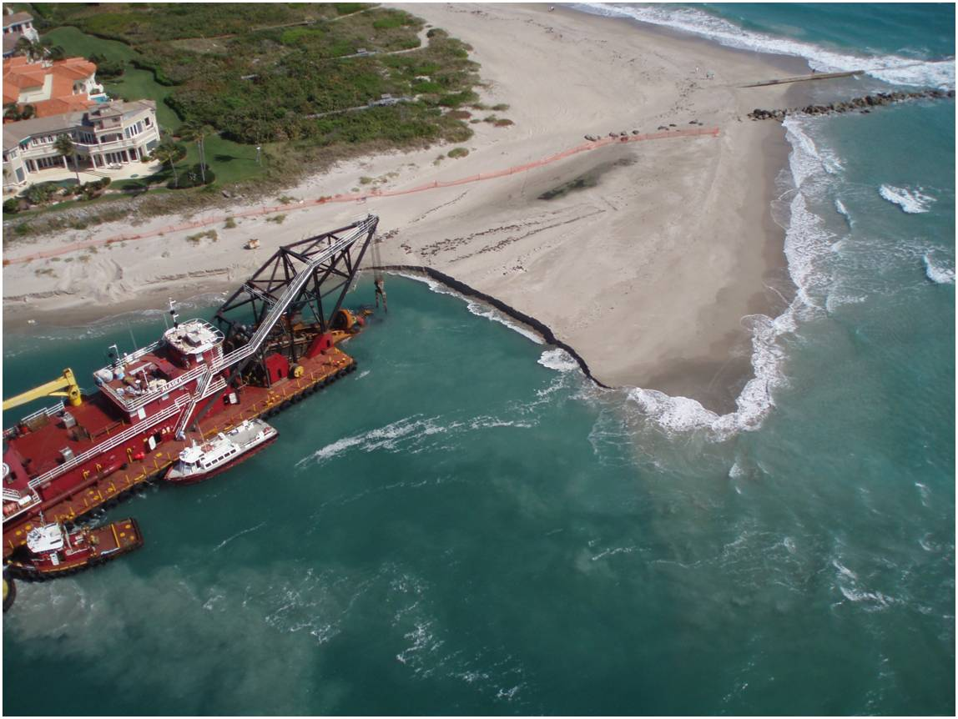
St Lucie Inlet Cutterhead Dredge
Sand shoal within
Channel boundaries
Notes:
This is an aerial view of a Typical 24 inch river dredge within bank near jetties.
Note tugs pushing the dredge in position here.

Slide 14
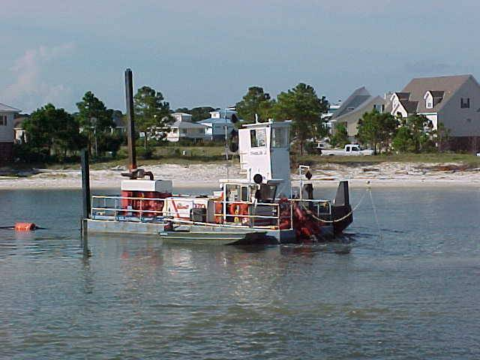
8-inch Cutterhead dredge
Notes:
This view is of a small size cutterhead dredge. The Dredge size is by the inside diameter of the discharge pipe to the disposal area.

Slide 15
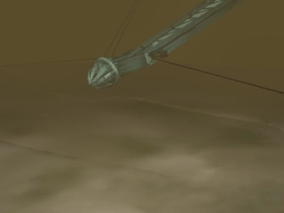
Cutterhead Dredge Animation Side
Notes:
This is an animation of the side view of the cutterhead.

Slide 16

Cutterhead Dredge Animation Front
Notes:
This is an animation of the front view of a cutterhead.

Slide 17
A. cont. Important features of Hydraulic Cutter Suction Dredges
High Production Rates 500 – 5000 cy/hr
Uses Pumps to move material
Can Pump or Haul Long Distances
Digs Soft to Hard Materials
Rivers, Estuaries, Inlets
Best sheltered from high seas,
Uses spuds or anchors to move
Mobility Varies From Limited to Superior
Notes:
Revisit overview of characteristics

Slide 18

B. Hydraulic Hopper Dredges
Hopper Dredge
Drag Arms
Notes:
This is a side view of an Hydraulic Hopper dredge that also pumps material. A typical hopper dredge is a ship with a holding compartment, or hopper. Drag arms lower to the bottom and vacuum up material. Once the hopper is full the ship will sail to a deep water disposal area and dispose of the material. Works cyclic in nature, making 3 to 15 trips per day to a disposal area – hence further the distance, greater the cost. Pumps for 20 minutes, sails approx 10 to 15 miles per hour. Example: if D/A is 20 miles away, then you pump 20 minutes and sail for 4 hours and you can only make approx. 5 loads per day

Slide 19
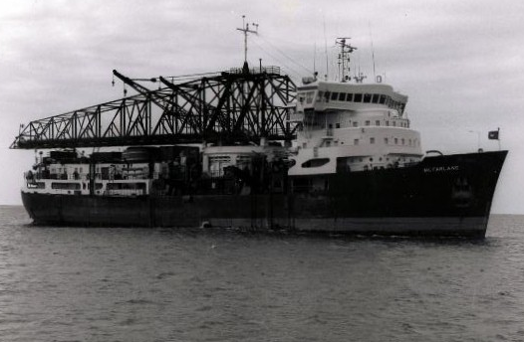
Hopper Dredge Features
Self-Propelled (Highly Mobile)
Works in Unprotected Waters
(Bar, Entrance Channels, Borrow Areas far offshore)
Disposal Limitations are
Deep Water is Best,
Bottom Dump placement usually
Direct Pump Out available to plant.
Notes:
Hopper dredges are ideal for working in rough sea conditions. They are Self-Propelled (Highly Mobile)
Can work in Unprotected Waters (Bar and Entrance Channels). Disposal Limitations Deep Water deeper than 15 foot for Bottom Dump. Direct Pump Out usually in deep water. Disposal is normally into a deep water site.

Slide 20
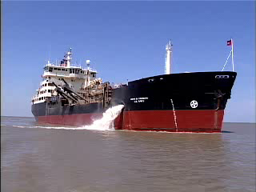
Hopper Dredge with Overflow
Notes:
Hopper dredge showing overflow ports with clean water flowing out.

Slide 21
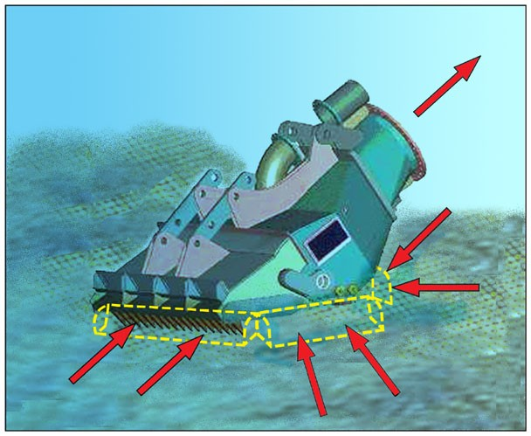
Dragarm SideView
Notes:
Drag arm side view with some indication of flows.

Slide 22
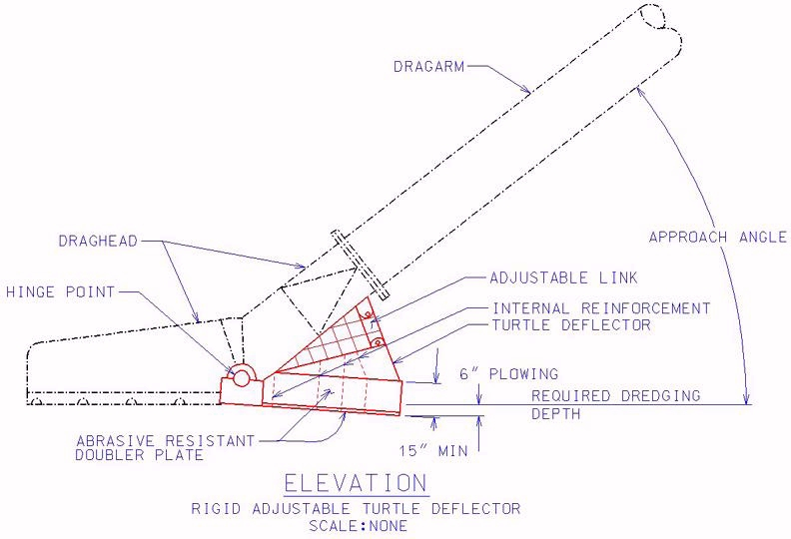
Dragarm Turtle Deflector Cross section
Notes:
Drag arm side view with the “new” turtle deflectors.

Slide 23
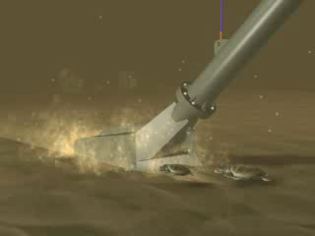
Dragarm Turtle Deflector Animation

Slide 24
B. Important features of Hopper Dredges
Can use in deep water
Material type variable but low detached rock content
Distance to D/A can be 20 to 30 miles.
Overflow until the hopper is full
Limited amount of dredges.
Cheap mobilization costs
Self propelled, doesn’t need tugs.
Load time is usually less than sail time.
Some better in sand/some mud
Direct Pump-out capability on a few
Good on sand in inlets
Good in rough seas
Notes:
Discuss each feature
Water depth – must be deep enough to sail and dump – small, 15 feet, to large 40 feet
Type material – some work better in sand, some better mud dredges – sand may be too heavy for some = hit load limit, others can’t pump sand as well it is too heavy
Distance – most hoppers are ideally suited for inlets – can handle rough seas – inlets usually have short haul requirements' – Also work ok in moderate hauls, like Tampa Bay– 20 –30 miles, - but mechanical becomes more efficient in this range. Hoppers provide incremental improvements to channel conditions.
Overflow –About 15 total contract hoppers in US Usually cheap to mob – as low as 50K – depends on bidding climate Expensive to operate – small, 500K/month, large 2+million /month 20 min load, 10 mph
Pumpout capability

Slide 25
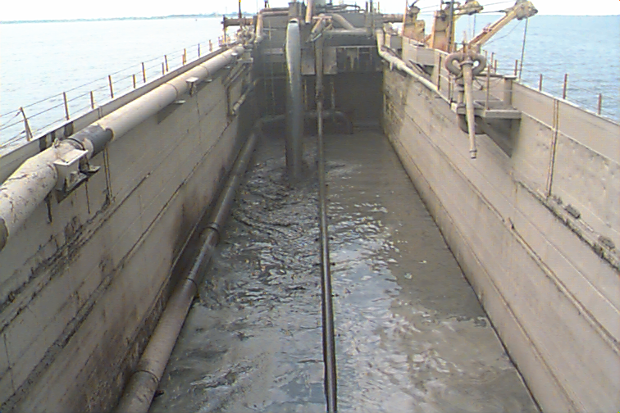
Hopper Empty and Filling
Notes:
A good mud dredge with 1 arm, 4300Kcy, fast, 12 mph, good at Mobile Harbor, poor on sand jobs, pump takes too long to load and too long to discharge. Hopper is filling.

Slide 26
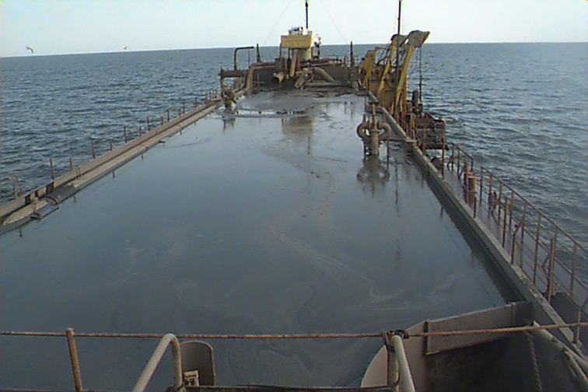
Hopper Full and Heading to Ocean
Notes:
Hopper is now full and heading to the Ocean Dredged Material Disposal Area. Discuss water content wasted effort hauling water. Note the drag arm is raised for the trip to the ODMDS.

Slide 27
Conceptual View of Ocean or nearshore Placement
Notes:
There are various types of hopper dredges. A Split hull - Catamaran type or Bottom doors or valves

Slide 28
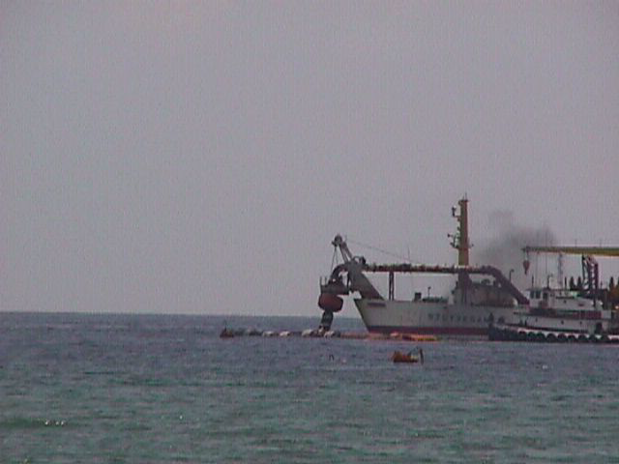
Hopper With Pumpout to Beach
Notes:
This is the Stuyvesant pumping out on Pensacola Beach –8 miles of beach at 100 cy/ft, about 4 million cy and $16 million – very efficient operation approx 2500 feet of line, tug delivers floating line to dredge for connection. Beach jobs are more often performed by large pipeline dredges, however, when conditions are right, hoppers can be competitive. In this case, the borrow location was close, deep water was near shore and the size of the job all contributed to making this an ideal job for a hopper.

Slide 29
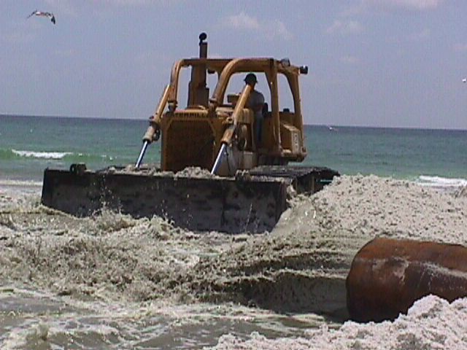
Placement at Beach or DMMA
Notes:
This is a picture of the outfall pipe on the beach. The material is being worked with a tractor to develop the appropriate slopes.

Slide 30
U.S. Fleet Commercial Hopper Dredges
.
Notes:
Here is a list of contract hopper dredges that work in the U. S. Sizes and depths vary

Slide 31
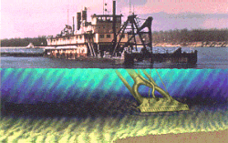
C. Dustpan Conceptual View
Notes:
The third and last kind, the dustpan dredge is slightly less usual but the “Beachbuilder” has been used in Florida before.

Slide 32
C. Important features of Dustpan
Water jets excavate and then suction
Precise bottom elevation
low production,
soft material,
small cut width,
used for small projects or ending clean-up.

Slide 33
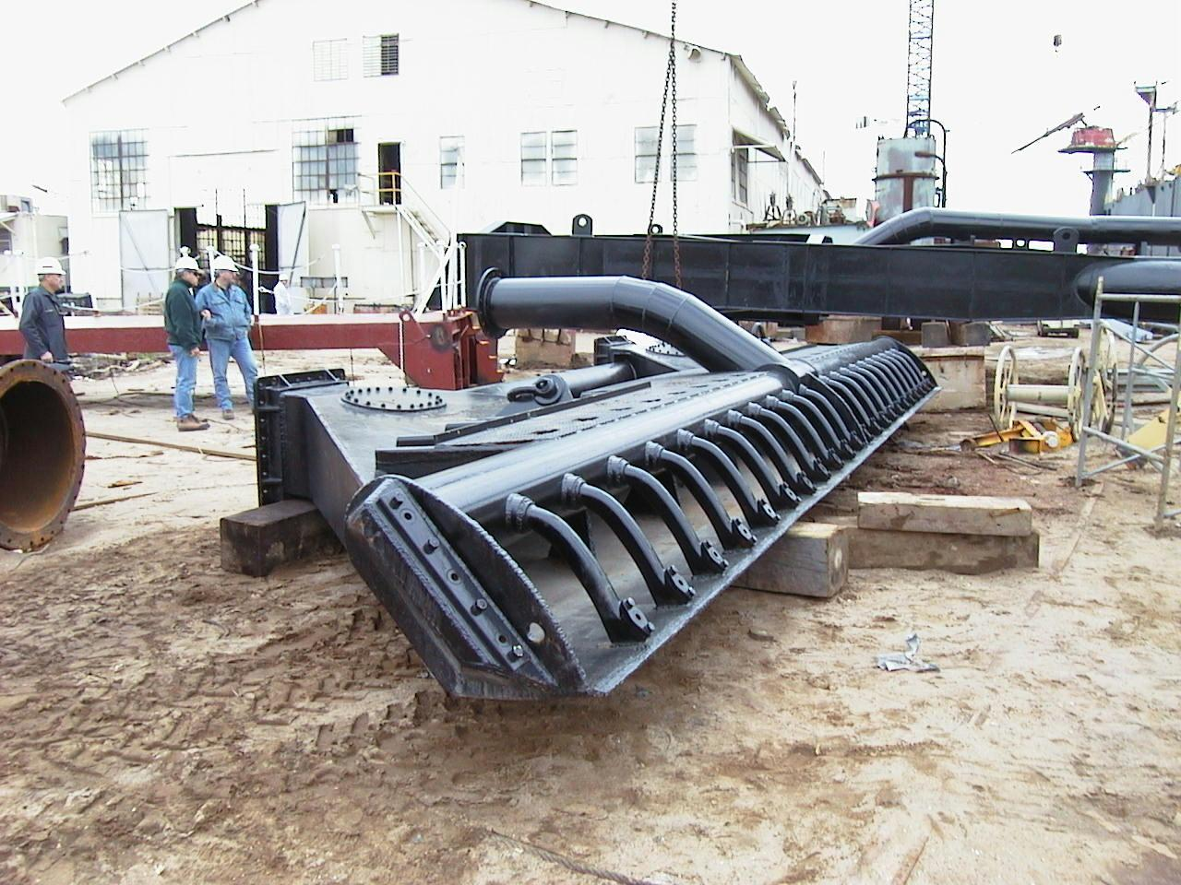
C. Dustpan View
Notes:
This is a picture of the actual dustpan showing nozzels and suction feature

Slide 34
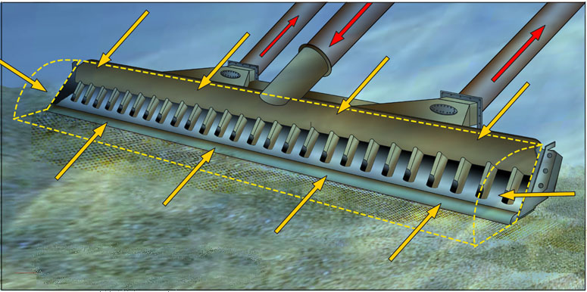
Dustpan Conceptual View
Notes:
This is a concept of the actual dustpan showing nozzles and suction directions

Slide 35

Dustpan Animation
Notes:
This is an animation of the dustpan dredge cutting feature.

Slide 36
2. Important Features of Mechanical Dredges
Long haul capable
Hard or soft material
Various water depths (dump scow dependant)
Can get close to bulkheads or berthing areas
Expensive to mobilize
Slow
Expensive to operate – tugs, fuel, etc.

Slide 37
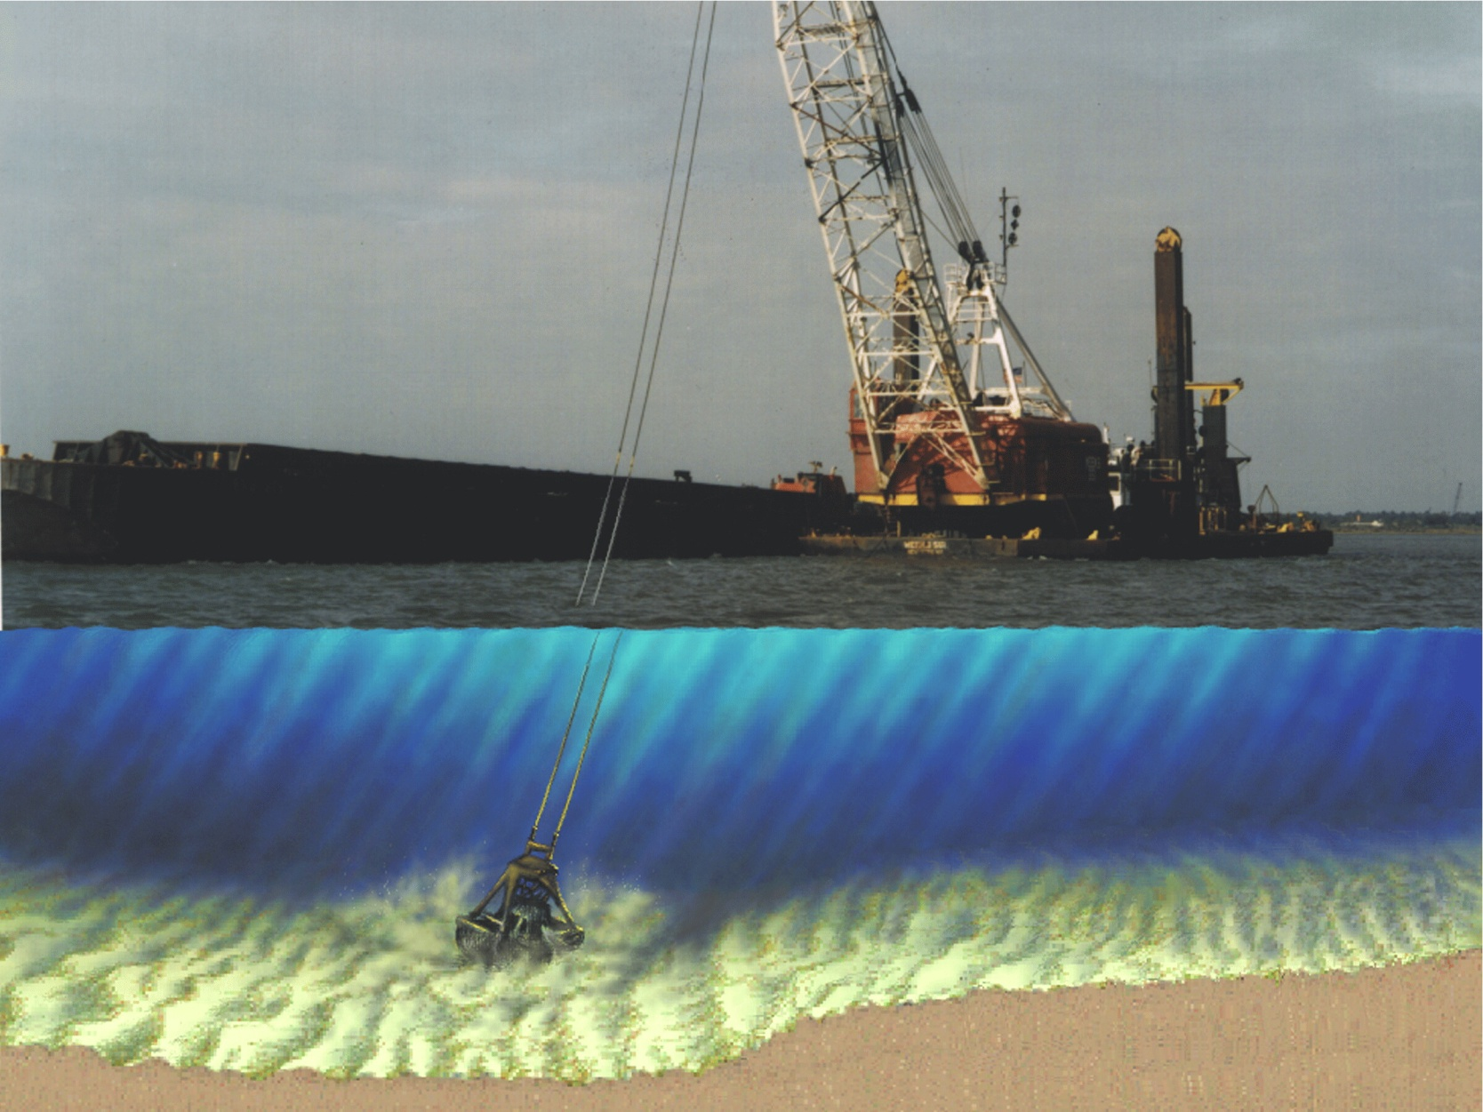
A. Clamshell to Hopper Barge
Clamshell and Hopper Barge
Notes:
A typical clamshell dredge includes a hopper barge along side the dredge. The disposal area may be distant.

Slide 38

Clamshell Animation

Slide 39
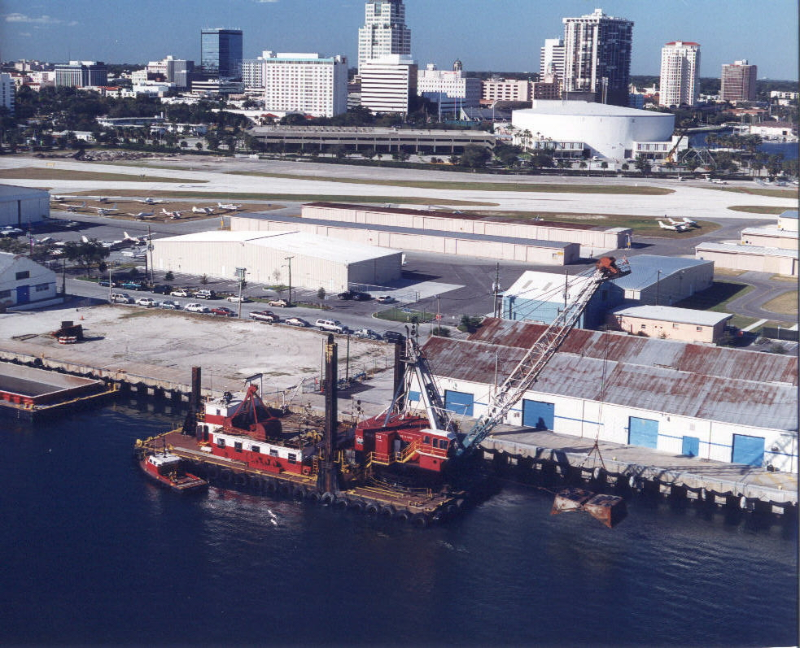
Large Clamshell at St. Pete Harbor

Slide 40
B. Backhoe Dredge to Barge Scow
Backhoe Dredge
Notes:
Here is a typical backhoe type dredge working on an improvement project in a local harbor – Maricavor – 17cy bucket – can dig rock – very fast and efficient.

Slide 41
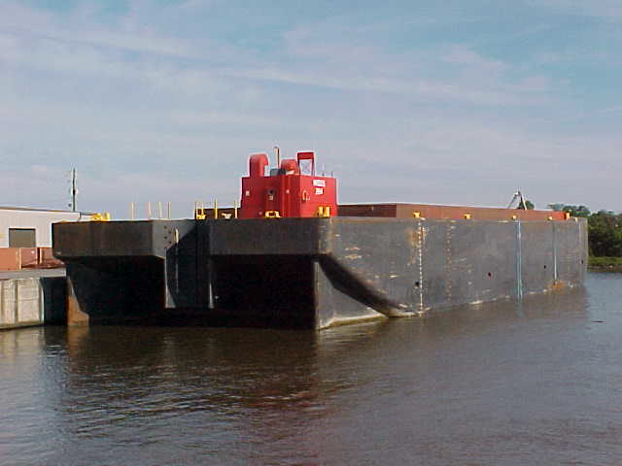
Split Scow Type Barge (up to 6000cy)
Notes:
A typical dump scow – 4-6000 cy range – split hull type

Slide 42
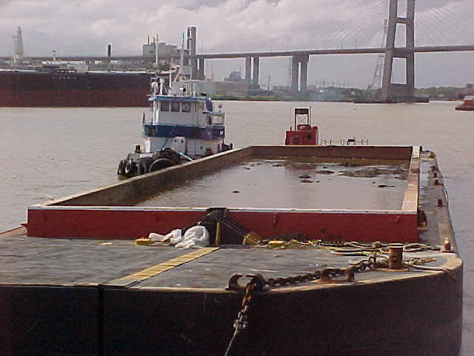
Split Scow Barge Full and Heading to Ocean
Notes:
A split scow barge full and heading to the ocean.

Slide 43
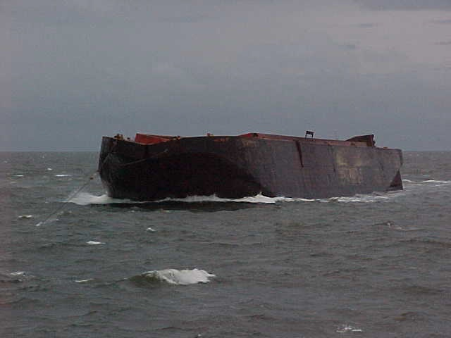
Split Scow Barge Emptying at Ocean
Notes:
Dumping – discuss barge displacement and tracking.

Slide 44
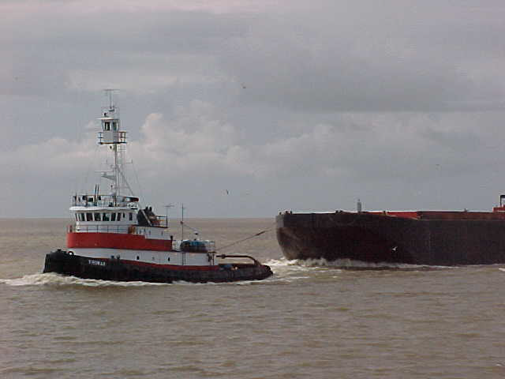
Split Scow Empty and Heading Home

Slide 45
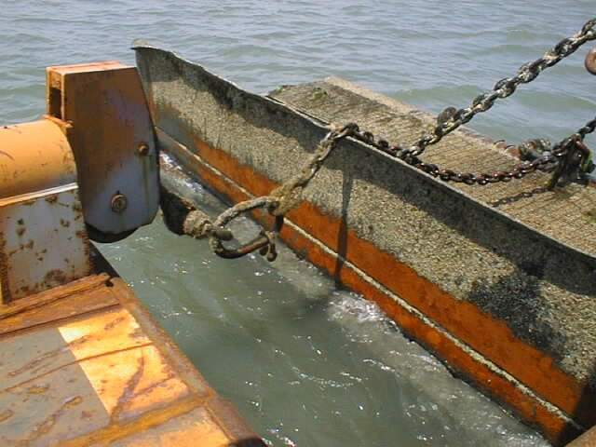
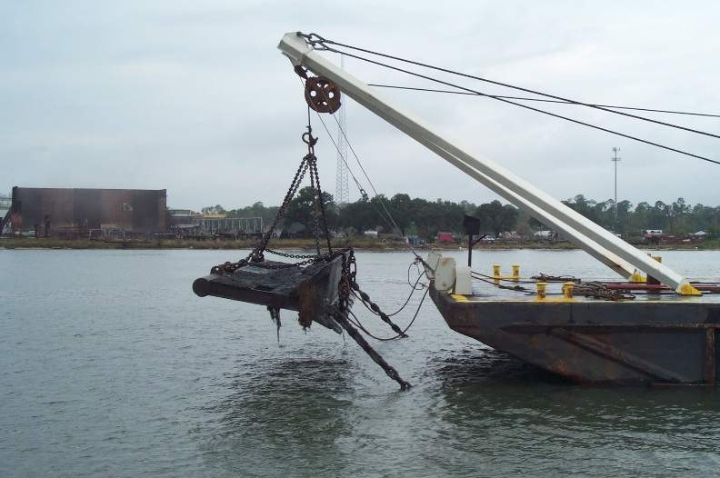
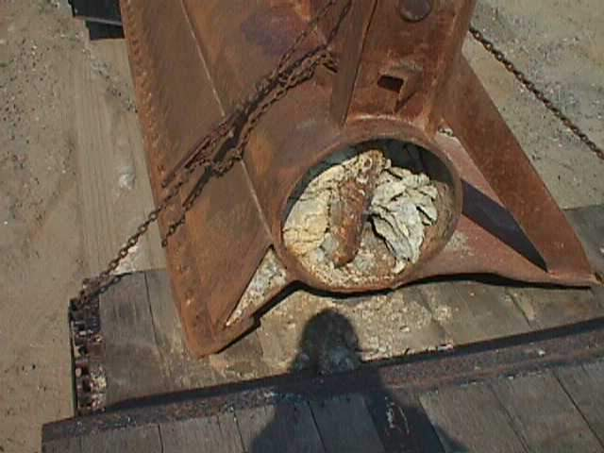
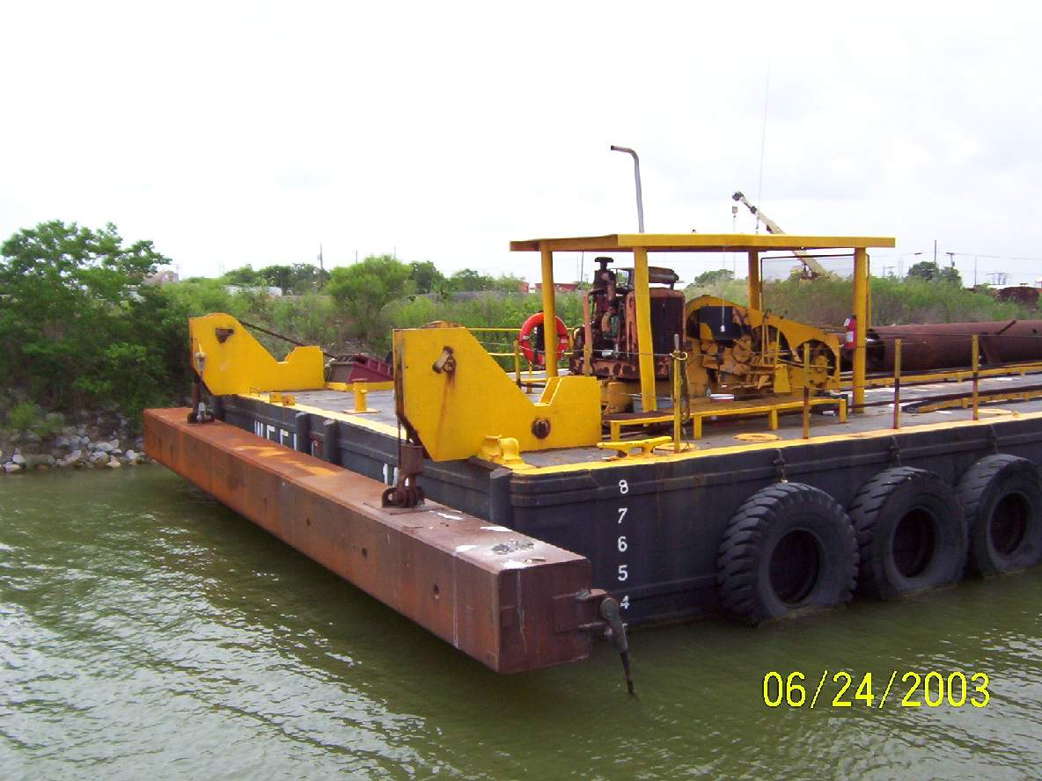
Dragbar Cleanup Operations all methods

Slide 46
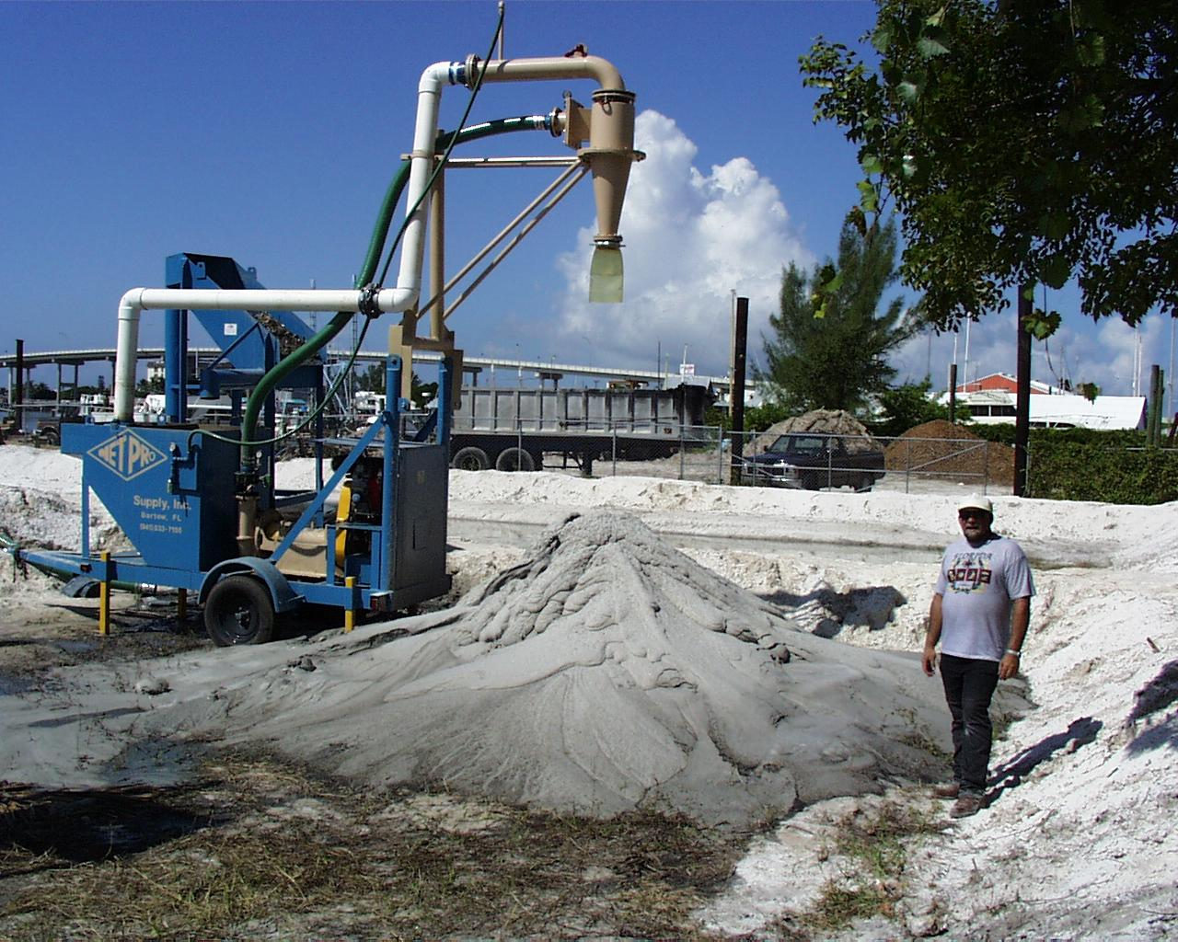
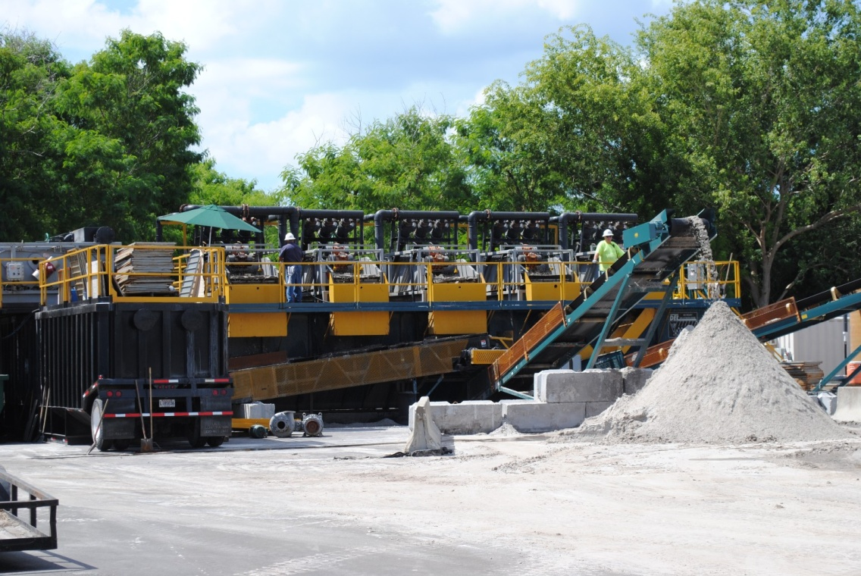
Innovative Stuff, Hydrocyclones
Notes:
Hydrocyclone and Del Tank Separators to get clean quality sand

Slide 47
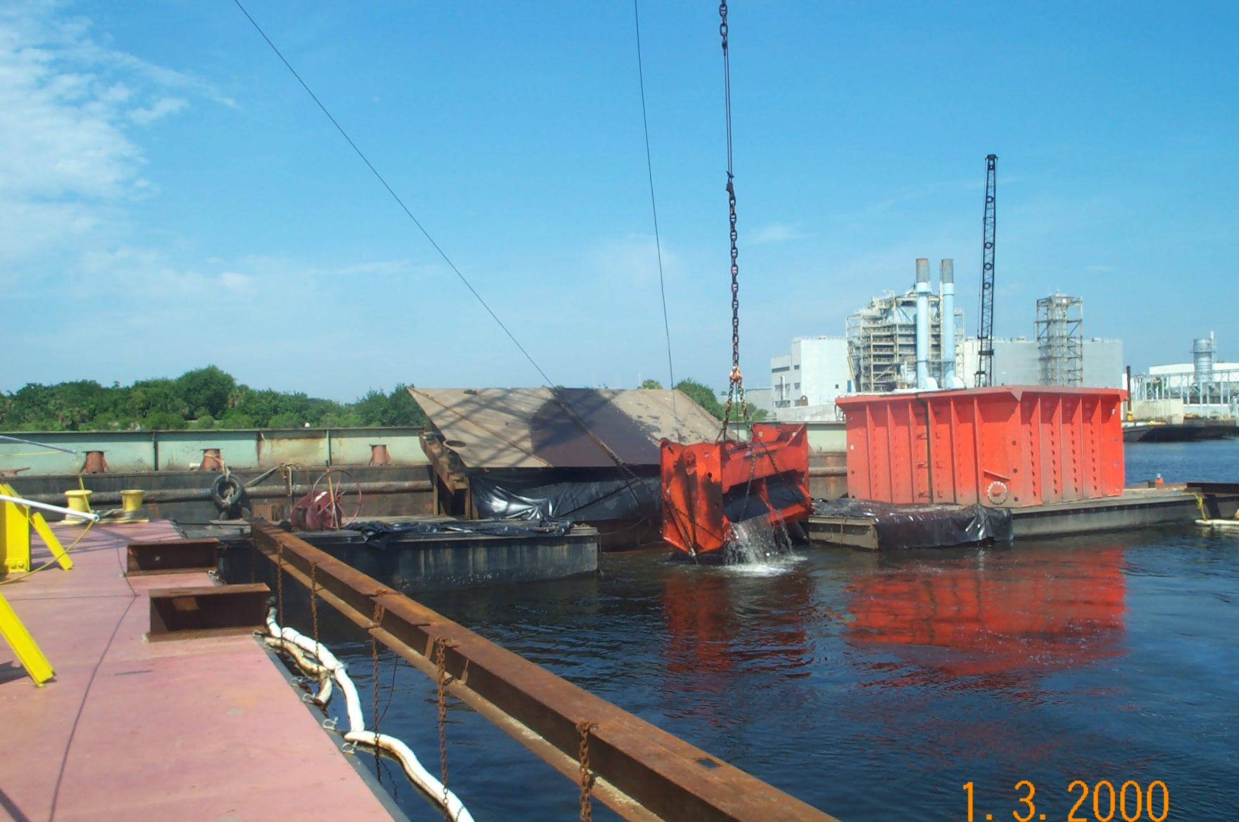
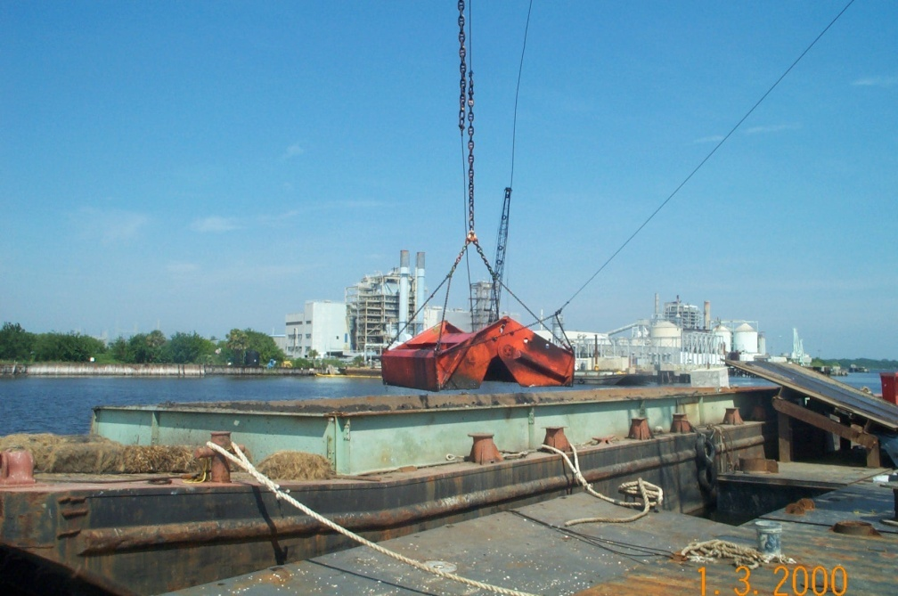
Environmental Closed Bucket Clamshell
Notes:
This is a closed bucket clamshell but used for contaminated material in Jacksonville. It has an extremely low spillage rate and production rate is relatively slow.

Slide 48
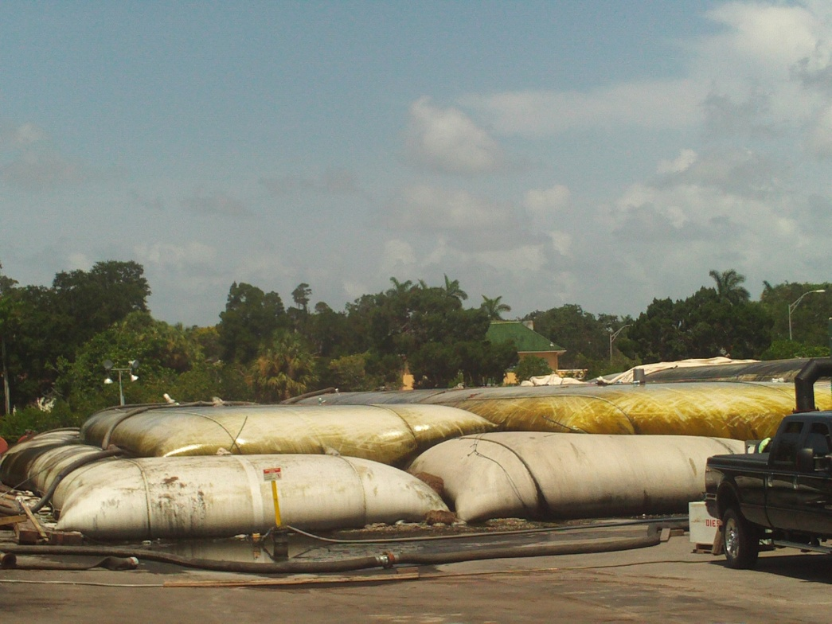
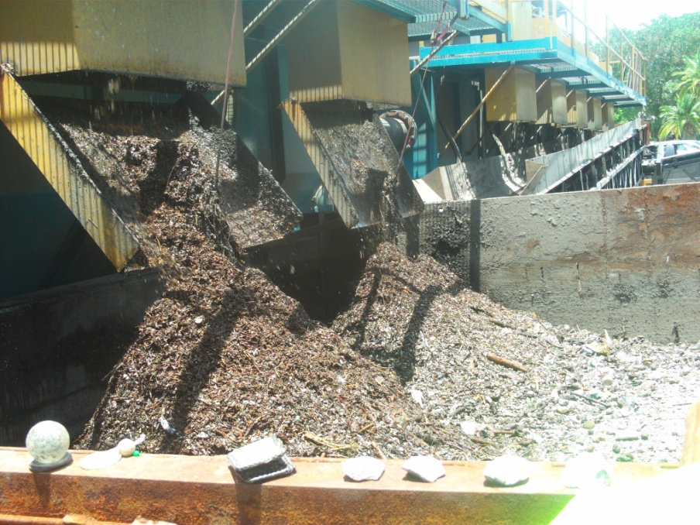
Environmental Geotubes for dredged material Dewatering
Notes:
Further Dredged material segregation and muck dewatering.

Slide 49
Placement or Disposal of Dredged Material
1. Dredged Material Management Areas
  A. Upland– Relatively fixed, bermed. Has inflow site and outflow weirs for decant water (unless restricted).
  B. Wetland Restoration–usually soft or maintenance type organic materials, sand foundation. Plants may be recruited or planted.
Beach Erosion Control Restoration–Areas already designated by feasibility and Federal projects. Borrow areas designated. Material is of superior quality 5 % silt or less.
Beach, Nearshore, Swash Zone Placement Disposal–Areas already designated by feasibility or Federal authorization. Material from maintenance of Federal navigation channels. Sand Material is of good quality 5 to 20 % silt or less.
Notes:
There are various types of hopper dredges. A Split hull - Catamaran type or Bottom doors or valves

Slide 50
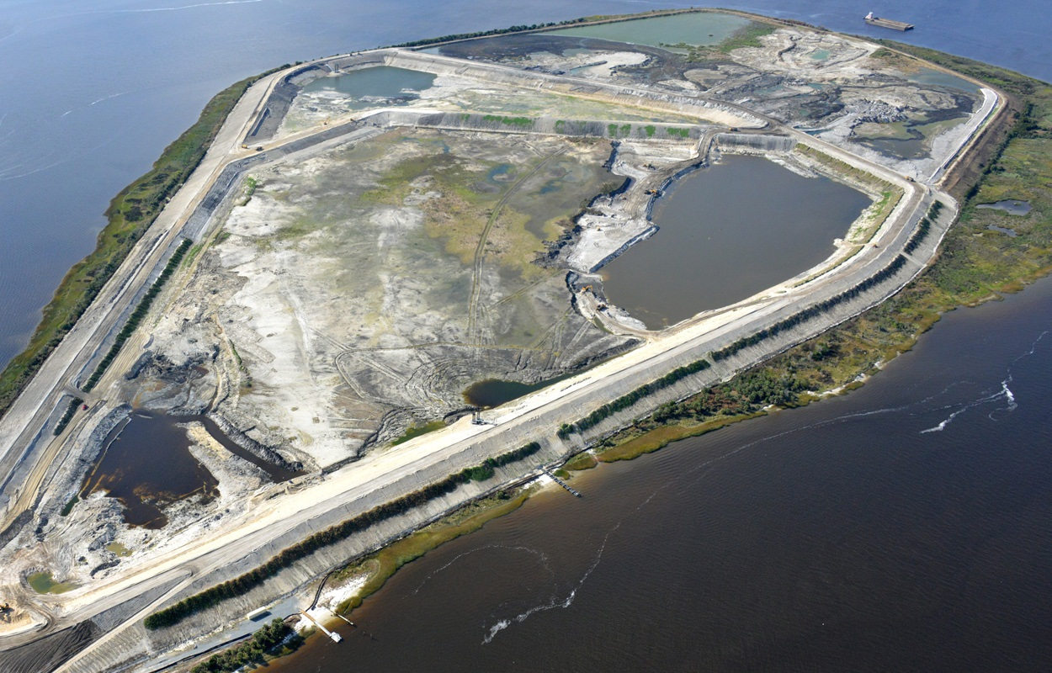
Dredged Material Management Area Placement
Previous inflow locations
Return water discharge weirs and pipe
Notes:
Bartram Island in Jacksonville Harbor. Cells are used for different purposes.

Slide 51
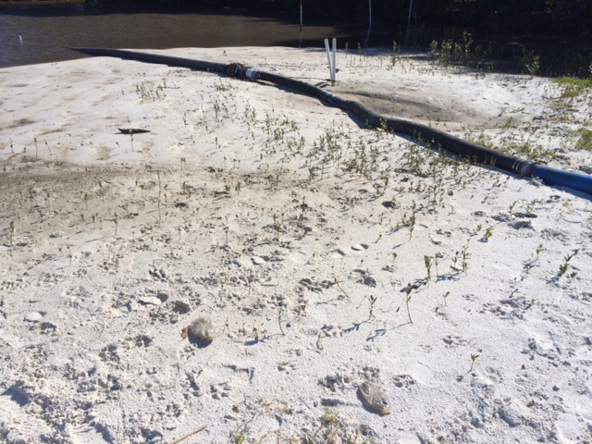
Wetland Restoration Area Placement Stevenson Creek
Sand discharge pipe and gradestake
Mangrove Seedlings
Notes:
Bartram Island in Jacksonville Harbor. Cells are used for different purposes.

Slide 52
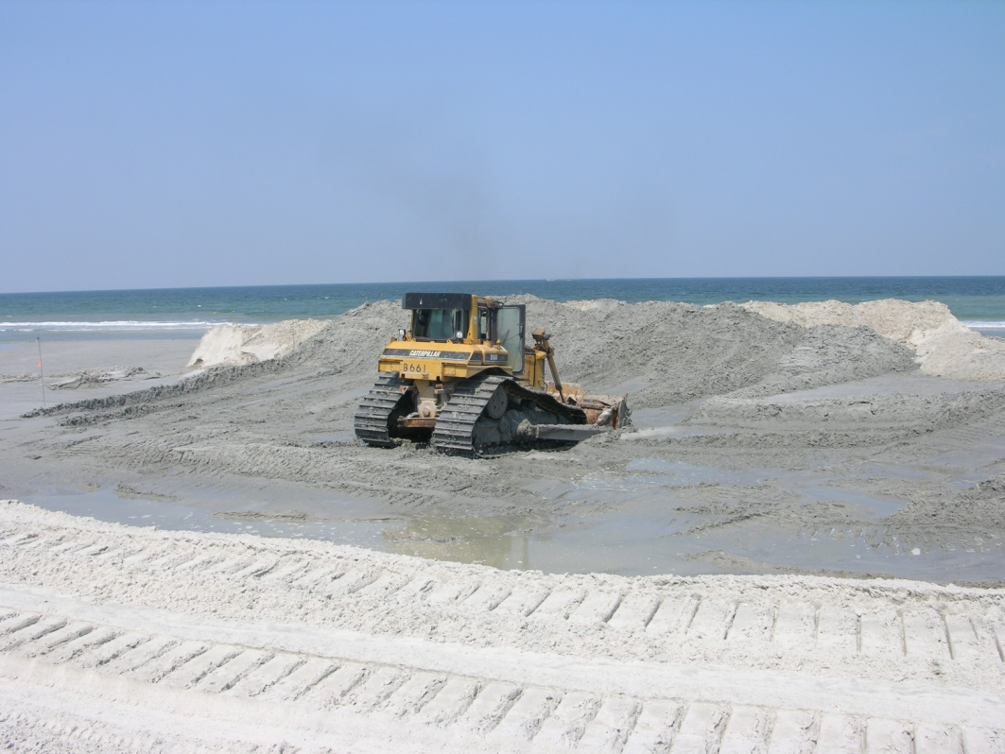
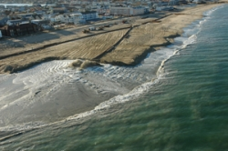
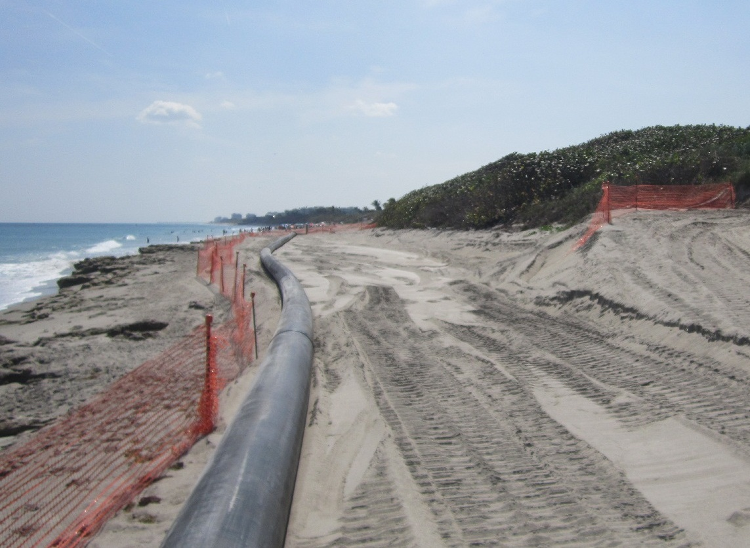
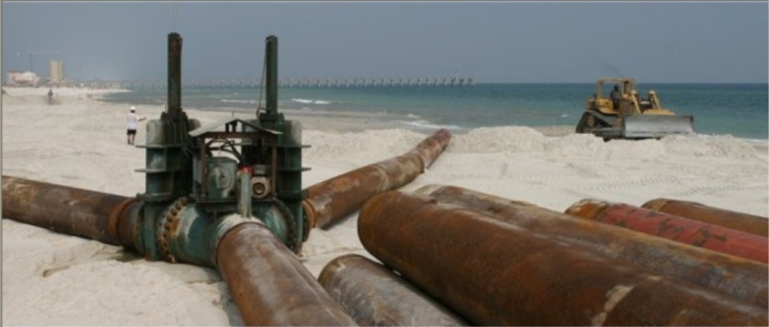
Beach Erosion Control Placement

Slide 53
Conceptual View of Ocean or Nearshore Placement
Notes:
A Split hull placing dredged material in littoral zone adjacent to beach.

Slide 54

Actual View of Nearshore or Swash Zone Placement
Notes:
Small hopper placing in swash zone within beach template.

Slide 55
Dredge Operating Characteristics Summary Slide
1. Hydraulic
  a. Cutterhead – high production, moderate disposal distance, soft to extremely hard material, moderate wave conditions. Relatively fixed plant.
  b. Hopper– moderate production related to haul distance, good in rough seas, usually soft or maintenance type materials. Rapidly moving plant.
  c. Dustpan-low production, soft material, small cut width, used for small projects or ending clean-up.
2. Mechanical. Clamshell, Backhoe– Soft to Hard material, good for new work, close in, and heavy shoaled areas, long haul barge disposal. Relatively fixed plant.

Slide 56

QUESTIONS?

Slide 57
ACOE DREDGING 001
Jim Mc Adams, THANKS
Notes:
We will discuss operating characteristics of the dredge types that typically are working for the Jacksonville District. There are many other types and configurations of dredges, especially when considering small dredges, however, the vast majority of of the Corps work is accomplished by large business contractors with a very limited number of dredges.

