Slide 1
State Programmatic General Permit
(SPGP) V R-1
Part I
Mac James
SLERC Program
13 November 2019

Slide 2
Acronyms
Jacksonville District’s Programmatic Biological Opinion (JAXBO)
State Programmatic General Permit (SPGP)
Project Design Criteria (PDC)
Designated Protected Species (DPS)
Designated Critical Habitat (DCH)
National Marine Fisheries Service (NMFS)
Florida Keys National Marine Sanctuary (FKNMS)
Essential Features / Primary Constituent Elements (PCE) / Physical Biological Features (PBF)

Slide 3
The Documents
Federal: SPGP V R-1
JAXBO
State: Coordination Agreement
Chapter 62-330, Florida
Administrative Code
Notes:
“The documents we use in the Implementation of SPGP include:”
403.813 Self cert Exemptions 62.330.051 Exemptions 63.330.407-635 General Permits
AH 1:3.2 Exemptions 3.2.4 Seawalls 3.2.6 Docks and Piers 3.4(?)

Slide 4
What is SPGP V-R1?
State Programmatic General Permit
  1st revision of the 5th generation
Changes made to comply with the Jacksonville District Programmatic Biological Opinion (JAXBO)
Allows the Department to provide federal authorization for projects that comply with qualifying criteria
Requires applicants apply to the U.S. Army Corps of Engineers (USACE) for review of projects that do not meet criteria
https://www.saj.usace.army.mil/SPGP/
Notes:
Authority and purpose

Slide 5
SPGP V-R1
Procedure
A: Work Authorized
B: Red and Green for all Projects
C: R/G Shoreline Stabilization
D: R/G Boat Ramps
E: R/G Piling supported structures
F: R/G Derelict Vessels
G: R/G Scientific Devices
Attachments
  DCH
  PDC
  Activity Checklists

Slide 6
JAXBO 101
“..insure that any action authorized, funded, or carried out …is not likely to jeopardize the continued existence of any endangered species or threatened species or result in the destruction or adverse modification of habitat of such species.” Section 7(a)(2), Endangered Species Act
Biological opinion produced by the National Oceanic and Atmospheric Administration’s (NOAA) National Marine Fisheries Service (NMFS), 11/20/17
Tool to address consultation requirements under Section 7 of the Endangered Species Act (ESA)
Evaluates effects of 10 categories of “in-water” activities on Threatened and Endangered (T&E) species
Provides concurrence if project meets Project Design Criteria (PDCs)
http://cdm16021.contentdm.oclc.org/utils/getfile/collection/p16021coll3/id/577
Notes:
“The Authority for the JAXBO comes from section 7 of the ESA”

Slide 7
JAXBO
Components
1. Consultation History
2. Activities that Effect Species
and their Critical Habitats
3. Status of Listed Species and
Critical Habitats likely to be
Adversely Affected
4. Environmental Baseline
5. Effects of the Action
6. Cumulative Effects
7. Jeopardy Analysis
8. Destruction and Adverse
Modification Analysis
9. Conclusion
Activities
1. Shoreline stabilization
2. Pile Supported Structures
3. Minor Muck Dredging
4. Water Management Outfall
Structures
5. Scientific Survey Devices
6. Boat Ramps
7. Aquatic Habitat Enhancement
8. Transmission/Utility Lines
9. Marine Debris Removal
10. Temporary Platforms, Fill and
Cofferdams

Slide 8
Reference Location
Activity | SPGP | JAXBO
Shoreline Stabilization | C | A1
Boat Ramps | D | A6
Piling Supported Structures | E | A2
Derelict Vessels | F | A9
Scientific Devices | G | A5
Notes:
In the Jaxbo they are identified by activity numbers (activity 1, activity 2, etc).
Within the SPGP instrument the activities are identified by SECTION.

Slide 9
Self-Certifications
SPGP V R-1: Procedure 4

Slide 10
Self-Certifications
Construction Repair & Replace
Construction of new single-family docks or boatlifts at a single-family residential lot
Repair and replacement with no changes to previous configuration
Modification of an existing single-family dock and/or adding a boatlift
Maximum two slips (new and existing)
Maximum size of 1,000 sq ft or
  Maximum size of 500 sq ft in an aquatic preserve or Outstanding Florida Water (OFW)
Self-cert docks and boat lifts must comply with size and other construction guidelines if aquatic vegetation is present
A pile supported structure on a natural waterbody within range of seagrass or if aquatic vegetation is present must comply with the construction guidelines

Slide 11
Single-Family Docks and Boat Lifts
Projects cannot be:
On an unbridged, undeveloped coastal island or undeveloped coastal island segment or undeveloped coastal barrier island
On sandy beaches fronting the Gulf of Mexico or Atlantic coast shoreline, exclusive of bays, inlets, rivers, bayous, creeks, passes, and the like
Within 50 ft of the MHWL at any riparian coastal location fronting the Gulf of Mexico or Atlantic Coast shoreline
Located in the coastal counties of Wakulla, Taylor, Dixie, Levy, Pasco, and Monroe
Located in Biscayne Bay Aquatic Preserve
Located in the range of Johnson’s seagrass
Notes:
***Most removed by application/program…wont’ allow self-certs in the protected areas

Slide 12
Single-Family Docks and Boat Lifts, 2
Projects cannot be:
In Federal Special Waters (Biscayne Bay National Park, Blackwater Creek, Faka Union Canal, Garfield Point, Loxahatchee River Okeechobee Waterway, Rock Springs Run, St. Marys River, Tampa Bypass Canal, Timucuan Preserve, Wekiva River)
Located in the restriction or exclusion zones of: smalltooth sawfish, Gulf sturgeon, Atlantic sturgeon, and North Atlantic right whales
Located in an area with non-ESA listed seagrasses and will result in any impacts or shading to these seagrasses, except for projects that comply with B.2.d./Special Condition paragraph 8.h.
Notes:
***Most removed by application/program…wont’ allow self-certs in the protected areas

Slide 13
Procedure
Application
PDC Checklist for USACE JaxBO Summary Checklist
One or more Individual Activity Sheets
Review for Red or Green Determination
Red: Project not authorized for SPGP V-R1; must apply to USACE
Green: Project authorized for SPGP V-R1; processed by Department
Commencement Notification
Self-certification Statement of Compliance
Notes:
Applicants that don’t use the self-certification process will follow this procedure to receive SPGP authorization:
***BE SURE APPLICANTS ARE USING the CURRENT version of the forms revised November 24, 2018 and not the PRIOR versions
Commencement Notification provided to the Corps within 10 days of initiating work
Self-certification of Compliance within 60 days of completing work.
Address in Special Condition 11

Slide 14
Application
SPGP V-R1 Works Authorized A.
  Request for Verification of Exemption
  (Section 62-330.050, F.A.C.)
  Notice of Intent to Use an Environmental Resource General Permit
  (Section 62-330.402, F.A.C.)
  Application for Individual and Conceptual Approval Environmental Resource Permit and Authorization to Use State-Owned Submerged Lands
  (Section 62-330.060, F.A.C.)
Notes:
Although exemptions do not require Verification, they projects will need verification for SPGP authorization.
Permitting fee for the Exemption allows the Agency to process and review the SPGP determination.

Slide 15
PDC Checklist
Used to determine if activity meets JAXBO PDCs
  If the information meets PDCs, the proposed activity is “green”
  Activity must meet general and special conditions of the SPGP V-R1 instrument
  Activity must meet the exemption or general permit conditions in
  Rule 62-330, F.A.C.
Annotated checklists provide references
  Example: AP 6 references PDCs for All Projects number 6 in JAXBO
  Example: A2.17 references PDC for Activity 2 number 17 in JAXBO
  Example: B.1.m references a red condition for all activities in SPGP
  Example: D.2 references a green condition for boat ramp activities in SPGP
  Example: E.2.c. references a specific requirement for a green piling supported structure activity in SPGP
Notes:
Because SPGP only authorizes specific exemptions and gps; if the activity does not meet the exemption or general permit conditions in 62-330 it is not a work authorized by SPGP.

Slide 16
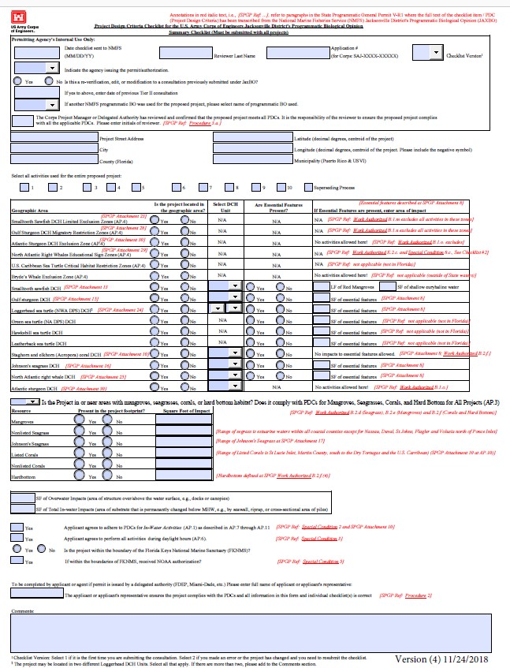
Summary Checklist
Project Information
  JAXBO Activity Number
Listed Species and DCHs
Vegetative Resources
Impacts and Certifications

Slide 17
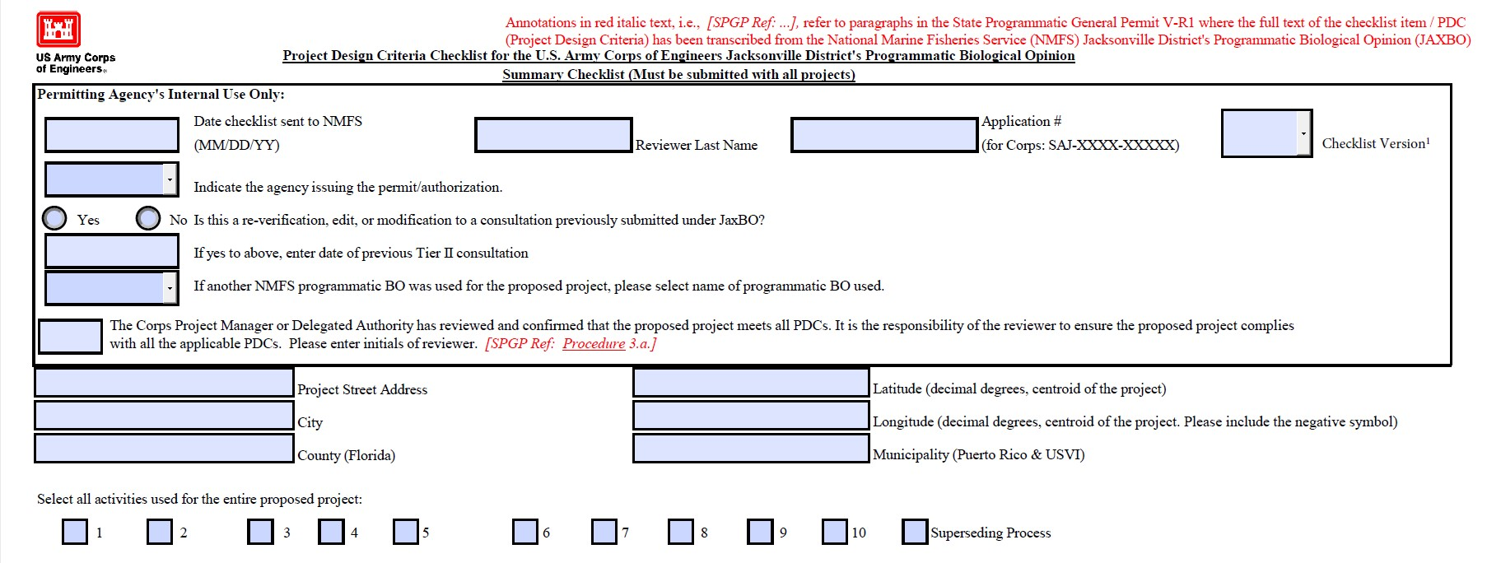
Summary Checklist, 2
JAXBO ACTIVITIES:
1. Shoreline Stabilization 6. Boat Ramps
2. Piling-supported Structures 7. Aquatic Habitat Enhancement
5. Scientific Survey Devices 9. Marine Debris Removal
Notes:
Permitters should double check coordinates to ensure they are correct for the project location; this could affect a determination of whether or not a project is located within the DCH of a DPS

Slide 18
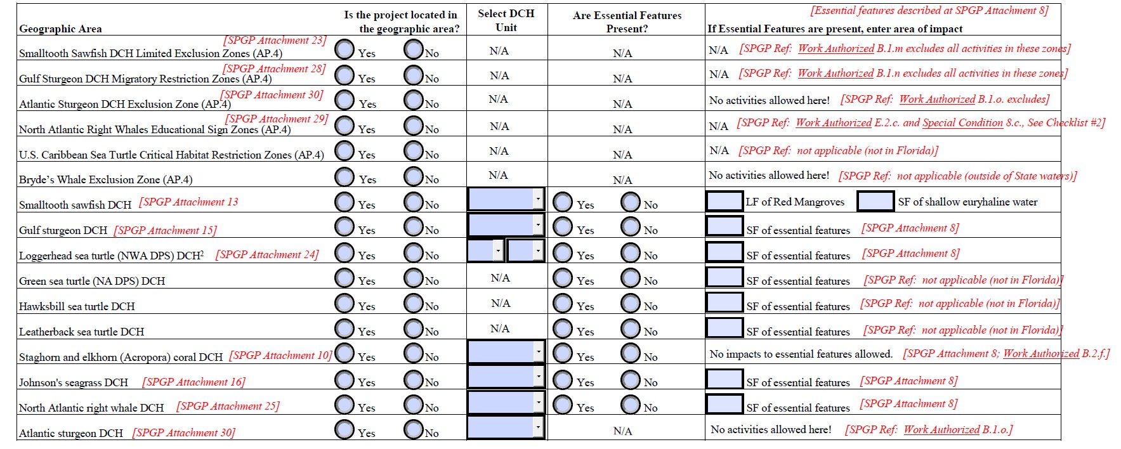
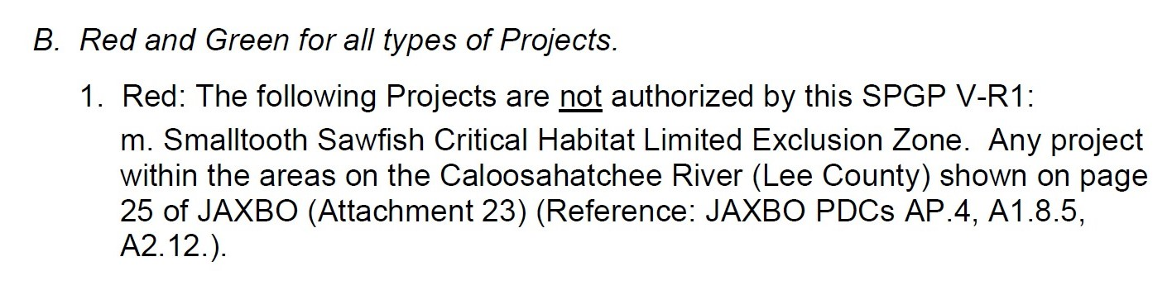
Summary Checklist, 3
Example: B.1.m references a RED condition for all activities in SPGP

Slide 19
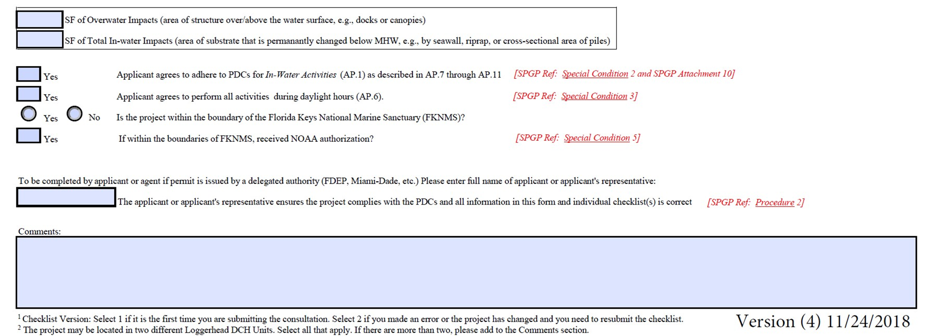
Summary Checklist, 4
  Example: AP 6 references PDCs for All Projects number 6 in JAXBO

Slide 20
Designated Critical Habitats (DCHs)
SPGP V R-1
  Attachments (8,10-21,24-30)
MapDirect
  Map Direct Gallery: Choose Map: State Programmatic General Permit (SPGP) Map
  ArcGIS Shapefile (*.shp)
  Google Maps (*.kml)
  Https://ca.dep.state.fl.us/mapdirect/

Slide 21
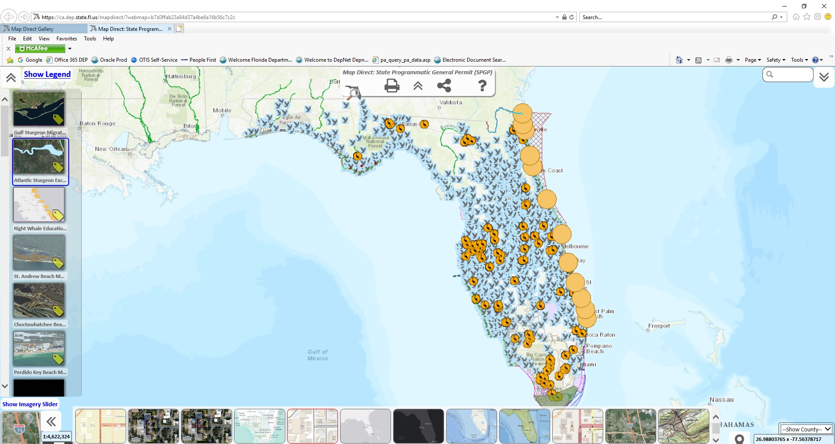
MapDirect SPGP

Slide 22
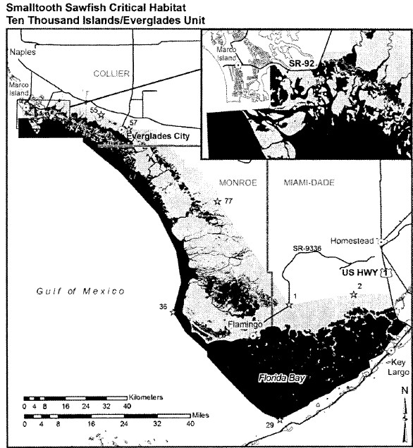
DCH SPGP
Notes:
May need to refer to the attachment for the designated unit of a DCH

Slide 23
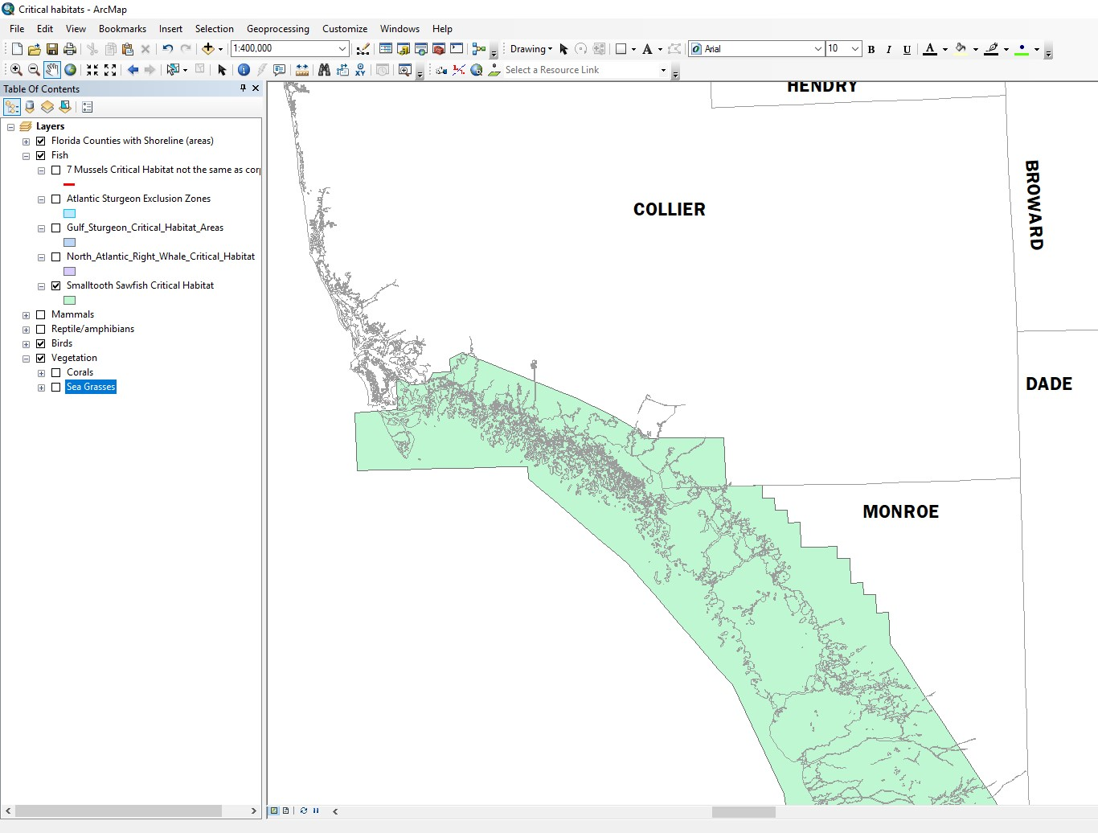
DCH ArcGIS

Slide 24
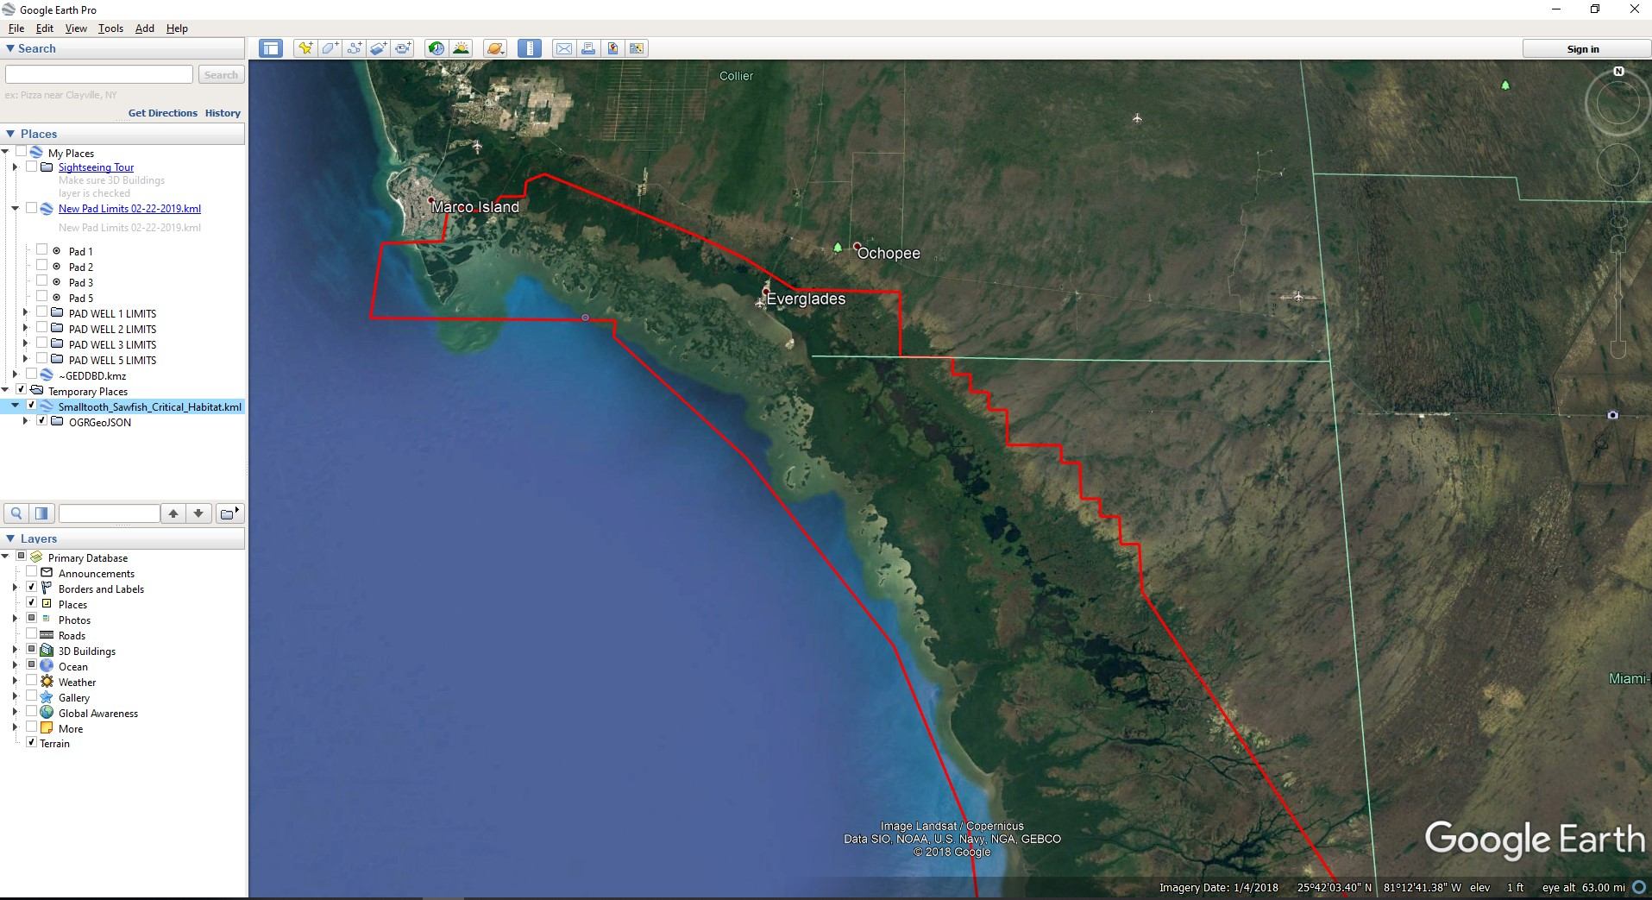
DCH Google Earth

Slide 25
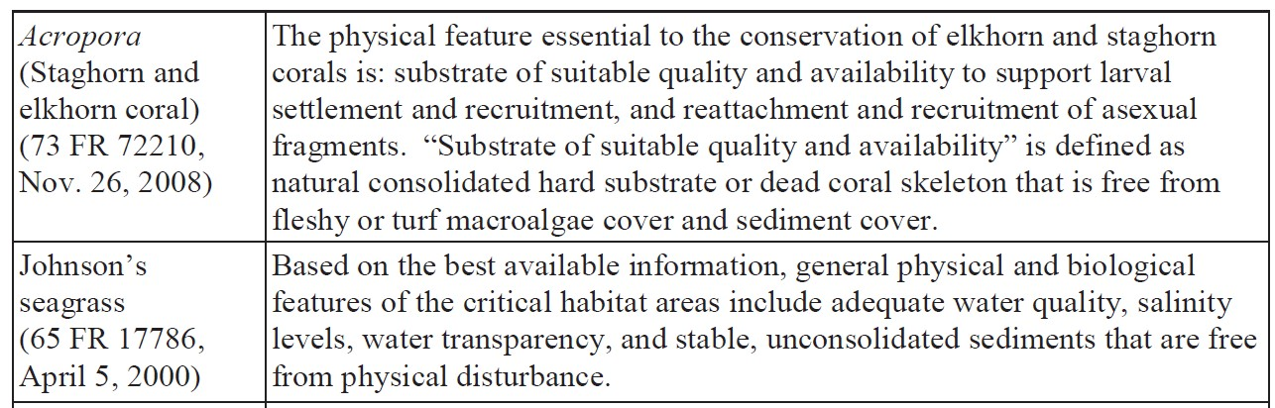
Essential Features
SPGP V R-1
  Attachment 9
Helps identify habitat essential to the conservation of the species

Slide 26
Review For Red/Green

Slide 27
All Activities
Red (B.1.) Projects NOT authorized
JAXBO Checklist not submitted, incomplete or inaccurate
Authorized under agency enforcement or compliance action
Authorized under agency emergency permitting
Projects in federal rights-of-way, navigation channels
Projects within specific geographic boundaries
Projects that “may affect” manatees
Projects in specific habitats of beach mice
Projects on or contiguous to beaches
Projects within 2,500 ft of a wood stork nesting colony
Projects that adversely impact any federally listed T/E species or its habitat

Slide 28
All Activities, 2
Red (B.1.) Projects NOT authorized
Projects that will adversely impact specific essential fish habitats
Parcel is substantially submerged and largely covered by seagrass
Smalltooth sawfish Critical Habitat Limited Exclusion Zone
Gulf sturgeon Critical Habitat Migratory Restriction Zone
Atlantic sturgeon Critical Habitat Exclusion Zone
Installation of metal pipe by impact hammer/or any by impact hammer >5/day
Projects requiring prior approval from NOAA’s Florida Keys National Marine Sanctuary
Projects within shipping safety fairways and anchorage areas
Projects authorized by agency “after the fact”
Projects wherein structures extend more than 25% of canal/channel width
Notes:
Red does not mean the Permittee can’t have the project, ONLY that the STATE AGENCY can not authorize the project, the Permittee will need to apply to the CORPS to review the project.

Slide 29
All Activities, 3
Green (B.2.) Projects must:
Not be “Red”
Have no effect on manatee
Use approved construction methods and materials
Protect seagrass and other aquatic vegetation
Limit impacts to mangroves
Not affect corals or hard bottom habitat
Meet activity specific Red and Green requirements

Slide 30
Activities

Slide 31
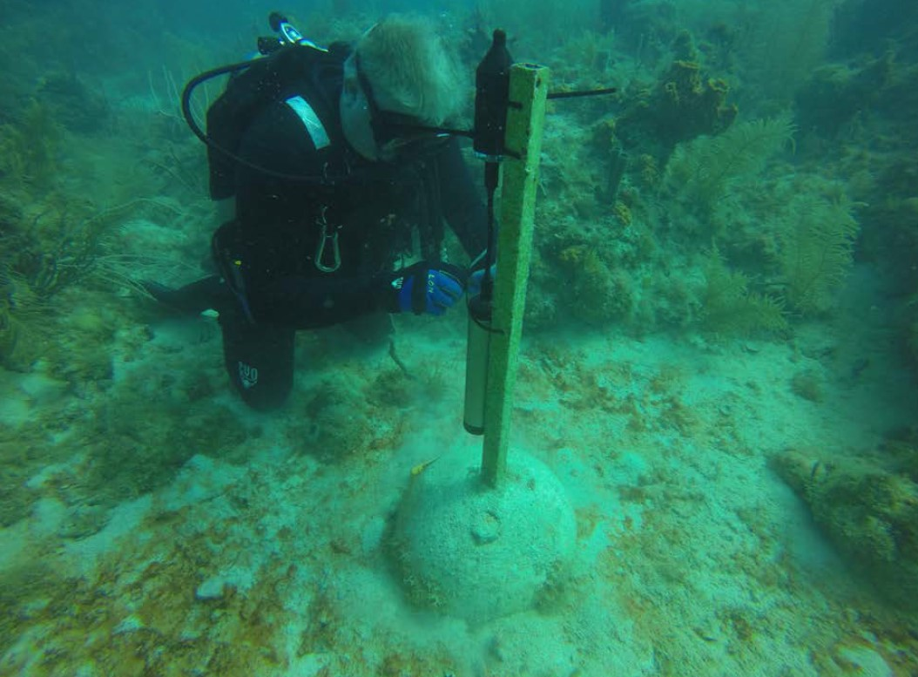
Scientific Devices
JAXBO A5 / SPGP G
Work Authorized A.5.: Construction Operation, Maintenance and Removal of Scientific Sampling, Measurement and Monitoring Devices (Section 62-330.051(11)(b), F.A.C.)
Request for
Verification
of Exemption
PDC for the JAXBO
Summary
PDC for the ACOE
JAXBO Activity 5:
Scientific Survey
Notes:
IF scientific device is on a pile supported structure then would also need checklist for piling..

Slide 32
Scientific Devices
RED (G.1.) Projects NOT authorized:
Projects other than installation, repair and removal of scientific survey devices for up to 24 months
Projects located in critical habitat where essential physical and biological features are present for: Acropora spp.; American crocodile; piping plover; or North Atlantic right whale
Projects located within the Florida panther focus area

Slide 33
Scientific Devices, 2
Green (G.2.) Project design limits:
Device shall not block access of species to an area
Device must be removed and site restored no later than 24 months after installation or upon completion of data acquisition
Device shall be inspected and maintained at least twice/year and following storm events

Slide 34
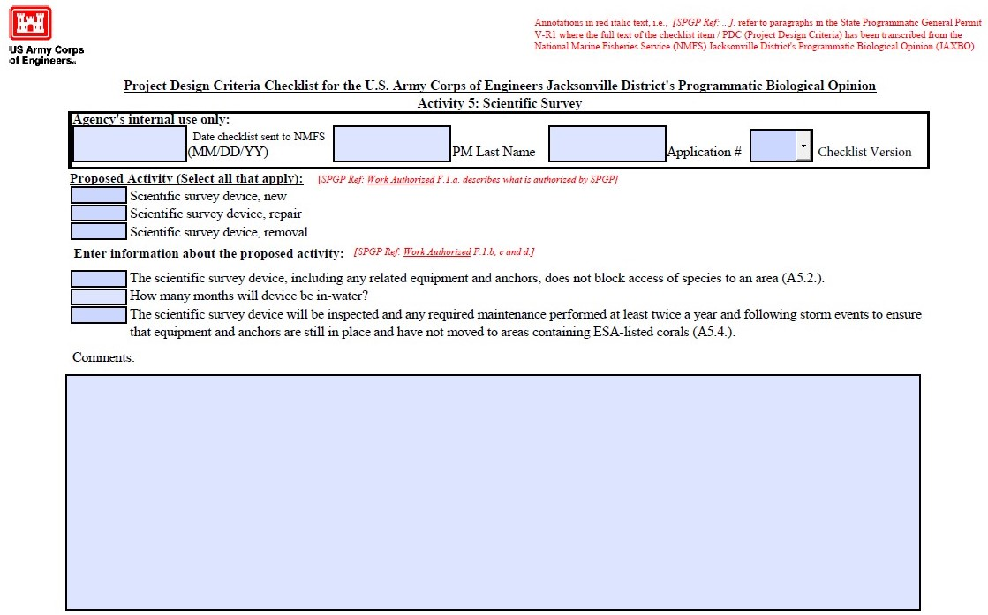
Scientific Devices, 3
20
36

Slide 35
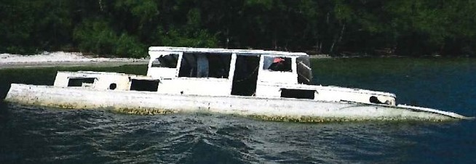
Derelict Vessels
JAXBO A9/SPGP V R-1 F
Work Authorized A.4.: Removal of Derelict Vessels
(Section 62-330.051(5)(g), F.A.C)
Request for Verification of Exemption
PDC for the ACOE JAXBO Summary Checklist
PDC for the ACOE JAXBO Activity 9: Marine Debris Removal

Slide 36
Derelict Vessels, 2
Red (F.1.) Projects not authorized:
Vessels do not pose a threat to human health and safety or aquatic natural resources
Projects located in DCH where the PBFs are present for: Acropora spp.; American crocodile; piping plover; or North Atlantic right whale
Projects located in the Florida panther focus area

Slide 37
Derelict Vessels, 3
Green (F.2.) Project design limits:
Visual confirmation to ensure the item can be removed without causing further damage to aquatic natural resources
If it can not be removed without harming coral, it will be disassembled
Monofilament debris will be carefully cut loose from coral, under no circumstance will line be pulled through the coral
Marine debris shall be lifted straight up, not dragged; trawling cannot be used; proper disposal of debris
An absorbent blanket or boom will be used if fuel, oil or other pollutants are observed during work

Slide 38
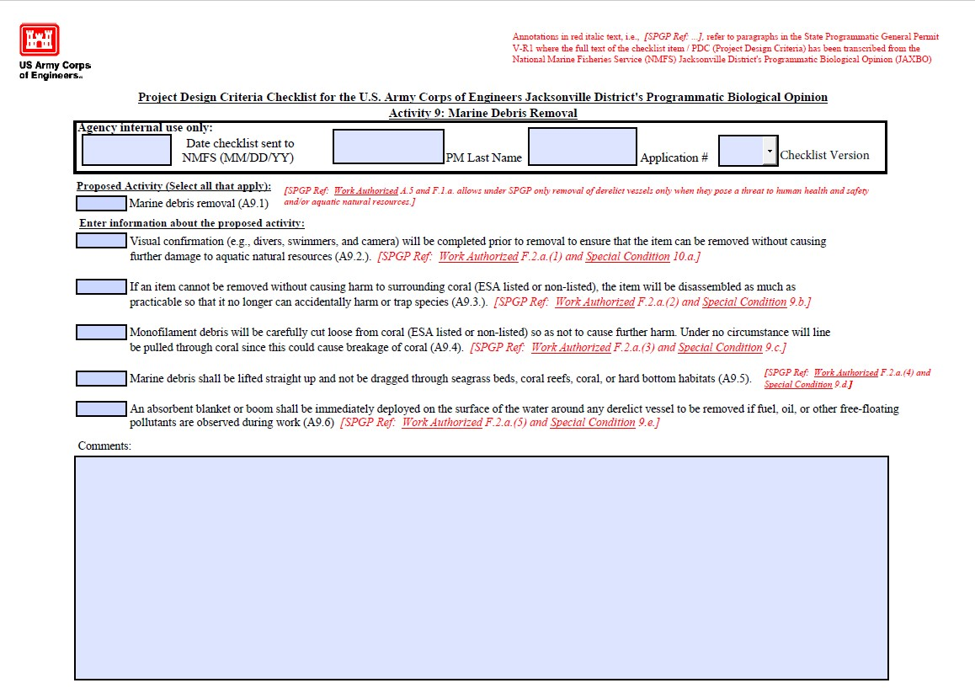
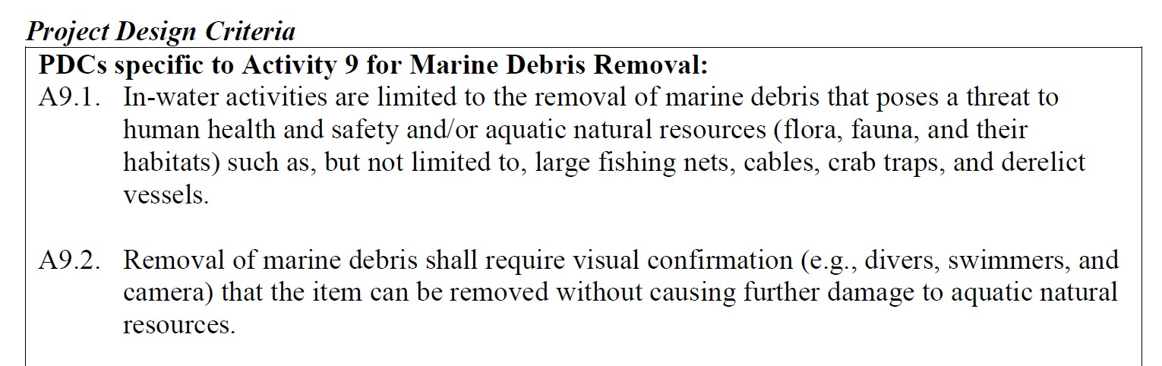
Derelict Vessels, 4
A derelict vessel has run aground on a sandbar in the vicinity of a popular swimming area and poses a risk to human safety. Divers with Underwater Marine Recovery, LLC have visually inspected the hull and confirm that the boat can be removed without damaging aquatic resources. No corals are present. The boat will be floated straight up and transported to land for disposal.
Example: A9.2 References a PDC for Activity 9 number 2 in JAXBO

Slide 39
Boat Ramps
JAXBO A6/SPGP V-R1 D
Work Authorized A.2.: Installation and maintenance to design specifications of boat ramps on artificial bodies of water or public boat ramps on any waters
(Section 62-330.051(5)(e), F.A.C.)
Request for Verification of Exemption
PDC for the ACOE JAXBO Summary Checklist
PDC for the ACOE JAXBO Activity 6: Boat Ramp
PDC for the ACOE JAXBO Activity 2: Pile Supported Structures (If dock Section 62-330.051(5)(e)3, F.A.C.)
Notes:
Because of the different federal and state limitations, this ONLY applies to private single-family boat ramps on artificial bodies of water

Slide 40
Boat Ramps, 2
Red (D.1.) Projects not authorized:
A project other than a private single-family boat ramp
A project located in specific rivers
A project located in DCH where PBFs are present for smalltooth sawfish; Gulf sturgeon; American crocodile; piping plover; freshwater mussels; or North Atlantic right whale
A project located in Florida panther focus area
Specifications for projects in smalltooth sawfish critical habitat
New or expanded boat ramps in Acropora critical habitat (repair/replacement is allowed)
New or expanded boat ramps in Johnson’s seagrass critical habitat (repair and replacement is allowed)
Located within loggerhead sea turtle critical habitat
Notes:
In C. this section as it relates to smalltooth sawfish more describes the areas that ARE NOT DCH (federally authorized or permitted man-made structures such as channels or canals (deeper than 3ft MLLW), boat ramps, docks, and marinas deeper than 3ft MLLW)
e.
1-new/expanded ramps cant result in the loss of an essential feature of the critical habitat
2. Boatramps can be constructed in waters vbetween MGHWL and -3ft MLLW, provided water depth not increased to deeper than -3ft MLLW
Repair and replacement within the same footprint is allowed.

Slide 41
Boat Ramps, 3
Green (D.2.) Project must meet:
Project limits
  Private, single-family boat ramp or structure requiring 50 cubic yards of fill material or less
  Ramp width does not exceed 30 ft
  Max one boat lane
  No more than two trailered vehicle parking spaces
  Repair and replacement of existing within same footprint
Restrictions on dredged material and disposal
Turbidity: length of new boat ramp and lengthening of existing boat ramps should ensure a water depth at the end of the ramp is deep enough to minimize sediment resuspension

Slide 42
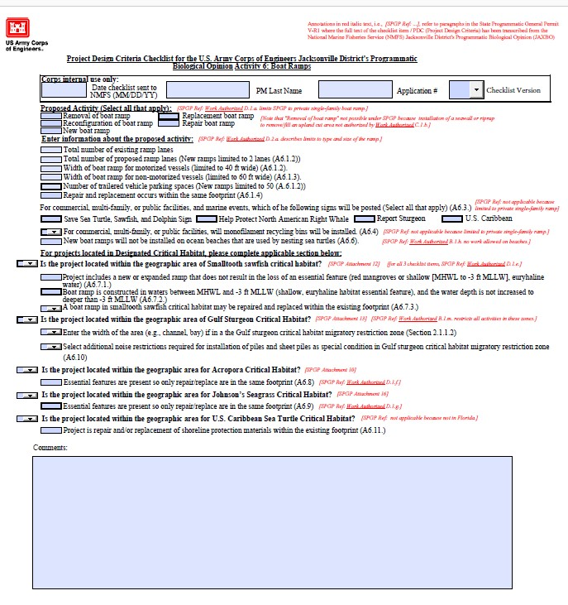
Boat Ramps, 4

Slide 43
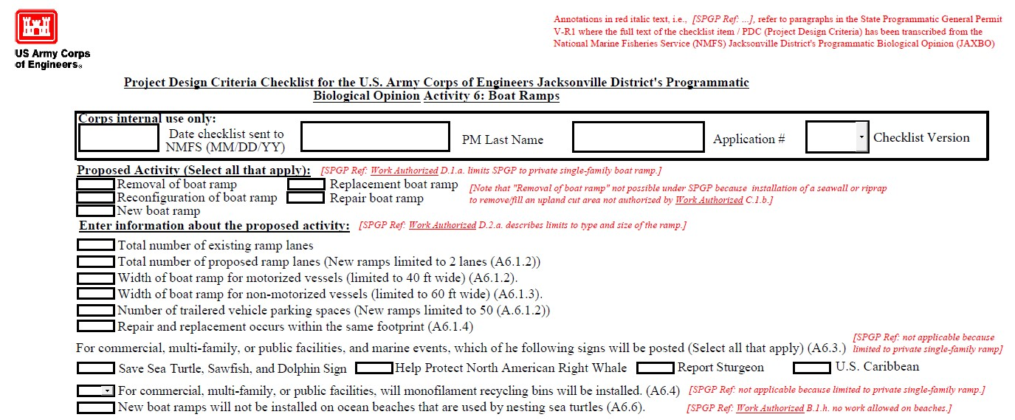
Boat Ramps, 5
0
1 lane
1
2
29
30 ft wide
4
1
2 trailered parking

Slide 44
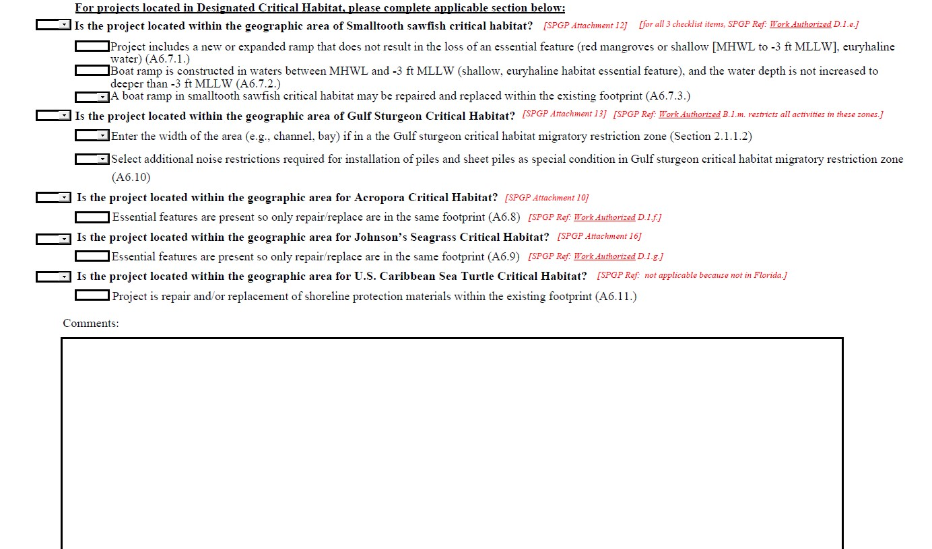
Boat Ramps, 6
Yes
No
Yes
No
NA
No
No
No
No
The boat ramp will cause water depth to increase to -4 ft of MLLW.

Slide 45
Part II Preview
Aquatic Vegetation
Docks, Piers and Piling-Supported Structures
Shoreline Stabilization
Compliance

Slide 46
Questions?

Slide 47
Contacts
Mac James
SLERC
(850) 245-8623
Mac.James@FloridaDEP.gov
Heather Mason
SLERC
(850) 245-8480
Heather.Mason@FloridaDEP.gov
Bob Barron
USACE
(904) 232-2203
Robert.B.Barron@usace.army.mil

