Slide 1
State Programmatic General Permit
(SPGP) V R-1
Part II
Mac James
SLERC Program
14 November 2019

Slide 2
PART I Recap
Self-Certifications
Application
Designated Critical Habitat (DCH)
Essential Features/Physical Biological Features
Scientific Devices
Derelict Vessels
Boat Ramps

Slide 3
Part II

Slide 4
Aquatic Vegetation

Slide 5
Essential Fish Habitats
B.1.k: Any project that will adversely impact the following Essential Fish Habitats is RED:
  Estuarine emergent vegetated wetlands
  (flooded saltmarshes, brackish marsh, and tidal creeks)
  Estuarine scrub/shrub (mangrove fringe)
  Submerged rooted vascular plants (sea grasses)
  Tidal freshwater wetlands
  Tidal freshwater forested wetlands
  Tidal freshwater submerged aquatic vegetation
  Coral and live/hard bottom habitats
  Oyster reefs and shell banks
However: projects that comply with B.2.d are authorized.

Slide 6
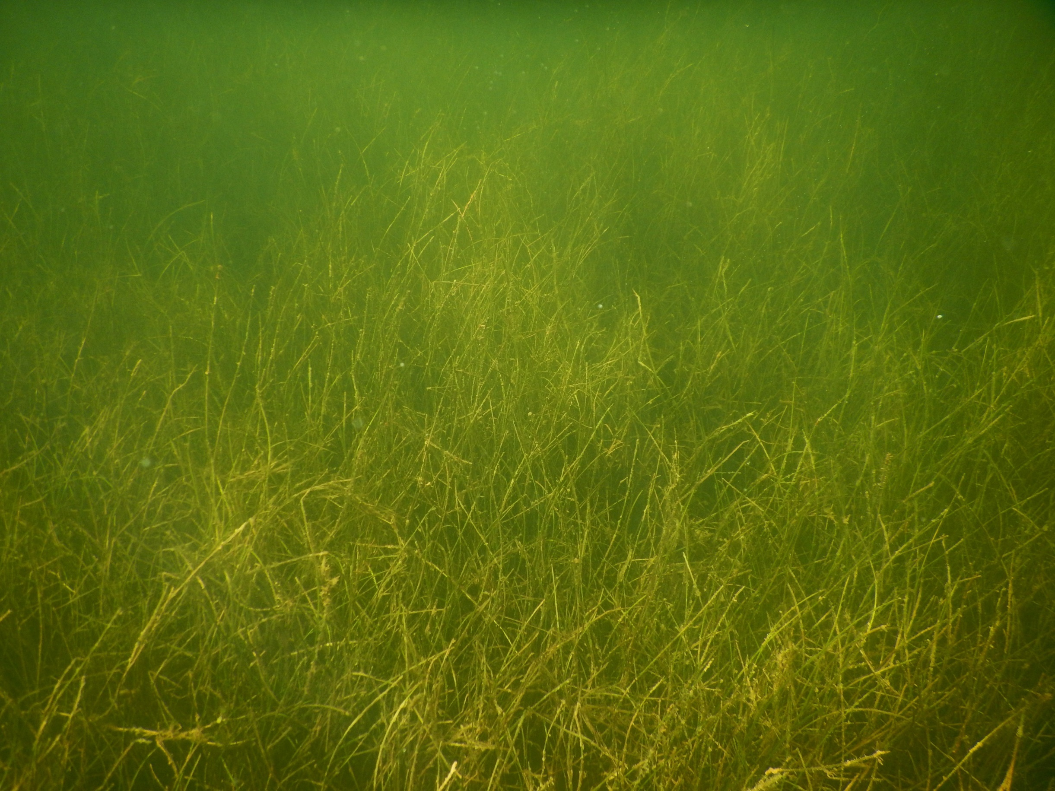
Submerged Aquatic Vegetation (SAV)
Life cycles of fish and marine invertebrates
  Refugia for small organisms (visual and physical/acoustic protection)
Primary producers are the base
of food web
  Sea turtles and manatees
  Substrate for epiphytes consumed
  by crustaceans and invertebrates
Sedimentation and stabilization
Carbon storage
Johnson’s seagrass (Halophila johnsonii) only reproduces asexually in Florida
Notes:
Why are sea grass and SAV important.

Slide 7
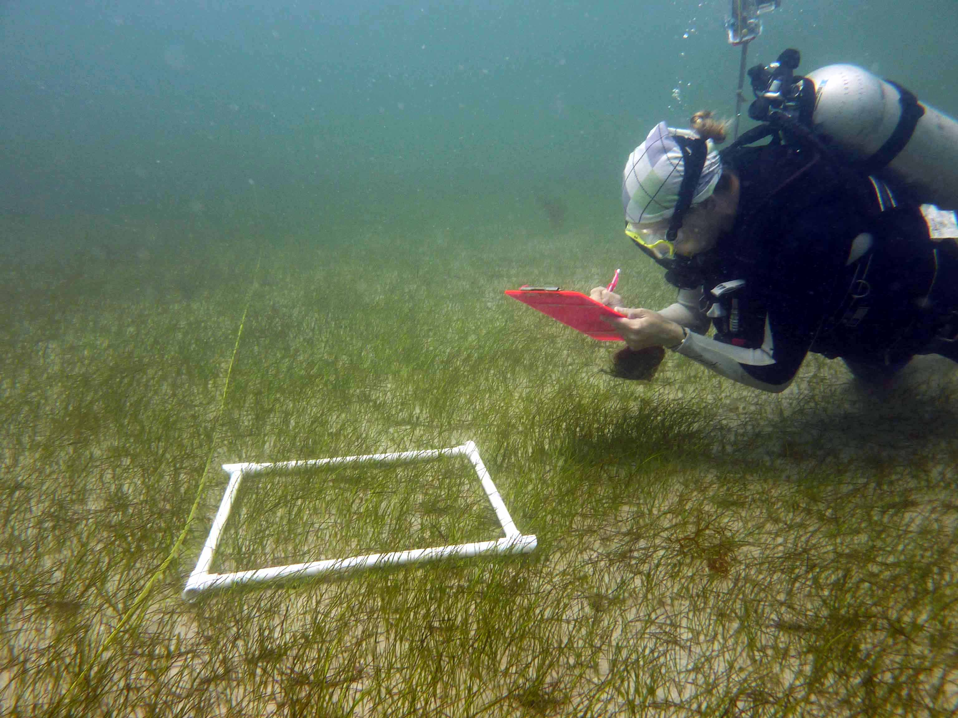
Submerged Aquatic Vegetation (SAV), 2
When is the Submerged Aquatic Vegetation survey needed?
All projects within range of Johnson’s seagrass (B.2.d.(2)(i))
All projects outside of the range of Johnson’s seagrass but within range of seagrass and within freshwater tidal waters (B.2.d.(2)(ii))
  Unless documented absence during the growing season
If no survey is conducted, SAV is
presumed to be present
Includes canals
Map Direct
(No seagrass SPGP attachment)
Notes:
Technically all projects other than a piling supported structure on a natural waterbody (because it has to use construction guidelines regardless)
The range of seagrass is defined as estuarine waters within all coastal counties except Nassau, Duval, St. Johns, Flagler and Volusia county north of Ponce Inlet)

Slide 8
Submerged Aquatic Vegetation (SAV), 3
Attachment 7: Submerged Aquatic Vegetation Survey Guidelines
Conducted between June 1 and September 30
Minimum 50 ft radius around location of proposed work
Report:
  Survey method
  Depict the locations of all SAV
  Depict the distribution of various species of SAV
  % cover of each species of SAV
  Frequency of occurrence of each species of SAV
  Shoot density of Johnson’s seagrass
  Name, mailing address, and telephone number
  Plan view drawing depicting existing structures and proposed work
Notes:
The growing season is different in different parts of the seagrass range, FWC recommends between April 1 – Oct 31 but for SPGP the June1-Sept 30 range is the primary consideration.

Slide 9
SAV Survey I
Conducted: November 30, 2018
Method:
  Transects parallel to the shoreline spaced 10 ft apart to 35 ft from shore (est.)
  Observations from shoreline
  Recorded locations of SAV
Prepared by: Contractor Services

Slide 10
SAV Survey II
Conducted: July 30, 2019
Method:
  Established 50 ft radius around
  proposed construction
  Transects parallel to the shoreline spaced 10 ft apart to 5 ft - 95 ft from shore
  Divers swam each transect in a zig-zag pattern to locate benthic resources
  Johnson’s seagrass (Halophila johnsonii) was located in the project area,
  observed in 34% (13/38) of quadrats
  with an average density of
  80 shoots/.25 m² and aerial 20% cover
Prepared By: Bert’s Benthos, LLC
  Bert Stumpkicker
  111 Open Sesame St.
  (555) 555-5555

Slide 11
Submerged Aquatic Vegetation (SAV), 4
Follow the Attachment 5 construction guidelines when:
  Within range of seagrass on a natural waterbody (B.2.d.(1))
  Aquatic vegetation is present (B.2.d.(2)(iv))
  Within range of Johnson’s seagrass and no current seagrass survey (B.2.d(2)(i))
Guidelines over SAV:
  Avoidance
  Minimum of 5 ft above MHW/OHW
  Maximum 4 ft width
  Over-SAV bed portions oriented in a north-south direction
  Terminal platforms waterward of SAV or in an area devoid of SAV
  One uncovered boat lift
  No sedimentary deposits (donuts or halos) around pilings
  Spacing of pilings thru SAV beds minimum of 10 ft
  Minimum ½” gap between deck boards
Notes:
Aquatic vegetation includes seagrass, tidal freshwater submerged aq and emergent veg
NO COVERED BOAT LIFTS OVER ANY SAV

Slide 12
Emergent Aquatic Vegetation
Follow the Attachment 5 construction guidelines when:
  Aquatic vegetation is present (B.2.d.(2)(iv))
Guidelines over Marsh:
  Piling-supported structure shall be aligned so as to have the smallest over-marsh footprint practicable
  Over-marsh portion of the piling-supported structure shall be elevated to at least 4 ft above the marsh floor
  Maximum 4 ft width; any exceptions to the width must be accompanied by an equal increase in height requirement

Slide 13
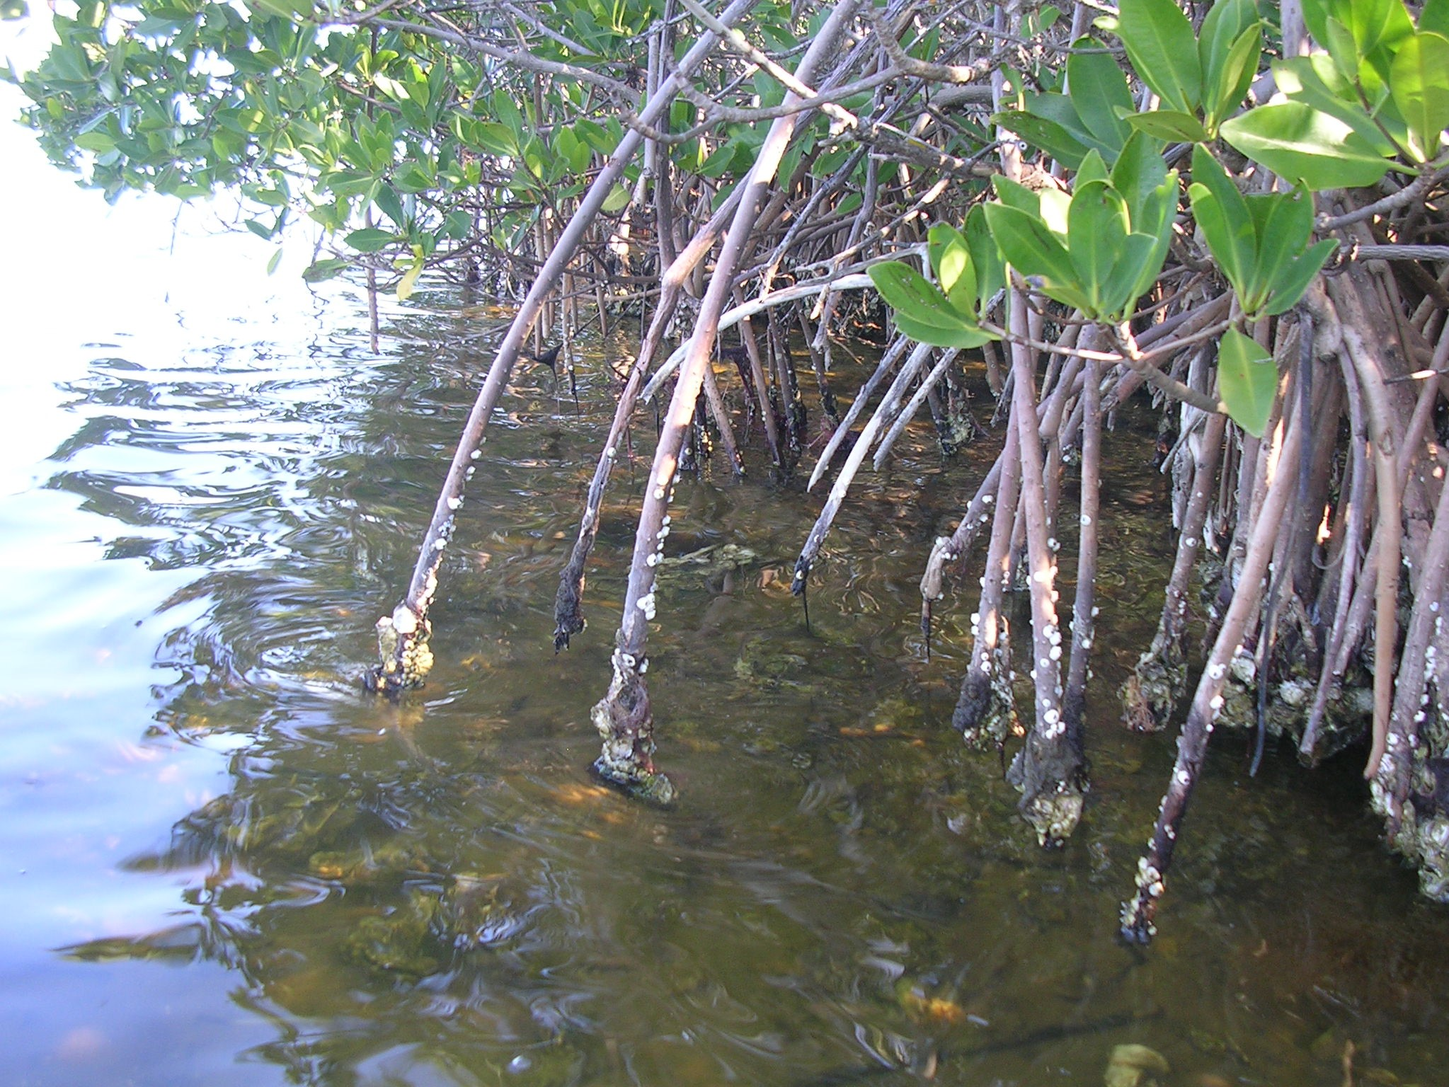
Mangroves
Avoid or minimize impacts
Avoid unnecessary removal and is limited to:
  Installation of 4 ft wide walkway for dock
  Removal above the MHWL; if that tree
  does not have any prop roots that
  extend into the water below MHWL
Mangrove trimming:
  Trimming waterward of the MHWL is
  authorized if the trimming occurs within
  the area the authorized structures are
  placed or will be placed (removal of overhanging branches), is necessary to provide temporary construction access, and avoids unnecessary trimming
  Projects proposing to remove red mangrove prop roots waterward of MHWL are not authorized, except for removal to install the dock walkways

Slide 14
Mangroves
Follow the Attachment 5 guidelines when:
  Mangroves are present within the project footprint (B.2.(e)(4))
Guidelines over mangroves:
  The width of the piling-supported structure is limited to a maximum of 4 ft
  Mangrove clearing is restricted to the width of the piling-supported structure
  The location and alignment of the piling supported structure should be through the narrowest area of the mangrove fringe

Slide 15
Activities

Slide 16
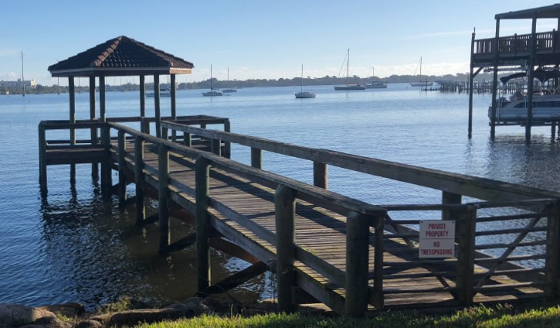
Docks Piers & Piling Supported Structures
JAXBO A2/SPGP V-R1 E
Work Authorized A.3.:
Request for Verification of Exemption
  Installation or repair of pilings and
  dolphins associated with private docking
  facilities or piers (Section 62-330.051(5)(a), F.A.C.)
  Installation of private and government docks where the cumulative square footage of all structures does not exceed 500/1,000 ft²
  (Section 62-330.051 (5)(b), F.A.C.)
  Construction of private docks of 1,000 square feet or less in artificial waters and residential canal systems (62-330.051(5)(c), F.A.C.)
  Replacement or repair of existing docks and piers, including mooring piles (Section 62-330.051(5)(d), F.A.C.)
  Installation of aids to navigation (ATONs) and buoys associated with such aids (Section 62-330.051(8), F.A.C.)
Notes:
AH Vol 1 3.2.6

Slide 17
Docks Piers & Piling Supported Structures, 2
JAXBO A2/SPGP V-R1 E
Request for Verification of Exemption (Cont.)
  Floating vessel platforms and floating boat lifts (Section 62-330.051(5)(f), F.A.C.)
  Installation of a boat lift at an existing facility (Section 62-330.051(5)(h), F.A.C.)
Notice of Intent to Use an Environmental Resource General Permit (Section 62.330.402, F.A.C.)
  Construction, extension and removal of certain piers and associated structures; <2,000 ft² (Section 62-330.427, F.A.C.)
  Piling supported structure, other than docks and piers, provided that the structure is not used for mooring, cumulative total size is less that 1,000 sq ft outside of OFWs, or less than 500 sq ft in OFWs (Section 62-330.474(1)(a), F.A.C.)
PDC for the ACOE JAXBO Summary Checklist
PDC for the ACOE JAXBO Activity 2: Pile Supported Structures

Slide 18
Docks Piers & Piling Supported Structures, 3
Red (E.1.) Projects not authorized:
DCH where Physical Biological Features (PBFs) are present for American crocodile; piping plover; or North Atlantic right whale
Florida panther focus area
Municipal or commercial fishing piers
Limitations within Acropora critical habitat: new or expanded not allowed, repair/replacement is authorized; ATONs designed not to contact coral
Limitations within Johnson’s sea grass critical habitat
Limitations within Loggerhead sea turtle critical habitat

Slide 19
Docks Piers & Piling Supported Structures, 4
Green (E.2.) Project must meet:
Authorized structures; docks/piers for a single-family residential lot are limited to four slips for motorized vessels; marinas and multi-family facilities are limited to a maximum of 50 total slips (wet and dry), anchored buoys and temporary pile supported structures
Chickees must be less than 500 square-feet, and support no more than two slips
Any dock project within 11 nautical miles of North Atlantic right whale critical habitat will attach the North Atlantic right whale information form
For boatlifts in Monroe County: forward a copy of the application to the USACE Miami office; they will notify within five days whether Agency can/cannot authorize SPGP
Notes:
***make reminder of the “Green” condition in B.2.d.(2)(iv) that if Aquatic Vegetation is present then the project must comply with construction requirements of Attachment 5

Slide 20
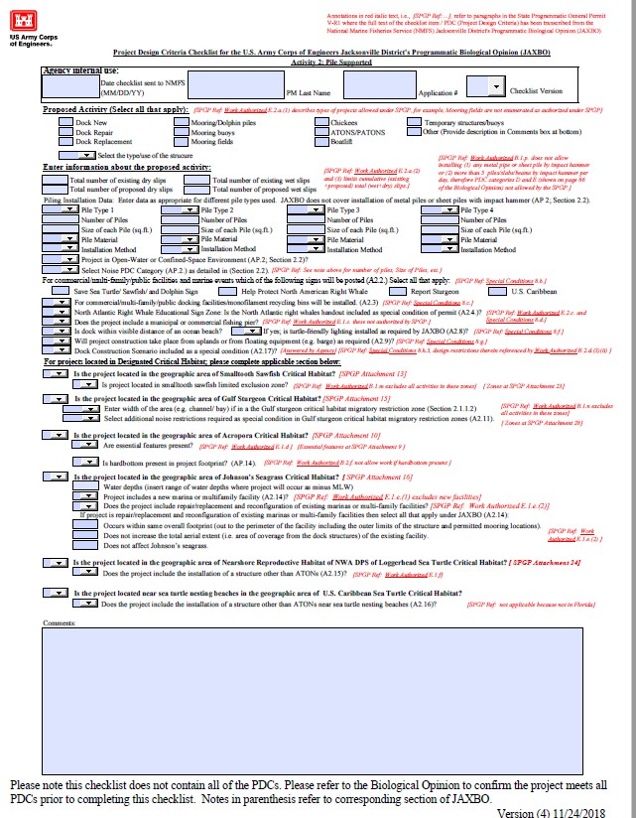
Docks Piers & Piling Supported Structures, 5

Slide 21
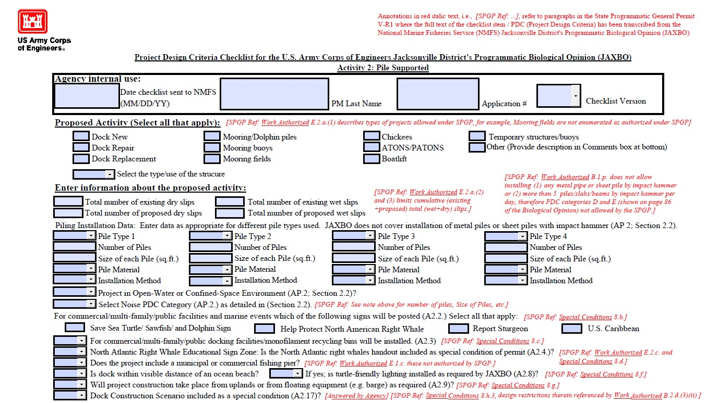
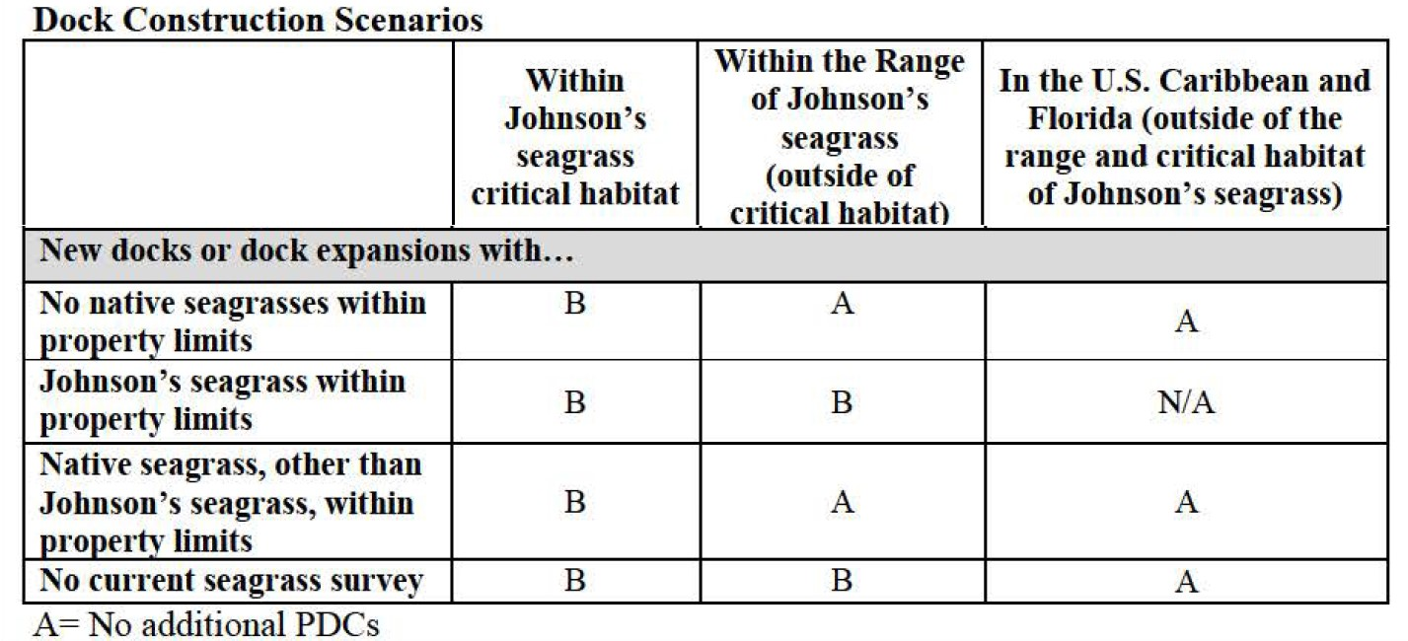
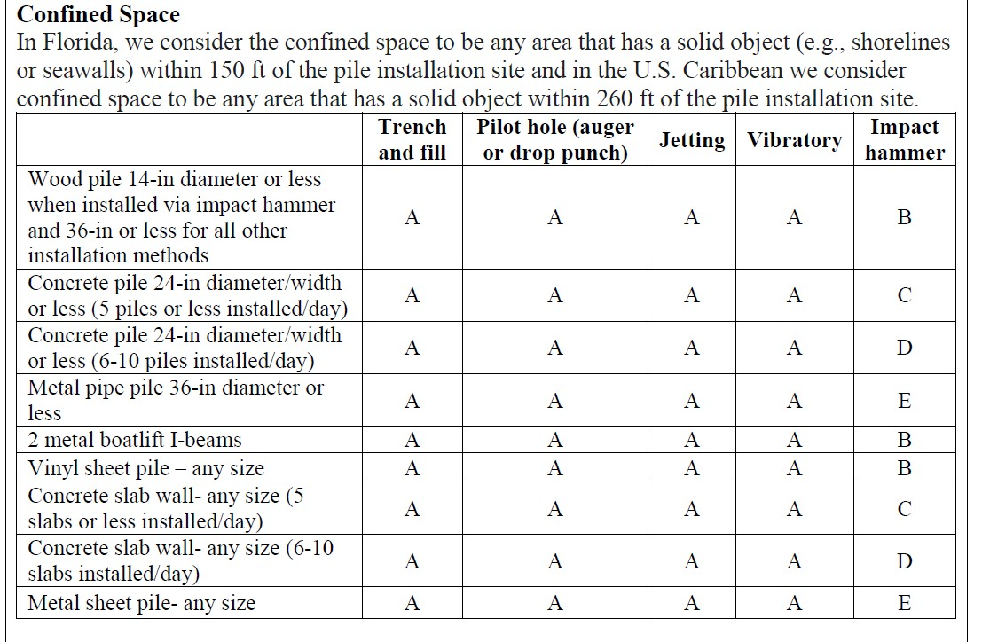
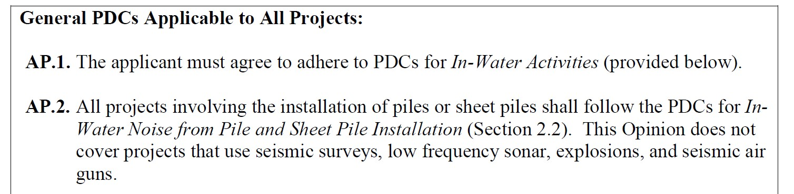
Docks Piers & Piling Supported Structures, 6
Single-family
0
A: Must Comply with PDCs for all projects, specifically:
1. All work must occur during daylight hours only (AP.6)
2. All construction personnel are responsible for observing water-related activities to detect the presence of these species and avoid them (AP.7)
B: Must comply with all of the conditions under A, and must limit the maximum number of piles installed per day to no more than 10 piles per day (SPGP authorizes five/day)
0
0
2
Pile
Pile
23
5
1
0.55
Wood
Wood
Jetting
Jetting
Confined-Space
A
NA
NA
No
No
Yes
A
Notes:
Noise Category in section 2.2 is a referenced to the PDCs for In-Water Noise from Pile and Sheet Pile Installation tables on page 86 of JAXBO
***Projects described as “B” can have installation of up to 10 piles/day by JAXBO – but SPGP only authorizes 5/day
**Doc Construction Scenario A is no additional pdcs. B is attachment 5 NA should never be an option.

Slide 22
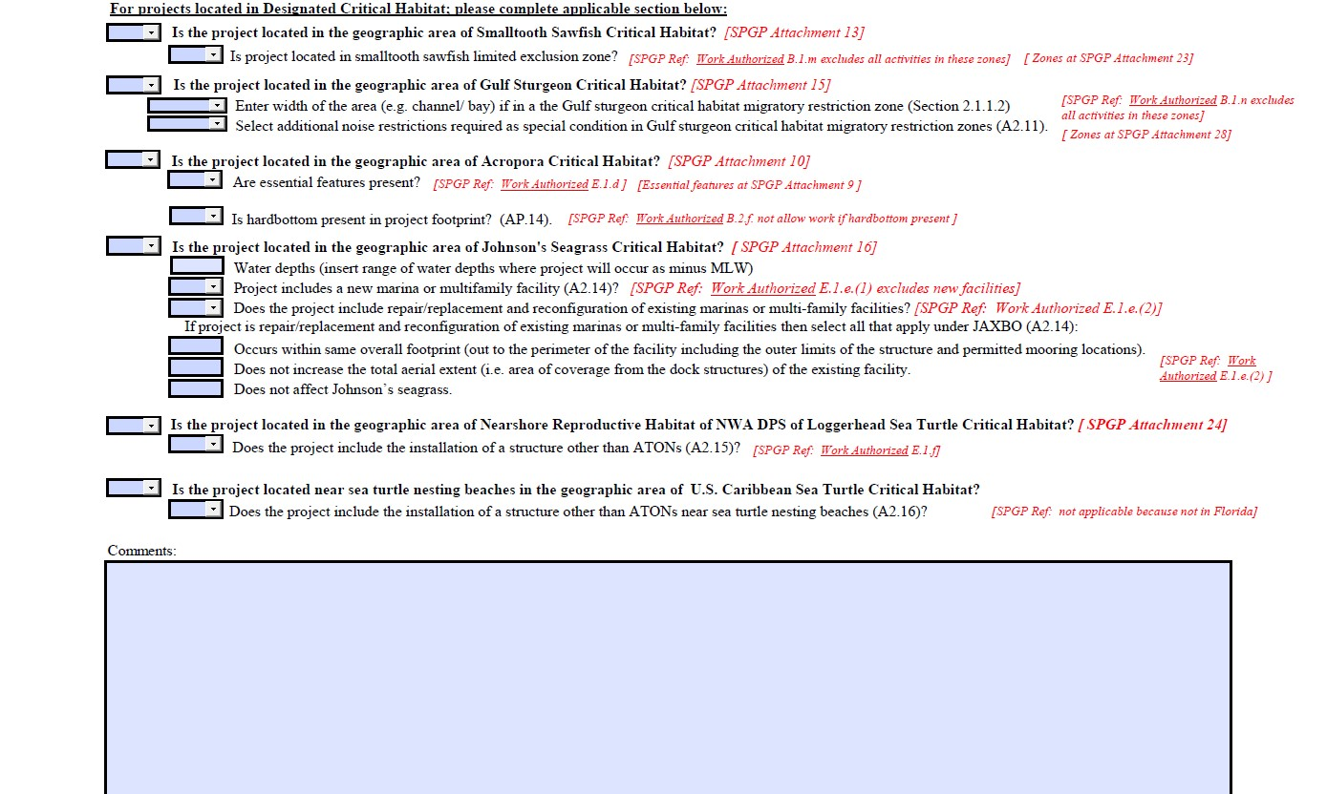
Docks Piers & Piling Supported Structures, 7
No
No
No
No
No
No

Slide 23
Shoreline Stabilization
JAXBO A1/SPGP V-R1 C
Work Authorized A.1.:
Request for Verification of Exemption
  Seawalls or riprap in artificially created waterways, including backfilling (Section 62-330.051(12)(a), F.A.C.)
  Restoration of seawall or riprap at its previous location or upland of, or within 18 inches waterward of, its previous location
  (Section 62-330.051(12)(b), F.A.C.)
  Construction of private vertical seawalls or riprap between and adjoining existing seawalls or riprap at both ends
  (Section 62-330.051(12)(c), F.A.C.)
  Installation of batter or king piles used exclusively to stabilize and repair seawalls and that do not impede navigation
  (Section 62-330.051(12)(d), F.A.C.)
  Living shorelines (Section 62-330.051(12)(e), F.A.C.)
Notes:
For Living shorelines green condition C.2.f; the native plants must be obtained from commercially-grown stocks as required in 62.330.051(12)(e)2.
Living shorelines a shoreline stabilization (activity 1) AND an aquatic vegetation enhancement (activity 7) so both would need to be checked on the Project Summary Sheet
***Seawall Restoration limitations by AH vol I 3.2.4 Routine Custodial maintenance is allowed if the SW still functions per 3.1.1.(d).
***Vertical Seawalls in estuaries and lagoons is prohibited by AH I 10.2.6 / IF vertical seawalls have riprap covering their face they are no longer considered vertical seawalls; AGH1.10.2.6 does allow for Vertical Seawalls in the DCH for smalltooth sawfish. (consider removing to the rip rap presentation)

Slide 24
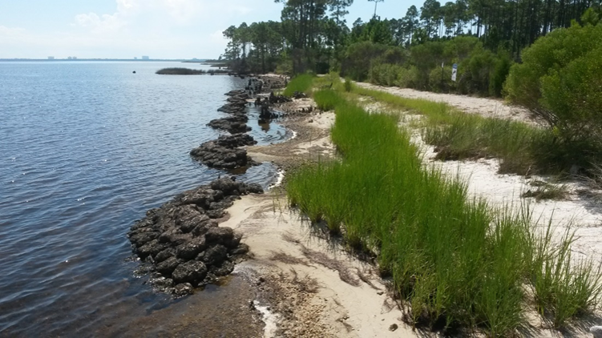
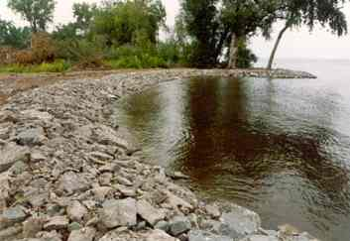
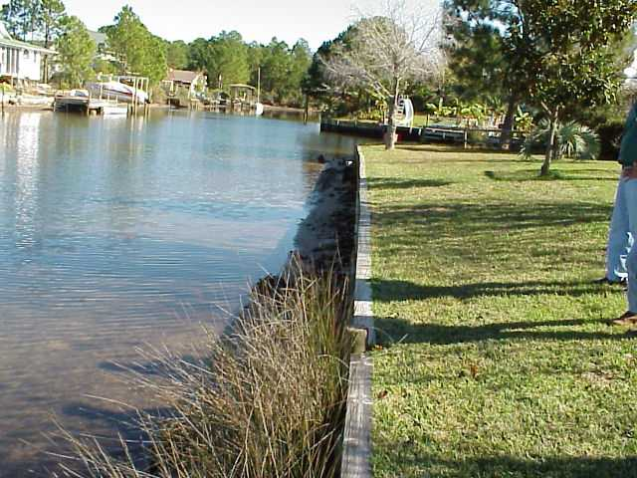
Shoreline Stabilization, 2
JAXBO A1/SPGP V-R1 C 2
Work Authorized A.1.:
Notice of Intent to Use an Environmental Resource General Permit (Section 62.330.402, F.A.C.)
  Installation of riprap (Section 62-330.431, F.A.C.)
PDC for the USACE JAXBO Summary Checklist
PDC for the USACE JAXBO Activity 1: Shoreline Stabilization
PDC for the USACE JAXBO Activity 7: Aquatic Restoration/Enhancement (Living Shorelines)

Slide 25
Shoreline Stabilization, 3
Red (C.1.) Projects not authorized:
Construction and/or repair to groins, jetties, breakwaters, and beach re/nourishment
Installation of a seawall or riprap to remove/fill an upland cut area (e.g. boat slip, boat ramp, boat basin)
Living shorelines, if the work extends waterward past the adjacent shorelines (this provision is to preclude changes in down drift currents)
Projects located in the main channels or tributaries of specific rivers
Projects located in the DCH where PBFs are present for: American crocodile; piping plover; or freshwater mussels
Projects located in Florida panther focus area
Limitations within smalltooth sawfish critical habitat

Slide 26
Shoreline Stabilization, 4
Red (C.1.), continued
Limitations within Gulf sturgeon critical habitat
Limitations within Acropora critical habitat (No living shoreline, only repair and replacement within existing footprint is authorized)
Limitations within Johnson’s seagrass critical habitat
Projects within Loggerhead sea turtle critical habitat
Projects within North Atlantic right whale critical habitat
Mangrove removal or trimming except as provided by B.2.e

Slide 27
Shoreline Stabilization, 5
Green (C.2) Project must meet:
Project must prevent erosion or stabilize a shoreline where erosion has taken place
Backfill is limited to where it is necessary to level the land behind seawalls or riprap
Limitations on project construction and design
Living Shorelines (vegetation limitations) can only be constructed in unvegetated, nearshore waters along shorelines to create tidal marshes or mangrove habitat for the purpose of shoreline erosion control or aquatic habitat enhancement; native plants can be placed along the shoreline or between the shoreline and the living shoreline structure
Living shoreline structure design criteria
For living shorelines, only native plant species can be planted

Slide 28
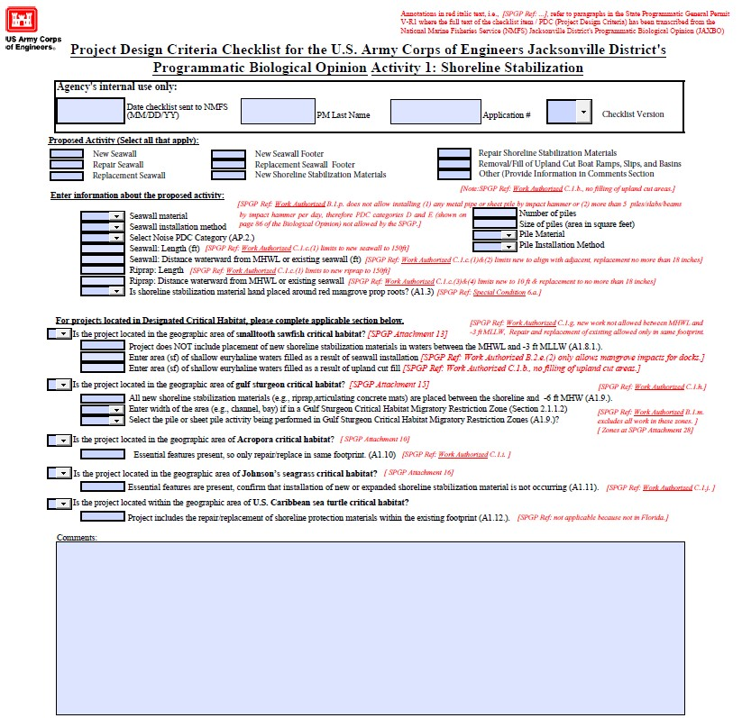
Shoreline Stabilization, 6

Slide 29
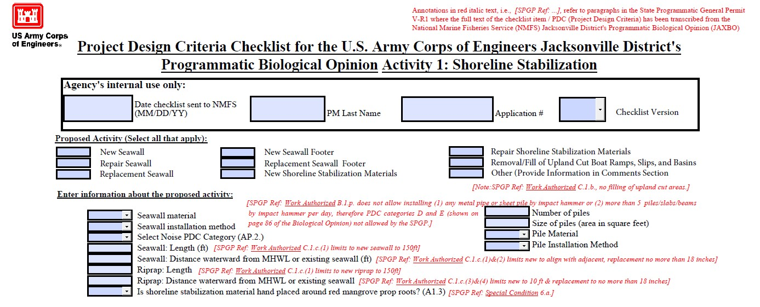
Shoreline Stabilization, 7
Concrete
17
1
B
Concrete
150.00
Impact Hammer
0.00

Slide 30
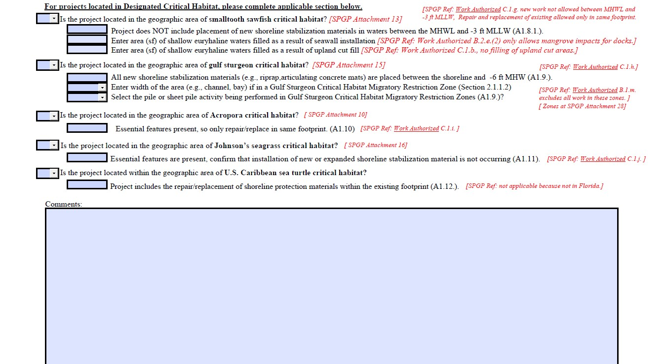
Shoreline Stabilization, 8
NO
NO
Yes
Yes
NO
NO

Slide 31
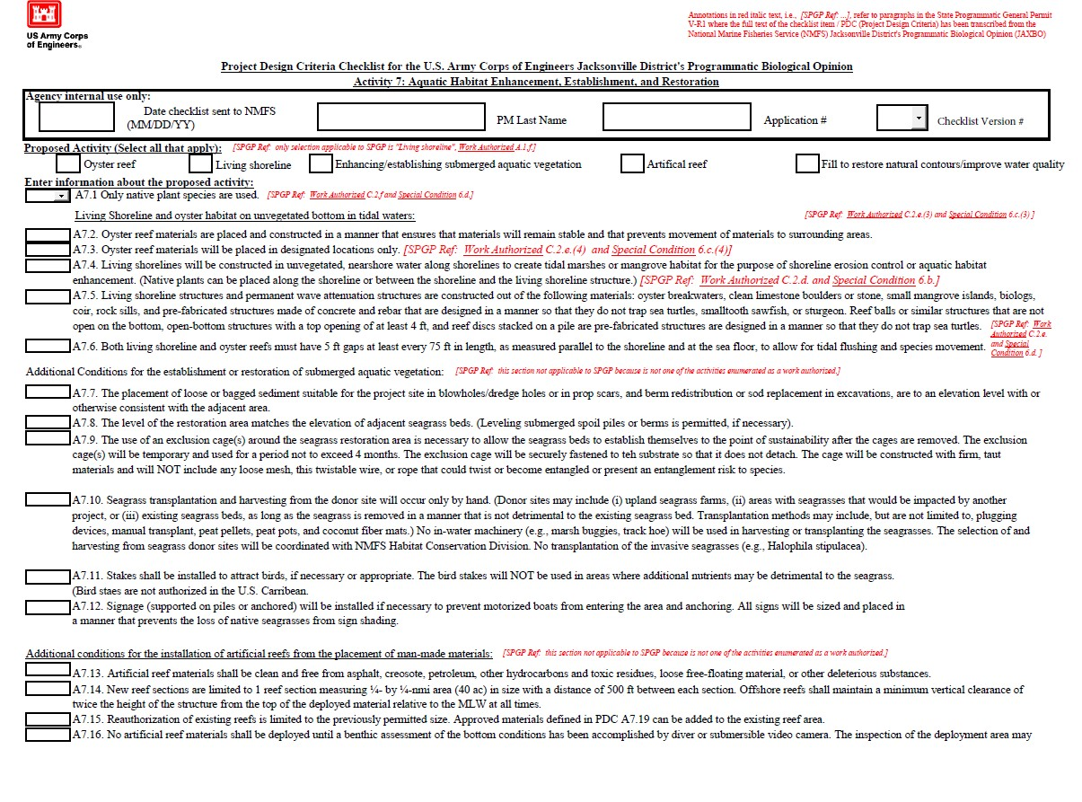
Shoreline Stabilization, 9
Yes

Slide 32
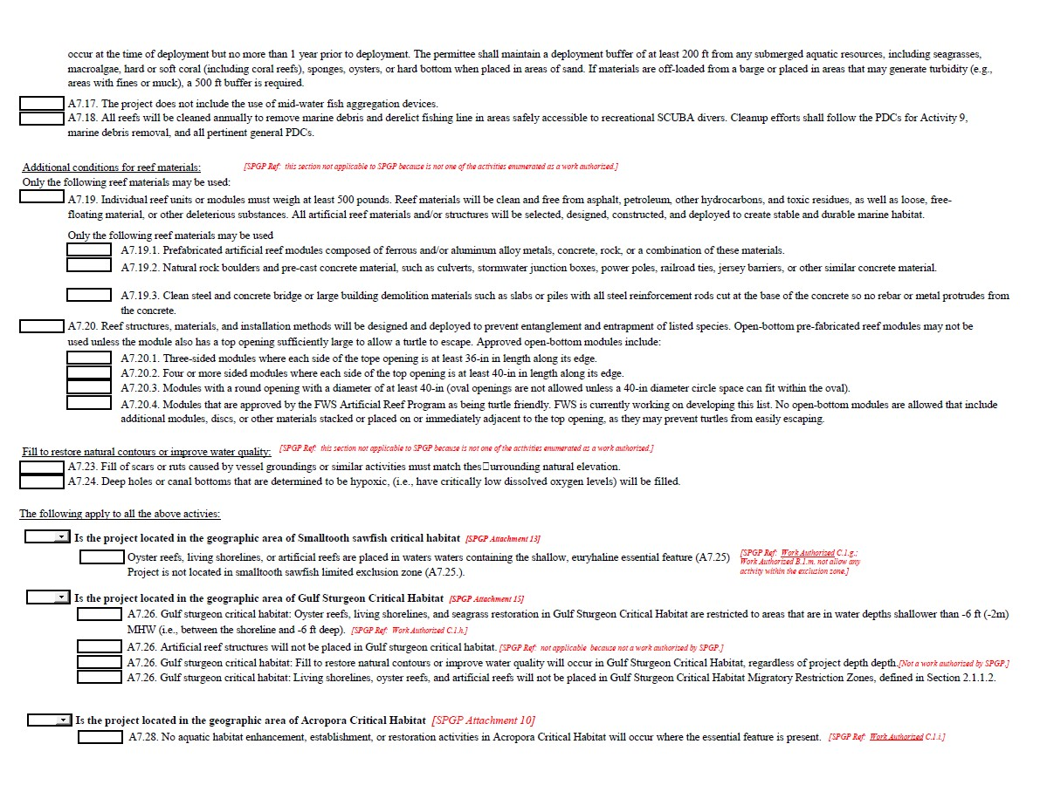
Shoreline Stabilization, 10
Yes
No
No

Slide 33
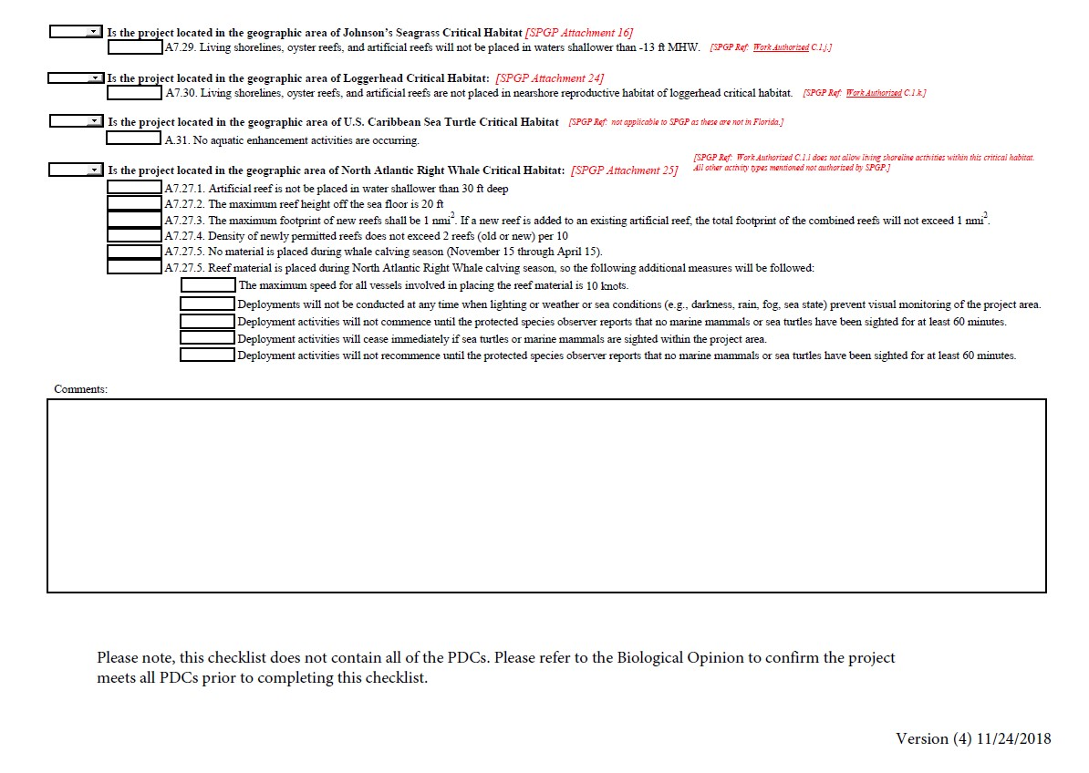
Shoreline Stabilization, 11
No
No
No
No

Slide 34
Additional Documentation
Commencement Notification
Self-Certification of Compliance
  Attachment 32
Included in Permit

Slide 35
In Case of Error
If SPGP authorization is inappropriately issued notify the applicant with:
“Our prior notification included a paragraph stating your proposed activity qualified for Federal authorization pursuant to the State Programmatic General Permit V-R1. We hereby rescind that paragraph either because that was included through an administrative error or because we have received new information from the Corps. A SEPARATE permit or authorization shall be required from the Corps. You must apply separately to the Corps using their APPLICATION FOR DEPARTMENT OF THE ARMY PERMIT, ENG FORM 4345, or alternative as allowed by their regulations. More information on Corps permitting may be found online in the Jacksonville District Regulatory Division Source Book at: https://www.saj.usace.army.mil/Missions/Regulatory/Source-Book”
  Coordination Agreement A.8.
  https://floridadep.gov/sites/default/files/SPGP_V-R1_ExecutedAgreementDEP.pdf

Slide 36
Compliance Monitoring
At least 10% of “green” projects within one year
  Inspection focus:
  Self-cert sf docks (10% for DEP exemptions)
  Docks within range of Johnson’s seagrass
  Docks located within/over any other aquatic resources
SPGP V-R1 Field Inspection Checklist
Projects not in compliance with SPGP must be reported:
  SAJ-RD-Enforcement@usace.army.mil
Any project not in compliance with Section 403.813, F.S., or Section 62-330, F.A.C. is not in compliance with SPGP

Slide 37
Questions???

Slide 38
Contacts
Mac James
SLERC
(850) 245-8623
Mac.James@floridadep.gov
Heather Mason
SLERC
(850) 245-8480
Heather.Mason@floridadep.gov
Bob Barron
USACE
(904) 232-2203
Robert.B.Barron@usace.army.mil

