Slide 1

How to Read Plans,
or,
How I Discovered a Cure for Insomnia and Proved it Through Repeated Experimentation!

Slide 2

Plan Reading
This workshop is intended to be interactive
My approach (yours is likely different)
Start at 30,000 feet level (literally)
Drill down to tiny details
Try to build a 3-D mental image
Every Sheet Tells a Story!
-Richard Musgrove, P.E.

Slide 3
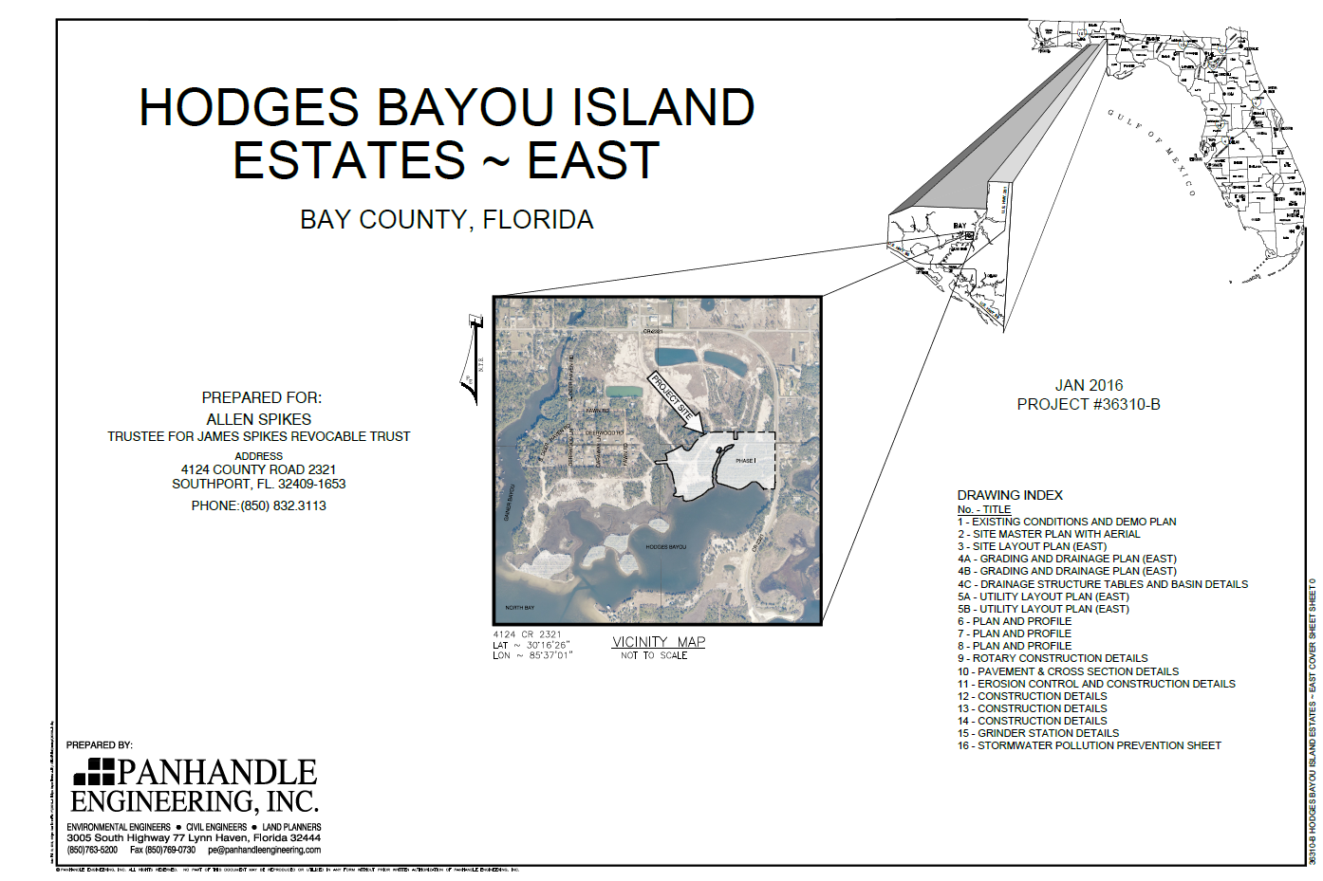
Cover Page
Notes:
Every plan set should (but may not) have a cover page. Useful things a cover page may give you are, of course, the project name, (*click*) and usually the applicant (*click*). This is also where the designers will usually provide a location map (*click*). An index (*click*)is a handy thing to have, because you’ll inevitably be switching from page to page as you convert the plan into a mental 3-D image. And since the designers (*click*) are proud of their work, you’ll generally find their logo somewhere here. The contact info is often handy to have readily available.

Slide 4
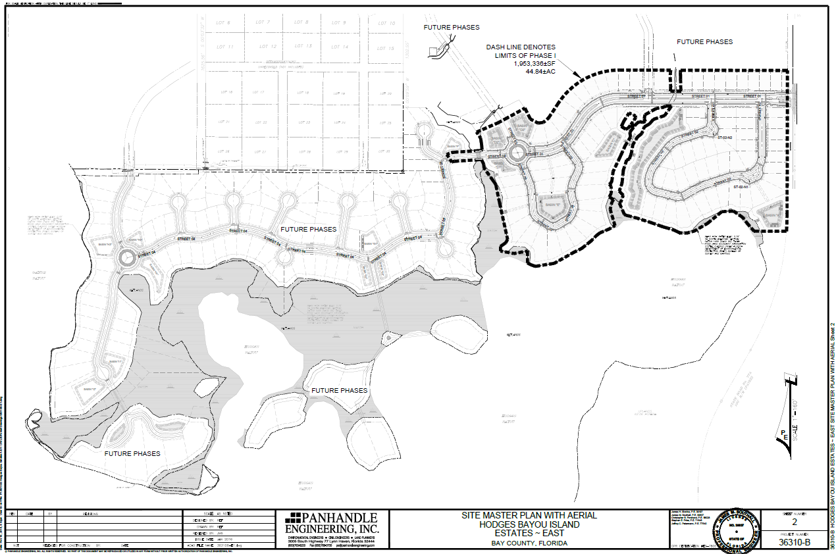
Project Boundary Line
Heavy Lines = Current Project
Project Access
Faint Lines = Off-Site Property
Property Lines
Property Lines
Mean High Water Description
Property Easement
Lighter Lines = Future Phases
Mean High Water Description
Note Greyed Text (Future Project)
Finished Grade Lines
Mean High Water Description
Note Bold Text (Current Project)
Note Greyed Text (Future Project)
SR-77A
Marsh
Wetlands
Uplands
Sign and Seal (Electronic)
Notes:
Our first example is a simple subdivision. The title explains that this is the master plan for a series of projects. *click* This sheet was signed and sealed electronically. *click* The designer has combined the north arrow with the scale. *click* Notice that the scale is one inch = 160 feet, which isn’t a standard scale. Why? (Wanted to fill the page) State road 77-A is on the right side of the page *click* and we have uplands, wetlands and marsh on the sight. *click 3 times* Did you notice how light the lettering is? That’s an indication the designer is just providing information and wants you to focus your attention elsewhere. Heavy bolder lines draw your eye to the current project, outlined with a dotted project boundary line. *click* That’s where the remaining sheets of this plan set would focus. Lighter lines indicate items of lesser importance. *click* Notice they’ve done the same thing with things like the Mean High Waterline description. *click* You have the bold description associated with the current project, and two more greyed out descriptions for future projects *click* Focusing more on the current project, I mentioned to road earlier. It provides the access point for the project. *click* Within the project boundaries, you can see a number of property lines, breaking the site into individual lots. *click* You’ll also see finished grade lines, such as the ones around the stormwater systems *click* and a property easement indication *click* to allow a pipe to carry road runoff to the stormwater system.

Slide 5
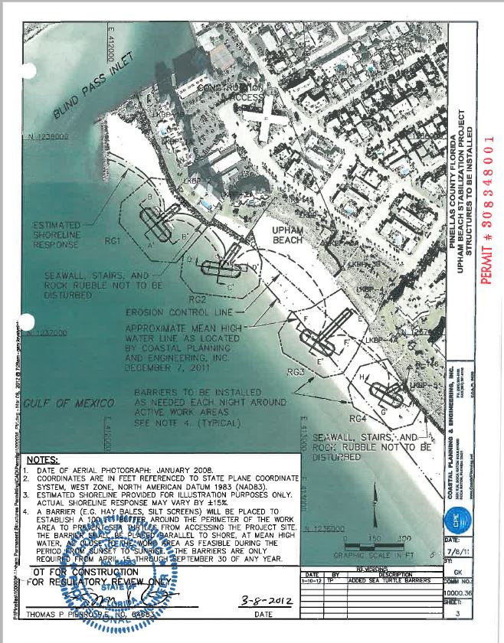
Project Access Point
Coordinates (See Note 2)
Structures to be Installed (Bold)
Cross Section Lines
Note 2
Structure Numeration
Scale and North Indicator
Sign and Seal
Revisions
Notes:
Our next example is an overview of a beach stabilization project. One thing you’ll immediately notice is that this drawing is overlaid onto an areal photograph. Some of the things you see here that are in common with the last example include the descriptive title block *click*, the north indicator and the scale *click*, the list of revisions to the original drawing *click*, and the sign and traditional seal block *click* This drawing indicates the project access point, *click*, but it’s difficult to read. *click* Notice the coordinate system on the drawing. Note 2 *click* explains that this is a Cartesian coordinate system, rather than the traditional latitude and longitude. *click* Like the last drawing, new structures are in heavy bold lines. We’re going to take a closer look at those structures in an upcoming slide. The drawing uses a long dashed line to indicate the existing mean high water line *click* , and a shorter dashed line for the new shoreline response to the new structures. *click* There is also something you’ll see in most other drawings, a reference to notes. *click* More often than not, you’ll have to hunt for notes on another page, but this one is on the same page. And finally, notice that the structures are numerated, and that they have cross sectional lines drawn through them. This indicates that there are details later in the planset, and we’ll take a look at them soon.

Slide 6
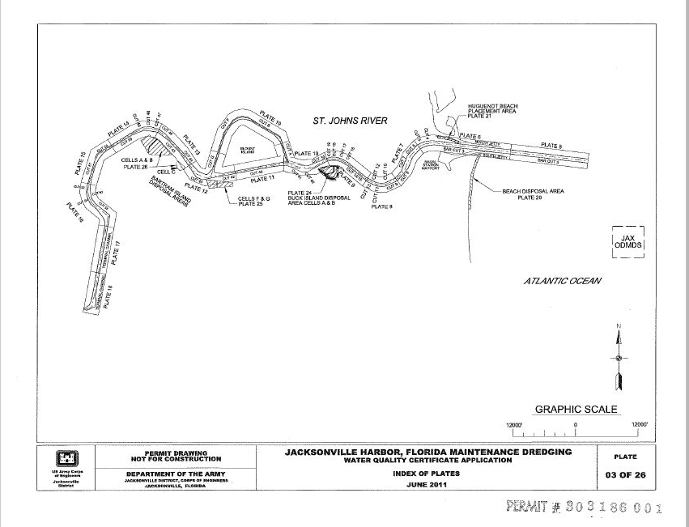

Notes:
By comparison, this drawing is reminiscent of the line drawings in “The Little Prince”. Let’s see if the Corps can also say so much with so little.

Slide 7
Station Numbers
Center Line of Cut
Index Numbers – Reference Other Pages
Spoil Disposal Areas – Reference Other Pages
Sign and Seal?
Notes:
This is the project overview of the Corps application to maintenance dredge the St. Johns River, over in Jacksonville. Short on details. Things it does have in common with the previous examples include the title block *click*, and the scale and north arrow. *click* One thing missing is signing and sealing by a registered professional. (It’s the Corps) *click* The project has a center line that splits the river. The plan set divides the river into convenient sections, *click* which are referenced on other pages (called plates here). Within those sections, points where the direction changes are labeled with station numbers, *click* some of which are on this page. The sheet also indicates where the material dredged from the river will be placed for disposal. *click*

Slide 8
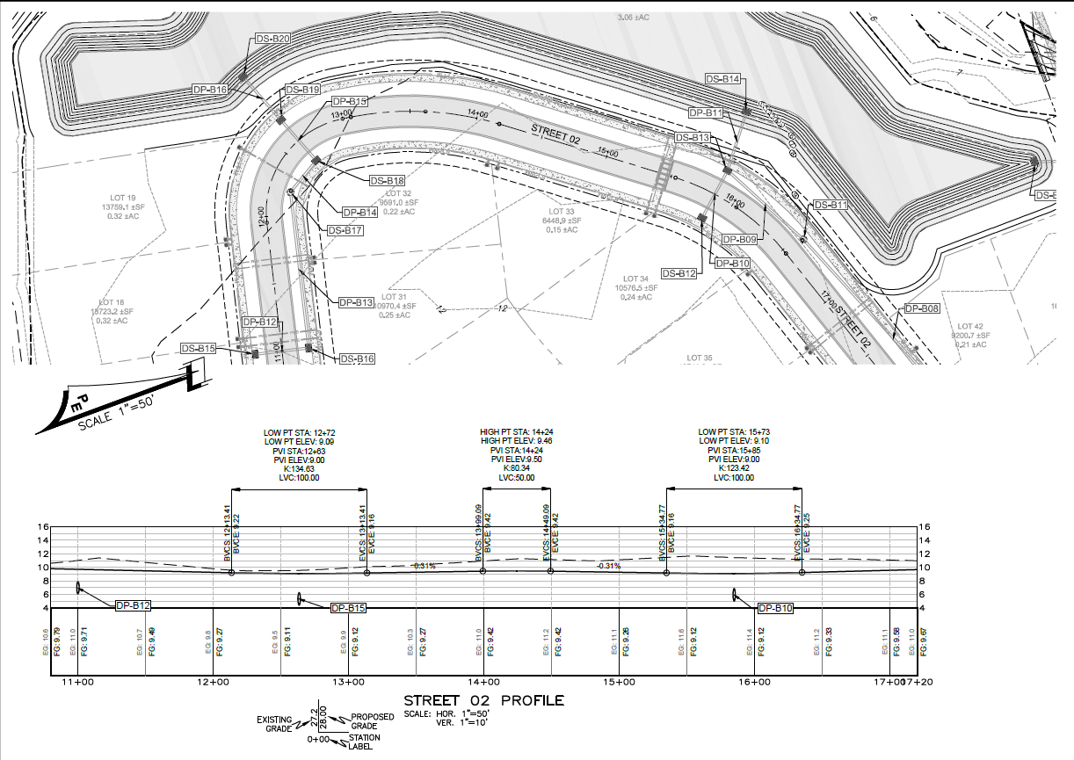
Plan and Profile - Street
Notes:
Let’s revisit the subdivision from earlier. Reasonably typical roadway cross section. Chose this one to demonstrate how plan and profile are handled for linear projects, especially curves. Notice the numbers at the bottom of the profile *click*. They’re called stations, and they match up with corresponding stations on the plan view. *click* That way, even if the road does a U-turn like this one, you know where you are. You can verify the location of things, such as the culverts under the road. *click* The station symbols also give you grading information. *click* What is the purpose of plans and profiles?

Slide 9
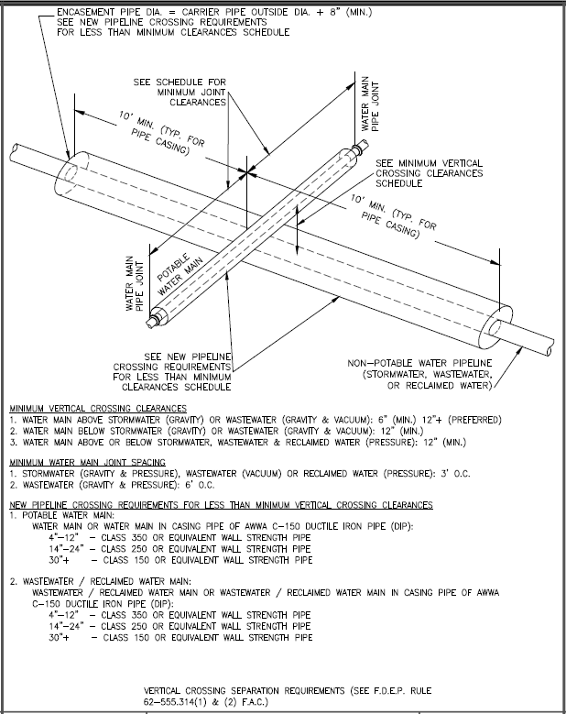
Notes:
Here’s a detail from the same plan set; shows how to avoid line crossing conflicts. Notice that both the potable and non-potable pipes water are encased with larger pipes, and that we want the potable water pipe above the non-potable one, so that when they leak, we have drinking water leaking to a waste flow pipe, and not the other way around. Also notice we want the pipes cased, to help guide leakage away from the crossing pipe. *click* Now notice that for the crossing clearance, we’ll need to reference a schedule. *click* And finally, this set indicates the rule reference for vertical crossing separation requirements. *click*

Slide 10
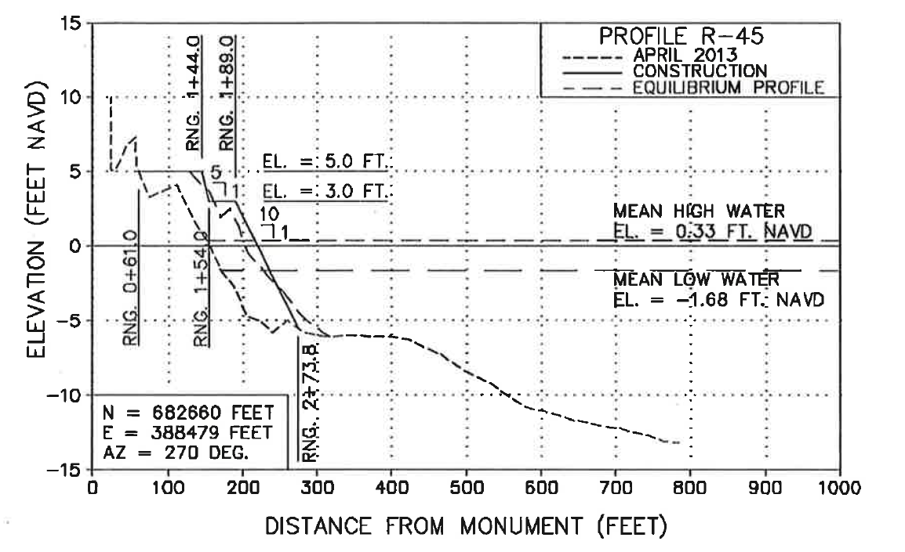
Beach Nourishment Profile
Notes:
Another use of profiles or cross sections, this one from a beach nourishment project. This one has some serious vertical elevation, 25 feet, and even goes under water. *click* Note the elevation on the Y-axis. Also take note of what datum the elevations are in, in this case NAVD. The elevation has a negative component, indicating it’s below sea level. *click* You can also find the mean high and low water elevations. *click* Now, notice the X-axis; the distance from a surveying monument. How do we know where that monument is located? *click* I’ve highlighted the box that tells us where. This diagram is giving us the location in geographic Cartesian coordinates, instead of the more conventional latitude and longitude. That brings us to the purpose of this drawing, the “story” it’s telling. *click* Notice the legend in the upper right corner. What’s being indicated is the existing beach *Blue Click*, the beach right after construction *Red Click*, and what the beach will look like after all the sand has settled into its natural angle of repose *Green Click*. And finally, notice that the designer points out the slopes on the constructed face. (describe)

Slide 11
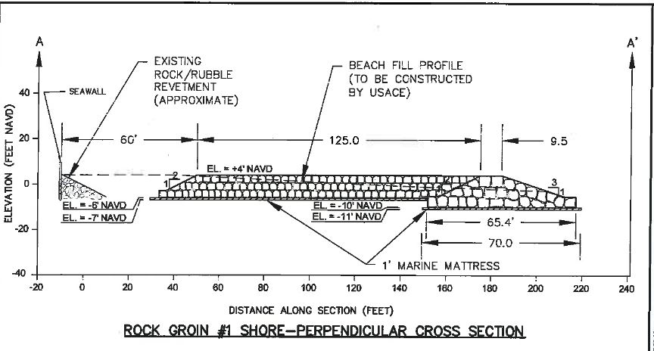
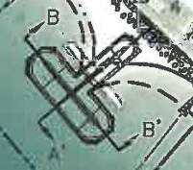
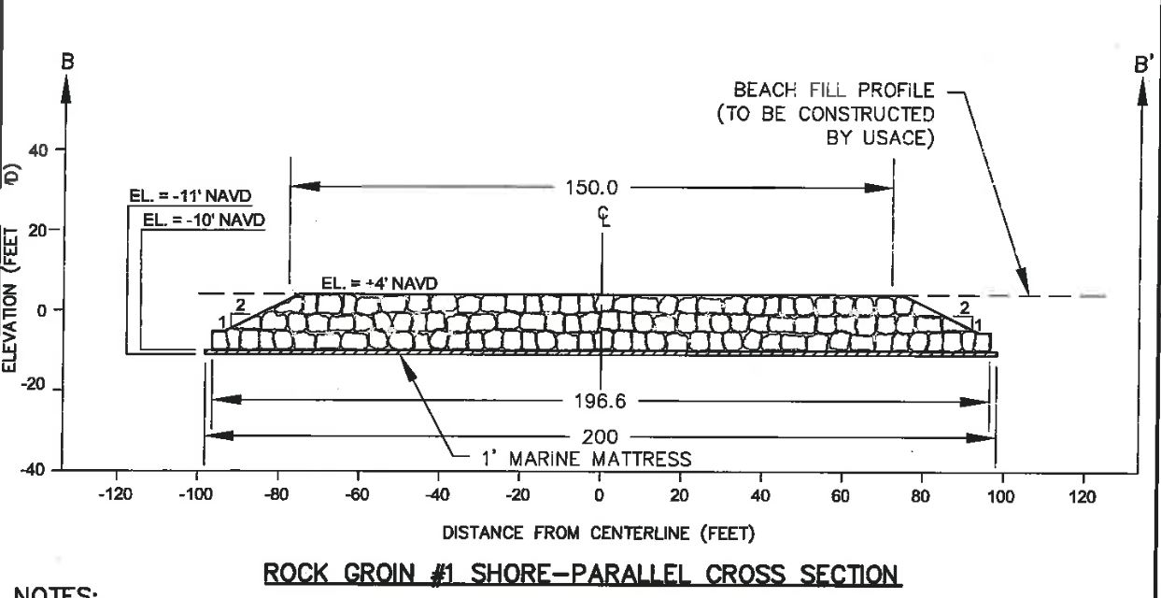
Rock Groin Cross Section
Notes:
Now, lets revisit the beach stabilization project, to see how to use cross sections, or a plan and profile view, to provide details about a structure. Notice on the colored drawing, the lines running through the structure: A and A prime , B and B prime. *click* A is kind of lost in the beach rip-rap. Now, if you look at the profiles, you can match the cut lines with the cross sections, and see what the structure looks from the side. Both the colored drawing and the perpendicular cross section at the top indicate an existing revetment. *click* which will help orient you, and so you can see that A prime indicates the off shore side. *click* Notice that elevation, in NAVD datum, *click* is on the Y-axis, and that much of the structure is below zero elevation. This means that it’s mostly going to be underwater, which you’d expect since it’s being built off-shore. But look at the X-axes, which indicates distance. *click* The top graph, the perpendicular cross section, has zero at the shore line, *click* but the parallel cross section has zero out in the water on the middle of the axis. *click* Why? (Distance from center line, A-A’.) (Also point out side slopes)

Slide 12
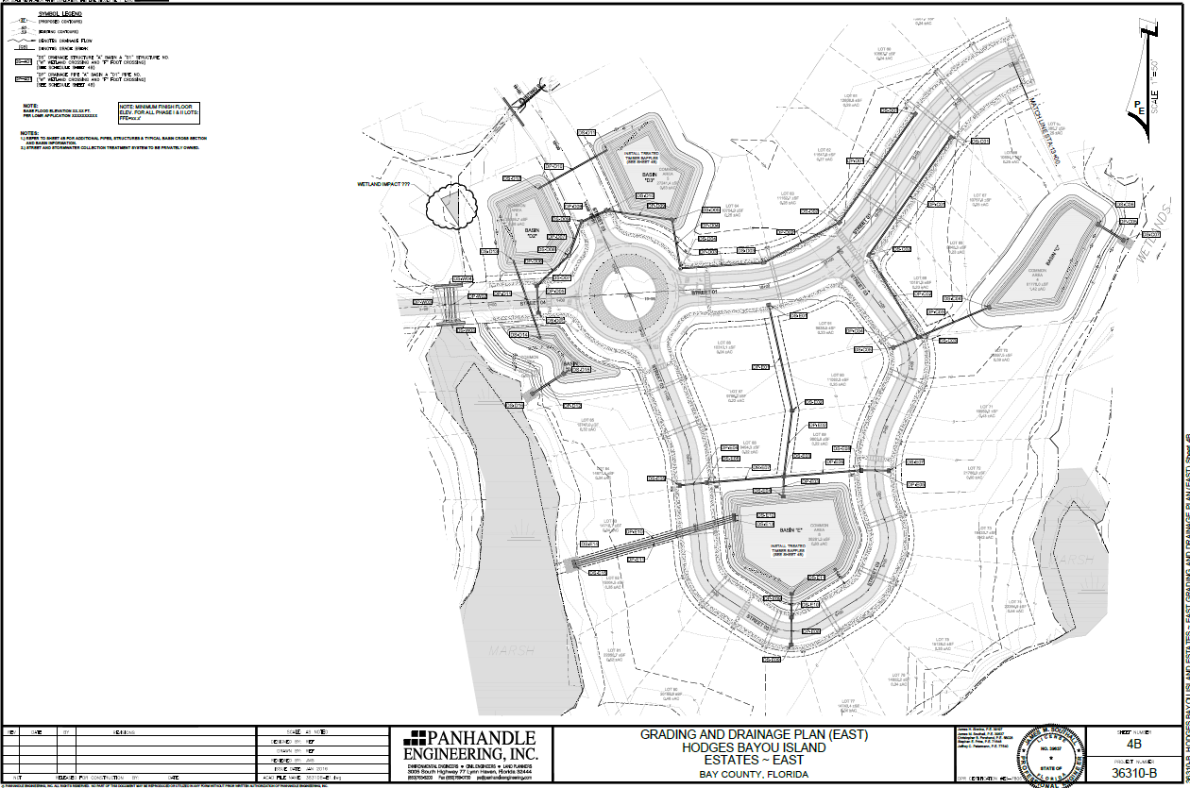
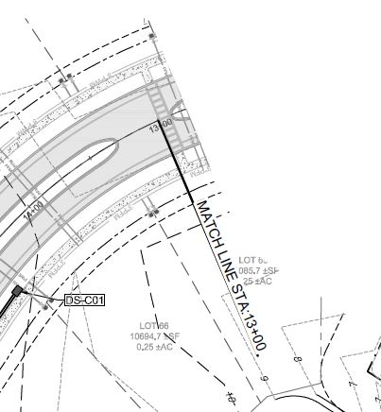
Match Lines
Notes:
What happens if the project is too big to fit on a single page and still show the detail the designer wants you to see? (Describe match lines. Point out station number.)

Slide 13
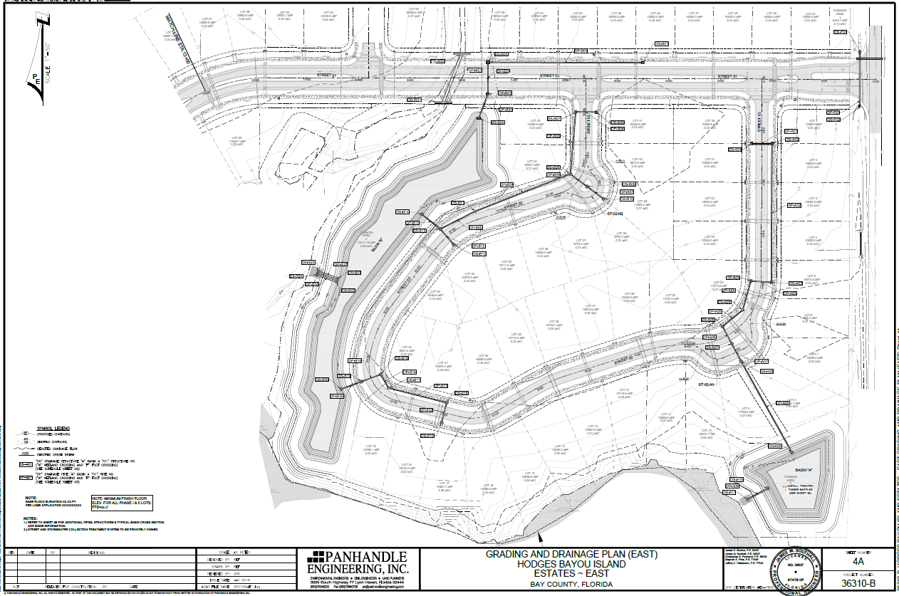
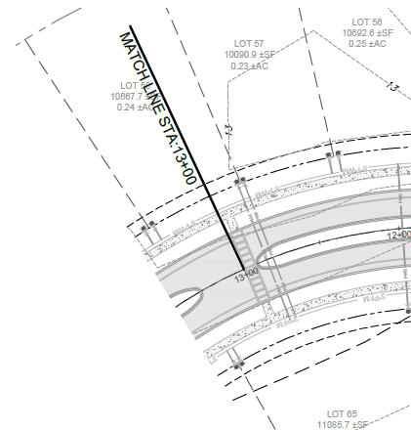
Match Lines
Notes:
(Match line section usually on next page)

Slide 14
Match Lines
Notes:
Note that the point of match is on the center line.

Slide 15
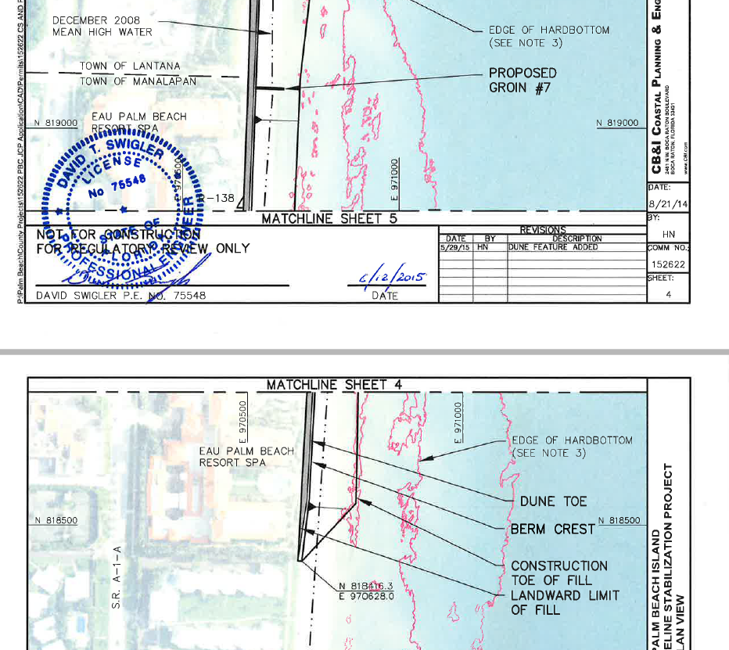
Another Way of Doing a Match
Notes:
Sometimes, for long projects, instead of doing a match line, the plan set will have match sheets. Notice the wording “matchline sheet 4” . The sheet above that is sheet 4. Since this isn’t a road, there’s no centerline here to match; you have to line the structure up like a puzzle. This is from a Palm Beach shoreline stabilization project. Other things to notice include the location of the mean high water line *click*, the fact that the project crossed from one town into another *click*, the location of some hard bottom, shown by the pink lines, some details of a dune feature and the construction and fill *click*, the location of the end of construction, again in Cartesian coordinates. *click* You can also see the engineer’s sign seal and date, manual in this case, although the seal looks like a stamp to me. *click*

Slide 16
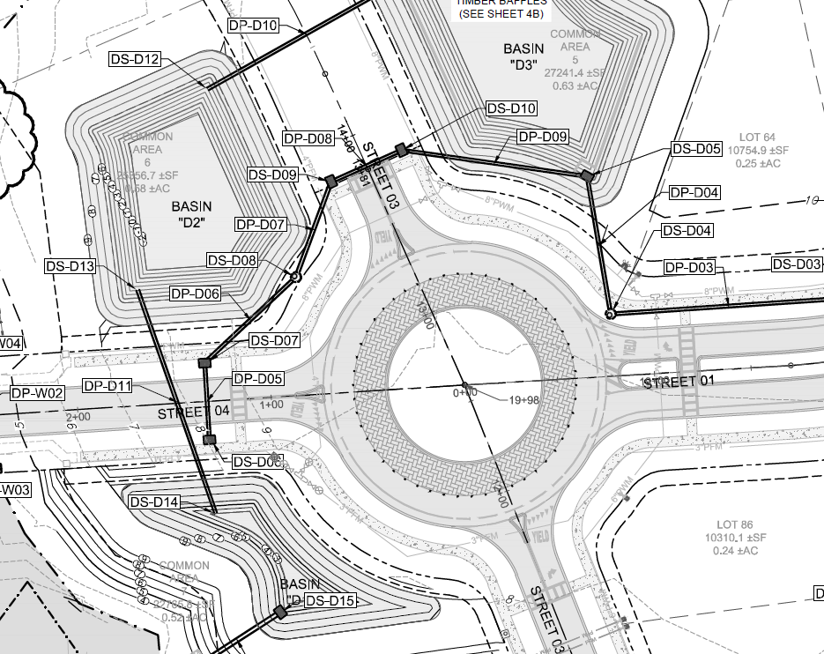
Details
Notes:
This is an extracted section of a larger drawing, focusing on a roundabout connecting two roads. You can see the road centerlines *click*, lot lines *click*, lot descriptions *click*, topographic lines *click*. But notice all these lines, as well as the lines depicting the roads and roundabout are greyed out, faint lines, and you now know that means that the focus of the page isn’t on them. Instead, the bold lines indicate the focus for this page is the stormwater management system, being outlined in green. *click* There are three treatment basins, conveniently labeled Basin, and they’re interconnected with pipes, indicated by the straight lines. The parallel lined in each one are contour lines, which give us the shape and depth of each basin. There is also part of a stormwater collection system, which will lead to another treatment basin located off this slide. Now that we know what the focus is, let’s get rid of all the clutter here so we can finally get to the point of the slide. *click*

Slide 17
Details
Notes:
Did you notice the little boxed letters and numbers? *click* Wonder what they are? DS = Drainage Structure; DP = Drainage Pipe These are a sign you’ll have to look on another sheet to see what each one is. How do you know which page? You could try flipping though the sheets until you find it. Or….

Slide 18
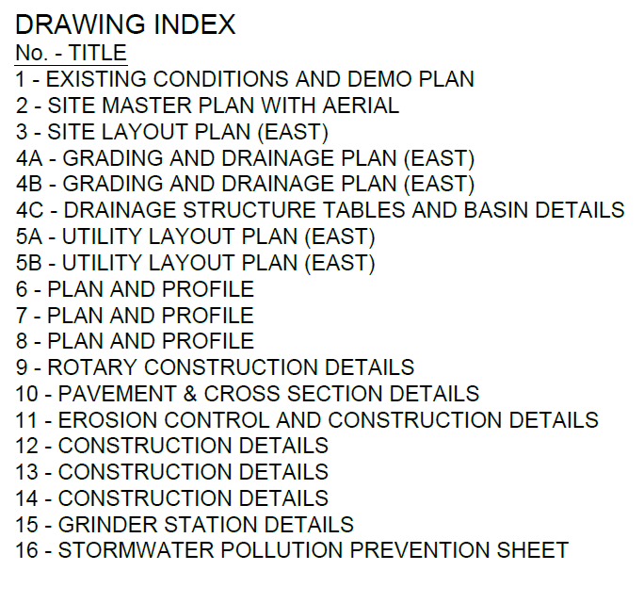
Where to Look for Details?
Notes:
Somewhere, usually on the cover page, or maybe on a page of its own if the plan set is really large, you should find a drawing index. Since we were looking at the grading and drainage plans, we’d want the drainage structure tables. *Click*

Slide 19
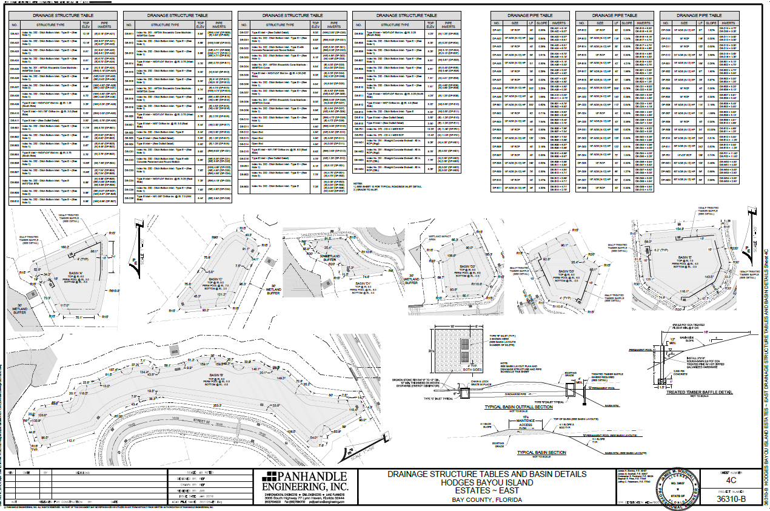
Drainage Structure Tables
Notes:
At the top, you can see where I’ve inserted the structure detail tables. This particular designer combined the tables with details with pictures of the stormwater treatment basins, to save space and make it much easier to go from drawing to table without having to flip pages back and forth. That’s really convenient, and might not be the case in other plan sets.

Slide 20
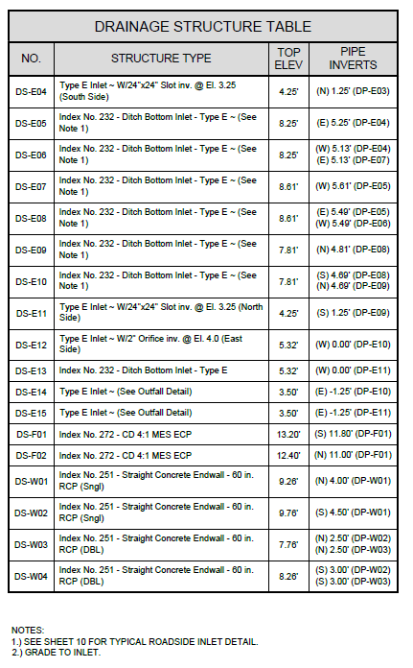
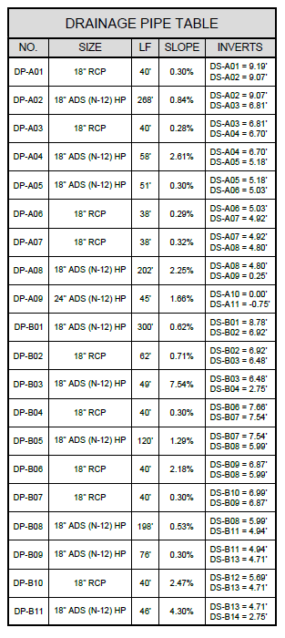
Drainage Structure Tables
Notes:
Here are examples of the tables for both structures and pipes. There’s a lot of good information here, especially the elevations, slopes and invert elevations. It’s a good idea to pick some, and follow the elevations for pipes and structures from intake to discharge, to make sure there wasn’t a mistake made, and they’re trying to make water flow uphill. How many depends on how much time you have to review, and how many there are. Do enough to give yourself reasonable assurance. *click* Also note that here, you have a note to see another page.

Slide 21
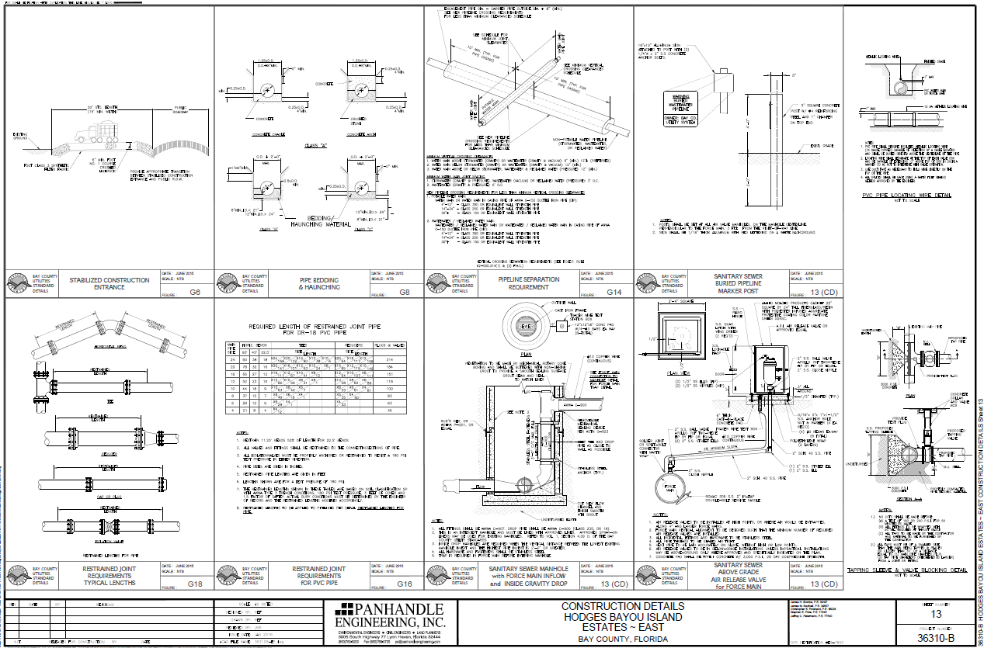
Construction Details
Notes:
Speaking of details, you’ll also see pages of them. Depending on the size and type of development, anywhere between 1 and a whole bunch. (That’s good to at least one significant digit.) Some of them will have drawings, like you see here. *click*

Slide 22
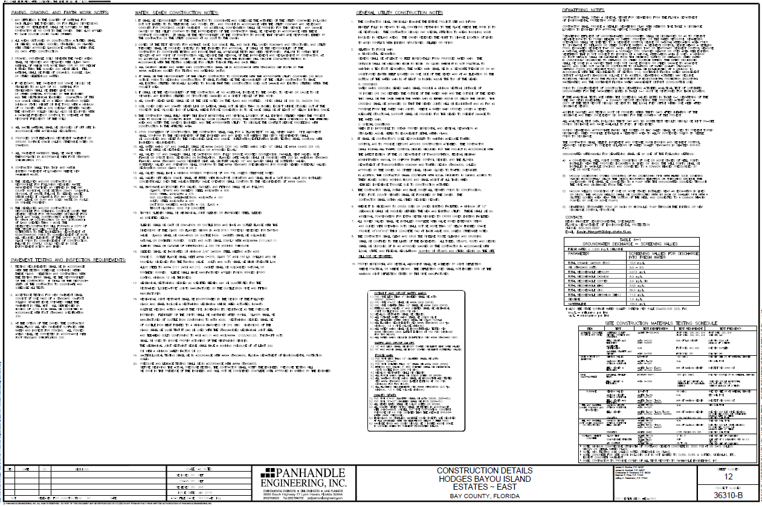
Construction Details
Notes:
Others won’t, like this one. One thing to remember about the details: They tend to be the same or similar from one project to the next, so the drafts-folk usually recycle them. That’s not necessarily a bad thing, since there’s no need to reinvent the wheel for each project. But that’s also an easy way for “errors and omissions” to creep in. It’s worth reading through them to make sure they all make sense for this project.

Slide 23

Questions and Discussion

Slide 24

Lee Marchman, P.E.
“My resume contains a laundry list of skills that were useful a couple of centuries ago” (Credit to Jim Butcher)
Lee’s Contact Info
BMC 625J
850-245-8520
X55520
Lee.Marchman@dep.state.fl.us
Award winning zymurgist.​ Superb chef. Long distance hiker. Advanced degreed engineer and scientist.​ Obsessive reader and collector of any written material. Skilled swordsman. Music connoisseur. Magnificent​ liar.

