Slide 1
Stormwater BMPs - Examples, Pitfalls, Your Questions Answered!
Third Tuesday Webinar Series
November 29, 2016

Slide 2

Topics
Design Requirements
Retention vs. Detention
  You mean they’re not the same??
Overview of Various BMPs
Q&A Throughout the Presentation

Slide 3
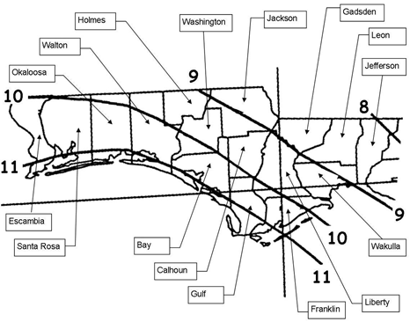
Design Requirements for Surface Water Management Systems
A (mostly) non-mathematical approach^{(*)}
Stormwater Quantity
  Rate and volume controls (i.e., flooding)
Stormwater Quality
^{(*)} If it can’t be expressed in figures, it is not science; it is opinion. (Robert Heinlein)
Notes:
This will be an introductory, very basic peek into the design of stormwater systems. We’re trying to control thtee things: how much water comes off a site, how fast it comes off, and how clean is the water when it runs off?

Slide 4
Stormwater Quality
Based on “First Flush” phenomena
~80% of Florida storms are one-inch or less
Pollutant removal goal is 80% of the average annual pollutant load
Therefore, if you treat 80% of the runoff from a one-inch storm, you’ve theoretically achieved the goal.
Usually called “treatment volume” by practitioners
Notes:
Dr. Marty Weinalista. First flush is pretty accurate for small drainage basins, but breaks down with larger ones.

Slide 5
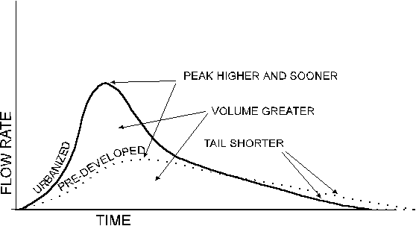
Stormwater Quantity
Notes:
Pre vs. post peak rates and volume discussion.

Slide 6
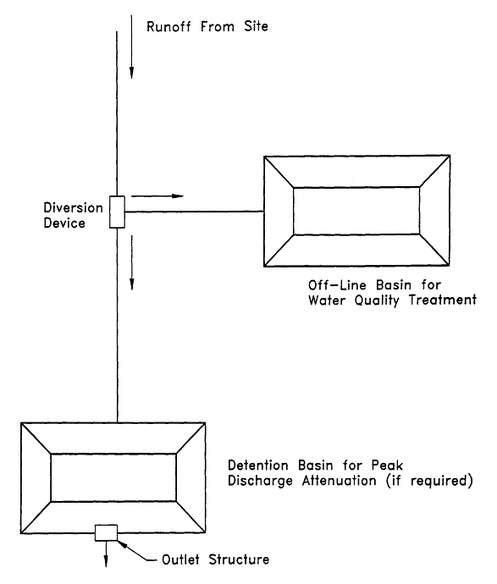
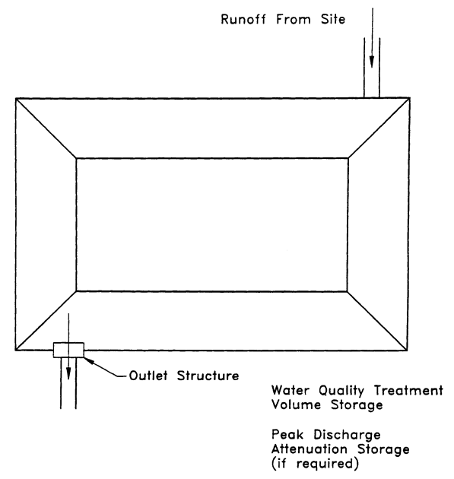
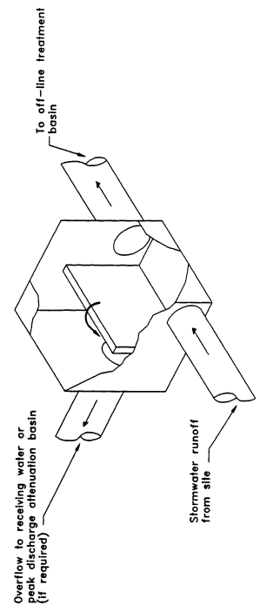
On-Line vs Off-Line Stormwater Systems
Off-Line Treatment System
On-Line Treatment System
Notes:
Exfiltration and vaults are always off-line.

Slide 7
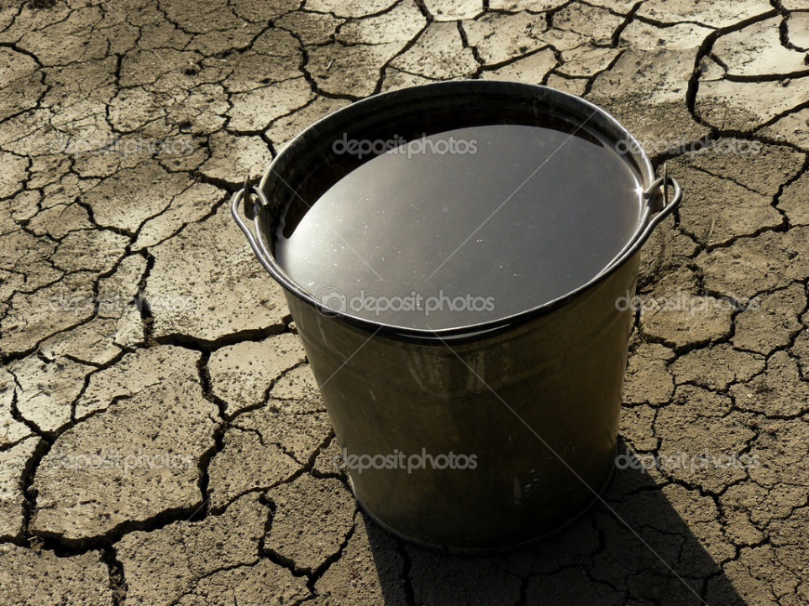
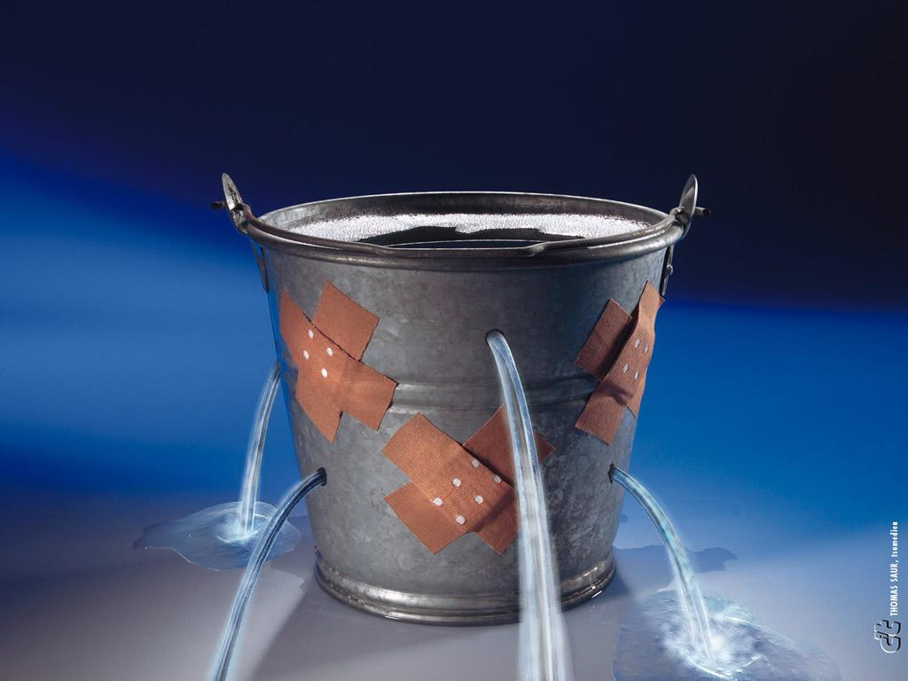
Retention vs. Detention
They’re not the same thing!
Retention
Detention
Notes:
Only two basic methods of treatment

Slide 8
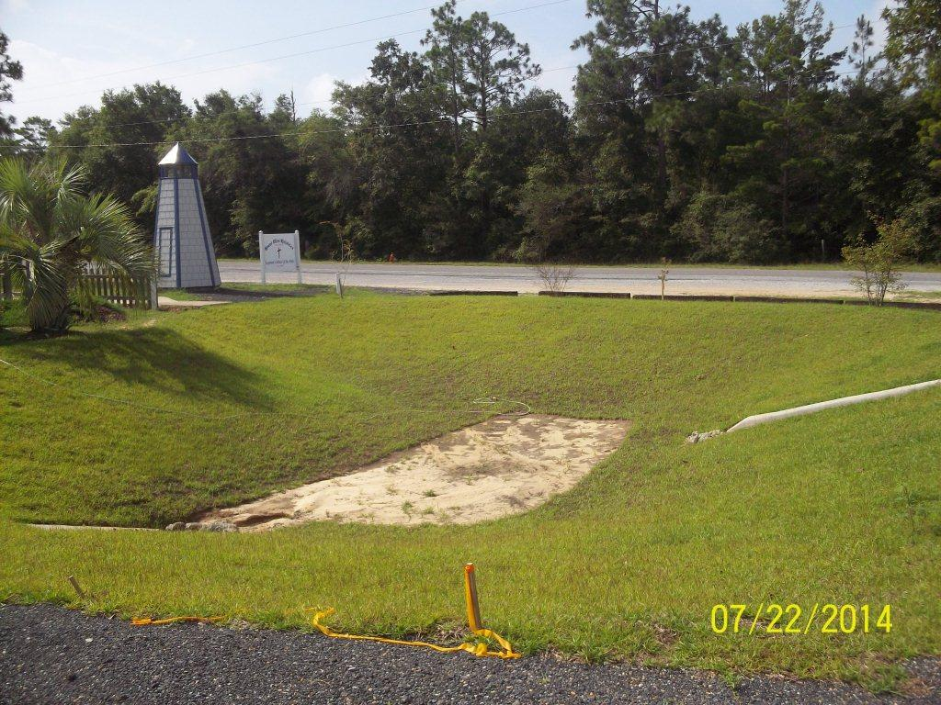
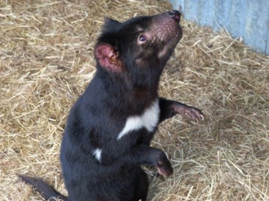
Retention Systems
Retention, Exfiltration, Underdrain, Vaults
Treat by holding water back for infiltration, evapotranspiration, etc., with no discharge to surface water
These systems are to recover the required treatment volume within 72 hours
Presumptive BMP presentation credits to Dana Palermo, P.E.
Notes:
Note: depending on design, vaults can be retention or detention

Slide 9
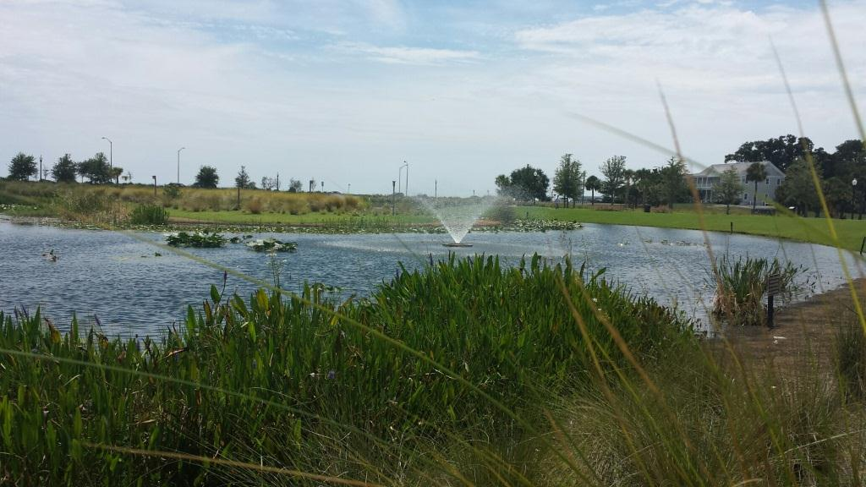
Detention Systems
Wet Detention, Dry Detention, Swales, Wetland Systems, Vegetated Natural Buffers, Stormwater Harvesting, Vaults
Treat by holding water for treatment, then release to surface water
Recovery times vary
Marsupial

Slide 10
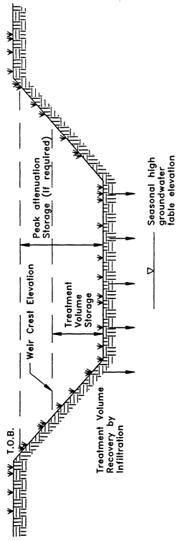
Retention
The term “retention system” is defined as a storage area designed to store a defined quantity of runoff, allowing it to percolate through permeable soils into the shallow ground water aquifer. Stormwater retention works best using a variety of retention systems throughout the project site. Examples of retention systems include:
  Man-made or natural depressional areas where the basin bottom is graded as flat as possible and turf is established to promote infiltration and stabilize the basin slopes
  Shallow landscaped areas designed to store stormwater
  Vegetated swales with swale blocks or raised inlets
  Pervious concrete with continuous curb
From Tasmania
Notes:
Need Class A or B soils to allow for percolation. Also need at least 2 feet between pond bottom and seasonal high water table. If coastal and soils are loose unconsolidated coarse sands, will not treat for nutrients (can correct with soil supplements). If off-line, can achieve 80% -- 95% removal. Can be designed to blend in with landscaping so you never know it’s there.

Slide 11
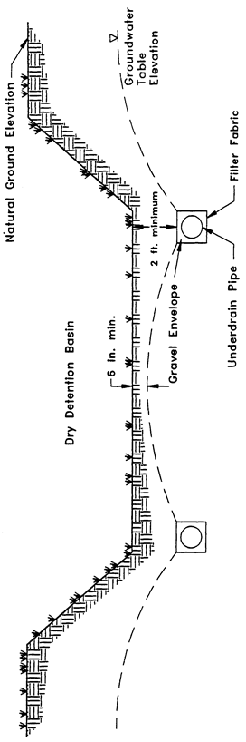
Underdrain
Stormwater underdrain systems consist of a dry basin underlain with perforated drainage pipe which collects and conveys stormwater following percolation from the basin through suitable soil
Underdrain systems are an option for the applicant where high water table conditions dictate that recovery of the stormwater treatment volume cannot be achieved by natural percolation (i.e., retention systems) and suitable outfall conditions exist to convey flows from the underdrain system to receiving waters
Underdrain systems are intended to control the water table elevation in the immediate vicinity of the treatment system in order to provide for the drawdown of the treatment volume. Underdrains are utilized where the soil permeability is adequate to recover the treatment volume since the on-site soils overlay the perforated drainage pipes
Notes:
Retention with high water table.

Slide 12
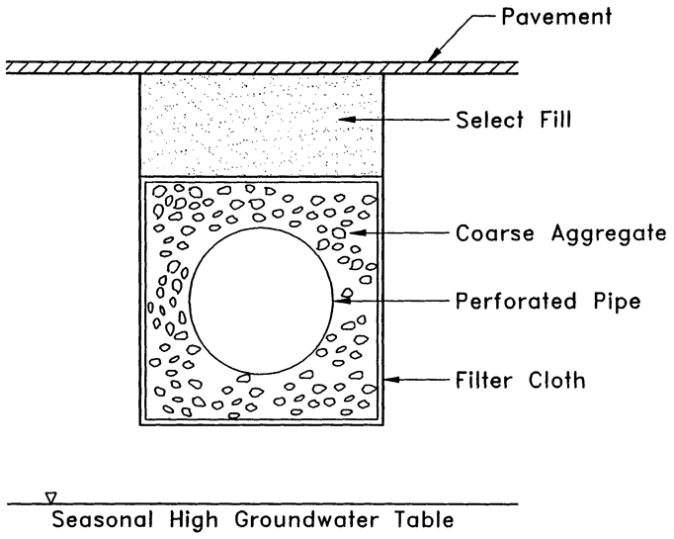
Exfiltration
An exfiltration trench is a subsurface system consisting of a conduit such as perforated pipe surrounded by natural or artificial aggregate which temporarily stores and infiltrates stormwater runoff
Generally, exfiltration trench systems are utilized where space is limited and/or land costs are high (i.e., downtown urban areas)
Soil permeability and water table conditions must be such that the trench system can percolate the required stormwater runoff treatment volume within a specified time following a storm event
Like retention basins, the treatment
volume in exfiltration trench systems
is not discharged to surface waters.
Thus, exfiltration is considered a
type of retention system
Notes:
Retention under the pavement.

Slide 13
Underground Vaults
Notes:
Special types of retention systems that capture the treatment volume in a “closed” environment, typically within a hardened structure. Generally, these systems have “open” bottoms in order to allow for soil infiltration.

Slide 14
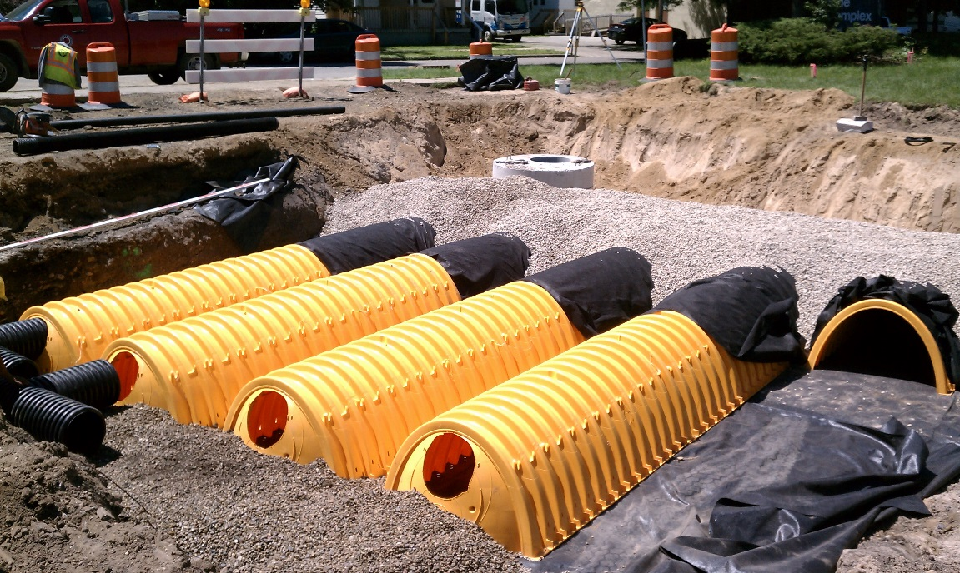
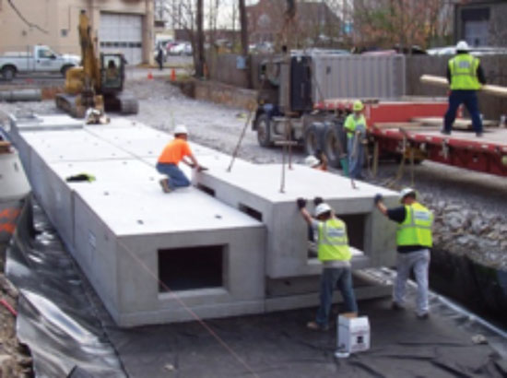
Underground Vaults
Hungry Marsupial from Tasmania
A poor design option
Maintenance worker safety is a concern in these types of “confined space” systems due to the anaerobic environment.
Notes:
OSHA confined space entry permit often required for each maintenance inspection. Vaults can also be used for detention; in New York City, they’re put in basements to collect a building’s runoff.

Slide 15
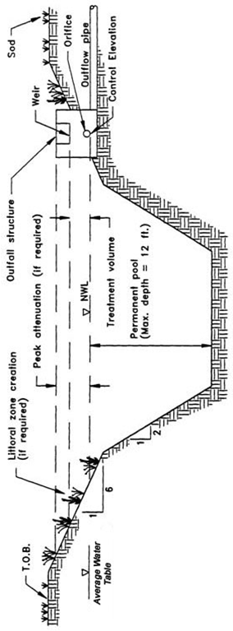

Wet Detention
Wet detention systems are permanently wet ponds which are designed to slowly release collected stormwater runoff through an outlet structure
Wet detention systems are the recommended BMP for sites with moderate to high water table conditions
Wet detention systems offer an effective alternative for the long term control of water levels in the pond, provide a predictable recovery of storage volumes within the pond, and are easily maintained by the maintenance entity
Tasmanian Devil Credits to Michael Bateman, P.E.
Notes:
Reasons for selection: high ground water table, or the project needs fill. Littoral zones required (some WMDs have an opt-out condition). Residence time is treatment: sedimentation, nutrient uptake by algae and/or fringe vegetation.

Slide 16
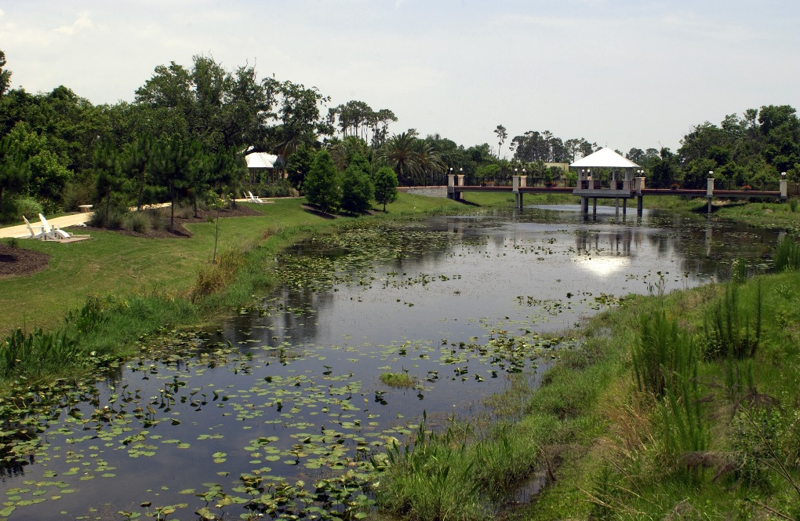
Wet Detention
Wet Detention treatment systems are required to treat the one inch of runoff from the contributing area
The outfall structure shall be designed to drawdown one-half the required treatment volume between 48 to 60 hours
Notes:
Can be designed to be very esthetically pleasing, and people are willing to pay more for “lake” front property. Can also be a muddy square pond with a chain link fence around it.

Slide 17
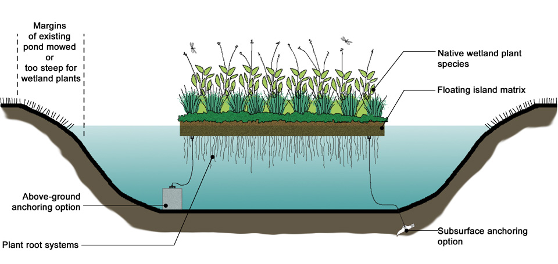
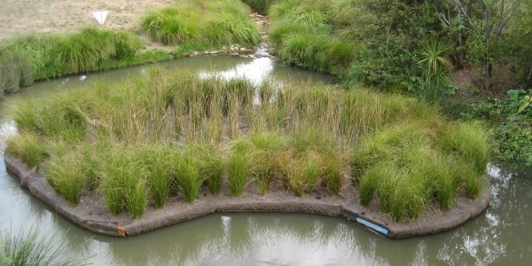
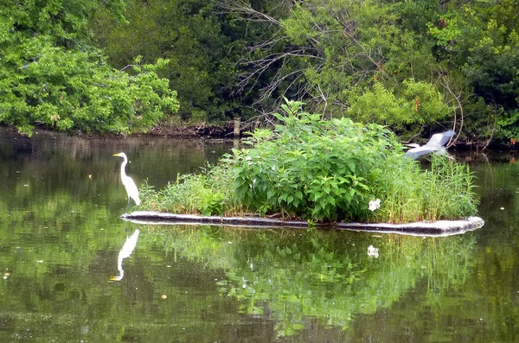
Floating Islands or Littoral Zones: A Variation
Notes:
An alternative to the usual littoral zone. The idea is that the root system is always where it should be for nutrient uptake. Also resists the Channeled Apple Snail invasion. Unfortunately, removal rates tend to be all across the board, usually from failure to harvest and incorrect installation.

Slide 18
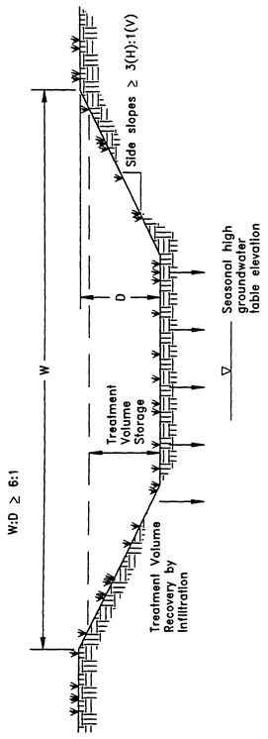
Swales
Swales are a man-made or natural system shaped or graded to specific dimensions and designed for the conveyance and rapid infiltration of stormwater runoff
Swales are designed to infiltrate a defined quantity of runoff through the permeable soils of the swale floor and side slopes into the shallow ground water aquifer
Soil permeability and water table conditions must be such that the swale can percolate the desired runoff volume from the 3-year, 1-hour storm event
The swale holds water only during and immediately after a storm event. Unlike retention basins, swales are “open” conveyance systems. This means there are no physical barriers such as berms or check-dams to impound the runoff in the swale prior to discharge to the receiving water. Swales can also be included within a series of systems
Notes:
Open conveyance system; treats while discharging. Statutory definition of swales: Top width to depth ration ≥ 6:1 or side slopes 3:1 or flatter. A ditch is not a swale!

Slide 19
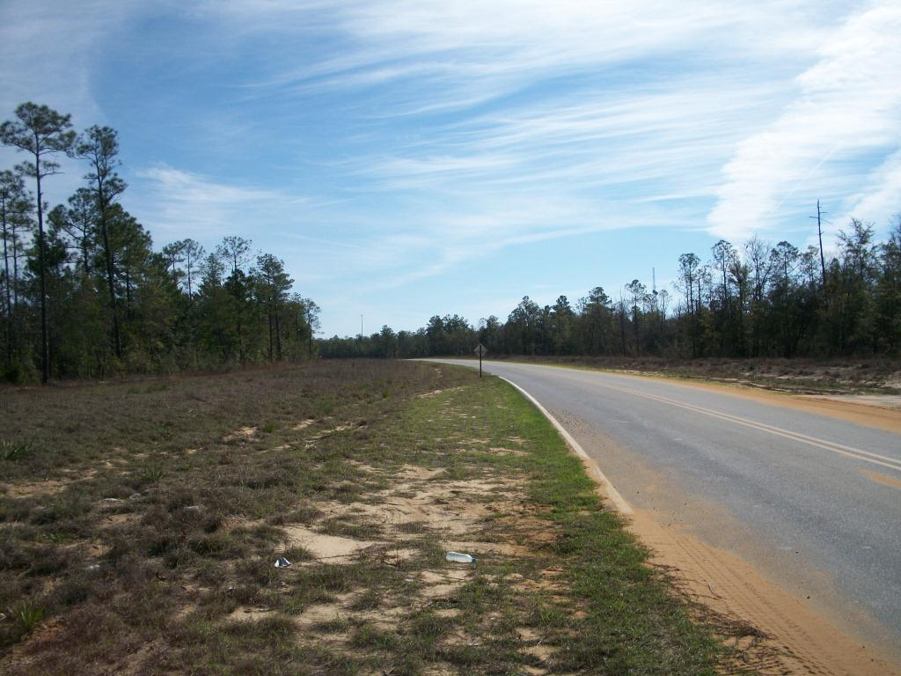
Swales
Swales should be designed to percolate 80% of the runoff from the 3 year / 1 hour design storm event (100% for discharge to OFW)
Swales must be within Hydrologic Soils Group (HSG) A or B soils
Notes:
3 yr./1 hr. storm is a lot of water (2.6 inches in Panhandle). A clever designer will specify ditch blocks, turning a swale into a series of linear retention ponds, a smaller treatment volume with presumably equivalent treatment.

Slide 20
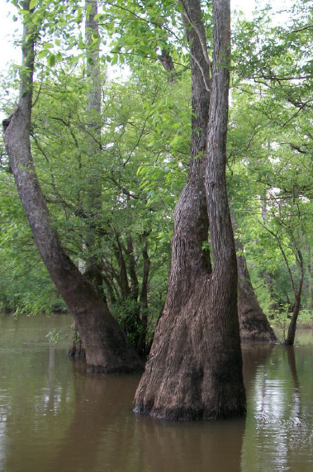
Wetland Stormwater Management System
By using wetlands for stormwater management, drained wetlands can be revitalized and landowners and developers have greater incentive to preserve or restore wetlands
For wetlands stormwater management systems the Agency must ensure that a proposed wetlands stormwater management system is compatible with the existing ecological characteristics of the wetlands proposed to be utilized for stormwater treatment
The Agency must also ensure that water quality standards will not be violated by discharges from wetlands stormwater management system
Notes:
Not in every AH II. Unless properly managed, winter die-off can turn nutrient removal rates negative. Plants should be harvested from time to time.

Slide 21
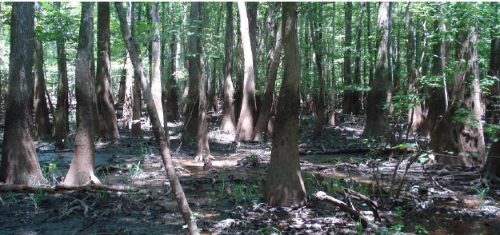
Wetland Stormwater Management System
Types of Wetlands that may be utilized for stormwater treatment
The only wetlands which may be considered for use to provide stormwater treatment are those which are
  isolated and wholly-owned by one individual
  connected to other waters solely by artificial watercourses

Slide 22
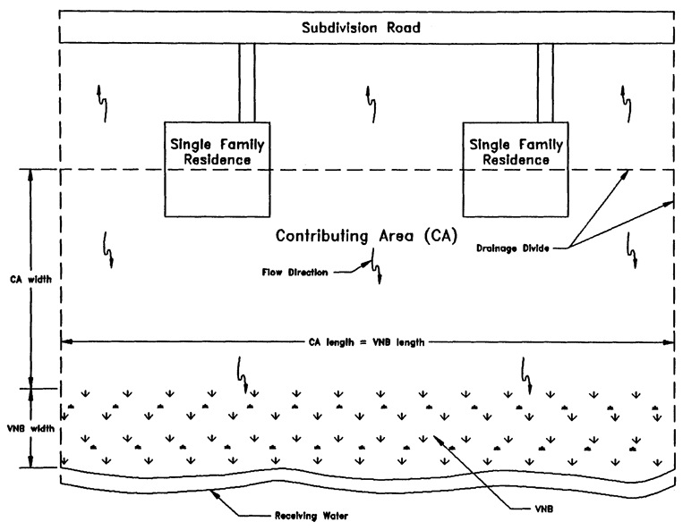
Vegetated Natural Buffer
Vegetated natural buffers (VNB) are defined as naturally vegetated areas that are set aside between developed areas and a receiving water or wetland for stormwater treatment purposes.
VNBs are sometimes an effective best management practice for the control of nonpoint source pollutants in overland flow
Notes:
Not in every AH II. Treatment is by overland flow and infiltration. Recall that undeveloped land typically infiltrates up to 70+% of rainfall.

Slide 23
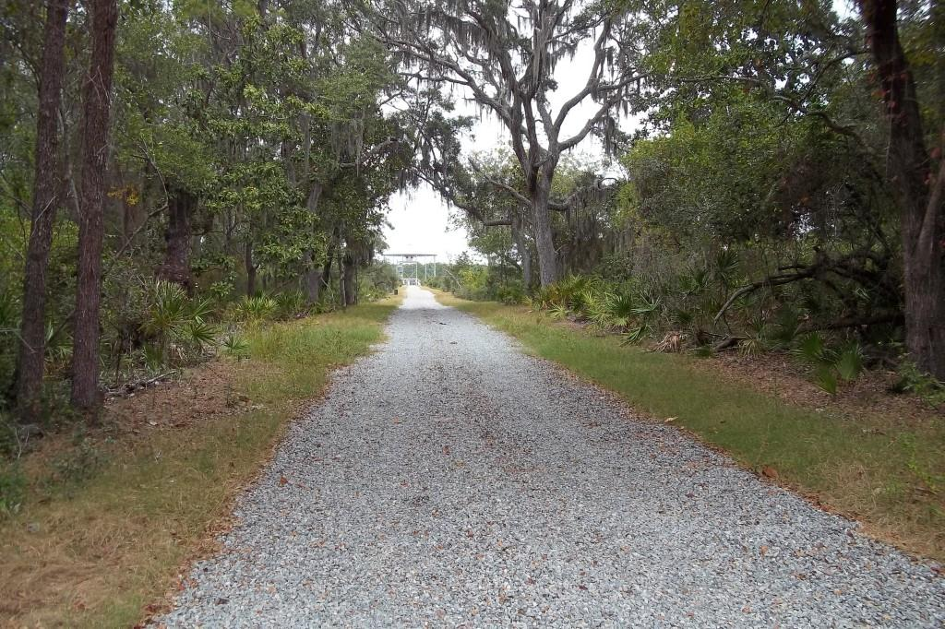
Vegetated Natural Buffer
VNBs are most commonly used as
an alternative to swales or berms
typically installed between
back-lots and the receiving water.
Potential impacts to adjacent
wetlands and upland natural areas
are reduced and can serve as
wildlife corridors, reduce noise,
and reduce the potential for
siltation into receiving waters.
Vegetative natural buffers are not intended to be the primary stormwater
management system for residential developments. They are most commonly
used only to treat those rear-lot portions of the development
that cannot be feasibly routed to the system serving the roads and fronts of lots.
Notes:
Leaving natural areas is contrary to the usual development practice of cutting down trees and naming streets after them. Also, contrary to the paragraph in red, the photo shows a state park road utilizing VNBs as the sole treatment!

Slide 24
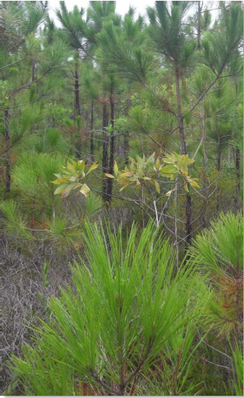
Vegetated Natural Buffers
VNBs must provide a travel time of 200 seconds by overland flow through the buffer for receiving water bodies (other than OFWs) for the 2 year / 24 hour storm event; at least 300 seconds for receiving water bodies being OFWs.

Slide 25
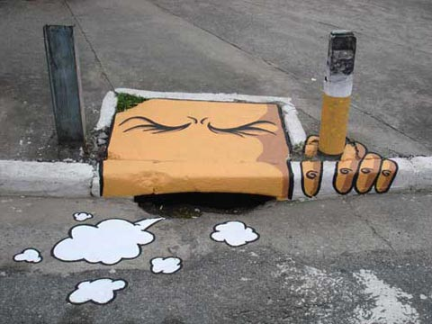
Florida Statewide Stormwater Rule
SSR not adopted; no work on rule since 2011
DEP, WMD’s will still accept designs
Handbook still available on-line: http://www.dep.state.fl.us/WATER/wetlands/erp/rules/stormwater/index.htm
Notes:
That’s a quick roundup of the more conventional systems. So, enter the old State Stormwater Rule attempt. One of the goals for the rule was to introduce a number of “new” BMPs, including LID. The Applicant’s Handbook is mostly finished, especially the section on LID. Even though it was never adopted by rule, applicants can propose BMPs from it under the alternative criteria section of the current rule.

Slide 26


Low Impact Development (LID)
What it is…
And what it isn’t.
"Any sufficiently advanced technology is indistinguishable from magic.“
Arthur C. Clarke
Notes:
Agency encourage low impact development, but haven’t really promoted it. LID isn’t even in any of the AH II’s.

Slide 27
What is LID?
Comprehensive approach
Hydrology integrated into framework
Simple, nonstructural methods
Control stormwater at the source
Microscale stormwater management
Decentralized BMPs and dispersed flows
Multifunctional landscape and infrastructure

Slide 28
ERP and Regulatory Framework
ERP rules don’t reference LID, but it easily fits:
Presumptive Criteria (volume based):
Retain first ½ inch of runoff
Retain first ¾ inch of runoff (direct OFW discharge)
Non-Presumptive Criteria (load based):
80% pollutant removal
95% pollutant removal (direct OFW discharge)
Net Improvement (load based):
Post-development pollutant load < pre-development for pollutant of impairment

Slide 29
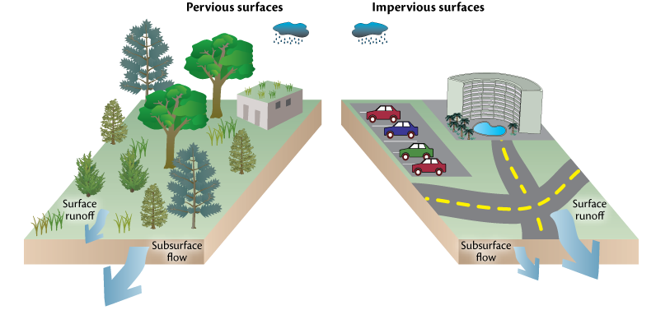
LID Non-Structural BMPs
Minimize disturbance
Protect vegetation, trees, wetlands
Minimize soil compaction
Reduce/disconnect impervious surfaces
Minimize pollutant sources
Minimize runoff volume/load
Don’t need to treat runoff you don’t produce!

Slide 30
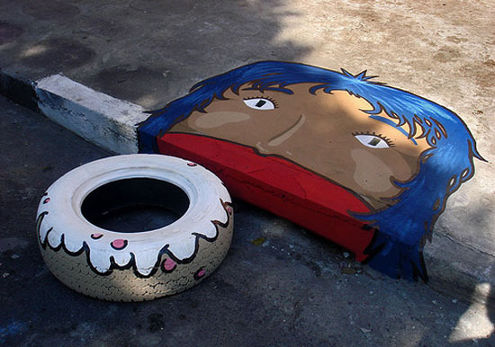
LID Structural BMPs
Retention basin and swales (already discussed)
Pervious pavement
Filter strips
Greenroofs
Stormwater harvesting
Biofiltration systems

Slide 31
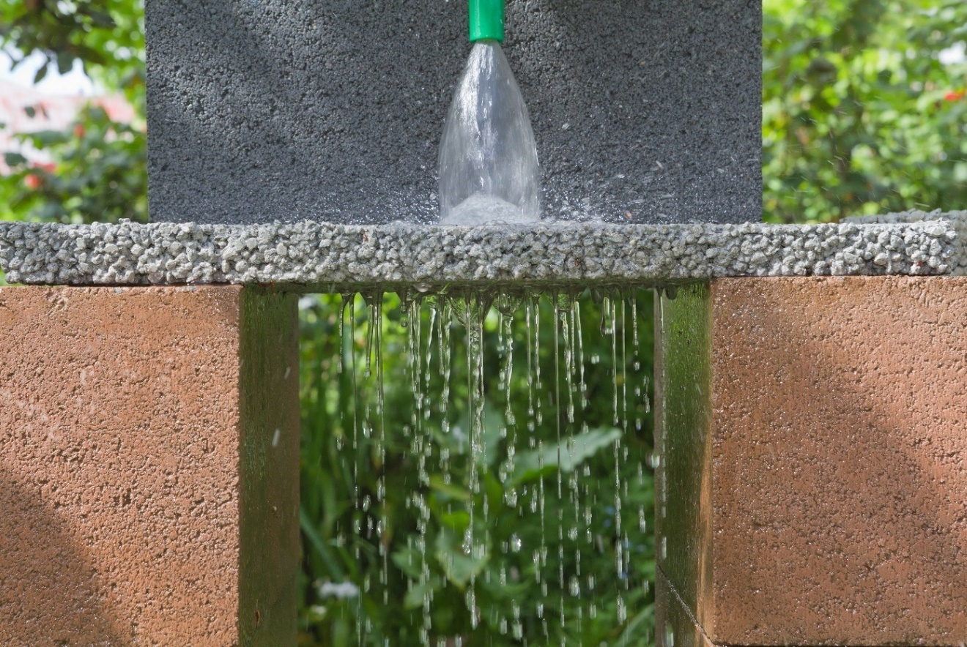
Pervious Pavement
“From an ERP perspective, pervious pavement is just a retention pond with cars on top.”
Hank Higginbotham, P.E.

Slide 32
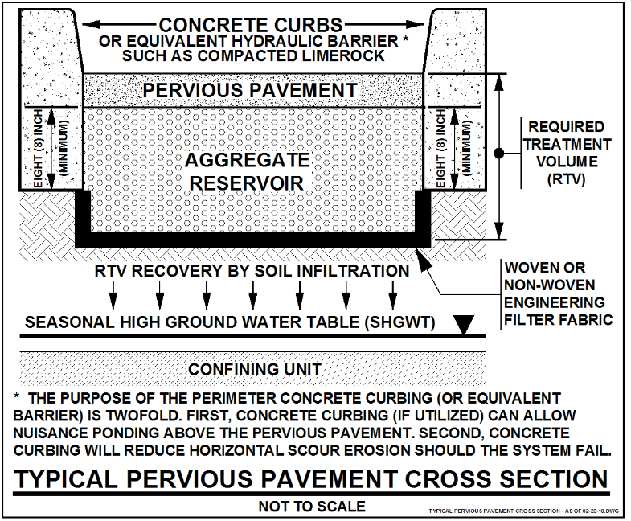
Pervious Pavement

Slide 33
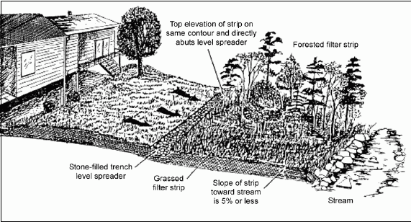
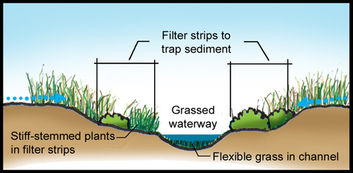
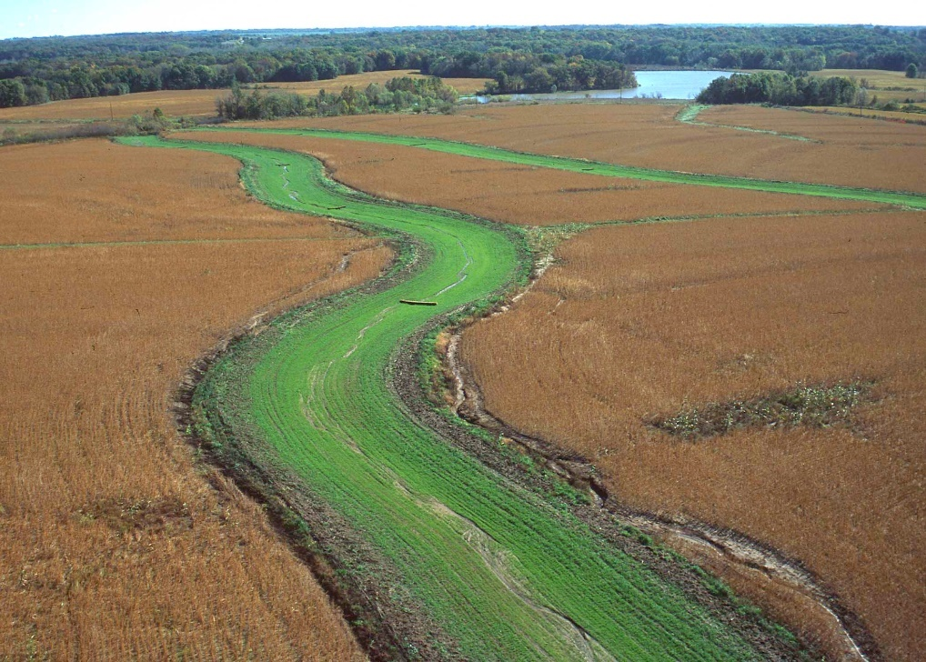
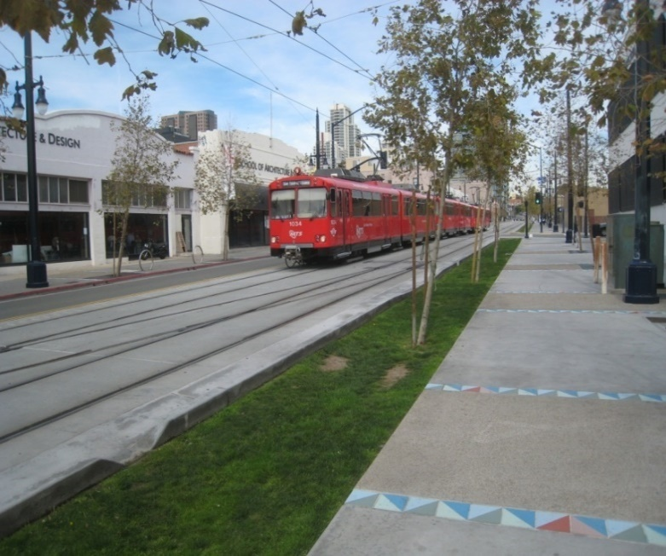
Filter Strips
Notes:
Filter strip is really just another application of vegetated natural buffers.

Slide 34
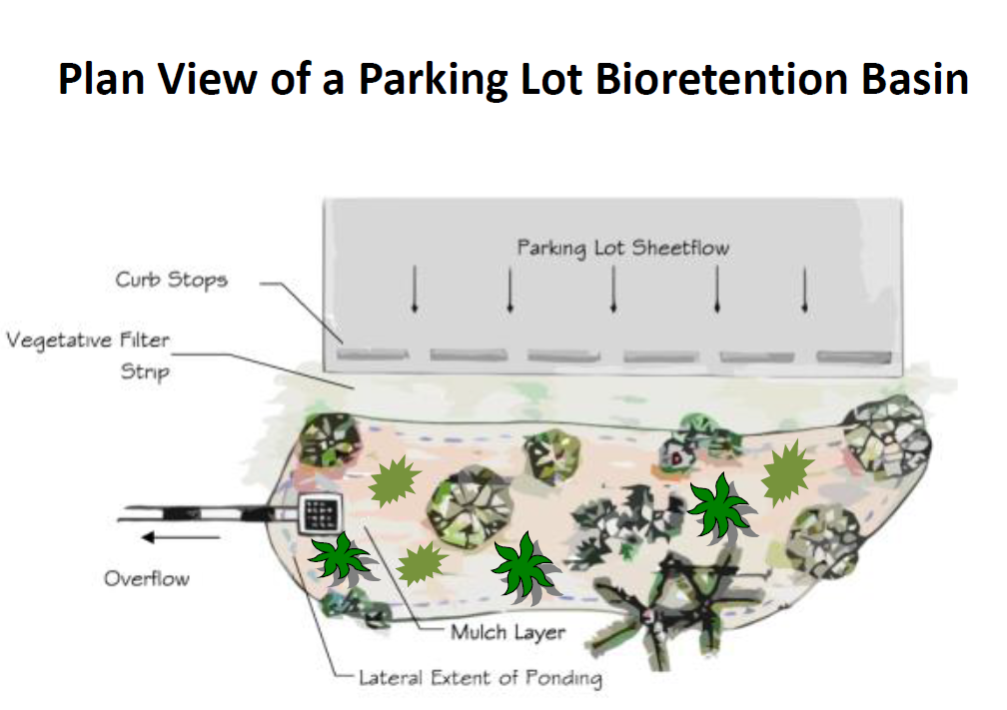
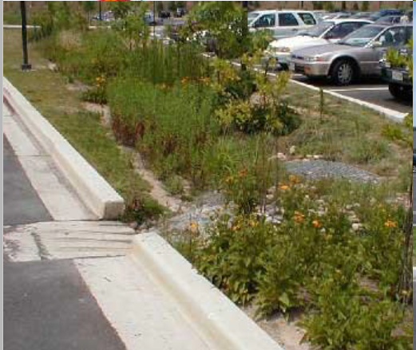
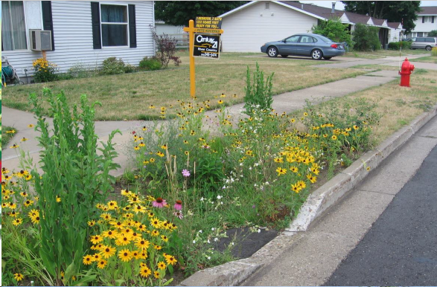
Biofiltration
From an ERP perspective, retention by any other name…is still retention.
Notes:
Biofiltration is just retention made pretty.

Slide 35
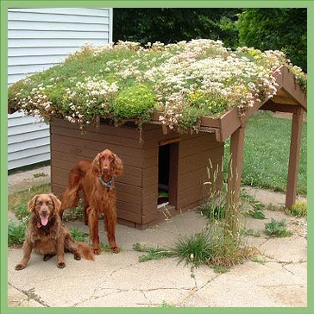
Green Roofs/Cistern Systems

Slide 36
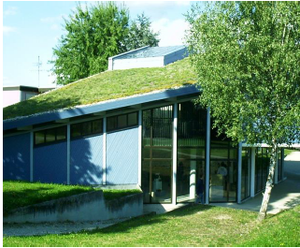
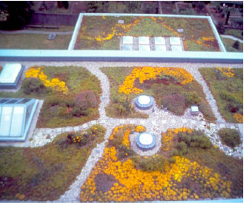
Green Roofs/Cistern Systems
Reduces volume of discharge and mass of pollutants
Neutralization of acid rain
Reduction of urban heat island effect
Increased roof lifespan (40+ years)
Sound insulation
Habitat and biodiversity
Reduction of heating and cooling costs by 25% to 50%
Notes:
Not in any AH II

Slide 37
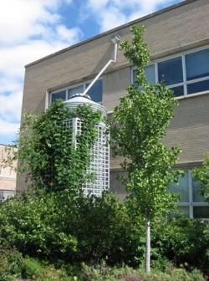
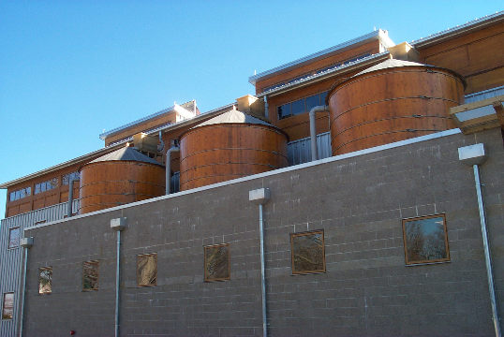
Green Roofs/Cistern Systems
Should be coupled with a cistern to collect and recycle runoff to irrigate roof
Notes:
You can have a cistern without a green roof, but can’t have a green roof without one.

Slide 38
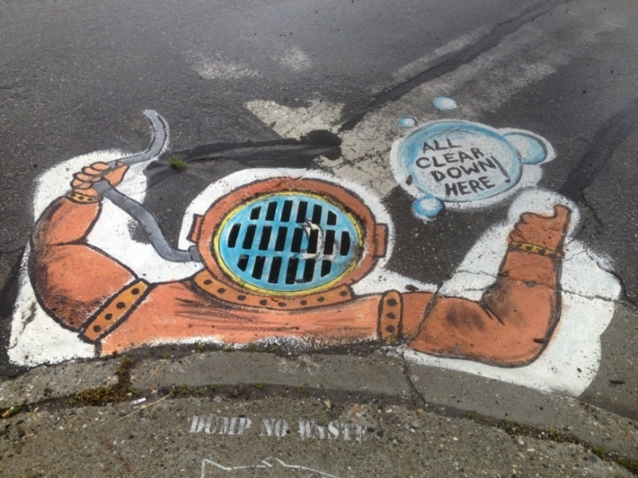
Green Roofs in Florida
Introduced to Florida in 2003: Now, at least 15 locations in Florida
UCF Student Union, Physical Science and Stormwater Lab (3)
FSGE (Envirohome) (2) in Indialantic
Bonita Bay (first one and has been modified for irrigation)
New American Home in Orlando
Charlotte County Stadium
UF Perry Construction Yard Building
Tecta-America Building in Sanford (tray vs. continuous)
Romano Eco Center in Lake Worth
Honda Headquarters in Clermont
Escambia County One Stop Permit Building
Residence on Casey Key
Orlando Fire Station #1
Environmental Center, Key West
Kimley-Horn in Vero Beach
Gulf Coast College in Panama City
Notes:
Started and evaluated at UCF.

Slide 39
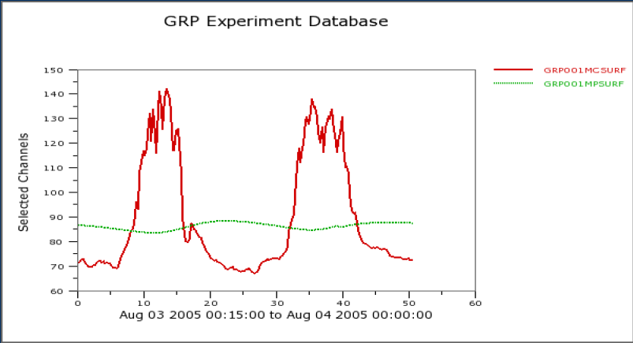
Green Roofs/Cistern Systems
Example Temperature Comparisons (ºF) at UCF Green Roof
Conventional Roof (red) vs. Green Roof (green) at roof surface

Slide 40
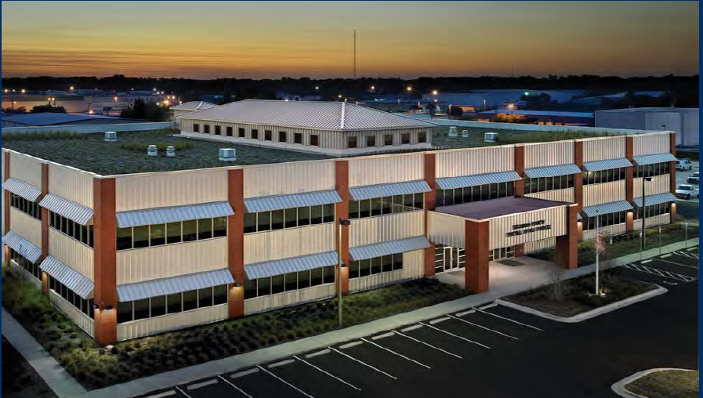
Green Roofs/Cistern Systems
Escambia County’s Central Office Complex
“Largest Green Roof in Florida”
33,500 sq. ft. of green roof area

Slide 41

Central Office Complex
FDEP TMDL category grant funding ($285,398.80)
LEED Gold Certification – credits for stormwater management, reduction of heat island effect, water efficient landscaping, optimized energy performance
Rating: 84
  National average: 50
Annual Energy Cost: $124,000/year
  National Average: $185,000/year
Notes:
Funding $285,398.8

Slide 42
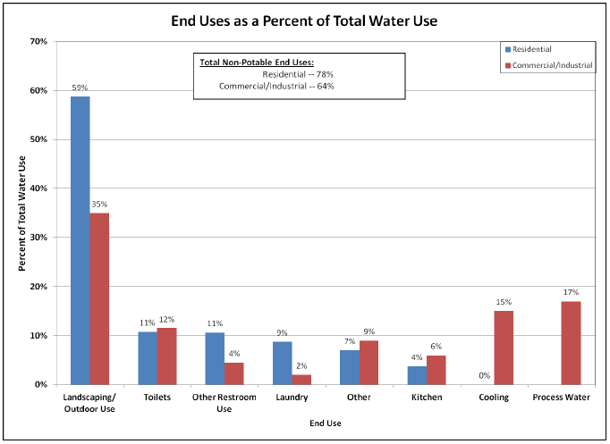
Stormwater Harvesting (Reuse)
Source: Rainwater Harvesting, EPA-841-R-13-002, Jan. 2013
Notes:
We started by calling it stormwater reuse, but the “real” reuse people threw a fit. About 50% of potable water delivered to residential units is used for irrigating lawns.

Slide 43
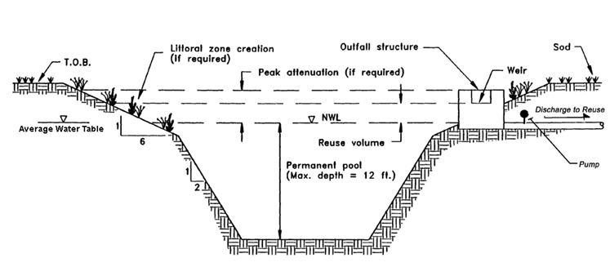
Stormwater Harvesting (Reuse)
The Agency encourages the use of stormwater reuse systems because of the following benefits they provide
  Reduction of runoff volume discharged to the receiving waters
  Reduction of pollutants discharged to the receiving waters
  Substitution of stormwater use instead of potable ground water withdrawals
  Potential economic savings from not having to pay user fees for potable water
Notes:
The agency does encourage this option. I know that because at least one AHII says so. Not as much as they could or should. This option isn’t even available in all AHIIs. (I think only two)

Slide 44
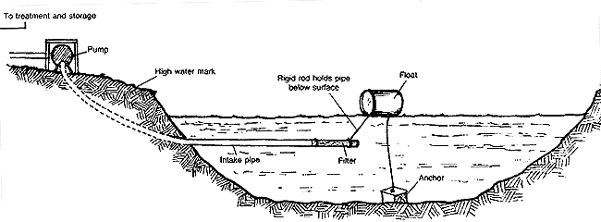
Stormwater Harvesting (Reuse)
Notes:
Cyanobacteria a.k.a. blue green algae

Slide 45

Stormwater Harvesting (Reuse)
A portion of the runoff from the site must be stored in the pond and withdrawn through the reuse system.
  Reuse at least 50 percent for sites discharging to a Class III receiving water bodies.
  Reuse at least 90 percent for sites discharging to an OFW.

Slide 46
Stormwater Harvesting (Reuse)
Stormwater reuse systems are designed to prevent the discharge of a given volume of stormwater into surface waters of the state by deliberate application of stormwater runoff for irrigation or other acceptable supplemental water uses
  Supplemental uses include hydration of wetlands, low flow augmentation, cooling water, process water, and wash water
A stormwater reuse pond is similar to a wet detention system except for the drawdown of the treatment volume storage
A stormwater reuse system has a mechanical reuse system which recovers the treatment volume storage by withdrawing water from the pond
In a reuse pond the treatment volume is termed "reuse volume" and the "control elevation" is the lowest elevation at which water can be withdrawn from the pond by the reuse system
Notes:
Again, way too many words on the page!

Slide 47

Chemical Treatment
Lake Ella
Notes:
Also not in current AH II’s, but in the proposed SSR AH, chemical treatment uses metal salts to rapidly precipitate nutrients, solids, heavy metals, and bacteria from runoff. Virtually all of the existing chemical stormwater treatment systems in the State of Florida use alum.

Slide 48
Chemical Treatment
Often has a smaller footprint (good for retrofits)
Requires more frequent maintenance by trained operator
Usually automated, injecting liquid alum into storm sewer lines on flow-weighted basis
Originated in Lake Ella (1986)
Lime, ferric sulfate and/or ferric chloride also used
Removal is a combination of enmeshment, adsorption and chemical transformation

Slide 49



Chemical Treatment
Lake Ella

Slide 50


Chemical Treatment
L-Street Pond Retrofit, Pensacola
Lake Ella

Slide 51

Dry Detention
ONLY available in SFWMD
Treats by detaining water over 72 hour period
Sedimentation is the primary pollutant removal mechanism due to short residence time

Slide 52

Dry Detention
Biological activity is severely limited
Removal efficiencies for dissolved constituents (nutrients) are low
Notes:
It’s common practice to design multiple smaller interconnected basins, rather than a single large basin. Helps increase efficiency, and allows the system to “spread out” into unused portions of the project area. Very poor performance for nutrients, falling far short of the required removal efficiencies. (Draft report for study by Dr. Harvey Harper, P.E.)

Slide 53

Detention with Filtration

Slide 54

Cautions Concerning the Use of
Detention with Filtration Systems
Prone to failure and high operation and maintenance (O & M) cost.
Such filter systems should only be considered where no other Best Management Practice (BMP) is feasible.
Not in every Applicant’s Handbook II, but allowed under the Alternative Design Section of Applicant’s Handbook Volume I

Slide 55
Issues Related to the Use of
Detention with Filtration Systems
Periodic in-situ testing for the life of the system
Routine inspection and cleaning by pressure back-washing
Annual reports prepared by a registered professional are necessary
Sufficient budgeting for O&M costs, that accounts for inspection and maintenance activities as well as periodic replacement of the filter
Heightened design considerations when proposed in poorly drained soils
Placement of systems within the wet SHGWT require more construction and O&M cost due to system being designed to eliminate groundwater intrusion
Use of system is limited to small drainage areas (less than five acres) such as highly imperious commercial/industrial sites that are well stabilized with little potential for erodible soils, organic matter, or other materials to impact the filter function. Filters are not recommended for subdivisions where homeowners’ associations are responsible for maintenance
Special protection of the filter bed from the time of construction until the site has been stabilized to prohibit blinding with silty material, excessive compaction, or damage to the drainage system

Slide 56

Biofiltration – Tree Box Filter

Slide 57




Biofiltration – Tree Box Filter

Slide 58

Bio-Sorption Activated Media (BAM)

Slide 59
Bio-Sorption Activated Media (BAM)
Sorption is a physiochemical process that occurs with solid media to build-up or concentrate pollutant(s) onto the media.
Activation occurs when the media and the working environment are altered to improve removal, sometimes by physical measures or biological means.
Thus BAM is a media for pollutant removal that has sorption properties in a specific environment.
Notes:
Another blatant violation of the “too many words” rule. Suffice to say that BAM sucks pollutants out of water like a sponge. In this state, we’ve mostly focused on nitrogen and phosphorus, but it can be fine-tuned to adsorb many other contaminants.

Slide 60
Possible Sources for BAM
Expanded Clay
Peat
Sandy/Loamy/Clayey Soils
Untreated Sawdust
Paper/Newspaper
Palm Tree Fronds
Tire Crumb or Chips
Limestone
Crushed Shells
Wood
Sawdust (untreated)
Activated Carbon
Compost
Coconut Coir
Notes:
One thing to notice about these sources; they’re all cheap and some of them are waste products.

Slide 61

Bio-Sorption Activated Media (BAM)
Over 15 years of experience at UCF
60-90% reduction in nitrate, and 80-90% reduction in phosphorus are achievable and typical removal ranges
Long life span (20+ years)
Many deployment options available (seemingly only limited by imagination!)
Retention basins, swales, rain gardens, exfiltration, baffle boxes, tree wells, pervious pavement, greenroofs, side drains, vegetated filter strips.
Notes:
Retention basins, swales, rain gardens, exfiltration, baffle boxes, tree wells, pervious pavement, greenroofs, side drains, vegetated filter strips.

Slide 62

Slide Credit to Clark Hull
Notes:
How far out into left field can we go? Being proposed by Clark Hull and Eric Livingston.

Slide 63

Retention Ponds in the Sky
First line of defense in stormwater source control
Increase evapotranspiration
A tree canopy can intercept 15-20% of water that falls on leaves
Cover impervious surface and shade buildings
Photo credit: Pooktre Tree Shapers

Slide 64

Lee Marchman, P.E.
“My resume contains a laundry list of skills that were useful a couple of centuries ago” (Credit to Jim Butcher, but mine does, too)
Lee’s Contact Info
BMC 625J
850-245-8520
X55520
Lee.Marchman@dep.state.fl.us
Award winning zymurgist.​ Superb chef. Long distance hiker. Advanced degreed engineer and scientist.​ Obsessive reader and collector of any written material. Skilled swordsman. Music connoisseur. Magnificent​ liar.

