Slide 1
Technical Staff Reports (TSRs)
SLERC 2017
Allyson Minick

Slide 2
Why do we do a Technical Staff Report?
Chapter 120, F.S. Administrative Procedure Act
Licensing (120.60, F.S.) provides procedures for the processing of an application for a license.
  3) Each applicant shall be given written notice, personally or by mail, that the agency intends to grant or deny, or has granted or denied, the application for license. The notice must state with particularity the grounds or basis for the issuance or denial of the license, except when issuance is a ministerial act. Unless waived, a copy of the notice shall be delivered or mailed to each party’s attorney of record and to each person who has made a written request for notice of agency action. Each notice must inform the recipient of the basis for the agency decision, inform the recipient of any administrative hearing pursuant to ss. 120.569 and 120.57 or judicial review pursuant to s. 120.68 which may be available, indicate the procedure that must be followed, and state the applicable time limits. The issuing agency shall certify the date the notice was mailed or delivered, and the notice and the certification must be filed with the agency clerk.
Notes:
Chapter 120, F.S. the Administrative Procedure Act, provides uniform procedures for the exercise of specified authority. For us at FDEP, this includes procedures for public meetings, hearings, and workshops, rulemaking, variances, waivers, publication, rule challenges, declaratory statements, mediation, summary hearing, Attorney’s fees, licensing, judicial review, enforcement of agency action, notice of non compliance, circuit court proceedings, and regulatory plans.
Specifically, the licensing section (102.60, FS) provides the procedures for processing a License (a.k.a. Permit). Paragraph (3), states that each applicant shall begiven written notice that the agency intends to grant of deny the application for a license (permit), the notice must that with “particularity” the grounds or basis for the issuance of denial of a license. Paragraph 3, further requires the notice to 1). inform the recipient of the basis for the agency decision, and 2) inform the recipient of any administrative hearing or judicial review available, and indicate the procedure to follow (the procedures for this are also in the Administrative Procedure Act). *2 This is the Notice of Rights

Slide 3
Where does the content in the Technical Staff Report come from?
5.5.4.1 Agency staff will commence the technical review when the application for an individual permit is complete. Criteria used in the evaluation will include Rules 62-330.075 (if the activity is located on state-owned submerged lands), 62-330.301 and 62-330.302, F.A.C., Parts II through V of this Volume, and Volume II, as applicable.
  The decision to issue or deny a permit will be based on a determination of whether the reasonable assurances required in the above rules and the Handbook have been provided, including the provisions for elimination or reduction of adverse impacts to wetlands and other surface waters, and a determination of whether mitigation is appropriate to offset those adverse impacts.
Notes:
Applicant’s Handbook Volume I, Section 5.5.4, Staff Evaluation and Agency Action contains the following.
“Criteria used in evaluation will include rules 62-330.075 (if located on SL’s), 62-330.301 (Conditions for Issuance), 62-330.302 (additional Conditions of Issuance) and Parts II – V of AH. Vol. I, and Vol. II as applicable (stormwater review criteria)

Slide 4
Conditions for Issuance of Individual and Conceptual Approval Permits
62-330.301, F.A.C.
(1) To obtain an individual or conceptual approval permit, an applicant must provide reasonable assurance that the construction, alteration, operation, maintenance, removal, or abandonment of the projects regulated under this chapter:
(a) Will not cause adverse water quantity impacts to receiving waters and adjacent lands;
(b) Will not cause adverse flooding to on-site or off-site property;
(c) Will not cause adverse impacts to existing surface water storage and conveyance capabilities;
(d) Will not adversely impact the value of functions provided to fish and wildlife and listed species by wetlands and other surface waters;
(e) Will not adversely affect the quality of receiving waters such that the state water quality standards set forth in Chapters 62-4, 62-302, 62-520, and 62-550, F.A.C., including the antidegradation provisions of paragraphs 62-4.242(1)(a) and (b), F.A.C., subsections 62-4.242(2) and (3), F.A.C., and Rule 62-302.300, F.A.C., and any special standards for Outstanding Florida Waters and Outstanding National Resource Waters set forth in subsections 62-4.242(2) and (3), F.A.C., will be violated;
(f) Will not cause adverse secondary impacts to the water resources. In addition to the criteria in this subsection and in subsection 62-330.301(2), F.A.C., in accordance with Section 373.4132, F.S., an applicant proposing the construction, alteration, operation, maintenance, abandonment, or removal of a dry storage facility for 10 or more vessels that is functionally associated with a boat launching area must also provide reasonable assurance that the facility, taking into consideration any secondary impacts, will meet the provisions of paragraph 62-330.302(1)(a), F.A.C., including the potential adverse impacts to manatees;
(g) Will not adversely impact the maintenance of surface or ground water levels or surface water flows established pursuant to Section 373.042, F.S.;
(h) Will not cause adverse impacts to a Work of the District established pursuant to Section 373.086, F.S.;
(i) Will be capable, based on generally accepted engineering and scientific principles, of performing and functioning as proposed;
(j) Will be conducted by a person with the financial, legal and administrative capability of ensuring that the activity will be undertaken in accordance with the terms and conditions of the permit, if issued; and,
(k) Will comply with any applicable special basin or geographic area criteria established as follows: (skipped list)
(2) In instances where an applicant is unable to meet state water quality standards because existing ambient water quality does not meet standards and the system will contribute to this existing condition, the applicant must implement mitigation measures that are proposed by or acceptable to the applicant that will cause net improvement of the water quality in the receiving waters for those parameters that do not meet standards.
(3) In addition to the critiera in subsections 62-330.301(1) through (2), F.A.C., applications for a mitigation bank must also meet the criteria of Chapter 62-342, F.A.C.
(4) The standards and criteria used to determine whether the reasonable assurances required in this section and Rule 62-330.302, F.A.C., have been provided, including the provisions for elimination or reduction of impacts and mitigation to offset adverse
Notes:
To obtain an individual or conceptual approval permit an applicant must provide reasonable assurance that the construction, alteration, operation, maintenance, removal or abandonment of the projects regulated under this chapter….

Slide 5
What criteria is used to determine whether or not reasonable assurances have been provided?
62-330.301,(4) The standards and criteria used to determine whether the reasonable assurances required in this section and Rule 62-330.302, F.A.C., have been provided, including the provisions for elimination or reduction of impacts and mitigation to offset adverse impacts, are contained in Volume I, incorporated by reference in subsection 62-330.010(4), F.A.C., and Volume II, incorporated by reference in subsection 62-330.010(4), F.A.C., for the applicable District.

Slide 6
Additional Conditions for Issuance of Individual and Conceptual Approval Permits
62-330.302, F.A.C.
(1) In addition to the conditions in Rule 62-330.301, F.A.C., to obtain an individual or conceptual approval permit under this chapter, an applicant must provide reasonable assurance that the construction, alteration, operation, maintenance, repair, removal, and abandonment of a project:
(a) Located in, on, or over wetlands or other surface waters will not be contrary to the public interest, or if such activities significantly degrade or are within an Outstanding Florida Water, are clearly in the public interest, as determined by balancing the following criteria as set forth in sections 10.2.3 through 10.2.3.7 of Volume I:
1. Whether the activities will adversely affect the public health, safety, or welfare or the property of others,
2. Whether the activities will adversely affect the conservation of fish and wildlife, including endangered or threatened species, or their habitats,
3. Whether the activities will adversely affect navigation or the flow of water or cause harmful erosion or shoaling,
4. Whether the activities will adversely affect the fishing or recreational values or marine productivity in the vicinity of the activity,
5. Whether the activities will be of a temporary or permanent nature,
6. Whether the activities will adversely affect or will enhance significant historical and archaeological resources under the provisions of Section 267.061, F.S.; and,
7. The current condition and relative value of functions being performed by areas affected by the proposed activities.
(b) Will not cause unacceptable cumulative impacts upon wetlands and other surface waters as set forth in sections 10.2.8 through 10.2.8.2 of Volume I.
(c) Located in, adjacent to or in close proximity to Class II waters or located in Class II waters or Class III waters classified by the Department of Agriculture and Consumer Services as approved, restricted, conditionally approved, or conditionally restricted for shellfish harvesting will comply with the additional criteria in section 10.2.5 of Volume I, as described in subsection 62-330.010(5), F.A.C.
(d) Involving vertical seawalls in estuaries or lagoons will comply with the additional criteria provided in section 10.2.6 of Volume I.
(2) When determining whether an applicant has provided reasonable assurances that the permitting standards of this chapter will be met, the Agency shall consider the applicant’s violation of any rules adopted pursuant to Sections 403.91 through 403.929, F.S. (1984 Supp.), as amended, or Part IV, Chapter 373, F.S., and efforts taken by the applicant to resolve these violations.
Notes:
In addition to the conditions in Rule 62-330.301, F.A.C., to obtain an individual or conceptual approval permit under this chapter, an applicant must provide reasonable assurance that the construction, alteration, operation, maintenance, repair, removal, and abandonment of a project:
Located in, on, or over wetlands or other surface waters will not be contrary to the public interest, or if such activities significantly degrade or are within an Outstanding Florida Water, are clearly in the public interest, as determined by balancing the following criteria as set forth in sections 10.2.3 through 10.2.3.7 of Volume I:
Will not cause unacceptable cumulative impacts upon wetlands and other surface waters as set forth in sections 10.2.8 through 10.2.8.2 of Volume I.
Located in, adjacent to or in close proximity to Class II waters or located in Class II waters or Class III waters classified by the Department of Agriculture and Consumer Services as approved, restricted, conditionally approved, or conditionally restricted for shellfish harvesting will comply with the additional criteria in section 10.2.5 of Volume I, as described in subsection 62-330.010(5), F.A.C.
Involving vertical seawalls in estuaries or lagoons will comply with the additional criteria provided in section 10.2.6 of Volume I.

Slide 7

Why does everything direct us to the Applicant’s Handbook?
The Florida Department of Environmental Protection (“Department” or “DEP”) and Florida’s five water management districts (“Districts” or “WMDs”) developed this Applicant’s Handbook to help persons understand the rules, procedures, standards, and criteria that apply to the environmental resource permit (ERP) program under Part IV of Chapter 373 of the Florida Statutes (F.S.).
This Photo by Unknown Author is licensed under CC BY-SA
Notes:
The opening paragraph of the Applicant’s Handbook Vol. I states that the handbook is developed to help persons. Notice it doesn’t say applicants, agents, consultants, citizens, etc. It says persons, this is an all inclusive term. Persons includes all of us here at the Department and our counterparts at the WMD’s. This handbook was developed to help persons understand the rules, procedures, standards and criteria that apply to an ERP.

Slide 8
Volume I Overview:
Volume I provides general background information on the ERP program, including points of contact, a summary of the statutes and rules used to authorize and implement the ERP program, and the forms used to notice or apply to the Agencies for an ERP authorization. This Volume also provides discussion on:
Activities regulated under Chapter 62-330, F.A.C., and Part IV of Chapter 373, F.S.;
Types of permits, permit thresholds, and exemptions;
Procedures used to review exemptions and permits;
Conditions for issuance of an ERP, including the environmental criteria used for activities located in wetlands and other surface waters;
Erosion and sediment control practices to prevent water quality violations;
Operation and maintenance requirements.
Notes:
Volume I provides general background information on the ERP program, including points of contact, a summary of the statutes and rules used to authorize and implement the ERP program, and the forms used to notice or apply to the Agencies for an ERP authorization. It provides information on processing and review procedures for all authorization types (exemption, general permit, individual, conceptual approval permit, formal determinations, etc.) It also, provides discussion on the conditions for issuance of an ERP.
However, just because something is not specifically discussed does not mean that it doesn’t need to be addressed during the review.

Slide 9
Why is a TSR important?
Provides the Basis of Issuance
Includes specificity on the decision to issue or deny
Becomes part of the file for use by future staff
Addresses potential objections
Notes:
Okay so now, that we have gone through the legal side. Why is it important to do a Technical staff report? Why is a technical staff report beneficial?
Provides the basis of issuance and includes specificity on the review as requires in 120.
Becomes part of the file for future staff (permitting or CAPS)
How many of you have worked on a permit modification for a project processed by someone else? Or have had to provide compliance assistance to a permittee. What happens when the processor isn’t available to answer questions. Or perhaps, so much time has gone by they no longer remember specifics. I know it can be frustrating digging for information and to be unsure how or why a certain condition is included in the permit? A well written TSR helps to fill in those blanks and clearly explain the decision to issue.
A TSR that clearly explains the decision to issue will outline the review process and address potential objections with the project. (Hopefully, saving staff time)

Slide 10

Stormwater Engineering Review:
pre-development vs. post-development
discharge rates, volumes, velocities
runoff hydrographs and rainfall
hydraulic capacity and conveyances
Floodways and floodplain assessments
BMP’s
Utilizing AH Vol. II
Environmental Specialist Review:
environmental considerations,
elimination or reduction of impacts
fish, wildlife, listed species and their habitats (with FWC)
water quantity impacts to wetlands and OSW’s (with Stormwater Eng.)
public interest (balance of criteria- with FWC, Stormwater, DHR, etc.)
water quality
secondary impacts
cumulative impacts
mitigation
Utilizing AH Vol. I
This Photo by Unknown Author is licensed under CC BY-NC-SA
Notes:
The TSR just like the ERP will require coordination with other programs and other agencies. Comments from stormwater engineers and other agencies are instrumental to providing a complete assessment of the application.

Slide 11
CONDITIONS FOR ISSUANCE
An applicant must provide reasonable assurance that…
(A.H. Vol. II, Part III)
Notes:
(a) Will not cause adverse water quantity impacts to receiving waters and adjacent lands;
(b) Will not cause adverse flooding to on-site or off-site property;
(c) Will not cause adverse impacts to existing surface water storage and conveyance capabilities;
(d) Will not adversely impact the value of functions provided to fish and wildlife and listed species by wetlands and other surface waters;
(e) Will not adversely affect the quality of receiving waters such that the state water quality standards set forth in Chapters 62-4, 62-302, 62-520, and 62-550, F.A.C., including the antidegradation provisions of paragraphs 62-4.242(1)(a) and (b), F.A.C., subsections 62-4.242(2) and (3), F.A.C., and Rule 62-302.300, F.A.C., and any special standards for Outstanding Florida Waters and Outstanding National Resource Waters set forth in subsections 62-4.242(2) and (3), F.A.C., will be violated;
(f) Will not cause adverse secondary impacts to the water resources. In addition to the criteria in this subsection and in subsection 62-330.301(2), F.A.C., in accordance with Section 373.4132, F.S., an applicant proposing the construction, alteration, operation, maintenance, abandonment, or removal of a dry storage facility for 10 or more vessels that is functionally associated with a boat launching area must also provide reasonable assurance that the facility, taking into consideration any secondary impacts, will meet the provisions of paragraph 62-330.302(1)(a), F.A.C., including the potential adverse impacts to manatees;
(g) Will not adversely impact the maintenance of surface or ground water levels or surface water flows established pursuant to Section 373.042, F.S.;
(h) Will not cause adverse impacts to a Work of the District established pursuant to Section 373.086, F.S.;
(i) Will be capable, based on generally accepted engineering and scientific principles, of performing and functioning as proposed;
(j) Will be conducted by a person with the financial, legal and administrative capability of ensuring that the activity will be undertaken in accordance with the terms and conditions of the permit, if issued; and,
(k) Will comply with any applicable special basin or geographic area criteria established as follows:

Slide 12
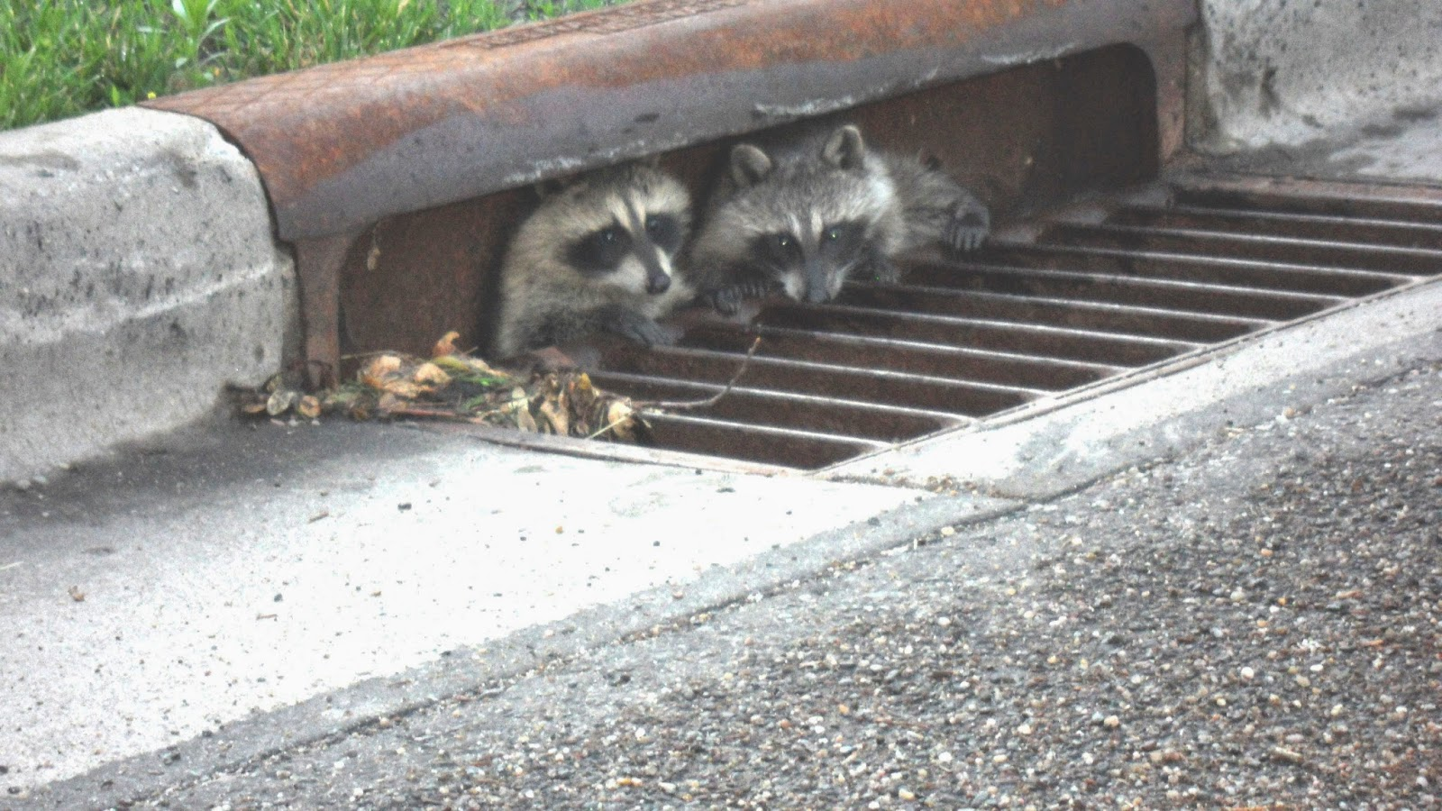
The Applicant’s Handbook Vol. II, Part III provides specific information for the review of water quantity and flooding.
For some projects such as an individual permit for a dock and riprap this may be easy.
For others, such as a landfill, this may require consultation with your district stormwater engineer.
This Photo by Unknown Author is licensed under CC BY-ND

Slide 13
ENVIRONMENTAL CONDITIONS FOR ISSUANCE
(10.1.1, AH Vol. I)

Slide 14
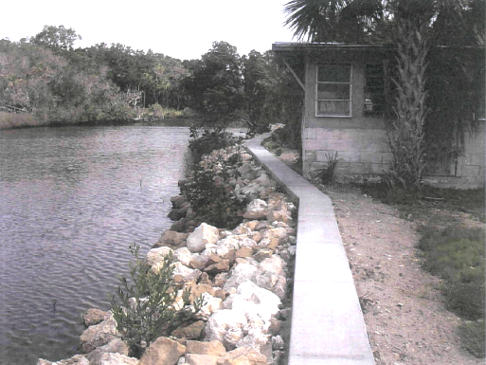
Elimination or Reduction of Impacts (10.2.1, A.H. Vol. I)
Shoreline Stabilization
Compliance photo:
The shoreline shows signs of erosion and has very limited vegetation (17 young mangroves recruiting, 7 larger mangroves). The contractor will hand place riprap around the mangroves to reduce impacts. Additionally, no backfilling is proposed in wetlands. All riprap will be placed on the natural shoreline, and a concrete cap will be re-located landward of the wetland boundary.
Notes:
How has the applicant addressed elimination and reduction of impacts?
1) The method of shoreline stabilization (choosing riprap instead of a seawall), 2) proposing and conditioning the permit to require the hand placement of the riprap to avoid mangroves, 3) placing the riprap along the natural shoreline with no backfilling within wetlands/surface waters, are all examples of reduction of impacts.

Slide 15
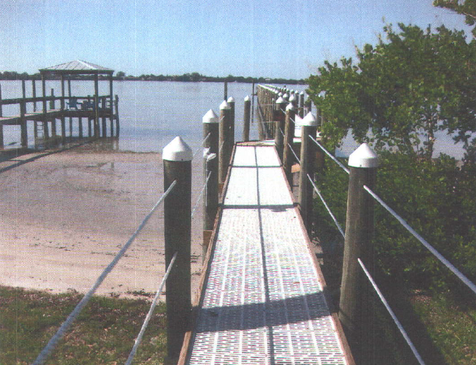
Elimination or Reduction of Impacts (10.2.1, A.H. Vol. I)
Dock
Compliance photo:
Applicant originally proposed a 1,420 square foot dock which crossed through mangroves and submerged aquatic vegetation. The revised structure has been relocated to avoid the mangroves and reduce impact (1,206 square feet). Alternative decking (thruflow interlocking panels- 70% of light penetrates) will be utilized over resources to reduce shading impacts. The dock was also extended so that mooring occurred beyond seagrass. Additionally, the dock was redesigned to have a 4 foot wide walkway instead of 5 foot.
Notes:
How has the applicant addressed elimination and reduction of impacts?
Reconfiguring the dock (zigging around the mangroves), using alternative decking to allow more light, reducing the width of the access walkway, extending mooring beyond seagrass limits, reducing the width of the walkway to 4 feet, and even one that is not mentioned in the description, the addition of handrails discourage additional mooring over areas with resources.
If an application submittal comes in and the design has already reduced impacts it is not necessary to require more. Often times the elimination and reduction is done by the consultant prior to the submittal of the application or has been recommended during pre-application discussions. It is perfectly acceptable to say that the application is designed to reduce impacts.
Also, the applicant’s handbook includes instances when design modification to eliminate or reduce impacts is not required when;
a. The ecological value of the functions provided by the area of wetland or other surface water to be adversely affected is low, based on a site specific analysis using the factors in section 10.2.2.3, below, and the proposed mitigation will provide greater long term ecological value than the area of wetland or other surface water to be adversely affected, or
b. The applicant proposes mitigation that implements all or part of a plan that provides regional ecological value and that provides greater long term ecological value than the area of wetland or other surface water to be adversely affected.

Slide 16
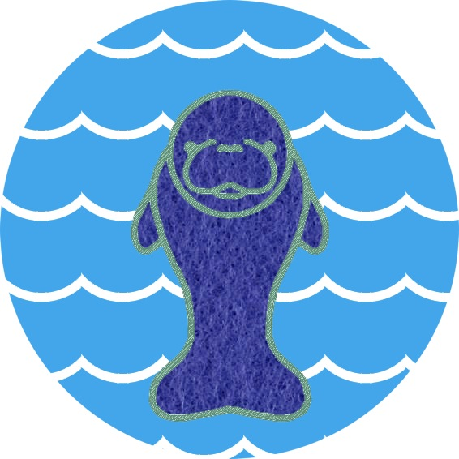
Fish, Wildlife, Listed Species and their Habitat (10.2.2 AH Vol. I)
Shoreline Stabilization
Dock
Ditch (redesign and installation culverts)
FFWCC has requested that the “Standard Manatee Conditions for In Water Work” be included in the permit.
Seagrasses will be impacted by the construction of the dock, but efforts have been made to minimize those impacts. The applicant is meeting all AP requirement and has proposed a minimum sized dock with alternative decking. FFWCC has requested Standard Manatee Conditions be included as permit conditions.
Operation and maintenance of culverts will not adversely affect these parameters. Habitats within the artificial drainage ditches are very low quality and do not support significant wildlife use. FWCC did not provide comments.
This Photo by Unknown Author is licensed under CC BY-NC-ND
Notes:
As part of the assessment of the impacts of regulated activities upon fish and wildlife, the Agency will provide a copy of all notices of applications for individual (including conceptual approval) permits that propose regulated activities in, on, or over wetlands or other surface waters to the Florida Fish and Wildlife Conservation Commission (FWC) for review and comment, in accordance with Section 20.331(10), F.S.
In addition, Agency staff may solicit comments from the FWC regarding other applications to assist in the assessment of potential impacts to fish and wildlife and their habitats, particularly with regard to listed species.
If you have any questions on the comments/specific conditions provided by FWC please call the reviewer. They will be happy to help reword or redraft a question or condition to address both FWC and DEP concerns.
* Sometimes FWC may provide comments on listed species that are not wetland dependent such as gopher tortoises. While the ERP can not be conditioned to require an FWC relocation permit staff should pass the comments along to the applicant (listed species table is included in table 10.2.7-1)
This question is also part of the “public interest test criteria”, it is okay to cross reference these answers (see other section X) instead of answering it two times. It is important to leave the prompt in the TSR so it easy for the public to verify that staff have considered all applicable rules/statutes.
In evaluating whether an applicant has provided reasonable assurances under these provisions, de minimis effects shall not be considered adverse for the purposes of this section.

Slide 17
Public Interest Test
(373.414(1)(a), F.S., 62-330.302(1)(a), F.A.C., 10.2.3, A.H. Vol. I)
Whether the activity will adversely affect public health, safety, or welfare or the property of others;
Whether the activity will adversely affect the conservation of fish and wildlife and their habitats;
Whether the activity will adversely affect Navigation or the flow of water or cause harmful erosion or Shoaling;
Whether the activity will adversely affect the fishing or recreational values or marine productivity in the vicinity of the activity;
Whether the activity is temporary or permanent in nature;
Whether the activity will adversely affect or will enhance significant historical and archeological resources;
The current condition and relative value of functions being performed by areas affected by the proposed activity.

Slide 18

Adversely affect public health, safety or welfare or property of others
Shoreline Stabilization
Dock
Ditch (redesign and installation culverts)
The project will not adversely impact public health, safety or welfare or property of others. The riprap will stabilize the property and prevent further erosion.
This project will not negatively affect public health. No adjacent property owners will be affected.
The culvert diameter, length, and invert elevations have been reviewed by the stormwater engineer. The provided culvert analysis demonstrates that the culverts are sized and designed appropriately to not cause flooding to properties of others upstream or downstream. The culverts within the ditch will not alter the hydrology of systems. The permit will contain specific conditions requiring maintenance of the culverts and ditch.
This Photo by Unknown Author is licensed under CC BY-SA
Notes:
Other parameters that may be addressed here, for a marina:
Spill contingency plan if fueling, navigation markers for channels,
DMMA:
Analysis by engineer, berm stability (size, dimensions, vegetation, monitoring, not allowing trees/woody vegetation, etc.) regular inspections, operational requirements, emergency outfalls
Evaluate whether the regulated activity located in, on, or over wetlands or other surface waters will cause:
(a) An environmental hazard to public health or safety or improvement to public health or safety with respect to environmental issues. Each applicant must identify potential environmental public health or safety issues resulting from their project. Examples of these issues include: mosquito control; proper disposal of solid, hazardous, domestic or industrial waste; aids to navigation; hurricane preparedness or cleanup; environmental remediation, enhancement or restoration; and similar environmentally related issues. For example, the installation of navigational aids may improve public safety and may reduce impacts to public resources;
(b) Impacts to areas classified by the Department of Agriculture and Consumer Services as approved, conditionally approved, restricted or conditionally restricted for shellfish harvesting. Activities that would cause closure or a more restrictive classification or management plan for a shellfish harvesting area would result in a negative factor in the public interest balance with respect to this criterion;
(c) Flooding or alleviate existing flooding on the property of others. There is at least a neutral factor in the public interest balance with respect to the potential for causing or alleviating flooding problems if the applicant meets the water quantity criteria in Part III of Volume II; and
(d) Environmental impacts to the property of others. For example, construction of a ditch that lowers the water table such that off-site wetlands or other surface waters would be partly or fully drained would be an environmental impact to the property of others. The Agency will not consider impacts to property values.

Slide 19

Adversely affect Navigation or the flow of water or cause harmful erosion or Shoaling
Shoreline Stabilization
Dock
Ditch (redesign and installation culverts)
The riprap will be placed along the natural slope of shoreline and will only extend 6 feet beyond the MHWL, no adverse impacts to navigation or flow are anticipated. The stabilization of the shoreline will prevent further harmful erosion and shoaling within Black Creek. The ~300 feet of riprap tie into riprap/seawalls on adjacent properties therefore, no harmful erosion will occur on adjacent shorelines.
This project will not negatively affect public navigation or the flow or water. The structure is over 1000 feet from the navigational channel. The dock is similar to surrounding docks and will not block ingress or egress of neighboring properties. The structure will not cause harmful erosion or shoaling.
The culverts are appropriately sized to handle velocities, scour protection at the base of the culverts will prevent harmful erosion and sedimentation. A specific condition requiring the permittee to monitor and maintain the culverts and scour protection in perpetuity will be added to the operating conditions of the permit.
This Photo by Unknown Author is licensed under CC BY-SA
Notes:
At the time these examples were selected I didn’t realize that they fall right in line with the provisions in 10.2.3.3 – Navigation, waterflow, Erosion, and Shoaling. Paragraph a. applies to docks, Paragraph B, applies to shoreline stabilization, and paragraph c. applies to conveyances.
(a) Significantly impede navigability or enhance navigability. The Agency will consider the current navigational uses of the surface waters and will not speculate on uses that may occur in the future. Applicants proposing to construct bridges or other traversing works must address adequate horizontal and vertical clearance for the type of watercraft currently navigating the surface waters. Applicants proposing to construct docks, piers and other works that extend into surface waters must address the continued navigability of these waters. An encroachment into a marked or customarily used navigation channel is an example of a significant impediment to navigability. Applicants proposing temporary activities in navigable surface waters, such as the mooring of construction barges, must address measures for clearly marking the work as a hazard to navigation, including nighttime lighting. The addition of navigational aids may be beneficial to navigation. If an applicant has a U.S. Coast Guard permit issued pursuant to 14 U.S.C. Section 81 or 33 C.F.R. Part 62 for a regulated activity in, on or over wetlands or other surface waters, submittal of this permit with the application may assist the applicant in addressing this criterion.
(b) Cause or alleviate harmful erosion or shoaling. Applicants proposing activities such as channel relocation, artificial reefs, construction of jetties, breakwaters, groins, bulkheads and beach nourishment must address existing and expected erosion or shoaling in the proposed design. Compliance with erosion control best management practices referenced in Part IV of this Volume, will be an important consideration in addressing this criterion. Each permit will have a general condition that requires applicants to utilize appropriate erosion control practices and to correct any adverse erosion or shoaling resulting from the regulated activities.
(c) Significantly impact or enhance water flow. Applicants must address significant obstructions to sheet flow by assessing the need for structures that minimize the obstruction such as culverts or spreader swales in fill areas. Compliance with the water quantity criteria found in section 10.2.2.4, above, shall be an important consideration in addressing this criterion.

Slide 20


Adversely affect the fishing or recreational values or marine productivity in the vicinity of the activity
Shoreline Stabilization
Dock
Ditch (redesign and installation culverts)
The riprap will not adversely impact recreation or marine productivity. The riprap may enhance the shoreline by preventing sedimentation. The riprap (in lieu of a vertical seawall) will allow utilization by juvenile fish and invertebrates.
The docking structure has been configured and designed to reduce impacts to seagrasses and mangroves which are important for fish nurseries. The grated decking will allow 705 of the light to penetrate through the surface. Care will be taken during construction around seagrasses and turbidity curtains will be positioned to avoid impacts to resources (no curtains directly in areas of dense beds where the curtain will scour/displace grasses).
The installation placement of culverts and ditch relocation activities will no affect recreational values or marine productivity.
Notes:
10.2.3.4 Fisheries, Recreation, Marine Productivity
In reviewing and balancing the criterion regarding fishing or recreational values and marine productivity, the Agency will evaluate whether the regulated activity in, on, or over wetlands or other surface waters will cause:
(a) Adverse effects to sport or commercial fisheries or marine productivity. Examples of activities that may adversely affect fisheries or marine productivity are the elimination or degradation of fish nursery habitat, change in ambient water temperature, change in normal salinity regime, reduction in detrital export, change in nutrient levels, or other adverse effects on populations of native aquatic organisms.
(b) Adverse effects or improvements to existing recreational uses of a wetland or other surface water. Wetlands and other surface waters may provide recreational uses such as boating, fishing, swimming, waterskiing, hunting, and birdwatching. An example of potential adverse effects to recreational uses is the construction of a traversing work, such as a road crossing a waterway, which could impact the current use of the waterway for boating.

Slide 21



Temporary or permanent
Staff should consider the frequency and duration of the impacts caused by the proposed activity. Temporary impacts will be considered less harmful than permanent impacts of the same nature and extent.
Notes:
In all of the examples above the projects are permanent in nature. The riprap shoreline stabilization, installation of a dock, and redesign of a ditch to include culverted crossings are all permanent.
Example: Temporary impacts installation of a pipeline, permanent impact filling of a wetland.

Slide 22
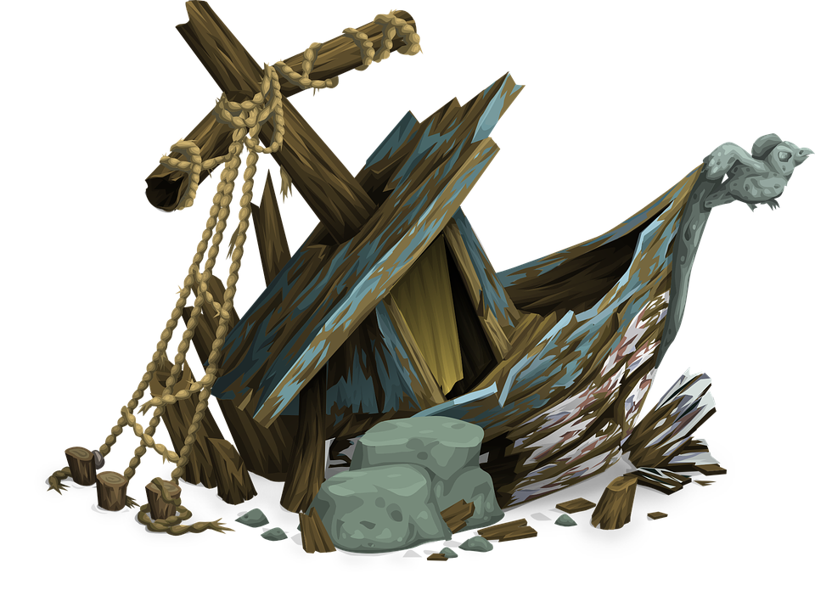
Adversely affect or will enhance significant historical and archeological resources
The Department of State, Division of Historic Resources (DHR), consultation is required for all individual permits. ERP processors must coordinate with DHR and seek comments on whether a project will adversely affect significant historical and archeological resources.
DHR may require a survey, if such resources are reasonably expected to be impacted by the regulated activity.
In all three examples provided. DHR was consulted and no comments or conditions were required.
Notes:
In reviewing and balancing the criterion regarding historical and archaeological resources, the Agency will evaluate whether the regulated activity located in, on, or over wetlands or other surface waters will impact significant historical or archaeological resources. The applicant must map the location of and characterize the significance of any known historical or archaeological resources that may be affected by the regulated activity located in, on or over wetlands or other surface waters. The Agency will provide copies of all individual (including conceptual approval) permit applications to the Division of Historical Resources of the Department of State and solicit its comments regarding whether the regulated activity may adversely affect significant historical and archaeological resources. The applicant will be required to perform an archaeological survey and to develop and implement a plan as necessary to demarcate and protect the significant historical or archaeological resources, if such resources are reasonably expected to be impacted by the regulated activity.

Slide 23
Current condition and relative value of functions
Shoreline Stabilization
Dock
Ditch (redesign and installation of culverts)
The native community type is a saltwater marsh primarily vegetated with needle rush (FLUCCS 6422) based on surrounding communities and historical aerial photographs. The toe of the shoreline is vegetated with white and black mangroves. Wildlife utilization and function of habitat will be the same or better since the shoreline stabilization and vegetation will protect resources.
The project occurs in a Resource Protection Area 1 (RPA) with high density turtle grass (thalassia). The installation of the alternative decking will allow for maximum penetration of light and therefore, the current condition and relative value of functions is not expected to be impacted adversely.
There will be no change in conditions or habitat functions within the system.

Slide 24
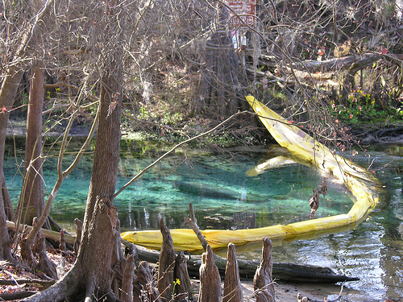
Water Quality – Short term
(10.2.4.1, AH Vol. I)
Riprap
Dock
Ditch (redesign and installation of culverts
A floating turbidity curtain will surround the site during construction. Riprap will be hand placed. Silt screens will be installed around upland staging areas and any disturbed soils stabilized.
The dock will be installed progressively from the uplands. Pilings will be installed by low pressure jetting operation and construction will take approximately three weeks. Turbidity curtains will be employed in areas void of seagrasses.
Installation of appropriate BMP’s prior to land clearing and placement of fill. Silt screens will be trenched along all disturbed areas and disturbed soils will be revegetated.
This Photo by Unknown Author is licensed under CC BY-ND

Slide 25

Water Quality – Long term
(10.2.4.2, AH Vol. I)
Riprap
Dock
Ditch (redesign and installation of culverts)
No long term water quality concerns. The installation of natural limestone riprap will help stabilize the shoreline and prevent erosion and sedimentation.
The single family dock will moor one recreational vessel and is not anticipated to impact water quality long term. The permit is conditioned to prevent discharges or disposal of material into the water.
Permit is conditioned to require maintenance of the culverts and ditch, including monitoring and repair of any erosion or sedimentation within the ditch system. If operated and maintained in accordance with these conditions, adverse water quality impacts will not occur.

Slide 26
Water Quality – Additional Considerations for Docking Facilities
(10.2.4.3, AH Vol. I)
Hydrographics (flushing time, number of slips, configuration of the facility, amplitude and periodicity of the tide, geometry of the water body, services provided, etc.)
Fueling facilities must have secondary containment
Operation and maintenance plans address domestic wastes including sewage and graywater discharges
Proper solid waste disposal
Leaching from treated pilings/decking and anti-fouling paints must be addressed
Notes:
The level and type of hydrographic information or studies that will be required for the proposed docking facility will be determined based upon an analysis of site specific characteristics. Mariano Guardo, Hydrographic Engineer with the Departments Engineering, hydrology and geology program (EHG) should be contacted with any questions.
Additionally, If the site of the proposed activity currently does not meet water quality standards, the applicant must demonstrate compliance with the water quality standards as applicable, and for the parameters that do not meet water quality standards, the applicant must demonstrate that the proposed activity will not contribute to the existing violation. If the proposed activity will contribute to the existing violation, mitigation may be proposed.

Slide 27
Water Quality
Mixing Zones (10.2.4.4 AH Vol. I )
A temporary mixing zone for water quality during construction or alteration may be requested by the applicant.
The Agency shall review such requests pursuant to Rule 62-4.242 (Antidegradation Permitting Requirements; OFWs, an ONRWs) and subsection 62-4.244(5), F.A.C. (Mixing Zones: Surface Waters)
When ambient does not meet standards
(10.2.4.4 AH Vol. I )
Shellfish Harvesting
(10.2. 5AH Vol. I )
The special value and importance of shellfish harvesting waters to Florida’s economy as existing or potential sites of commercial and recreational shellfish harvesting and as a nursery area for fish and shellfish is recognized by the Agencies.
Read 10.2.5 of the A.H. Vol I, and consult the shellfish harvesting map layers in map direct.
Additionally, If the site of the proposed activity currently does not meet water quality standards, the applicant must demonstrate compliance with the water quality standards as applicable, and for the parameters that do not meet water quality standards, the applicant must demonstrate that the proposed activity will not contribute to the existing violation. If the proposed activity will contribute to the existing violation, mitigation may be proposed.

Slide 28
Vertical Seawalls
(10.2.6 AH Vol. I )
Construction of vertical seawalls in an estuary or lagoon is prohibited unless one of the following conditions exists:
Construction is at a Port (315.02 or 403.021, F.S.)
Necessary for: Creation of a marina, providing access to watercraft, or public facilities
Construction is within an existing manmade canal and the canal is occupied in whole or part by vertical seawalls
Construction is conducted by a public utility acting in the performance of its obligation to provide service
Construction is located within the coastal areas of Collier, Lee, Miami-Dade, and Monroe Counties, or Charlotte Harbor/Peace River in Charlotte County designated by the National Marine Fisheries Service as Critical Habitat for the smalltooth sawfish (Pristis pectinata) http://www.nmfs.noaa.gov/pr/pdfs/criticalhabitat/smalltoothsawfish.pdf
Notes:
When considering an application for a permit to repair or replace an existing vertical seawall, the Agency shall require such seawall to be faced with riprap material, or to be replaced entirely with riprap material unless a condition specified above, exists. However, nothing in this subsection shall be construed to hinder any activity previously exempt or permitted under Part IV of Chapter 373, F.S., or permitted under Chapter 161, F.S.
If an activity meets the exemption, staff must issue an exemption (can not hinder) a statutory exemption. However, if it no longer qualifies for an exemption and the construction requires a permit the applicant may have to place riprap at the toe of the seawall or modify materials.

Slide 29
Secondary Impacts
(10.2.7 AH Vol. I )
Document how the applicant provided reasonable assurance that the secondary impacts from construction, alteration, and intended or reasonably expected uses of a proposed activity will not cause or contribute to violations of water quality standards, will not adversely impact the functions of wetlands or other surface waters, and will not adversely impact the ecological value of uplands for bald eagles, and aquatic or wetland dependent listed animal species
Secondary Impacts Training was recently provided by Heather Mason, if you have any questions please contact SLERC for more information.
Notes:
This training is meant to be used in conjunction with the Secondary impacts training (webinar) recently provided by Heather Mason.

Slide 30
Cumulative Impacts
(10.2.8 AH Vol. I )
Document how the applicant provided reasonable assurance that a regulated activity will not cause unacceptable cumulative impacts upon wetlands and other surface waters within the same drainage basin as the regulated activity
The amount of documentation necessary to address cumulative impacts will depend on the complexity of the project. For a simple project, cumulative impacts may be address by saying “mitigation is being conducted within the drainage basin to offset any impacts.”
Heather Mason, SLERC, will be providing a complete training on assessing Cumulative Impacts on October 18, 2017.

Slide 31
Mitigation
(10.3 AH Vol. I )
Document the acreage and type of system proposed to be impacted, include details on UMAM (functional loss), how will the mitigation be accomplished (i.e. purchase what type of credit from which mitigation bank, creation onsite/offsite, enhancement, preservation, etc.) If creation or enhancement describe the monitoring requirements of the permit and include a description of success criteria and any financial responsibility.
The SLERC fundamentals training included a presentation on Mitigation which addresses the topic of mitigation in more detail.

Slide 32
The END
Please contact Allyson Minick, SLERC, with any questions regarding Technical Staff reports
Notes:
In summary, the technical staff report provides the basis of issuance as required by Chapter 120, F.S. It is important that the conditions for issuance and additional conditions for issuance of an ERP be addressed with sufficient detail to support the agency action. Often times this will require a paragraph style response (a yes or no, answer is not sufficient). A technical staff report completed with sufficient detail, can be a helpful tool to ensure all permitting requirements are addressed and thereby allaying fears from potential objectors to a project.

