Slide 1
Uniform Mitigation Assessment Method (UMAM) Functions
Mac James
SLERC
December 2021
Notes:
The purpose of this presentation is to reinforce the concepts Avoid, Minimize, Mitigate; identification of wetland functions 62-345.400(7); understanding how the indicator category metrics62-345.500(6). are used to assess the wetland functions

Slide 2
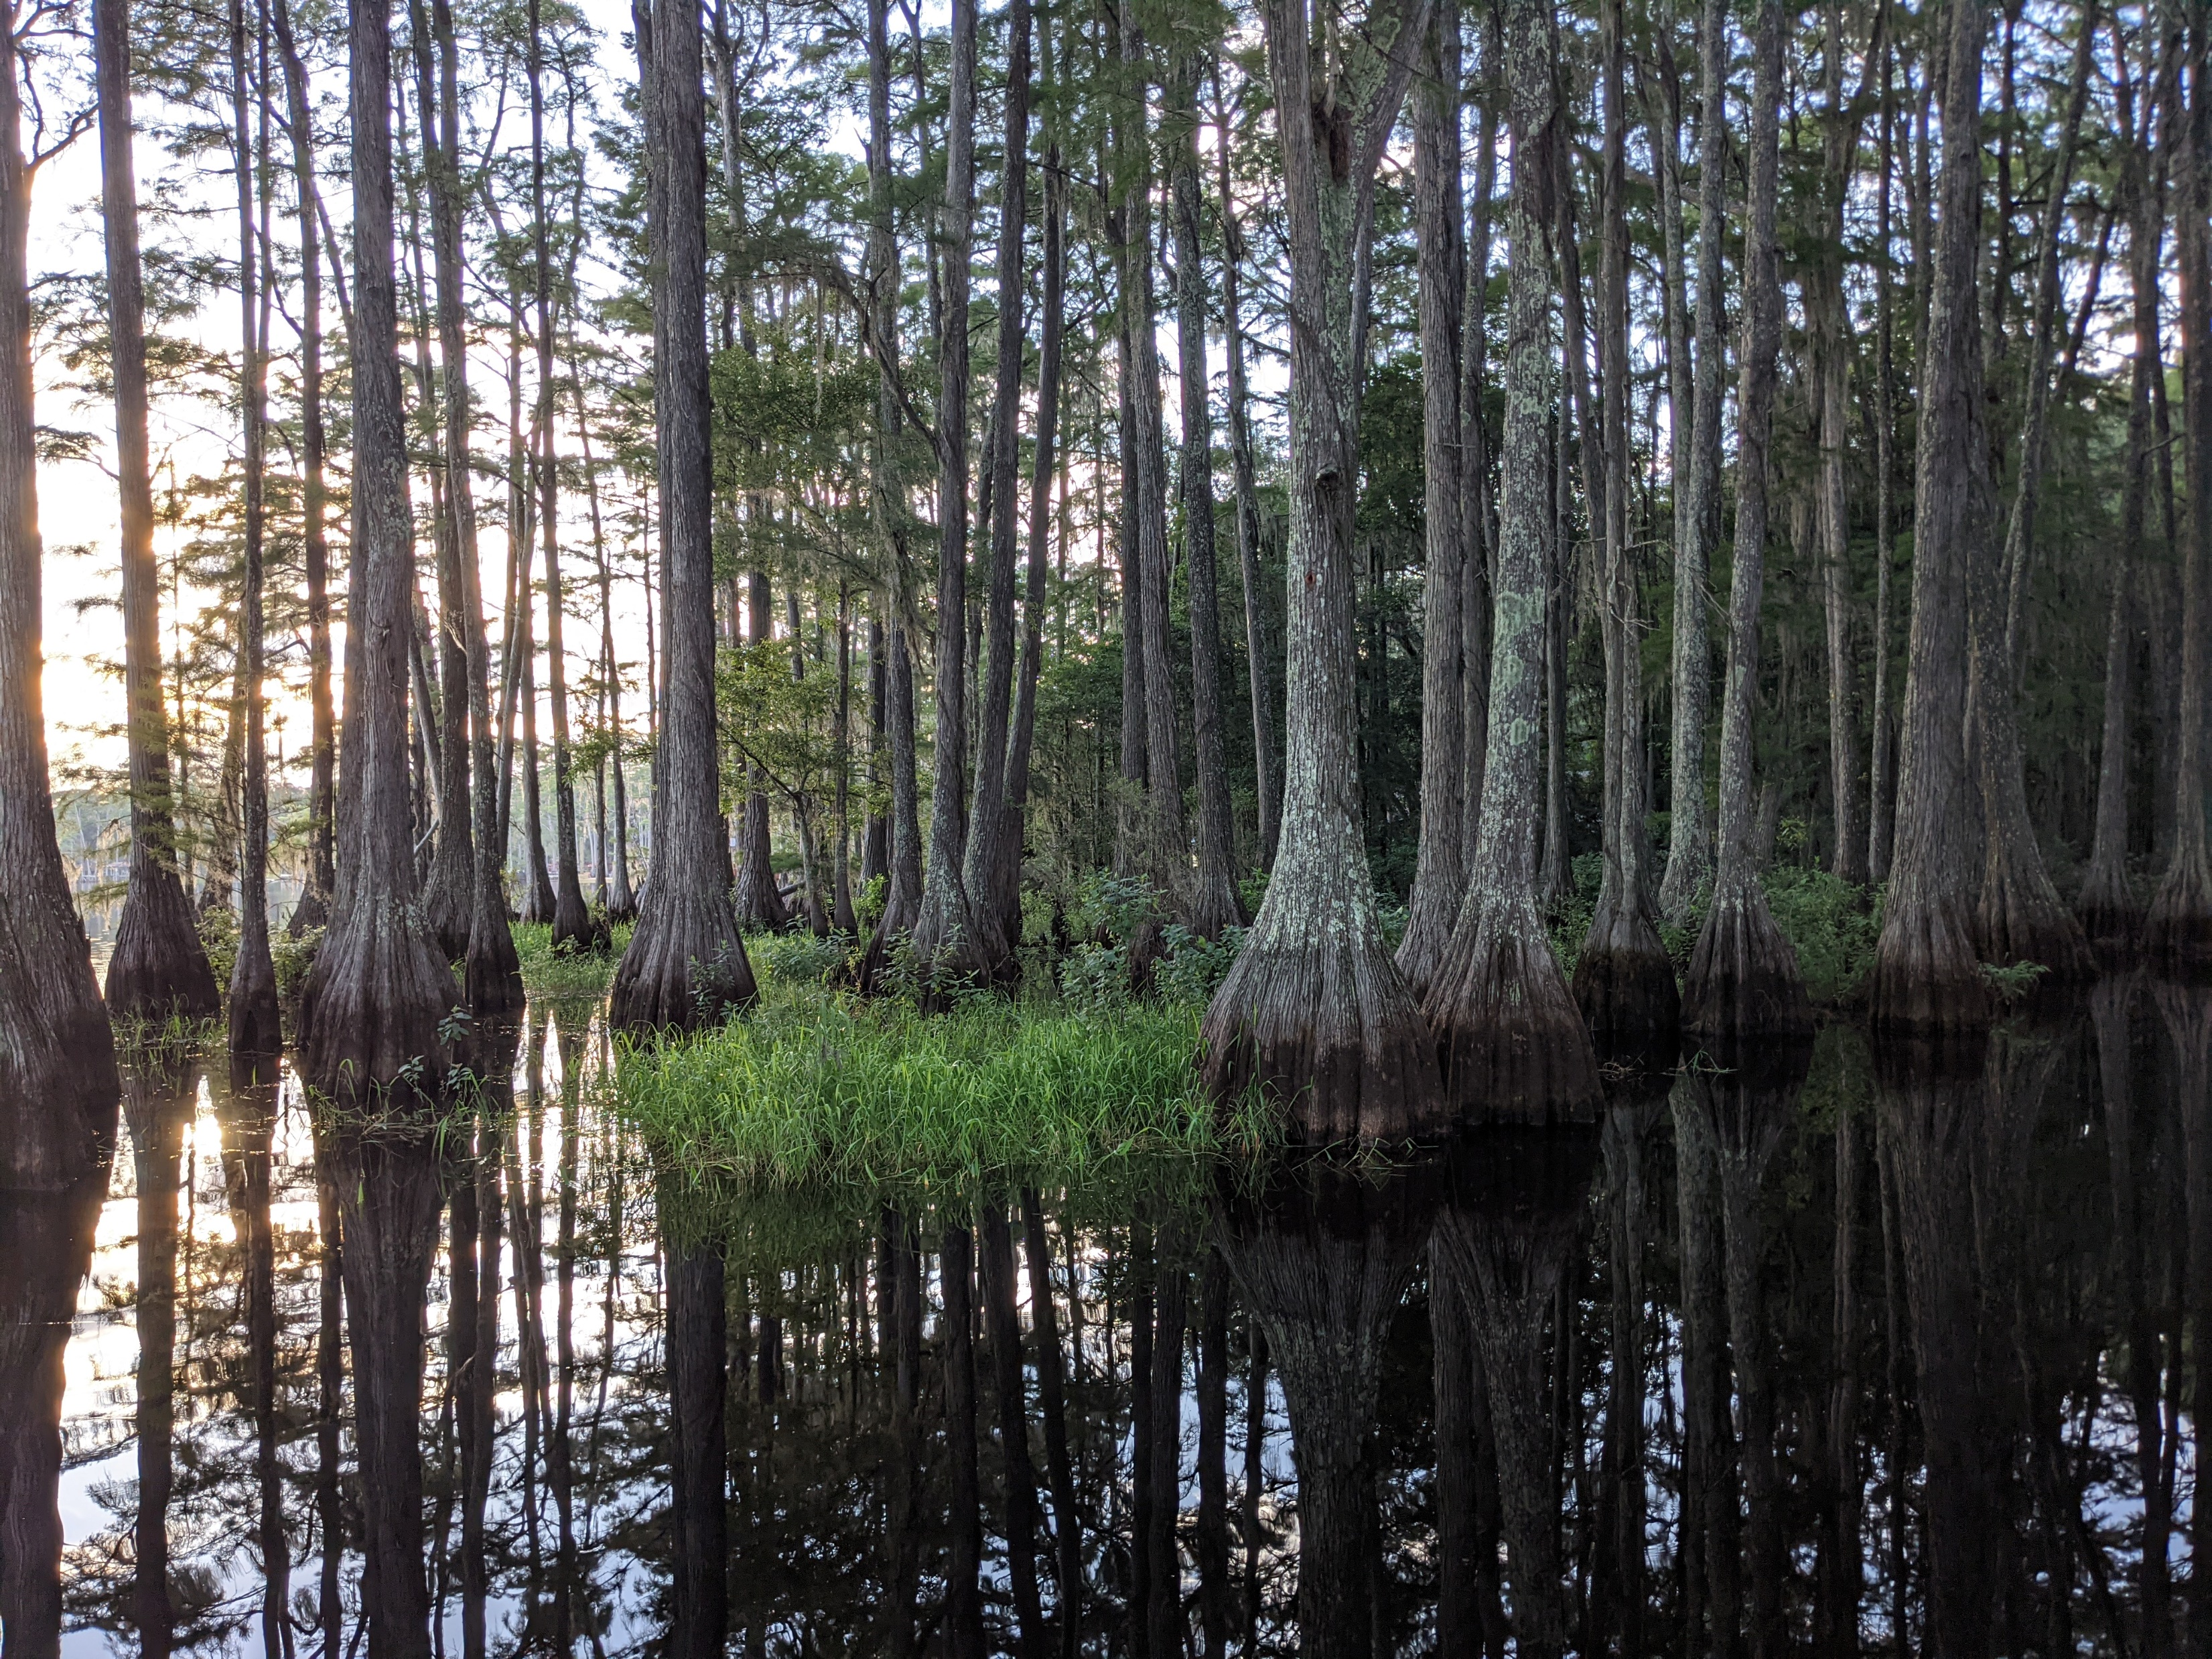
Wetland Ecology

Slide 3
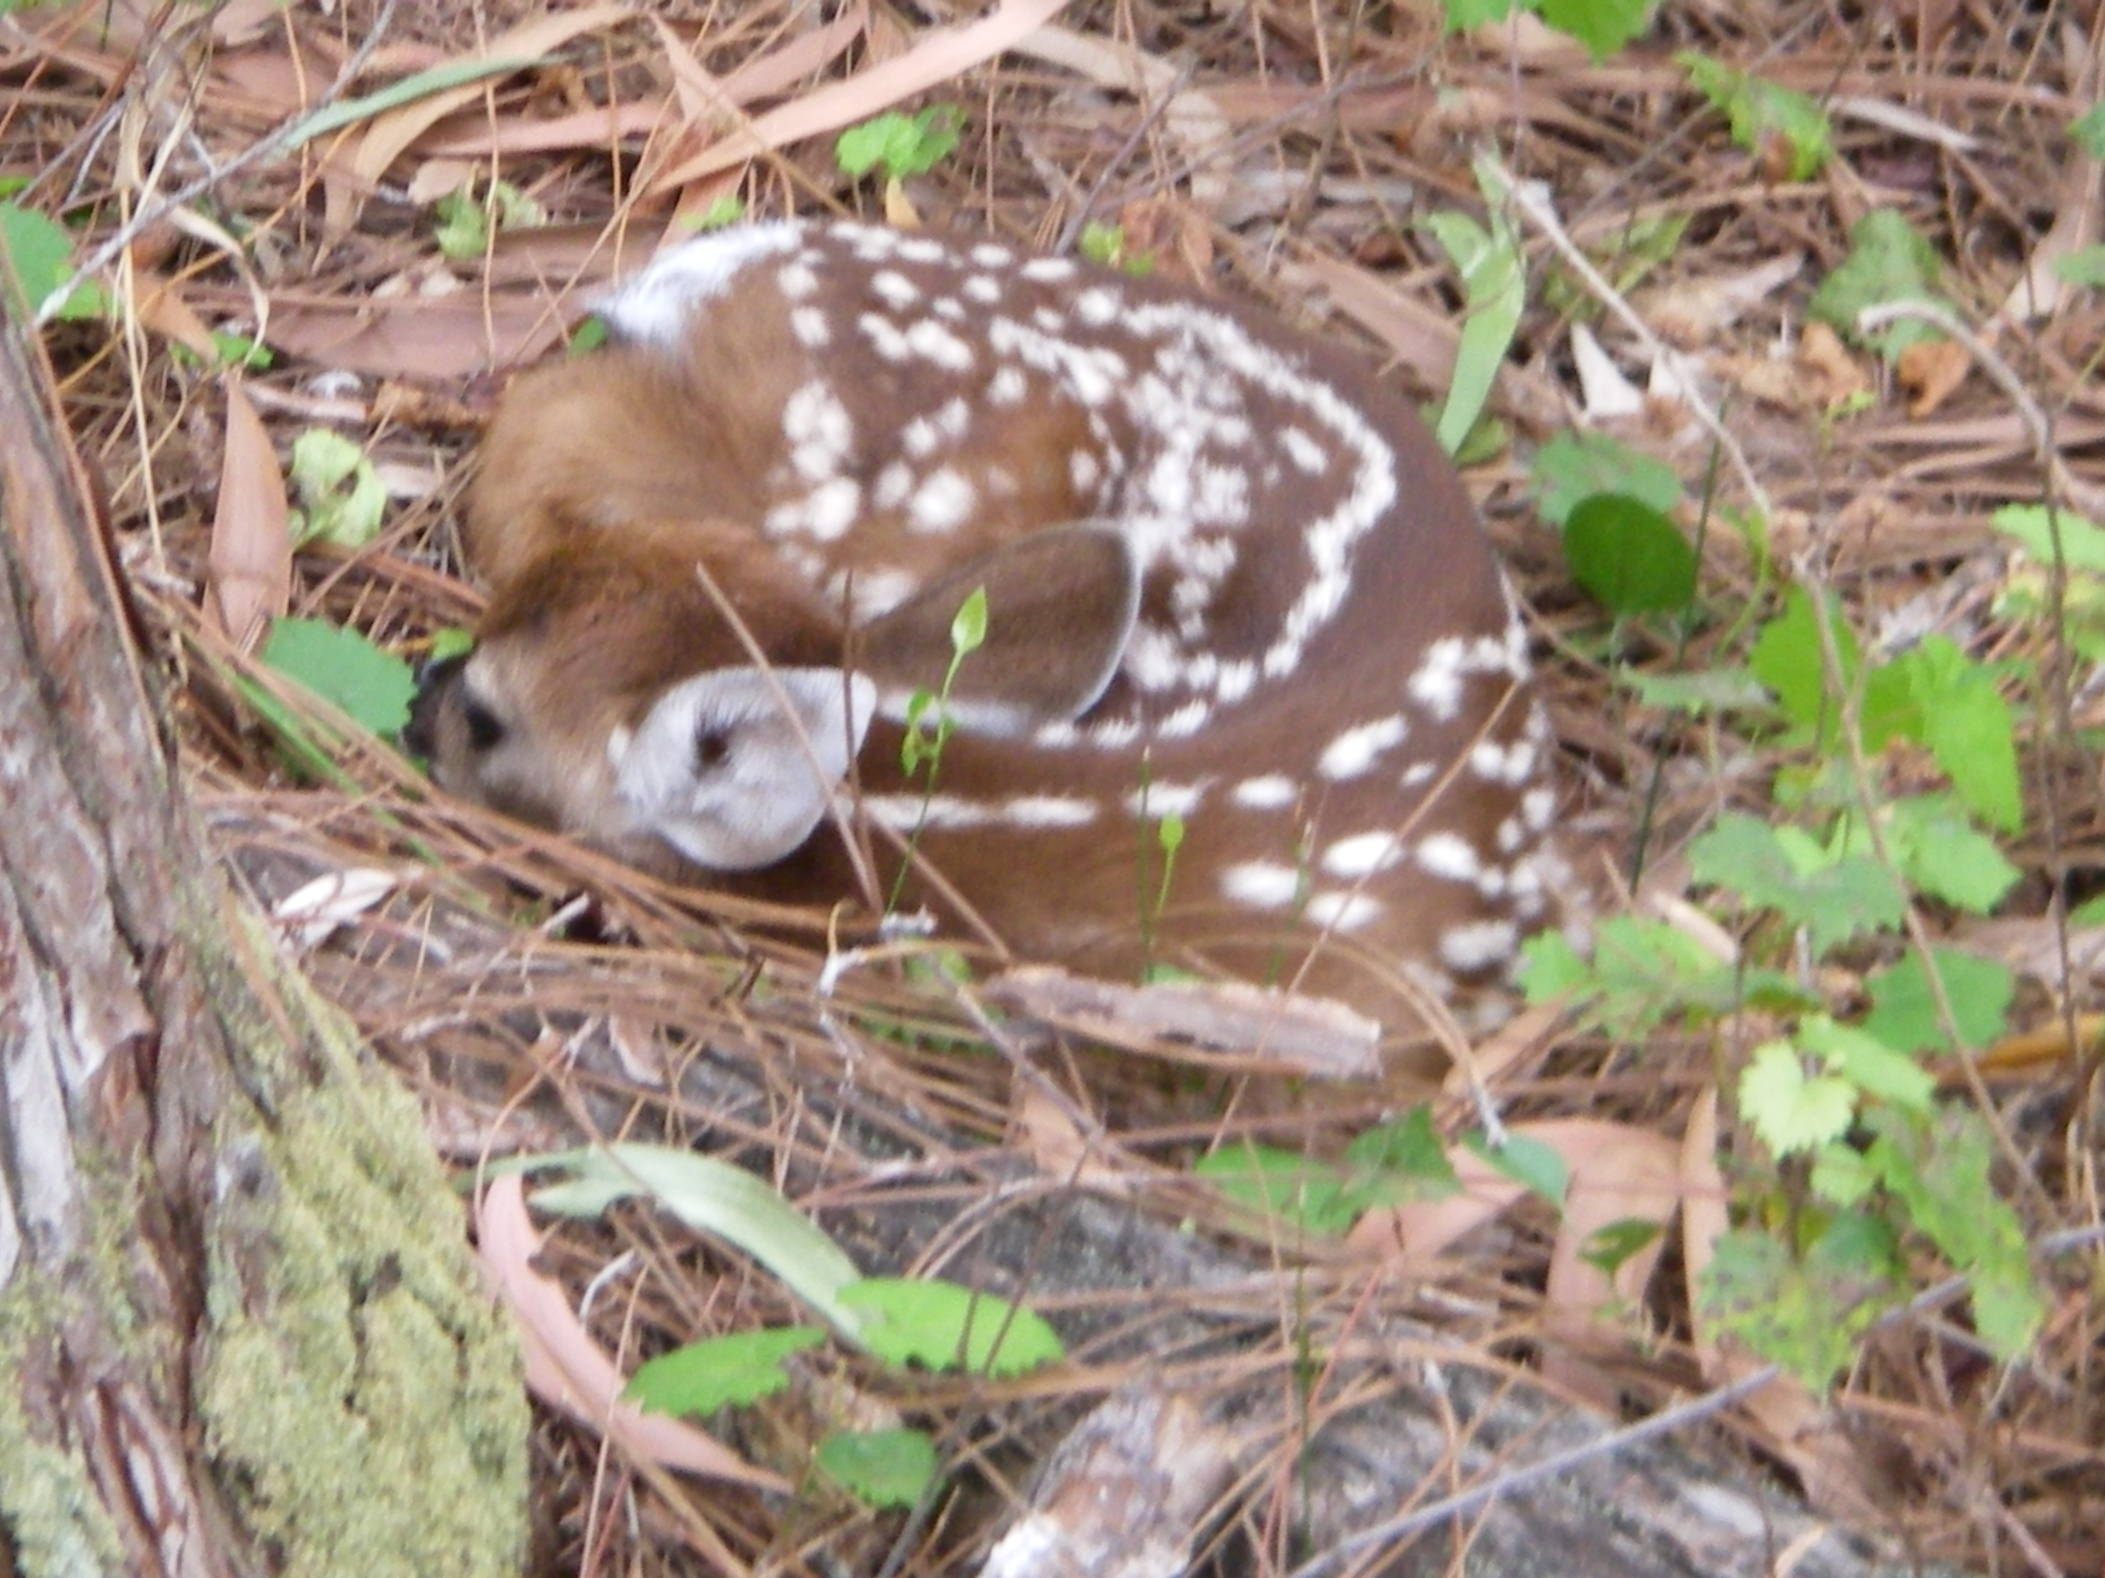
Message
From our sponsor (the rules)
Avoid
Minimize
Mitigate
Notes:
*** The modest use of animation IS and capitalization IS intended to STRESS the consideration of avoidance and minimization first.

Slide 4
Indicator Categories
Section 62-345.500(6), F.A.C.
(a) Location and Landscape Support
  8 Metrics
(b) Water Environment
  12 Metrics
(c) Community Structure
  10 Metrics
Notes:
One function can be considered for multiple assessment criteria.
The type of consideration given to a function and an assessment criteria is directly related to the NEEDS of the species of wildlife (Part I) being considered.

Slide 5
Wetland Functions
Section 62-345.400(7), F.A.C.
Providing Cover, Substrate, and Refuge
Breeding, Nesting, Denning, and Nursery Areas
Natural water storage, Flow attenuation, and Water quality improvement
Corridors for Wildlife Movement
Food Chain Support
Notes:
REP 2
We use the assement criteria(in L&L, WE, and CS) to evaluate how an assessment area provides/ or will provide these specific functions.
LOW VALUE DOES NOT MEAN NO VALUE, a wetland may have some impaired functions and still provide beneficial functions.

Slide 6
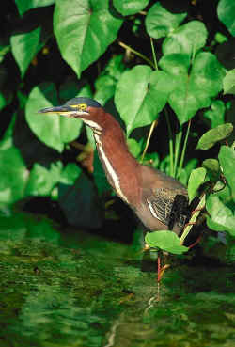
Reminder
Avoid
Minimize
Mitigate

Slide 7
Hydrologic Functions
Natural Water Storage
Natural Flow Attenuation
Water Quality Improvement
Notes:
The assessment area’s ability to provide natural water storage, natural flow attenuation and WQ Improvement relative to the AA and species part I
The optimal condition or impaired condition is relative to the species using the assessment area.

Slide 8
Hydrologic
Natural water storage
Capacity of wetland to store precipitation / runoff following rain events.
Isolated and Connected wetlands
Natural
Surficial aquifer (UPLs)
UPLs = Uplands

Slide 9
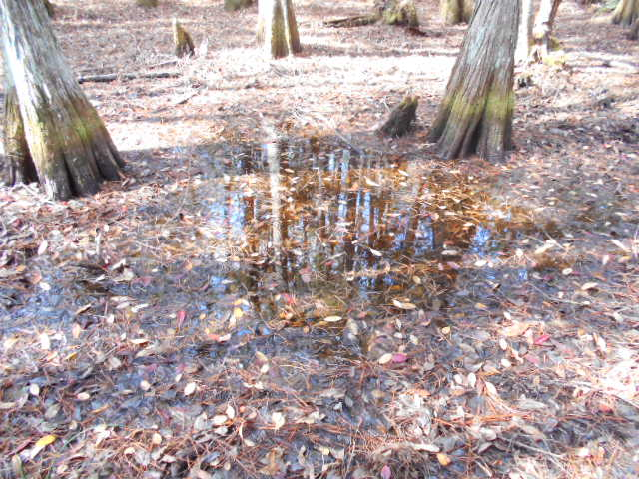
Natural Water Storage
Location Landscape Support:
d. AA benefits downstream fish/wildlife
f. AA provides hydro benefits downstream
h. Upland, protection of wildlife
Water Environment:
b. Water level indicators
d. Erosion/deposition
g. Vegetative signs of hydro stress
i. Plant community composition associated with WQ degradation or alterations of hydroperiod
Community Structure:
(VIII) Topographic features
AA = Assessment Area; WQ = Water Quality
Notes:
***Community structure is very relevant to water storage/a function of storage in snadhill lake communities excessive storage in sandhill lakes oaks die, impaired storage in sandhill lakes – upl community creeps wetlandward – NORMAL
UPL erosion decrease storage capacity in wl

Slide 10
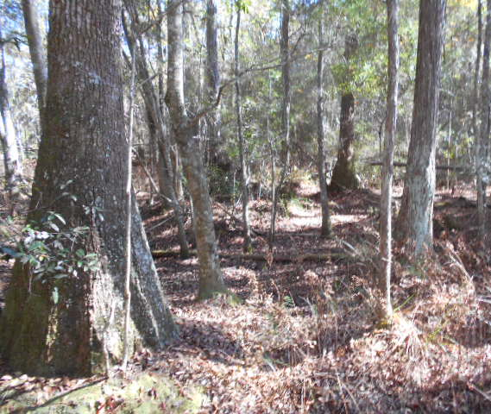
Natural Water Storage 2
Water Environment:
a. Water levels and flows
b. Water level indicators
g. Vegetative signs of hydro stress
i. Plant community assoc. with alterations in hydroperiod
Community Structure:
(I) Appropriate plant species in strata
(III) Regeneration and recruitment
(IV) Age and size distribution
(VIII) Topographic features

Slide 11
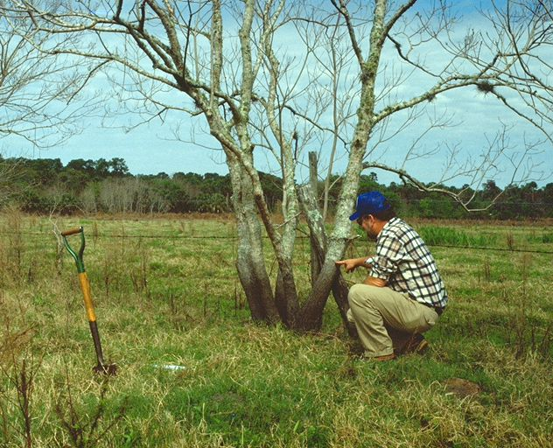
Natural Water Storage 3
Water Environment:
b. Water level indicators
f. Community zonation
g. Veg. signs of hydro stress
i. Plant community associated with altered hydroperiod
Community Structure:
(III) Regeneration and recruitment
(IV) Age and size distribution
(V) Density & quality of snags
(VII) Land management
(VIII) Topographic features
Notes:
Discuss pastures on floodplain or sandhill lake type storage
***Community structure is a function of water storage in sandhill lake communities (Quercus)– upl community creeps wetlandward – NORMAL

Slide 12
Hydrologic 2
Natural flow attenuation
Capacity to moderate the rate of flow through vegetation and natural depressions
Natural

Slide 13
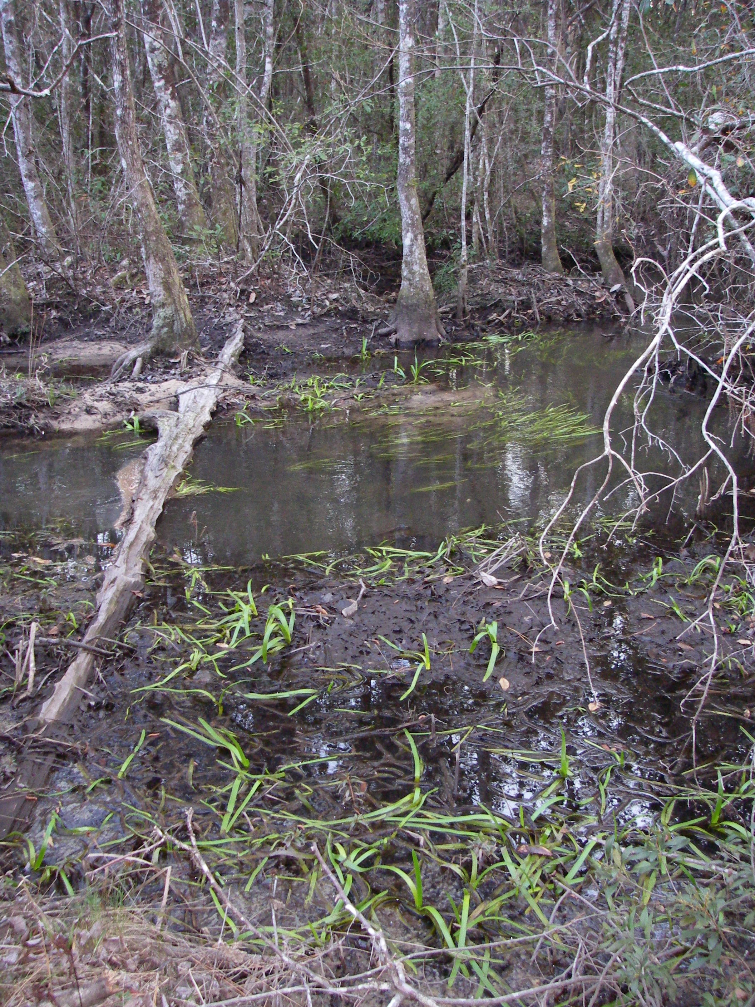
Natural Flow Attenuation
Location Landscape Support:
d. AA benefits downstream fish/wildlife
f. AA hydrologic benefits downstream
Water Environment:
d. Erosion / deposition patterns
l. Water depth, wave energy, currents and light penetration
Community Structure:
(V) Density & quality of coarse woody debris, snag, den, and cavity
(VIII) Topographic features
(IX) SAV: siltation or algal growth
AA = Assessment Area; SAV = Submerged Aquatic Vegetation​​
Notes:
STRESS THE WORD NATURAL
g. Downstream habs discharges from AA
Water levels and flows
(I) Appr plant species in strata

Slide 14
Hydrologic 3
Water Quality Improvement
Any factors affecting the amount of nutrients, dissolved oxygen, pH, temperature, or salinity in the water column of a waterbody

Slide 15
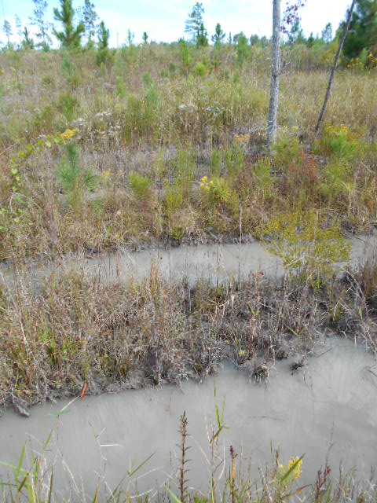
Water Quality Improvement
Location Landscape Support:
d. AA benefits downstream fish/wildlife
Water Environment:
d. Soil erosion or deposition patterns
h. Use by species with hydro requirements
j. Direct observation of water quality
l. Water depth, wave energy, currents and light penetration
Community Structure:
(III) Regeneration and natural recruitment
(VII) Land management
(IX) SAV: siltation or algal
AA = Assessment Area; SAV = Submerged Aquatic Vegetation​​
Notes:
e. Land uses outside AA imp PI wlf
f. AA provide hydro benefits downstream
g. Downstream habs dependence on discharges from AA
g. Vegetative signs of hydrologic stress
Appr plant species in strata
(VIII) Topographic features

Slide 16
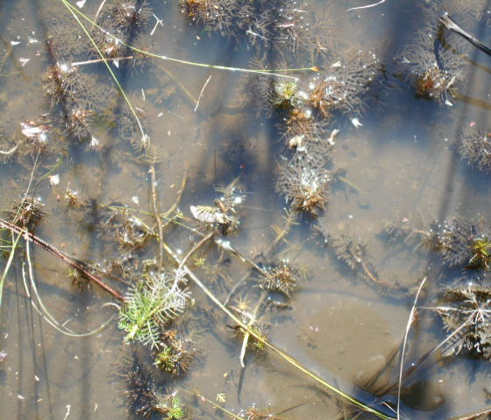
Water Quality Improvement 2
Location Landscape Support:
e. Land uses outside AA
Water Environment:
d. Erosion or deposition
h. Species with hydro requirements
j. Direct observation of WQ
l. Water depth, wave energy, currents and light penetration
Community Structure:
(VII) Land management practices
(VIII) Topographic features
(IX) SAV: siltation or algal growth
AA = Assessment Area; SAV = Submerged Aquatic Vegetation​​
Notes:
g. Vegetative signs of hydrologic stress

Slide 17
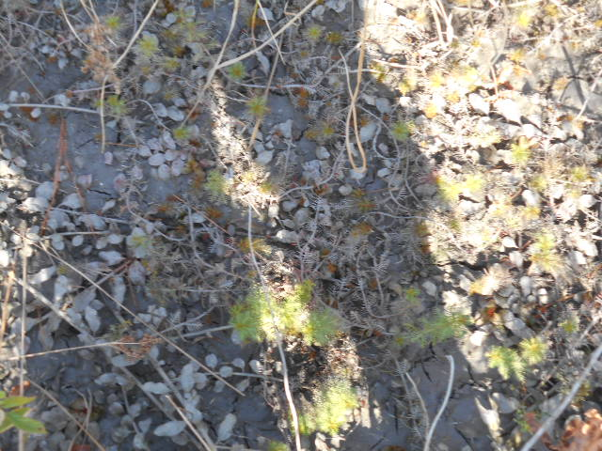
Water Quality Improvement 3
Location Landscape Support:
e. Land uses outside AA
Water Environment:
d. Erosion or deposition
h. Species with hydro requirements
Community Structure:
(VII) Land management practices
(VIII) Topographic features
(IX) SAV: siltation or algal growth impede normal growth.
AA = Assessment Area; SAV = Submerged aquatic vegetation
Notes:
g. Vegetative signs of hydrologic stress

Slide 18
Functions
Corridors for Wildlife Movement
Food Web
Notes:
The assessment area’s ability to provide food web support or act as a corridor for wildlife movement for species identified in part I
The optimal condition or impaired condition is relative to the species using the assessment area.

Slide 19
Corridors for Wildlife Movement
A wildlife corridor is an area of habitat connecting wildlife populations separated by human activities or structures
Notes:
Type of wildlife identified in Part I will have different corridor requirements

Slide 20
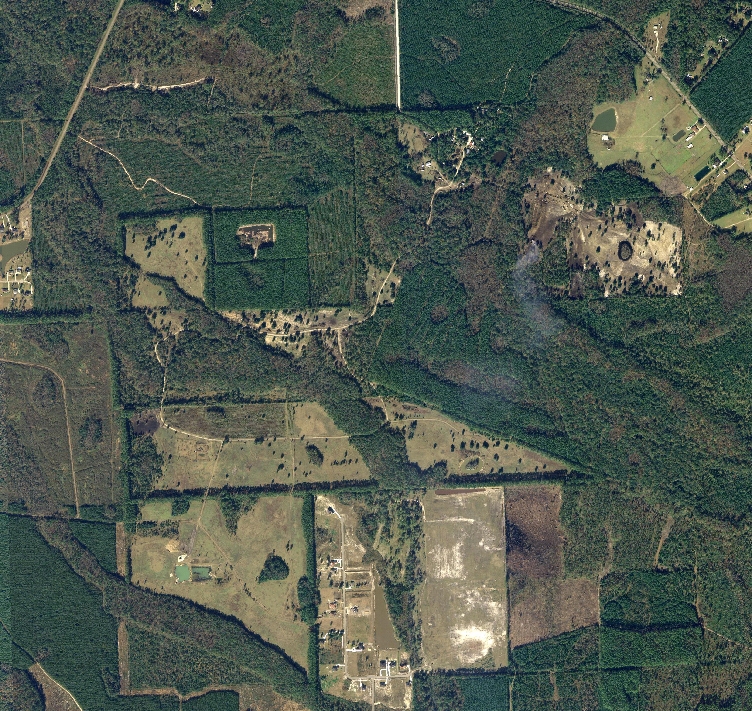
Corridors for Wildlife Movement 2
Location Landscape Support:
a. Habitats outside AA support P1 wildlife
c. Wildlife access to and from AA
e. Land uses outside AA impact P1
f. AA hydro benefits downstream
Community Structure:
(III) Regeneration and recruitment
(IV) Age and size distribution
(VII) Land management
(VIII) Topographic features
(X) UPL, habitat / support for P1 Wildlife
AA = Assessment Area; P1 = Part 1​​; UPL = upland
Notes:
Discuss at the landscape level (across landscape) and within a particular site (within a property connectivity)
Discuss surface water connections as corridors for wildlife movement
Type of wildlife identified in Part I will have different corridor requirements
ex, female panthers won’t cross roads, so a project site would need to have a path offsite without roads to provide a corridor for wildlife movement.
ex alligator snapping turtles, or alligators, may require a slough / surface water connection as a corridor for wildlife movement
ex flood stage hydrologic connections between “isolated” wetlands provie a corridor for minnow/crayfish movement between normally isolated wetlands / ephemeral features
Examples: corridors
Sloughs between wetlands with cover
Streams for reptiles (alligators, snapping turtles ets)
Ephemeral streams between surface waters and wetlands (crayfish, amphibians?, minnows)
Game trails (as indicators of wildlife paths)

Slide 21
Food Chain Support
A ‘linear network’ of links in a food web starting from producer organisms and ending at apex predator species, detritivores, or decomposer species

Slide 22
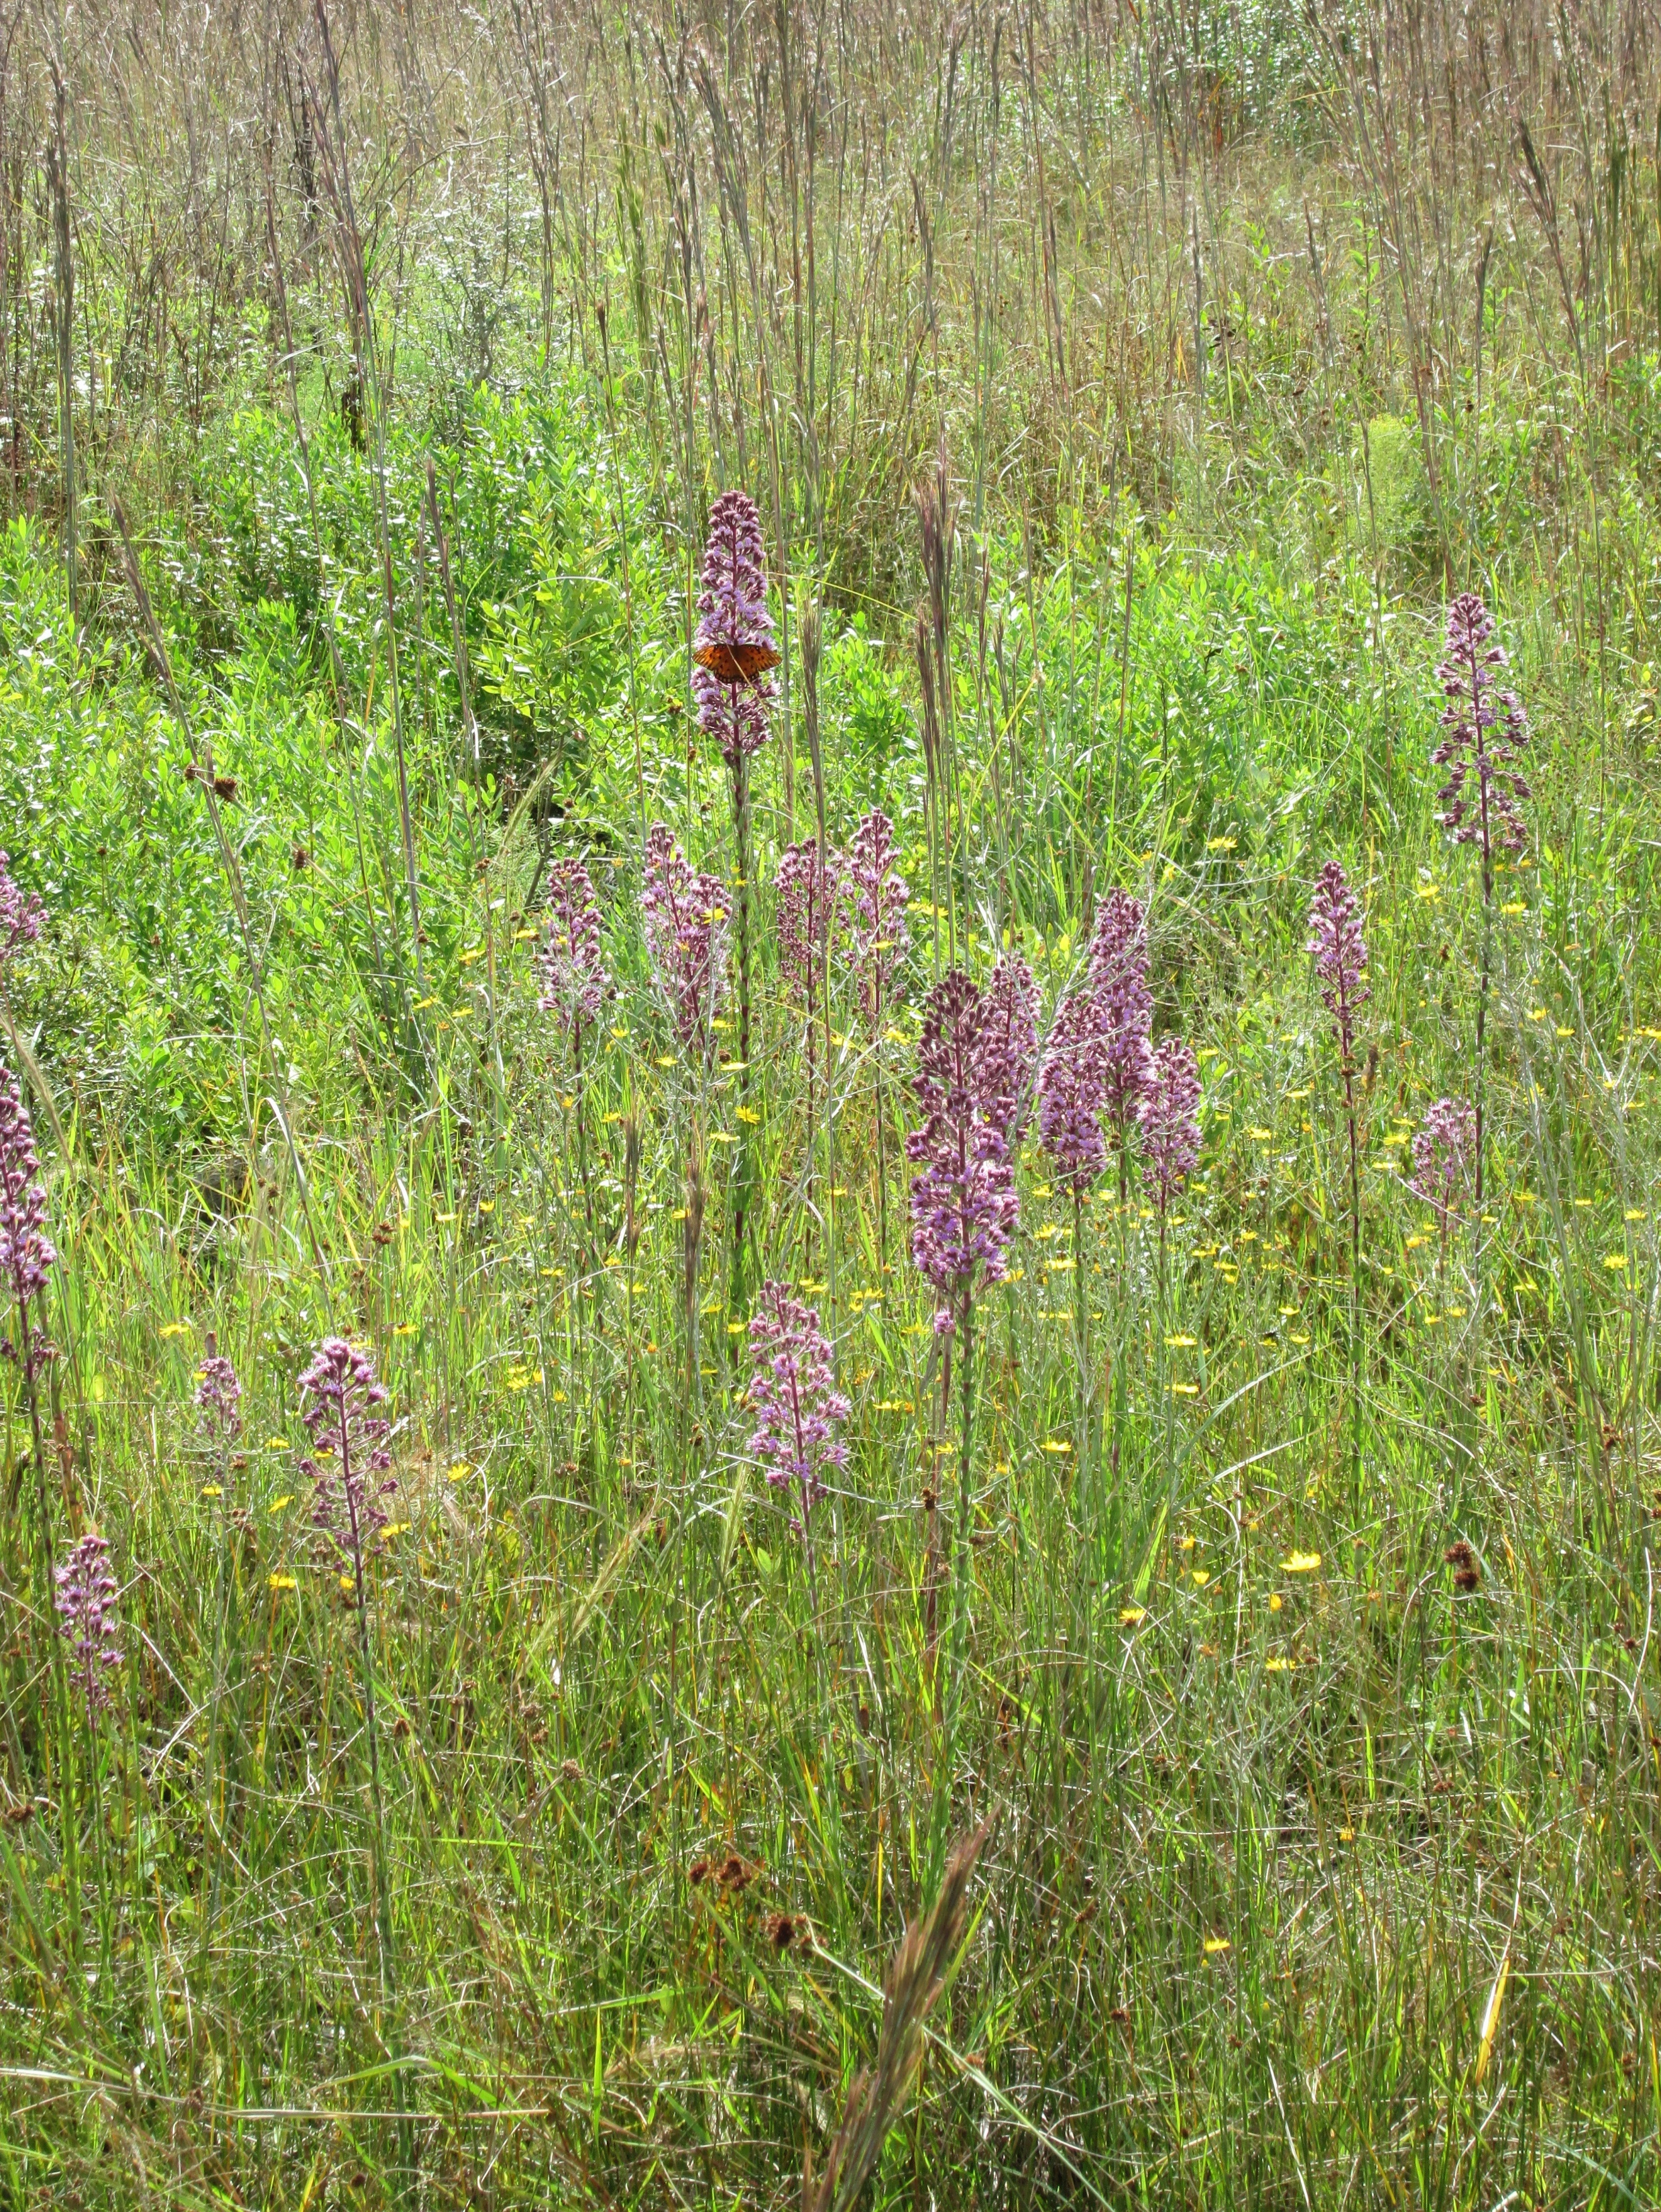
Food Chain Support 2
Location Landscape Support:
a. Habitats outside AA support P1 wildlife
c. Wildlife access to and from AA
e. Land uses outside AA impact P1
Water Environment:
c. Soil moisture
Community Structure:
(I) Appropriate plant species in strata
(III) Regeneration and natural recruitment
(V) Coarse woody debris, snag, den, and cavity
(VII) Land management
AA = Assessment Area; P1 = Part 1​​
Notes:
Pollinators / insects
h. Upl, protection of wl functs
(X) UPL, hab and life history support for Part I Wlf.
Flowers/Pollinators
clethra or itea

Slide 23
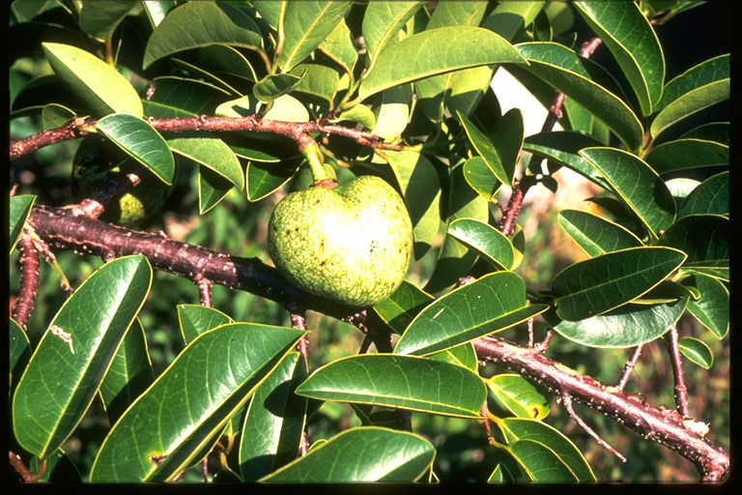
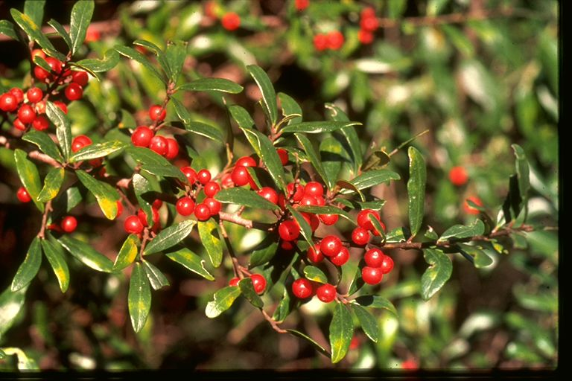
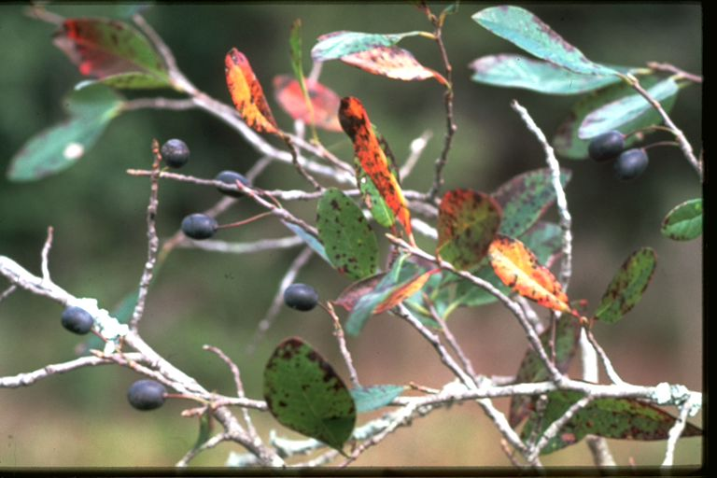
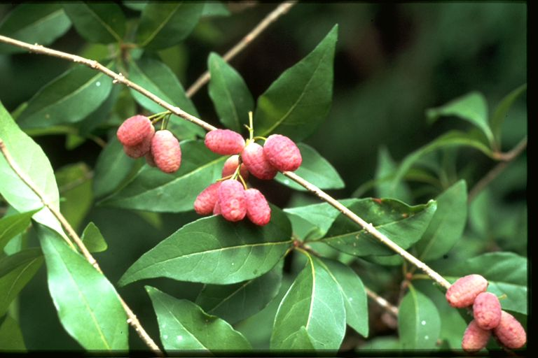
Food Chain Support 3
Location Landscape Support:
c. Wildlife access to and from AA
e. Land uses outside AA impact P1
Water Environment:
a. Water levels and flows
e. Fire history
f. Community zonation
Community Structure:
(I) Appropriate plants in strata
(III) Regeneration and recruitment
(VII) Land management
AA = Assessment Area; P1 = Part 1​​
Notes:
Annona, Ilex, Nyssa, Forestiera
Vaccinium
Fruits, Nuts, Mast
(IV) Age and size distribution
Sap suckers
Flowers/Pollinators
Mast / fruits
Life cycle / nelumbo/insects/fish
Scats – pelletized organics
Prefer black gum with gray cat birds

Slide 24
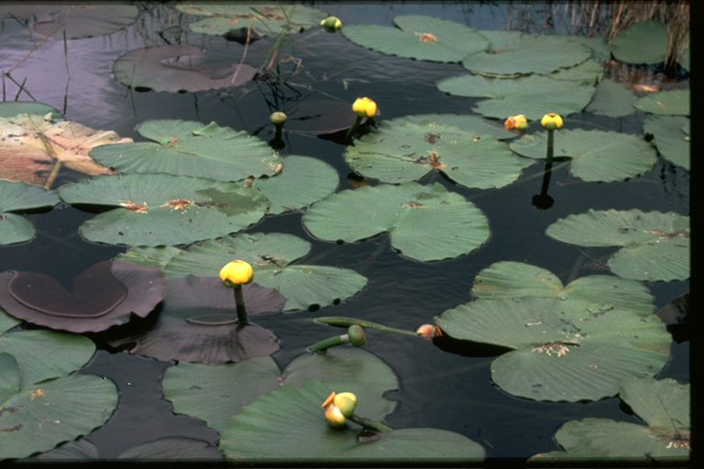
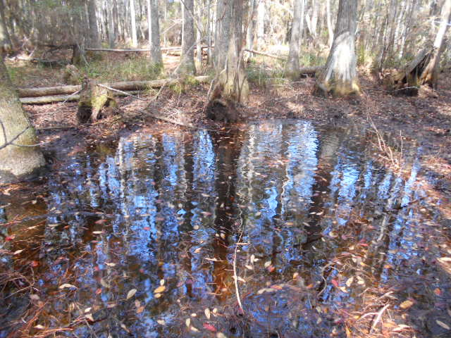
Food Chain Support 4
Location Landscape Support:
c. Wildlife access to and from AA
d. AA benefit downstream fish/wildlife
Water Environment:
a. Water levels and flows
h. Use by species with hydro requirements
j. Direct observation of water quality
Community Structure:
(I) Appropriate plant species in strata
(V) Density & quality of coarse woody debris, snag, den, and cavity
(VIII) Topographic features
AA = Assessment Area
Notes:
f. Community zonation
l. Water depth, wave energy, currents and light penetration
(III) Regen and natural recruit
(IV) Age and size distribution
(VII) Land mgmt practices
Nuphar animals graze on leaves stems and roots, turtles, birds, deer, etc.
Water-lily leaf beetle
Minnow concentrating refugia

Slide 25
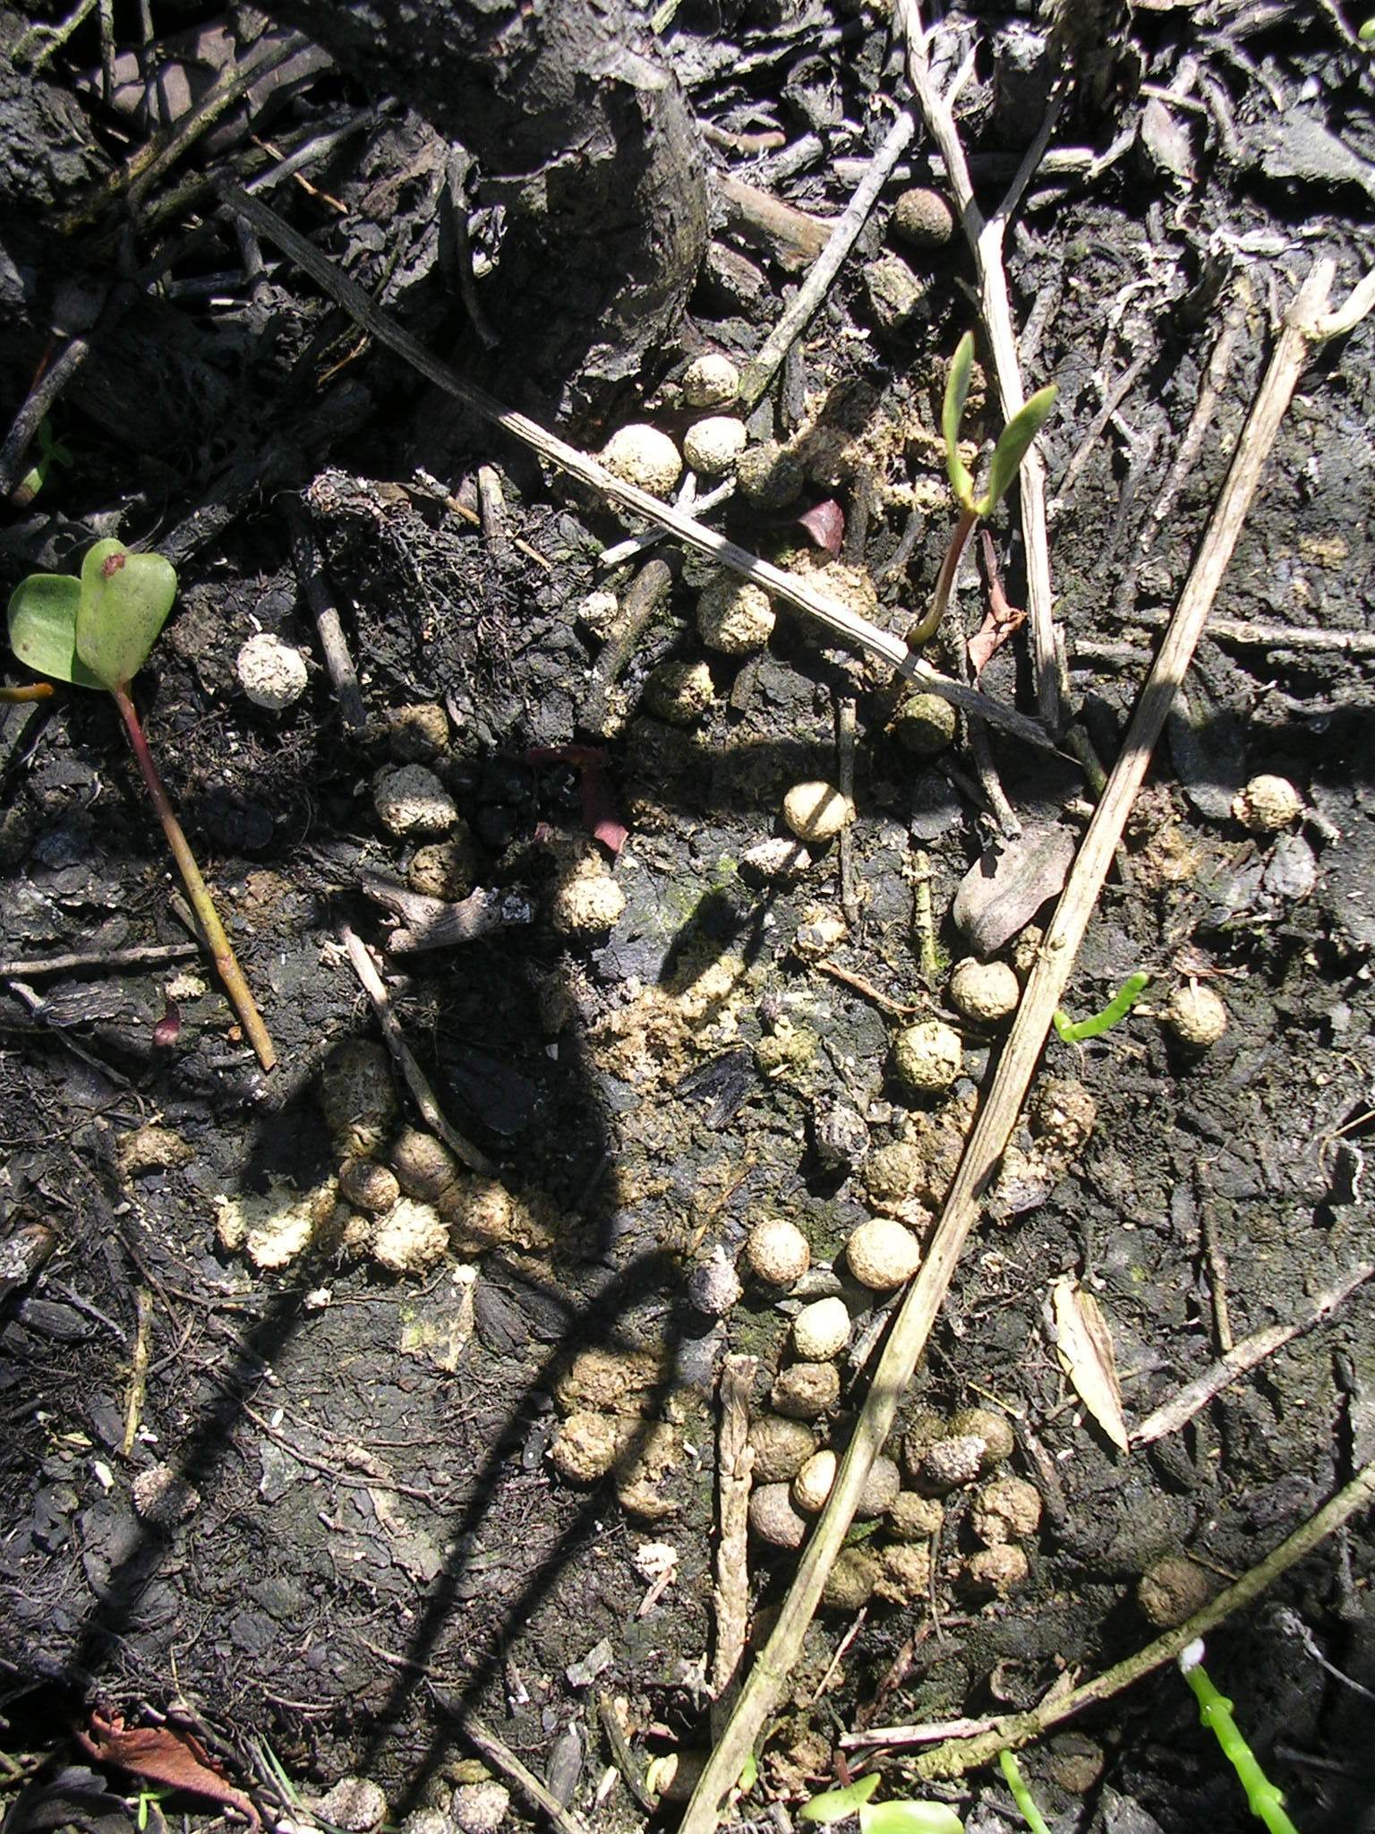
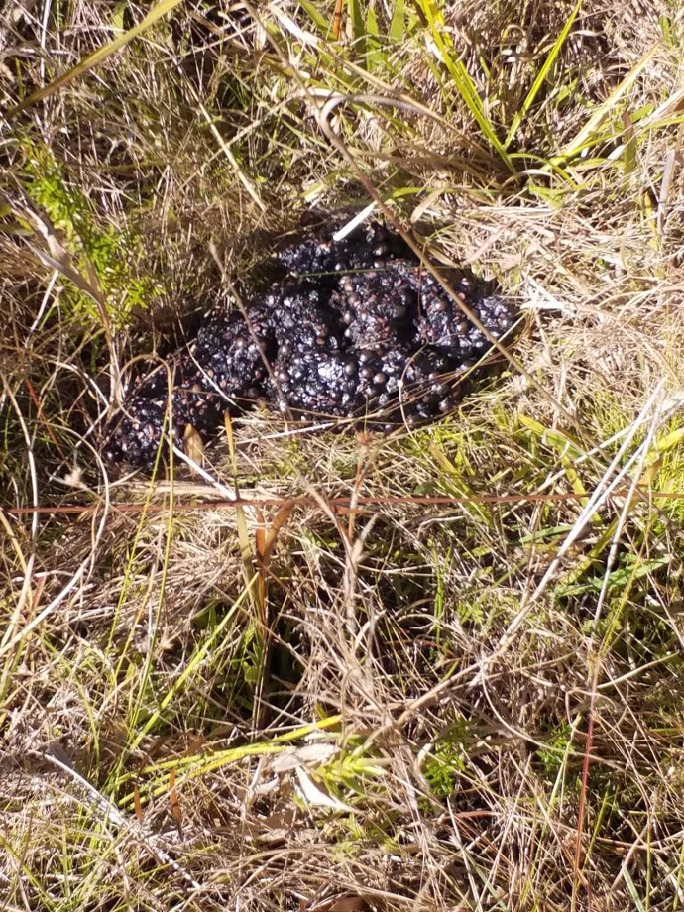
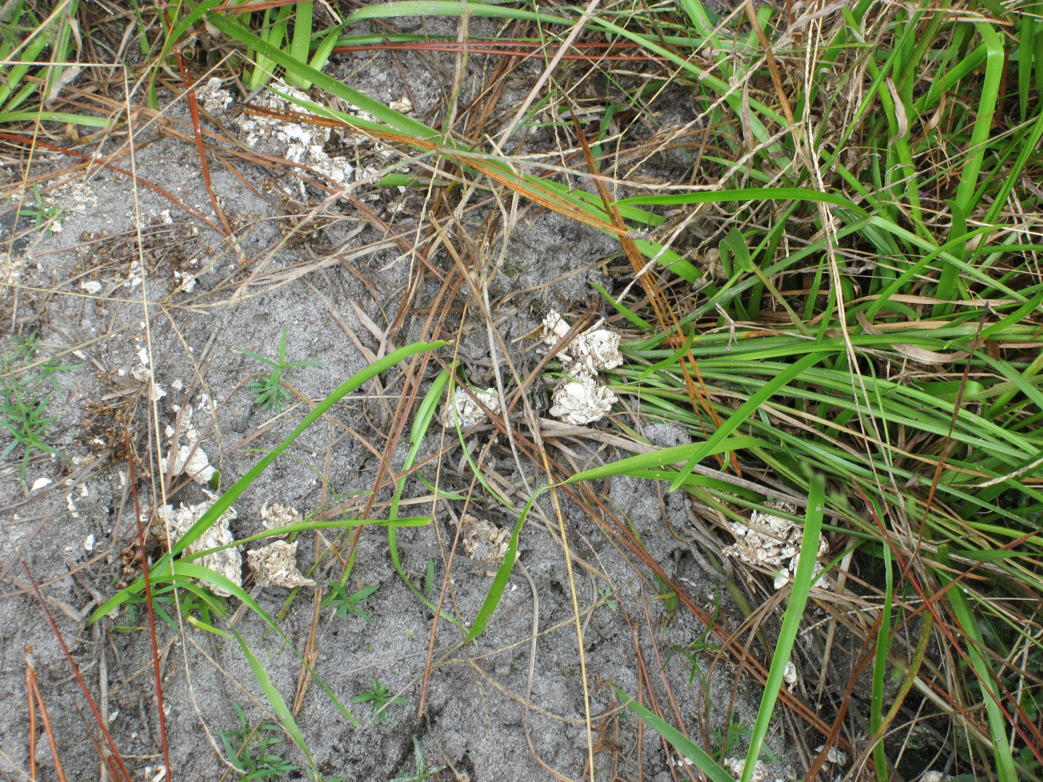
Food Chain Support 5
Location Landscape Support:
a. Habitats outside AA support P1 wildlife
c. Wildlife access to and from AA
Water Environment:
c. Soil moisture
h. Use by species with hydro requirements
Community Structure:
(I) Appr plant species in strata
(V) Density & quality of coarse woody debris, snag, den, and cavity
(VII) Land management practices
AA = Assessment Area; P1 = Part 1​​
Notes:
Scats/Left-overs
e. Land uses outside AA imp P1
(III) Regen and natural recruit
(IV) Age and size distribution
Snag as a good place to locate scat.

Slide 26
Pop Quiz
Which UMAM indicator metric is essential to an assessment area’s food web function?
A. Invasive or exotic species in proximity of AA
B. Water levels and flows
C. Soil moisture
D. Fire history
E. Wildlife access to and from the AA
Notes:
Umam indicator metrics are relative to the function, some may be more or less relevant to a given function for a particular wetland. CASE BY CASE

Slide 27
Pop Quiz 2
Which UMAM indicator metric may be used to assess the Natural Water Storage function of an assessment area?
A. Hydrologic indicators distinct and consistent
B. Invasive or exotic plants
C. Plant cover appropriate and desirable
D. Observation of discoloration, turbidity, or sheen
E. Age and size distribution
Notes:
Confidence builder, the indicators we use for 62-340 provide information on wetland function

Slide 28
Pop Quiz 3
Which of the below is BOTH a hydrologic indicator AND an indicator of wetland functions?
A. Aufwuchs
B. Morphological plant adaptations
C. Elevated lichen lines
D. None of the above
E. All of the above
Notes:
Aufuwchs – Substrate
Morph plant adapatations – natural water storage
Elevated lichen lines – natural water storage

Slide 29
Ecological Value
Section 62-345.200(3), F.A.C
Ecological Value means the value of functions performed by uplands, wetlands, and other surface waters to the abundance, diversity, and habitats of fish , wildlife, and listed species.

Slide 30
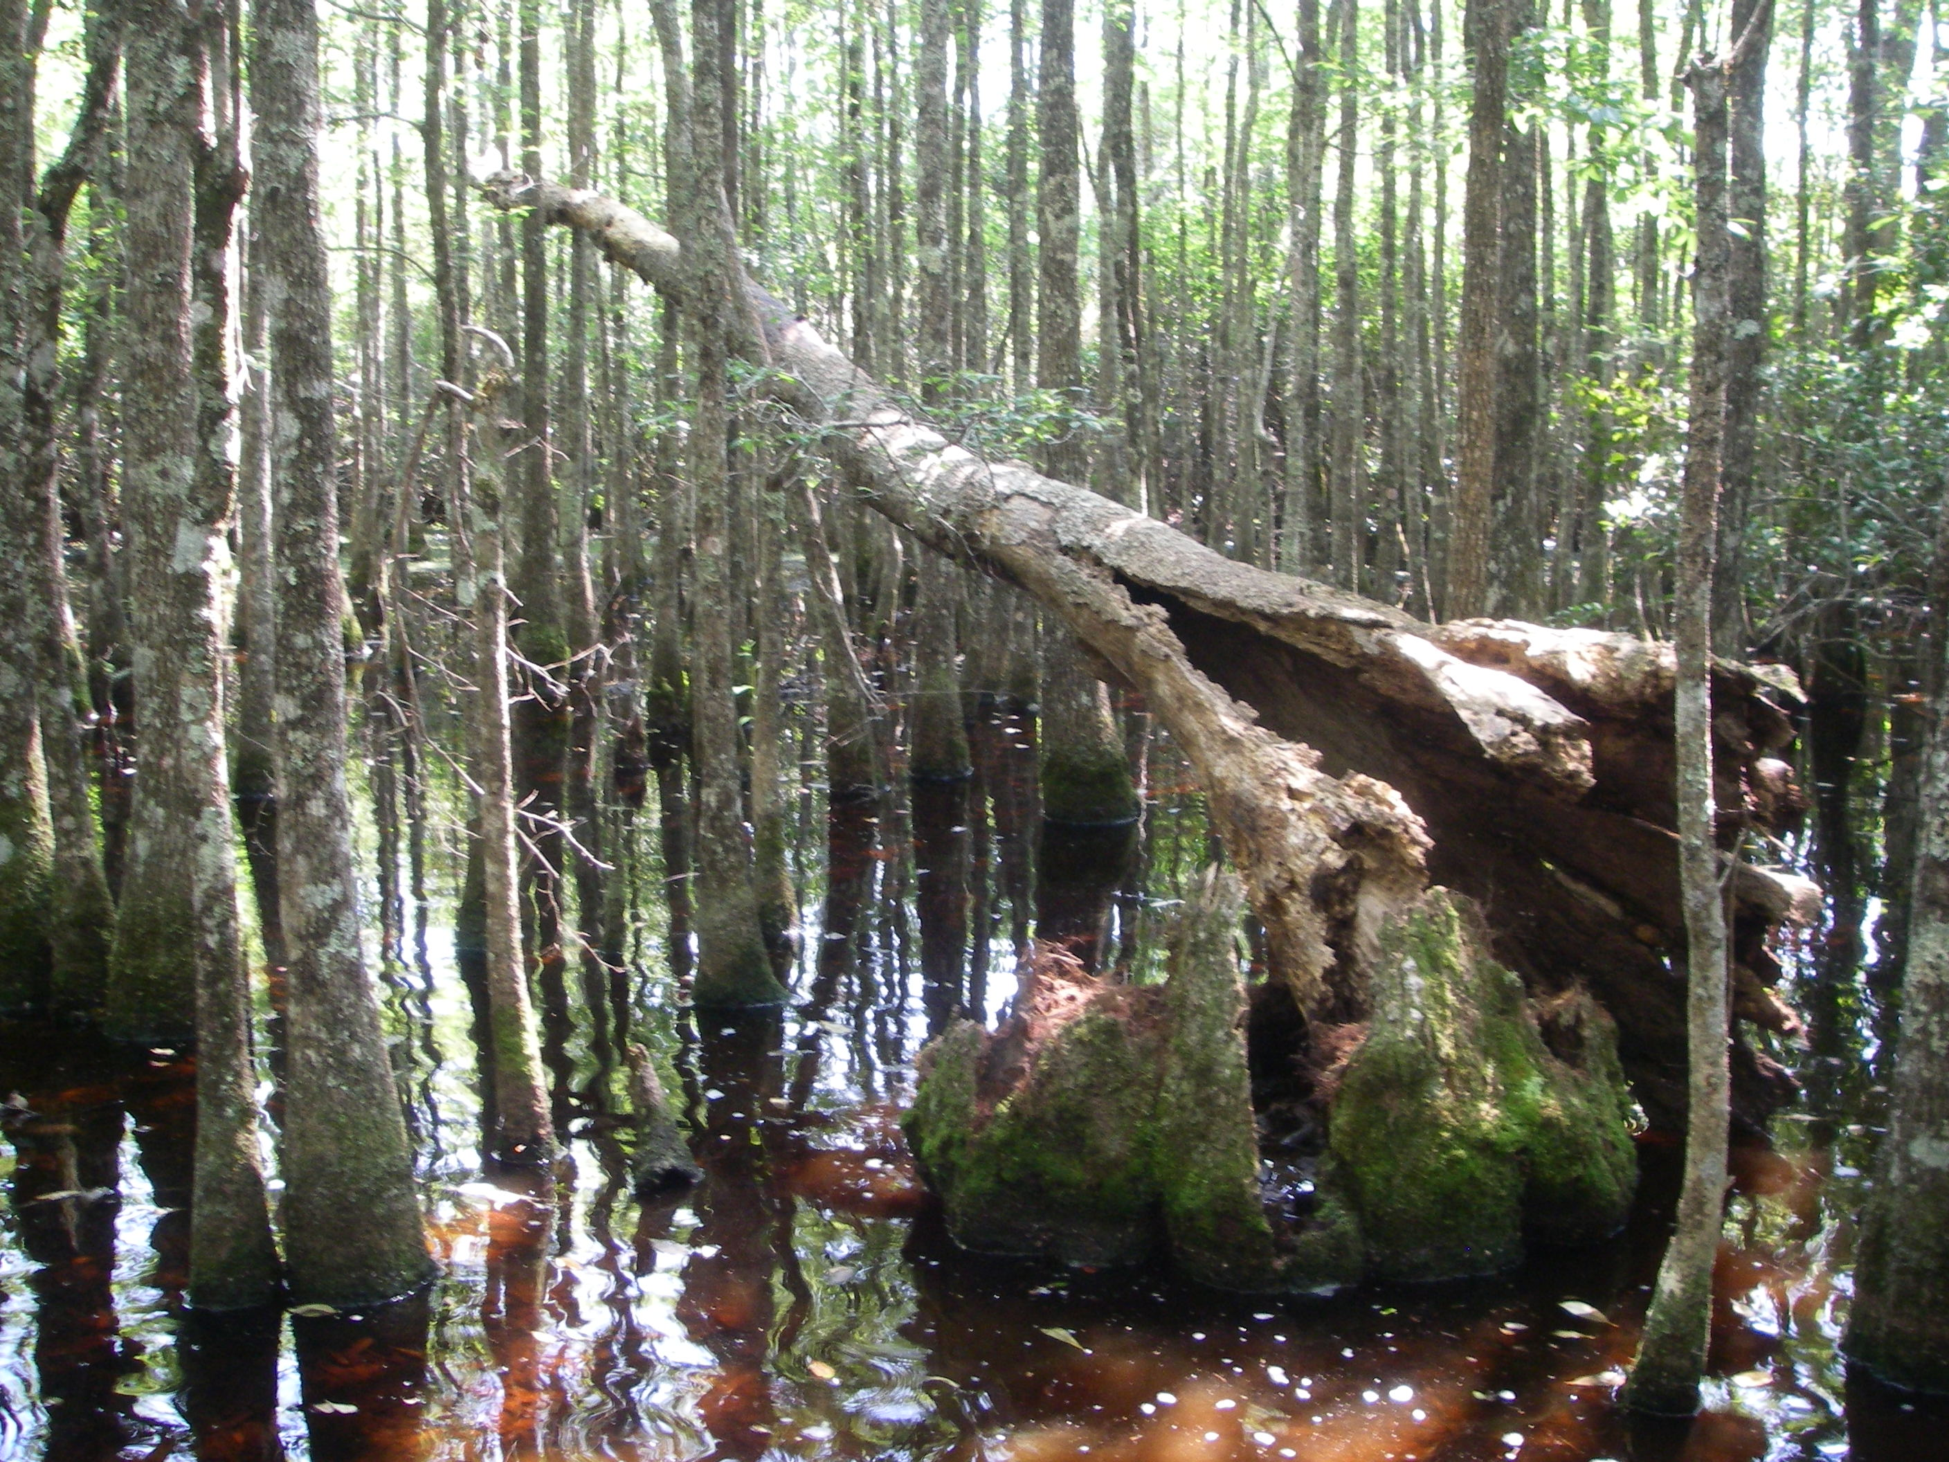
Ecological Functions

Slide 31
Wetland Functions
Section 62-345.400(7), F.A.C
Functions performed by the assessment area’s native community type. Functions to be considered are: providing cover, substrate, and refuge; breeding, nesting, denning, and nursery areas; corridors for wildlife movement; food chain support; and natural water storage, natural flow attenuation, and water quality improvement, which enhances fish, wildlife, and listed species utilization;

Slide 32
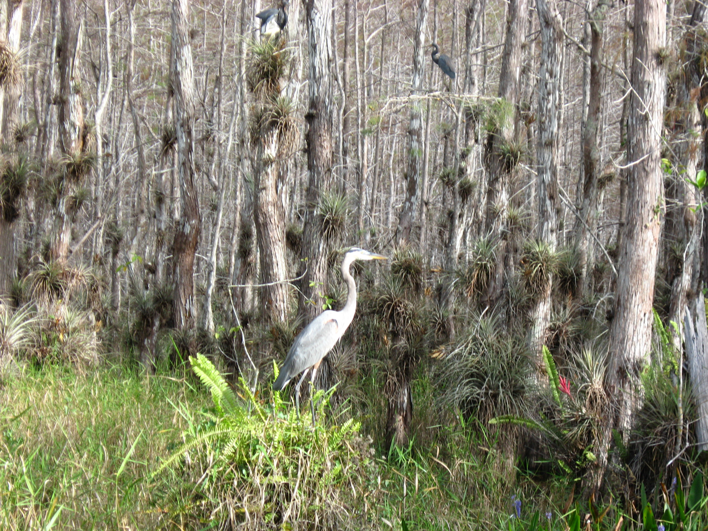
Wetland Functions

Slide 33
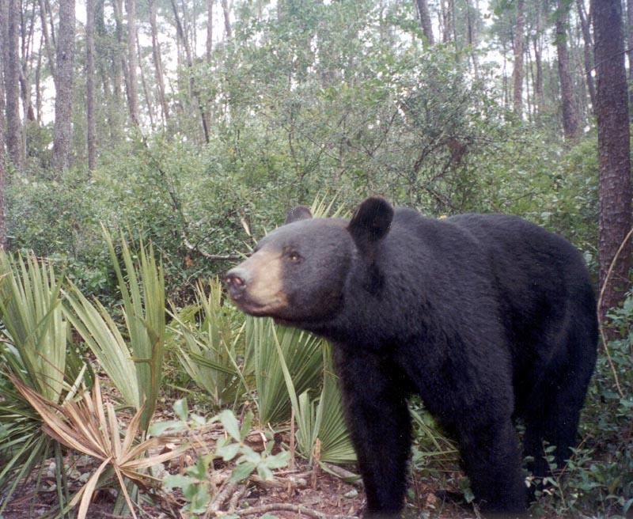
Bear in mind to:
Avoid
Minimize
Mitigate

Slide 34
The photographs used in this presentation are the property of Mac James or Florida Department of Environmental Protection staff.
Mac.James@FloridaDEP.gov
(850) 245-8623

