Slide 1
UMAM CALCULATIONS
Mac James SLERC Jan 16, 2020

Slide 2
The Rule
373.414(18), Florida Statute
62-345, Florida Administrative Code

Slide 3
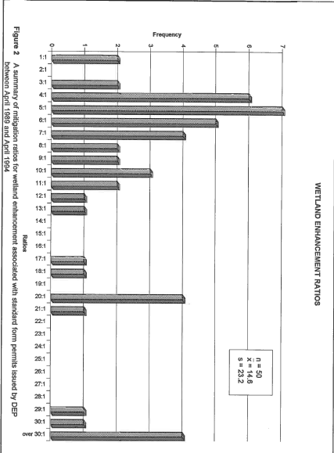
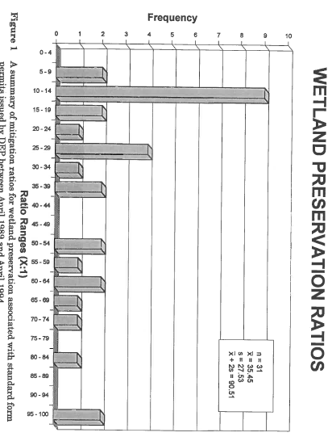
“No Net Loss”
1987 National Wetland’s Policy Forum
1989 Adopted by President George H.W. Bush administration
1989-2004 Mitigation Ratios
2000 373.414(18), F.S.
2004 62-345, F.A.C. Uniform Mitigation Assessment Method
373.414(18), F.S.: “ The department and each water management district responsible for implementation of the environmental resource permitting program shall develop a uniform mitigation assessment method for wetland and other surface waters…The rule shall provide an exclusive and consistent process for determining the amount of mitigation required to offset impacts to wetlands and other surface waters. Once the department adopts the uniform mitigation assessment method by rule… shall be the sole means to determine the amount of mitigation needed to offset adverse impacts to wetlands and other surface waters and to award and deduct mitigation bank credits.”
62-345.100, F.A.C.: Intent and Scope.
(1) The intent of this rule is to fulfill the mandate of Section 373.414(18), F.S., which requires the establishment of a uniform mitigation assessment method to determine the amount of mitigation needed to offset adverse impacts to wetlands and other surface waters and to award and deduct mitigation bank credits. This chapter shall apply to those impacts subject to review under Section 373.414, F.S., excluding Sections 373.414(1)(a)1., 3., 5., 6. and (b)3., F.S.
Notes:
The first time mitigation was a condition of a permit was in 1979.
“No net loss” is the United States government’s overall policy goal regarding wetlands preservation. Policy Goal NOT a requirement. The idea was first recommended at the 1987 National Wetlands Policy Forum and was first adopted by President George H.W. Bush’s administration in 1989.
In 1988 There was no mitigation section in Fl DER’s(Department of Environmental Resources) Wetland dredge and fill rule (17-12)
From about 89-94 there appear to have been independent approaches to ratios , 95-2004 state level guidance for ratios from study of prior mitigation permits.
Mitigation Ratios most frequently used for enhancement were 5:1,4:1,6:1; there were even some 20:1 and over 30:1
For wetland preservation 10-14:1 was the most common, with some 20-29:1 and as high as 95-100:1; IF the mitigation required >100:1 it was considered not appropriate
*these ratios come from a summary of mitigation ratios from permits issued by DEP between 1989 and 1994
We evolved from ratios to UMAM for greater consistency due to wide variability across the state.

Slide 4
UMAM Is A Tool
Any tool is only as good as the user
Man is a tool-making animal (Benjamin Franklin)
A good tool improves the way you work. A great tool improves the way you think (Jeff Duntemann)
A bad workman quarrels with his tools (George Herbert)
Science is a way of equipping yourself with the tools to interpret what happens in front of you. (Neil DeGrasse Tyson)

Slide 5
UMAM Procedure
Part I Analysis
Part II Assessment & Scoring
Mitigation Determination
Assess and score the Location and Landscape Support
Assess and score the Water Environment
Assess and score the Community Structure
http://publicfiles.dep.state.fl.us/DWRM/slerp/Monthly_Webinar_Series/UMAM/
Calibration
Characterize assessment area
Describe wildlife use of the assessment area
Describe functions the assessment area provides for wildlife and hydrology
Quantify the degradation or improvement of the assessment area as a result of the proposed activity.
Ensure no net loss of wetland functions
Mitigation
Elimination
Reduction
Evaluate reference communities for calibration
Do not score or evaluate a mitigation proposal that is not appropriate.
Notes:
“after mitigate MUST SAY “In accordance with AH I 10.2”
Maybe got ahead of myself on this slide:
Part I “Additional resources that will help you describe the community include historic aerials, community descriptions, etc. The Federal Register is an excellent resource for identifying the functions an assessment area provides for listed species. Anticipated wildlife utilization can be determined from the community description or with the aide of the FNAI biodiversity matrix).
http://publicfiles.dep.state.fl.us/DWRM/slerp/Monthly_Webinar_Series/UMAM/

Slide 6
The Calculations
62-345.600, F.A.C.
Time lag, Risk, and
Mitigation Determination
Notes:
This presentation will focus more on UMAM calculations than on the separate parameters and metrics evaluated in UMAM. The DEPT has created excellent training and guidance documents that are available on the departments website; UMAM webinars are available on our FTP site.

Slide 7
Equations
FL =
Impact Δ * Impact acres
Mitigation Δ * P.A.F.
RFG =
Risk * T-factor
FG =
RFG * Mitigation acres
What do the variables mean?
The percent of change (gain or loss) in ecological value due to an activity.
Delta (Δ):
Functional Loss (FL):
Relative Functional Gain (RFG):
Functional Gain (FG):
Preservation Adjustment Factor (P-factor):
Time Lag (T-factor):
Risk:
Δ =
With – Cur
Δ =
With – Cur
or
30
The loss in ecological value from an impact area (direct or secondary).
30
20
20
The gain in ecological value adjusted for time lag and risk
FL =
Impact Δ * Impact acres
The gain in ecological value from a mitigation area.
Mitigation Δ * P-factor
RFG =
Risk * T-factor
An adjustment for the ecological value provided by proposed preservation.
FG =
RFG * Mitigation acres
Period of time between when the functions lost at an impact site are gained at the mitigation site.
An adjustment for the degree of uncertainty that the proposed conditions will be achieved.
Notes:
Consider adding the phrase “adjustment” to time lag definition

Slide 8
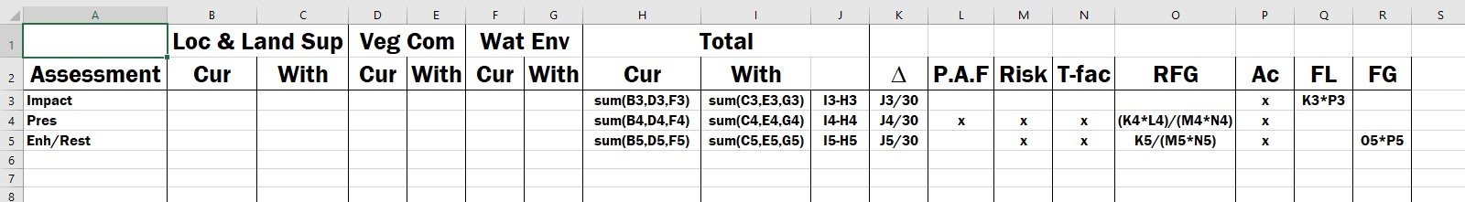
Excel Spreadsheet
Setting up
Label Fields
Insert Formula (=)
62.345.300(3) Excel : https://floridadep.gov/sites/default/files/62-345_300_3_0.xls
Notes:
“For this presentation we will not look at upland mitigation, but for upland mitigation projects, the water environment is not assessed, so instead of dividing by 30, the with and current scores are divided by 20”
Creation uses the formulas as Enhancment/Restoration
An “=“ should be placed into the cells with formula for the table to operate.
https://floridadep.gov/sites/default/files/62-345_300_3_0.xls is the web address for the official UMAM calculations spreadsheet.

Slide 9
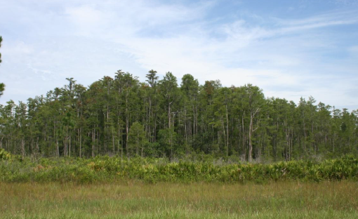
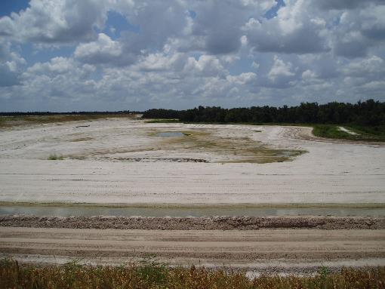
Credit/Unit
What is the value?
1.0 credit/unit is the value of 1.0 acre of an optimally functioning wetland community.
Functional Loss(FL) provides the value of 1 credit.
-1.0 credit/unit is the numerical equivalent of complete loss of wetland functions from 1 acre of pristine wetland.
FL =
With – Cur
Impact Δ * Impact acres
Δ =
30
30
Notes:
Credit is for Mitigation Banks
Units is for mitigation projects
“First we will discuss the equation for functional loss, then we will discuss the equations for functional gain.”
1.0 credit/unit is the value of 1.0 acre of an optimally functioning wetland community.

Slide 10
Mitigation For Loss

Slide 11
Types of Mitigation
How do we gain a credit?
Preservation:
Enhancement / Restoration:
Creation:
Protection of wetlands, other surface waters or uplands from adverse impacts by placing a conversation easement over the property.
Improving the ecological value of wetlands in comparison to their current condition. Converting back to a historic condition those wetland, surface waters, or uplands that currently exist as a land form that differs from the historic condition.
The establishment of new wetlands or surface waters by conversion of other land forms.
Notes:
For example: Preservation of an intact cypress dome.
Enhancement by replanting cypress in a logged cypress swamp
Restoration– restoring historic cypress dome in an area that is presently a hydric/ slash pine plantation.
Creation – establishment of a cypress dome in an area that was historically an upland.

Slide 12
Adjustments
Mitigation Δ * P.A.F.
RFG =
Risk * T-factor
P.A.F., Risk, & Time-lag
Mitigation Δ
Mitigation Δ
The following examples are for the purpose of this exercise, all UMAM considerations and adjustments should be tailored to the specific system and functions being evaluated.
Adjustments reduce Mitigation Δ
Lower the RFG the more mitigation required
Adjustments are sometimes manipulated to make FG >= FL
Due to the adjustments 1.0 ac of mitigation can not offset the -1.0 functional loss from the 1.0ac impact
Mitigation Δ * P.A.F.
T-factor
Time Lag
Scored on scale using Table 1 in 62-345.600(d), F.A.C.
Short time lag has a score of 1
Long time lag has a score of 3.91
Risk
Risk
Scored in 0.25 increments from 1-3
A score of 3.0 is high risk
A score of 1.0 is low risk
P.A.F.
Scored in 0.10 increments from 0.10-1.0
A value of 1.0 is high preservation value
A value of 0.10 is low preservation value
Adjusted Mitigation Δ = Mit Δ * P.A.F.
High: 1 * 0.8 = 0.8
Short: 1 / 1 = 1
High : 1 / 3 = 0.33
TABLE 1.
Year | T-factor
< or = 1 | 1
2 | 1.03
3 | 1.07
4 | 1.10
5 | 1.14
6-10 | 1.25
11-15 | 1.46
16-20 | 1.68
21-25 | 1.92
26-30 | 2.18
31-35 | 2.45
36-40 | 2.73
41-45 | 3.03
46-50 | 3.34
51-55 | 3.65
>55 | 3.91
Low: 1 * 0.3 = 0.3
Long: 1 / 3.91 = 0.256
Low: 1 / 1 = 1
Pres:0.10 * 0.7 = 0.07
Ex C: 1 / 1.46 = 0.685
Ex C: 1 / 2.18 = 0.459
Ex A: 1 / 2.5 = 0.4
Ex D: 1 / 1.46 = 0.685
Ex D: 1 / 1 = 1
Ex B: 1 / 1.5 = 0.66
Ex A: Mitigation proposes natural recruitment to restore aerial cover of sub-canopy mast species. Only 1 individual present in wetland and the species is dioecious.
Ex C: Mitigation plan identifies structural support (nesting, roosting) as wetland functions to be enhanced with mitigation. The mitigation consists of planting bare root and 1 gallon trees. Applicant proposes a 15 year time lag.
Ex E: 1 / 1 = 1
Ex B: Mitigation proposes to restore ground cover diversity by broadcasting native seed mixes appropriate for the vegetative community during a season optimal for germination. The plan includes adaptive management to account for poor germination.
Ex D: Mitigation plan is to restore an herbaceous wetland(to reduce time lag adjustments associated with planting trees). Applicant proposes a 1 year time lag.
Ex E: Mitigation plan is the preservation of an intact wetland system that currently provides habitat for threatened or endangered plant species.
~ 15 years
~ 30 years
Notes:
Disclaimer: The following examples are for the purpose of this exercise, all UMAM considerations and adjustments should be tailored to the specific system and functions being evaluated.
We will assume a Mitigation Delta of “1” to show the effects of the adjustments on the Mitigation Delta and RFG. Recognizing a Mitigation delta of “1” for a preservation project is not-likely / impossible…because if there is that much lift it isn’t a preservation project it is either restoration or enhancement.—or creation for that matter)
Risk
Ex: A Is the occurring tree female? If female how will it be pollinated? Will seeds be consumed? Will the seeds germinate? Will seedlings survive to maturity/reproductive age? Will something happen to the 1 tree (eg. Deer browse, bear climb and break or, man with a machete)
Ex B If the proposal includes re-seeding with native seeds of species appropriate for the community at a particular rate (ie. 100 lbs per acre of native grass seed-..but it could decrease risk if more seeds were used). risk profile shifts from what happens with the 1 seed-source tree, and will the tree produce seed to Will the seed packs be distributed at a time of year when they are likely to germinate and grow? Quality of the seed-source, etc.
Time Lag
Ex C For species that require cavities in the trees for nesting (wood ducks) the time lag is very long for a bare root seedling to develop sufficient diameter to provide cavities. Similarly, tall trees with strong upper branches necessary for roosting require long time lags to develop (min 30 for a few trees to develop structural habitat supports – 50 yrs for the average tree to provide structural support. This time lag could be less depending on the species identified in Part I, e.g. small song birds that don’t require cavities can benefit from the structural support earlier.
Ex D Although an herbaceous wetland may appear relatively quickly – the species diversity typical of a freshwater marsh or hydric savannah community require time (and forcing functions /risk) to develop. (moderate time lag)
Ex E The functions are already being provided that benefit wildlife. ** Were we to consider risk for the preservation component of mitigation, we would also consider the strength of the protection mechanism. For example, is the protection mechanism a standard Conservation Easement, or is it a Deed Restriction that provides additional protection for the resource like prohibiting the landowner from collecting or harvesting the listed plant species or giving permission to others to do so… (581.186 protects plants species)

Slide 13
Preservation
Mitigation Δ: Low
P-factor: Yes
Risk: Low
Time lag: Moderate-low
With – Cur
Mitigation Δ * P.A.F.
RFG =
Δ =
FG =
RFG * Mitigation acres
30
30
Risk * T-factor
Notes:
Recall we started with a 1 ac Cypress Dome that was converted into an upland (veg removed and wetland filled); how do we mitigate for that 1 ac impact.
Preservation scenario is a wetland that was perhaps logged 70 years ago, but has similar habitat quality to our perfect wetland, There really is only limited lift for land management practices associated with the preservation that protects the wetland from a future logging events.

Slide 14
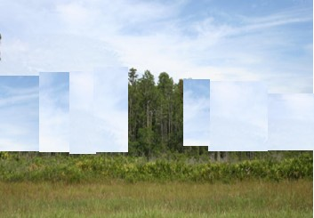
Enhancement
Mitigation Δ: Moderate-High
P-factor: No
Risk: Moderate-Low
Time lag: Moderate
Mitigation Δ * P.A.F.
With – Cur
RFG =
Δ =
FG =
RFG * Mitigation acres
Risk * T-factor
30
30
Notes:
Enhancement scenario is a wetland that was logged 20 years ago, the dome structure has been impaired, some limited regeneration is occurring.. Proposed enhancement will replant trees to recover normal density

Slide 15
Creation
Mitigation Δ: High
P-factor: No
Risk: High
Time lag: High
Mitigation Δ * P-factor
With – Cur
FG =
RFG * Mitigation acres
RFG =
Δ =
30
30
Risk * T-factor
Notes:
Scenario is the creation of a 5 acre forested wetland, from an upland with ideal expectation of community structure and water environment, which created high risk and long time lag

Slide 16
Summary
Adjustments are minimized to gain “lift” but the cost is loss in wetland functions
RFG demonstrates that Enhancement and Restoration can provide the greatest gain in ecological function and are the preferred options to offset wetland impacts.

Slide 17
The Calculations
62-345.600(3), F.A.C.
Mitigation Determination

Slide 18
Application
To determine if mitigation is provided:
To determine the number of mitigation bank credits needed to offset impacts:
Assessment | FL | FG | FG>FL
Impact | -1
Preservation |  | 0.5 | No
Enhancement |  | 0.7 | No
Creation |  | 0.5 | No
The mitigation bank must provide the type and quantity of credits needed to offset impacts
FG>FL
ΣFL = FL₁+FL₂+FL₃+FL₄+…
 | Loc & Land Sup |  | Veg Com |  | Wat Env |  | Total
Assessment | Cur | With | Cur | With | Cur | With | Cur | With |  | Δ | Ac | FL
Impact | 10 | 0 | 10 | 0 | 10 | 0 | 30 | 0 | -30 | -1 | 1 | -1
Impact 2 | 8 | 7 | 9 | 3 | 9 | 3 | 26 | 13 | -13 | -0.4 | 7 | -3.03
Impact 3 | 8 | 0 | 9 | 0 | 9 | 0 | 26 | 0 | -26 | -0.9 | 5 | -4.33
Impact 4 | 7 | 2 | 8 | 3 | 7 | 2 | 22 | 7 | -15 | -0.5 | 3.5 | -1.75
 |  |  |  |  |  |  |  |  |  |  |  | -10.1
Forested Wetland
Freshwater Marsh
Wet Flatwood
Forested Wetland

Slide 19
Application
To determine the number of potential mitigation credits a bank or ROMA can provide:
1. FG_{n}= RFG_{n} * Mitigation Ac_{n}
2. ΣFG

Slide 20
Application
To determine the acres of 1 mitigation area needed to offset impacts:
If there are multiple impacts assessment areas and or multiple mitigation assessment areas:
Assessment | FL | FG | FG>FL
Impact | -1
Impact 2 | -3.03
Impact 3 | -4.33
Impact 4 | -1.75
Preservation |  | 0.533
Preservation 2 |  | 3.5
Enhancement |  | 0.714
Enhancement 2 |  | 1.961
Enhancement 3 |  | 1.569
Creation |  | 0.519
Creation 2 |  | 2.182
Total | -10.1 | 10.98 | Yes
Assessment | FL | RFG | Ac
Impact | -1
Preservation |  | 0.053 | 19
Enhancement |  | 0.143 | 7
Creation |  | 0.104 | 9.6
FL
Mitigation acres =
RFG
 | Ac | Ac | Ac
Assessment | Prop | Req | Needed
Preservation | 10 | 19 | 9
Enhancement | 5 | 7 | 2
Creation | 5 | 9.6 | 4.6
ΣFG > ΣFL
Notes:
Add table showing proposed mitigation acreage with the RFG and the required mitigation acre
Add Mitigation Ratios

Slide 21
UMAM Rounding
The hundredth (0.01) is the smallest increment of credit that can be used by a mitigation bank.
Round up Functional Loss (FL) to the nearest hundredth to determine credits needed.
For projects with multiple Impact (FL) areas:
1. Σ FL, by type
2. RoundUP
62-342.470(6), F.A.C.: Mitigation Credits that have been released may be used to offset adverse impacts from an activity regulated under part IV, chapter 373, F.S. Mitigation credits may be used in whole or in part. However, Mitigation Credits in increments of less than a hundredth of one credit shall not be used.
Rounding up ensures mitigation offsets functional loss. (FG ≥ FL)

Slide 22
UMAM Rounding 2
The hundredth (0.01) is the smallest increment of credit that can be used by a mitigation bank.
Round down Functional Gain (FG) to the nearest hundredth to determine credits gained.
For projects with multiple mitigation (FG) areas:
1. Σ FG, by type
2. Rounddown
Assessment | FG | Rounddown(B1,2)
Freshwater Marsh | 0.533333333 | 0.53
Forested Wetland | 0.714285714 | 0.71
Forested Wetland | 1.960784314 | 1.96
Freshwater Marsh | 1.568627451 | 1.56
Total
Forested Wetland | 2.675070028 | 2.67
Freshwater Marsh | 2.101960784 | 2.1
Assessment | FG | Rounddown(B1,2)
Preservation | 0.533333333 | 0.53
Enhancement | 0.714285714 | 0.71
Enhancement 2 | 1.960784314 | 1.96
Enhancement 3 | 1.568627451 | 1.56
Rounding down ensures a project is not given more credit for functional gain than was earned by mitigation.

Slide 23
Questions
Mac James
Mac.James@FloridaDEP.gov
(850)245-8623

