Slide 1
“Non-Wetland Surface Waters” Identification and Delineation of
Other Surface Waters pursuant to Chapter 62-340, F.A.C.
Eric Hickman Environmental Administrator
Wetland Evaluation and Delineation dep.state.fl.us/water/wetlands/delineation

Slide 2
62-340.100 Intent.
(1) This rule’s intent is to provide a unified statewide methodology for the delineation of the extent of wetlands and surface waters to satisfy the mandate of Section 373.421, F.S. This delineation methodology is intended to approximate the combined landward extent of wetlands as determined by a water management district and the Department immediately before the effective date of this rule. Before implementing the specific provisions of this methodology, the regulating agency shall attempt to identify wetlands according to the definition for wetlands in subsection 373.019(17), F.S., and subsection 62-340.200(19), F.A.C., below. The landward extent of wetlands shall be determined by the dominance of plant species, soils and other hydrologic evidence indicative of regular and periodic inundation or saturation. In all cases, attempts shall be made to locate the landward extent of wetlands visually by on site inspection, or aerial photointerpretation in combination with ground truthing, without quantitative sampling. If this cannot be accomplished, the quantitative methods in paragraph 62-301.400(1)(c), F.A.C., shall be used unless the applicant or petitioner and regulating agency agree, in writing, on an alternative method for quantitatively analyzing the vegetation on site. The methodology shall not be used to delineate areas which are not wetlands as defined in subsection 62-340.200(19), F.A.C., nor to delineate as wetlands or surface waters areas exempted from delineation by statute or agency rule.
(2) The Department shall be responsible for ensuring statewide coordination and consistency in the delineation of surface waters and wetlands pursuant to this rule, by providing training and guidance to the Department, Districts, and local governments in implementing the methodology.
Specific Authority 373.421 FS. Law Implemented 373.421, 373.4211 FS. History–New 7-1-94, Formerly 17-340.100.

Slide 3
What are Other Surface Waters or Non-Wetland Surface Waters?
Any area of the landscape that meets the definition of surface waters in Chapter 62-340.600 F.A.C. but fails to meet the definition/criteria to be a wetland as set forth in Chapter 62-340.300 F.A.C. is classified as an “other surface waters”.

Slide 4
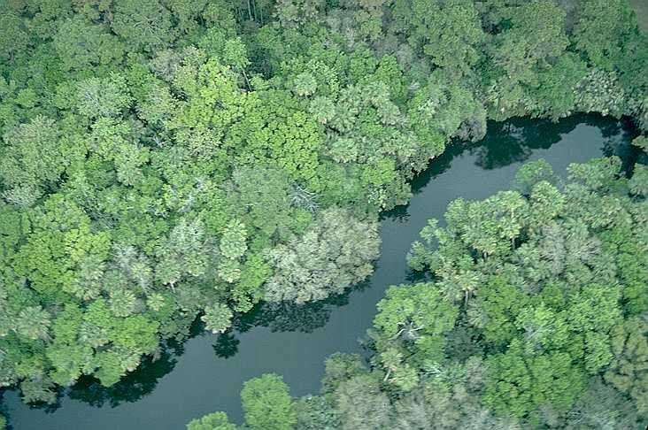

Slide 5
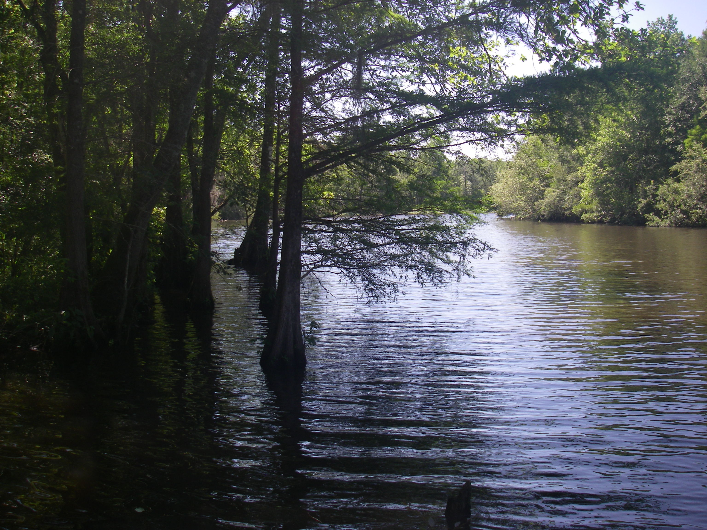

Slide 6
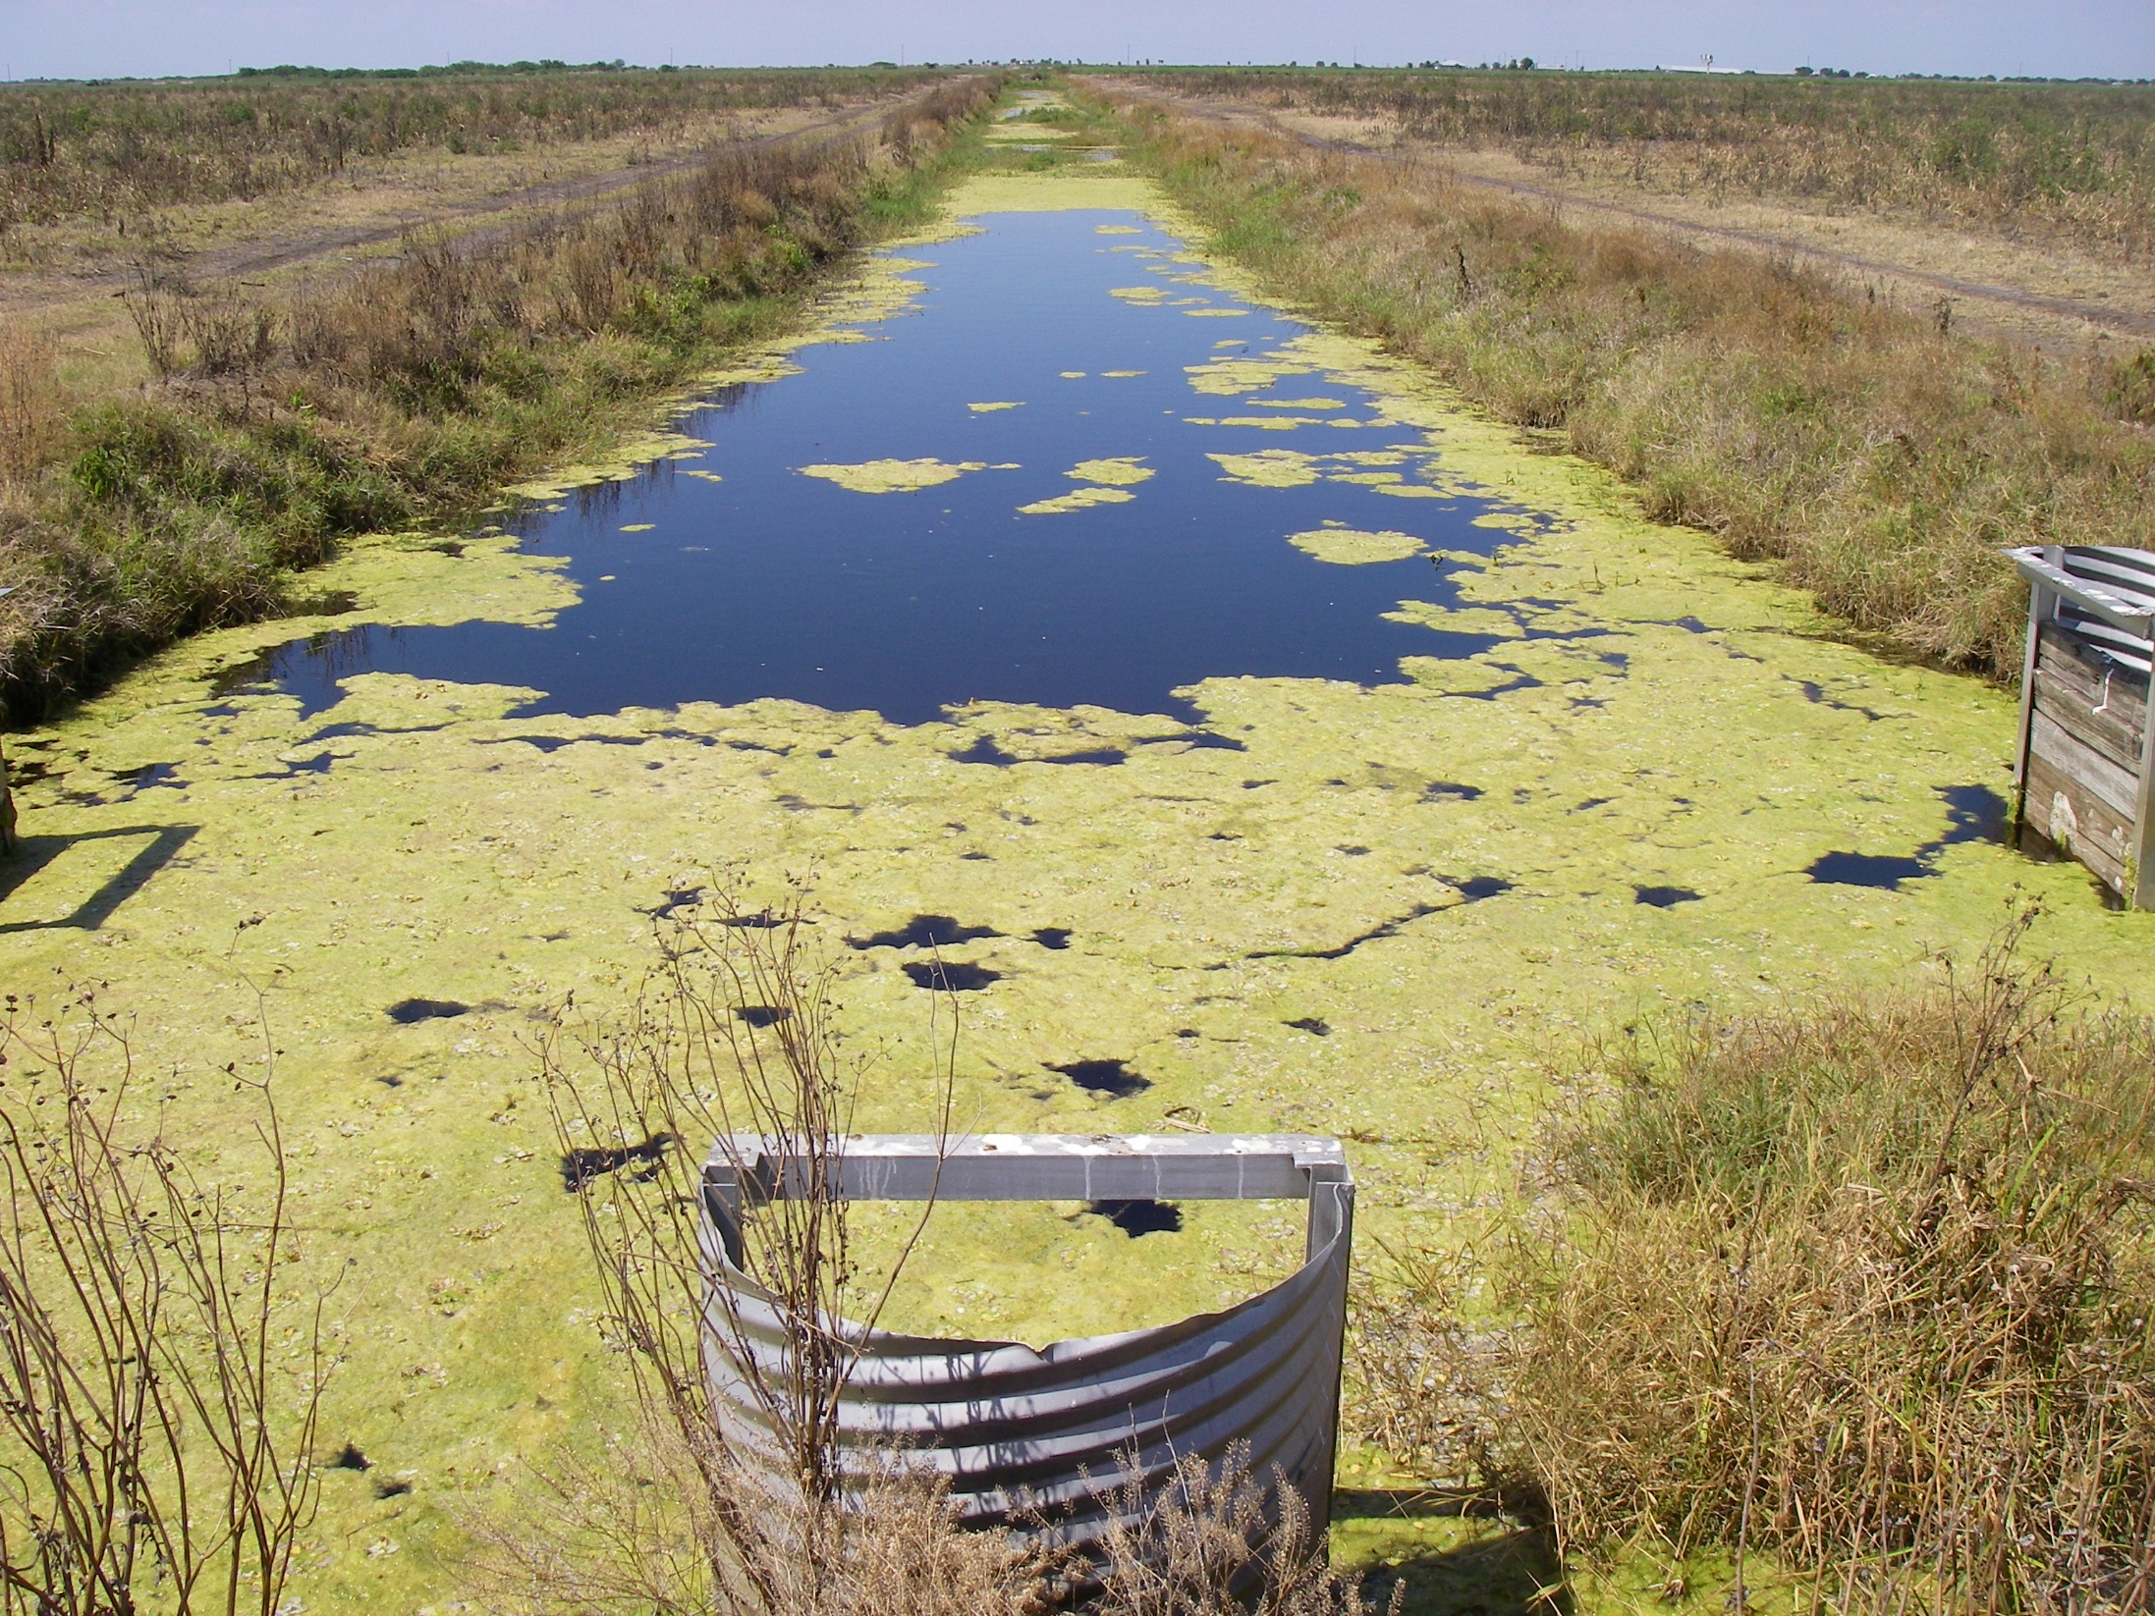

Slide 7
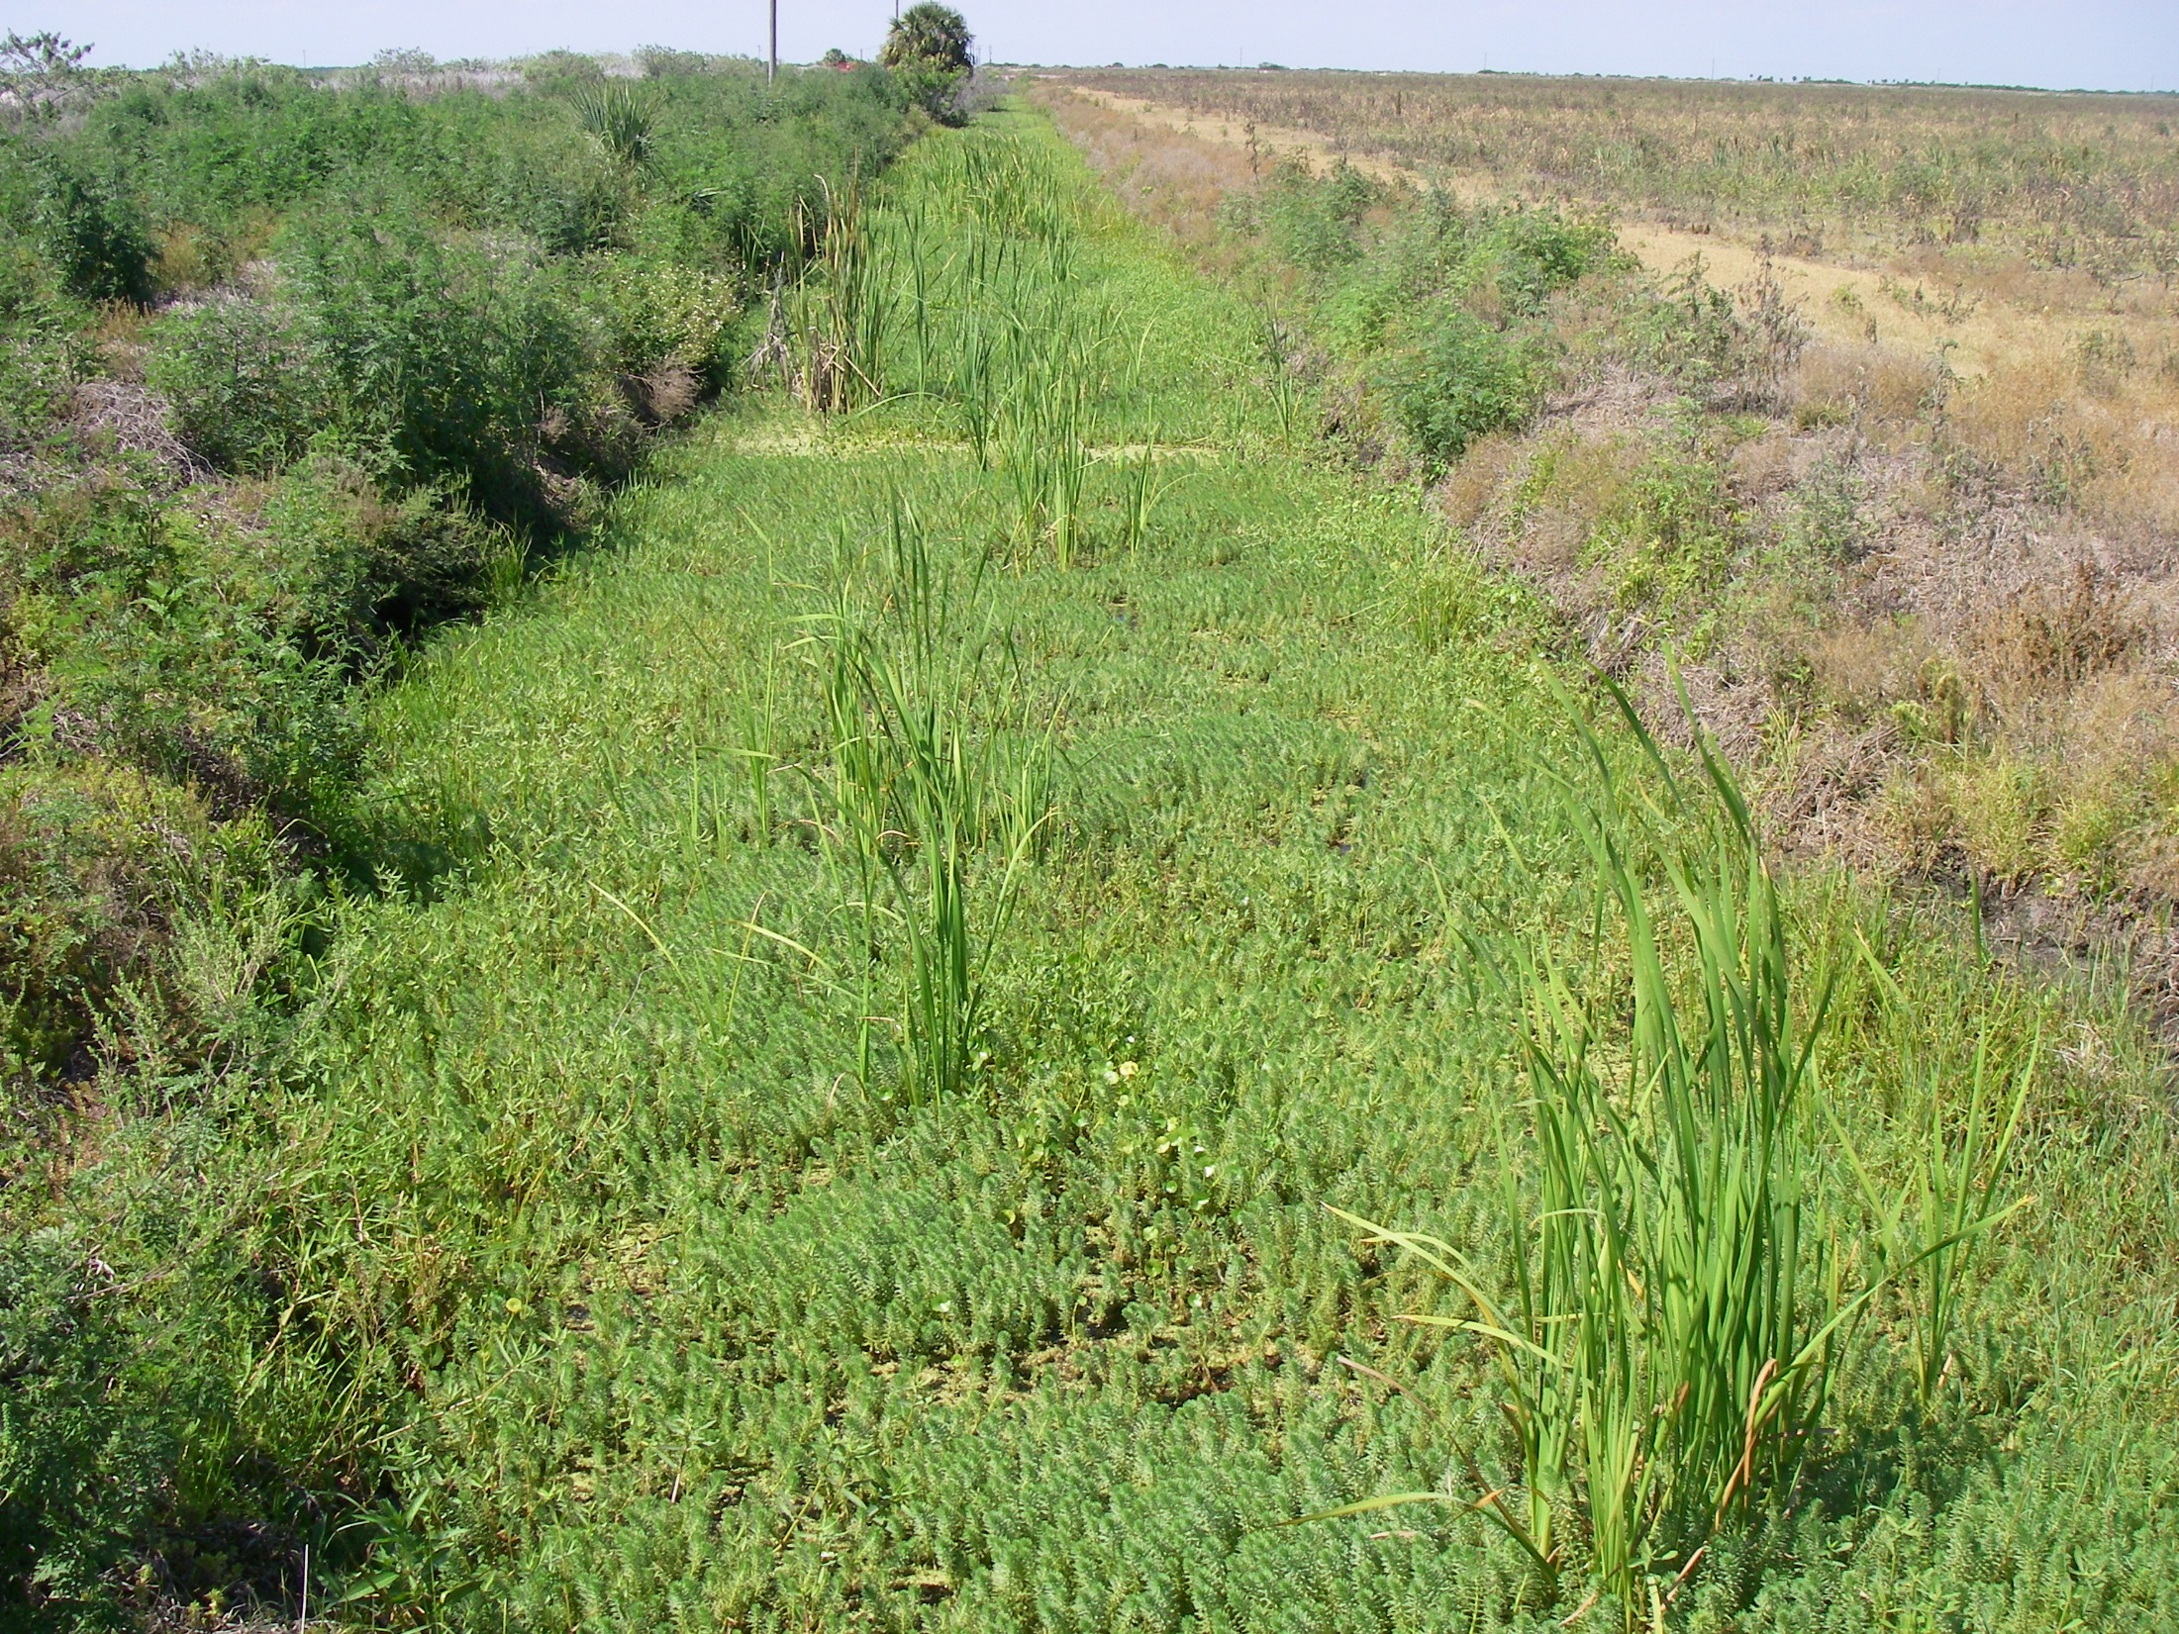

Slide 8
If the features below fail the criteria to be a “wetland” they may still be delineated as “other” Surface Waters
373.019 F.S. Definitions
(2) “Canal” is a manmade trench, the bottom of which is normally covered by water with the upper edges of its sides normally above water.
(7) “Drainage ditch” or “irrigation ditch” is a manmade trench dug for the purpose of draining water from the land or for transporting water for use on the land and is not built for navigational purposes.
(8) “Impoundment” means any lake, reservoir, pond, or other containment of surface water occupying a bed or depression in the earth’s surface and having a discernible shoreline.
(14) “Other watercourse” means any canal, ditch, or other artificial watercourse in which water usually flows in a defined bed or channel. It is not essential that the flowing be uniform or uninterrupted.
(18) “Stream” means any river, creek, slough, or natural watercourse in which water usually flows in a defined bed or channel. It is not essential that the flowing be uniform or uninterrupted. The fact that some part of the bed or channel has been dredged or improved does not prevent the watercourse from being a stream.
(19) “Surface water” means water upon the surface of the earth, whether contained in bounds created naturally or artificially or diffused. Water from natural springs shall be classified as surface water when it exits from the spring onto the earth’s surface.

Slide 9
What are Waters?
373.019 F.S. Definitions
(20) “Water” or “waters in the state” means any and all water on or beneath the surface of the ground or in the atmosphere, including natural or artificial watercourses, lakes, ponds, or diffused surface water and water percolating, standing, or flowing beneath the surface of the ground, as well as all coastal waters within the jurisdiction of the state.

Slide 10
What are Surface Waters?
373.019 F.S. Definitions
(19) “Surface water” means water upon the surface of the earth, whether contained in bounds created naturally or artificially or diffused. Water from natural springs shall be classified as surface water when it exits from the spring onto the earth’s surface.

Slide 11
Surface Waters per section 62-340.600, F.A.C.
(1) For the purposes of Section 373.421, F.S., surface waters are waters on the surface of the earth, contained in bounds created naturally or artificially, including, the Atlantic Ocean, the Gulf of Mexico, bays, bayous, sounds, estuaries, lagoons, lakes, ponds, impoundments, rivers, streams, springs, creeks, branches, sloughs, tributaries, and other watercourses. However, state water quality standards apply only to those waters defined in subsection 403.031(13), F.S.
(2) The landward extent of a surface water in the State for the purposes of implementing Section 373.414, F.S., shall be the more landward of the following:
(a) Wetlands as located by Rule 62-340.300, F.A.C., of this chapter;
(b) The mean high water line elevation for tidal water bodies;
(c) The ordinary high water line for non-tidal natural water bodies;
(d) The top of the bank for artificial lakes, borrow pits, canals, ditches and other artificial water bodies with side slopes of 1 foot vertical to 4 feet horizontal or steeper, excluding spoil banks when the canals and ditches have resulted from excavation into the ground; or
(e) The seasonal high water line for artificial lakes, borrow pits, canals, ditches, and other artificial water bodies with side slopes flatter than 1 foot vertical to 4 feet horizontal along with any artificial water body created by diking or impoundment above the ground.
(3) Determinations made pursuant to paragraphs (2)(b) and (2)(c) shall be for regulatory purposes and are not intended to be a delineation of the boundaries of lands for the purposes of title.
Specific Authority 373.421 FS. Law Implemented 373.421, 373.4211, 403.031(13) FS. History–New 7-1-94, Formerly 17-340.600.

Slide 12
“Surface Water in the State” vs. “Surface Water of the State”
State water quality standards apply only to those waters defined in subsection 403.031(13), F.S.
403.031 Florida Statutes, Definitions:
(13) “Waters” include, but are not limited to, rivers, lakes, streams, springs, impoundments, wetlands, and all other waters or bodies of water, including fresh, brackish, saline, tidal, surface, or underground waters. Waters owned entirely by one person other than the state are included only in regard to possible discharge on other property or water. Underground waters include, but are not limited to, all underground waters passing through pores of rock or soils or flowing through in channels, whether manmade or natural. Solely for purposes of s. 403.0885, waters of the state also include navigable waters or waters of the contiguous zone as used in s. 502 of the Clean Water Act, as amended, 33 U.S.C. ss. 1251 et seq., as in existence on January 1, 1993, except for those navigable waters seaward of the boundaries of the state set forth in s. 1, Art. II of the State Constitution. Solely for purposes of this chapter, waters of the state also include the area bounded by the following:
(a) Commence at the intersection of State Road (SRD) 5 (U.S. 1) and the county line dividing Miami-Dade...(boundary for Everglades).
(b) The area…(any water contiguous with the Everglades).

Slide 13
Delineation of Surface Waters per subsection 62-340.600(2), F.A.C.
(2) The landward extent of a surface water in the State for the purposes of implementing Section 373.414, F.S., shall be the more landward of the following:
(a) Wetlands as located by Rule 62-340.300, F.A.C., of this chapter;
(b) The mean high water line elevation for tidal water bodies;
(c) The ordinary high water line for non-tidal natural water bodies;
(d) The top of the bank for artificial lakes, borrow pits, canals, ditches and other artificial water bodies with side slopes of 1 foot vertical to 4 feet horizontal or steeper, excluding spoil banks when the canals and ditches have resulted from excavation into the ground; or
(e) The seasonal high water line for artificial lakes, borrow pits, canals, ditches, and other artificial water bodies with side slopes flatter than 1 foot vertical to 4 feet horizontal along with any artificial water body created by diking or impoundment above the ground.
(3) Determinations made pursuant to paragraphs (2)(b) and (2)(c) shall be for regulatory purposes and are not intended to be a delineation of the boundaries of lands for the purposes of title.
Specific Authority 373.421 FS. Law Implemented 373.421, 373.4211, 403.031(13) FS. History–New 7-1-94, Formerly 17-340.600.

Slide 14
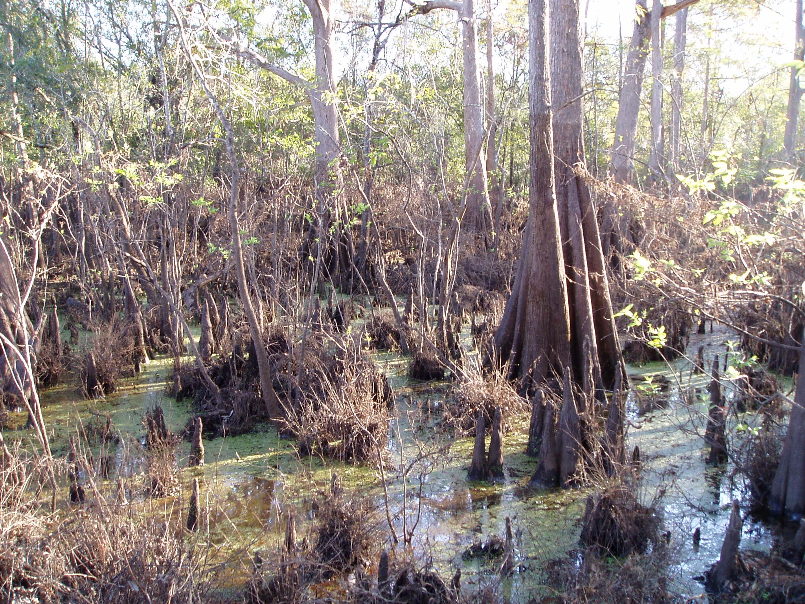

Slide 15
Delineation of Surface Waters per subsection 62-340.600(2), F.A.C.
(2) The landward extent of a surface water in the State for the purposes of implementing Section 373.414, F.S., shall be the more landward of the following:
(a) Wetlands as located by Rule 62-340.300, F.A.C., of this chapter;
(b) The mean high water line elevation for tidal water bodies;
(c) The ordinary high water line for non-tidal natural water bodies;
(d) The top of the bank for artificial lakes, borrow pits, canals, ditches and other artificial water bodies with side slopes of 1 foot vertical to 4 feet horizontal or steeper, excluding spoil banks when the canals and ditches have resulted from excavation into the ground; or
(e) The seasonal high water line for artificial lakes, borrow pits, canals, ditches, and other artificial water bodies with side slopes flatter than 1 foot vertical to 4 feet horizontal along with any artificial water body created by diking or impoundment above the ground.
(3) Determinations made pursuant to paragraphs (2)(b) and (2)(c) shall be for regulatory purposes and are not intended to be a delineation of the boundaries of lands for the purposes of title.
Specific Authority 373.421 FS. Law Implemented 373.421, 373.4211, 403.031(13) FS. History–New 7-1-94, Formerly 17-340.600.

Slide 16
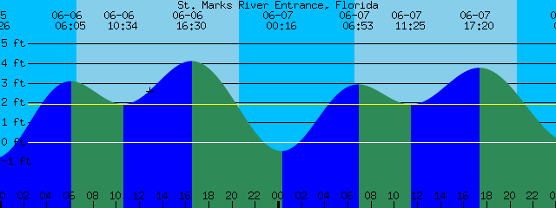
(b) The mean high water line elevation for tidal water bodies;
The mean high water line is a calculated elevation based on long term (19yrs) tidal data.
Only a Florida licenced surveyor is qualified to determine and delineate the location of the MHWL. Questions: Rod Maddox at State Lands (850) 245-2606.

Slide 17
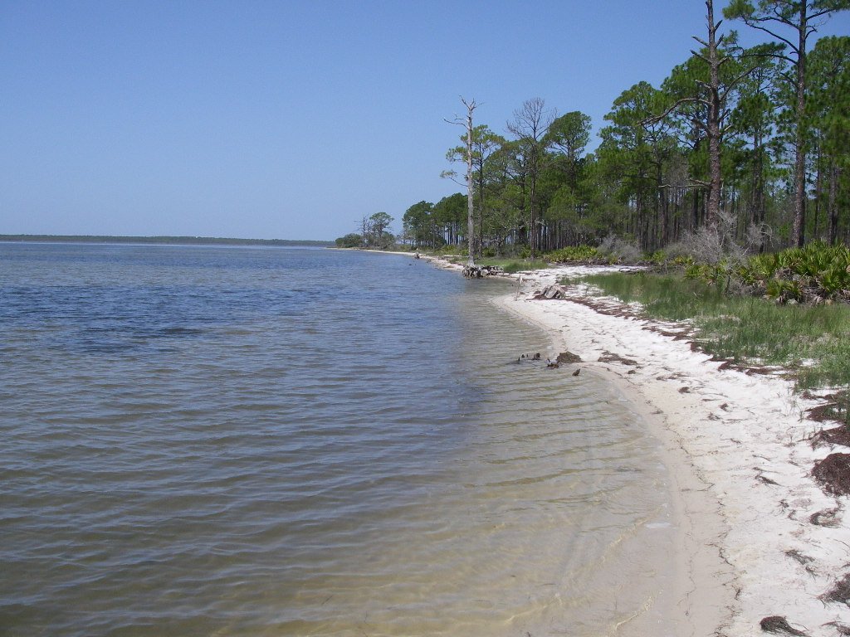

Slide 18
Delineation of Surface Waters per subsection 62-340.600(2), F.A.C.
(2) The landward extent of a surface water in the State for the purposes of implementing Section 373.414, F.S., shall be the more landward of the following:
(a) Wetlands as located by Rule 62-340.300, F.A.C., of this chapter;
(b) The mean high water line elevation for tidal water bodies;
(c) The ordinary high water line for non-tidal natural water bodies;
(d) The top of the bank for artificial lakes, borrow pits, canals, ditches and other artificial water bodies with side slopes of 1 foot vertical to 4 feet horizontal or steeper, excluding spoil banks when the canals and ditches have resulted from excavation into the ground; or
(e) The seasonal high water line for artificial lakes, borrow pits, canals, ditches, and other artificial water bodies with side slopes flatter than 1 foot vertical to 4 feet horizontal along with any artificial water body created by diking or impoundment above the ground.
(3) Determinations made pursuant to paragraphs (2)(b) and (2)(c) shall be for regulatory purposes and are not intended to be a delineation of the boundaries of lands for the purposes of title.
Specific Authority 373.421 FS. Law Implemented 373.421, 373.4211, 403.031(13) FS. History–New 7-1-94, Formerly 17-340.600.

Slide 19
(c) The ordinary high water line for non-tidal natural water bodies;
There is no definition of OHWL in Rule or Statute
62-340.600(3) Determinations made pursuant to paragraphs (2)(b) and (2) (c) shall be for regulatory purposes and are not intended to be a delineation of boundaries of lands for the purposes of title.
The FL Wetlands Delineation Manual pg. 37 “OHWL is that point on the slope or bank where the surface water from the water body ceases to exert a dominant influence on the character of the surrounding vegetation and soils.”
The FL Wetlands Delineation Manual pg. 38 “high water events leave indicators on the vegetative community, including but not limited to those listed in 62-340.500 which are correlated to the duration and frequency of events.”
The FL Wetlands Delineation Manual pg. 37 “to determine an accurate elevation for the OHWL, the hydropattern of the water body needs to be assessed. This can of course be accomplished through long-term hydrologic data collection. When available, the mean annual flood is an acceptable approximation of the OHWL for flowing water systems.”

Slide 20
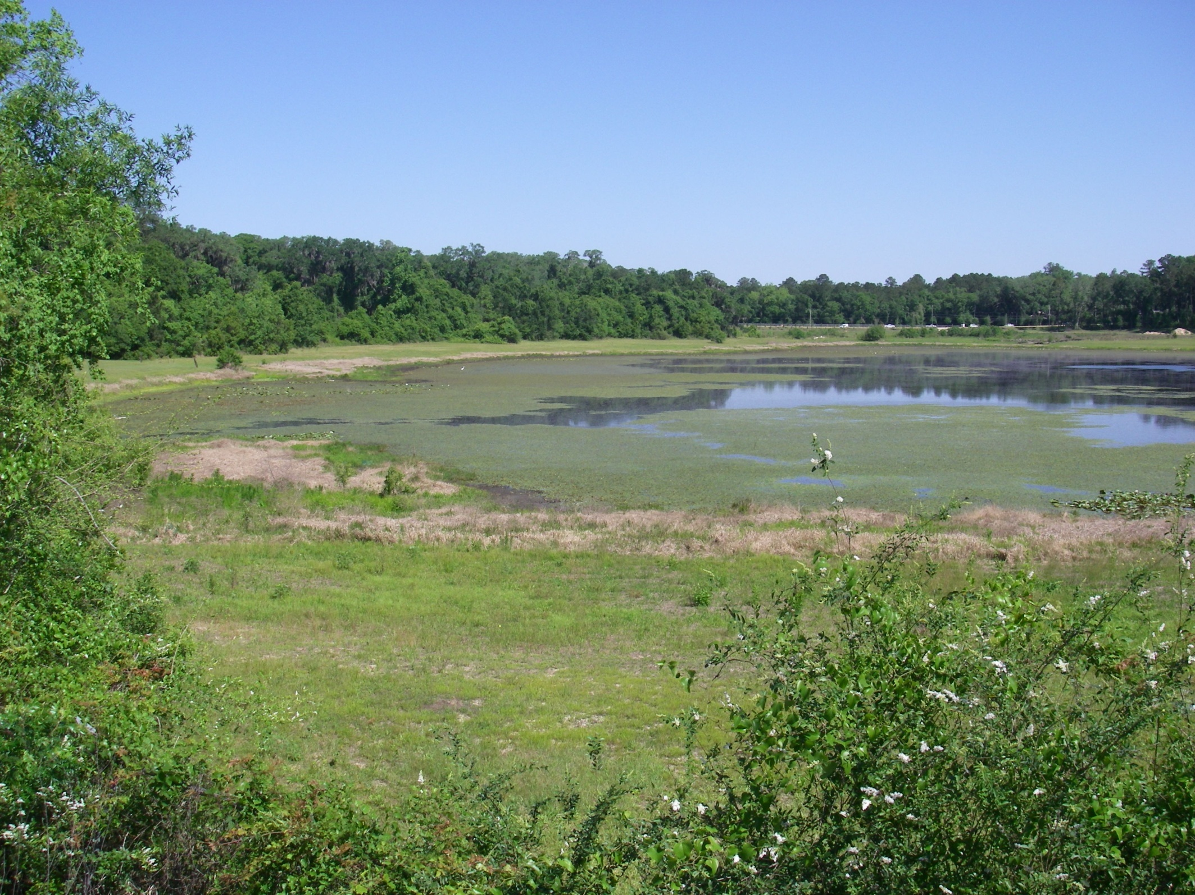
The FL Wetlands Delineation Manuel pg. 37 “OHWL is that point on the slope or bank where the surface water from the water body ceases to exert a dominant influence on the character of the surrounding vegetation and soils.”

Slide 21
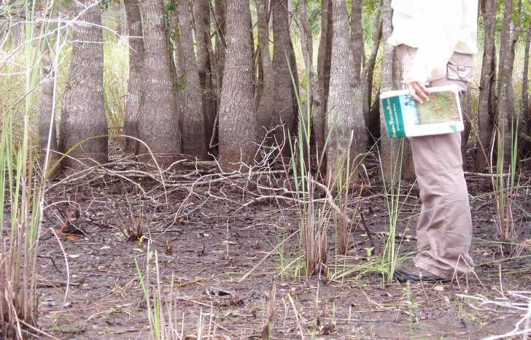

Slide 22
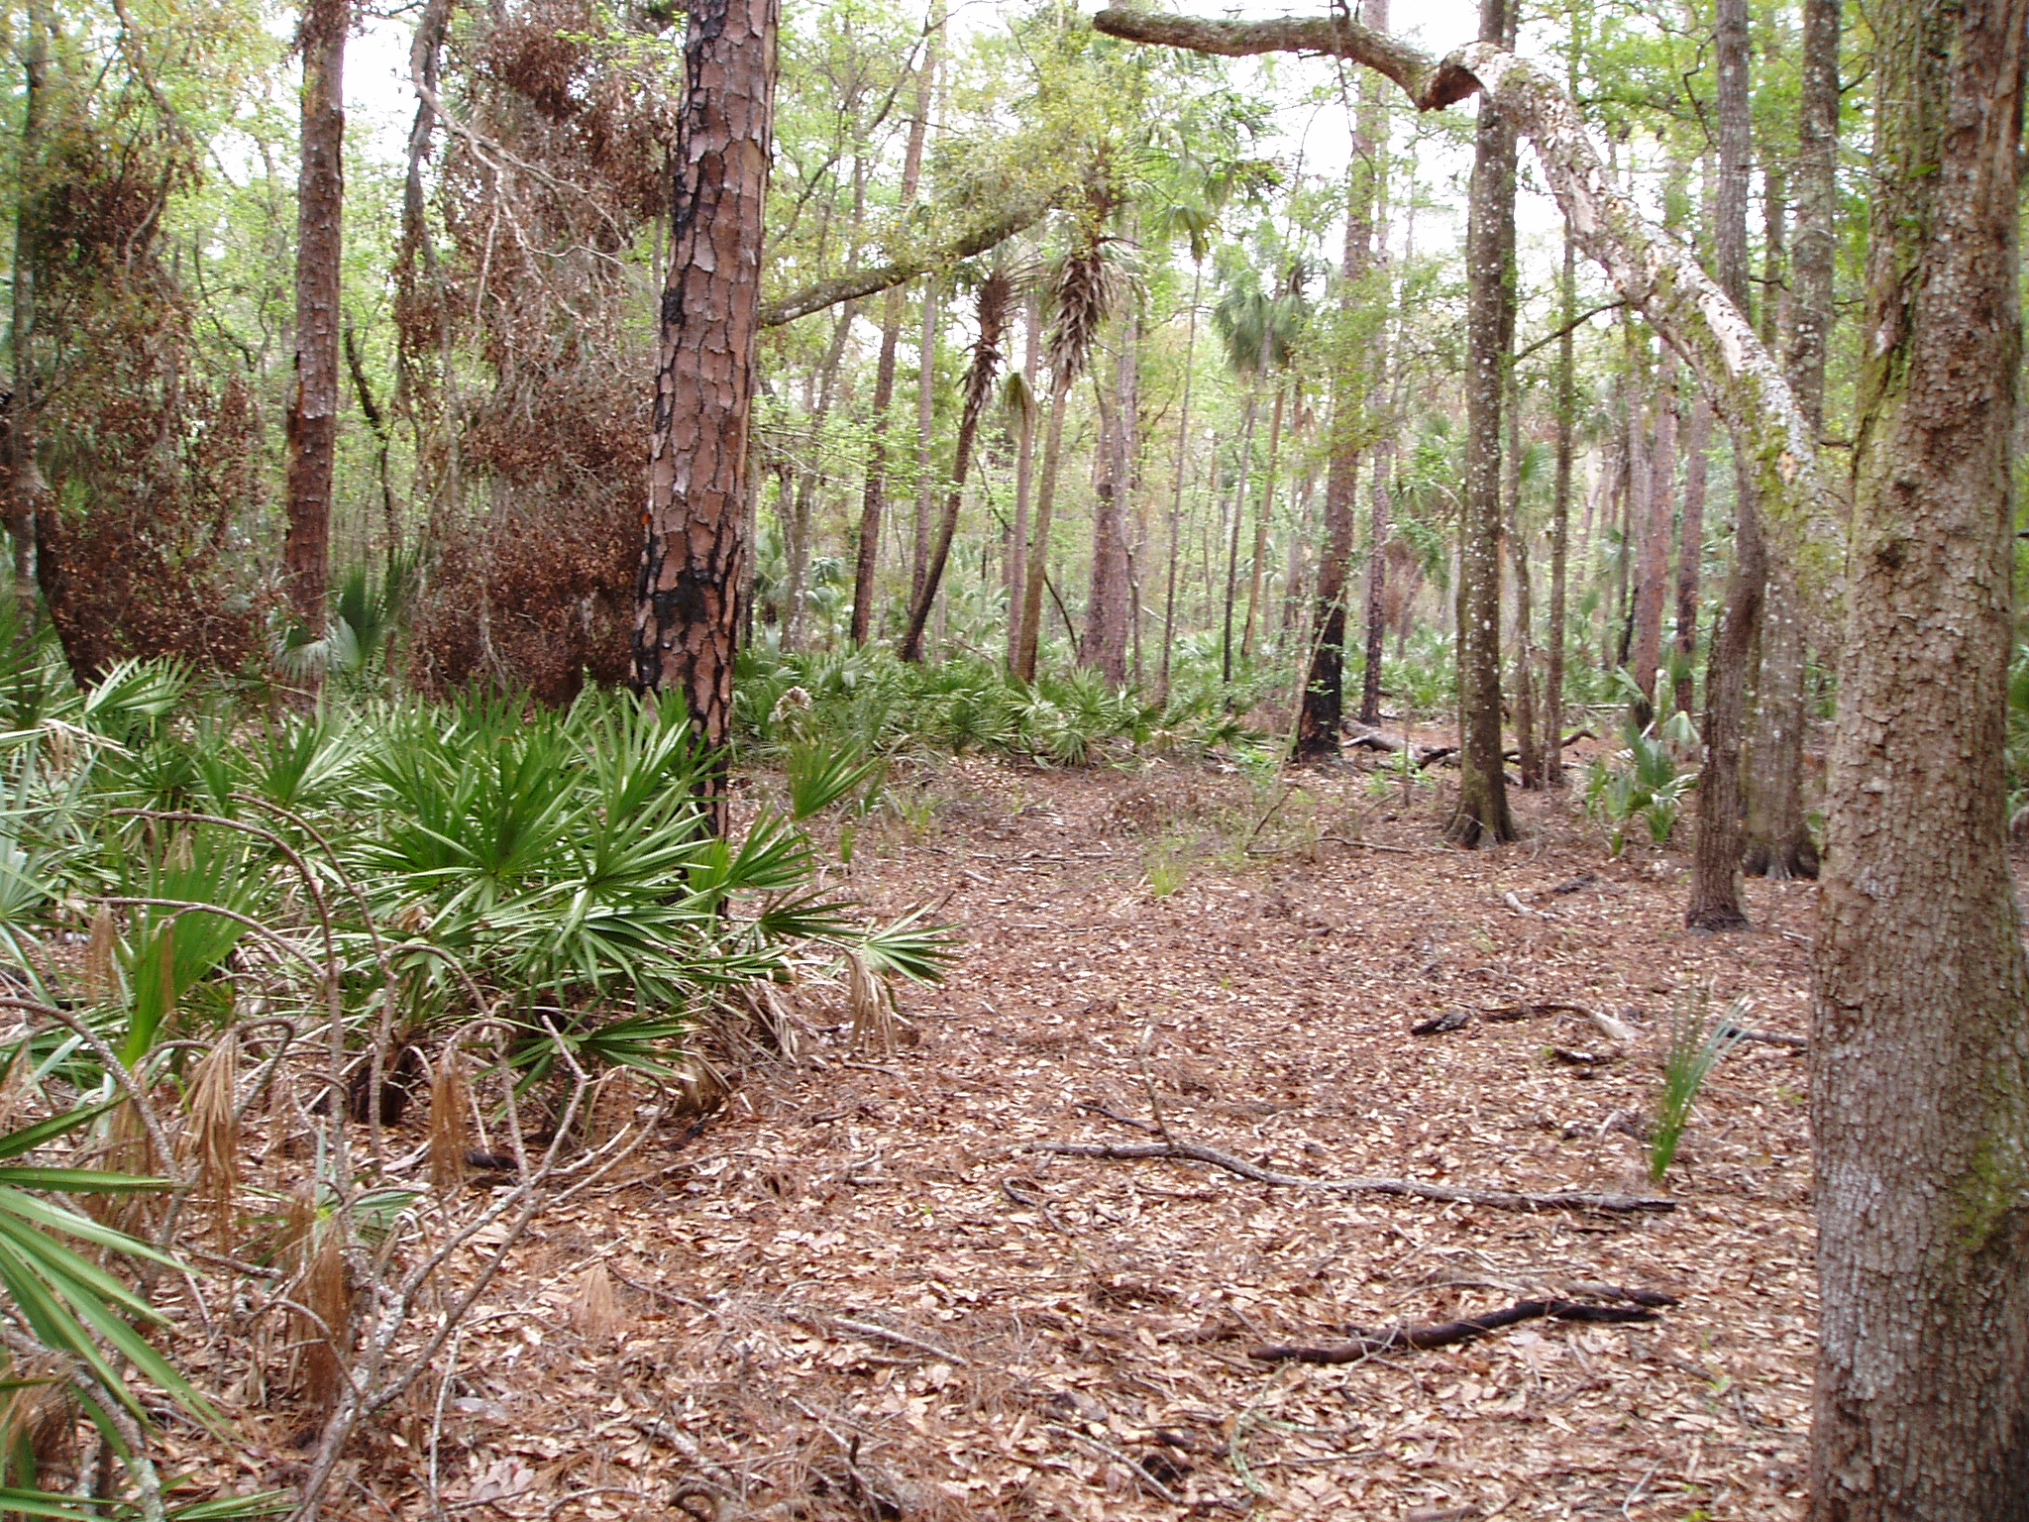

Slide 23
Mean Annual Flood or MAF
The FL Wetlands Delineation Manual pg. 37 “to determine an accurate elevation for the OHWL, the hydropattern of the water body needs to be assessed. This can of course be accomplished through long-term hydrologic data collection. When available, the mean annual flood is an acceptable approximation of the OHWL for flowing water systems.”
Richard W. Cantrell, BJ-51-253736-3, June 15, 1998 letter:
“The Department, based upon a common sense approach, chose the Mean Annual Flood elevation as an acceptable approximation of the regulatory OHWL envisioned in Section 403.913 F.S. which was frequently available to petitioners. Fundamental to the choice of the Mean Annual Flood elevation as an acceptable approximation of the regulatory OHWL was the statutory establishment of “regular and periodic inundation” as the basis for determinations of the natural landward extent of waters for regulatory purposes (403.817 F.S.). The Mean Annual Flood is, as you note, a 2.33 year flood or viewed another way, has a nearly 50% probability of occurring in any given year. This was the single elevation, routinely available, which appeared to most conservatively fit the “regular and periodic inundation” statutory basis for the Department’s authority in establishing the landward extent of waters of the state.”

Slide 24
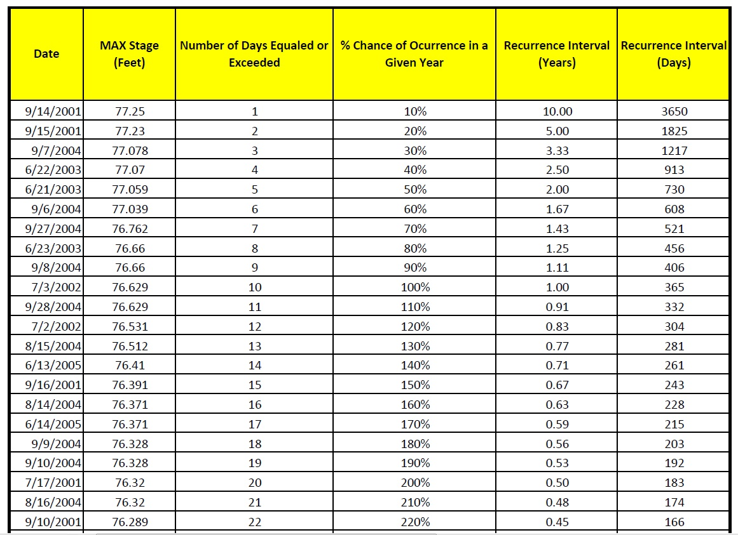
MAF is a statistical return interval calculation, it is temporal based and not a mean of elevations

Slide 25
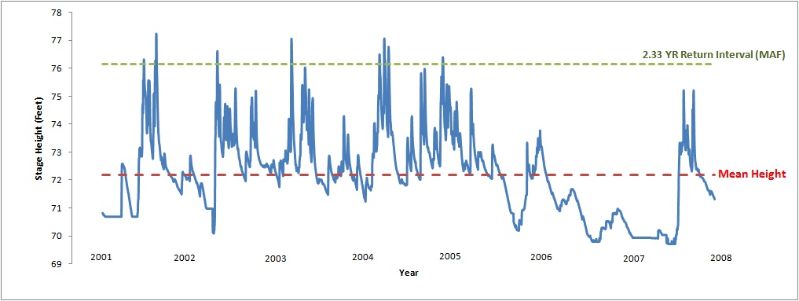
Most widely excepted MAF calculation is the 2.33 return interval

Slide 26
Delineation of Surface Waters per subsection 62-340.600(2), F.A.C.
(2) The landward extent of a surface water in the State for the purposes of implementing Section 373.414, F.S., shall be the more landward of the following:
(a) Wetlands as located by Rule 62-340.300, F.A.C., of this chapter;
(b) The mean high water line elevation for tidal water bodies;
(c) The ordinary high water line for non-tidal natural water bodies;
(d) The top of the bank for artificial lakes, borrow pits, canals, ditches and other artificial water bodies with side slopes of 1 foot vertical to 4 feet horizontal or steeper, excluding spoil banks when the canals and ditches have resulted from excavation into the ground; or
(e) The seasonal high water line for artificial lakes, borrow pits, canals, ditches, and other artificial water bodies with side slopes flatter than 1 foot vertical to 4 feet horizontal along with any artificial water body created by diking or impoundment above the ground.
(3) Determinations made pursuant to paragraphs (2)(b) and (2)(c) shall be for regulatory purposes and are not intended to be a delineation of the boundaries of lands for the purposes of title.
Specific Authority 373.421 FS. Law Implemented 373.421, 373.4211, 403.031(13) FS. History–New 7-1-94, Formerly 17-340.600.

Slide 27
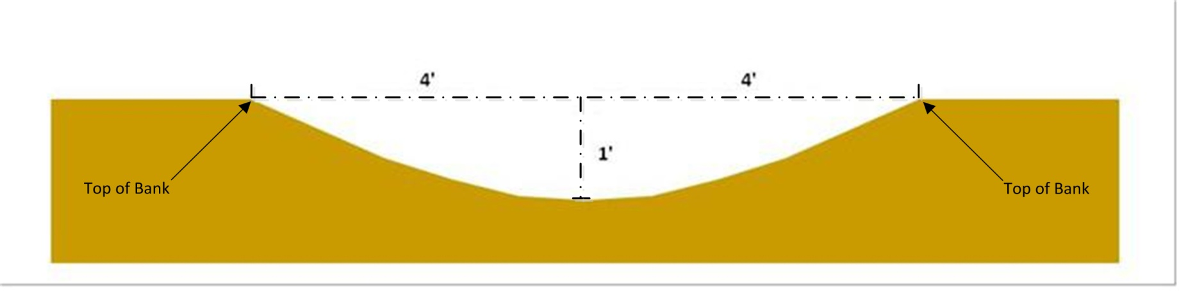
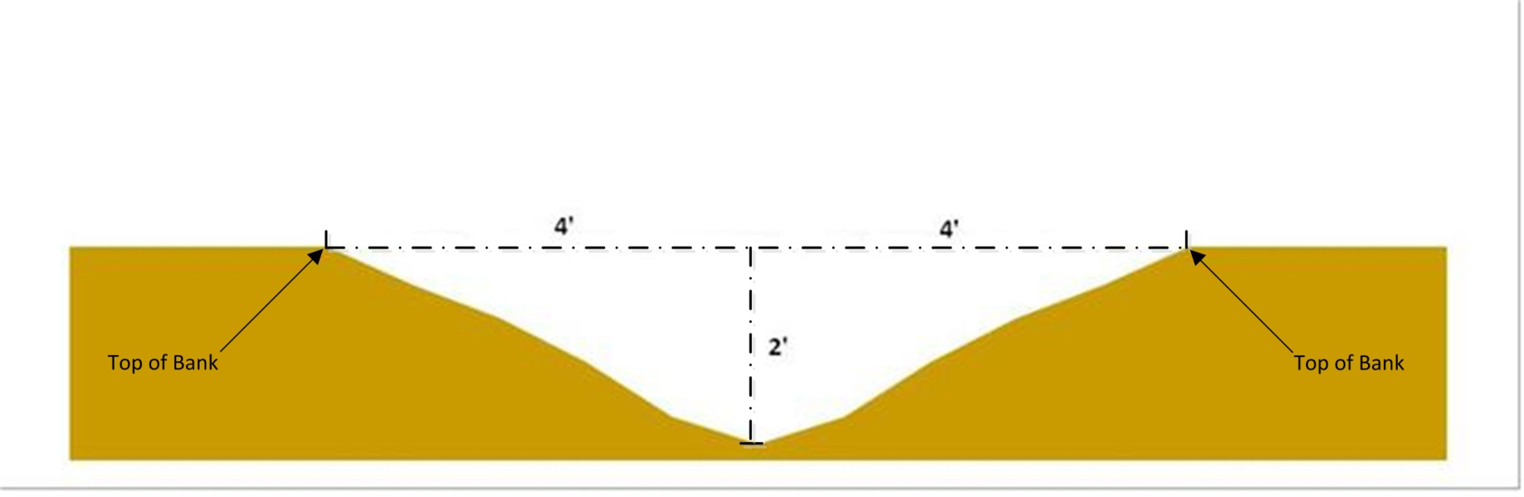
(d) The top of the bank for artificial lakes, borrow pits, canals, ditches and other artificial water bodies with side slopes of 1 foot vertical to 4 feet horizontal or steeper, excluding spoil banks when the canals and ditches have resulted from excavation into the ground;

Slide 28
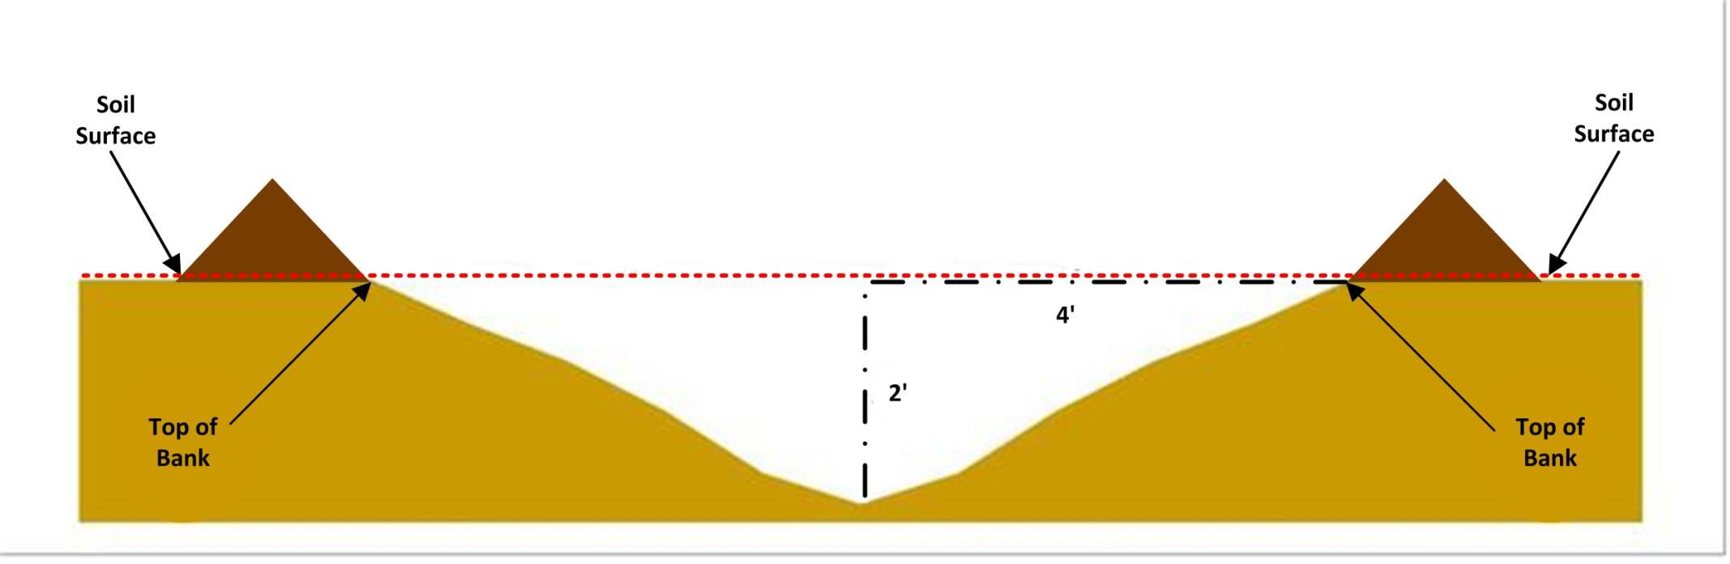
(d) The top of the bank for artificial lakes, borrow pits, canals, ditches and other artificial water bodies with side slopes of 1 foot vertical to 4 feet horizontal or steeper, excluding spoil banks when the canals and ditches have resulted from excavation into the ground;

Slide 29
Delineation of Surface Waters per subsection 62-340.600(2), F.A.C.
(2) The landward extent of a surface water in the State for the purposes of implementing Section 373.414, F.S., shall be the more landward of the following:
(a) Wetlands as located by Rule 62-340.300, F.A.C., of this chapter;
(b) The mean high water line elevation for tidal water bodies;
(c) The ordinary high water line for non-tidal natural water bodies;
(d) The top of the bank for artificial lakes, borrow pits, canals, ditches and other artificial water bodies with side slopes of 1 foot vertical to 4 feet horizontal or steeper, excluding spoil banks when the canals and ditches have resulted from excavation into the ground; or
(e) The seasonal high water line for artificial lakes, borrow pits, canals, ditches, and other artificial water bodies with side slopes flatter than 1 foot vertical to 4 feet horizontal along with any artificial water body created by diking or impoundment above the ground.
(3) Determinations made pursuant to paragraphs (2)(b) and (2)(c) shall be for regulatory purposes and are not intended to be a delineation of the boundaries of lands for the purposes of title.
Specific Authority 373.421 FS. Law Implemented 373.421, 373.4211, 403.031(13) FS. History–New 7-1-94, Formerly 17-340.600.

Slide 30
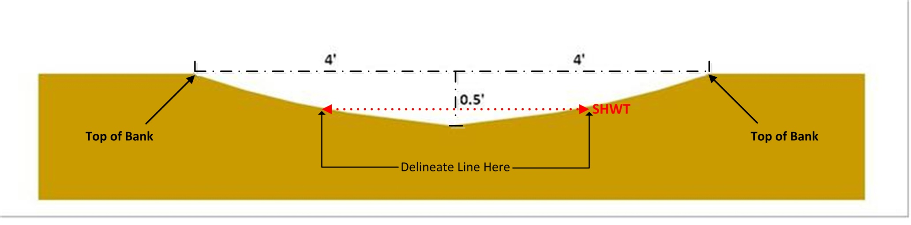
(e) The seasonal high water line for artificial lakes, borrow pits, canals, ditches, and other artificial water bodies with side slopes flatter than 1 foot vertical to 4 feet horizontal along with any artificial water body created by diking or impoundment above the ground.
Definition in 62-340.200(15) “Seasonal High Water” means the elevation to which ground and surface water can be expected to rise due to a normal wet season.”

Slide 31
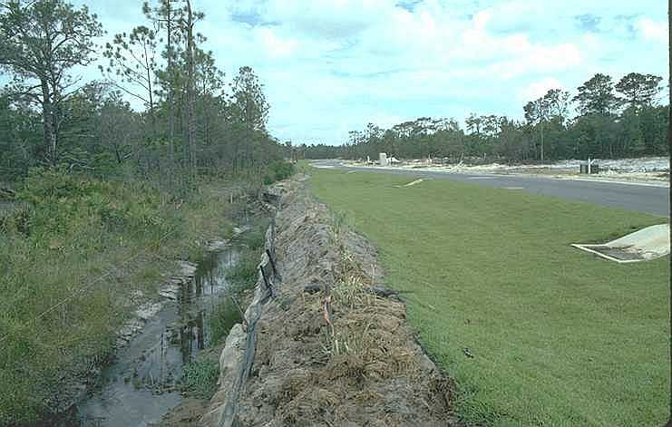
Ditches and Swales
see section 403.803(7)&(14) for definitions
Presentation©2006, FDEP

Slide 32
Swales are exempt surface waters, but must meet all of the swale criteria below :
403.813(2)(j) Exemptions F.S.
403.803(14) Florida Statutes, “Swale” means a manmade trench which:
(a)Has a top width-to-depth ratio of the cross-section equal to or greater than 6:1, or side slopes equal to or greater than 3 feet horizontal to 1 foot vertical;
(b)Contains contiguous areas of standing or flowing water only following a rainfall event;
(c)Is planted with or has stabilized vegetation suitable for soil stabilization, stormwater treatment, and nutrient uptake; and
(d)Is designed to take into account the soil erodibility, soil percolation, slope, slope length, and drainage area so as to prevent erosion and reduce pollutant concentration of any discharge.

Slide 33
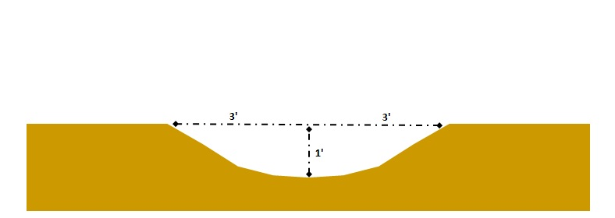
403.803(14) Florida Statutes, “Swale” means a manmade trench which:
(a)Has a top width-to-depth ratio of the cross-section equal to or greater than 6:1, or side slopes equal to or greater than 3 feet horizontal to 1 foot vertical;

Slide 34
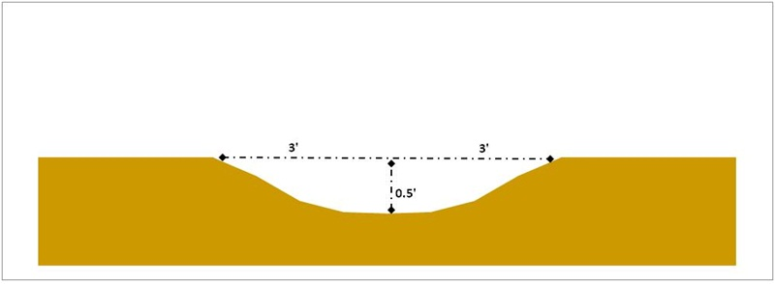
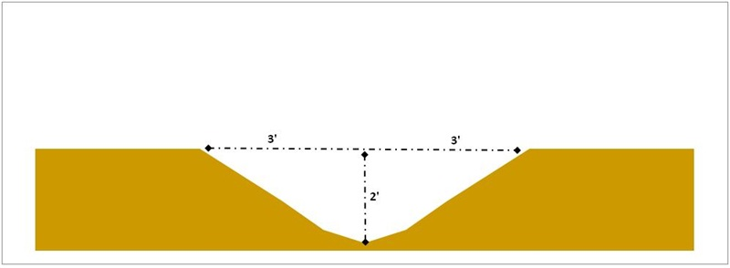

Slide 35
Delineation of Surface Waters per subsection 62-340.600(2), F.A.C.
(2) The landward extent of a surface water in the State for the purposes of implementing Section 373.414, F.S., shall be the more landward of the following:
(a) Wetlands as located by Rule 62-340.300, F.A.C., of this chapter;
(b) The mean high water line elevation for tidal water bodies;
(c) The ordinary high water line for non-tidal natural water bodies;
(d) The top of the bank for artificial lakes, borrow pits, canals, ditches and other artificial water bodies with side slopes of 1 foot vertical to 4 feet horizontal or steeper, excluding spoil banks when the canals and ditches have resulted from excavation into the ground; or
(e) The seasonal high water line for artificial lakes, borrow pits, canals, ditches, and other artificial water bodies with side slopes flatter than 1 foot vertical to 4 feet horizontal along with any artificial water body created by diking or impoundment above the ground.
(3) Determinations made pursuant to paragraphs (2)(b) and (2)(c) shall be for regulatory purposes and are not intended to be a delineation of the boundaries of lands for the purposes of title.
Specific Authority 373.421 FS. Law Implemented 373.421, 373.4211, 403.031(13) FS. History–New 7-1-94, Formerly 17-340.600.

Slide 36
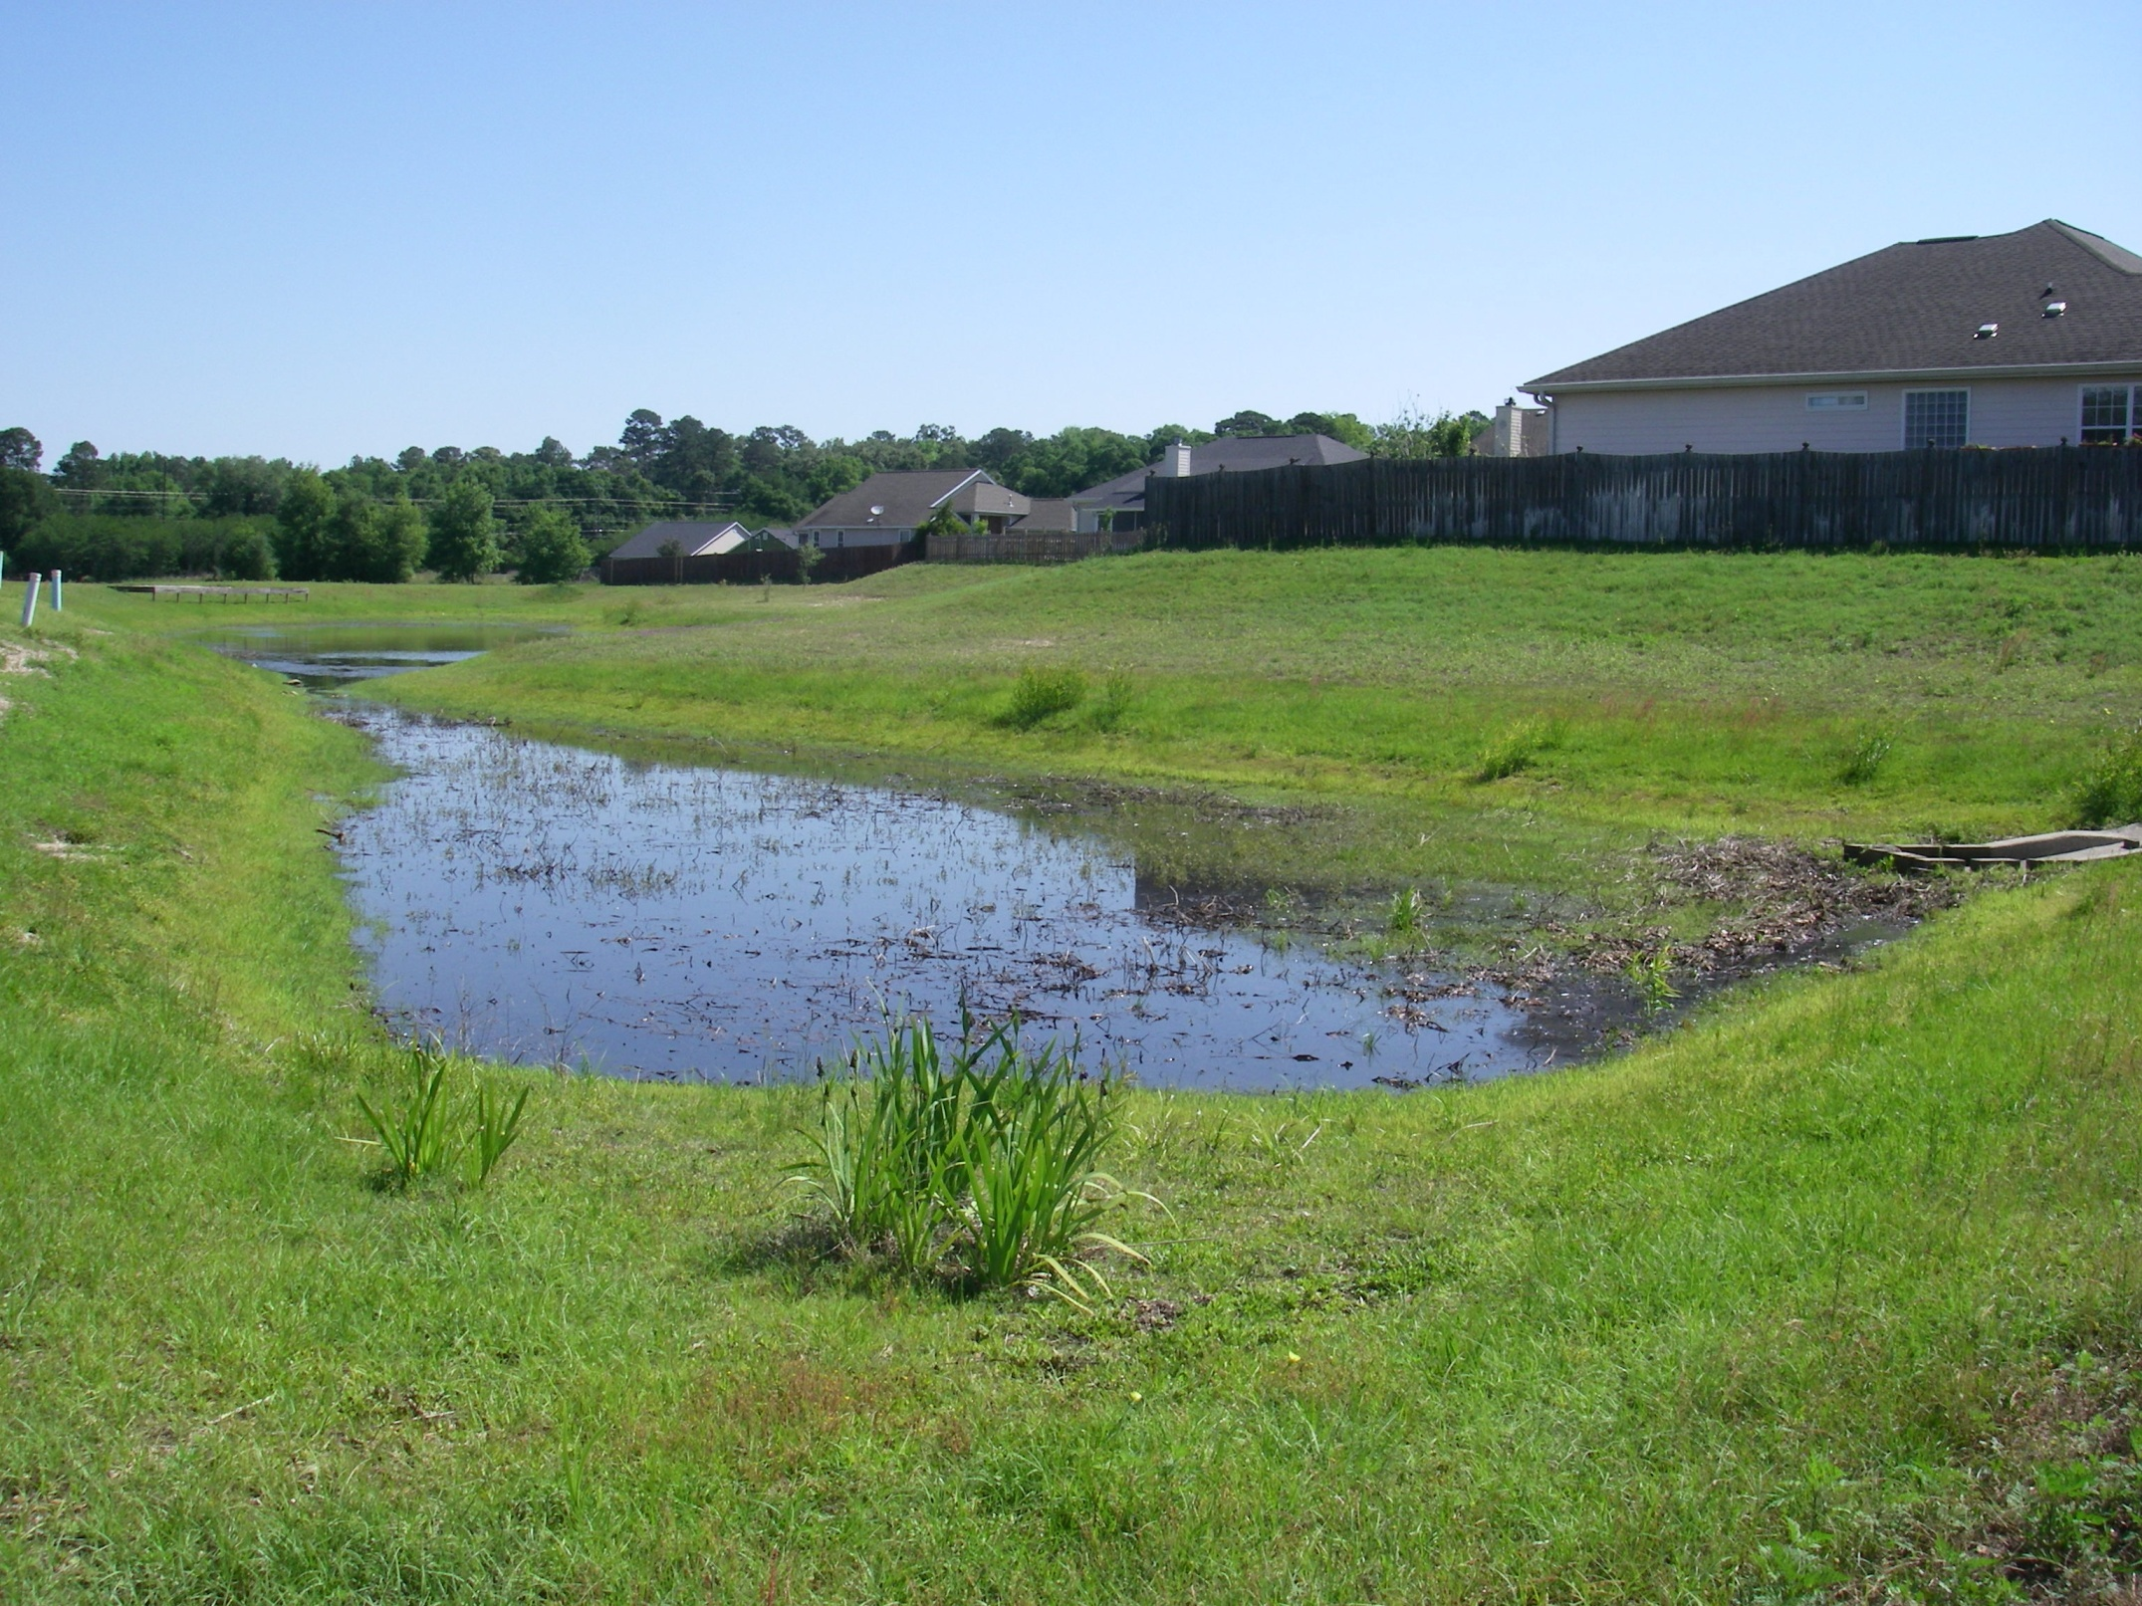

Slide 37
Page 39 FL Delineation Manual Exemptions section 62-340.700, F.A.C. “This section further expresses the legislative intent regarding the regulation of surface waters by excluding from delineation or limiting the scope of regulatory review in surface waters.”
Wastewater Treatment areas
except wetlands used for treating effluents under permit
Not delineated as Wetland or Surface Waters
None of the additional wetland permitting criteria apply
Stormwater Treatment areas
< 0.5 acres in combined area
Not Delineated as Wetland or Surface Waters
None of the additional wetland permitting criteria apply
Delineated as Wetland or Surface Waters
Only the permitting criteria related to Endangered and Threatened Species apply
Stormwater Treatment areas
≥ 0.5 acres in combined area
Previously existing wetlands incorporated into Stormwater Treatment areas
Delineated as Wetland or Surface Waters
Only the permitting criteria related to Fish and Wildlife apply

Slide 38
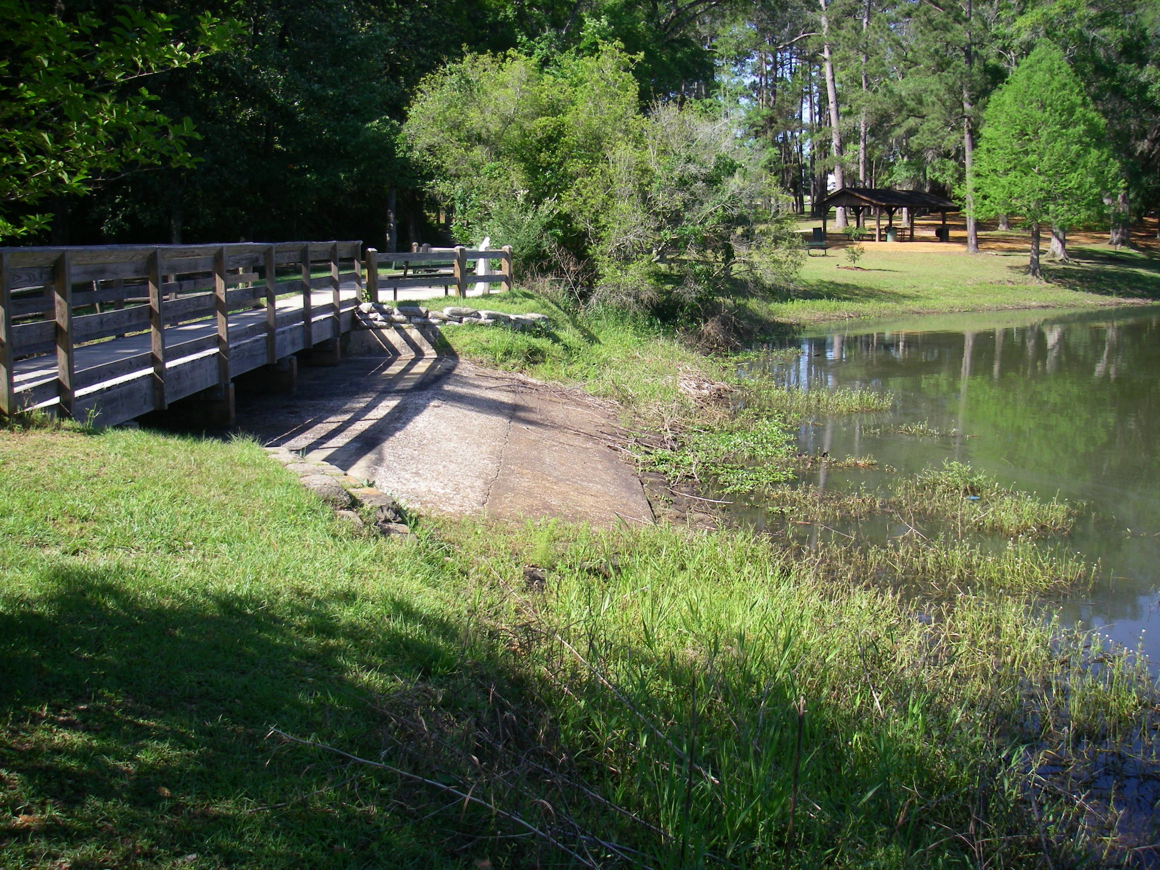

Slide 39
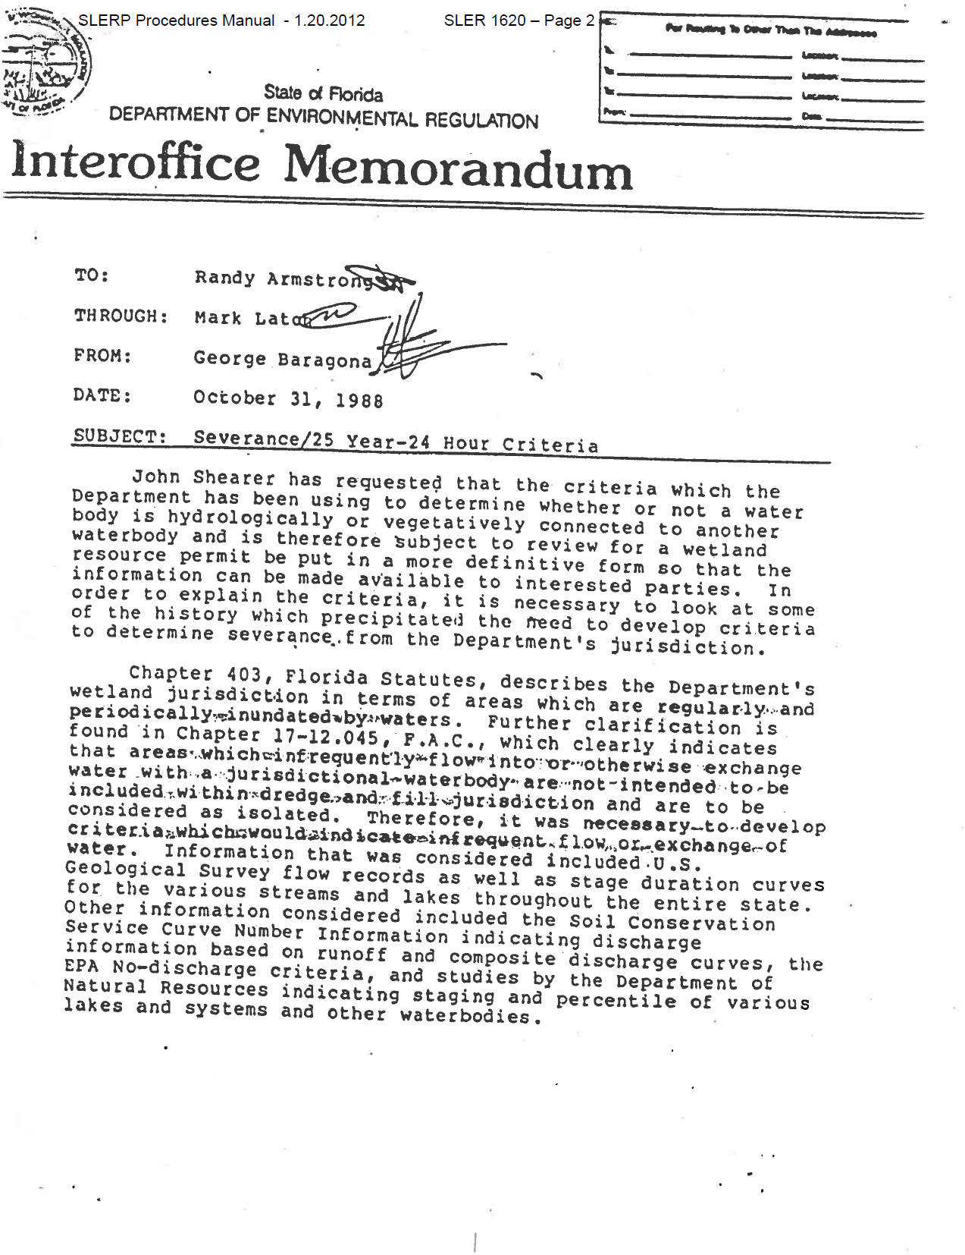

Slide 40
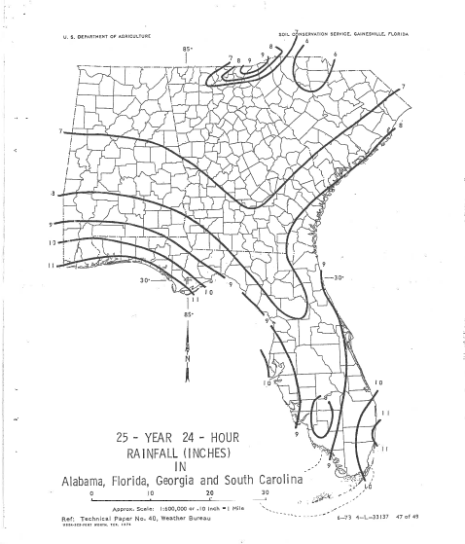

Slide 41
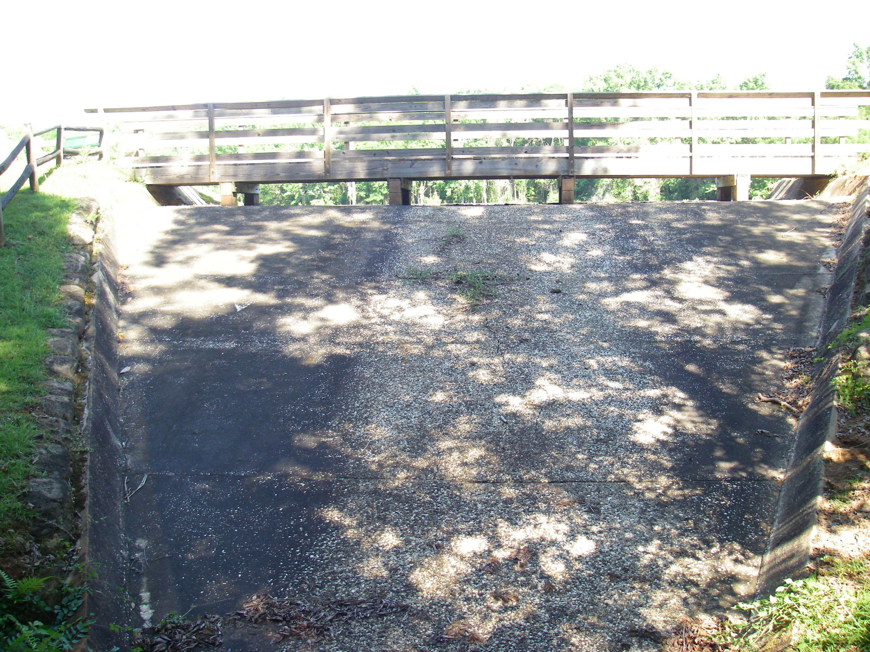

Slide 42
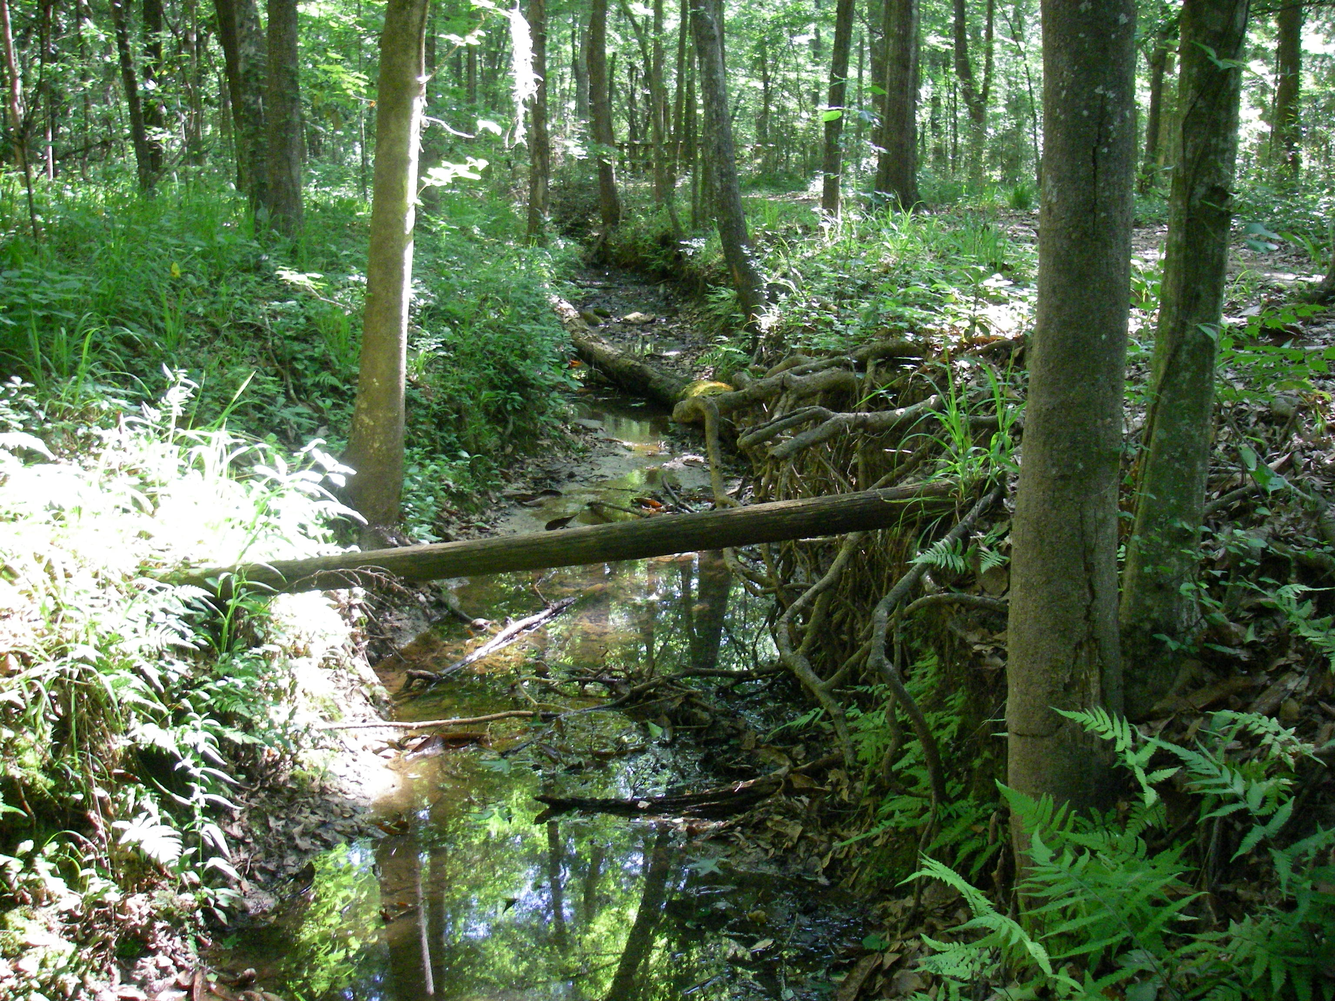

Slide 43
62-340.750 Exemption for Surface Waters or Wetlands Created by Mosquito Control Activities.
Construction, alteration, operation, maintenance, removal, and abandonment of stormwater management systems, dams, impoundments, reservoirs, appurtenant works, or works, in, on or over lands that have become surface waters or wetlands solely because of mosquito control activities undertaken as part of a governmental mosquito control program, and which lands were neither surface waters nor wetlands before such activities, shall be exempt from the rules adopted by the department and water management districts to implement subsections 373.414(1) through 373.414(6), 373.414(8), and 373.414(10), F.S.; and subsection 373.414(7), F.S., regarding any authority granted pursuant to Section 373.414, F.S. (1991). Activities exempted under this section shall not be considered in determining whether any wetland permitting threshold is met or exceeded under part IV of Chapter 373, F.S. This exemption shall not affect the regulation of impacts on other surface waters or wetlands, or the application of state water quality standards to waters as defined in subsection 403.031(13), F.S., including standards applicable to Outstanding Florida Waters.
Specific Authority 373.414(9) FS. Law Implemented 373.414(9) FS. History–New 7-1-94, Formerly 17-340.750.

Slide 44
Quiz Examples

Slide 45
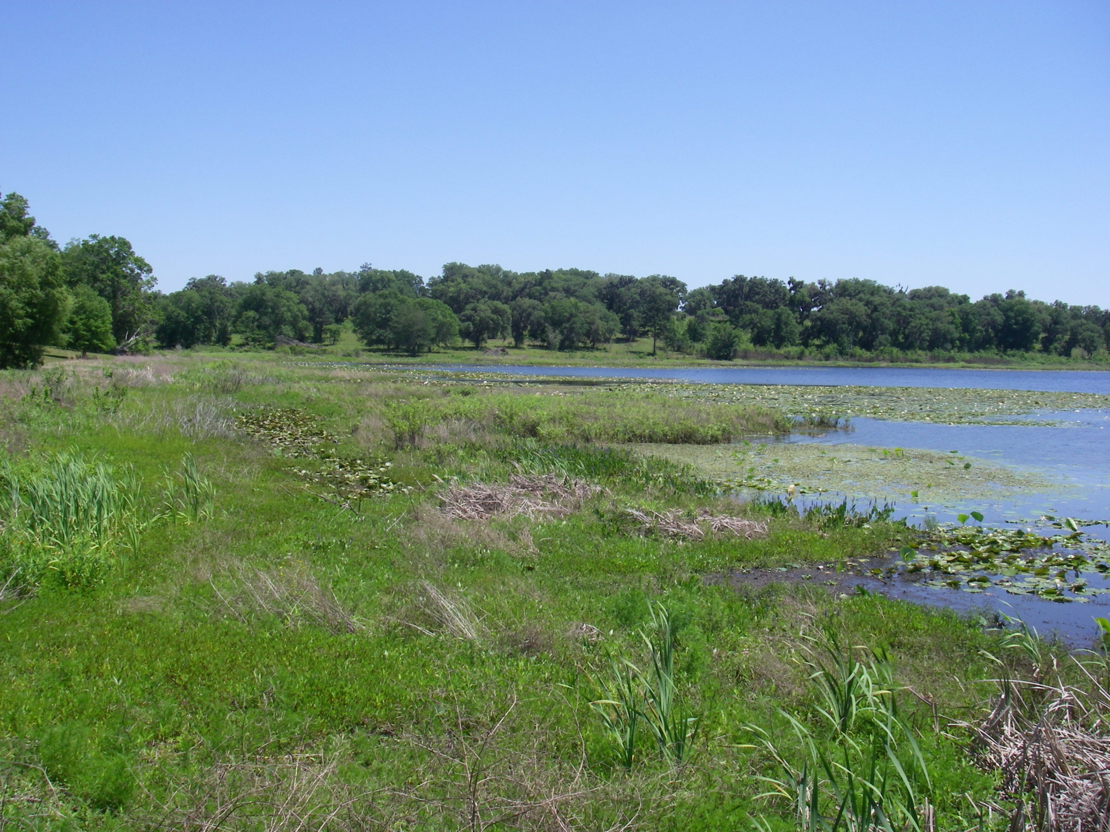

Slide 46
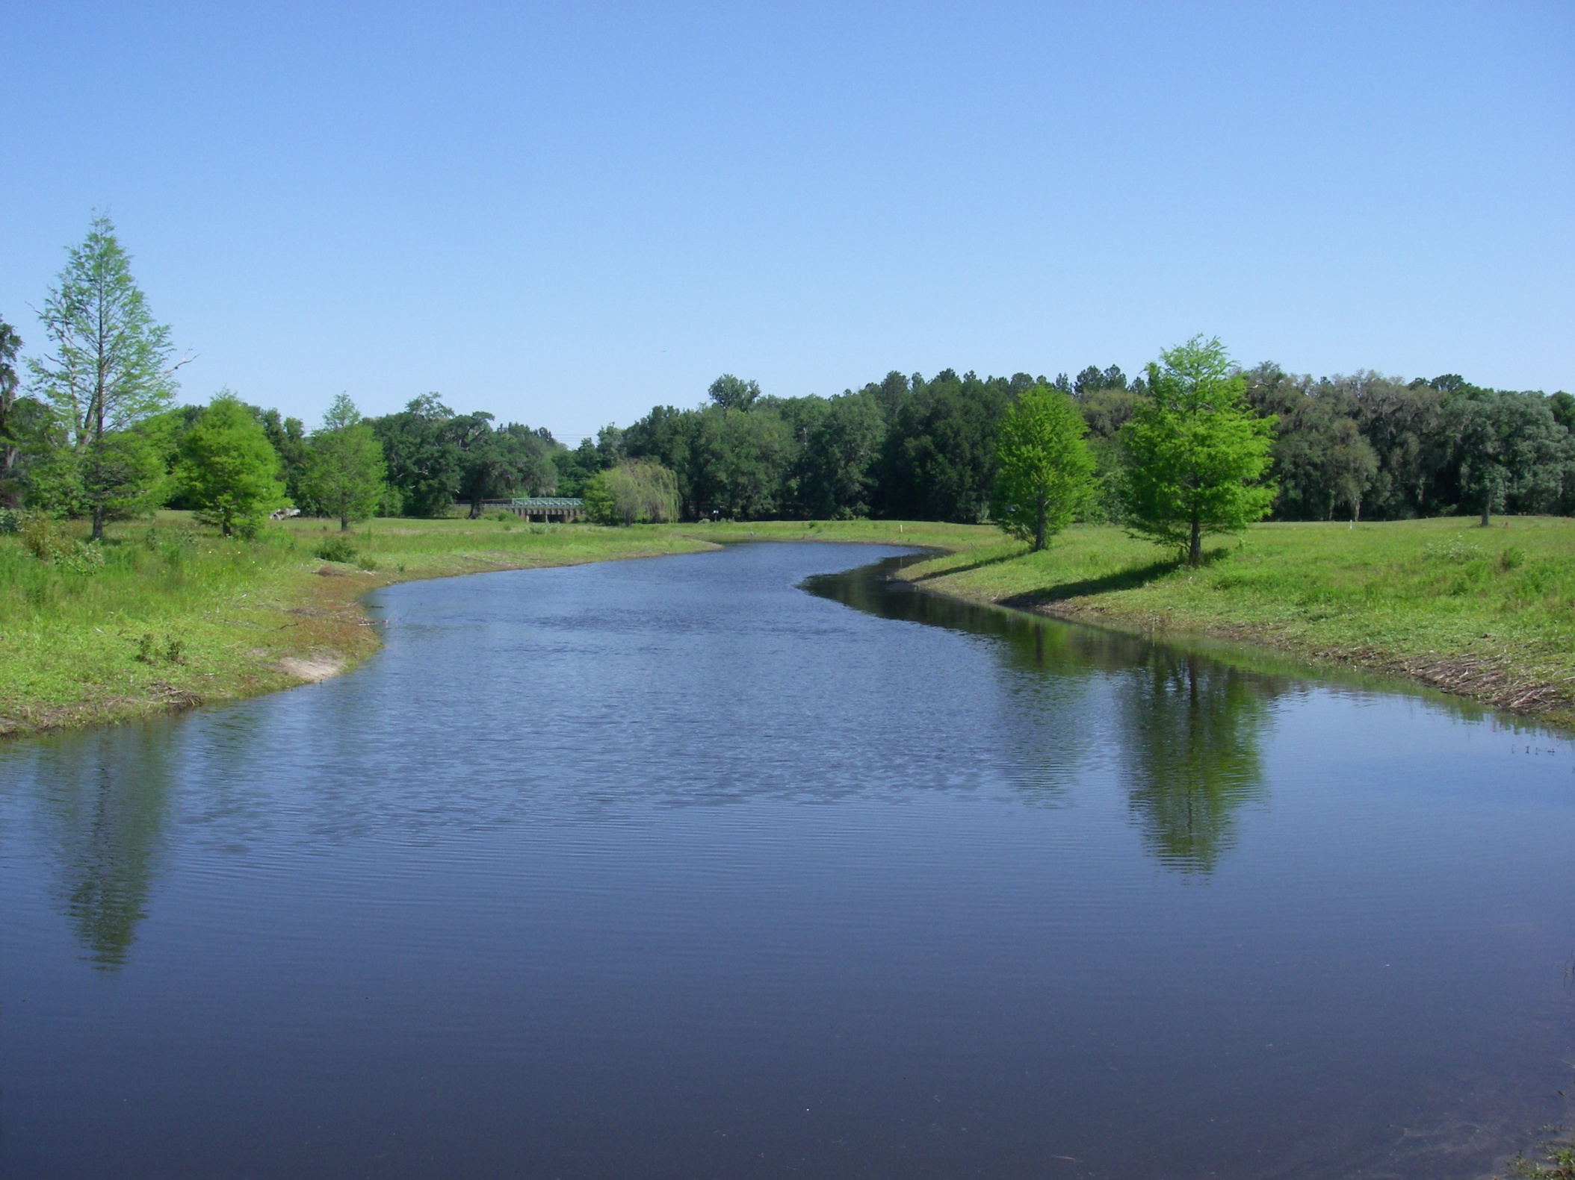

Slide 47
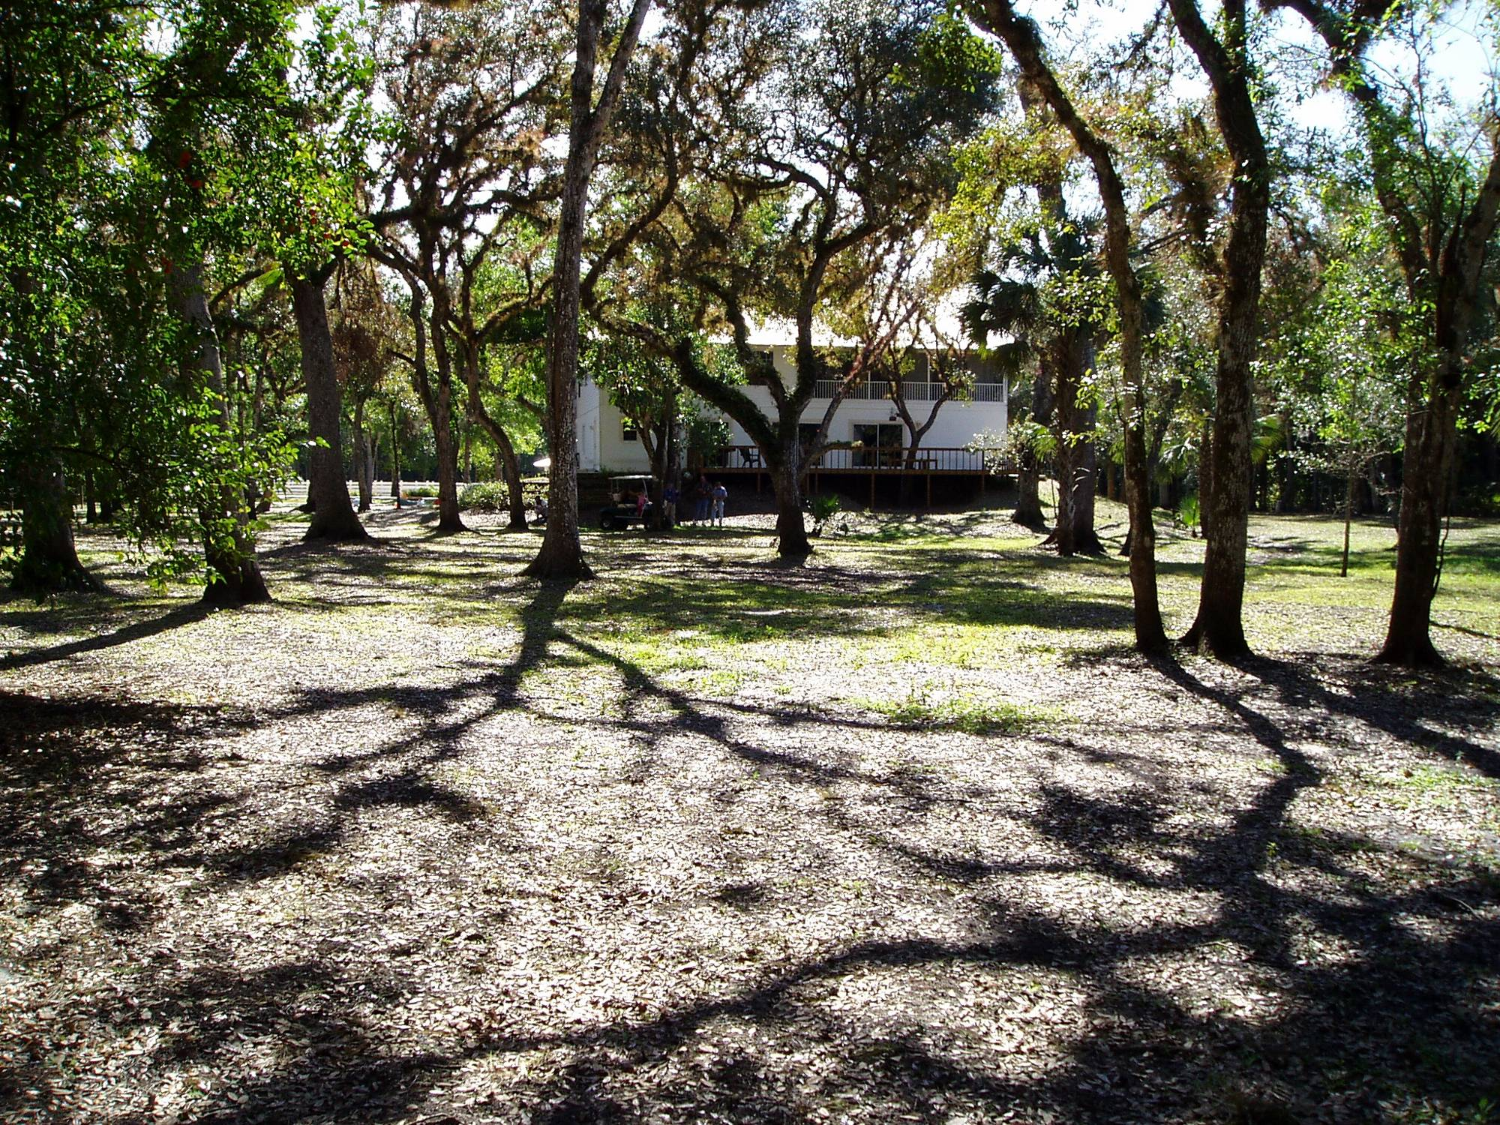

Slide 48
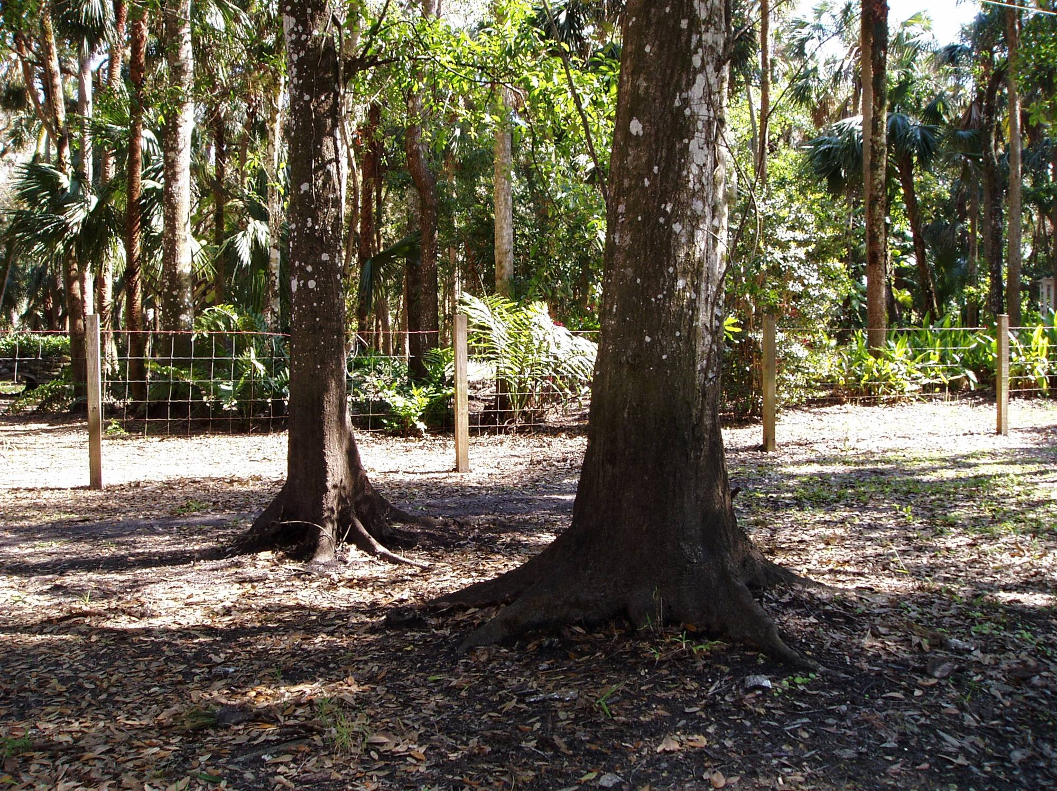

Slide 49
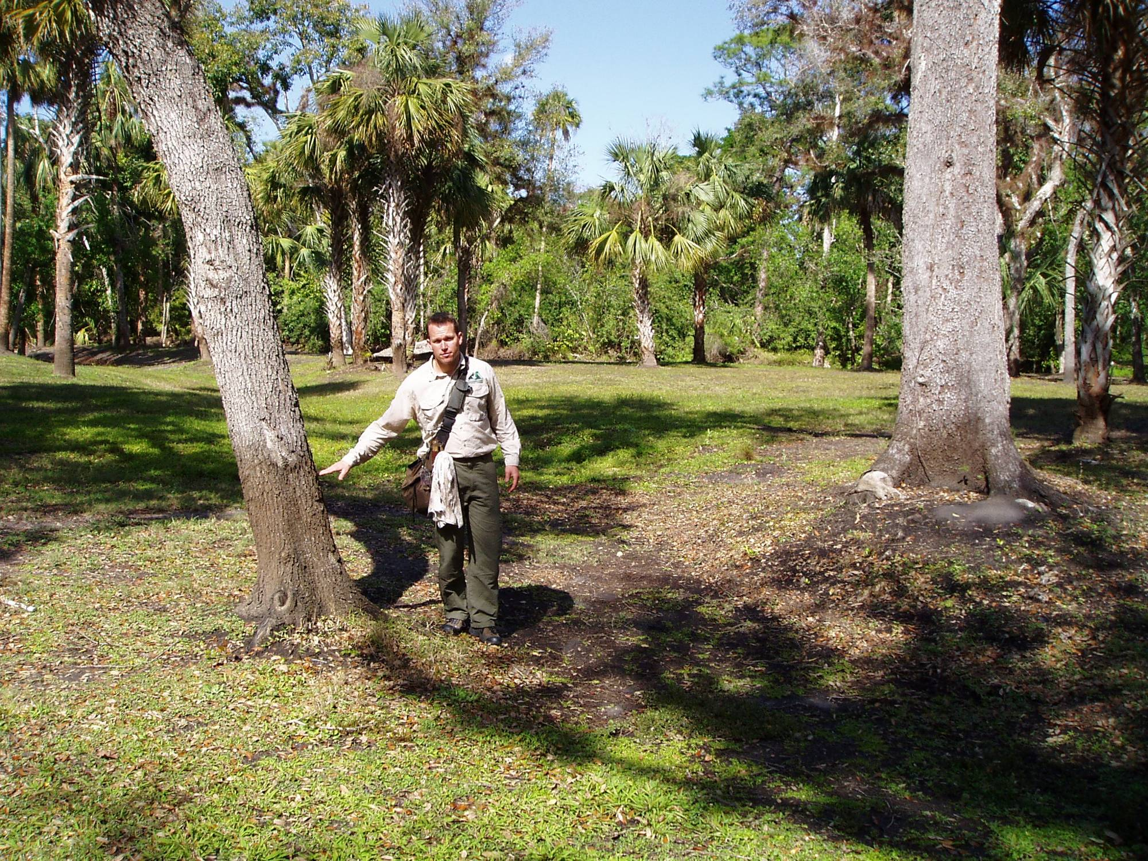

Slide 50
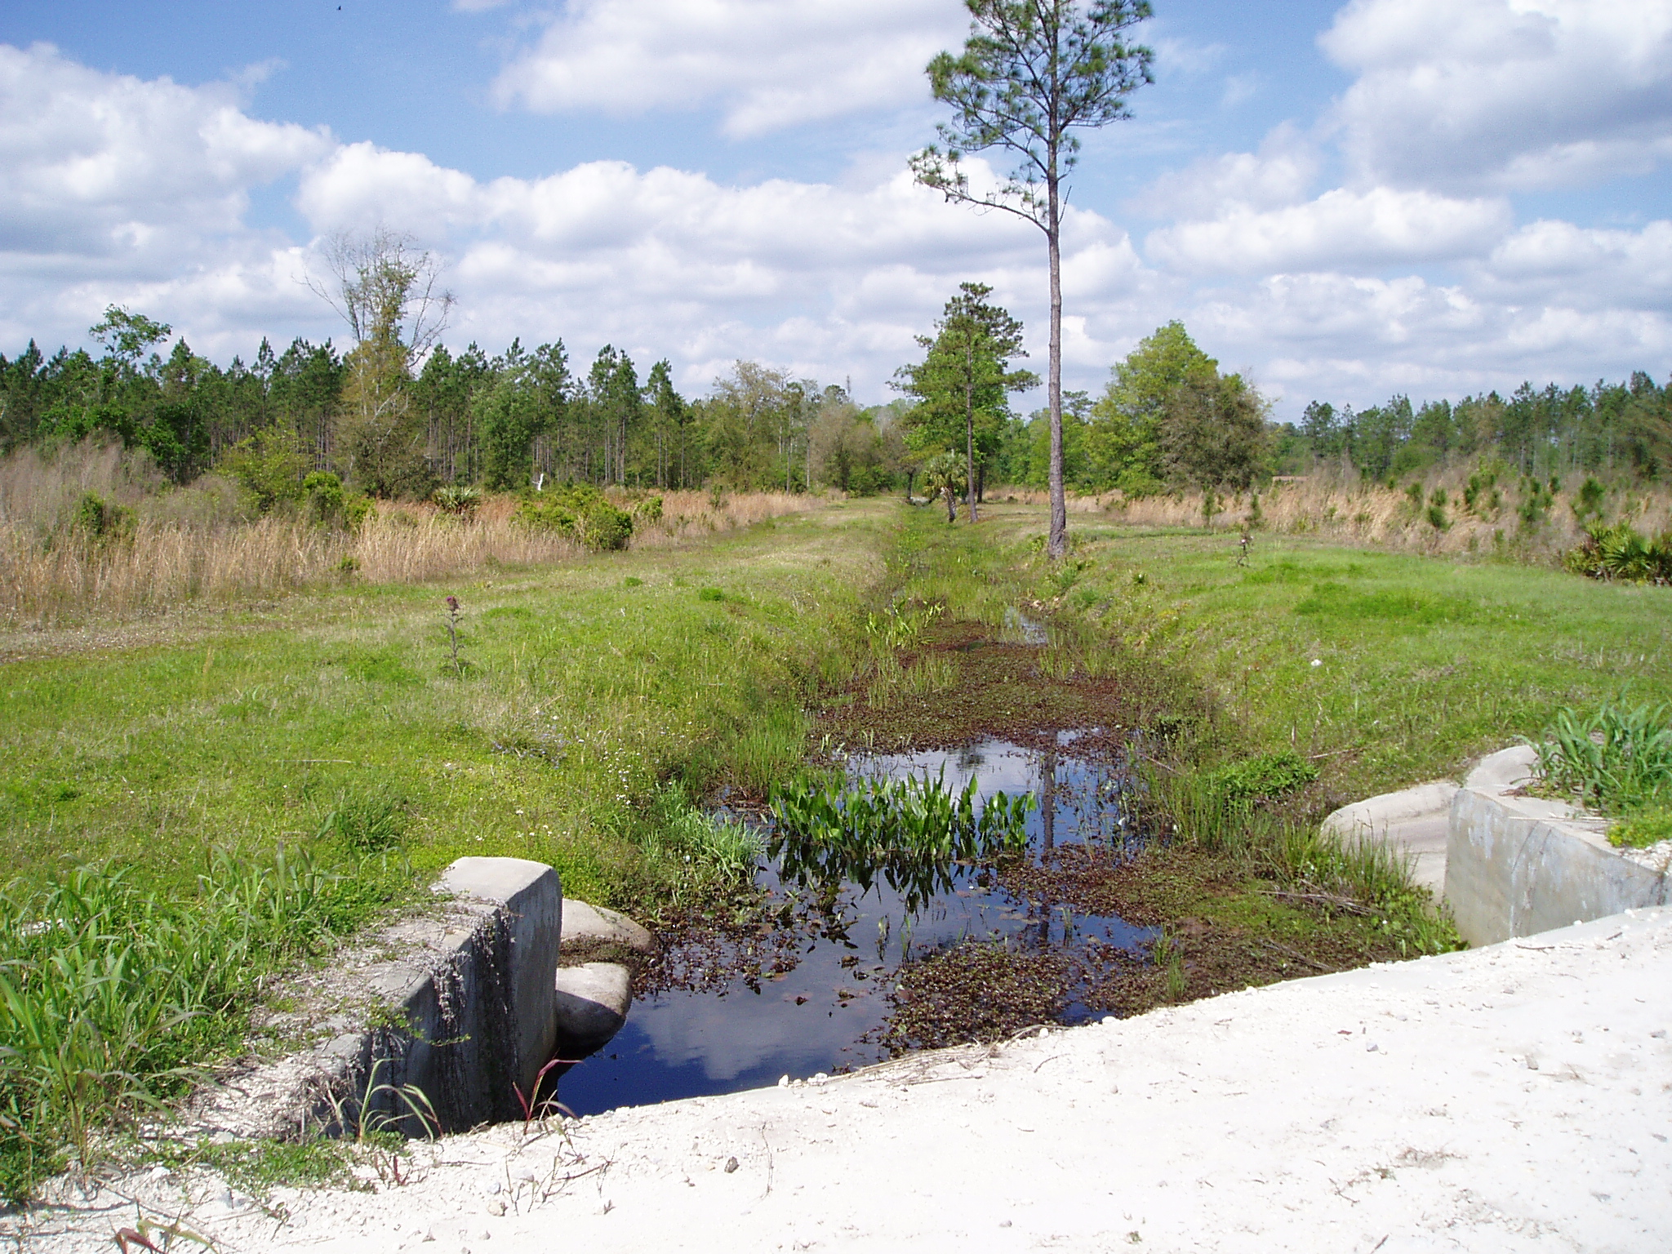

Slide 51
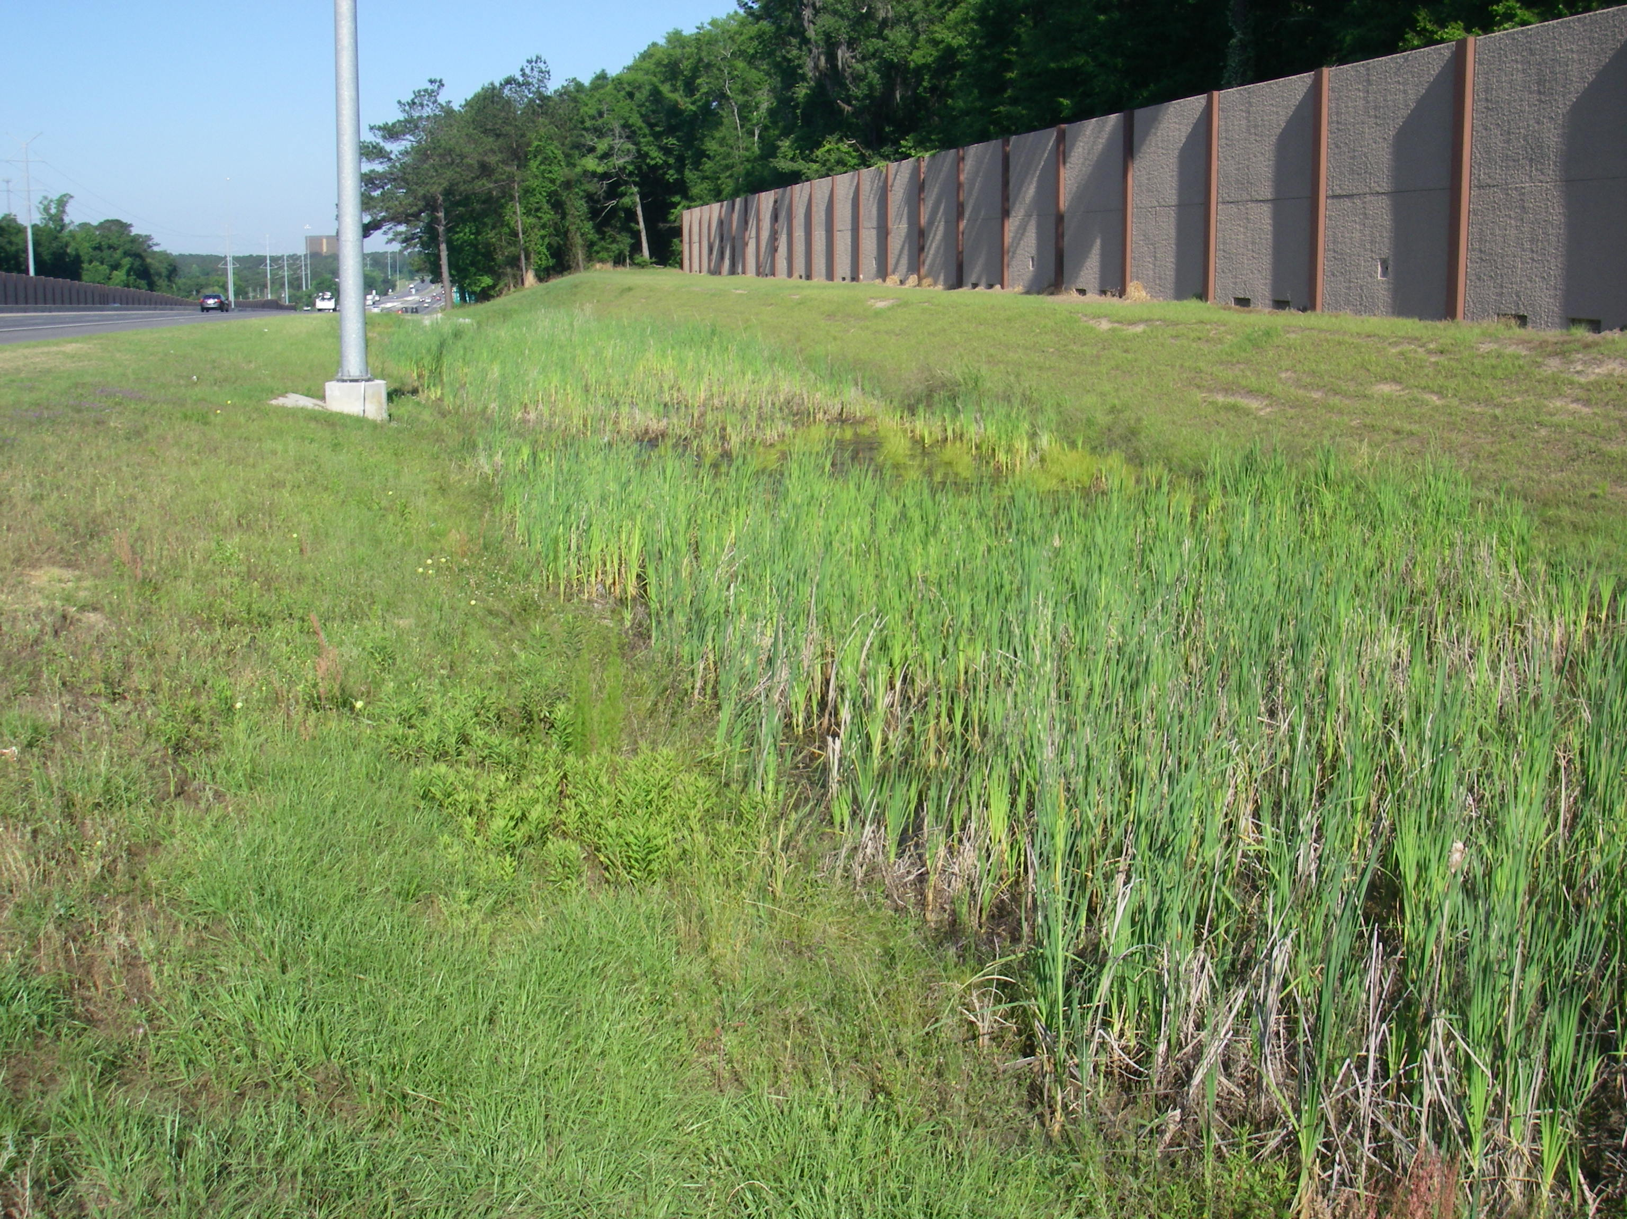

Slide 52
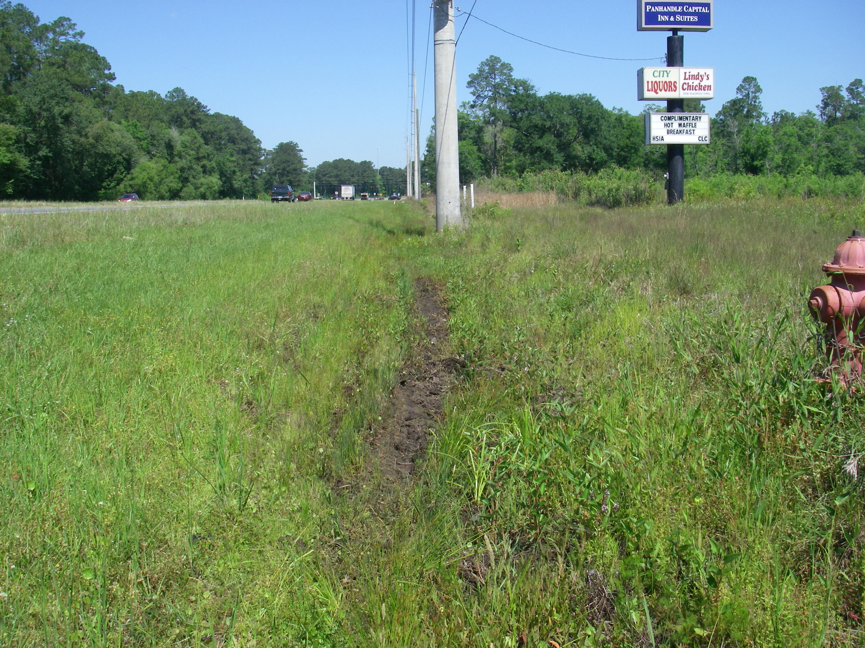

Slide 53
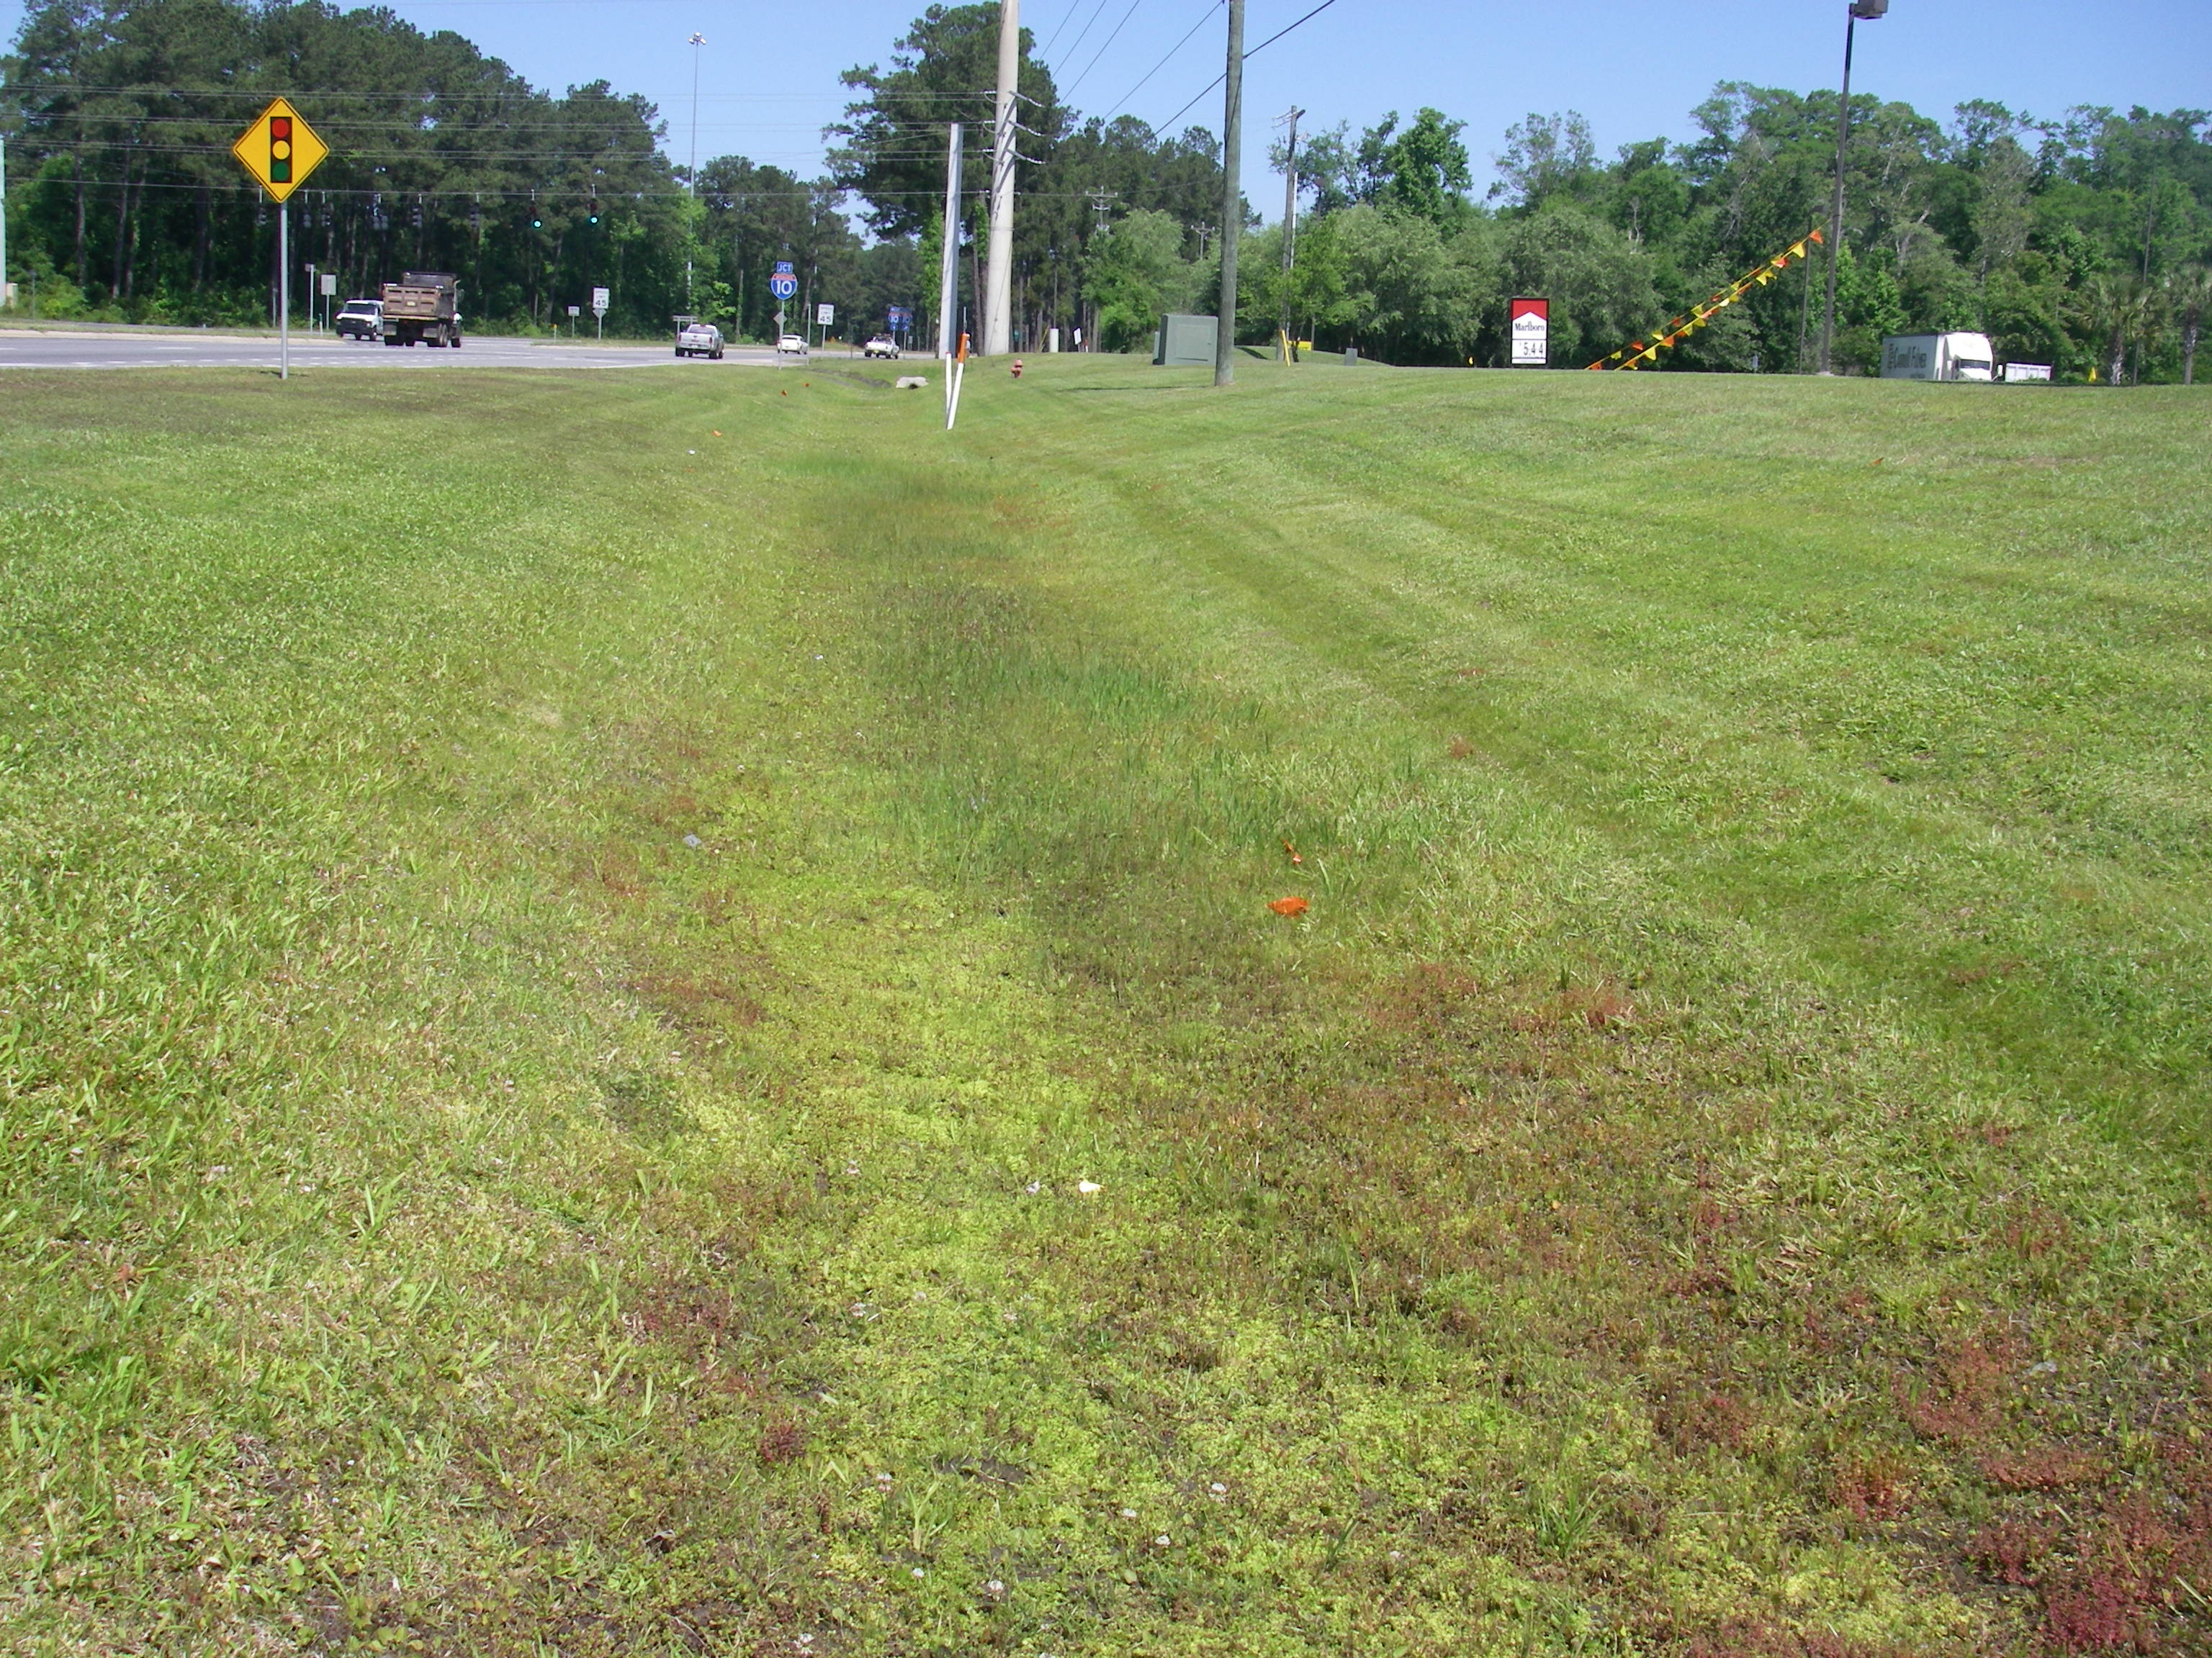

Slide 54
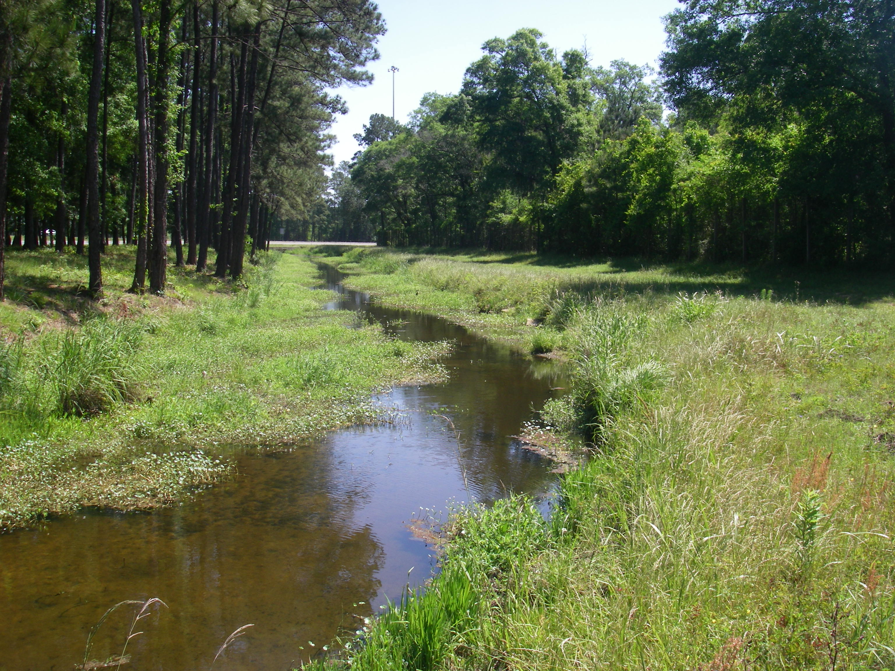

Slide 55
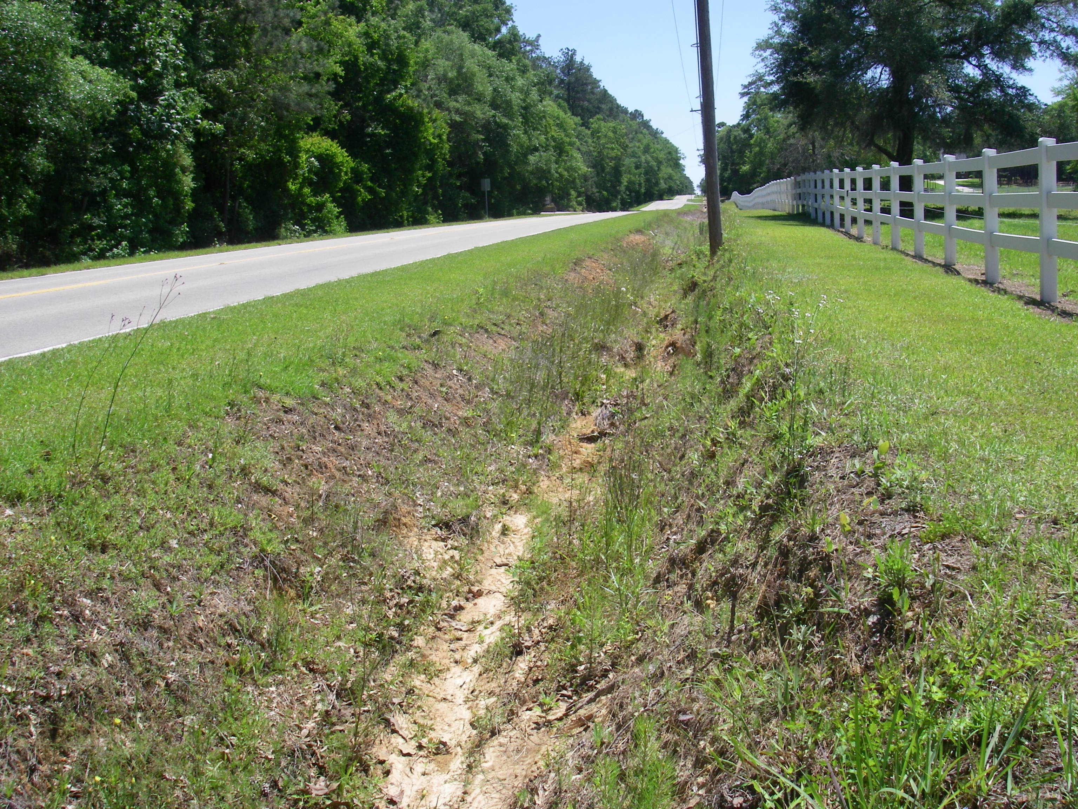

Slide 56
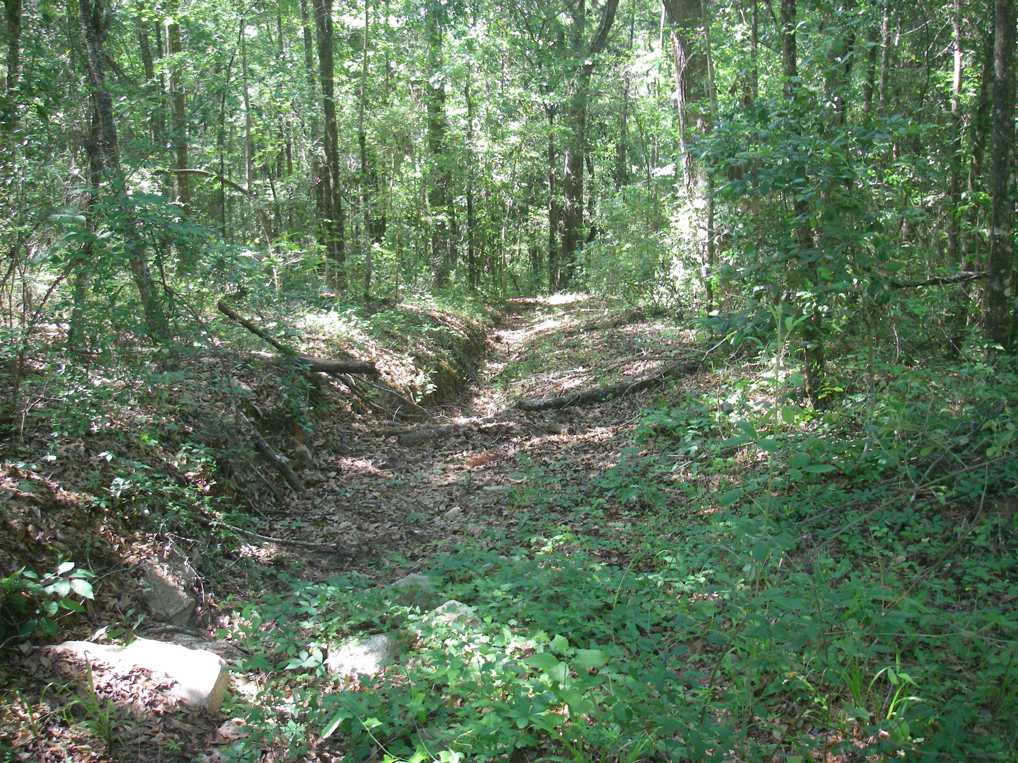

Slide 57
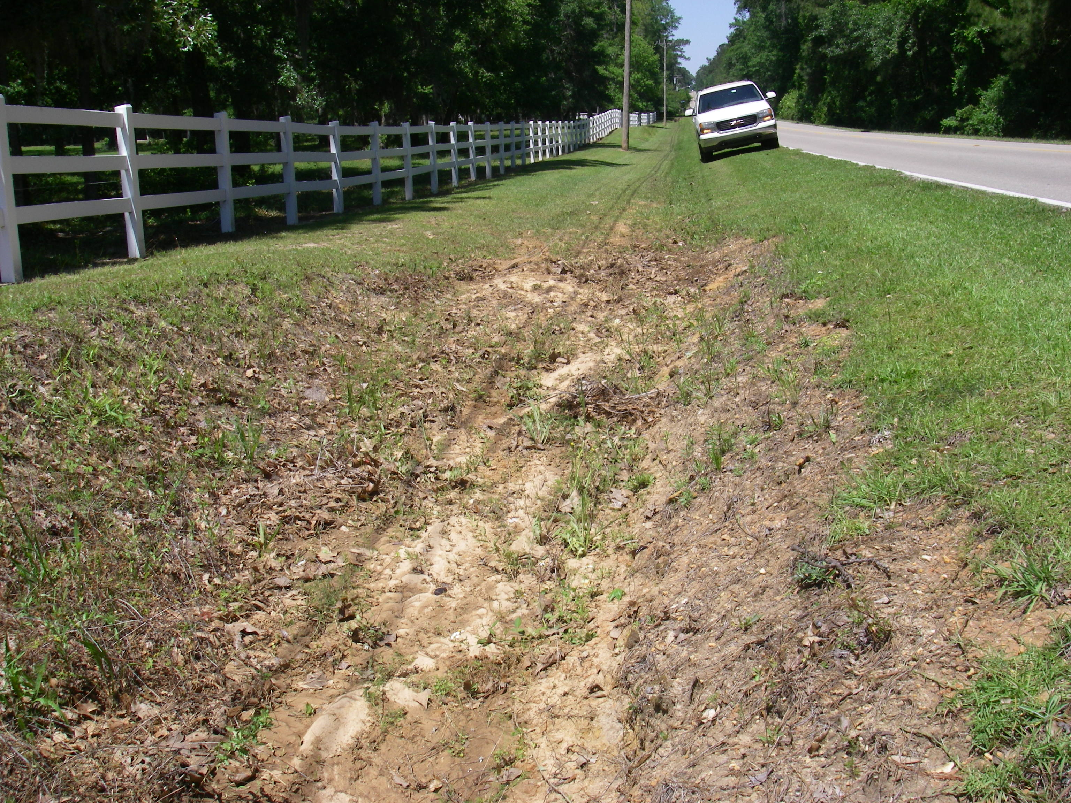

Slide 58
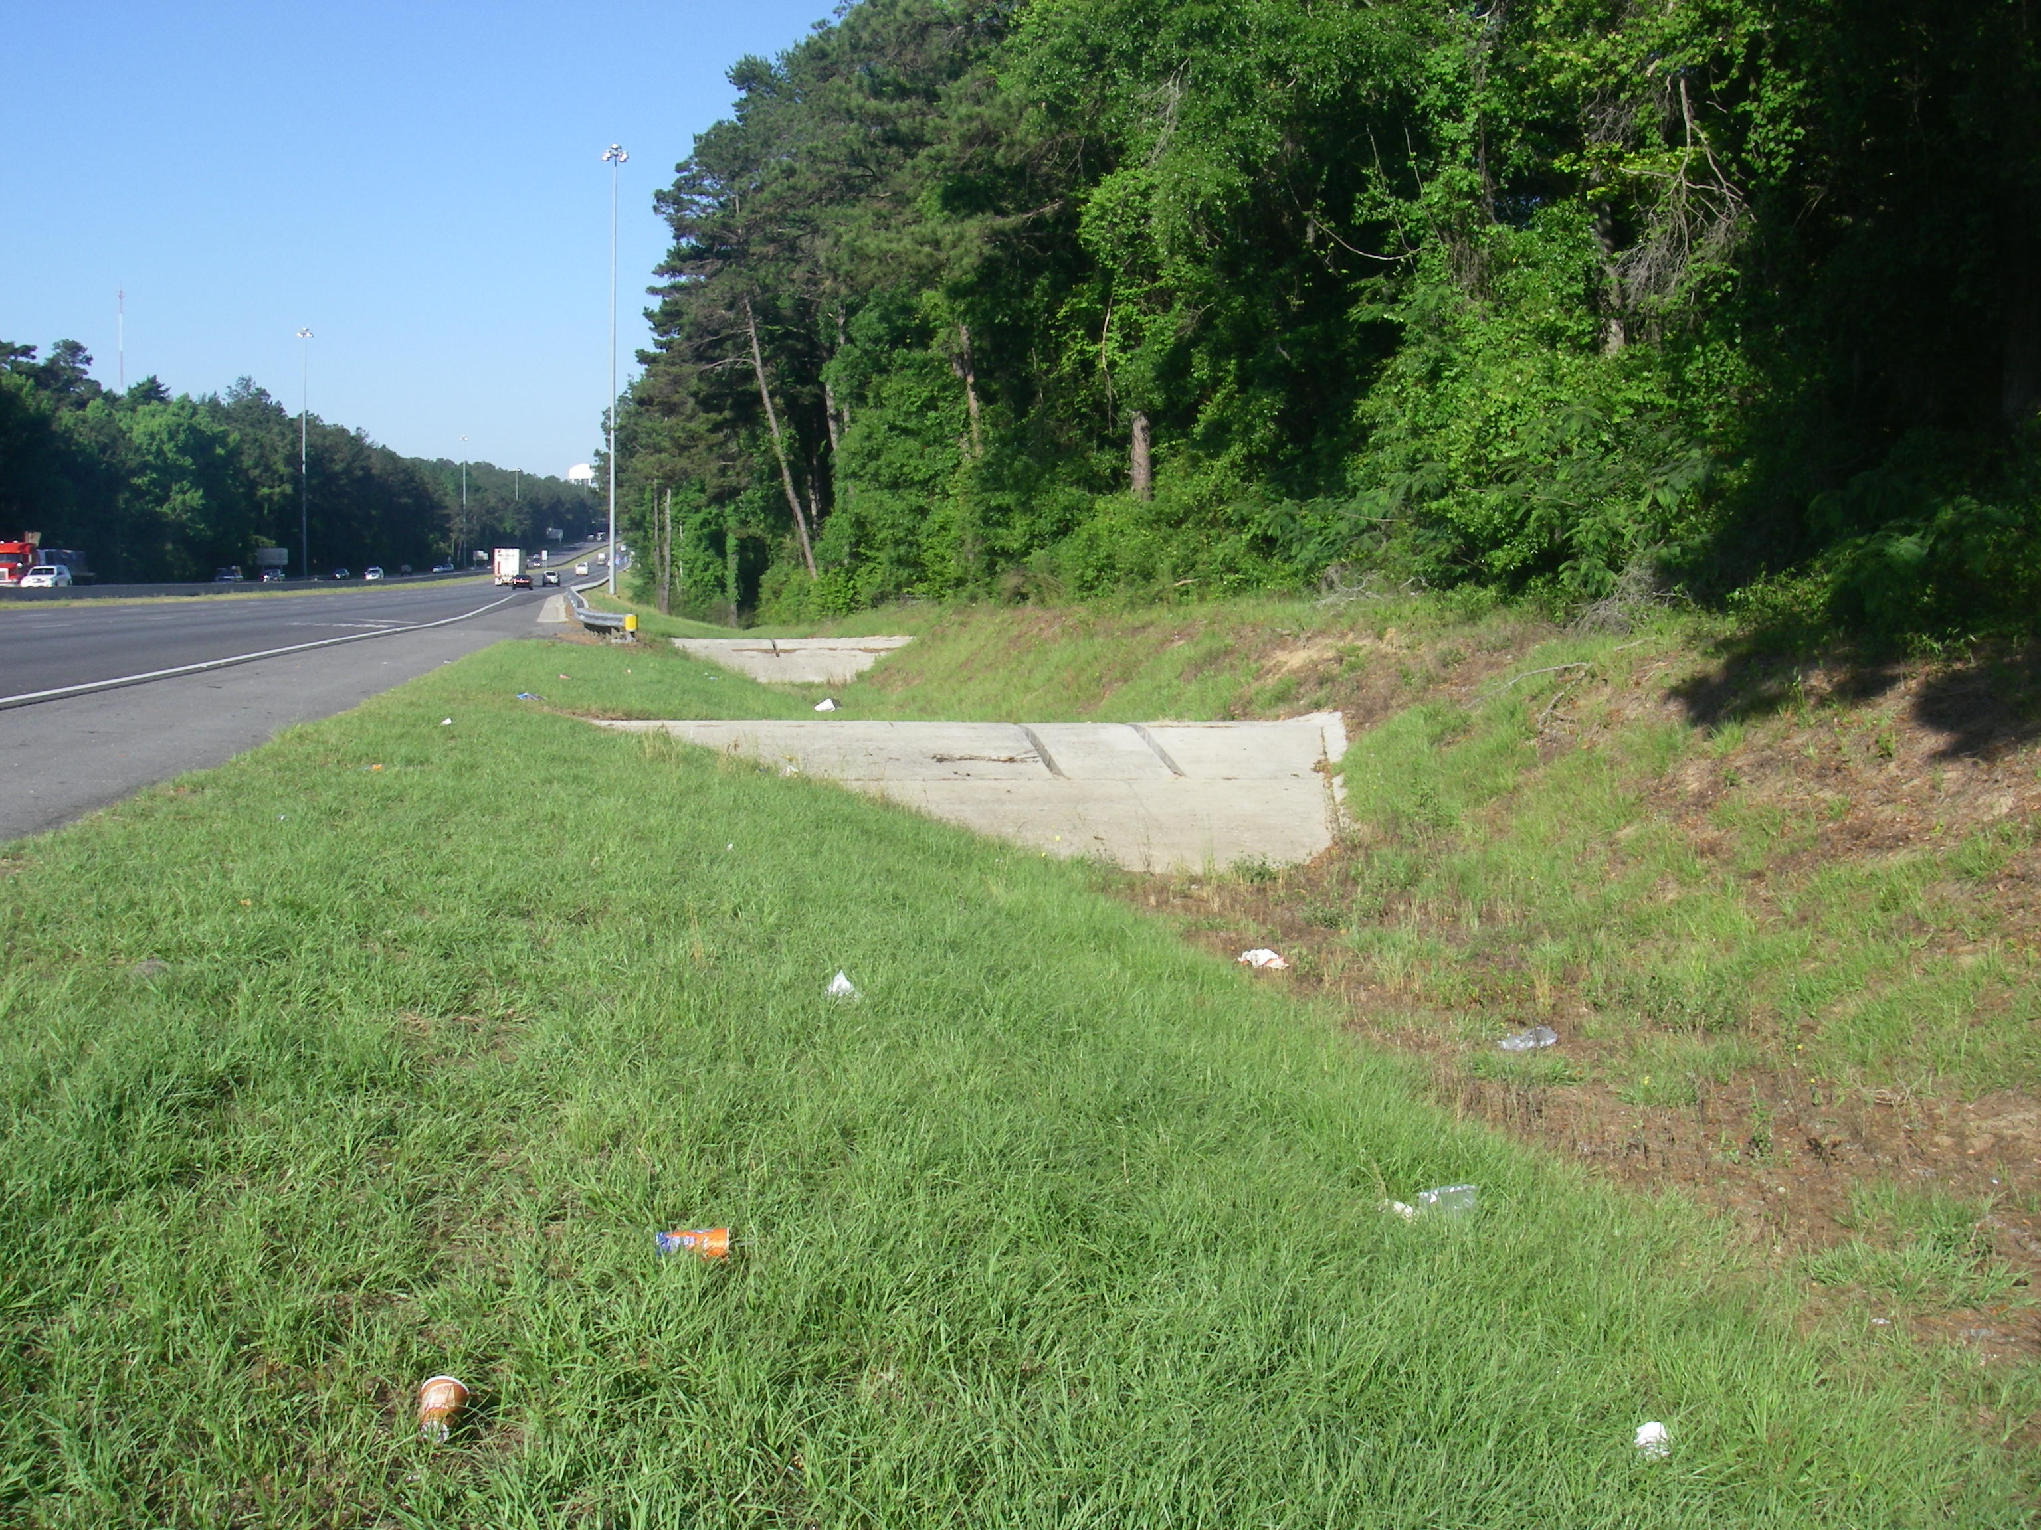

Slide 59
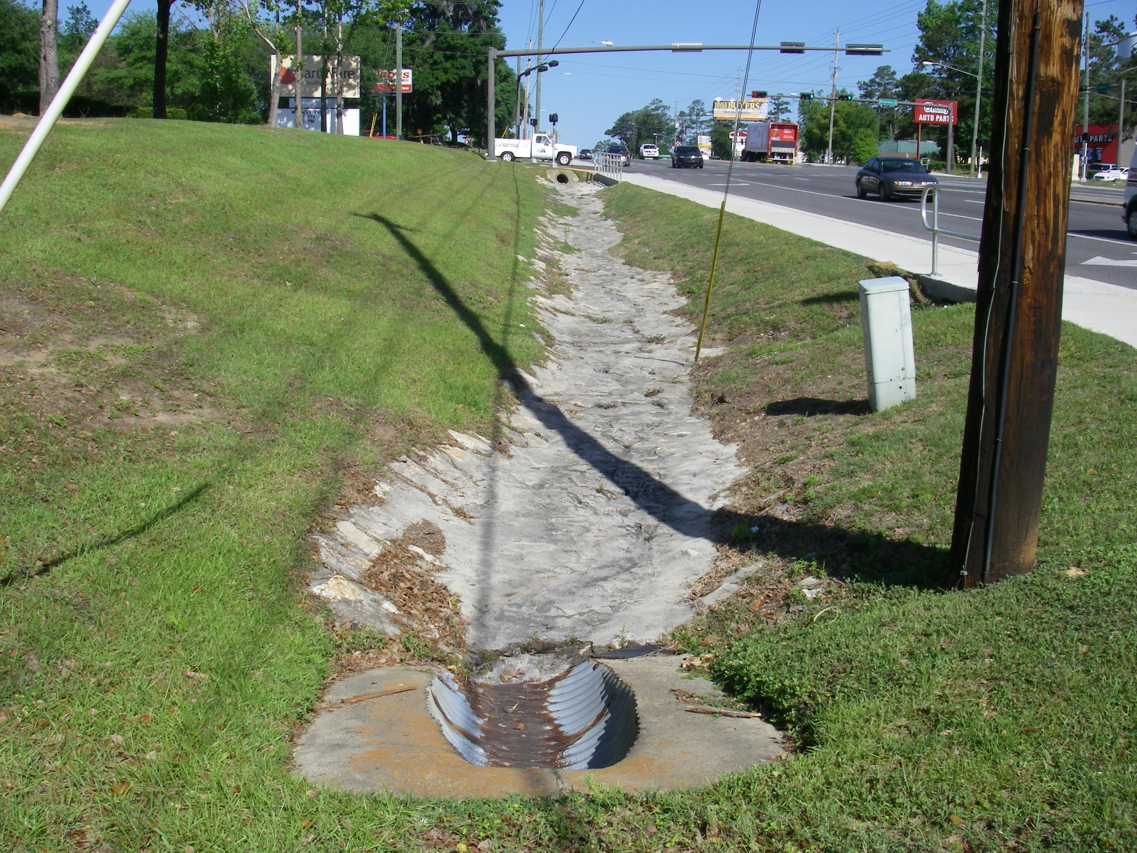

Slide 60
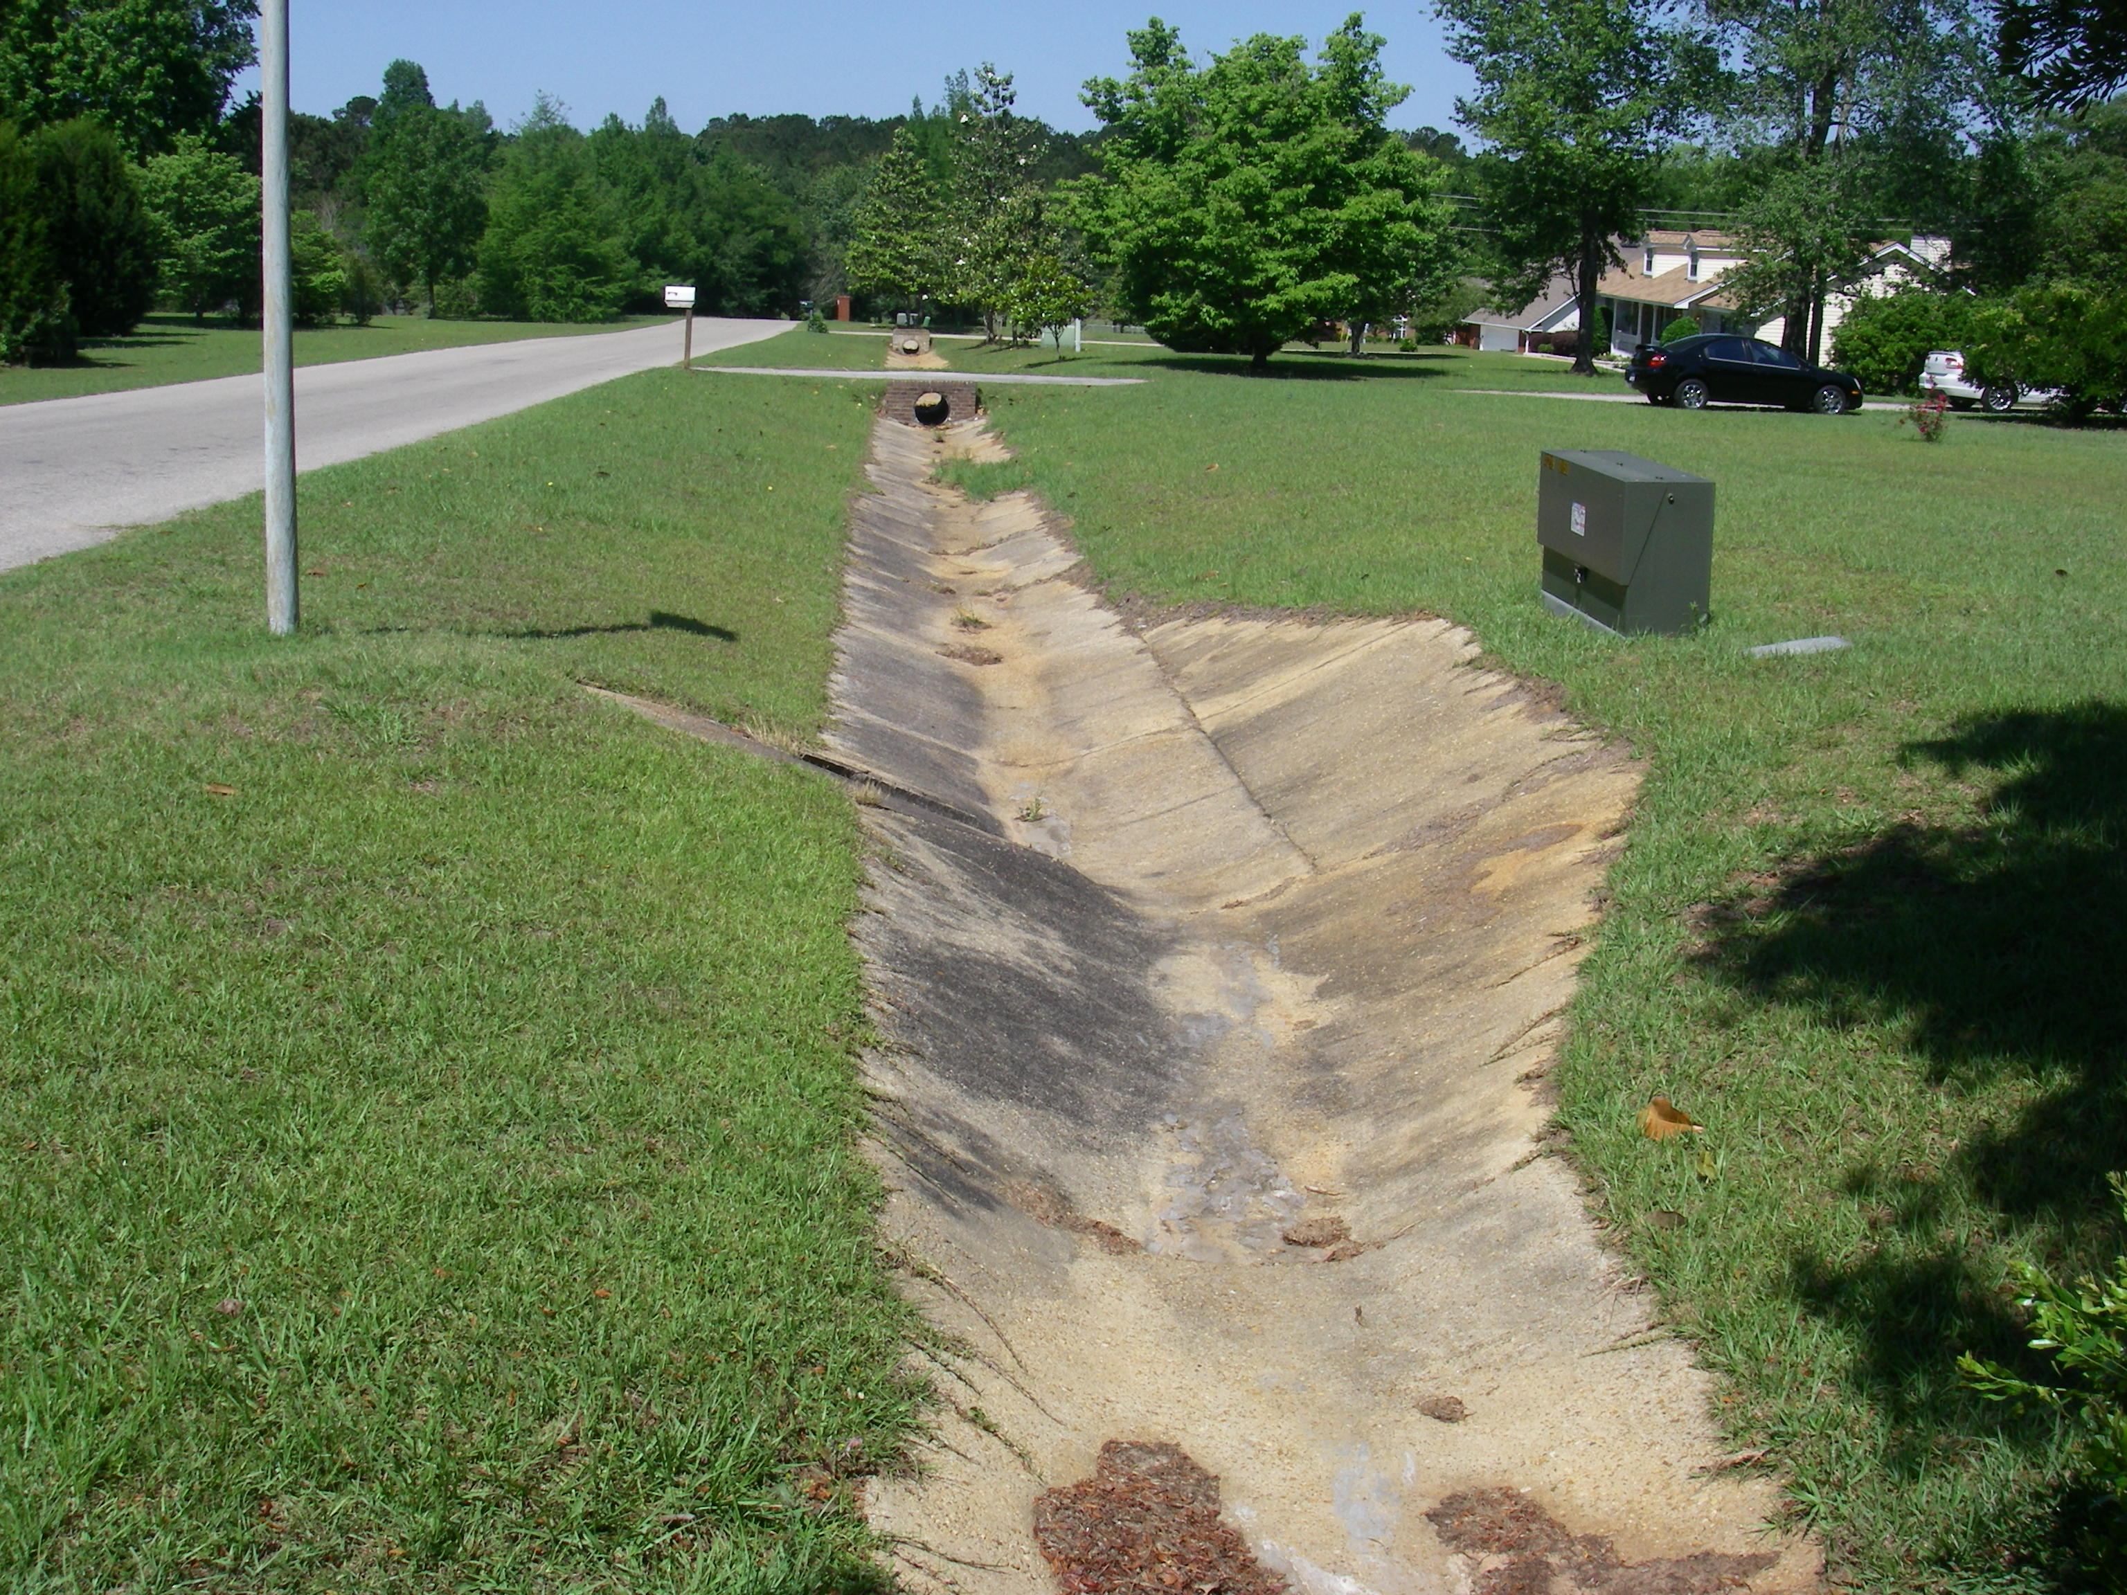

Slide 61
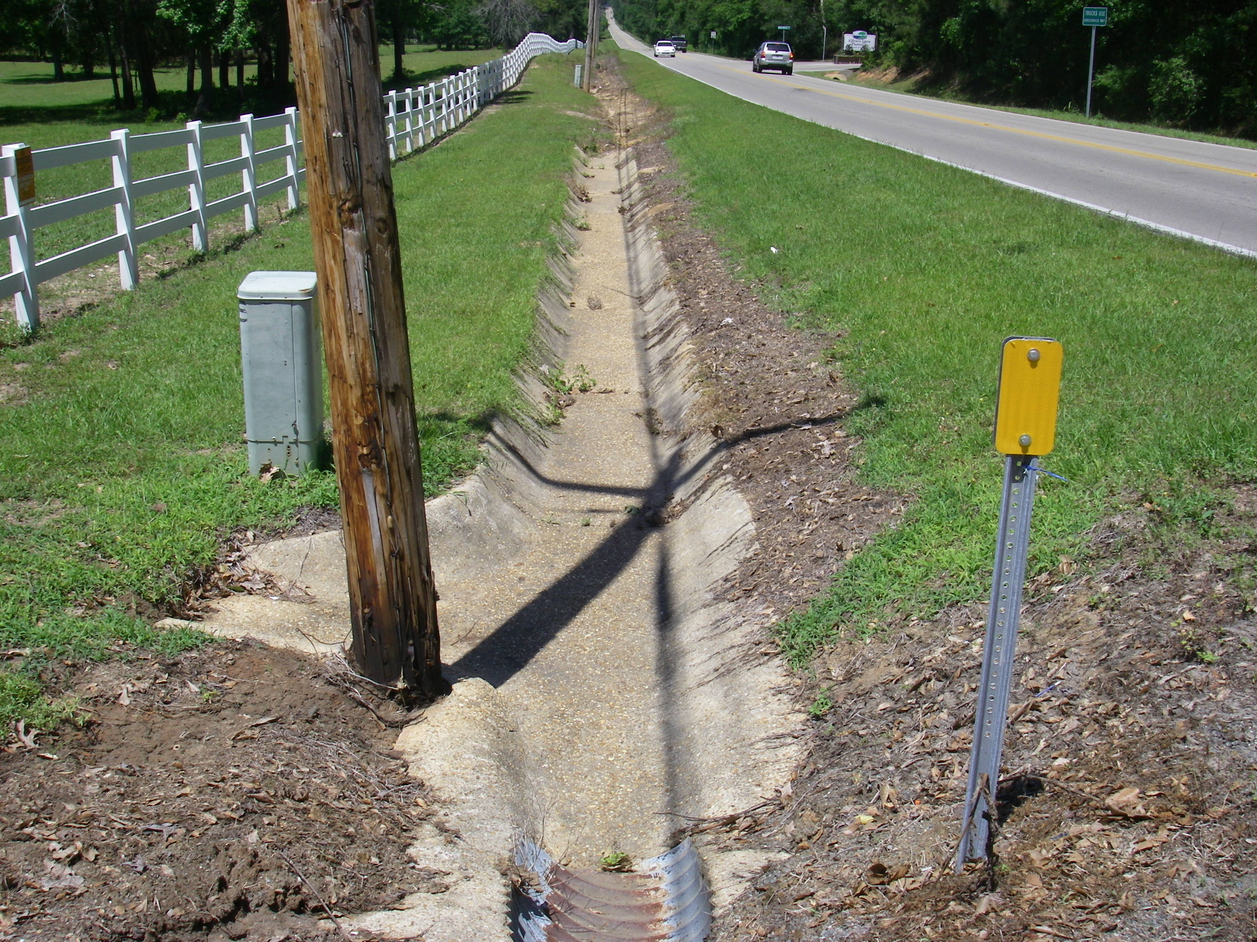

Slide 62
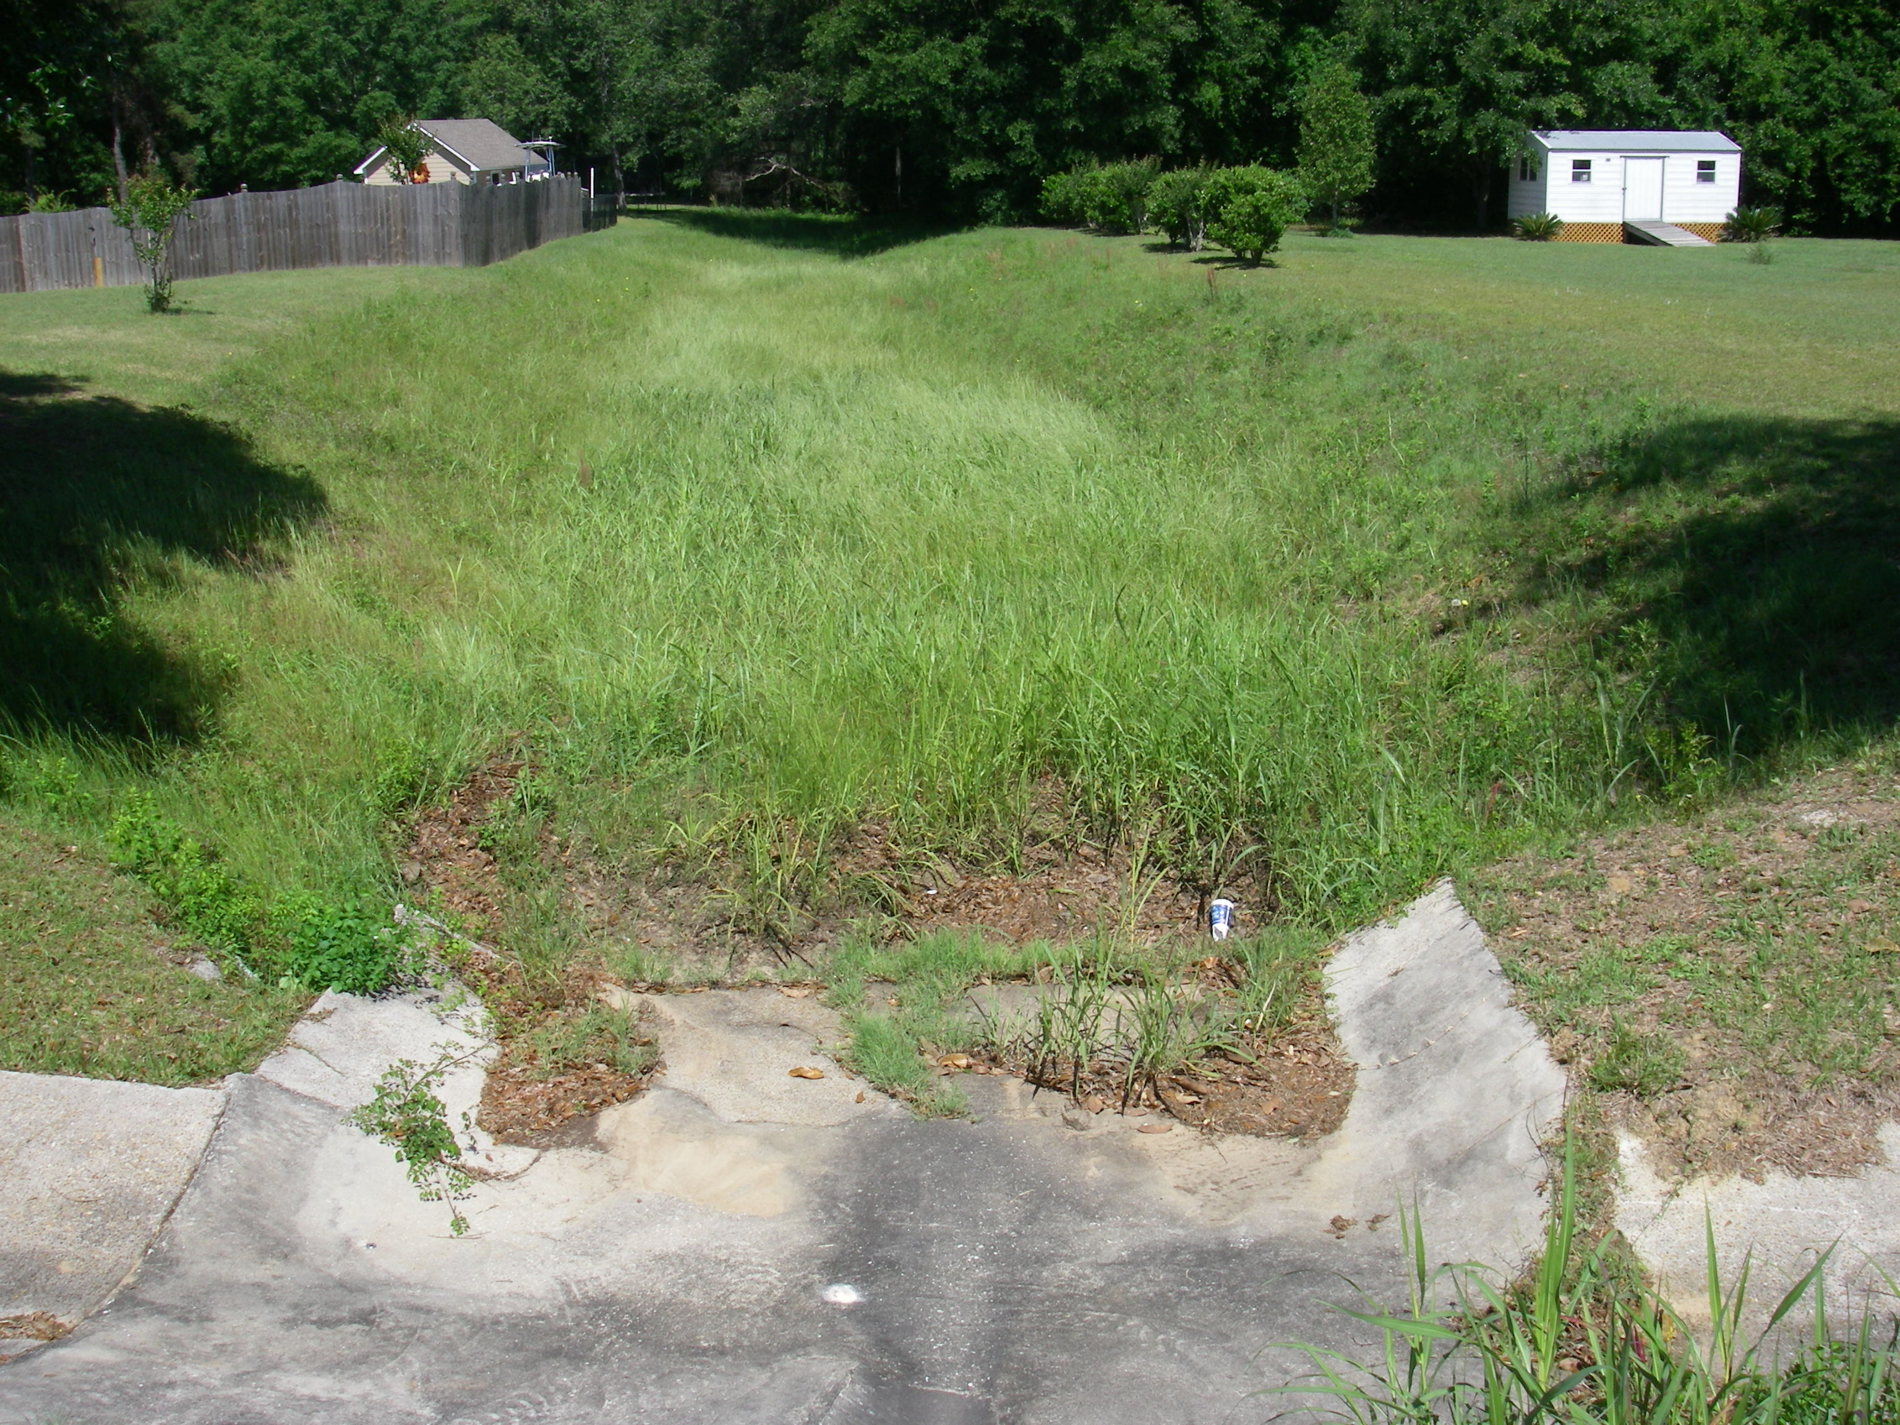

Slide 63
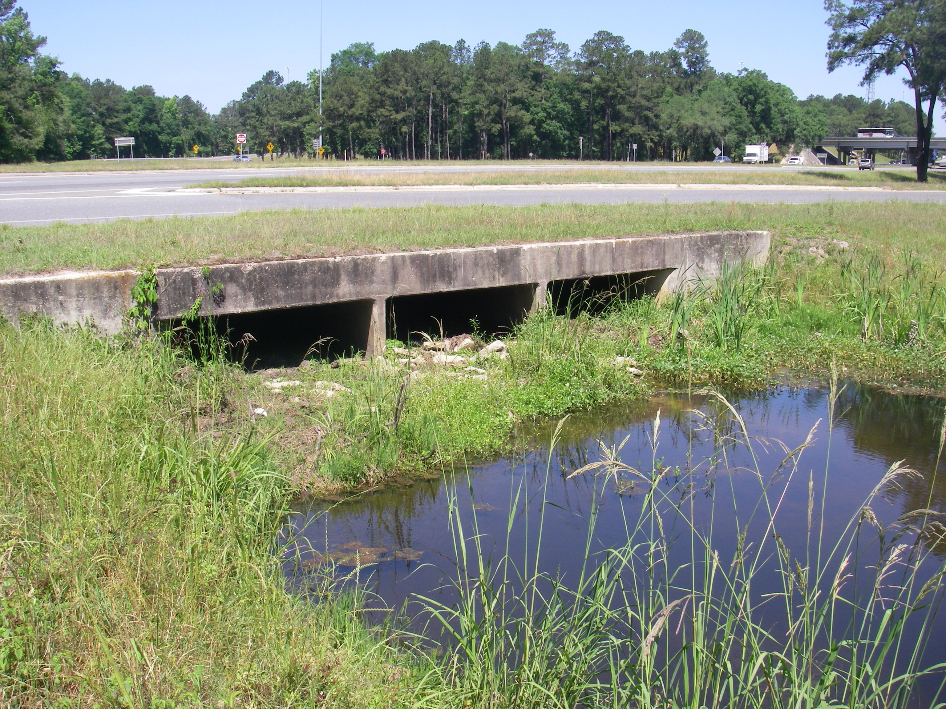

Slide 64
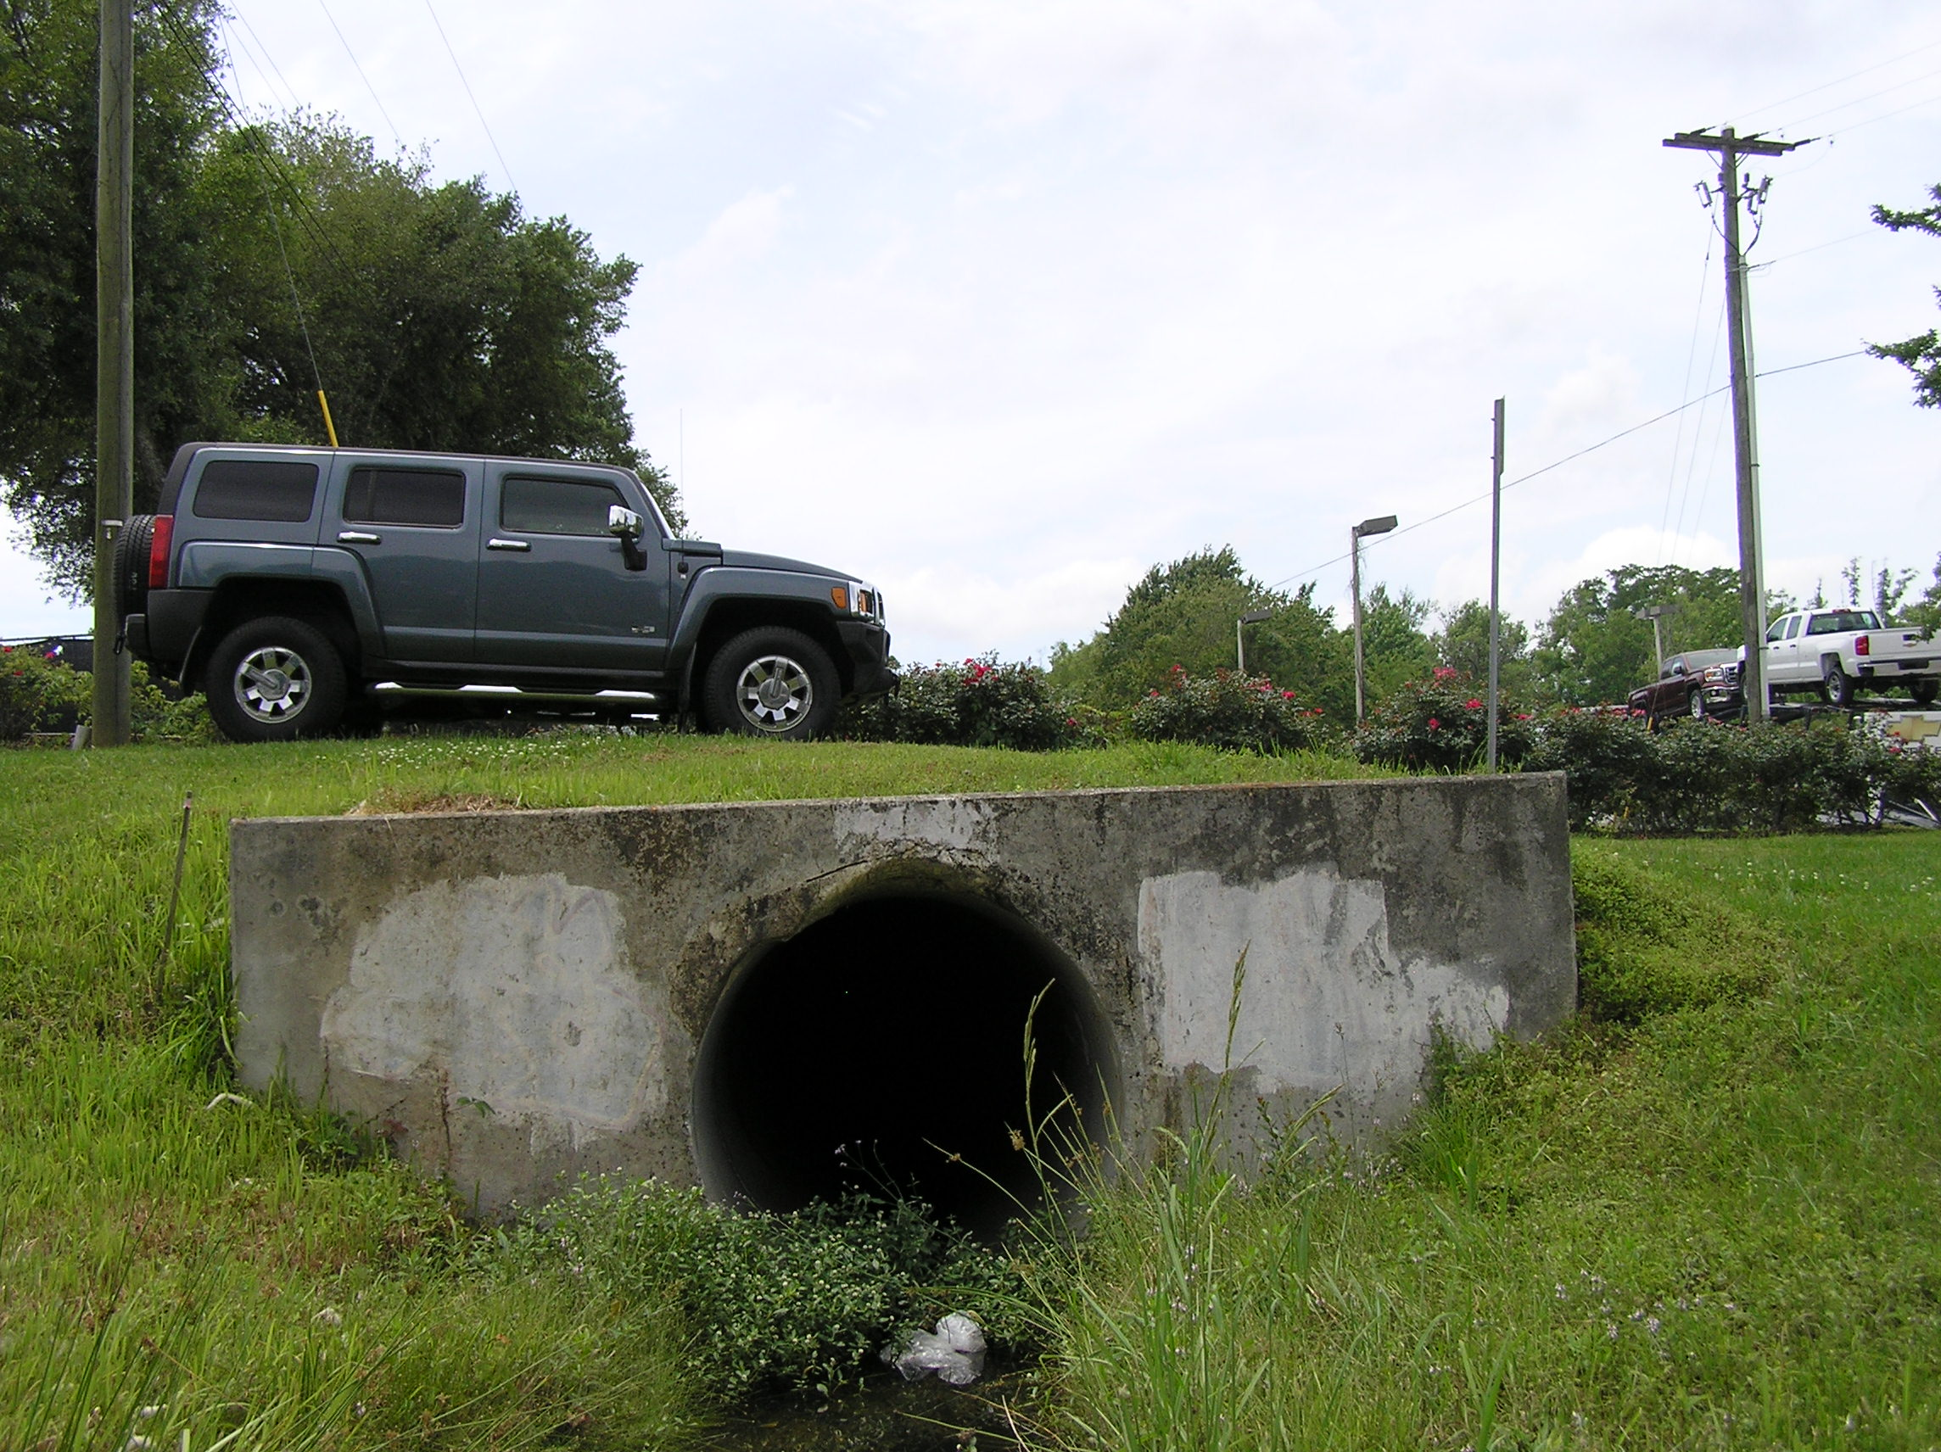

Slide 65
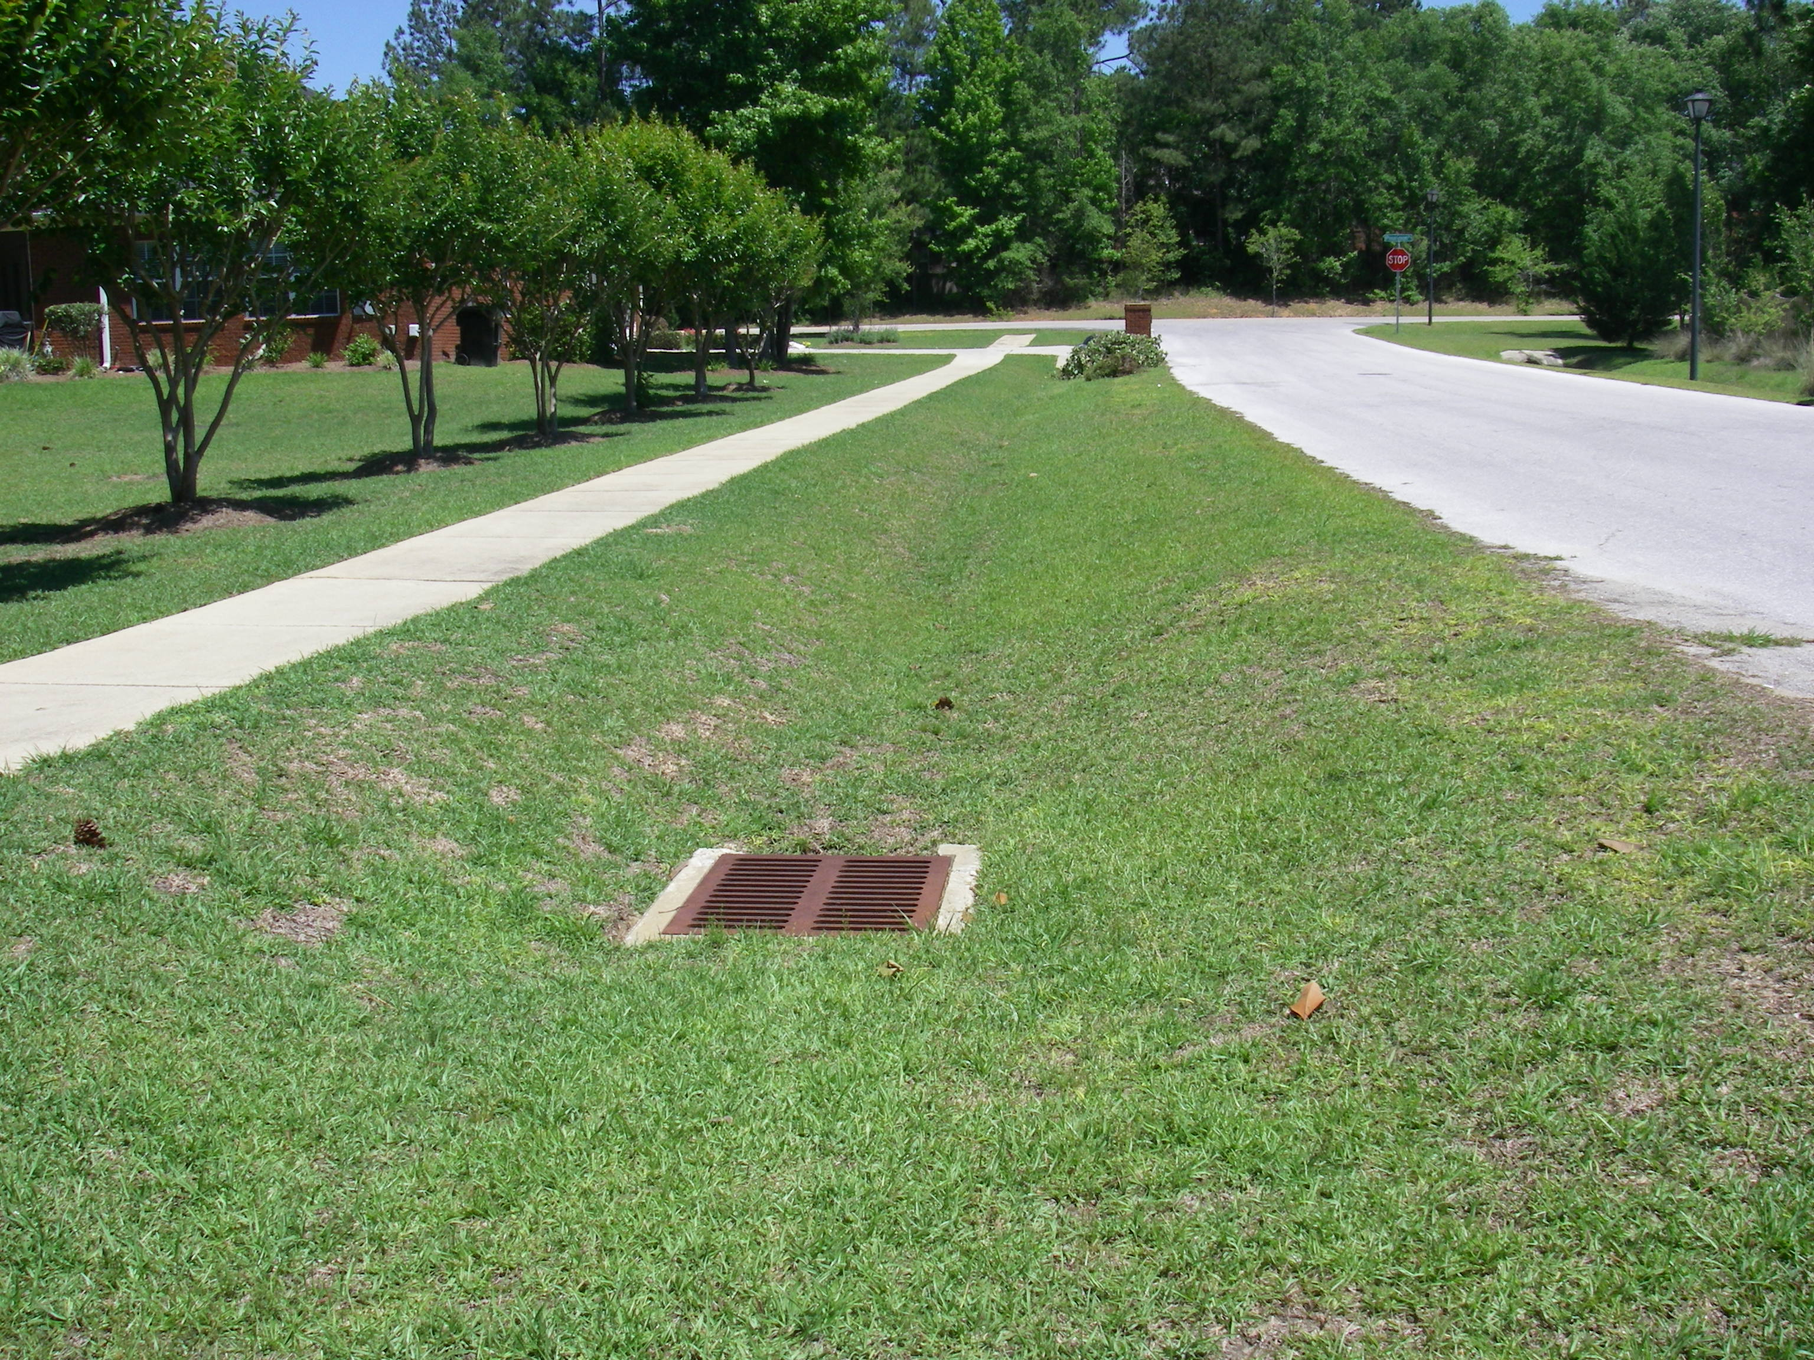

Slide 66
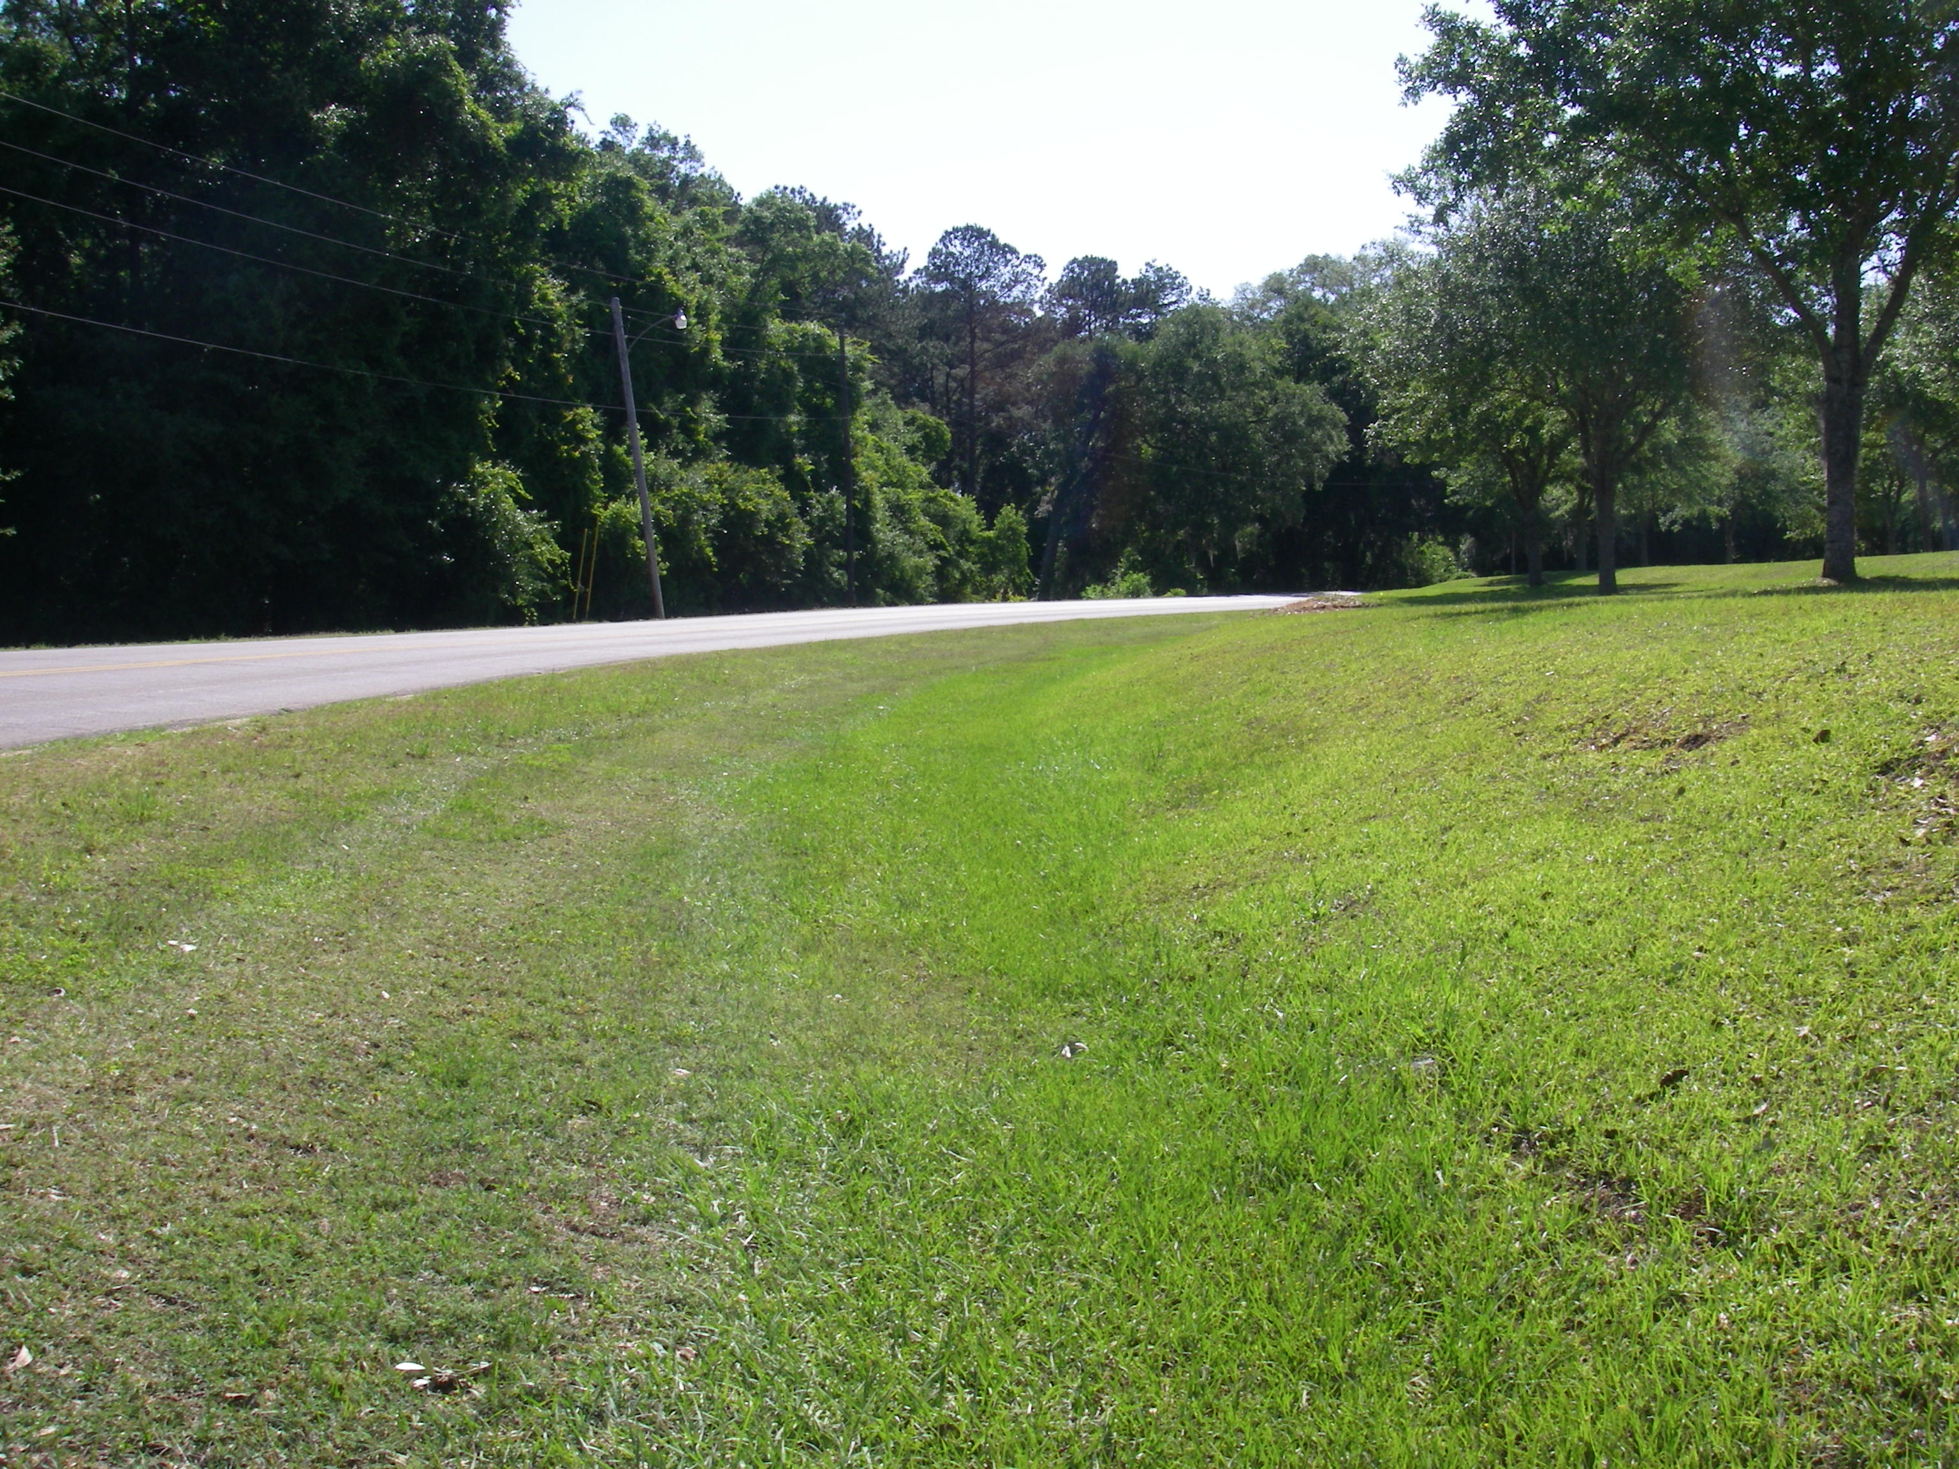

Slide 67
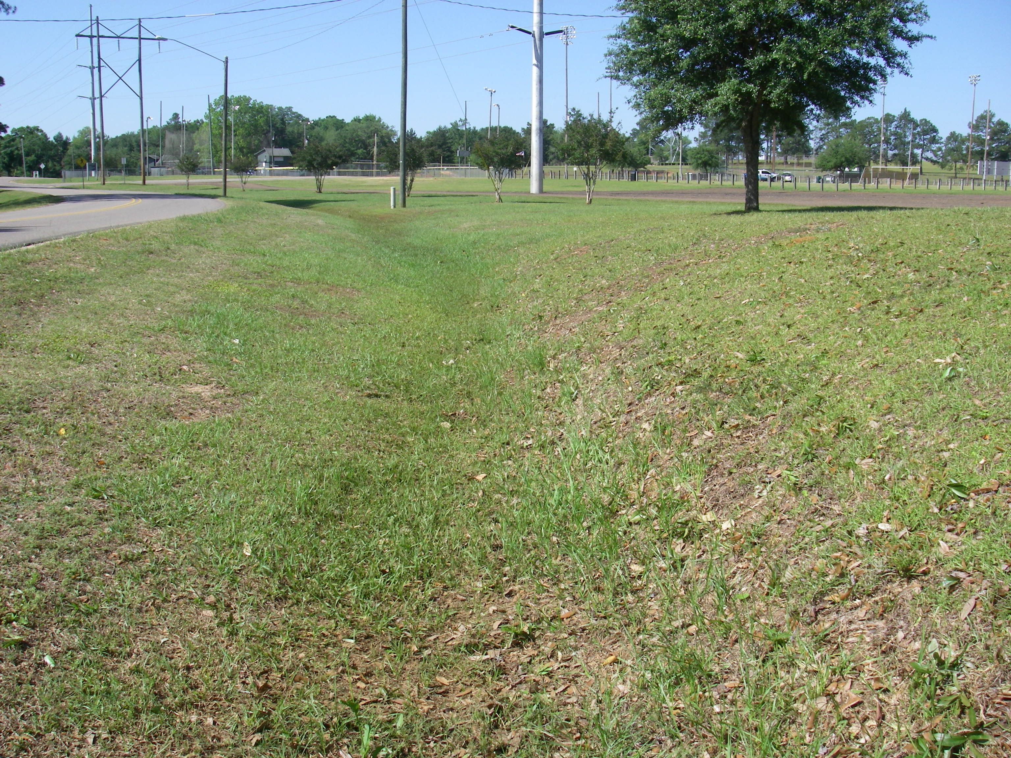

Slide 68
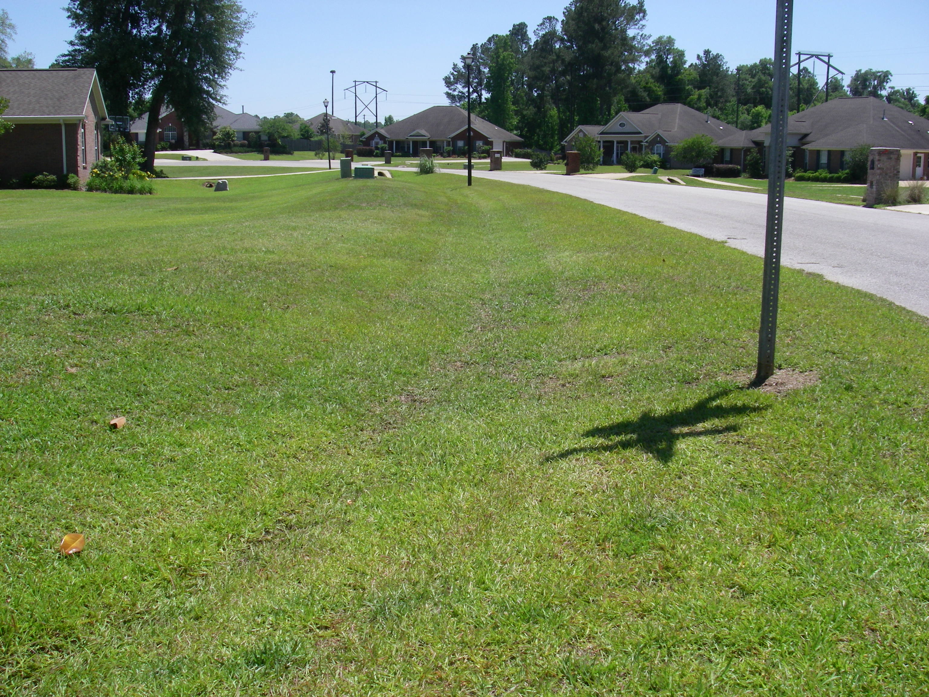

Slide 69


Slide 70


Slide 71


Slide 72


