Slide 1
Mining and Mitigation Program
Florida Department of Environmental Protection
Petition Process for Formal Determinations of Wetlands and Other Surface Waters
Charles Bidwell, charles.bidwell@dep.state.fl.us
Jay Kamke, (850) 245-8497, jay.kamke@dep.state.fl.us
Daniel Irick, (850) 245-7560, daniel.Irick@dep.state.fl.us
June 2015

Slide 2
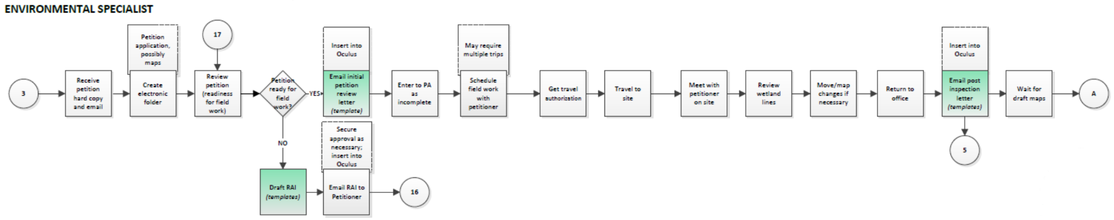
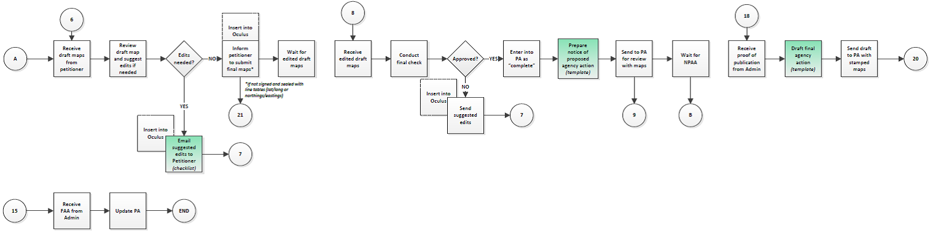
Petition Process Flowchart
Process flowchart is available on One Drive

Slide 3
Petition Process
Receive and Review Petition
Schedule and Conduct Site Inspection
Post Inspection Correspondence
Map Review
Map Approval
Notice of Proposed Agency Action
Receive Proof of Publication
Notice of Agency Action

Slide 4
Specific Authority
62-330.201 Formal Determinations of the Landward Extent of Wetlands and Other Surface Waters.
(1) A real property owner, an entity having a contract to purchase real property, an entity having the power of eminent domain, or any other person who has legal or equitable interest in real property, may petition the Agency for a formal determination of the landward extent of wetlands and other surface waters for that property pursuant to Section 373.421(2), F.S. A formal determination means the Agency will make a binding determination of the landward extent (boundaries) of wetlands and other surface waters as defined by Chapter 62-340, F.A.C. A formal determination is binding on the real property for which that determination is sought for as long as the determination is valid, in accordance with Sections 373.421(2) and (3), F.S. If the petitioner is not the owner of the land, the petitioner must provide the Agency with information sufficient to contact the current owner, and the Agency shall provide notice of receipt of the petition to the landowner.
(2) Procedures for the submittal, review, noticing, and action on a petition for a formal determination are contained in sections 7.2 through 7.2.7 of Volume I. The petition shall be submitted using Form 62-330.201(1), “Petition for a Formal Determination of the Landward Extent of Wetlands and Other Surface Waters,” [October 1, 2013], incorporated by reference herein (http://www.flrules.org/Gateway/reference.asp?No=Ref-02471). It shall be submitted with the fee prescribed in Rule 62-330.071, F.A.C.
Rulemaking Authority 373.026(7), 373.043, 373.4131, 373.421(2), 403.0877 FS. Law Implemented 120.54(5)(a), 373.026, 373.4131, 373.421(2), 373.441 FS. History–New 7-4-95, Amended 8-14-96, 8-16-98, 2-19-03, Formerly 62-343.040, Amended 10-1-13.

Slide 5
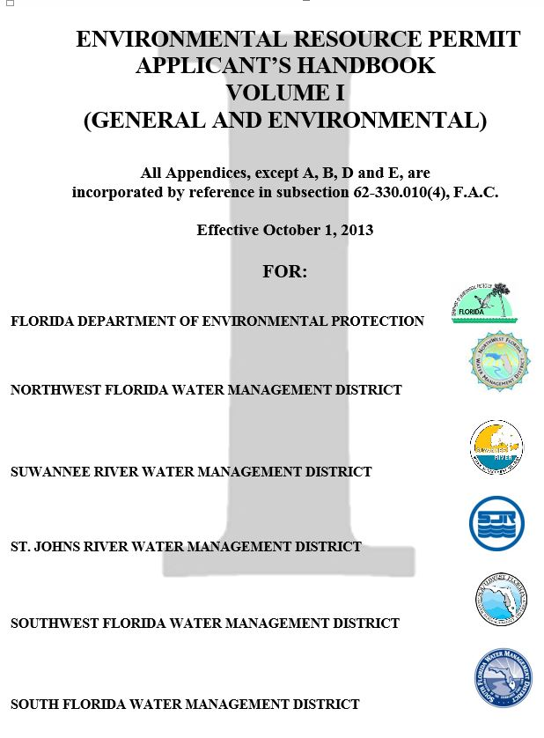
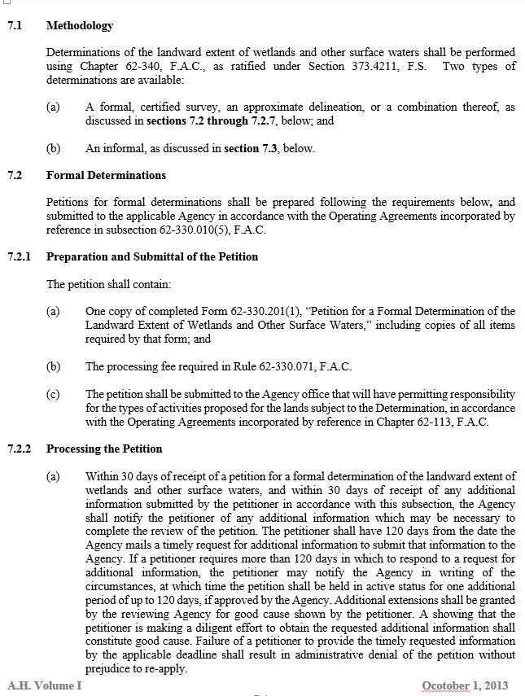
ERP Applicant’s Handbook Vol I

Slide 6
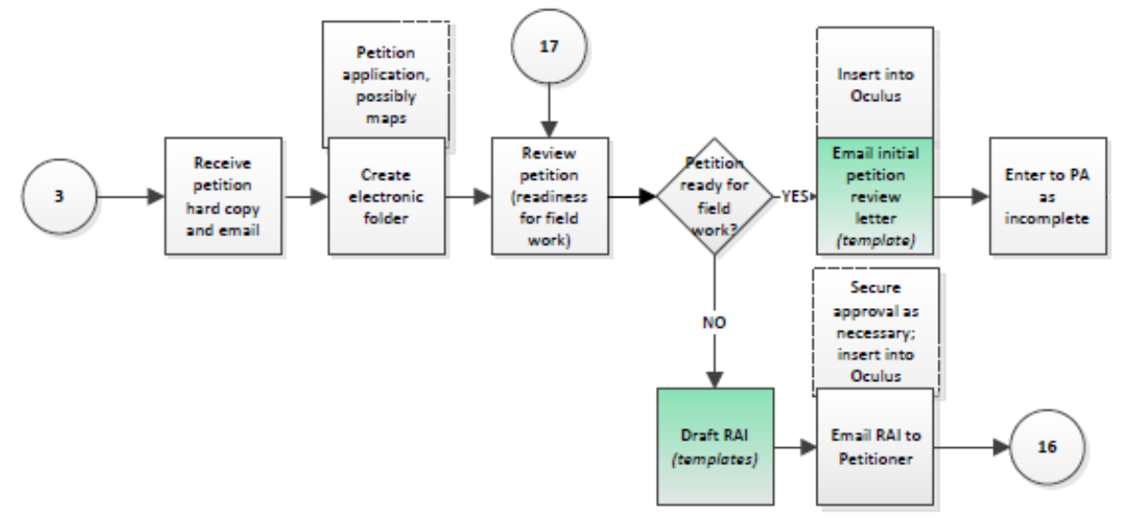
1. Receive and Review Petition

Slide 7
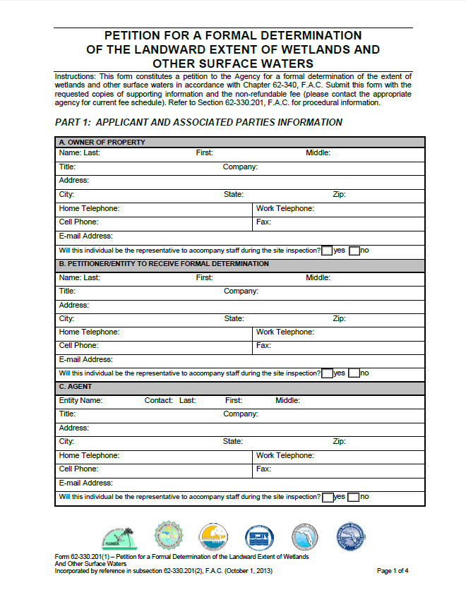
Petition Form

Slide 8
Petition Review
Review petition documents to determine if enough information is provided to conduct a site inspection
Is the fee amount submitted accurate?
Has permission been granted to access the site?
Were maps submitted with the petition?
Do the maps clearly demarcate boundaries?

Slide 9
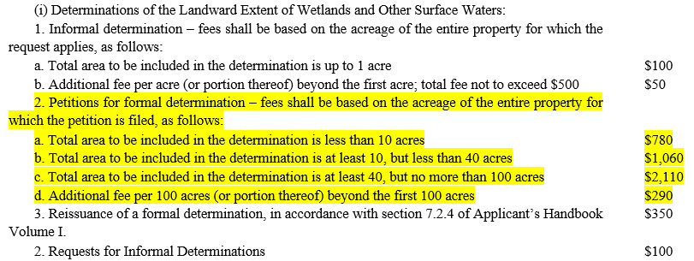
Fee Schedule
62-4.050 Procedures to Obtain Permits and Other Authorizations
If the project site is 320 acres,
the total fee will be,
$2,110 + $290 + $290+ $290 = $2,980

Slide 10
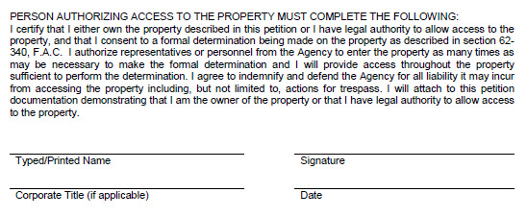
No Trespassing!

Slide 11
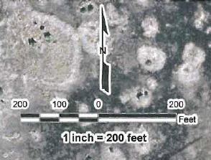
Examples of Maps (Scale)
*This scale is not to scale

Slide 12
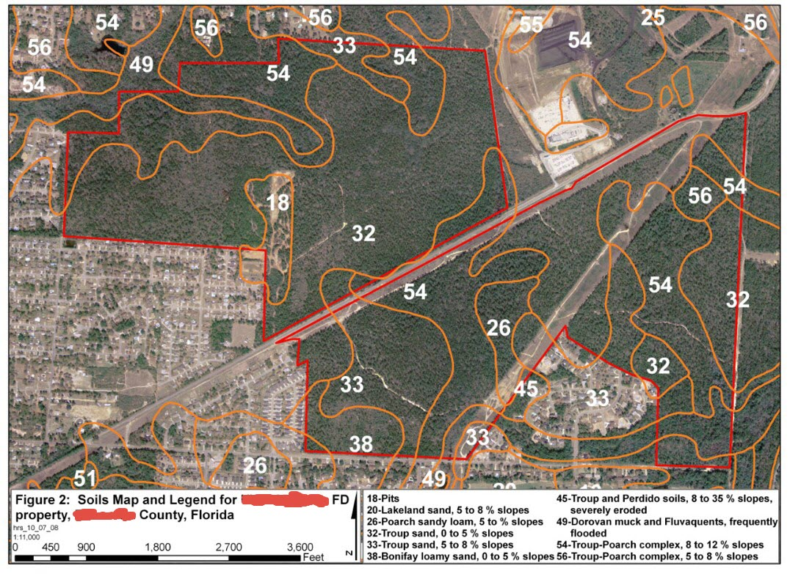
Examples of Maps (Soils)

Slide 13
Petition Review Correspondence
(Items Missing)
If the petition does not include sufficient information to conduct a site inspection send a Request for Additional Information (RAI).
A template is available through One Drive
The file name is “Petition Review RAI”

Slide 14
Petition Review Correspondence
(No Items Missing)
If the petition does include sufficient information to conduct a site inspection send a letter indicating all items have been received.
A template is available through One Drive
The file name is “Initial Review Letter”

Slide 15
Update Permitting Database
If an Initial Review Letter is sent to the Petitioner or Agent, Permitting Application (PA) should be updated to reflect the petition status.
Enter the petition as “Incomplete” in PA (given the process and review of wetland lines, allow for additional days to process)
Petition will remain “Incomplete” until the Department accepts the Final Maps after a site inspection

Slide 16
Certified Survey? Approximate Delineation? Combination thereof?
Applicant’s Handbook (A.H.) Volume I
7.1 Methodology
Determinations of the landward extent of wetlands and other surface waters shall be performed using Chapter 62-340, F.A.C., as ratified under Section 373.4211, F.S. Two types of determinations are available:
(a) A formal, certified survey, an approximate delineation, or a combination thereof, as discussed in sections 7.2 through 7.2.7, below;
7.2.2 Processing the Petition
(e) A petitioner may request a formal determination in the form of a certified survey, an approximate delineation, or combinations thereof, as described below.
When a certified surveyed delineation of the extent of wetlands and other surface waters is used, the survey shall be prepared and certified by a Professional Surveyor and Mapper registered in the State of Florida. The surveyor or the surveyor's representative shall accompany the Agency representative on the delineation verification described in section 7.2.2(f), below, and shall have the surveyor survey the verified boundaries of wetlands and other surface waters.
When an approximate delineation is used, it shall consist of a depiction of the approximate boundary of wetlands and other surface waters produced by using a GPS, or the boundary of wetlands and other surface waters drawn on rectified aerial photographs, or a combination thereof. The approximate delineation shall be subject to the following…

Slide 17
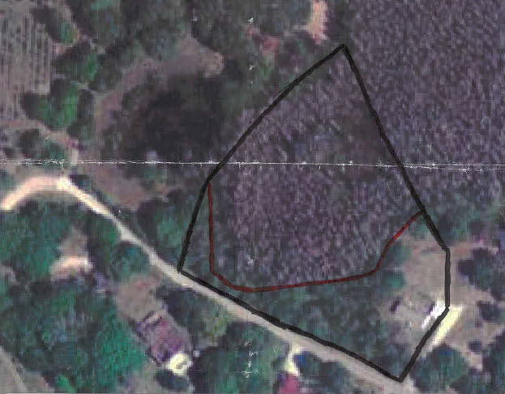
Map Submittals…Unacceptable*
*Unless the surveyor is present during the site inspection

Slide 18
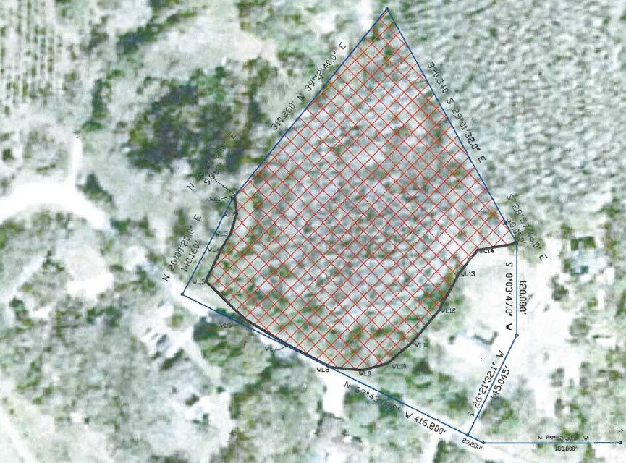
Map Submittals…Acceptable*
*Surveyor does not have to be present during site inspection

Slide 19
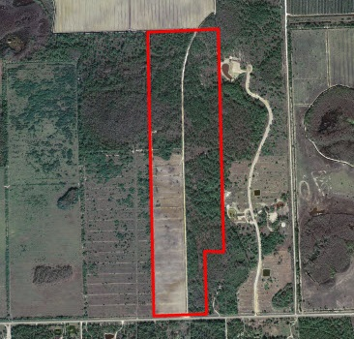
Examples of Maps (Project Boundary)

Slide 20
Examples of Maps (Project Boundary)
Changes in Land Use.
Portions of Inspection Boundary that are naturally marked.
Roads.

Slide 21
Approximate Determinations
(Comparison Points)
A.H. Volume I, Section 7.2.2(e)2.
For approximate determinations, a measure of the range of variability is required. This is a determination of how far the aerial photograph or GPS interpretation of the wetland boundary line deviates from where the line would be if it were flagged and surveyed. To do this:
1. A comparison is made of specific reference points determined by photointerpretation or GPS with actual physical flagged points on the real wetland boundary line. The number of comparison points and their location is decided upon, or at least agreed to, by DEP. The number of comparison points must be a minimum of 1 per 1000 feet of line and on any site there must be at least 3 points.
2. A rectified aerial photograph shall serve as the basis for an approximate delineation hand-drawn on aerial photographs only when the boundaries of wetlands and other surface waters are accurately depicted on the aerial photograph by the clear expression of vegetative or physical signatures of the vegetative communities as verified by ground-truthing. If these conditions are not met, either the procedure for a Certified Survey or the procedure for a GPS-Approximate delineation can be used in those areas without clear vegetative or physical signatures. A combination of any of the three methodologies can be, and oftentimes are, used.
3. The FD will not be deemed complete until receipt of a survey prepared and certified by a Professional Surveyor and Mapper registered in the State of Florida, to show the relationship of field located surveyed comparison points to the approximate field GPS boundary points or the wetlands and other surface waters boundary drawn on a rectified aerial photograph.

Slide 22
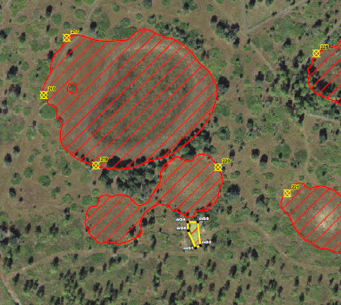
Comparison Points

Slide 23
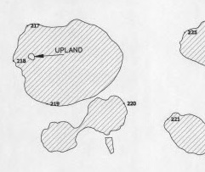
Specific Purpose Survey

Slide 24
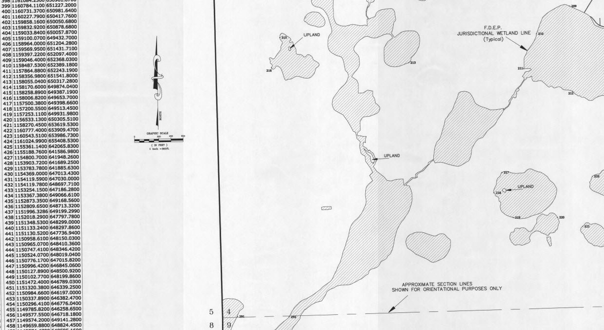
Specific Purpose Survey (Line Tables)

Slide 25
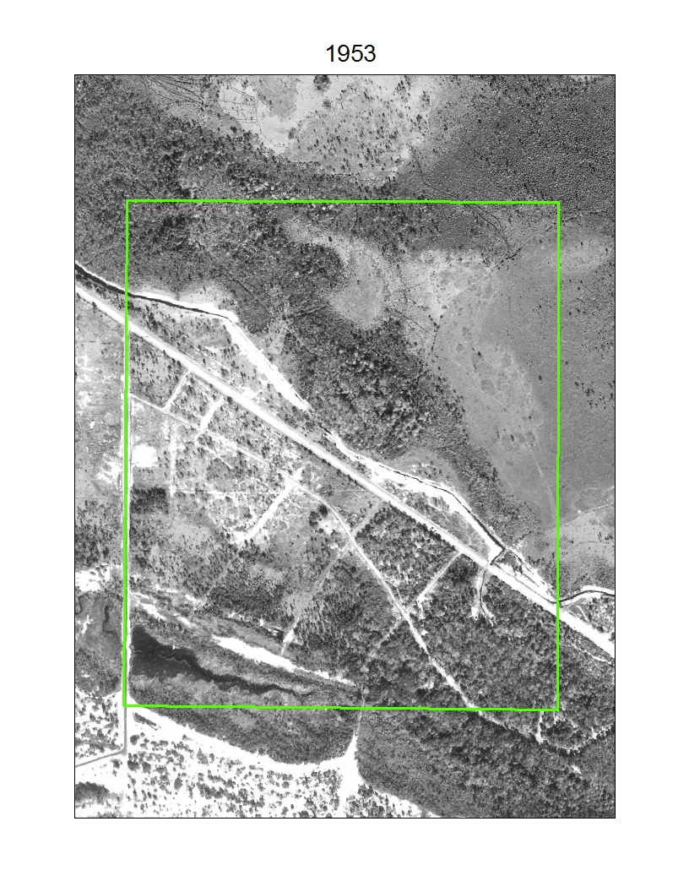
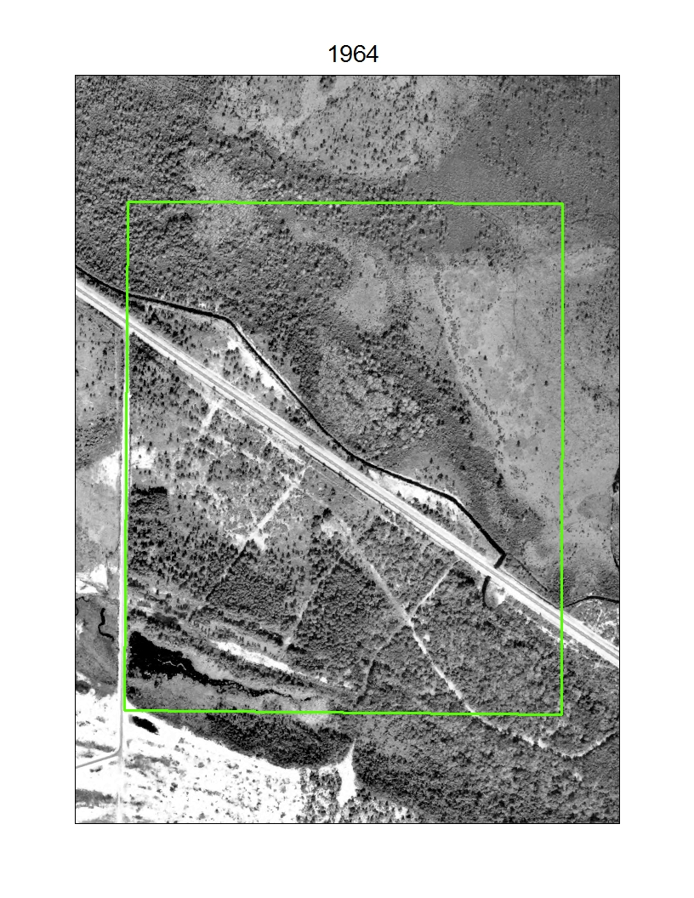
Historical Aerial Images
Historical aerials can be useful for site inspection to determine the history of wetlands and other surface waters from 1940s to 1970s.
Historical aerials are available from http://ufdc.ufl.edu/aerials

Slide 26
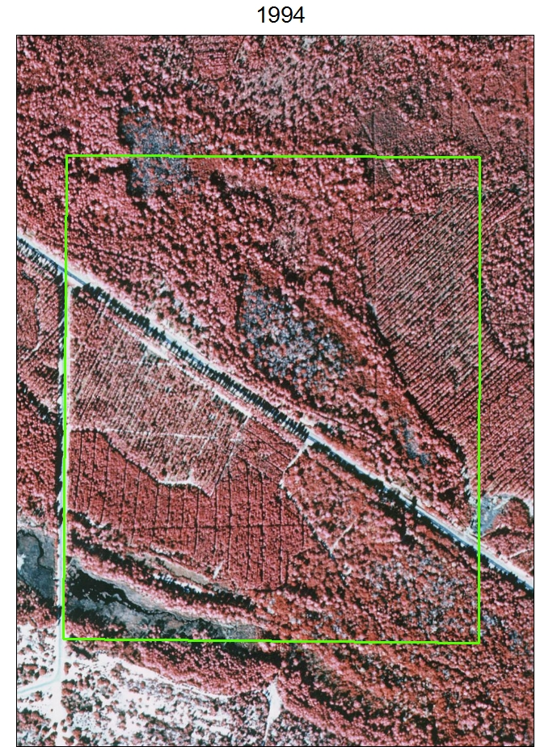
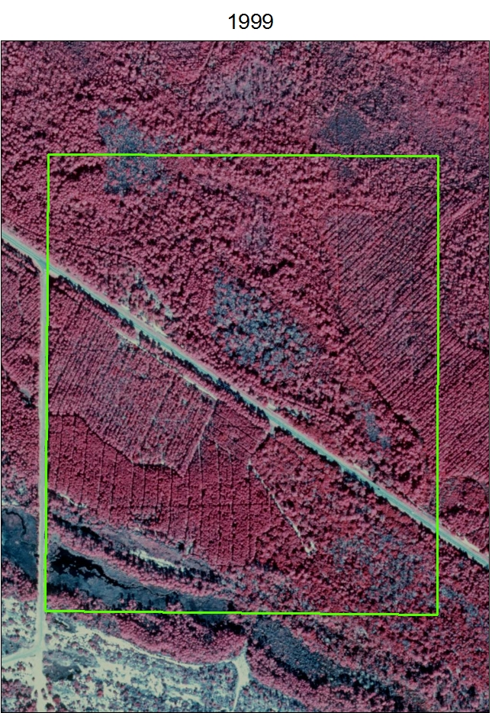
Infrared Aerial Images
Infrared aerials can be useful for site inspection to determine the history of wetlands and plant community types especially pine plantations.
Infrared aerial images are available through One Drive

Slide 27
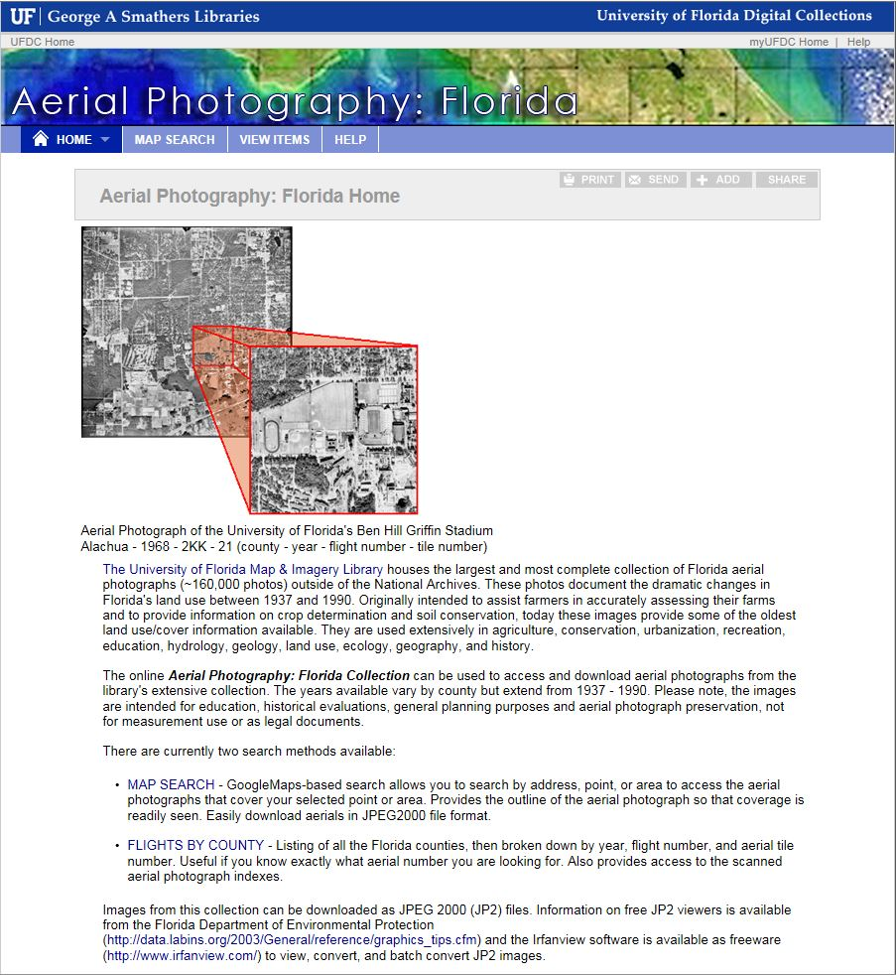
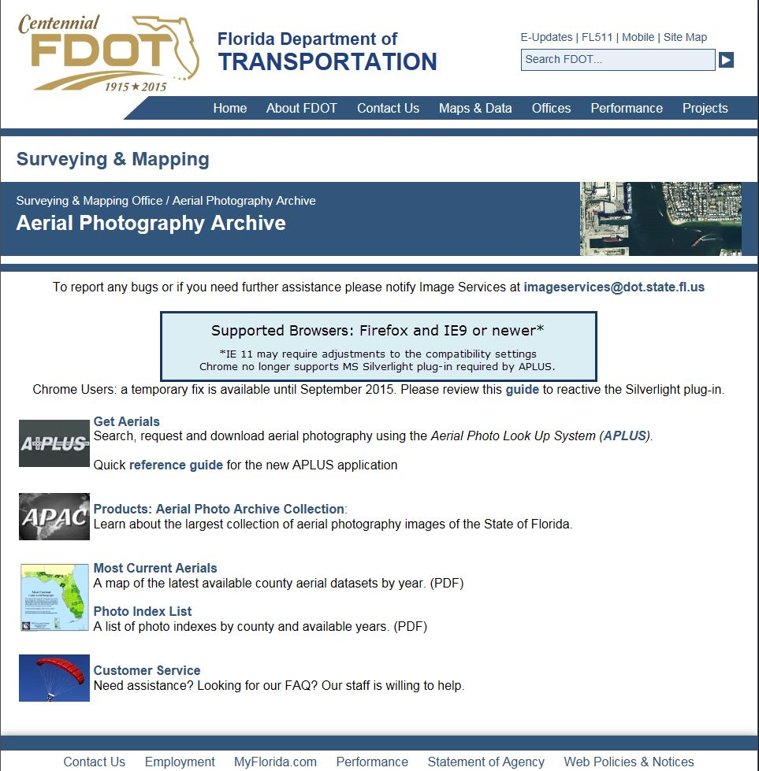
Online Resources
Websites with historic aerial images

Slide 28
Review Soil Survey
Review the soil survey for the area within, and adjacent to, the inspection boundary
62-340.300(2)(c) – Soil map units identified as “Frequently Flooded” or “Depressional” qualify for “C” Test

Slide 29
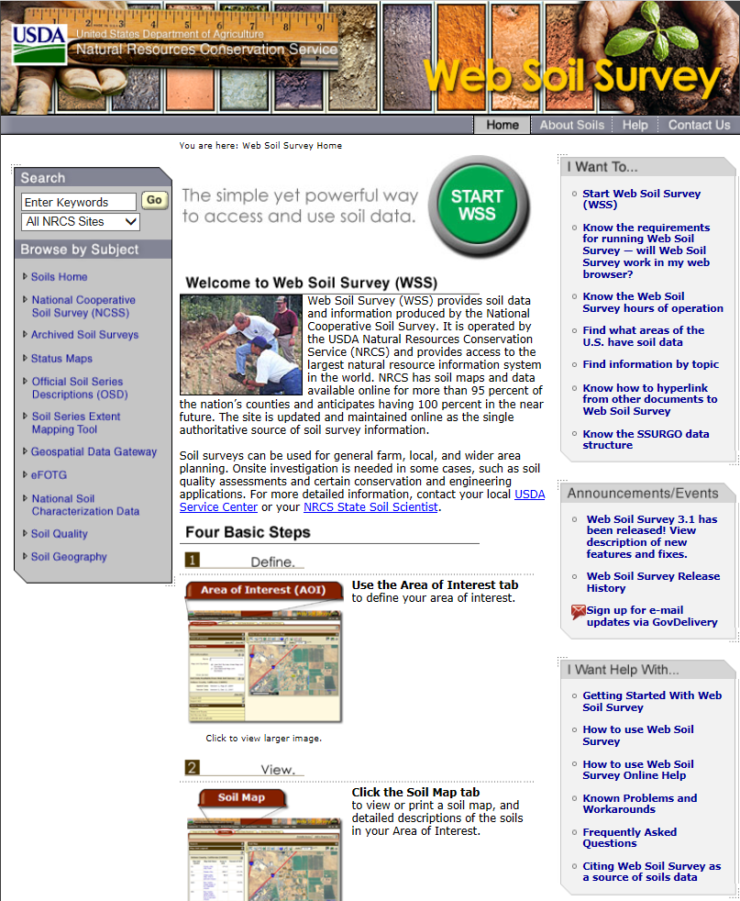
Soil Survey Resources
http://websoilsurvey.sc.egov.usda.gov/App/HomePage.htm

Slide 30
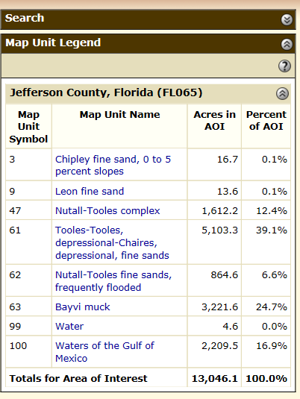
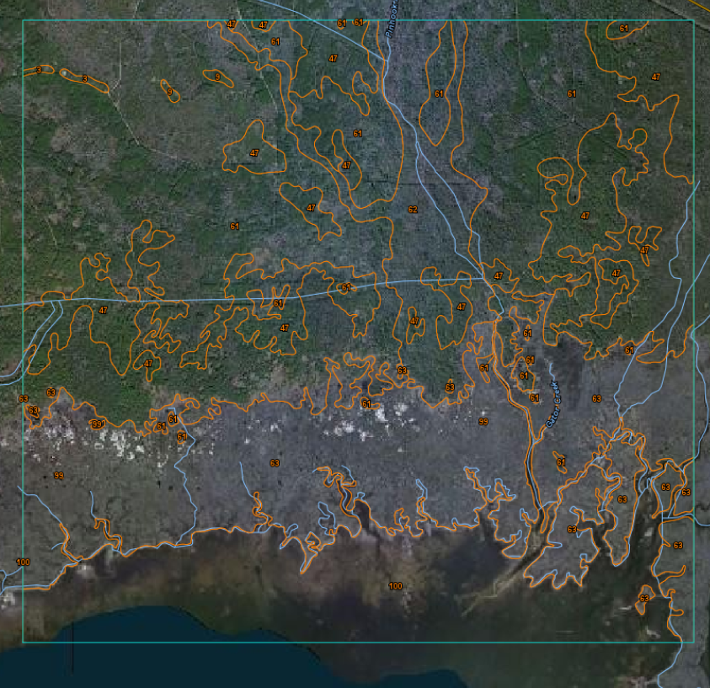
Example: Web Soil Survey Data

Slide 31
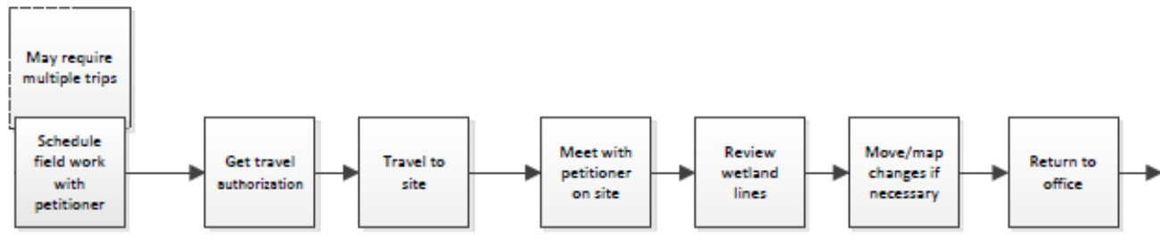
2. Schedule and Conduct Site Inspection
Advice for data collection during fieldwork
Make sure DEP field edits are reflected on the Petitioner/Agent field maps

Slide 32
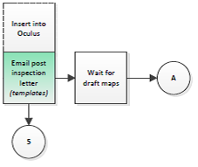
3. Post Inspection Correspondence

Slide 33
Post Inspection Letter
After the site inspection has been completed, send a letter, or email, outlining what information should be submitted to complete the petition
A template is available through One Drive
The file name is “Post Inspection Letter”

Slide 34
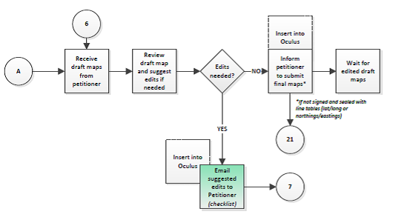
4. Map Review
After the final maps have been submitted, the maps should reviewed prior to approval.
Compare maps with field notes/maps
Review the title, legend, scale bar and FD number

Slide 35
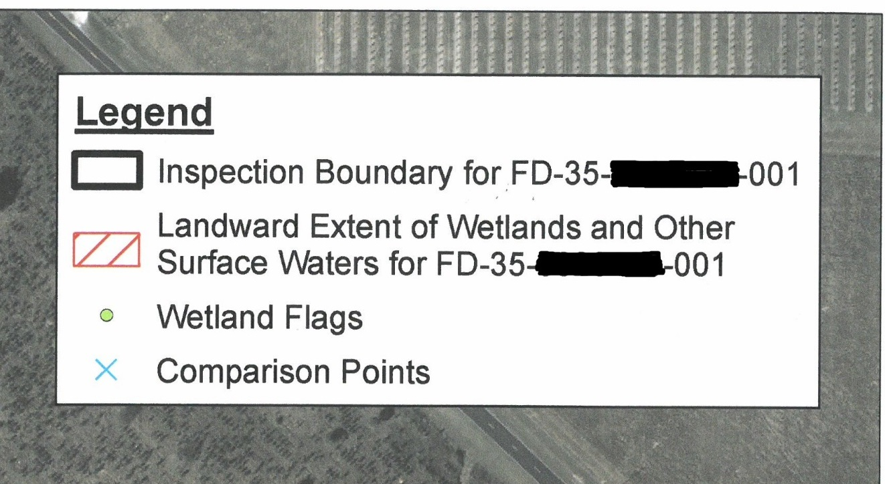
Map Legend
Example of Map Legend in Survey and Aerial Maps.

Slide 36
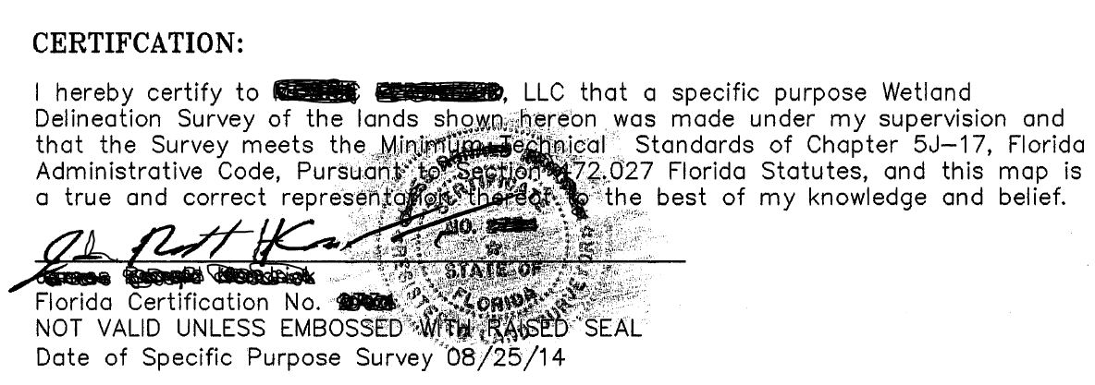
Map Review
Surveys should be reviewed prior to approval.
Ensure line tables, legal descriptions, wetland acreages are depicted.
Ensure maps are signed and sealed by a PLS
Shade the raised seal with pencil for scanning

Slide 37
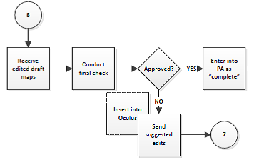
5. Map Approval
After edits to the final maps have been submitted, the maps should reviewed again prior to approval.
Compare maps with suggested edits and previously submitted maps
If the maps are acceptable update the project status in PA to complete

Slide 38
6. Notice of Proposed Agency Action
After the final maps have been approved, and PA had been updated to complete, issue the Notice of Proposed Agency Action.
A template is available through One Drive
The file name is “Proposed Agency Action for FD”

Slide 39
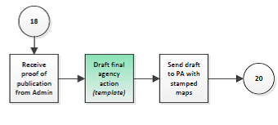
7. Receive Proof of Publication
After receiving the proof of publication, draft the Final Agency Action during the 21-day review period for the Notice of Proposed Agency Action.
A template is available through One Drive
The file name is “Final Agency Action for FD with expiration date”
Do not send the draft to the Administrator until the issue date has been determined

Slide 40
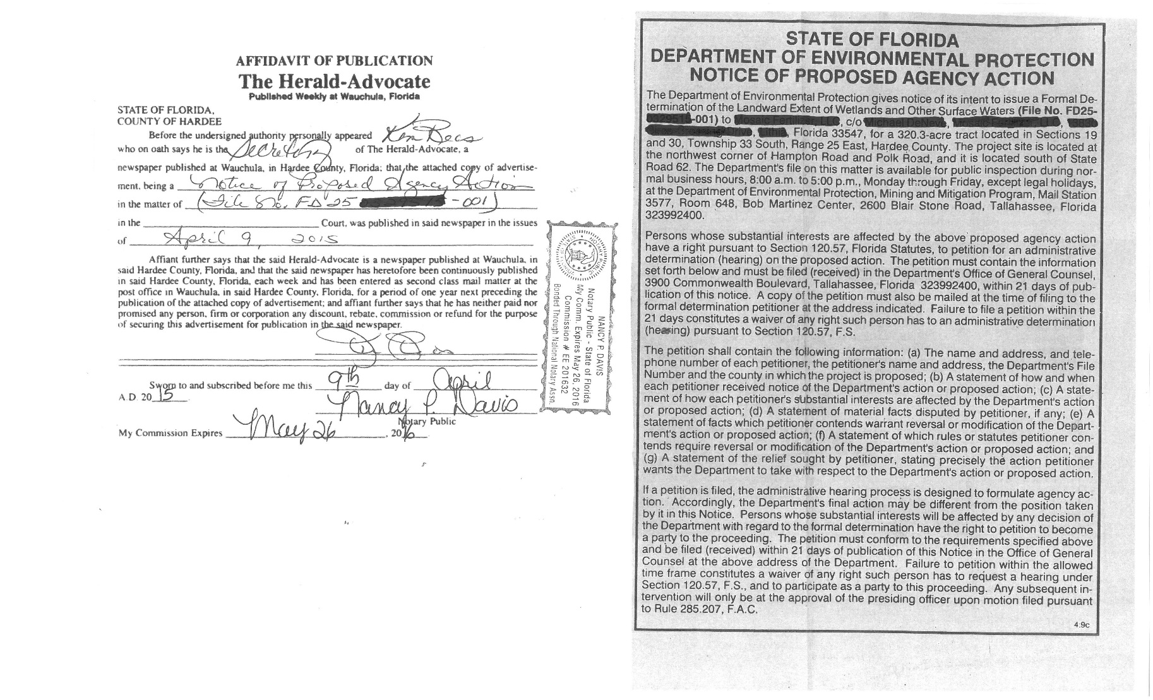
Example: Proof of Publication
See A.H. Volume I, 7.2.2(a)1. for timelines
At this time an original copy is required

Slide 41
8. Notice of Agency Action
After the 21-day review period for the Notice of Proposed Agency Action has expired the Agency Action can be issued.
Enter the correct Issued and Expiration Dates in the Agency Action and the Approved Maps.
Send the Agency Action and Approved Maps to Administrator for review and signatures

Slide 42
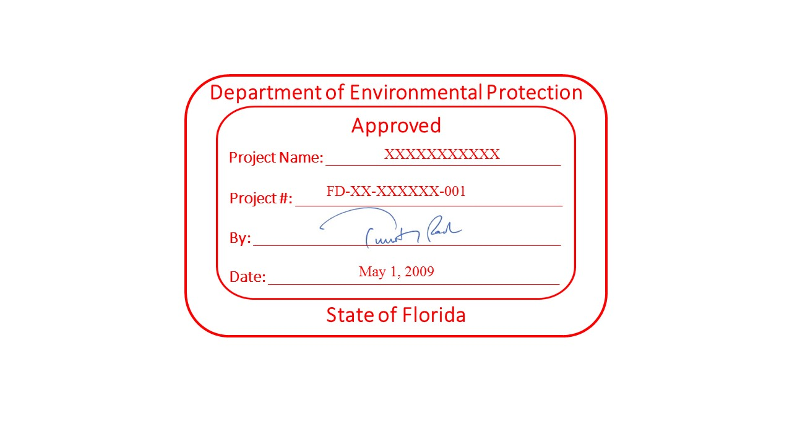
Notice of Agency Action
Prepare and insert the DEP Approved stamp on every sheets of final maps.

Slide 43

Notice of Agency Action
After the Agency Action has been signed, send the Agency Action to the petitioner and interested parties.
Enter Secured PDF documents into Oculus
Update the petition status in PA to “issued”

Slide 44
Questions?

