Slide 1
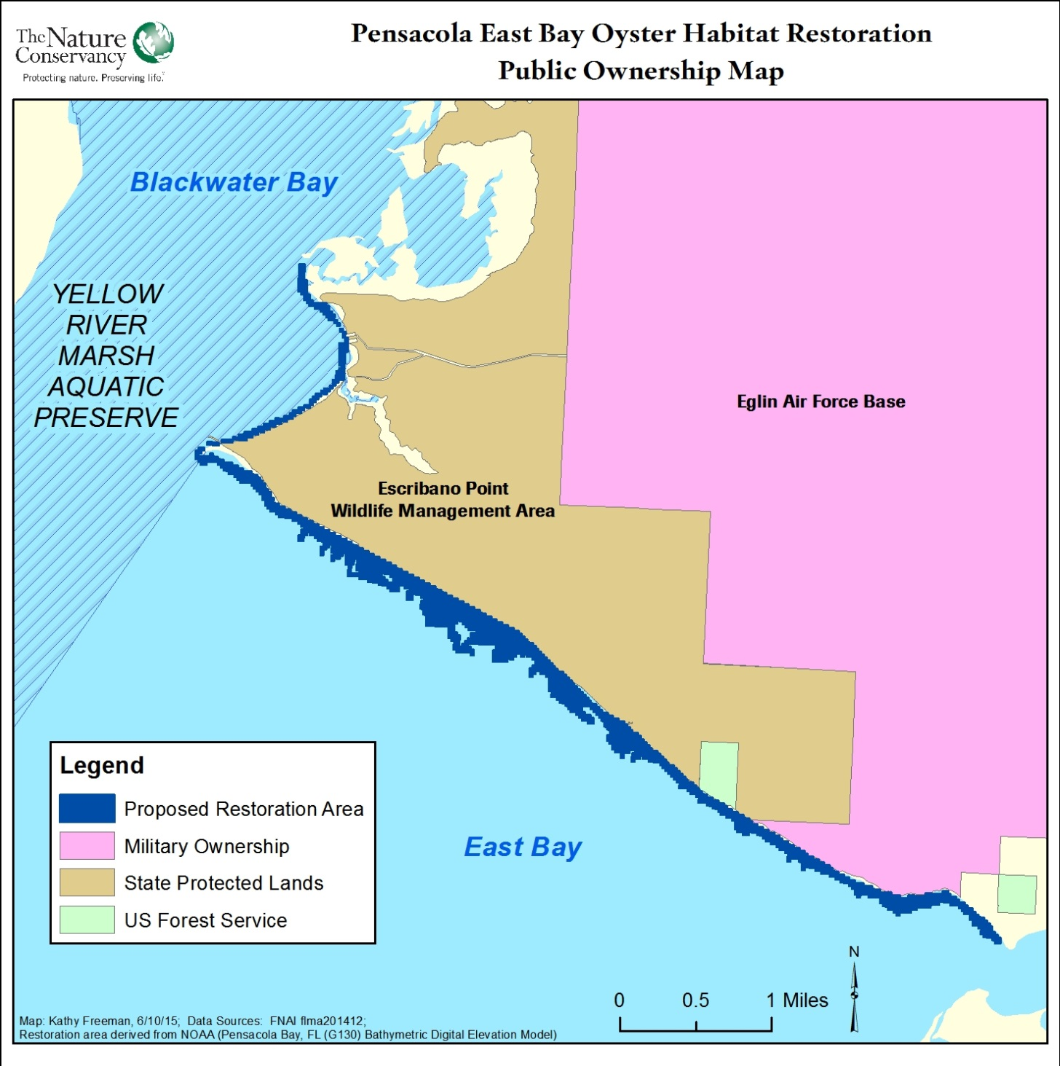
Figure 1. Project Map
Pensacola East Bay Oyster Habitat Restoration Project The Nature Conservancy

