Slide 1


Slide 2


Slide 3
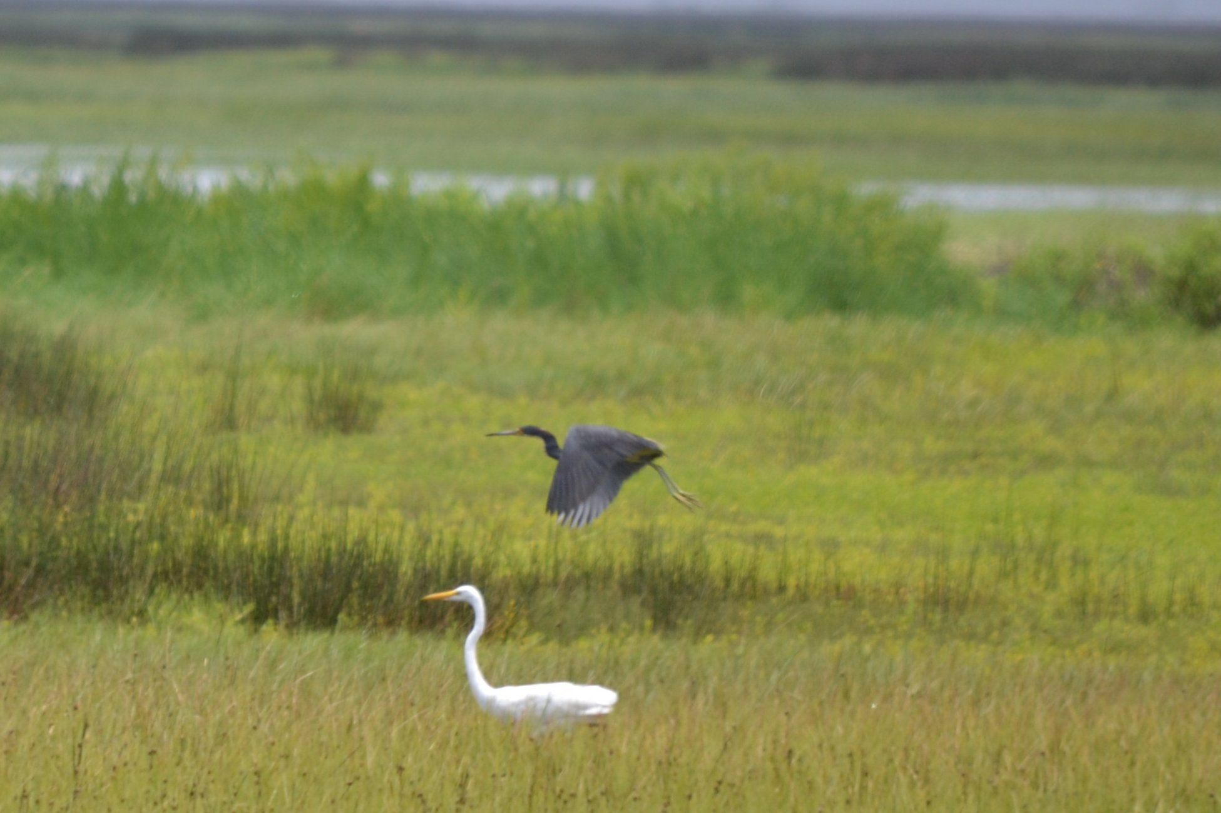

Slide 4
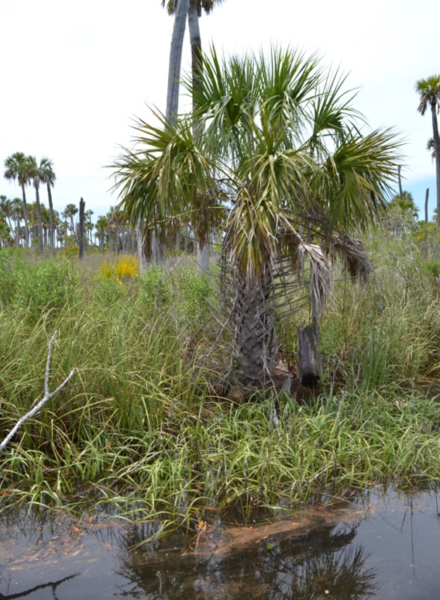
Background
The Yates Creek watershed consists of 270+ acres of undeveloped wetlands and uplands that harken back to “Old Florida” in its earliest, most pristine days

Slide 5
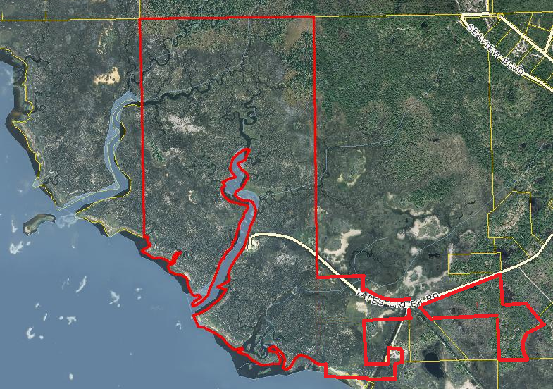
YATES CREEK PROPERTY BOUNDARIES

Slide 6
YATES CREEK PROPERTY BOUNDARIES

Slide 7
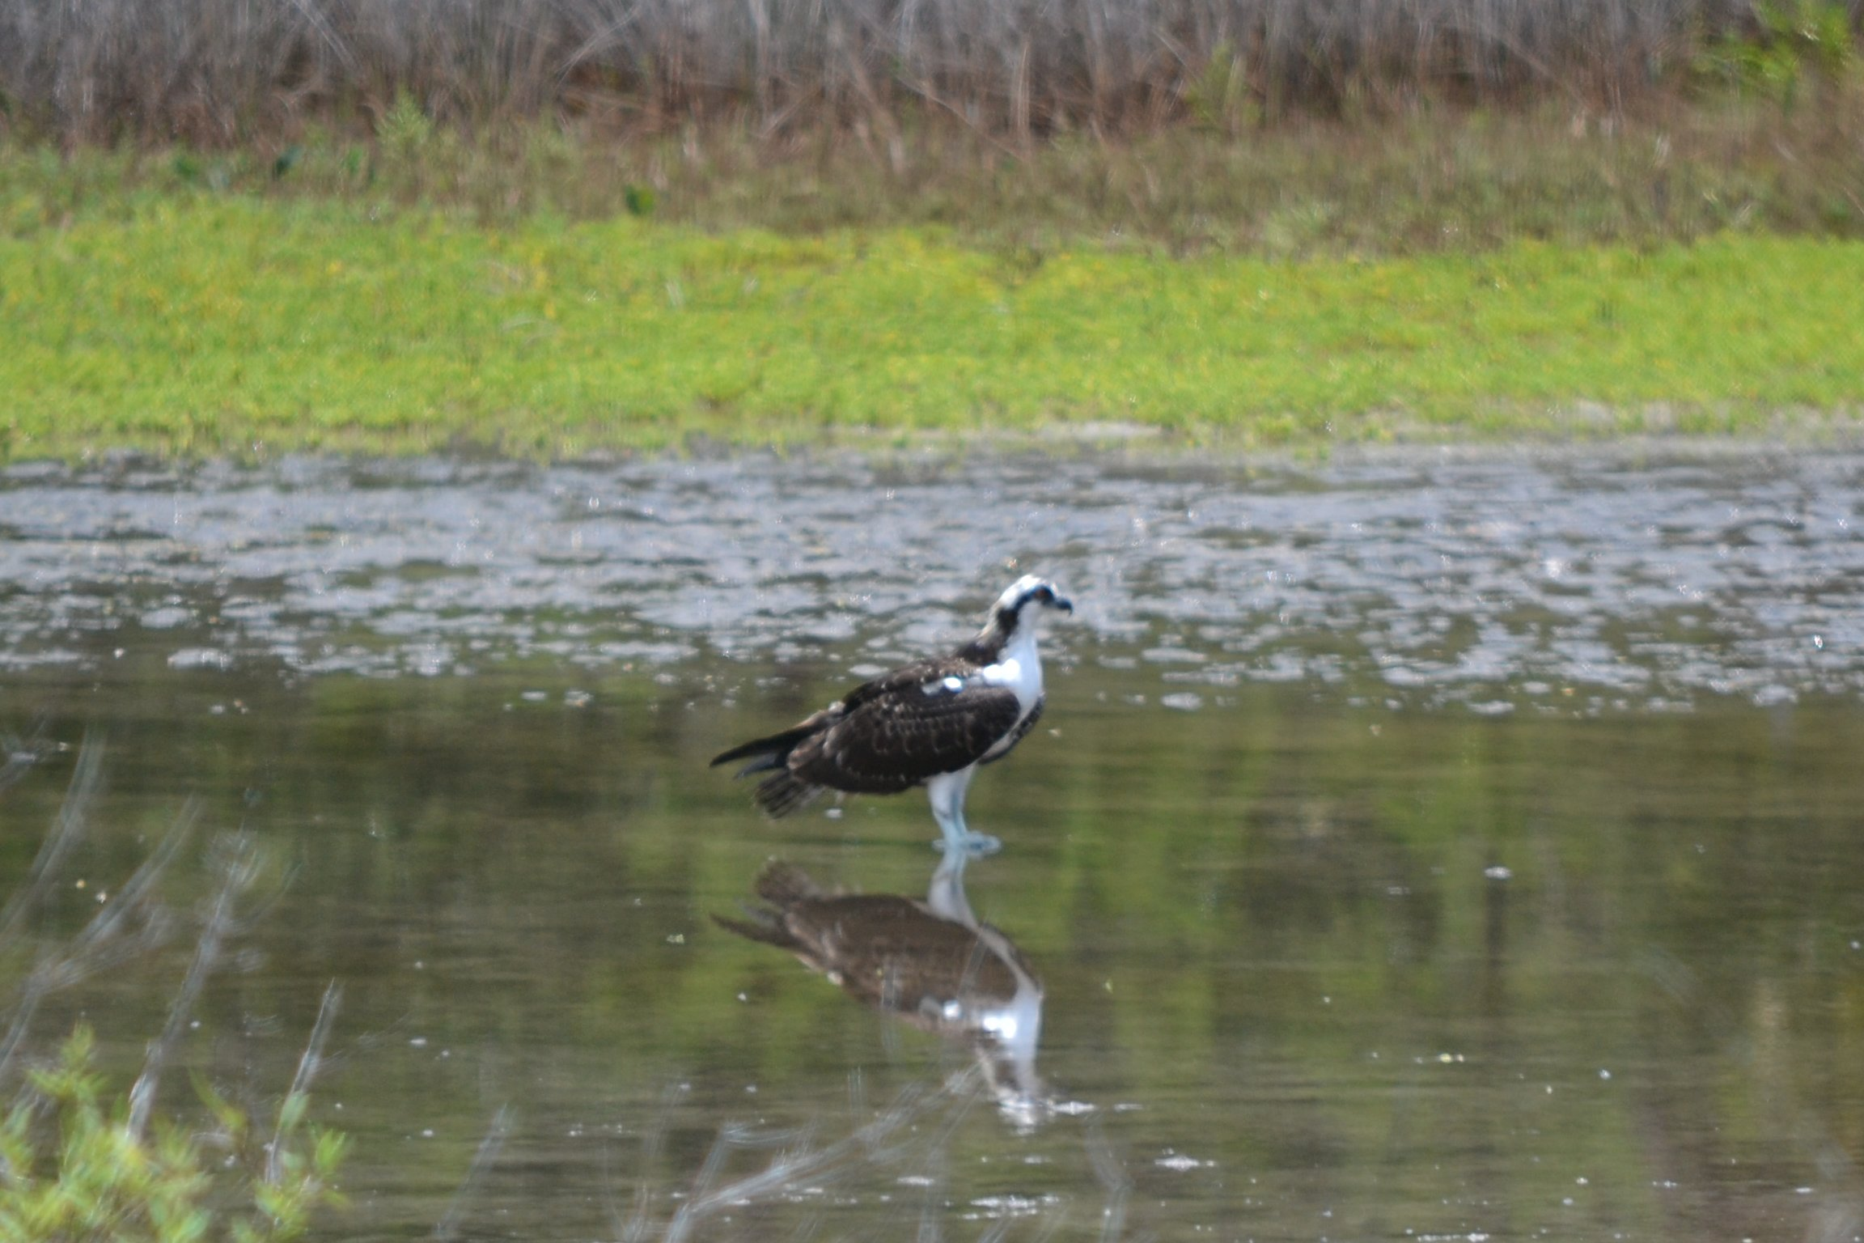

Slide 8
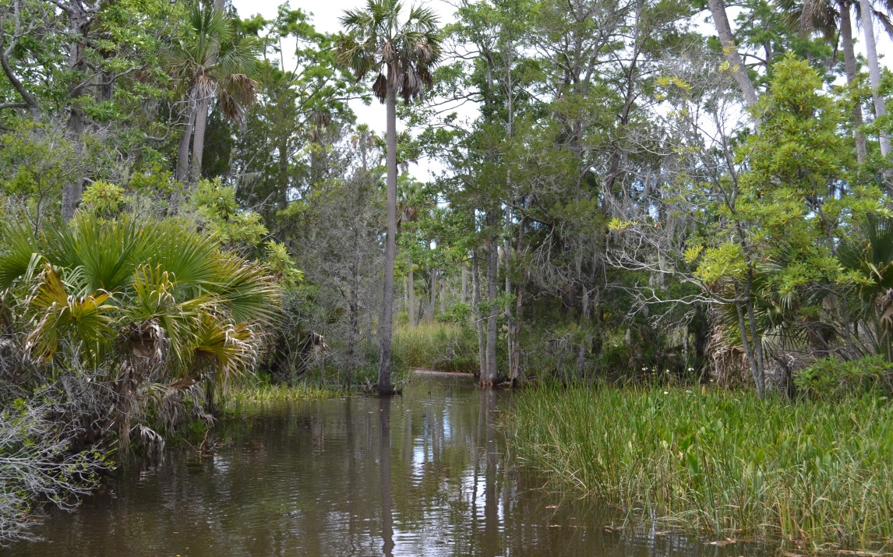
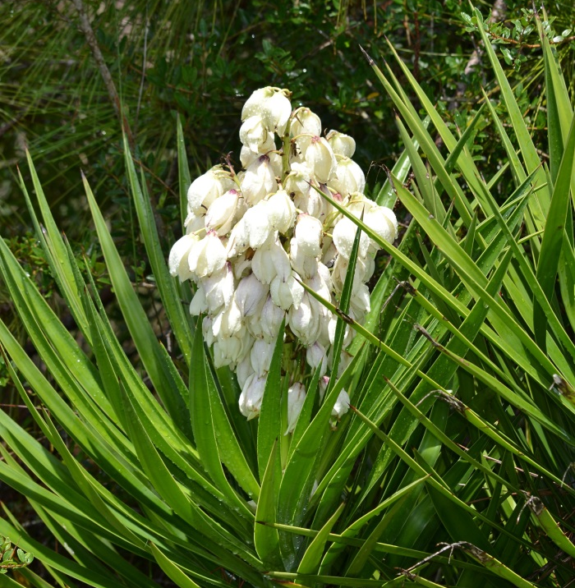
Project Purpose
Conservation and preservation of the Yates Creek watershed for the purpose of providing educational and recreational facilities for Taylor County and the surrounding areas

Slide 9
Project Purpose
Conservation and preservation of the Yates Creek watershed for the purpose of providing educational and recreational facilities for Taylor County and the surrounding areas

Slide 10
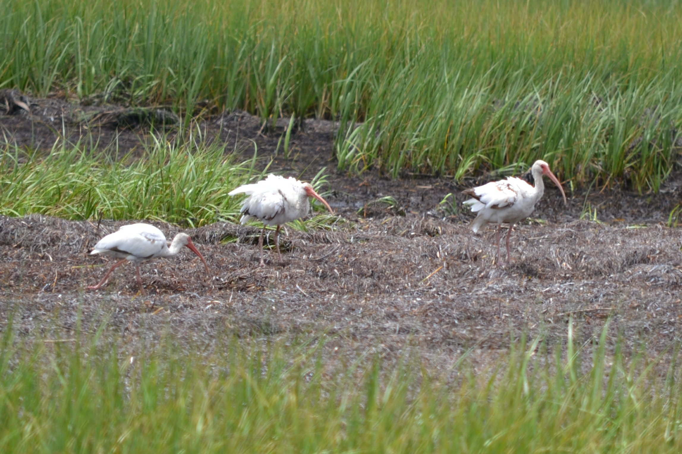

Slide 11
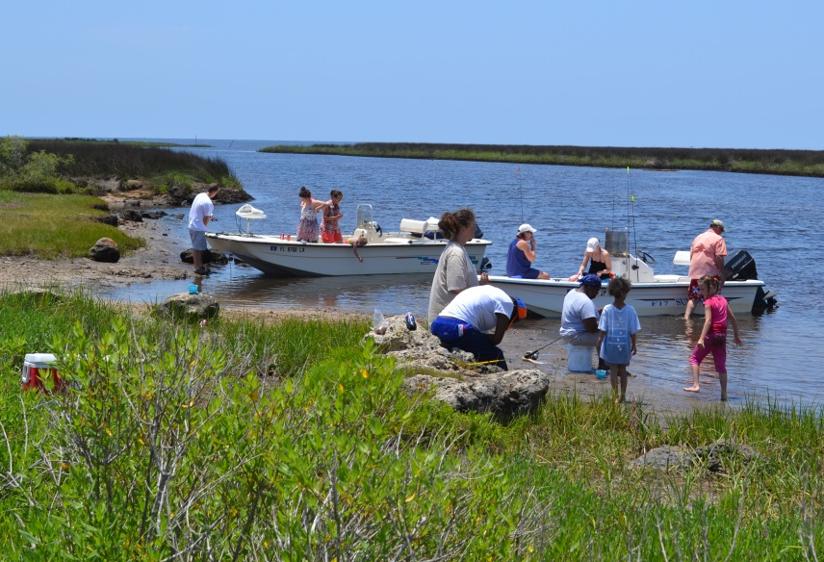
Project Components
This would be the only public boat ramp
along 10 miles of this portion of the Gulf Coast

Slide 12
Project Components
This would be the only public boat ramp
along 10 miles of this portion of the Gulf Coast

Slide 13
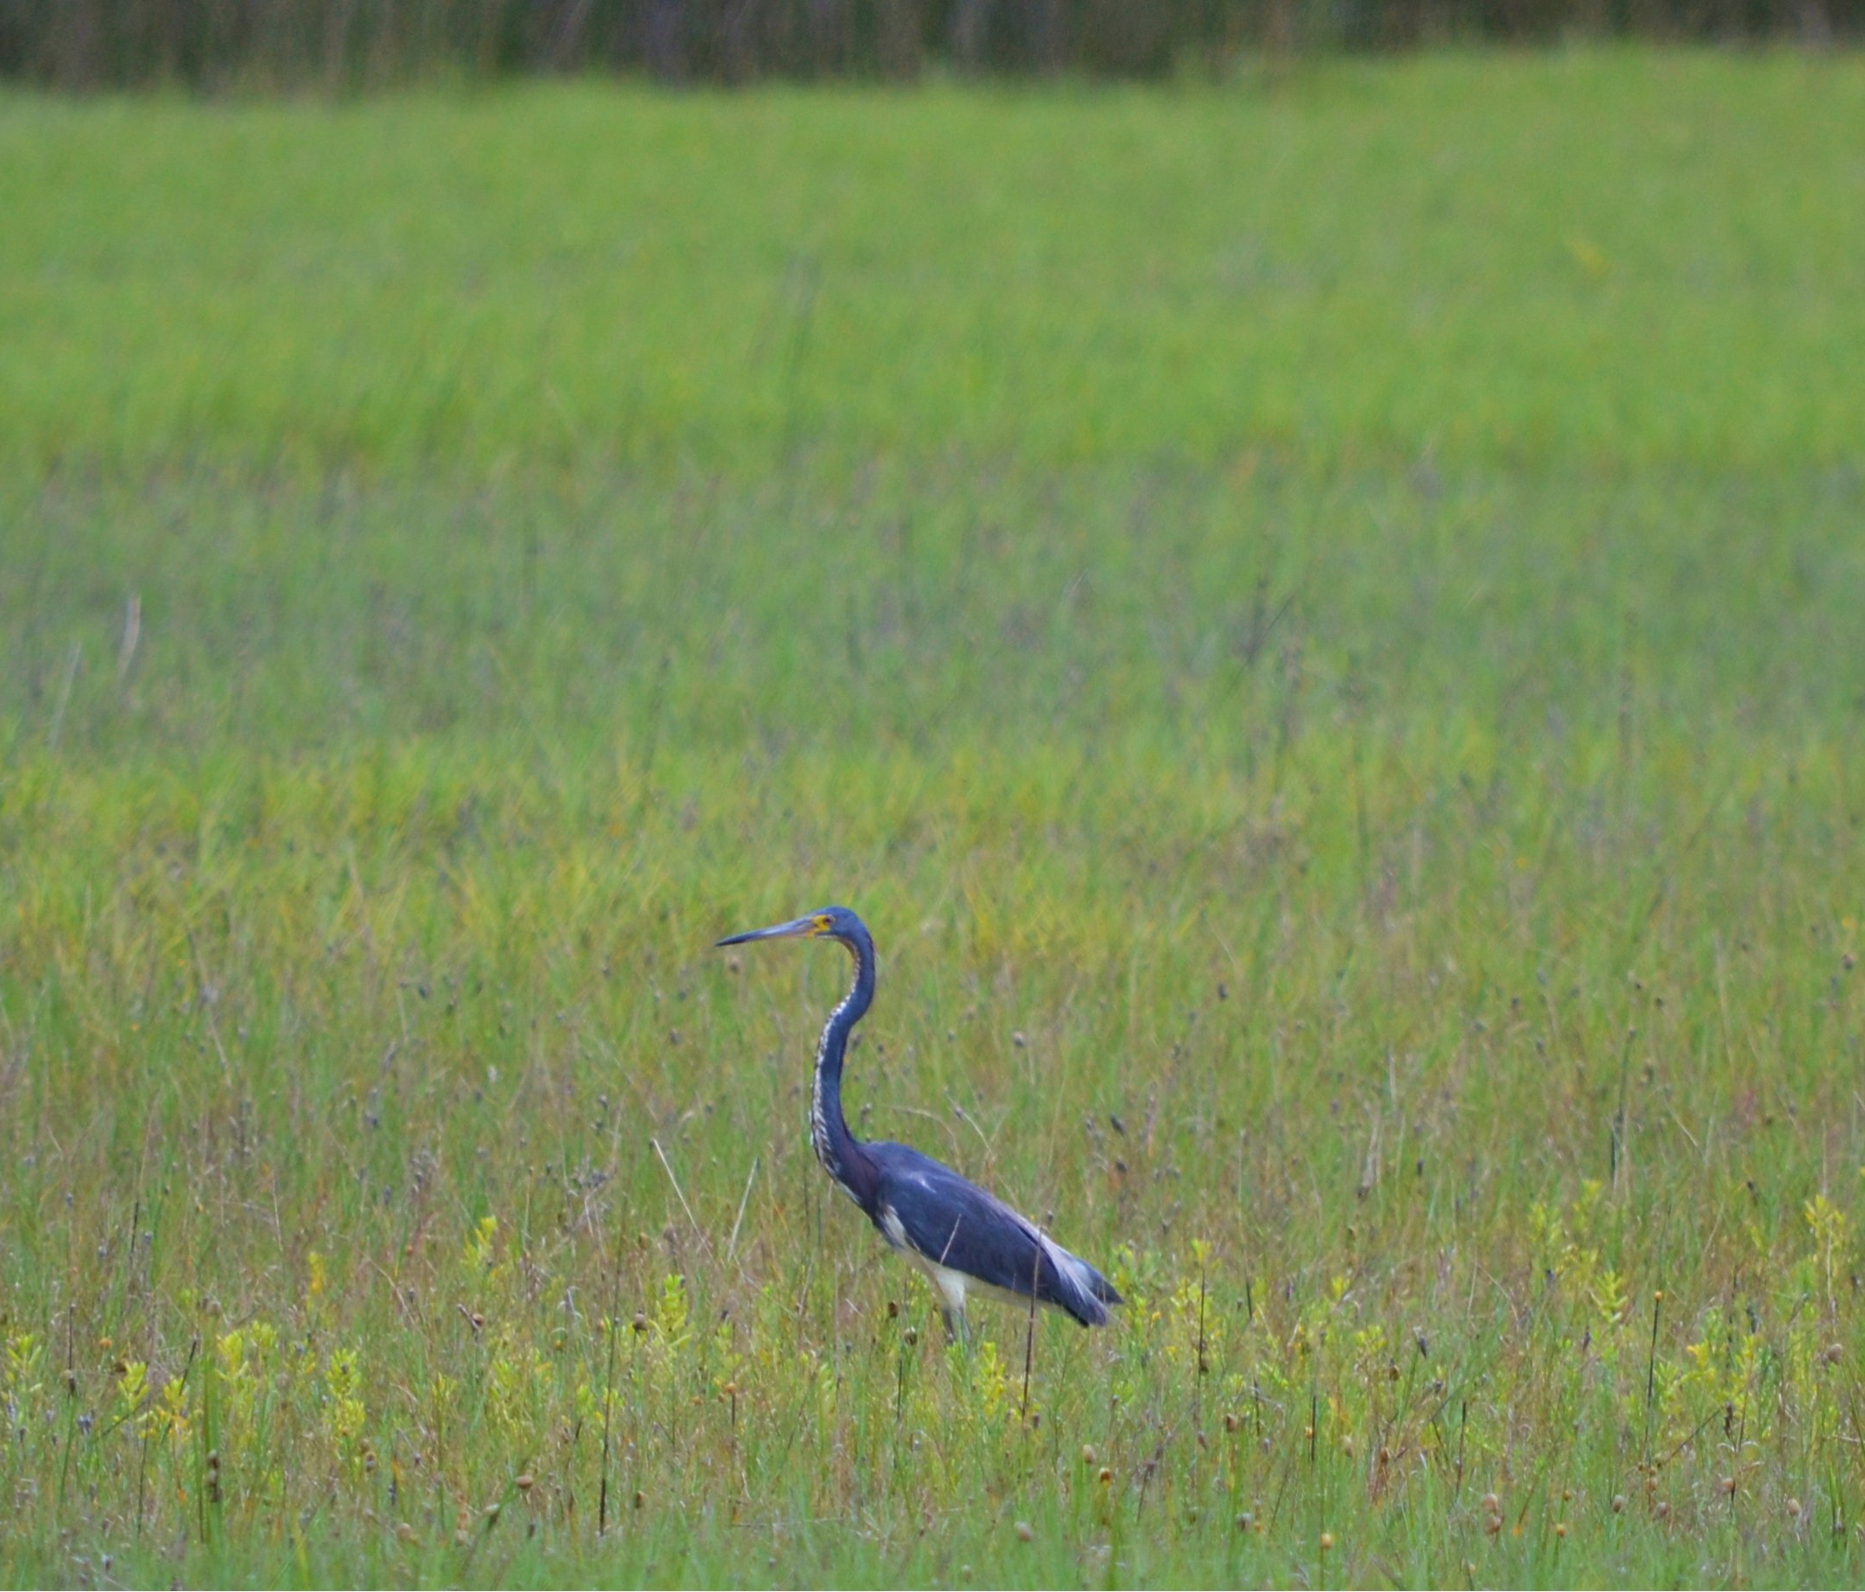

Slide 14
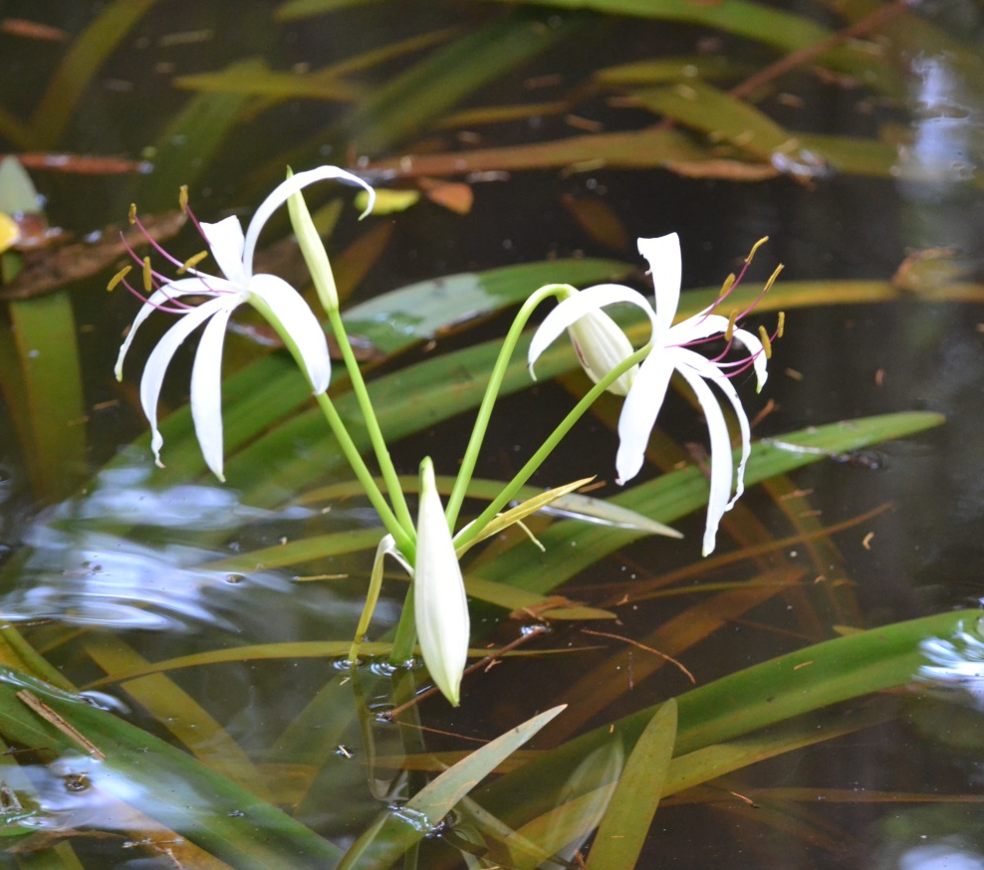
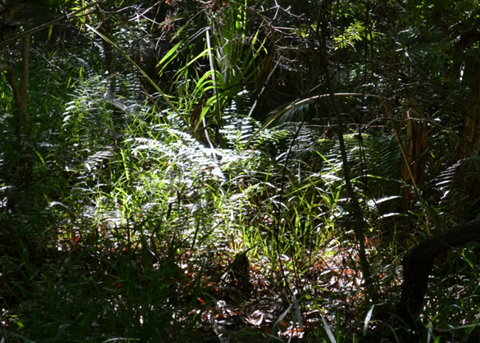
Project Components
The Boardwalk/Nature Trail and Wildlife Viewing Stations would enable the public to unobtrusively enjoy nature

Slide 15
Project Components
The Boardwalk/Nature Trail and Wildlife Viewing Stations would enable the public to unobtrusively enjoy nature

Slide 16
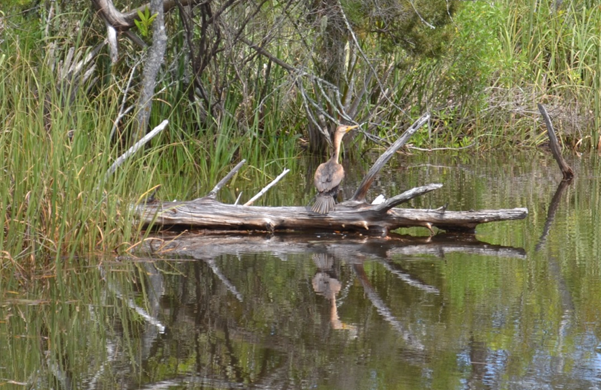

Slide 17
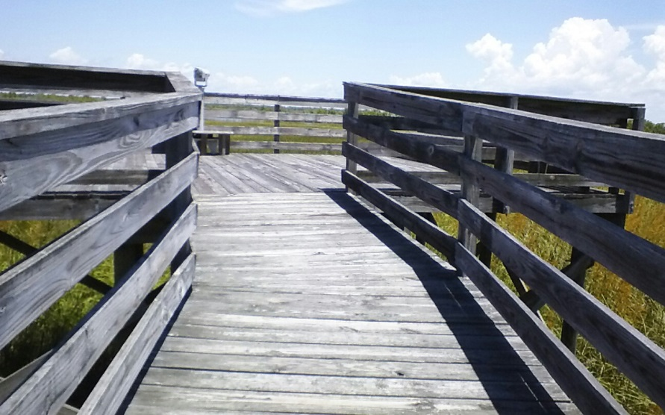
Potential for Non-Invasive Access
The Yates Creek Basin is an ideal location for “nature friendly” boardwalks with bird watching stations

Slide 18
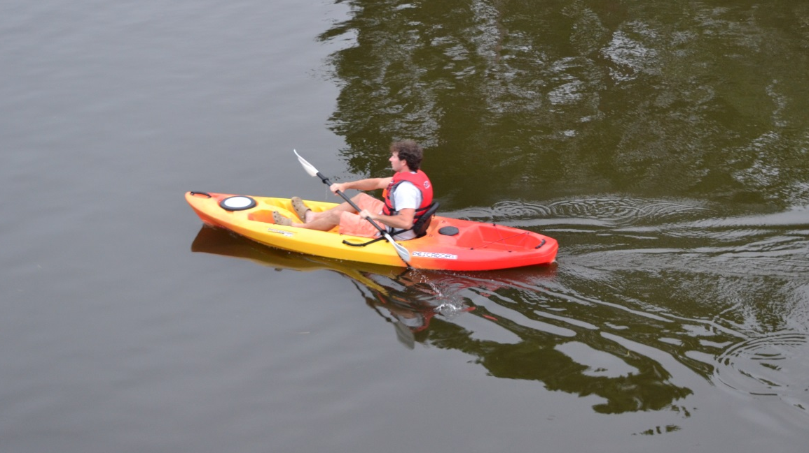
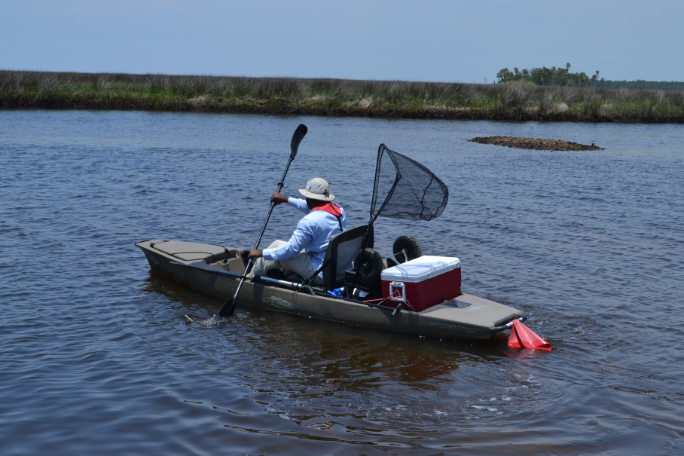
Project Components
Kayaking Routes
These trails would link with the existing Florida Circumnavigational Saltwater Paddling Trail and the Big Bend Saltwater Paddling Trail

Slide 19
Project Components
Kayaking Routes
These trails would link with the existing Florida Circumnavigational Saltwater Paddling Trail and the Big Bend Saltwater Paddling Trail

Slide 20
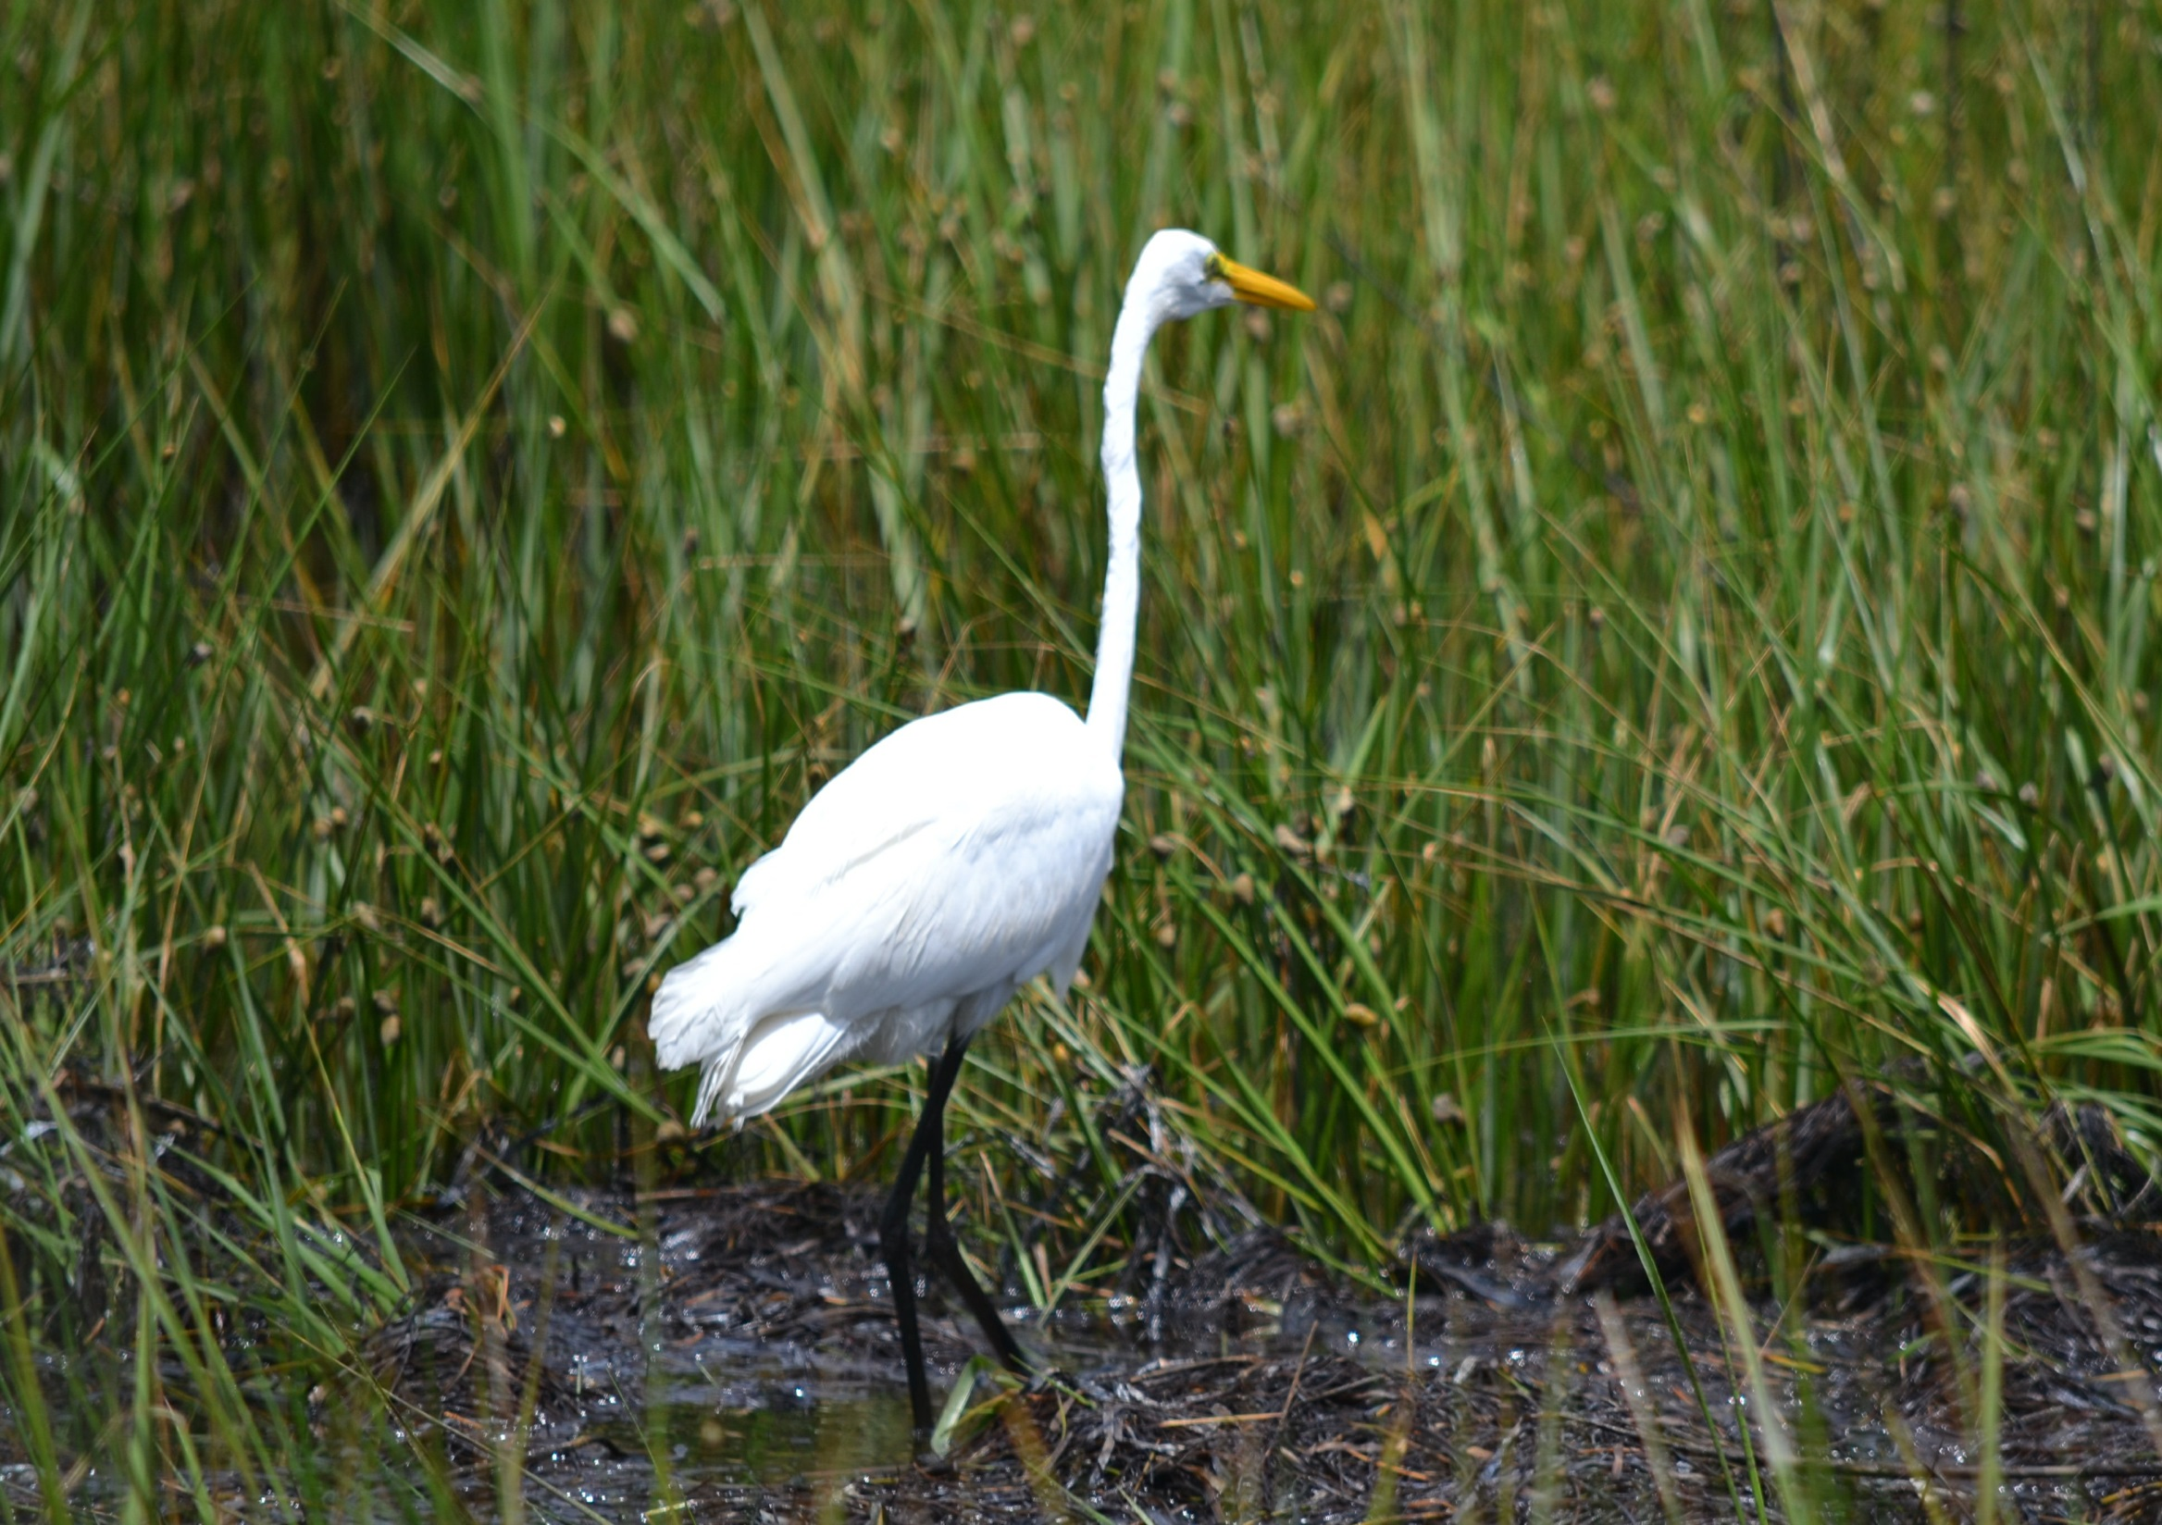

Slide 21
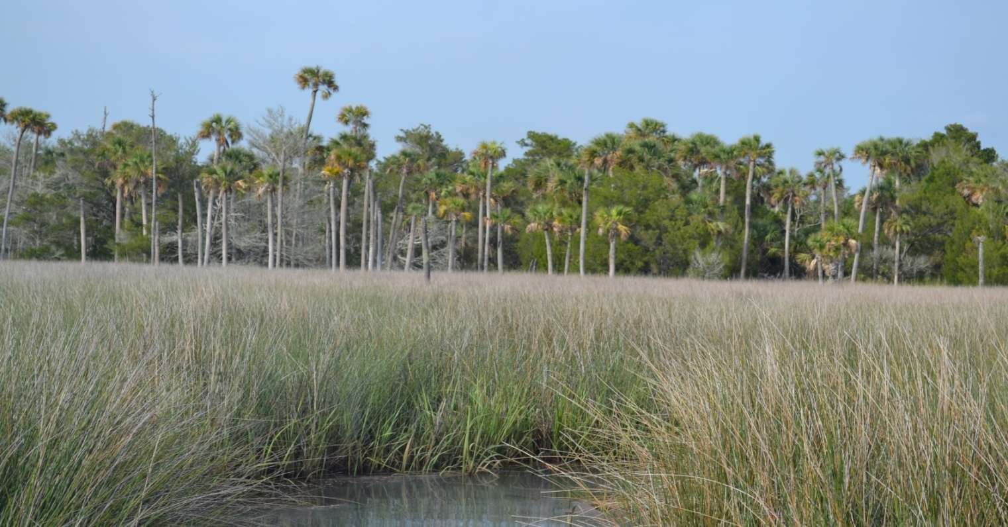
Project Components
The Primitive Camp Site would connect with the boardwalk system and kayak trails

Slide 22
Project Components
The Primitive Camp Site would connect with the boardwalk system and kayak trails

Slide 23
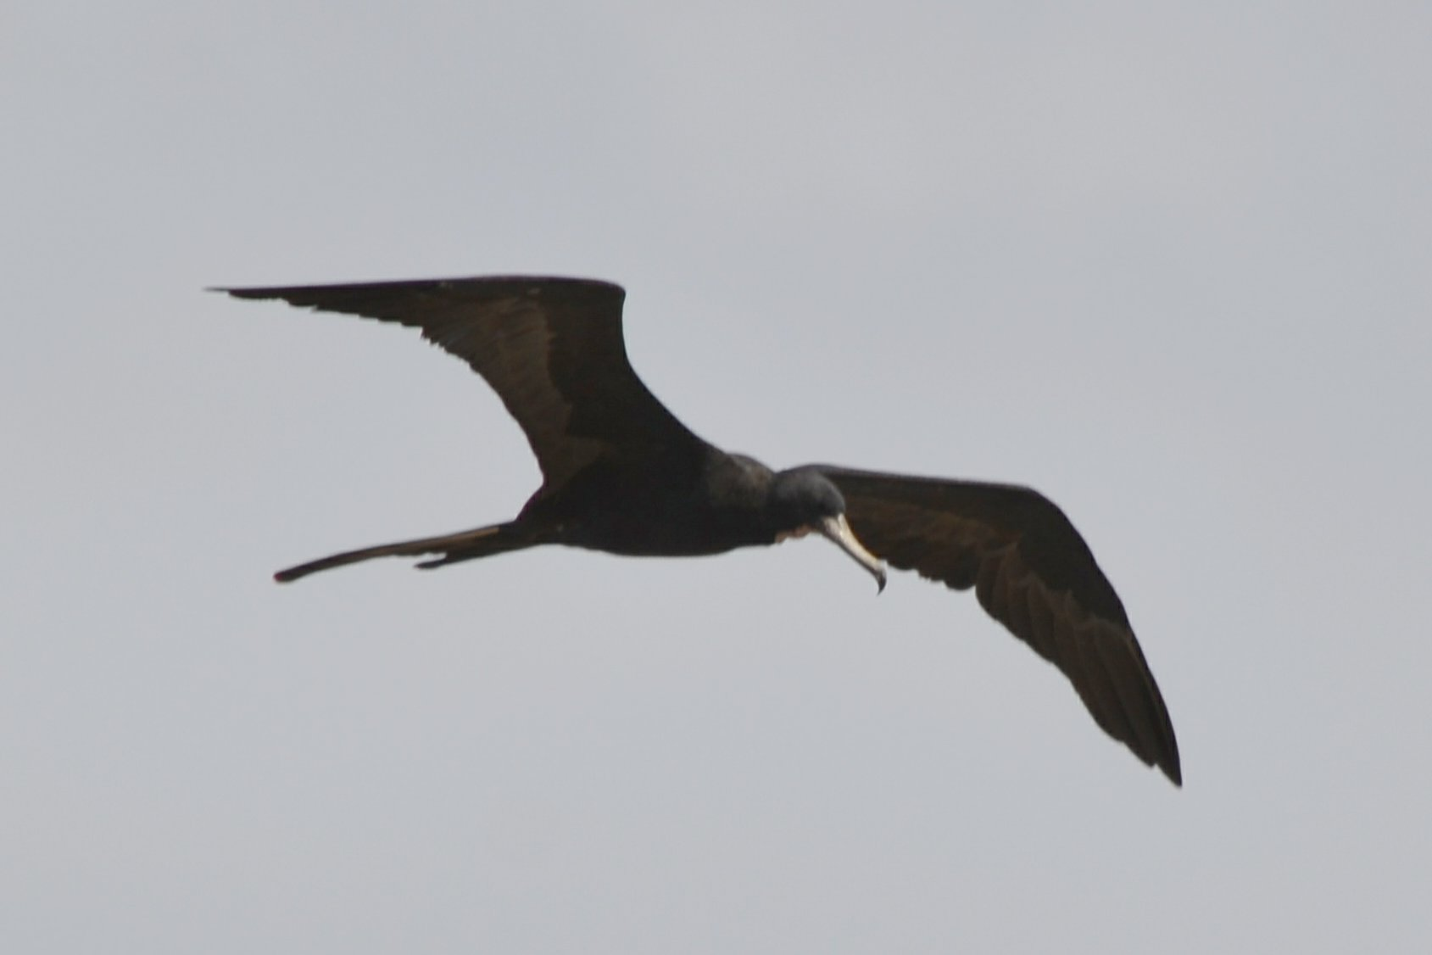

Slide 24
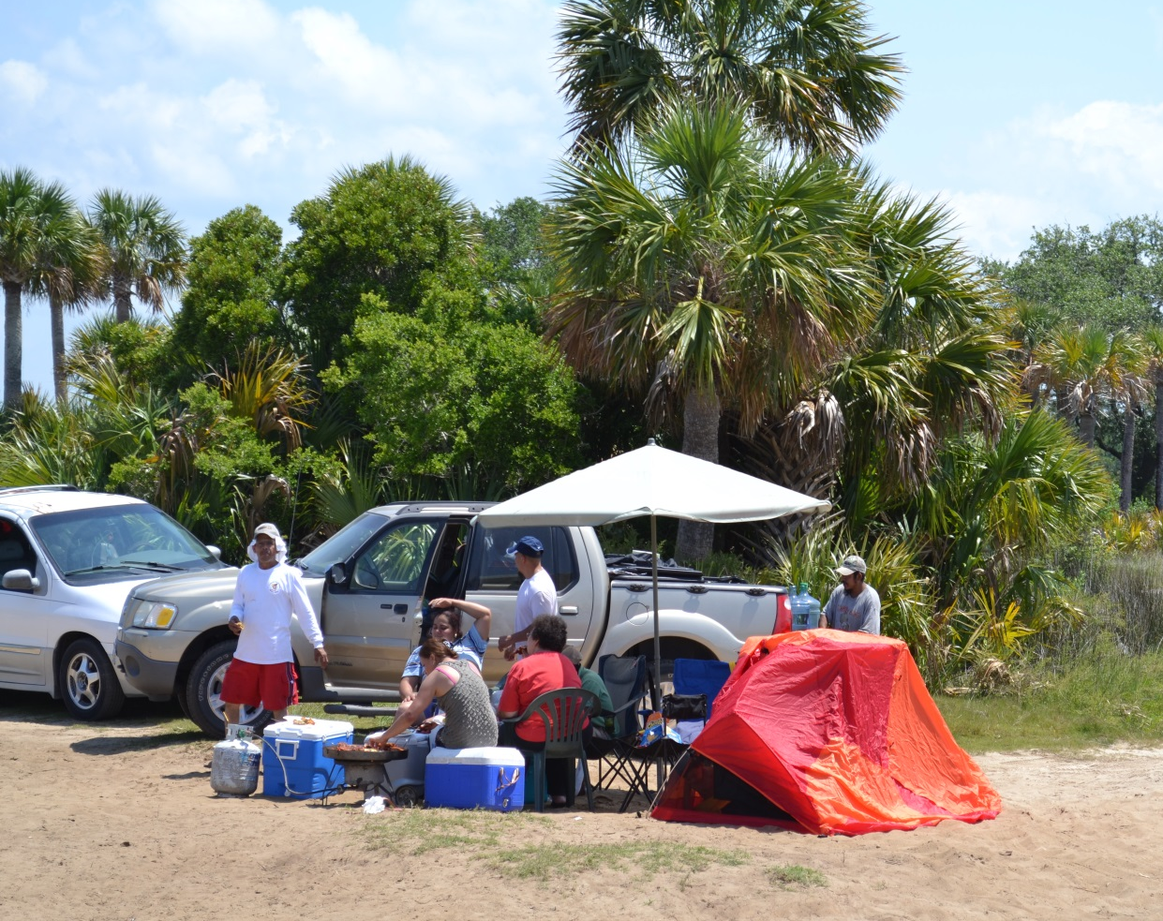
Project Components
Playground and Restroom Facilities would enhance the public’s visit to Yates Creek

Slide 25
Project Components
Playground and Restroom Facilities would enhance the public’s visit to Yates Creek

Slide 26
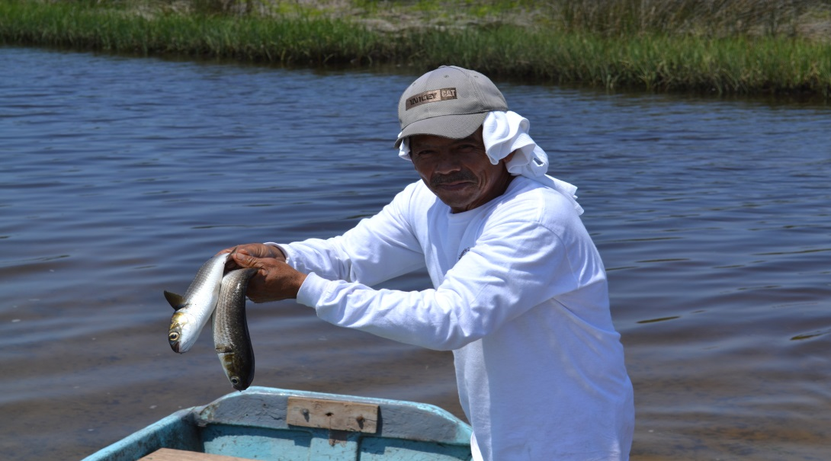

Slide 27
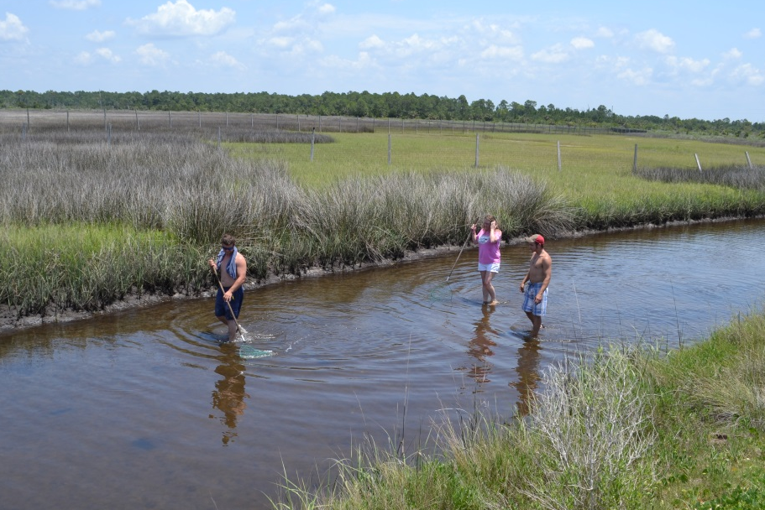
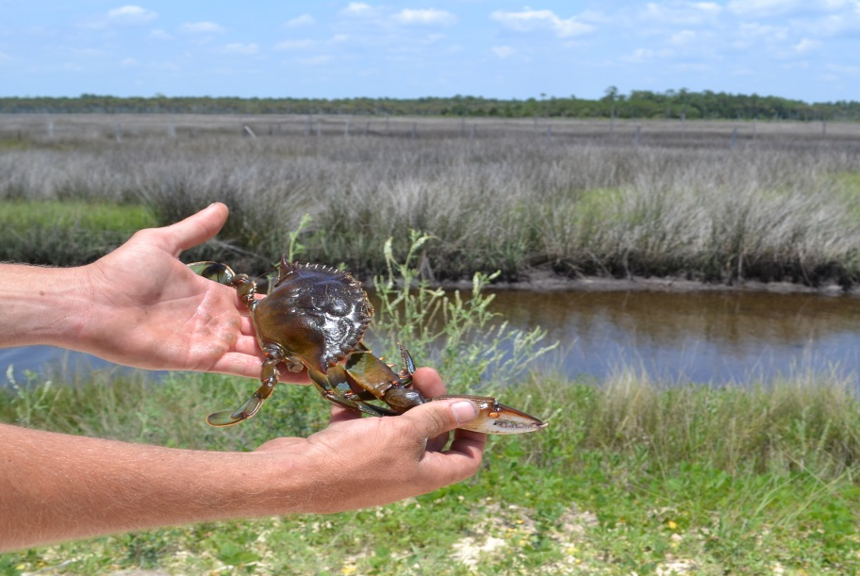
Project Components
Water Sports and Recreation: The Yates Creek project is focused on maximizing these popular local activities

Slide 28
Project Components
Water Sports and Recreation: The Yates Creek project is focused on maximizing these popular local activities

Slide 29
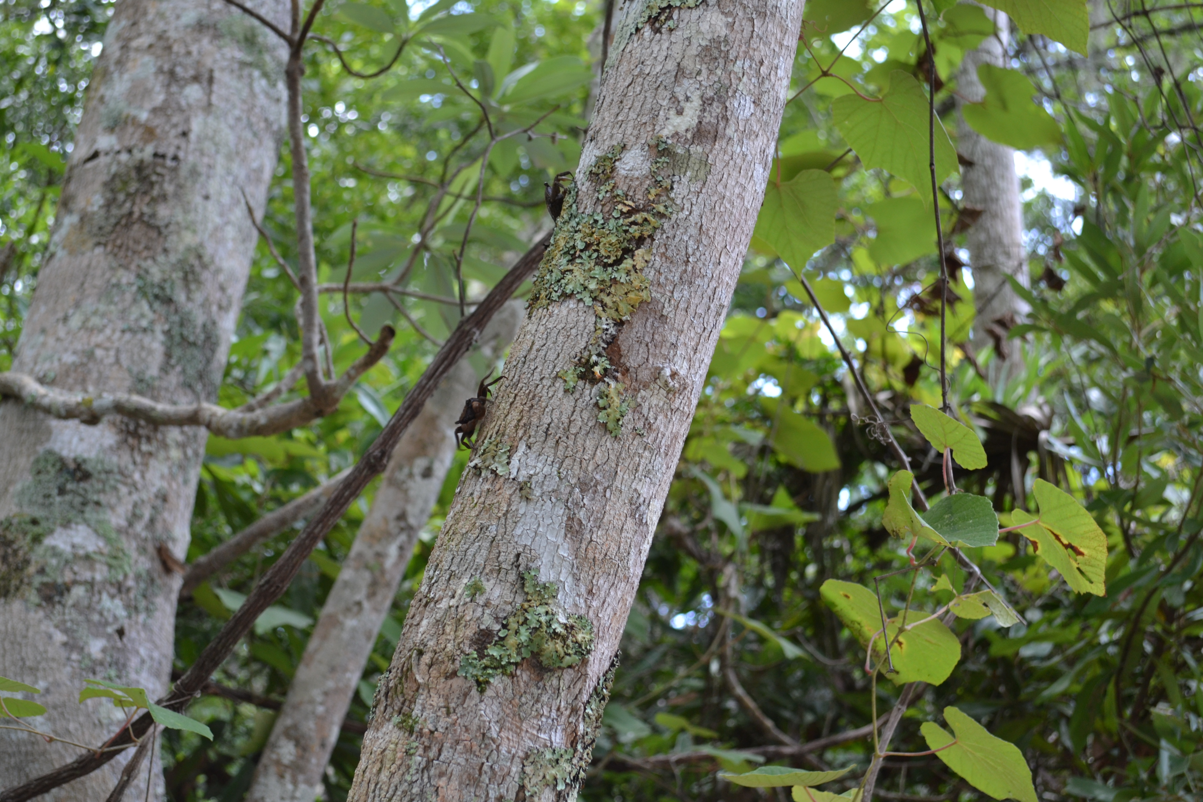

Slide 30
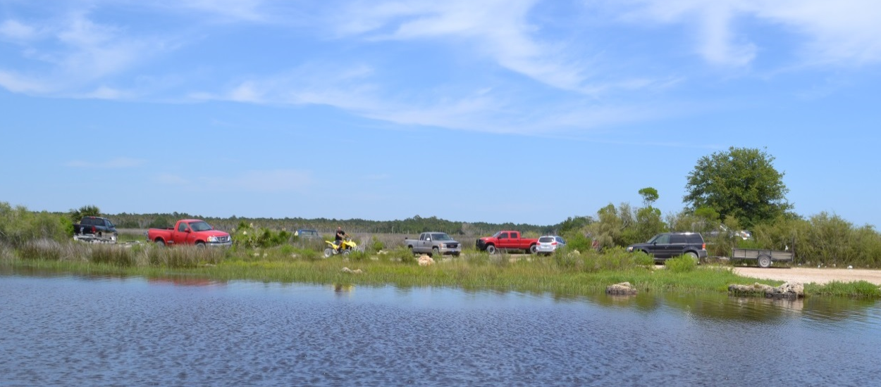
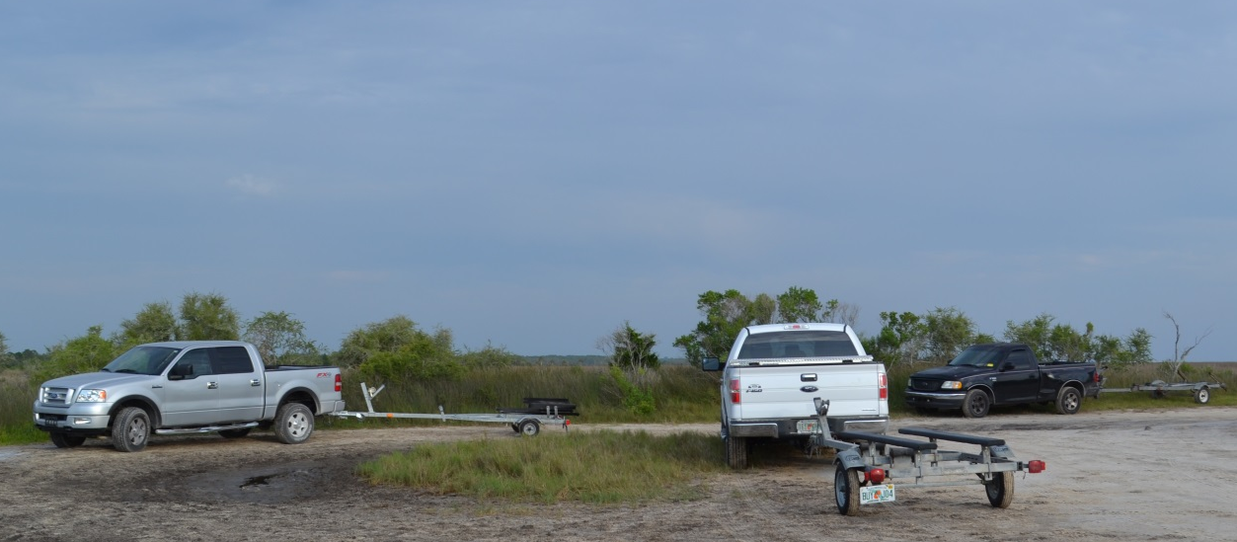
Project Components
Parking lots would provide improved access to Yates Creek and all of the planned services

Slide 31
Project Components
Parking lots would provide improved access to Yates Creek and all of the planned services

Slide 32
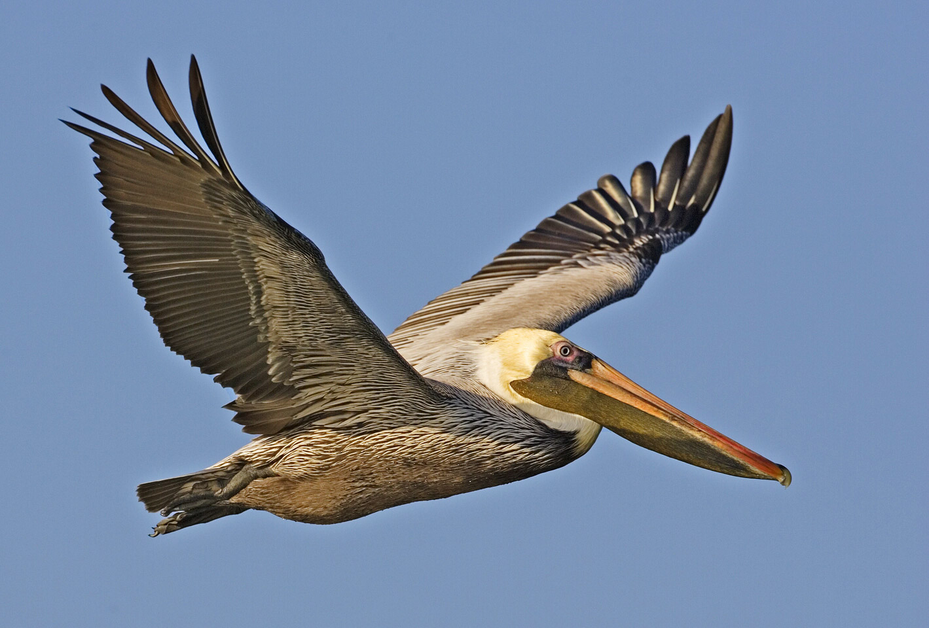

Slide 33
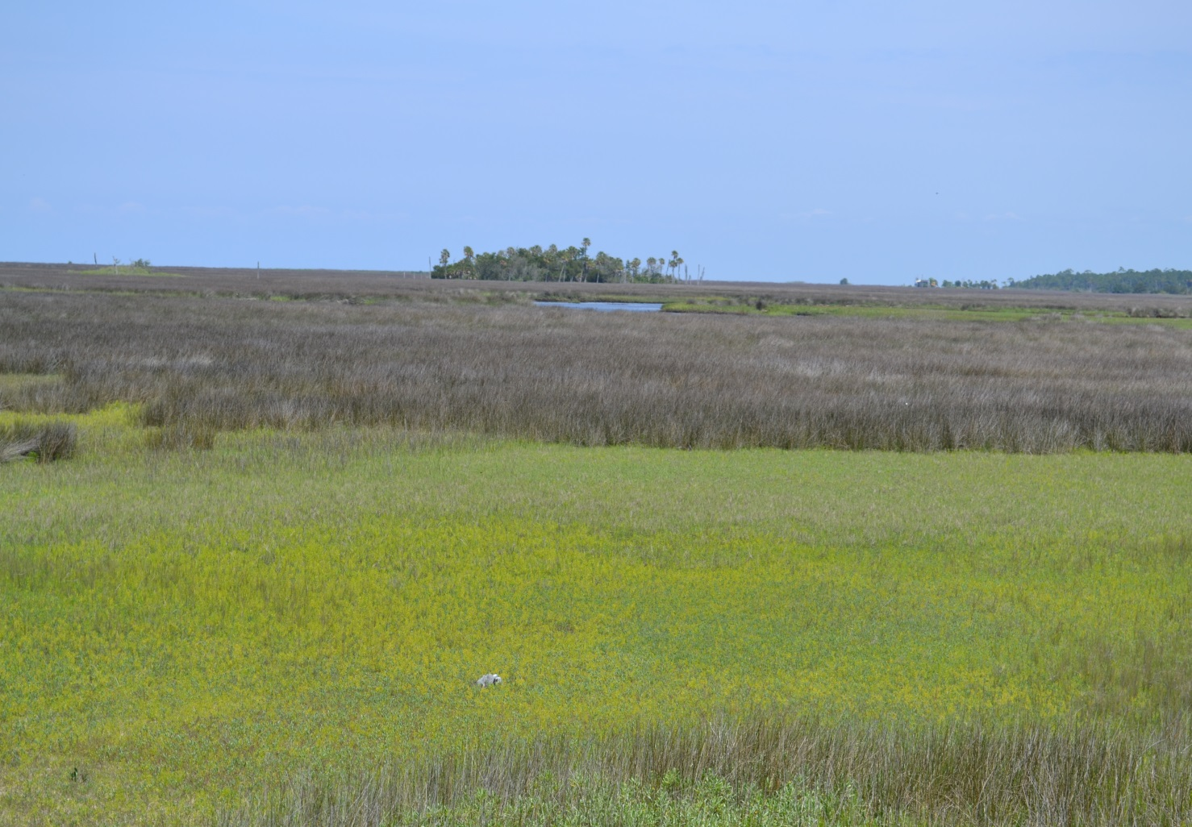
Project Benefits
Preserve 270 acres of natural Florida coastline in a pristine state
Leverage growing enthusiasm for Eco-tourism, while improving the local coastal economy (motels, restaurants, etc.)
Provide expanded recreational and educational facilities

Slide 34
Project Benefits
Preserve 270 acres of natural Florida coastline in a pristine state
Leverage growing enthusiasm for Eco-tourism, while improving the local coastal economy (motels, restaurants, etc.)
Provide expanded recreational and educational facilities

Slide 35
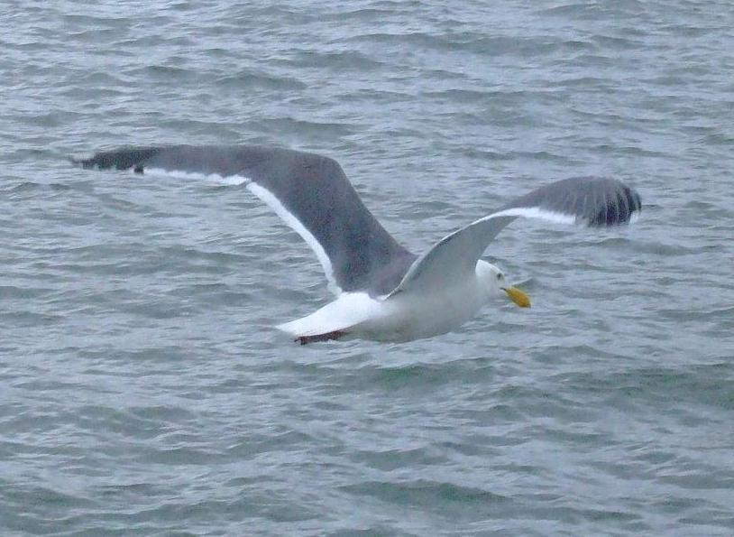

Slide 36
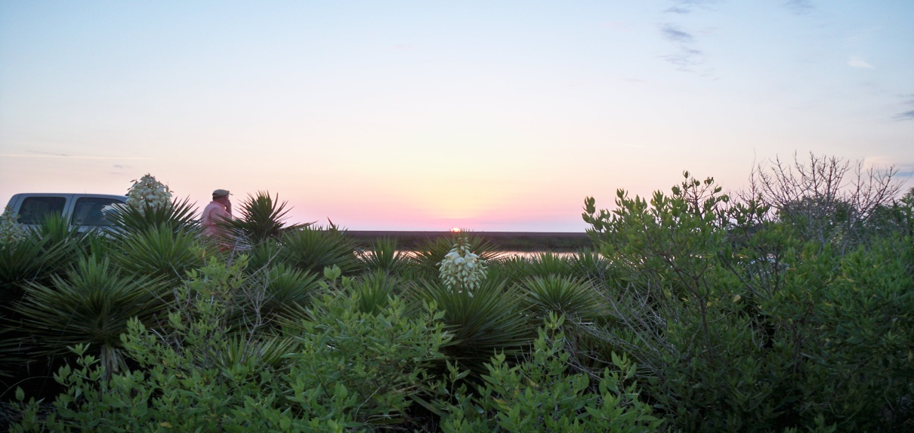
Project Cost
Our proposed project budget would include $2.4 million for the County’s purchase of the 270 acres
An additional $200,000 would be requested to be used at the County’s discretion for making improvements to the park, such as the primitive campground, restrooms, nature trails and bird-watching stations

Slide 37
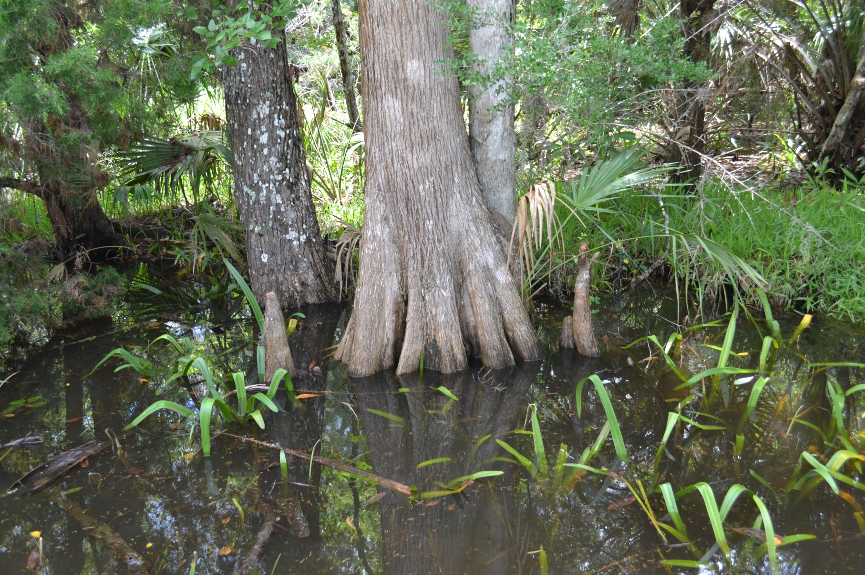
Endorsed by
Taylor County Development Authority
“The park will be designed to protect native habitat in this environmentally sensitive area, and allow the public an opportunity to experience a taste of ‘Old Florida’”
Scott Frederick
Director

Slide 38
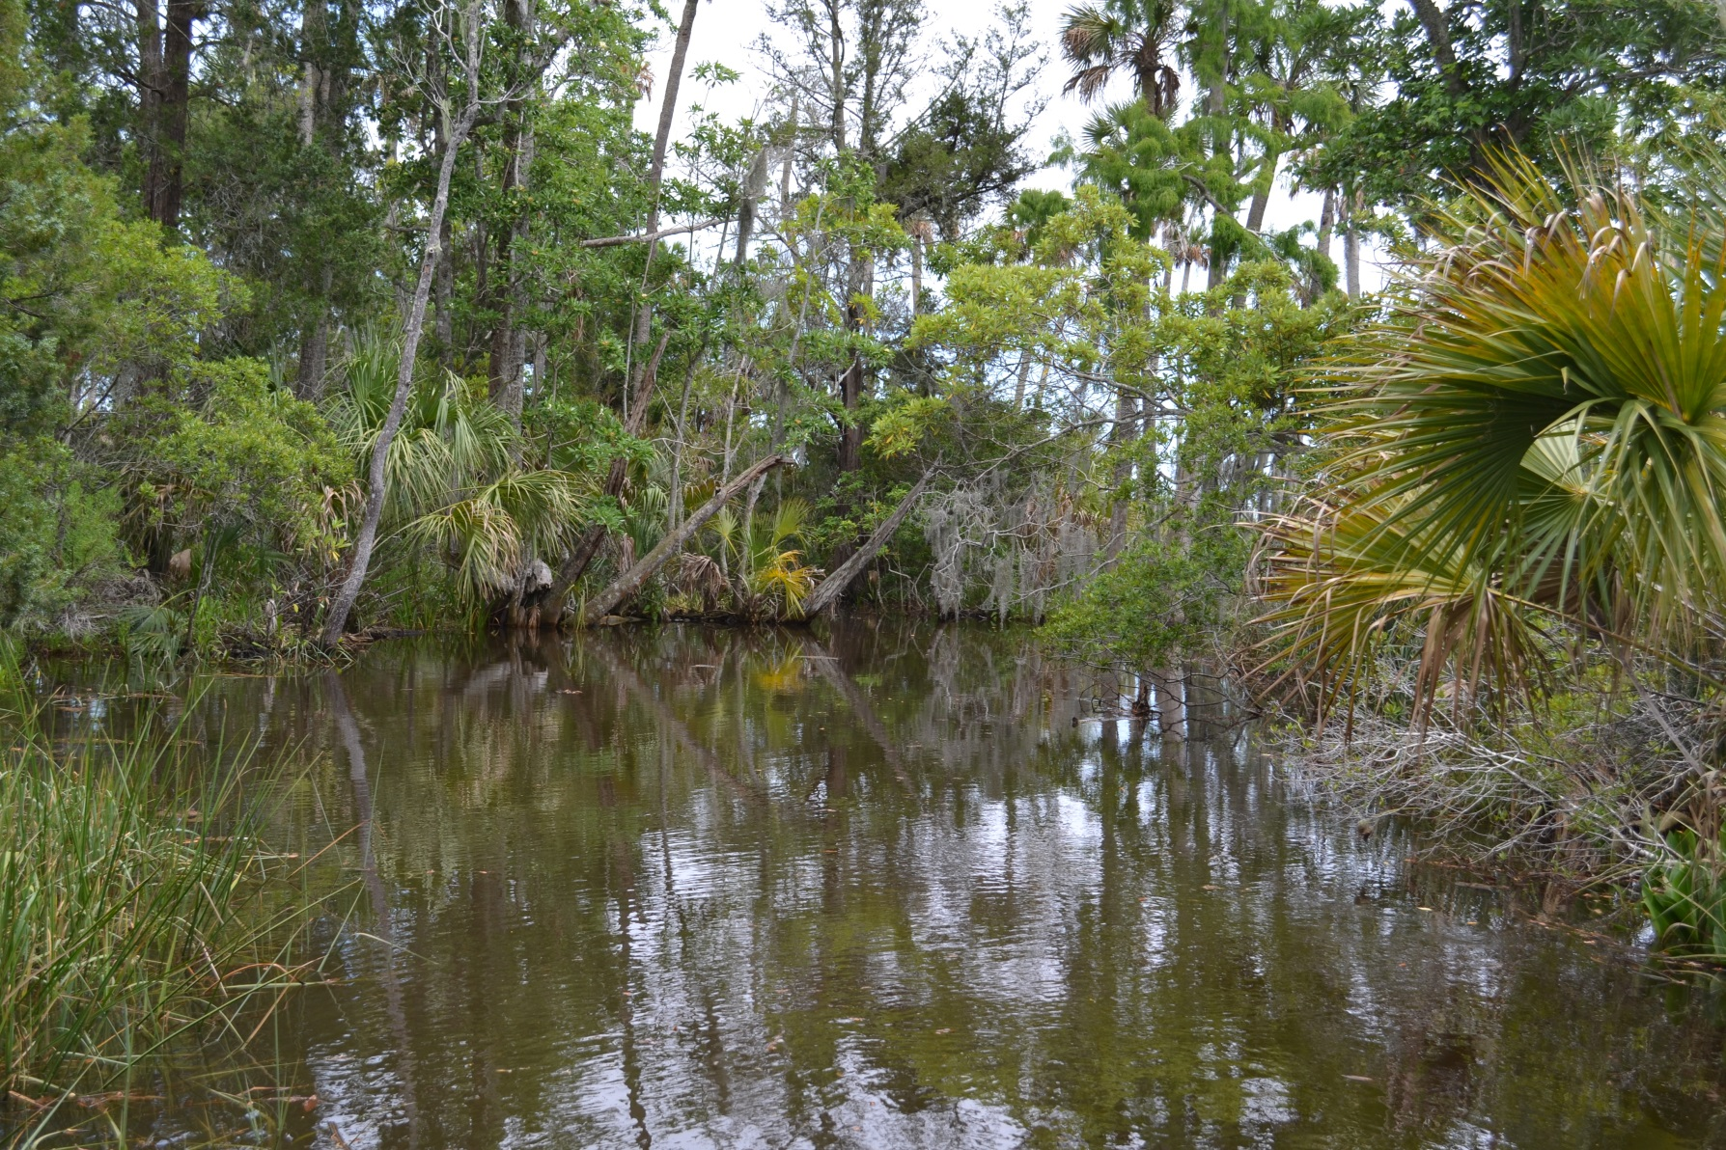
Endorsed by
Foley Timber and Land Company
“This unique property exemplifies the beautiful landscape that makes up Taylor County’s coastline and provides access to some of the quality of life treasures enjoyed along this rural stretch of Florida’s Gulf Coast.” Angus B. Taff III
Sr. Vice President, Planning

Slide 39
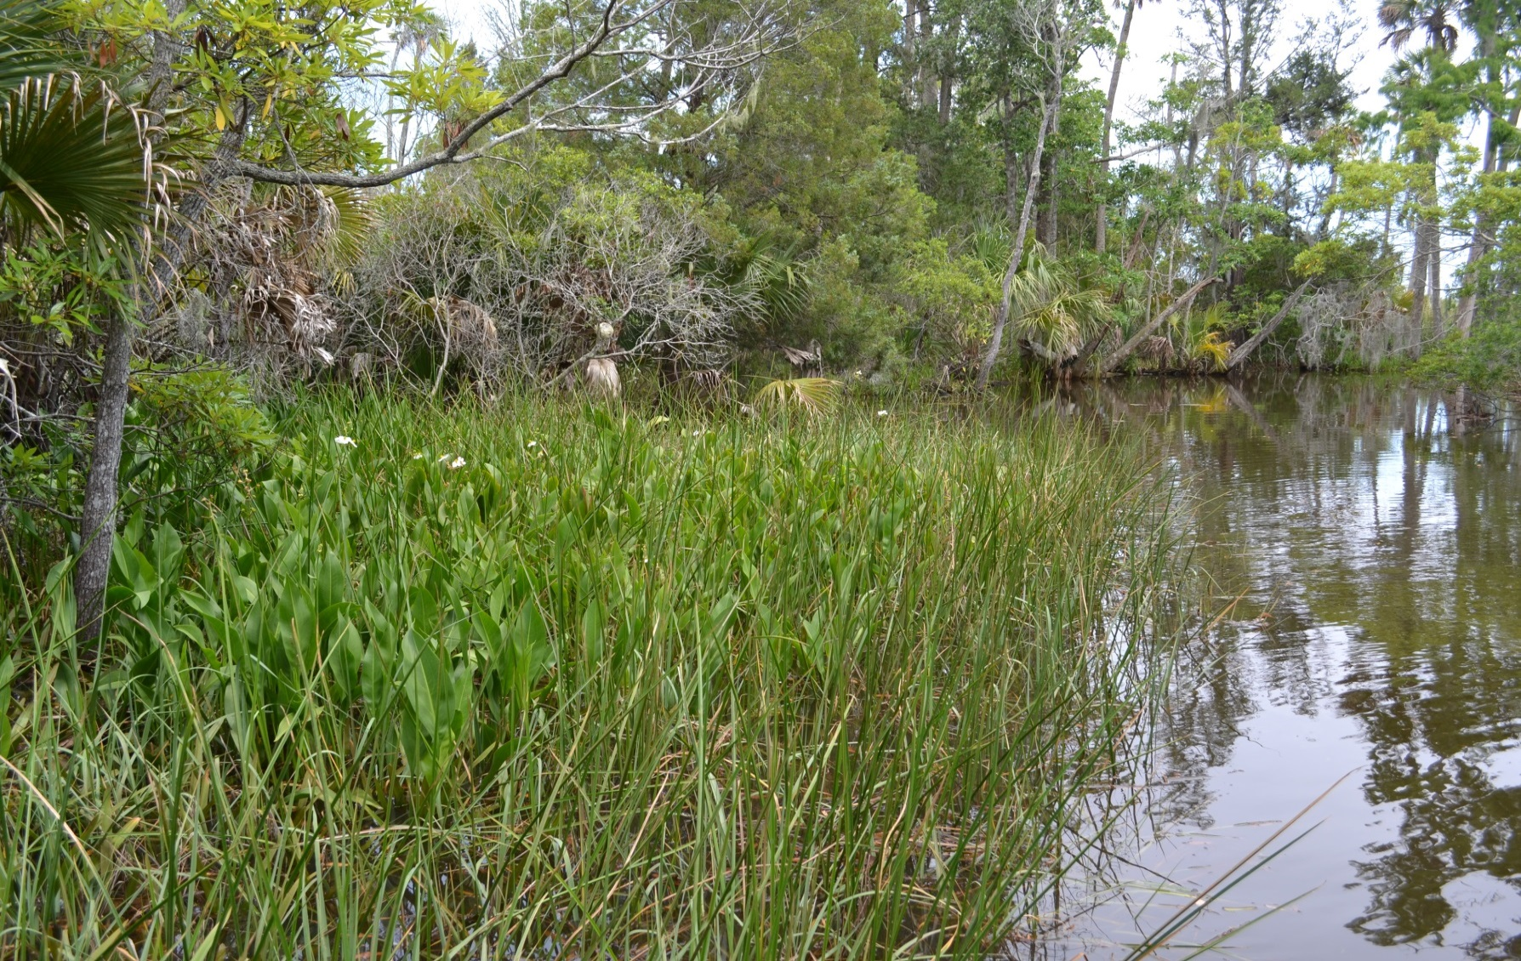
Endorsed by the
Florida Wildlife Federation
“…the estuarine nursery areas of places like Yates Creek are critical to the ecology of the entire Gulf.”
Preston T. Robertson
Vice President/General Counsel

Slide 40
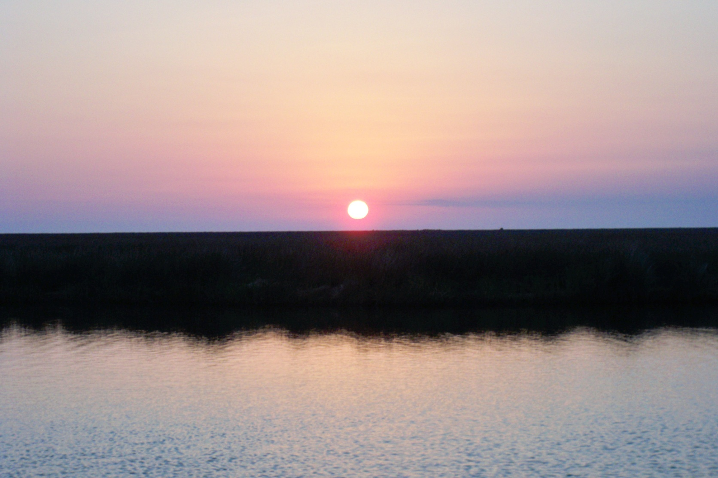
Questions?

