Slide 1

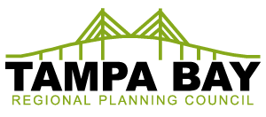

Hurricane Phoenix Simulation
Sean Sullivan, Executive Director, Tampa Bay Regional Planning Council
Created by:
Funded by:

Slide 2
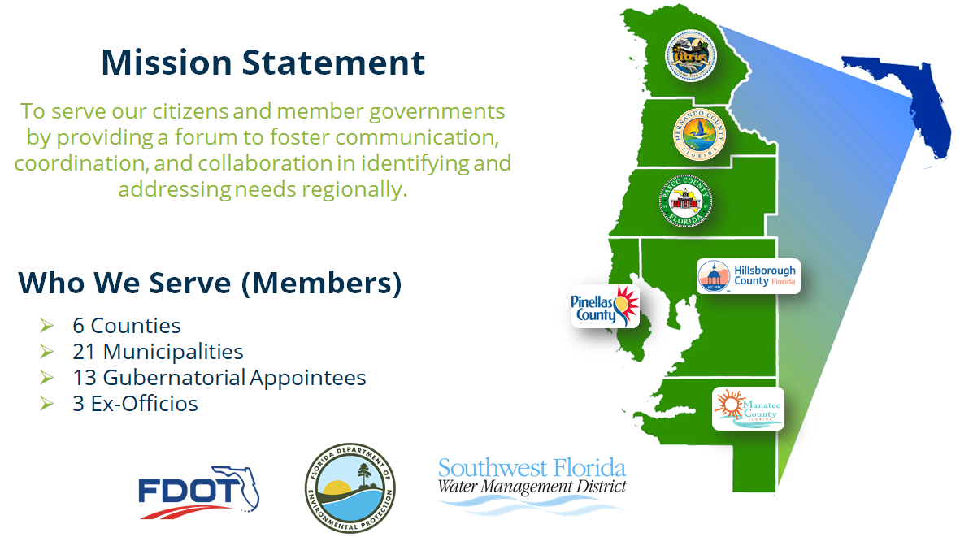
Mission Statement

Slide 3

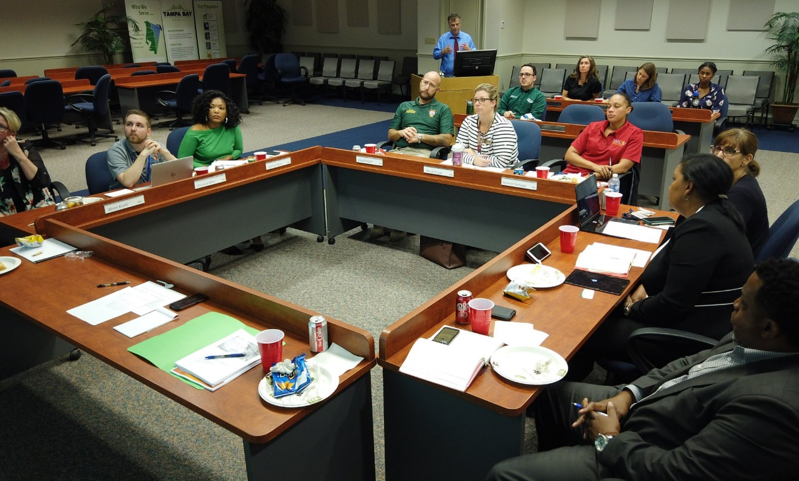

Project Phoenix Creation
Created by:
Funded by:
In coordination with emergency management agencies
from throughout the 6-county Tampa Bay region.
Project Phoenix 2.0: The Recovery
A Hurricane Simulation for Tampa Bay Small Businesses & Emergency Management Agencies
Learn more at tbrpc.org/phoenix

Slide 4
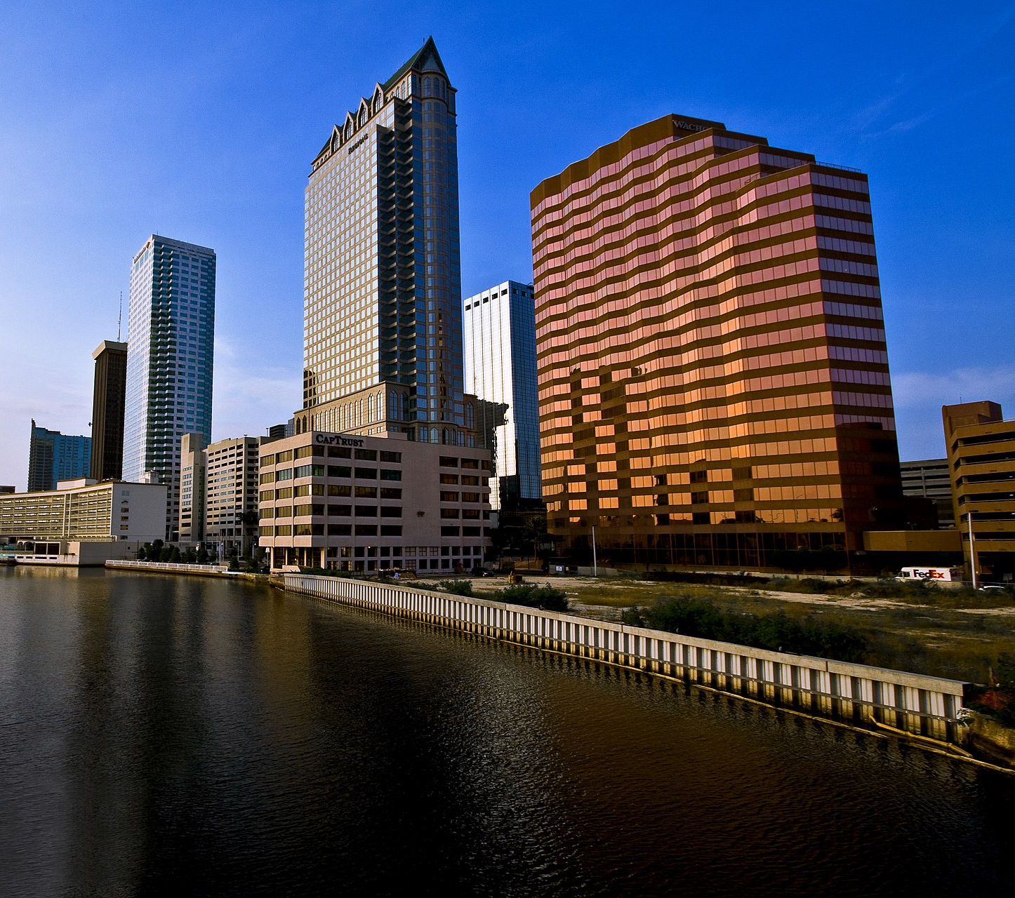
Tampa Bay Region Facts
Tampa Bay Region Facts
Population of 3.8 Million
17th largest metropolitan economy in the United States at $164 Billion dollars.
If the Tampa Bay Region were its own country, we would have the 55th largest economy in the world.
Notes:
https://www.youtube.com/watch?v=LE6nXn9pGaU

Slide 5
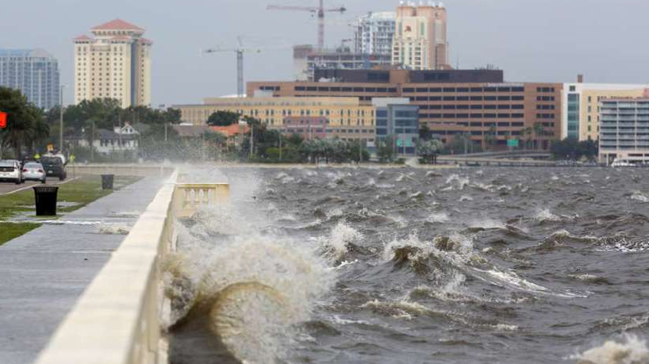
Structures and Estimated Damage Costs
Structures and Estimated Damage Costs
1.35 Million existing structures of which over 100,000 would be severely damaged or destroyed.
Estimated 300 billion in losses with more than 50 million tons of debris.
40% of small businesses would not reopen following a storm with an additional 25% to permanently close one year after a storm.
Notes:
https://www.youtube.com/watch?v=LE6nXn9pGaU

Slide 6
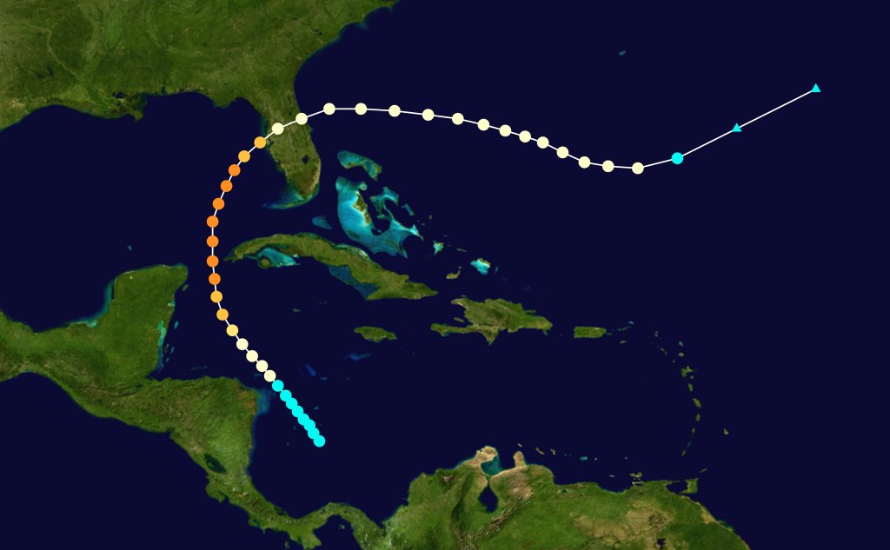
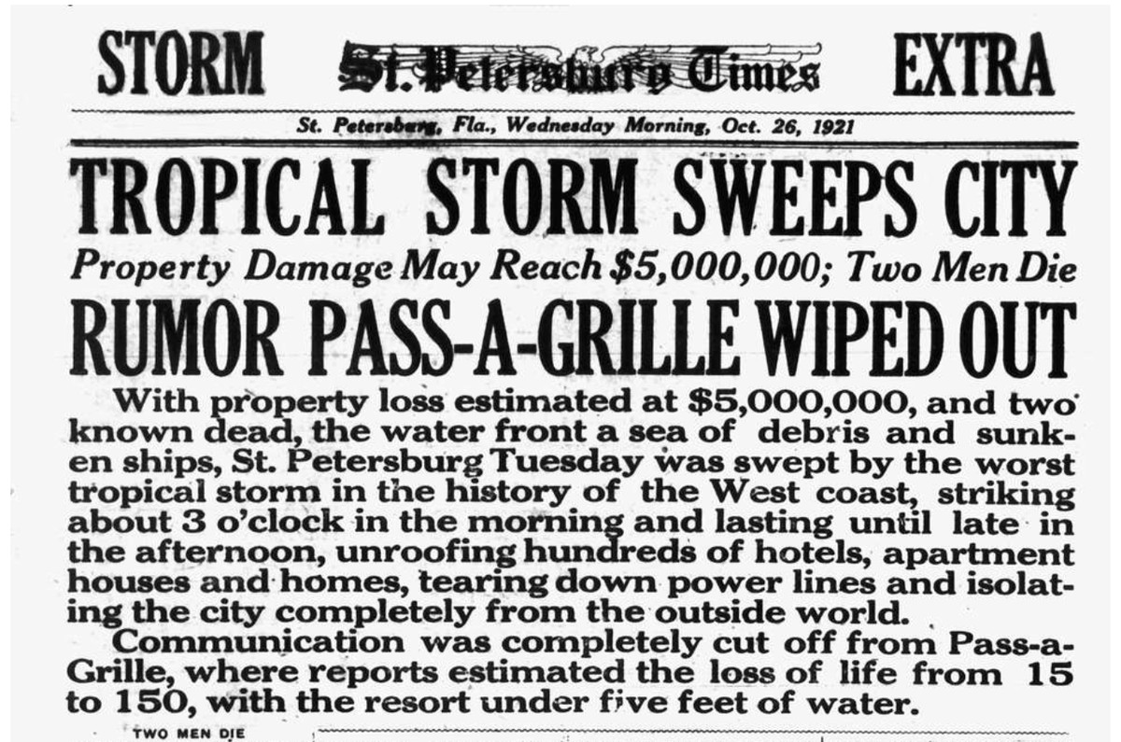
Historical 1921 Tropical Storm
Source: Florida's Hurricane History – Jay Barnes

Slide 7
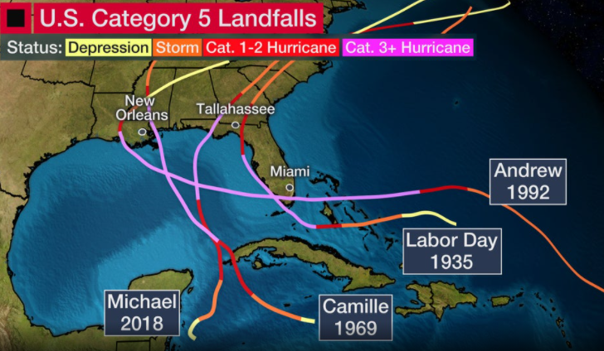
Historical Category 5 Hurricanes Near Tampa Bay
Source: The Weather Channel, weather.com

Slide 8
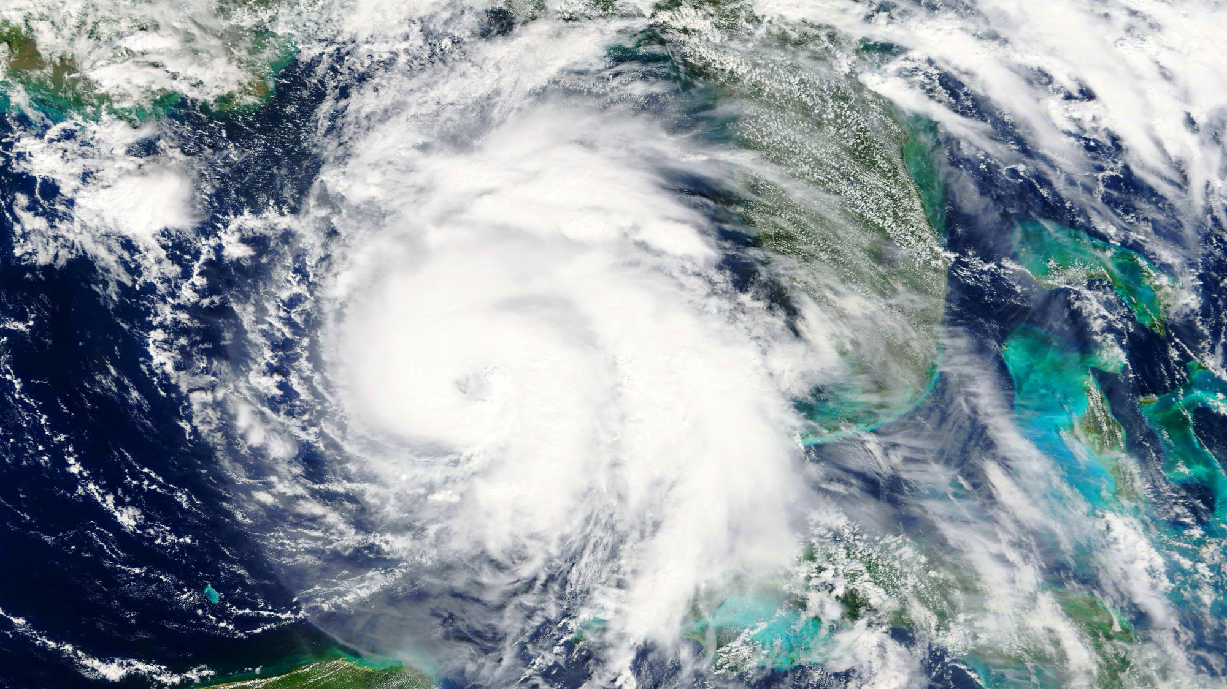

What if a Category 5 Hurricane Struck Tampa Bay?
What if a Category 5 hurricane struck the Tampa Bay region?

Slide 9

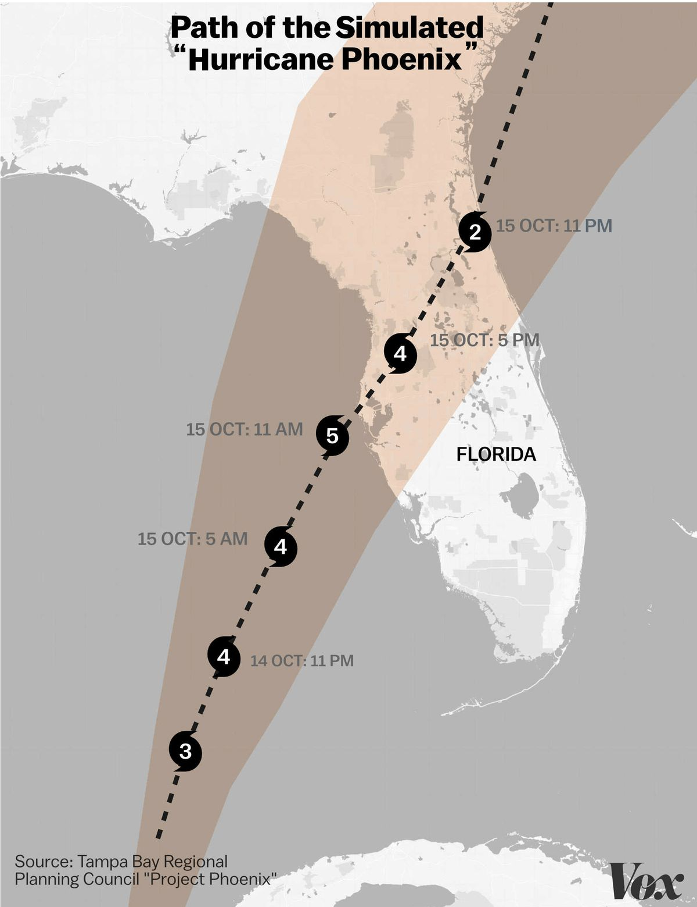
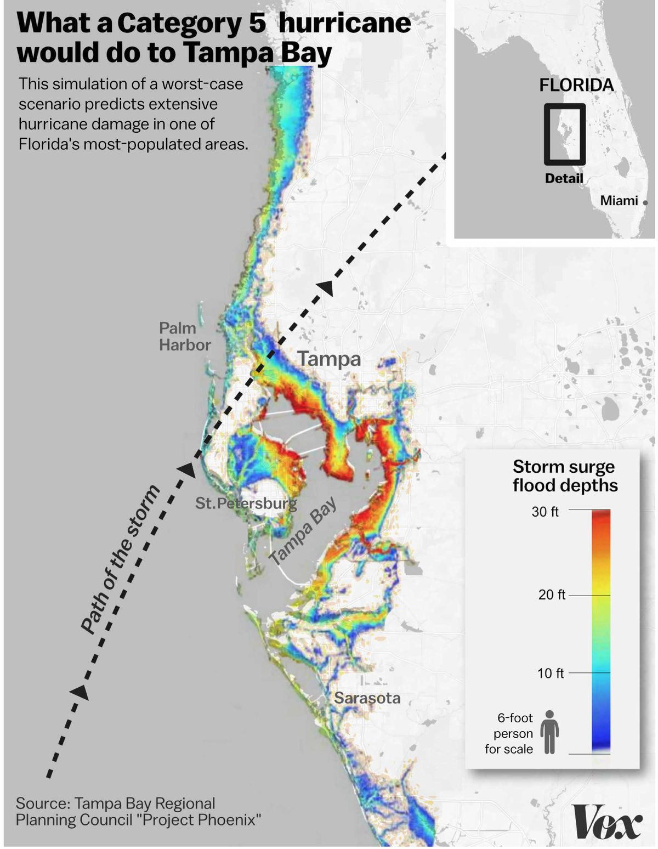
See How Hurricane Phoenix Would Impact Your Home or Business
SEE HOW HURRICANE PHOENIX WOULD IMPACT YOUR HOME & BUSINESS:
www.tampabayregion.org/phoenix-impacts/
Notes:
Damages are estimates based on the Federal Emergency Management Agency's (FEMA) modeling program HAZUS-MH and combines science, engineering and mathematical modeling with geographic information system (GIS) technology to estimate losses of life and property—and shows those losses on a map.

Slide 10
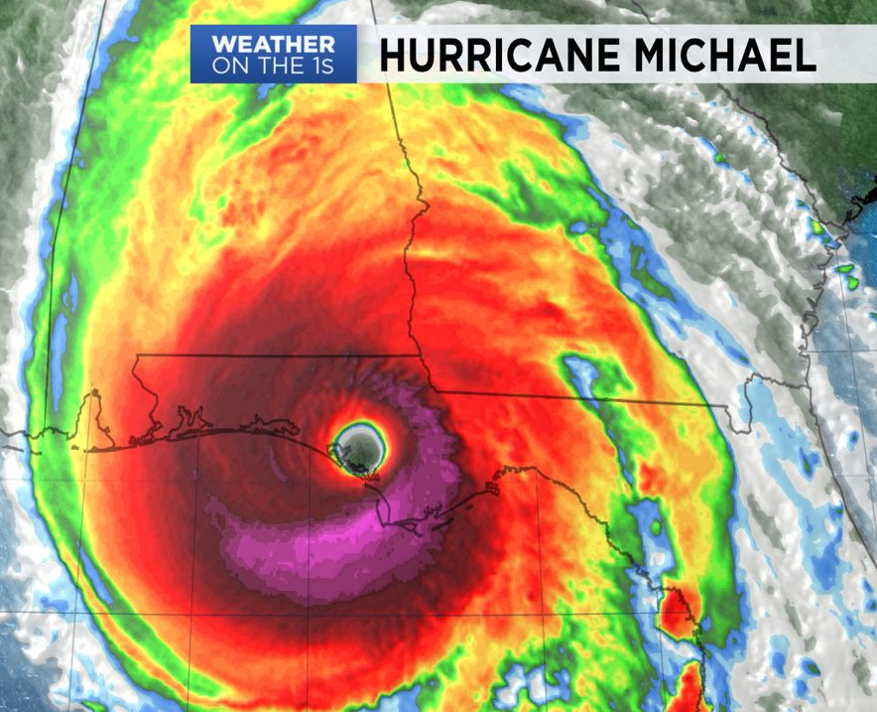
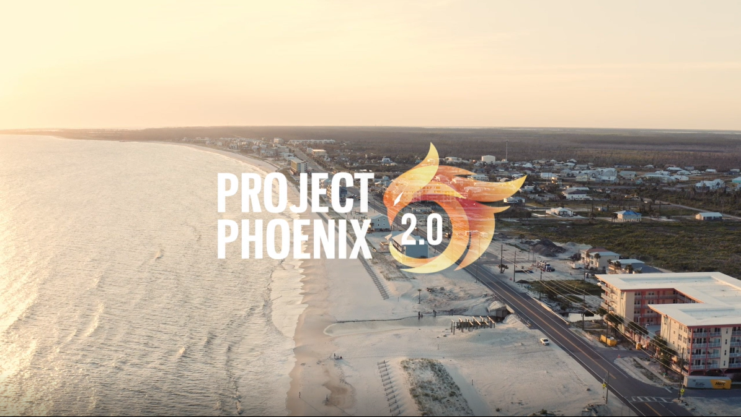
What can recovery look like after a Category 5 hurricane?
What can recovery look like after a Category 5 hurricane?
True stories and words of advice from small business owners recovering
from Hurricane Michael (2018) in Mexico Beach, Florida
Notes:
https://www.youtube.com/watch?v=LE6nXn9pGaU

Slide 11
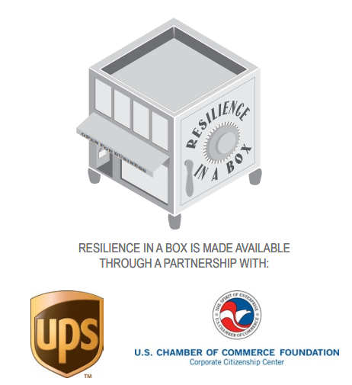



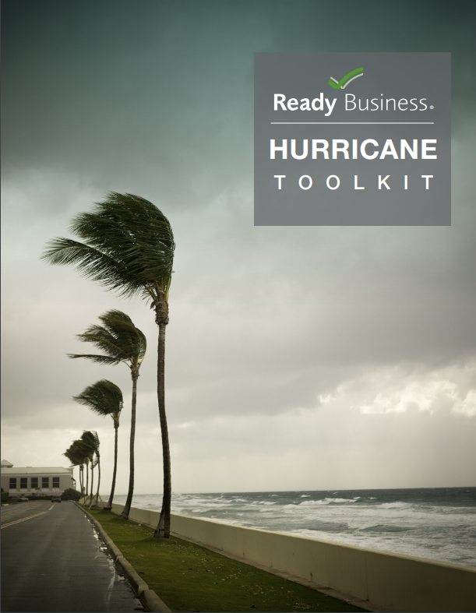
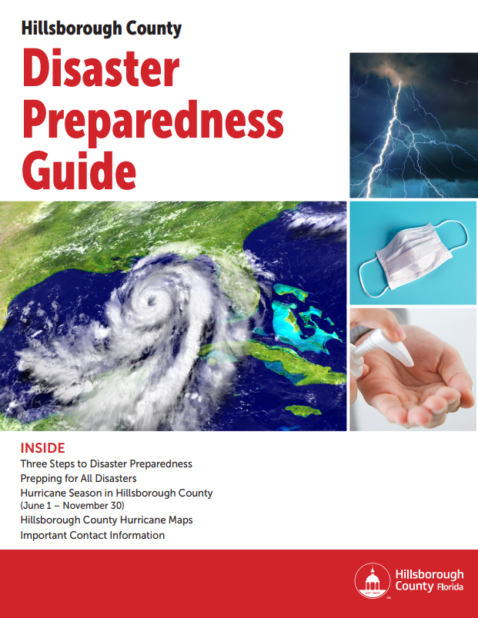
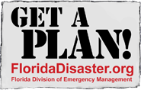

Resources to Prepare your Home/Business
Resources to Prepare your Home/Business
Your Chamber of Commerce
State of Florida — floridadisaster.org
TBRPC — tampabayprepares.org
FEMA's "Ready Business" Hurricane Toolkit
Hillsborough County Disaster Preparedness Guide
"Resilience in a Box" — U.S. Chamber of Commerce Foundation
"The time to repair the roof
is when the sun is shining."
- John F. Kennedy

Slide 12
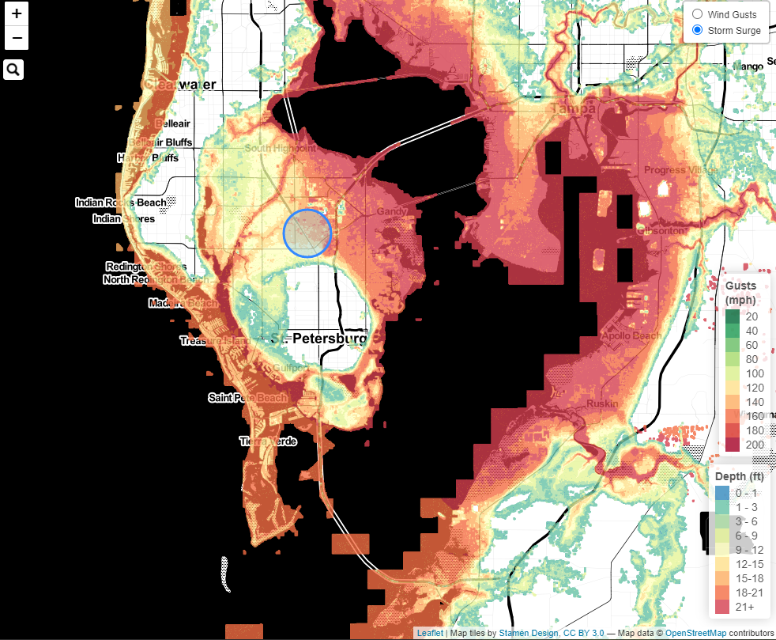
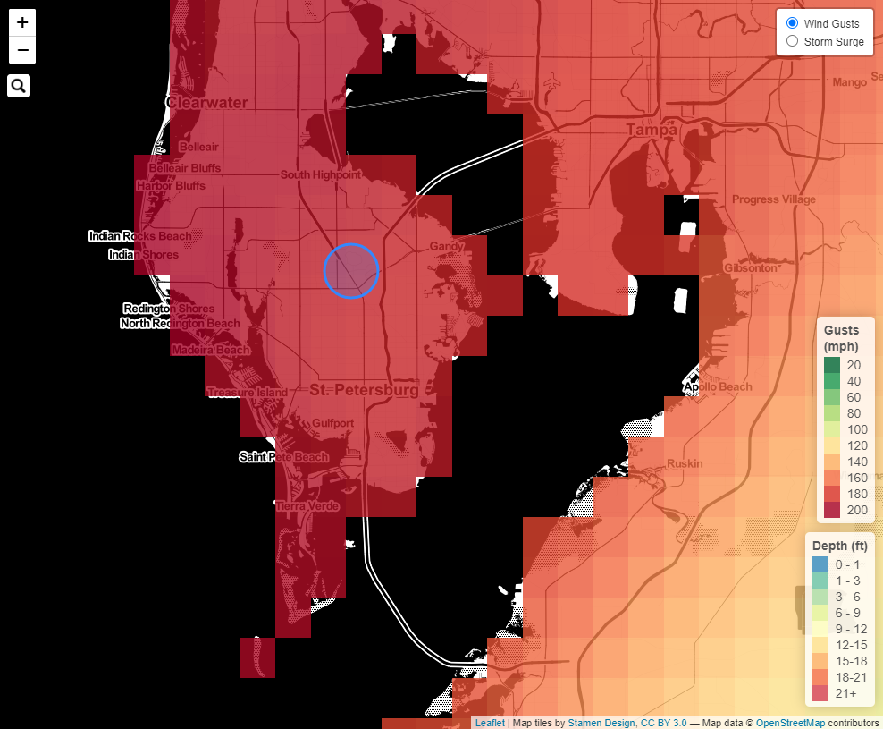
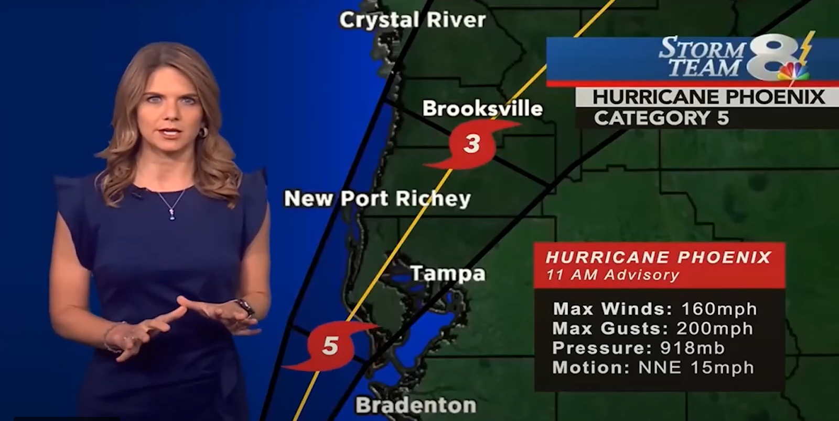
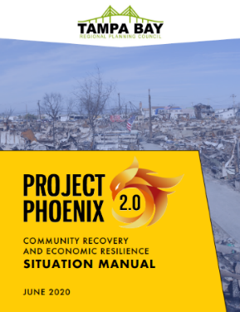
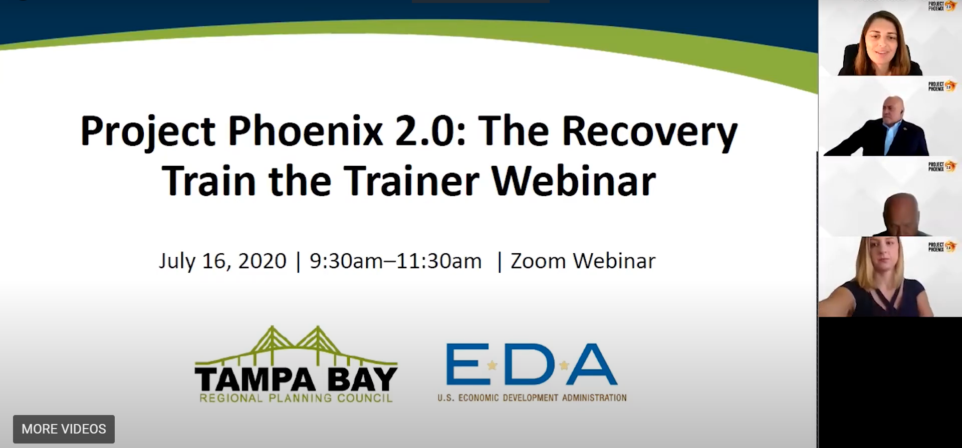
Host a Project Phoenix training exercise in your community!
Host a Project Phoenix training exercise in your community!
Small business organizations and local government emergency management staff are encouraged to apply the Hurricane Phoenix scenario for educational purposes.
Training materials and tools are available to prepare trainers to develop and facilitate an exercise.
Materials are easily customizable for a specific audience and goals, and for a variety of in-person or virtual training events.
Download videos & tabletop exercise training materials:
www.tbrpc.org/phoenix
Storm Surge
Wind Gusts

