Slide 1



The Business Case for Resilience in Southeast Florida
Jennifer L. Jurado, PH.d
Chief Resilience Officer, Deputy director
Broward County

Slide 2
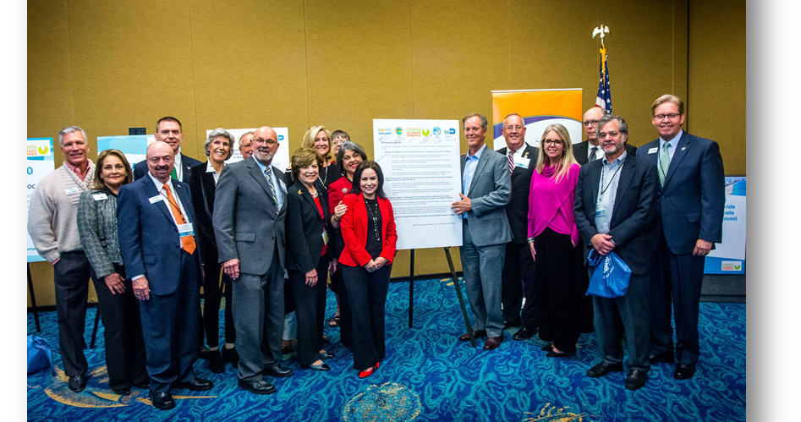
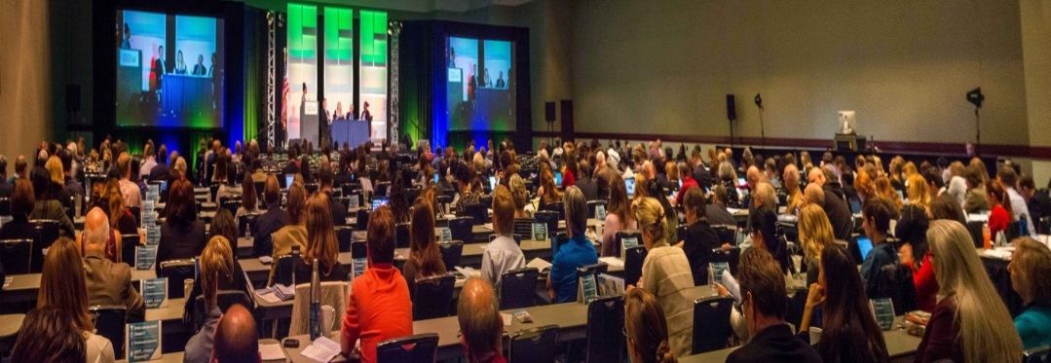









Background
2010 SE Florida Compact Established
2017 Formalized Regional Collaboration on Economic Resilience
Shared Priorities and Objectives
  Messaging
  Outreach
  Advocacy

Slide 3
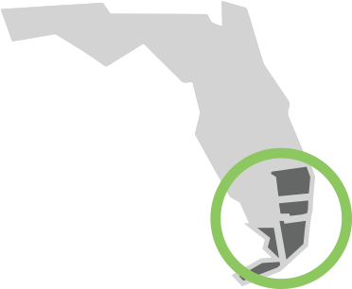
Project Partnership and Purpose
Project Partnership and Purpose
Funders & Partners
  Florida DEP Grant
  Broward, Miami-Dade, Monroe, and Palm Beach Counties
  Business Community
  Philanthropy
Coordination by ULI
Project management by Brizaga
Economic modeling by AECOM
To identify the return on investment for resilience and adaptation measures in Southeast Florida.

Slide 4
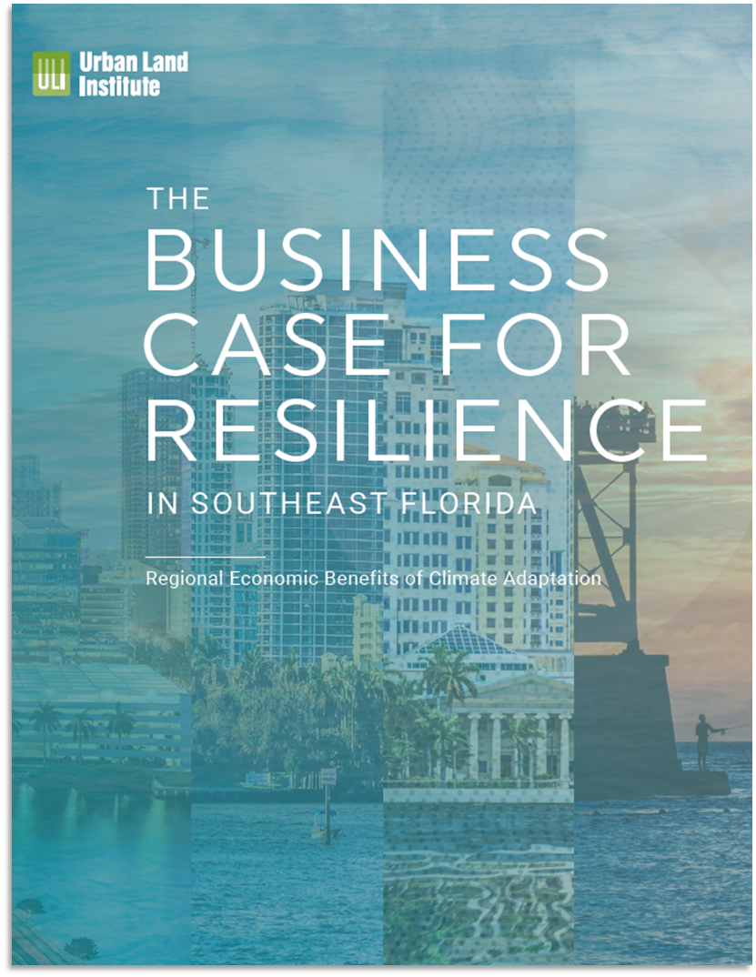
Study
Process
  What is the business case for adapting to sea level rise and more frequent flooding?
Prosd
1
2
3
Identify Vulnerabilities
Determine
Costs + Benefits
Recommend Immediate Steps
Identify Vulnerabilities
Determine
Costs + Benefits
Recommend Immediate Steps
Gather existing data and analyze future coastal conditions to identify impacted areas.
Calculate avoided damages (i.e., benefits) and costs of proposed adaptation strategies. Identify co-benefits of proposed strategies.
Develop recommendations to advance investment in resilient institutions, infrastructure, and economies.
Gather existing data and analyze future coastal conditions to identify impacted areas.
Calculate avoided damages (i.e., benefits) and costs of proposed adaptation strategies. Identify co-benefits of proposed strategies.
Develop recommendations to advance investment in resilient institutions, infrastructure, and economies.
Note: This study represents a high-level regional analysis, leveraging readily available and regionally standardized physical and economic data, replicable analysis techniques, and generalized assumptions.
3

Slide 5
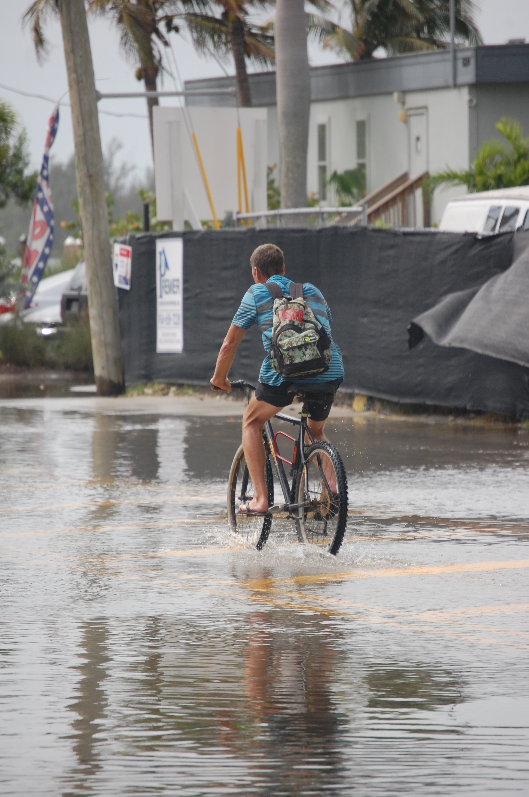
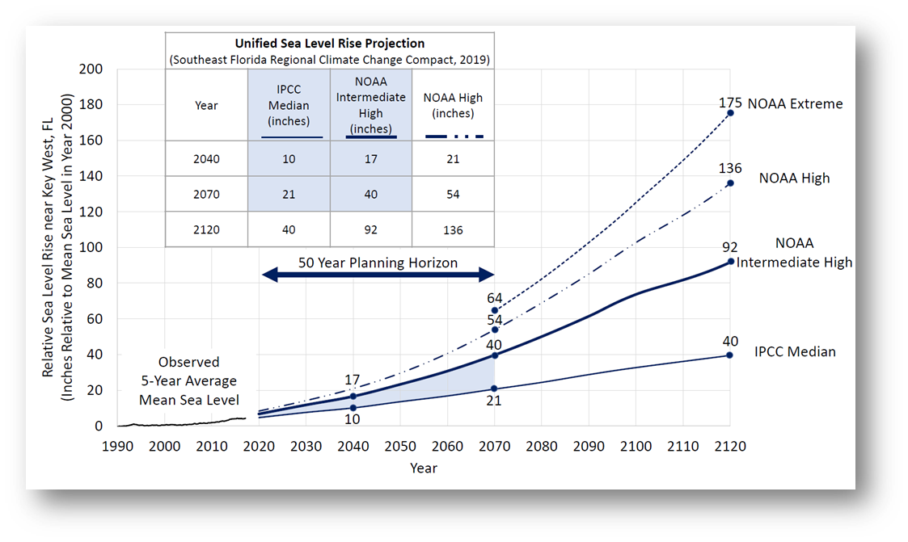
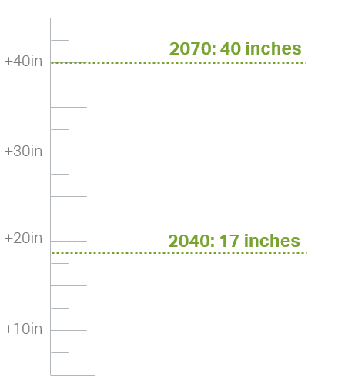
Why Higher Frequency Flooding?
This study examines flooding that occurs often and is not associated with large catastrophic events.
This study examines events that occur frequently, where the economic implications
are not readily understood.
Adaptation can reduce flooding from higher frequency events.
These events will get noticeably worse as sea levels rise.

Slide 6
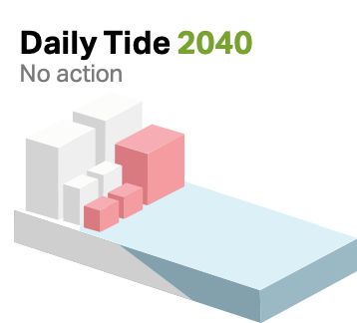
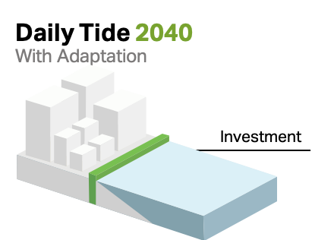
Understanding Flood Events and Adaptation
Investment
Examined: Daily Tide, 1-Year Tide (King Tide), and 10-Year Storm Tide
Key Terms
Mean Higher High Water: Average of the highest of the two high tides occurring each day. Referred to in this study also as daily inundation.
1-Year Tide: The annual highest tide, also referred to as the King Tide.
10-Year Storm Tide: A tide with a 10% chance of occurring in any given year. This event represents high frequency conditions of temporarily elevated water levels due to coastal storms.
Graphics provided by AECOM.

Slide 7



Calculating
Avoided Damages
2
Temporary Storm Damages
Permanent Damages
from Rising Sea Levels
Impacts were modeled for parcels where
or more of the parcel footprint is exposed to the modeled coastal conditions.
Direct Property Impacts
Direct Property Impacts
25%
Structure and content damages
Relocation costs
Property value loss
Business and
Employment Impacts
Business and
Employment Impacts
Sales output loss
Income loss
Job impacts
Sales output loss
Income loss
Job impacts
Fiscal Impacts
Fiscal Impacts
Sales tax loss
Tourist development tax loss
Property tax loss
Sales tax loss
Tourist development tax loss

Slide 8
2040 Highlights
2
Temporary Storm Damages
Permanent Damages
from Rising Sea Levels
2040 Highlight of
Avoided Damages
Direct Property Impacts
$3.2bil
$4.2bil
In structure and content losses from one 10-year tide event under 2040 conditions.
In property value exposed to daily tidal inundation in 2040.
Business and
Employment Impacts
jobs
360
jobs
720
Impacted by a 10-year tide in 2040.
Impacted by daily tidal inundation in 2040.
$2mil
$28mil
Fiscal Impacts
Sales & tourism tax losses from 10-year tide in 2040.
Fiscal loss from daily tidal inundation in 2040.
*Results shown here are not adjusted to account for financial discounting. Parcels impacted by daily tidal inundation are excluded from the 10-year tide damages. The 10-year tide results account for the impacts of one storm event and are not adjusted for probability of the storm event occurring.
6

Slide 9
2070 Highlights
2
Temporary Storm Damages
Permanent Damages
from Rising Sea Levels
2070 Highlight of
Avoided Damages
Direct Property Impacts
$16.5bil
$53.6bil
In structure and content losses from one 10-year tide event under 2070 conditions.
In property value exposed to daily tidal inundation in 2070.
Business and
Employment Impacts
17,800
1,300
jobs
jobs
Impacted by a 10-year tide in 2070.
Impacted by daily tidal inundation in 2070.
$8mil
$384mil
Fiscal Impacts
Sales & tourism tax losses from 10-year tide in 2070.
Fiscal loss from daily tidal inundation in 2070.
*Results shown here are not adjusted to account for financial discounting. Parcels impacted by daily tidal inundation are excluded from the 10-year tide damages. The 10-year tide results account for the impacts of one storm event and are not adjusted for probability of the storm event occurring.
6

Slide 10
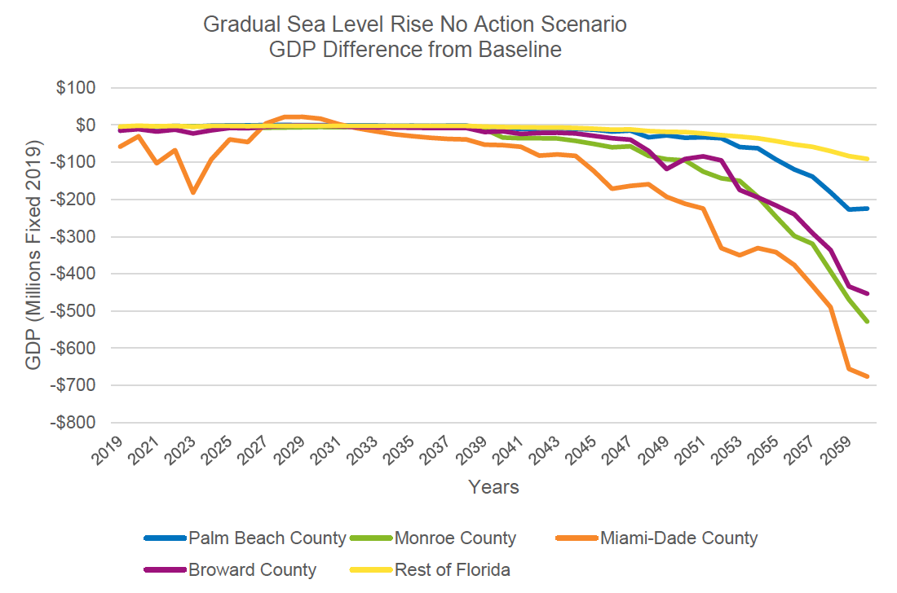
Sustaining our Economy
Our Regional Economy is At-Risk
Without adaptation investment, regional and local economies will suffer.
Image from AECOM Technical Report.

Slide 11
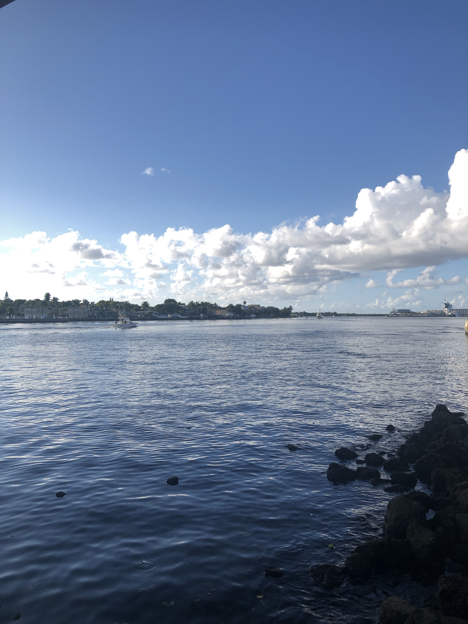
There is a compelling business case for the region to make significant investments in resilient infrastructure now and to collaboratively coordinate within the region applicable methods to address these threats.

Slide 12
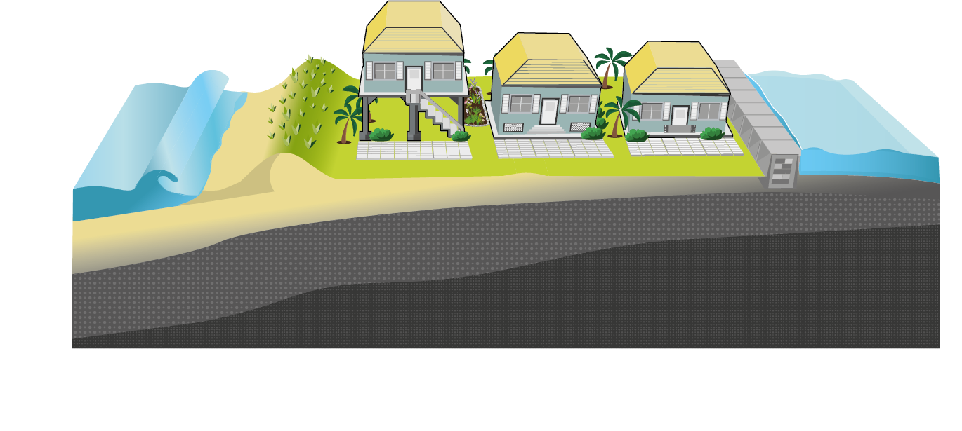
Community-wide Adaptation
Building-level Adaptation
A combination of soft and hard engineering investments at the open coast, intracoastal and inland areas.
A combination of structural improvements to property itself.
Note: Building-level adaptation will not provide benefit to regional infrastructure or to coastal resources such as beaches.
Notes:
Broward Level

Slide 13
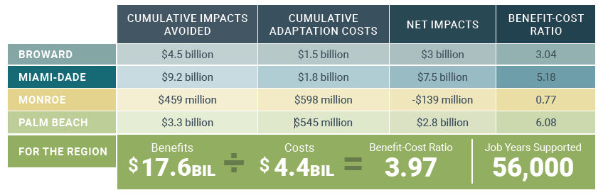


Building-level Adaptation
One Job
Ten Years
Ten Job Years
x
=
¹⁰
*Results presented in net present value terms using a 5 percent discount rate over the period of analysis from 2020 to 2070
**Presented in terms of job years. Job years is equivalent to one year of work for one person; for example, a new construction job that lasts two years will equate to two job years. Estimated job years supported due to direct investment spending in the four counties of analysis

Slide 14
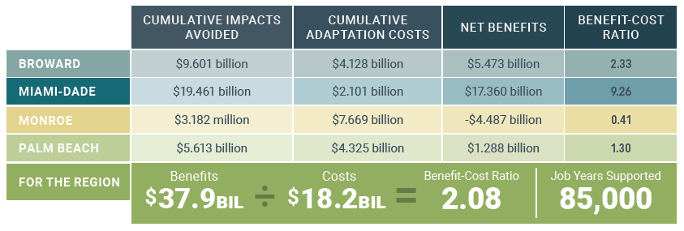
Community-Wide Adaptation
One Job
Ten Years
Ten Job Years
x
=
¹⁰
*Results presented in net present value terms using a 5 percent discount rate over the period of analysis from 2020 to 2070
**Presented in terms of job years. Job years is equivalent to one year of work for one person; for example, a new construction job that lasts two years will equate to two job years. Estimated job years supported due to direct investment spending in the four counties of analysis

Slide 15
Recommendations
Key Strategies
1
Increase Climate Risk Awareness
2
Develop Actionable Funding and Financing Plans to Pay for Resilience
3
Invest in Key Vulnerable and Emerging Industries
4
Develop an Occupational Roadmap to Resilience
5
Engage with and Provide Support to the Small Business Community
6
Make Social Vulnerability a Priority during Adaptation Decision-Making
7
Prioritize Projects Strategically and Monitor Equity and Efficacy
8
Maximize Adaptation Investments through Coordinated Benefits
9
Understand and Prepare for Reputational Risk and Associated Impacts
10
Conduct Further In-Depth Analysis at County and Project-Level to Optimize Benefits and Costs

Slide 16

Reflections and Next Steps
  Process benefited from extensive engagement with stakeholders
  Case studies were critical to informing regional scale analysis
  Results are considered conservative
  ROI strongly influenced by landscape and development
  Reinforce findings and strategy with local projects
  Invest in organized communications

Slide 17
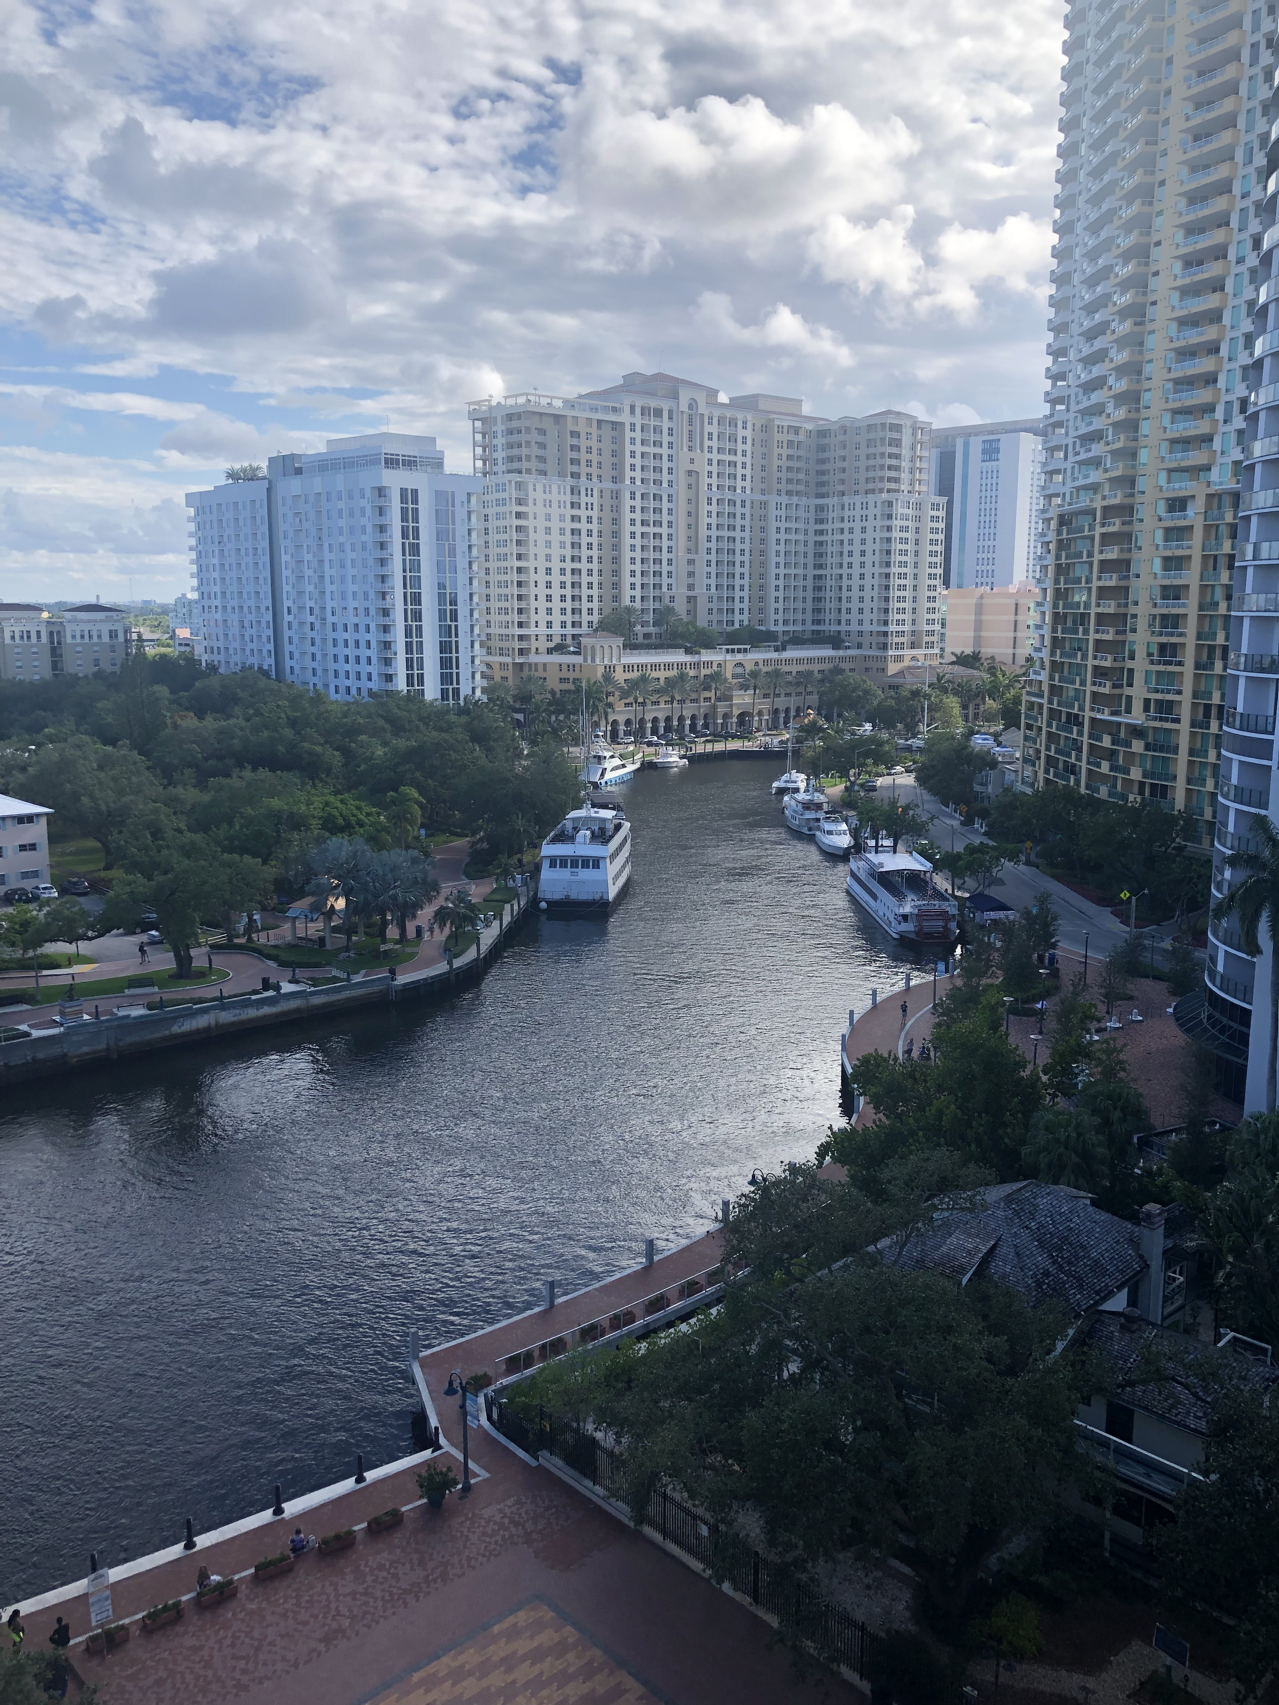
Questions? jjurado@broward.org
954-519-1464

