Slide 1
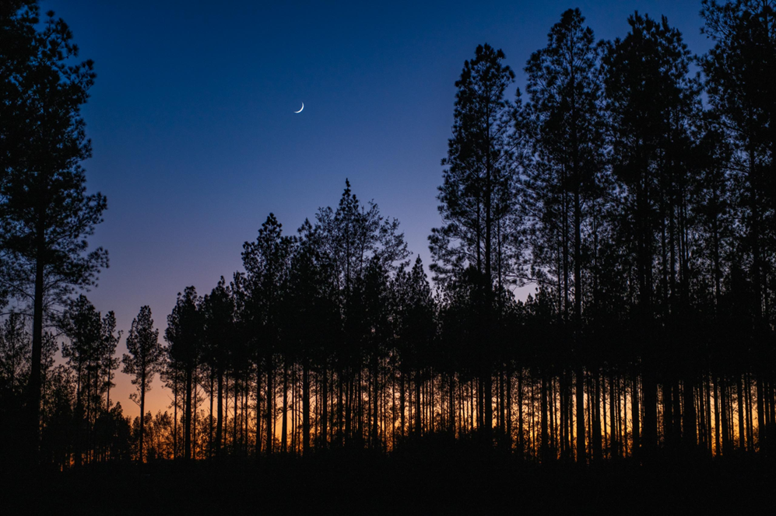
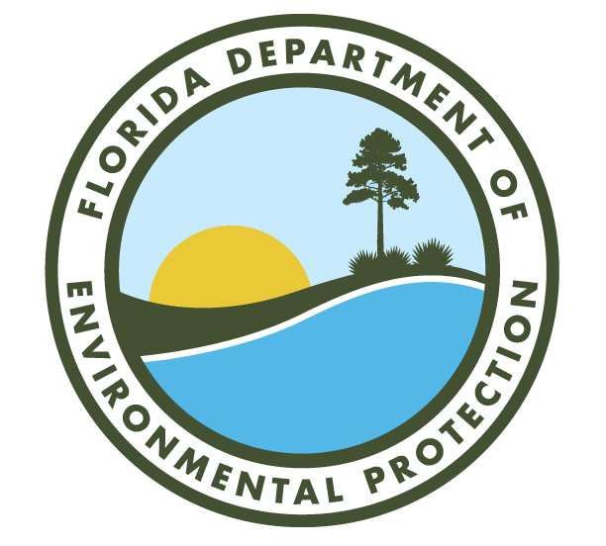
DIVISION OF STATE LANDS FLORIDA FOREVER
ACQUISITION UPDATE
Coastal Headwaters Longleaf Forest
Conservation Easement

Slide 2
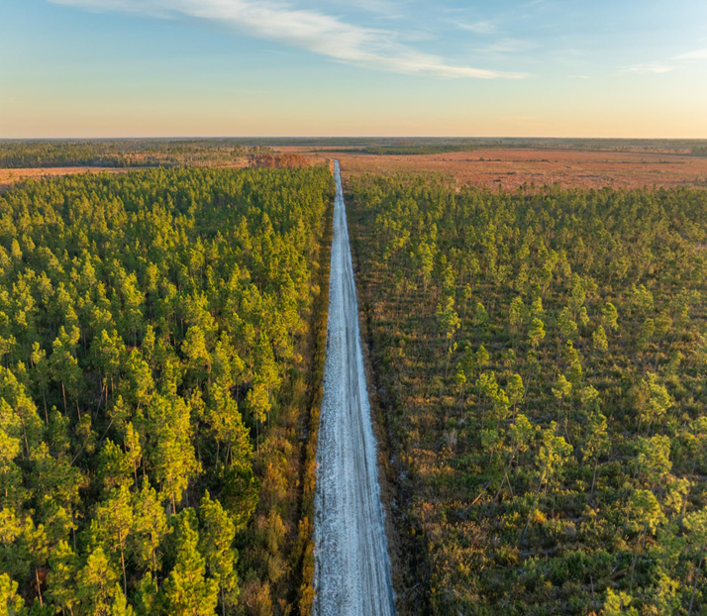
Florida Forever / DSL
CY 2024 Highlights
CY 2024 – Largest $ production calendar year in Florida Forever program
  69,546 acres / $321,550,394 / 106 transactions / 37 projects
  Since January 2019, over $846 million invested to acquire over 311,000 acres - 90% of which lies within the Wildlife Corridor
4 more Florida Forever projects were completed in 2024; 22 have now been completed since January 2019
$300 million in ARPA funding fully expended by June 2024 – 1 ½ years ahead of schedule
Osceola to Ocala Corridor (O2O) and Caloosahatchee Big Cypress Corridor (CBC) funded projects in progress with 31,410 acres acquired and another 126,000 acres currently in process
DSL also manages all BOT dispositions, exchanges, donations, and non-conservation acquisitions – 20 additional transactions representing over 919 acres and $75 million
Bear Creek Forest
New State Forest

Slide 3
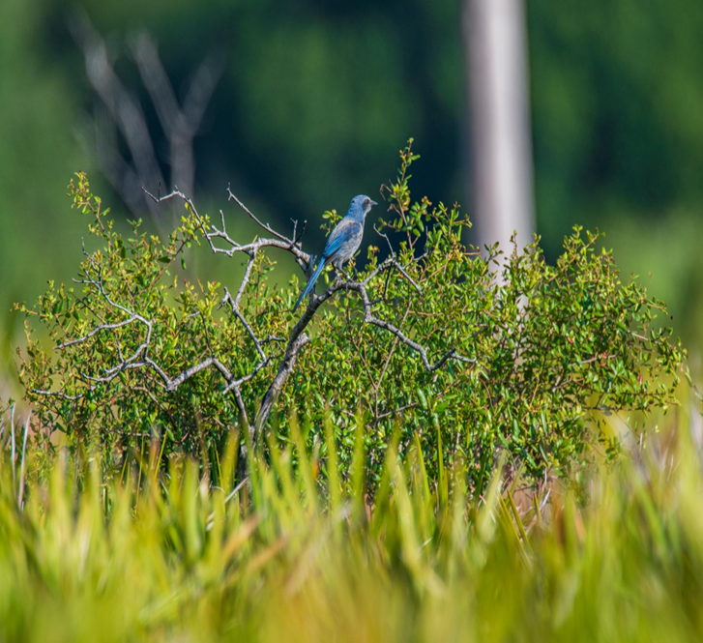
Florida Forever
Acquisitions CY 2024
106 transactions in 37 project areas = 69,546 acres/$321,550,394 for CY 2024
Aucilla/Wacissa Watershed
Big Cypress/Caloosahatchee
Blackwater River State Forest
Caloosahatchee Ecoscape
Cayo Costa Island
Charlotte Harbor Estuary
Coupon Bight/Key Deer
Crayfish Habitat Restoration
Deer Creek Ranch
Etoniah/Cross Florida Greenway
Fakahatchee Strand
Fisheating Creek Ecosystem
Florida Keys Ecosystem
Florida’s First Magnitude Springs
Floyds Mound
Garcon Ecosystem
Green Swamp
Heartland Wildlife Corridor
Hosford Chapman’s Rhododendron Zone
Kissimmee-St. Johns River Connector
Lake Hatchineha Watershed
Lake Wales Ridge Ecosystem
Middle Chipola River
Myakka Ranchlands
North Waccasassa Flats
Perdido Pitcher Plant Prairie
Pinhook Swamp
Pumpkin Hill Creek
Raiford-Osceola Greenway
Red Hills Conservation
South Walton County Ecosystem
St. Joseph Bay Buffer
Strategic Managed Area Lands List (SMALL)
Watermelon Pond
Wekiva-Ocala Greenway
Wolfe Creek Forest
Yarborough Ranch
Deer Creek Ranch
Conservation Easement

Slide 4
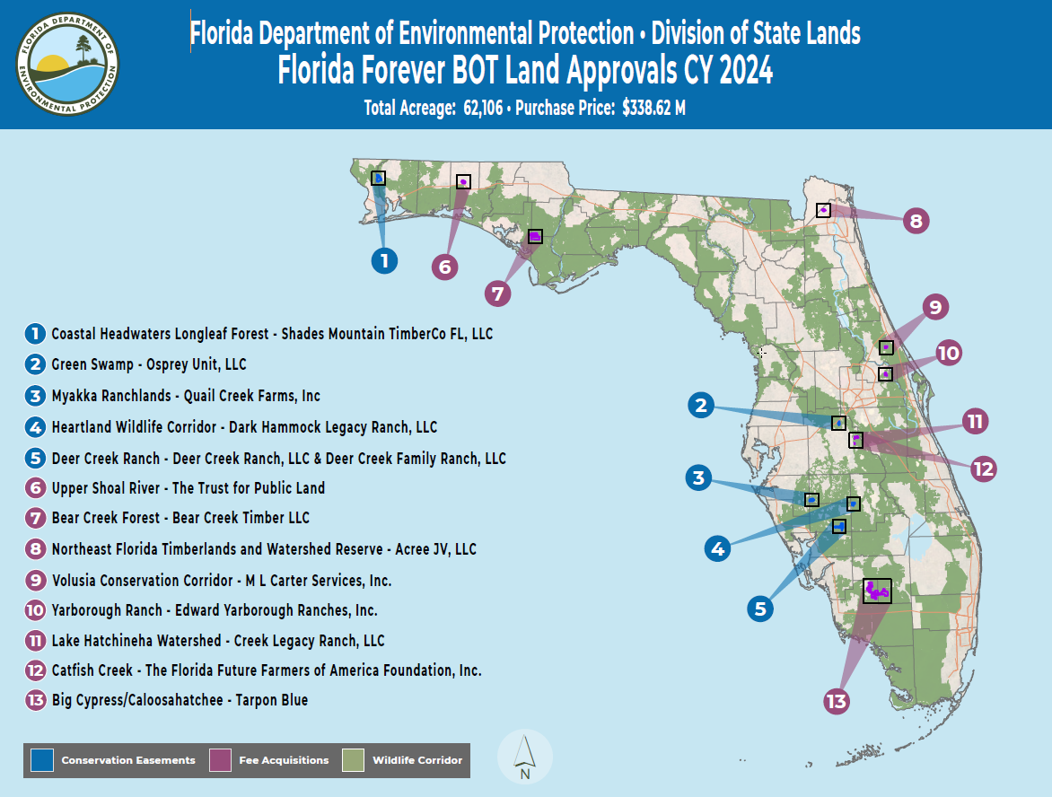

Slide 5
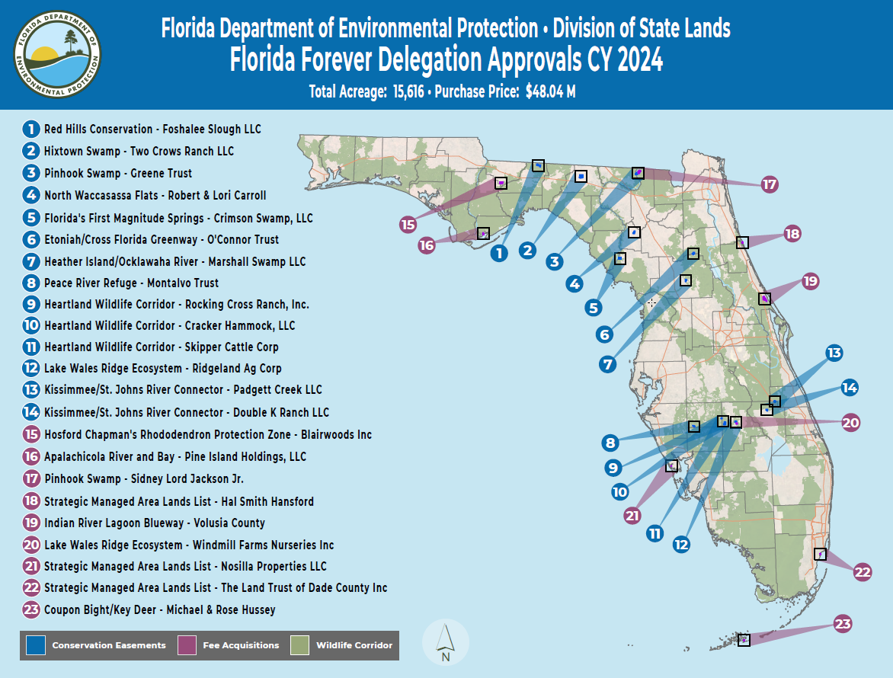

Slide 6
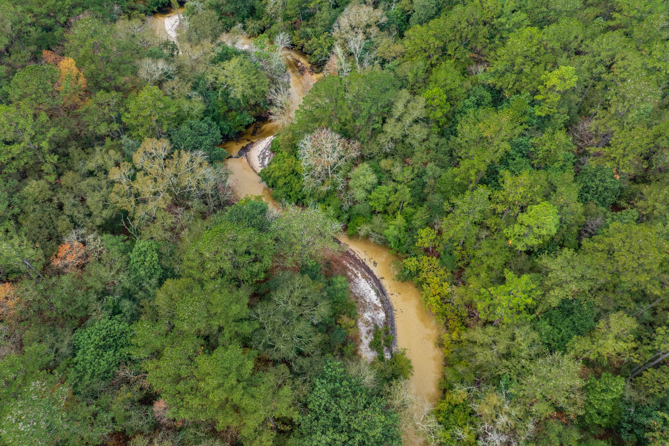
Florida Forever / DSL
FY 2024-2025 Overview
FYTD 2024-2025*
Closed
45,193 acres / $ 261,096,322
In Closing
39,545 acres / $152,141,150
Additional Acres/Expenditures in Acquisition Process
197,201 acres / $497,474,551
Approved BOT Agenda
25,127 acres / $116,233,250
Approved through Delegation
14,183 acres / $45,178,400
*FTYD as of January 31, 2024
Upper Shoal River
New State Park

Slide 7
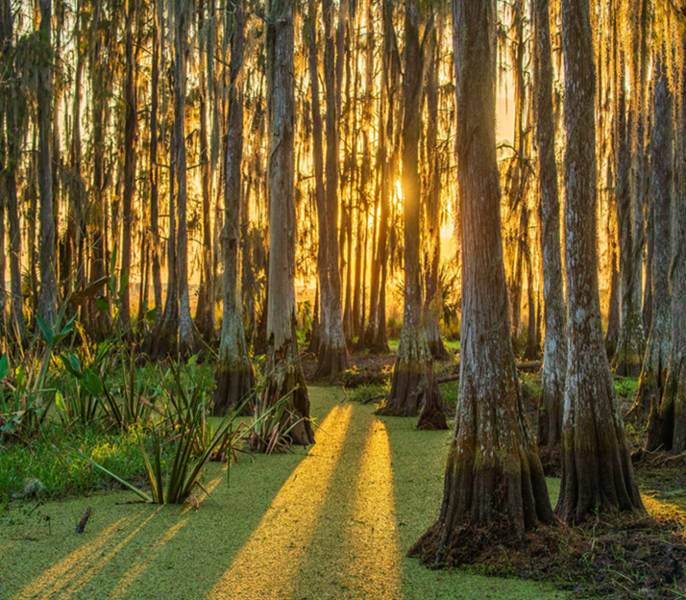
Florida Forever / DSL
Active Project Areas
Currently working in 52 Florida Forever Project Areas*
Apalachicola River
Aucilla/Wacissa Watershed
Bar B Ranch
Bear Creek
Big Bend Swamp/Holopaw Ranch
Big Cypress/Caloosahatchee
Blackwater River State Forest
Camp Blanding to Raiford
Carr Farm/Price’s Scrub
Catfish Creek
Cayo Costa Island
Charlotte Harbor Estuary
Coastal Headwaters Longleaf Forest
Coupon Bight/Key Deer
Crayfish Habitat Restoration
Devils Garden
Etoniah/Cross Florida Greenway
Fakahatchee Strand
Fisheating Creek Ecosystem
Florida Keys Ecosystem
Florida’s First Magnitude Springs
Ford Marsh
Garcon Point Ecosystem
Green Swamp
Gardner Marsh
Heartland Wildlife Corridor
Heather Island/Ocklawaha River
Hixtown Swamp
Hosford Chapman’s Rhododendron Zone
Indian River Lagoon Blueway
Kissimmee St. Johns River Connector
Lake Hatchineha
Lake Santa Fe
Lake Wales Ridge Ecosystem
Mill Creek
NE FL Timberlands & Watershed Preserve
Osceola Pine Savannas
Peace River Refuge
Pinhook Swamp
Raiford to Osceola Greenway
Ranch Reserve
Red Hills Conservation
Sand Mountain
Strategic Managed Area Lands List (SMALL)
St. Joe Timberland
Terra Ceia
Upper Shoal River
Volusia Conservation Corridor
Waccasassa Watershed
Wakulla Springs Protection Zone
Wekiva-Ocala Greenway
Withlacoochee River Corridor
Lake Hatchineha Watershed
New FWC WMA – Creek Ranch Wildlife Management Area
*As of January 31, 2024

Slide 8
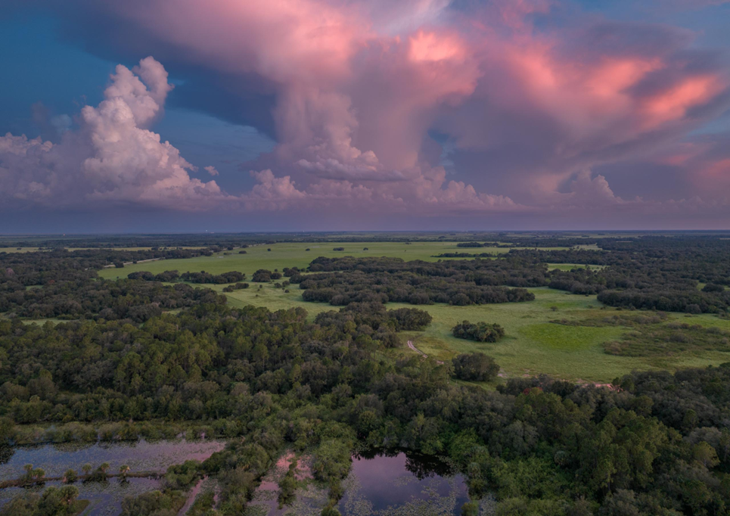

REPORT INFORMATION
Provided by:
Bureau of Real Estate Services
Division of State Lands
Mapping credits to:
Taylor Barnes
DSL’s Bureau of Surveying & Mapping
Project photography credits to: Carlton Ward, Jr.
Lauren Yoho
Wild Path
@pathofthepanther
Green Swamp
Conservation Easement
Volusia Conservation Corridor
Conservation Easement

